Slide 1
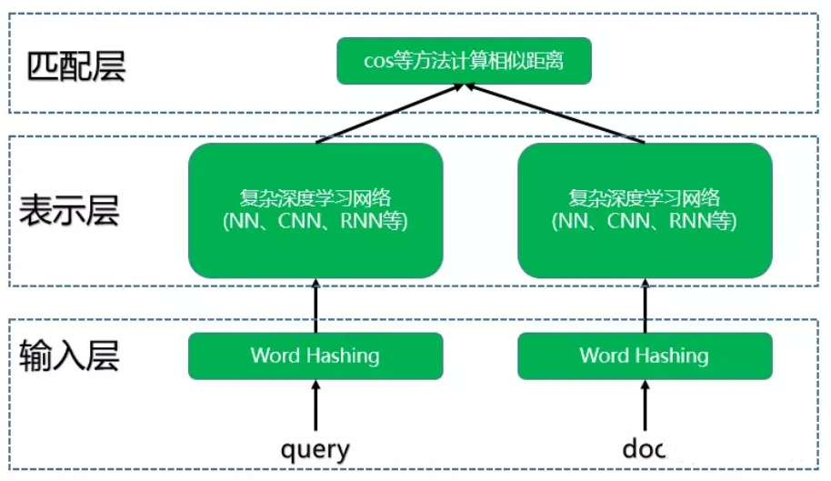
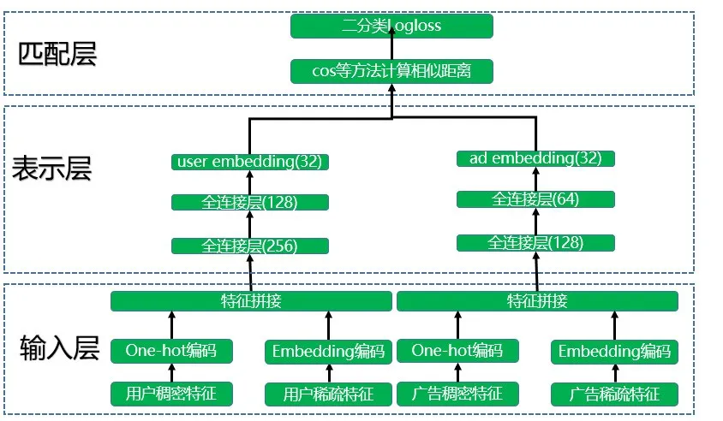
DSSM双塔模型结构 （基础Baseline）
Learning Deep Structured Semantic Models for Web Search using Clickthrough Data

Slide 2
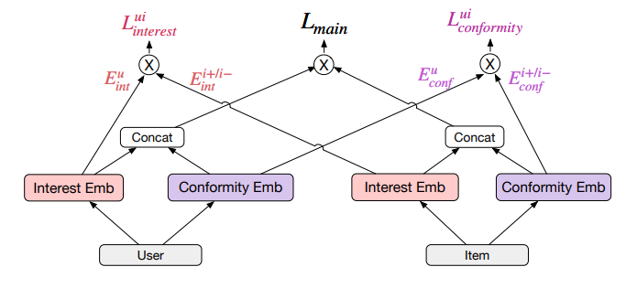
DCCL模型
Disentangled Causal Embedding With Contrastive Learning For
Recommender System (2023) （与我们的模型相关）

Slide 3
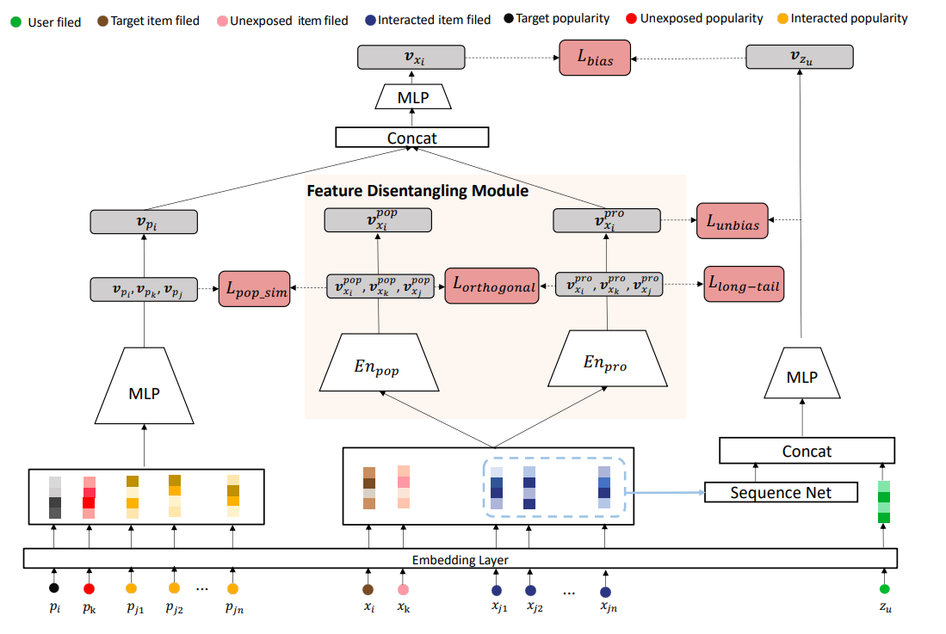
CDAN模型
Co-training Disentangled Domain Adaptation Network for Leveraging Popularity Bias in Recommenders (2022 SIGIR) （与我们的模型相关）

Slide 4
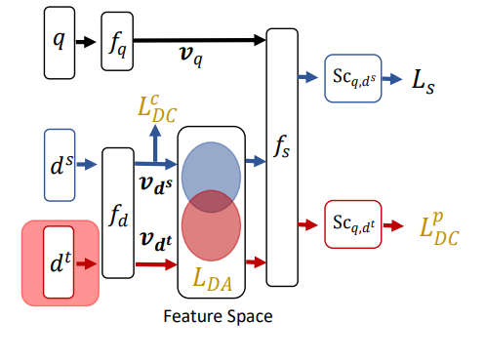
ESAM模型
ESAM: Discriminative Domain Adaptation with Non-Displayed
Items to Improve Long-Tail Performance SIGIR 2020
这个模型代码的项目文件为ESAM_project(论文代码已开源)

Slide 5
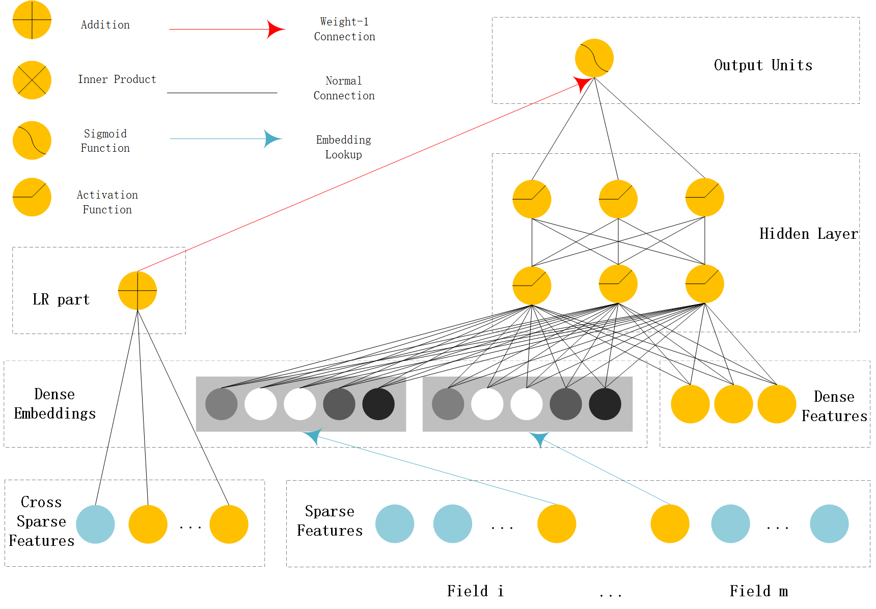
Wide&Deep模型
Wide & Deep Learning for Recommender Systems-KDD 2016

Slide 6
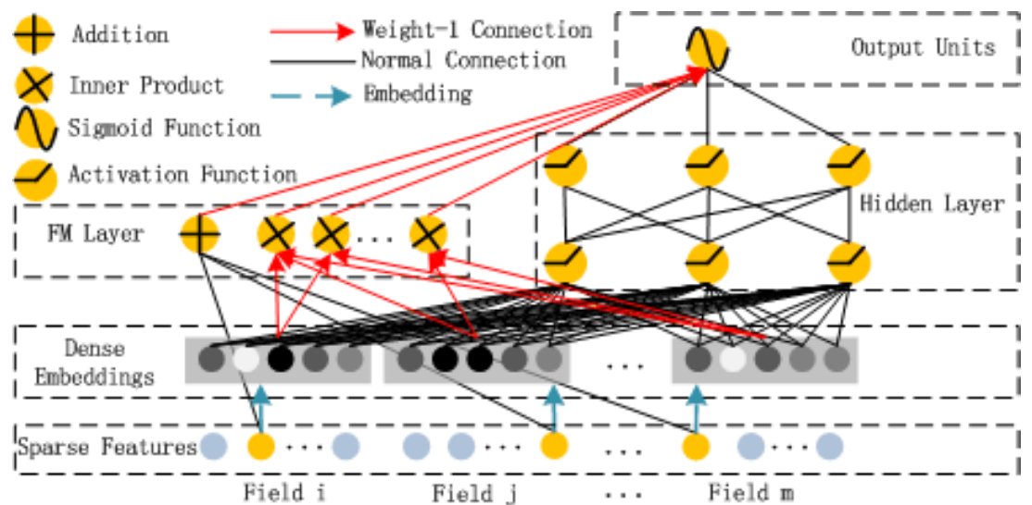
DeepFM模型
《DeepFM: A Factorization-Machine based Neural Network for CTR Prediction

Slide 7
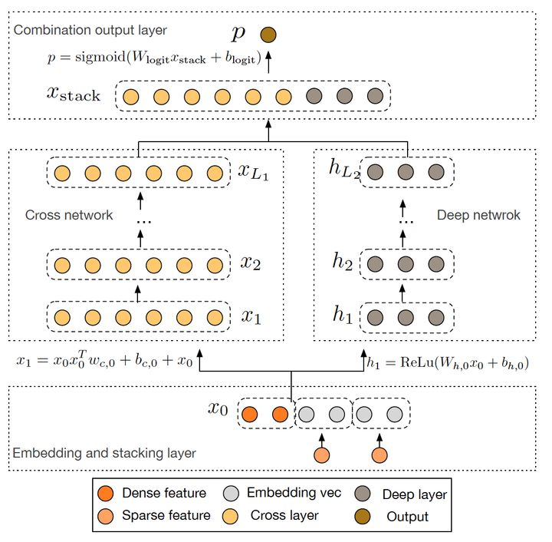
Deep&Cross Network（DCN）模型
Deep & Cross Network for Ad Click Predictions-RecSys2017
https://blog.csdn.net/Dby_freedom/article/details/86502623
https://blog.csdn.net/Eric_1993/article/details/105670381

Slide 8
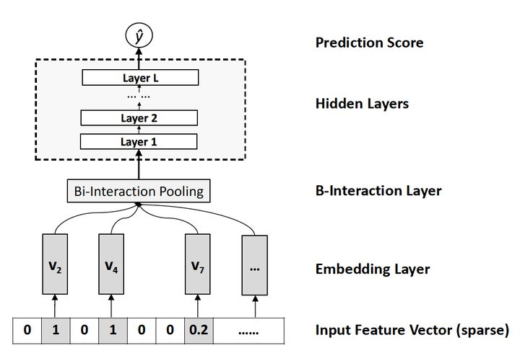
NFM模型
Neural Factorization Machines for Sparse Predictive Analytics

Slide 9
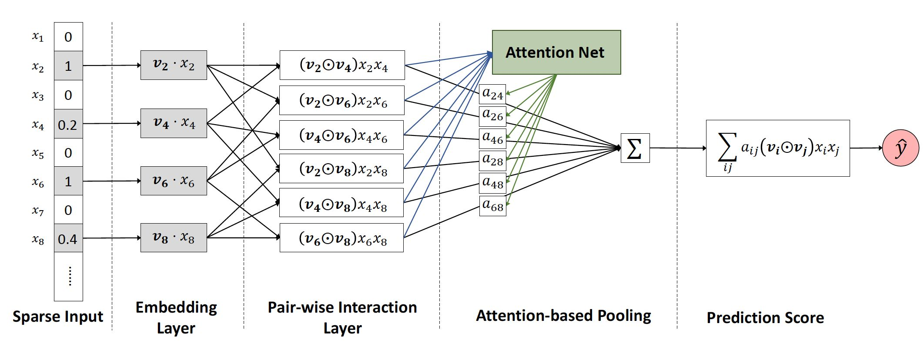
AFM模型
Attentional Factorization Machines: Learning the Weight of Feature Interactions via Attention Networks

Slide 10
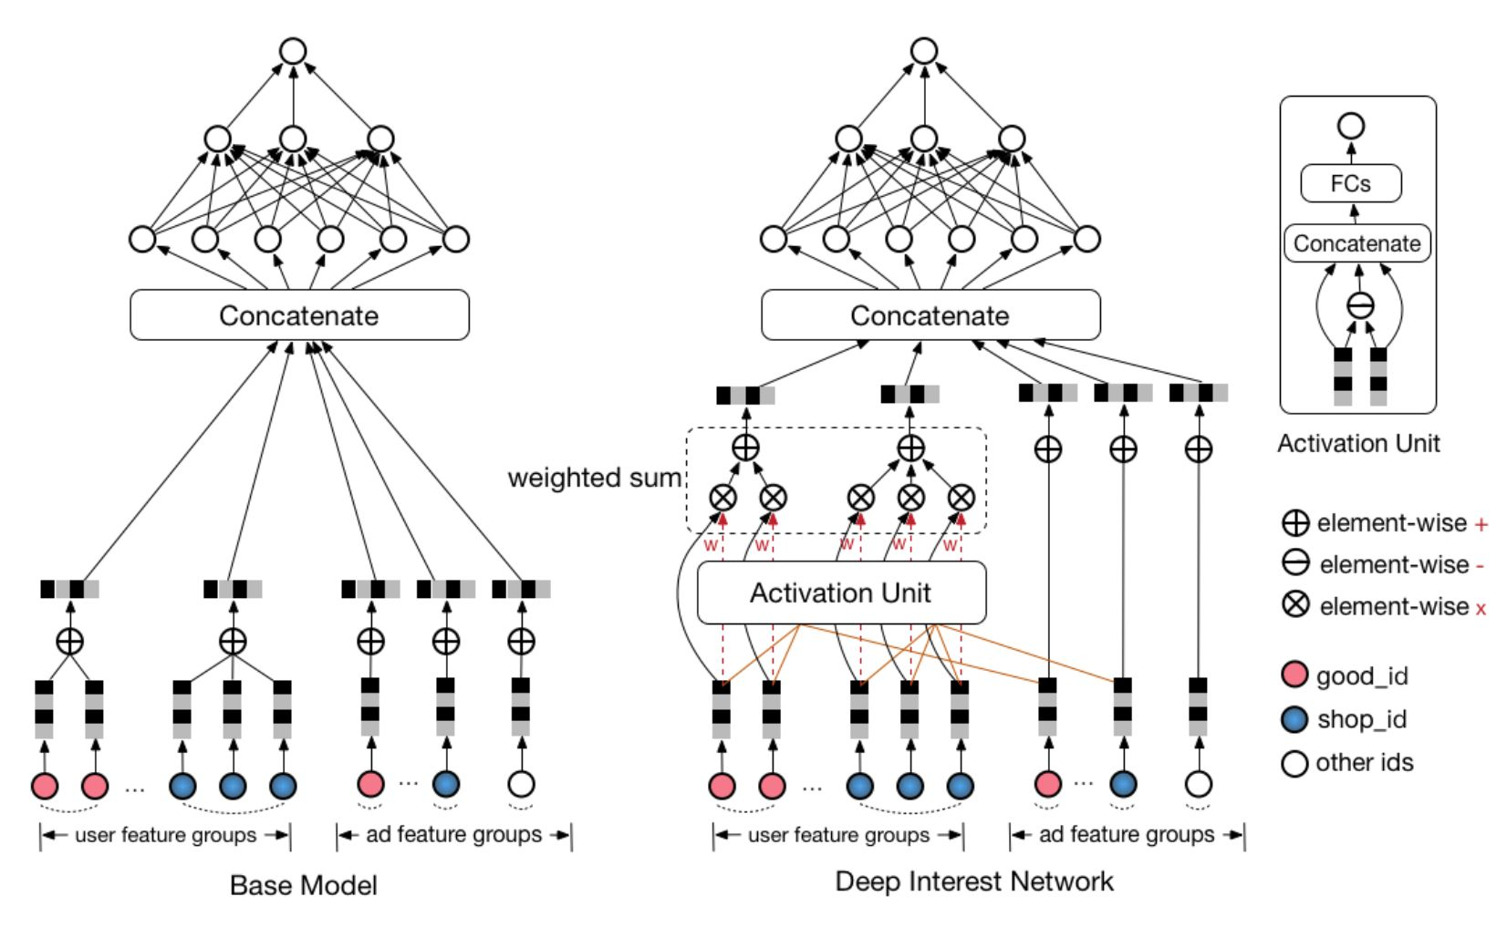
DIN模型
Deep Interest Network for Click-Through Rate Prediction

