Slide 1
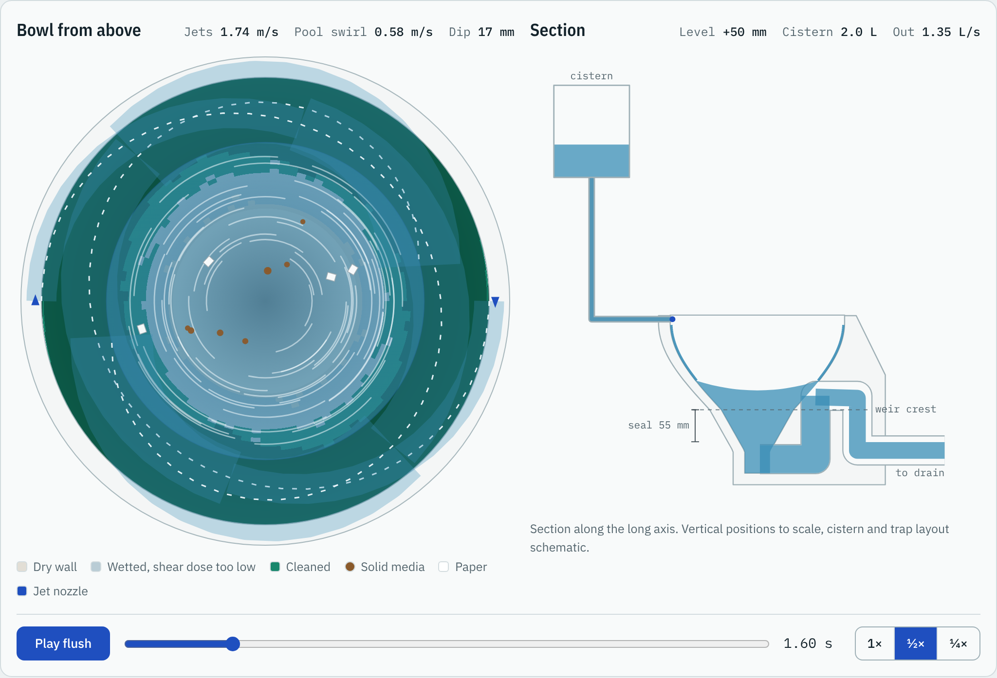
Tangential jet flush model
One flush in milliseconds: compare designs quickly, then check the best ones with CFD
ILLUSTRATIVE ESTIMATES, DEFAULT DESIGN
88 %
of the bowl wall above the waterline cleaned
99 %
of a 250 g solid test load removed
4.5 L
water per flush, EU washdown, full flush
Try it live
fintlp.github.io/jet-flush-model
Illustrative estimates from a reduced-order model. Coefficients are not yet calibrated against CFD or rig data, so results show trends between designs, not validated values.
Peter Fintl · github.com/fintlp/jet-flush-model · v1.2.0 · 20 October 2026
Notes:
The video shows the first 8 seconds of a full 4.5 L flush at 0.6x speed.
Left view: bowl from above. Green wall areas have received enough shear to count as cleaned. The white dashed lines are the two jet films, and the pool shows the swirl.
Right view: section through cistern, bowl and trap with live water levels.
To show the live simulator on this slide instead of the video, install the Web Viewer add-in from the Office Store (Insert > Get Add-ins), add it to the slide and enter https://fintlp.github.io/jet-flush-model/. It needs internet during the talk.

Slide 2
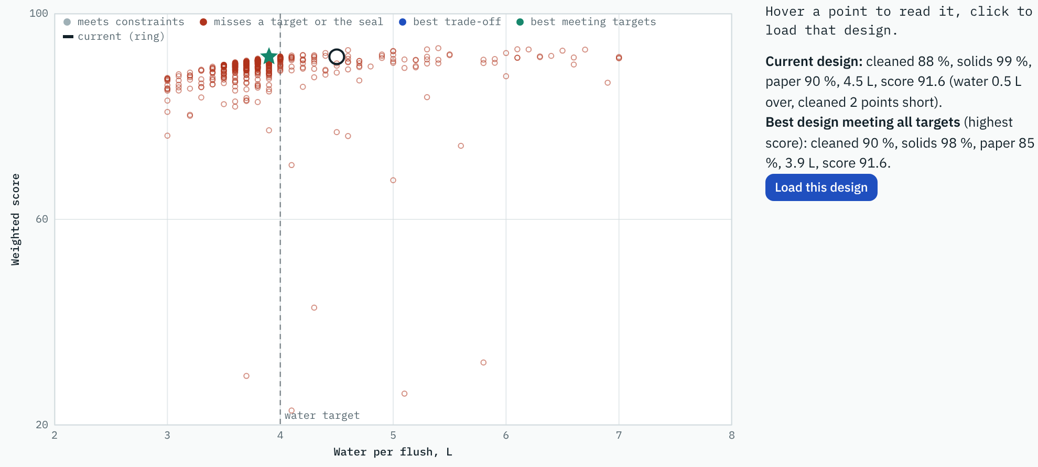
AI lab: let the model search
Three ways AI works with the physics model, all running in the browser
1
Design optimiser
Finds the best settings you allow, or a design that meets targets such as at most 4.0 L and at least 90 % cleaned. About 540 flushes in 4 seconds.
2
Neural surrogate
Learns the model from 300 flushes and answers roughly a thousand times faster. In practice it would be trained on PreonLab runs.
Each dot is one simulated flush; red rings miss a target. The blue curve is the best trade-off between score and water, and the green star is the best design that meets all targets.
3
Hybrid calibration
Fits the model to reference runs and corrects the rest with data. On synthetic test data it cuts the error on unseen designs by about two to eight times.
5–20 ms
≈ 5 µs
minutes to hours
physics model, per flush
neural surrogate, per design
PreonLab or CFD, rough estimate
Results come from the uncalibrated model: suggestions are candidates for a CFD or rig check, not final answers. The calibration demo uses synthetic reference data.
Peter Fintl · github.com/fintlp/jet-flush-model · v1.2.0 · 20 October 2026
Notes:
The chart is a real optimiser run: the AI lab was asked for a design with at most 4.0 L that still cleans at least 90 % and removes 95 % of solids and 80 % of paper.
Speed figures: the physics model is measured in the browser; the surrogate figure is measured after training; the PreonLab range is a rough estimate extrapolated from FIFTY2 published GPU runtimes, not a benchmark.
Hybrid calibration: the reference data comes from a hidden model with different coefficients and extra effects, standing in for PreonLab. With real PreonLab runs the steps are the same.

Slide 3
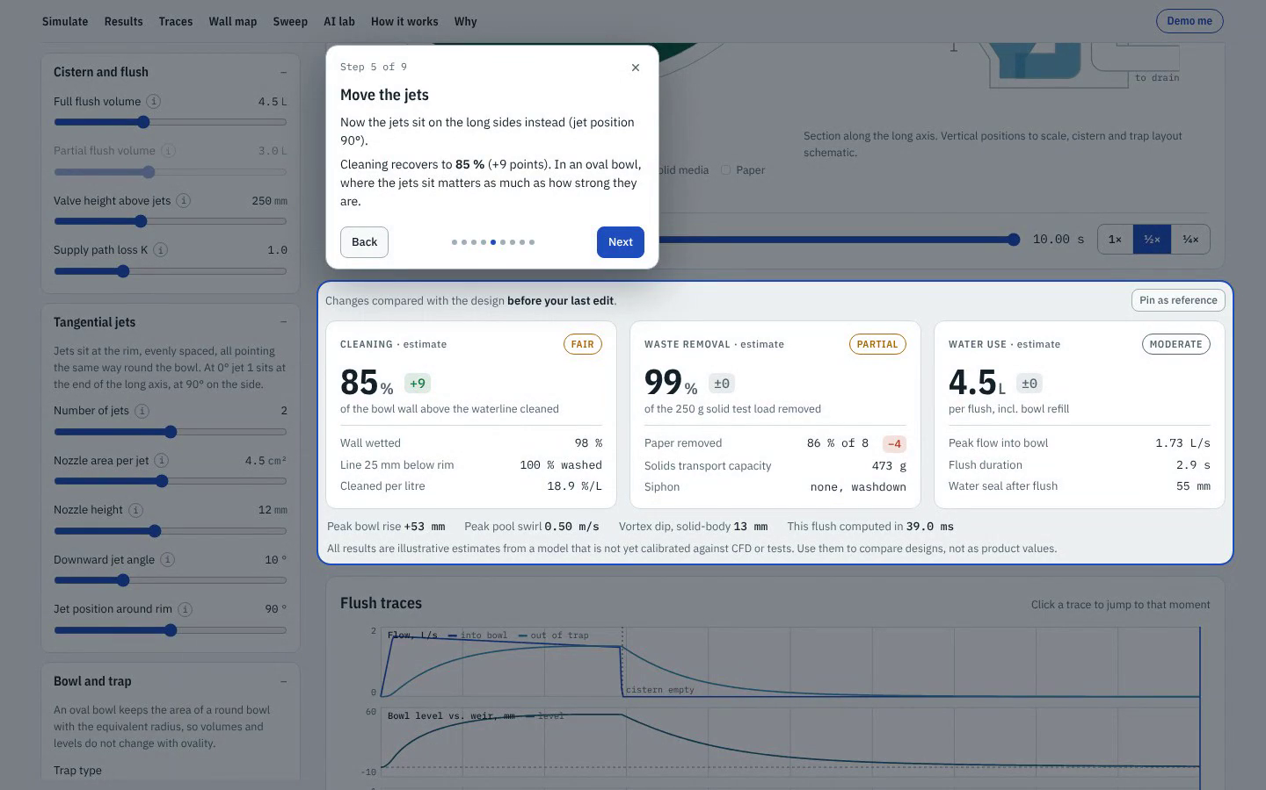
Guided demo in one minute
Play a flush, make the bowl oval, let the AI find a better design, all live in the browser
88 % → 76 %
cleaning when the bowl turns oval, jets at the ends
76 % → 85 %
after moving the jets to the long sides
90 % at 4.0 L
AI lab design: more cleaning, 0.5 L less water
Start it yourself
fintlp.github.io/jet-flush-model/#demo
Recorded from the live page on 19 October 2026. Illustrative estimates from the uncalibrated model.
Peter Fintl · github.com/fintlp/jet-flush-model · v1.2.0 · 20 October 2026
Notes:
The video is a screen recording of the Demo me walkthrough, about 75 seconds.
Opening the link with #demo at the end starts the same walkthrough live; it needs internet. The visitor can stop it at any time with Esc and gets their own design back.

