Slide 1

Procurement ai,
Agentic Negotiator
Supplier cost assessment
and Sourcing
US$220,000 Pre-seed
Finux Labs
October 2026
Notes:
Finux Labs: Agentic Negotiator, Procurement Accelerator. The C$550,000 pre-seed target supports an 18-month founder-led plan. Supplier Cost Explorer and Finance Decision Intelligence remain working alpha products. Buyer Procuring Agent and Supplier Agent negotiation is proposed. Agents would exchange offers within authorized limits, initiate preliminary agreement, and return terms to people for detailed review, refinement or approval. The cover is a conceptual AI-generated illustration, simplified from the prior buyer-factory supply network. Artwork remains fully opaque, with richer solid surfaces and no transparency overlay. Embedded artwork: finux-cover-violet-mint-v4.png.
Visual theme: Finux Violet Circuit. The conceptual illustration was recoloured with the built-in image generation tool. Content and commercial assumptions remain unchanged.

Slide 2
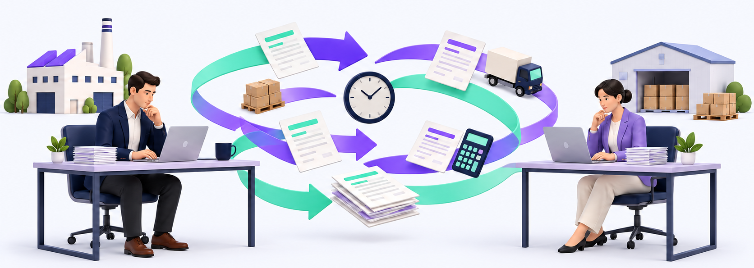
The complexity of Supplier Sourcing
Price, volume, freight and delivery terms can trigger repeated offers and counteroffers
Buyer
Offers and counteroffers
Supplier
Each revision can trigger another quote, cost calculation and approval.
Finux Labs
02
Notes:
Conceptual illustration of bilateral buyer-supplier price negotiation. Exactly two peers exchange quotations and revise price, order volume, freight and delivery terms. A change to one term can affect the total cost and prompt another quote, calculation or internal approval. This is a problem hypothesis for customer discovery, with no claimed measured time saving or transaction volume. This slide precedes the existing detailed problem slide and the proposed agent workflow. The image is an AI-generated conceptual editorial illustration, not a real customer negotiation or a precise process diagram. Created with the built-in image generation tool. Embedded asset: finux-negotiation-violet-mint-v4.png. Buyer and Supplier labels and all slide text remain native editable PowerPoint text.
Visual theme: Finux Violet Circuit. The conceptual illustration was recoloured with the built-in image generation tool. Content and commercial assumptions remain unchanged.

Slide 3
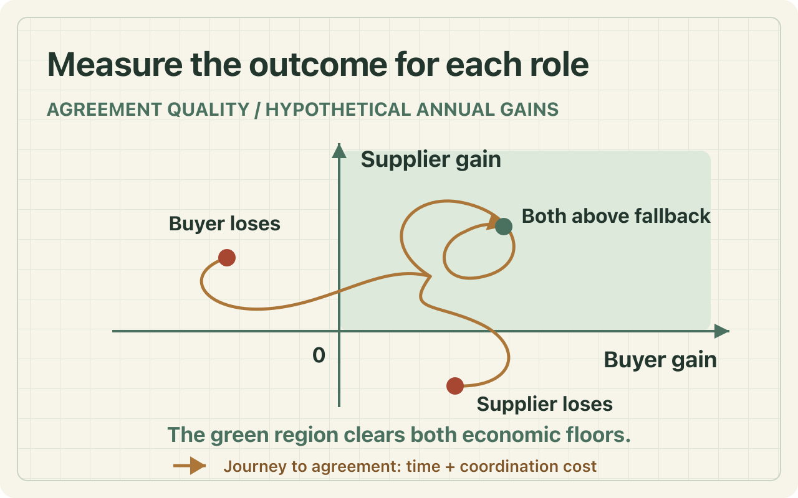
Repeated negotiation rounds take time
Initial customer hypothesis: manufacturers and distributors with 20–499 employees
Each pricing round adds time and coordination cost
Buyer: procurement manager
Partner: finance and operations
Pricing rounds
Coordination
Repeated offers and clarifications stretch time to agreement.
Teams reconcile price, volume, freight and delivery terms.
Rework
Approval
Revised quotes trigger new comparisons and internal reviews.
Decision makers need clear terms and a traceable agreement.
Finux Labs
03
Notes:
The customer problem is the repeated staff effort and elapsed time needed to reach pricing agreement between a buyer and a supplier. Teams exchange offers, clarify volume and freight assumptions, recalculate cost and seek internal approval. These are customer-discovery hypotheses, not validated Finux Labs time-saving metrics. The initial customer segment remains manufacturers and distributors with 20–499 employees. Pilots should measure pricing-round counts, staff minutes per round, elapsed time to a preliminary agreement, and human rework after agent negotiation. The supplier must voluntarily provide its own constraints to its own agent.

Slide 4
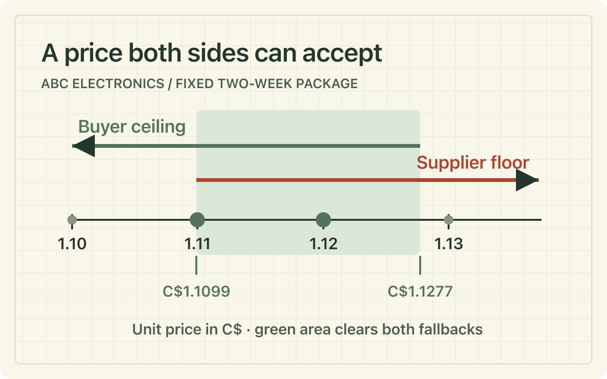
The procurement decision assistant
Proposed workflow: agents initiate preliminary terms, then people review the agreement
01
02
Set the strategy
Compare the bids
Define demand, service targets, budget and sourcing constraints.
Normalize supplier terms and calculate total annual cost.
03
04
Agents negotiate
People decide
Buyer and Supplier Agents exchange offers within agreed limits.
Review initial terms, refine details or approve the agreement.
Agents propose the initial agreement. People review details and approve final terms.
Finux Labs
04
Notes:
The proposed sequence is strategy definition, supplier cost assessment, agent-to-agent negotiation and a human decision. A Buyer Procuring Agent represents the buyer mandate. A Supplier Agent represents supplier price, capacity, logistics and service limits. Agents can explore offers and counteroffers within those limits. Their first agreement is preliminary and returns to authorized humans for review, detail changes, rejection or approval. Material changes return to negotiation. Supplier Cost Explorer provides the existing alpha cost foundation; the agents, approval workflow and production integrations are roadmap capabilities.
Sources and assumptions
Finux Labs Supplier Cost Explorer, live alpha inspected October 31, 2026. https://sourcing-alpha.connextium.xyz/#workspace ; Calculation source https://github.com/SmartFinuxLabs/SupplierCostExplorer/blob/main/dist/model.mjs

Slide 5

Buyer and supplier agents negotiate first
Proposed capability: preliminary pricing agreement with a human decision at the end
Buyer Procuring Agent
Offer / counteroffer
Supplier Agent
Target cost, demand, volume
and service constraints
Price bounds, capacity,
freight and delivery limits
Within authorized limits
Initial agreement
Proposed pricing and terms
Human review and decision
Review details, revise or approve
Roadmap capability. Agents propose terms. Authorized people review, refine or approve the final agreement.
Finux Labs
05
Notes:
This proposed dual-agent workflow directly addresses repeated buyer-supplier pricing negotiation. Each organization controls the mandate of its own agent. The buyer supplies demand, target cost, quantity, service requirements and approval authority. The supplier supplies price floors or ranges, capacity, freight rules and delivery limits. Agents exchange and revise offers while the deterministic model evaluates the cost consequences. Agents may identify an initial agreement on candidate pricing and terms. This agreement is a draft for human review and does not authorize a purchase, supplier award or legally binding commitment. People can inspect the details, request changes, reject terms or approve through a defined authorization process. Changes can return to another negotiation round. An unresolved negotiation escalates to people. AI agent functionality is planned, not part of the currently demonstrated alpha products. Compare negotiation rounds, preparation effort, elapsed time and post-review rework against a buyer-approved baseline.
Visual: Mint and violet robot icons identify the Buyer Procuring Agent and Supplier Agent. Human reviewer icons flank the Human review and decision step, indicating people retain final review and approval. The four conceptual icons were generated with the built-in image tool and are placed as separately cropped image objects. Embedded asset: finux-agent-human-icons-v5.png.

Slide 6
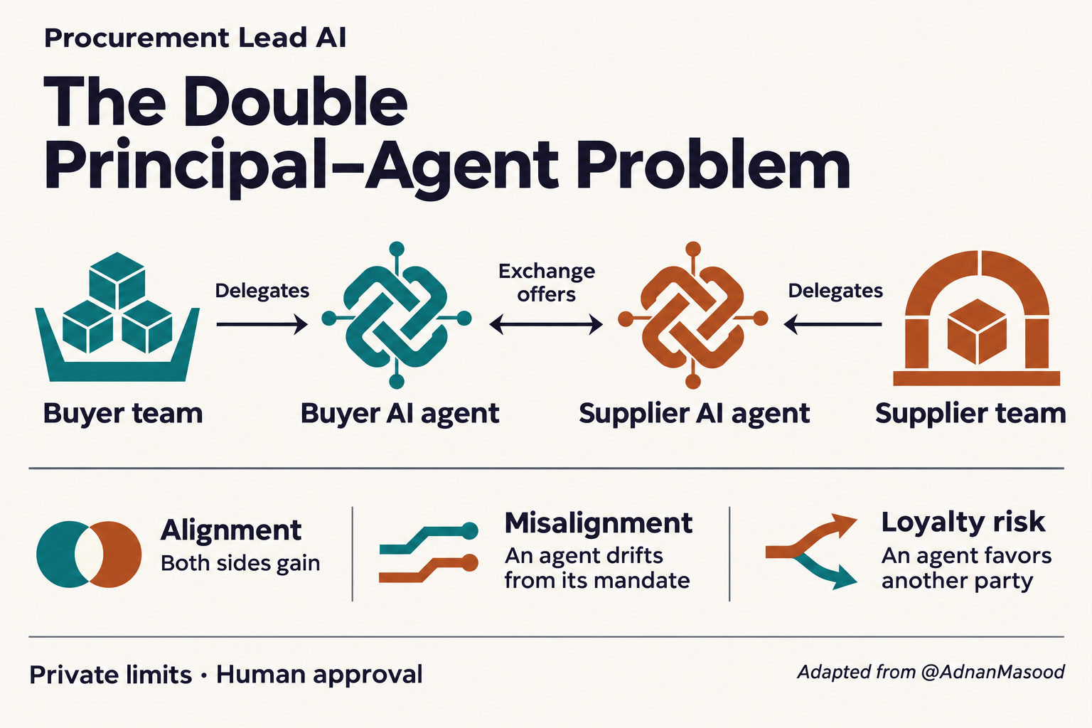
The evidence behind each decision
Proposed agent negotiation with deterministic cost checks and human approval
Quotations and mandates
Source-linked inputs
Buyer / Supplier Agents
Mandate-bound negotiation
Cost engine
Verified calculations
Initial agreement
Human review and approval
Human review and approval
Authorized final decision
Finance impact
Cash and payment scenarios
Approved terms and records · ERP integration roadmap
Potential defensibility: approved term histories, cost-model coverage and measurable customer outcomes.
Finux Labs
06
Notes:
This is a proposed product architecture. Existing alpha assets are the deterministic supplier cost engine and the separate finance dashboard. AI document extraction, field evidence and versioning, enterprise tenant storage, role-based approvals, live ERP interfaces and cross-product integration remain development scope. The connecting lines show an intended review flow and are not a claim of existing automated data transfer. Build traceability by retaining quotation version, field provenance, units, currency, source date, calculation version and approved decision context. Customer permissions, retention policy and contractual data rights must govern any use of approved outcomes. The listed defensibility is potential to develop, not an established proprietary-data moat.
Sources and assumptions
Finux Labs Supplier Cost Explorer, live alpha inspected October 31, 2026. https://sourcing-alpha.connextium.xyz/#workspace ; Calculation source https://github.com/SmartFinuxLabs/SupplierCostExplorer/blob/main/dist/model.mjs
Finux Labs Finance Decision Intelligence, guest sample workspace inspected October 31, 2026. https://fdi-alpha.connextium.xyz/guest ; Implementation source https://github.com/SmartFinuxLabs/FinanceDecisionIntelligence/blob/main/app/finance-workspace.tsx
Revision: source-linked inputs and buyer/supplier mandates feed the two agents. Agents negotiate within authorized limits while the existing deterministic cost model checks scenarios. Initial agreements return to humans for detailed review and approval before any award or commitment. Approved terms can then support finance scenarios and future ERP exports. Production agent services, supplier connectivity, approval storage and the shared finance connection remain proposed architecture.

Slide 7
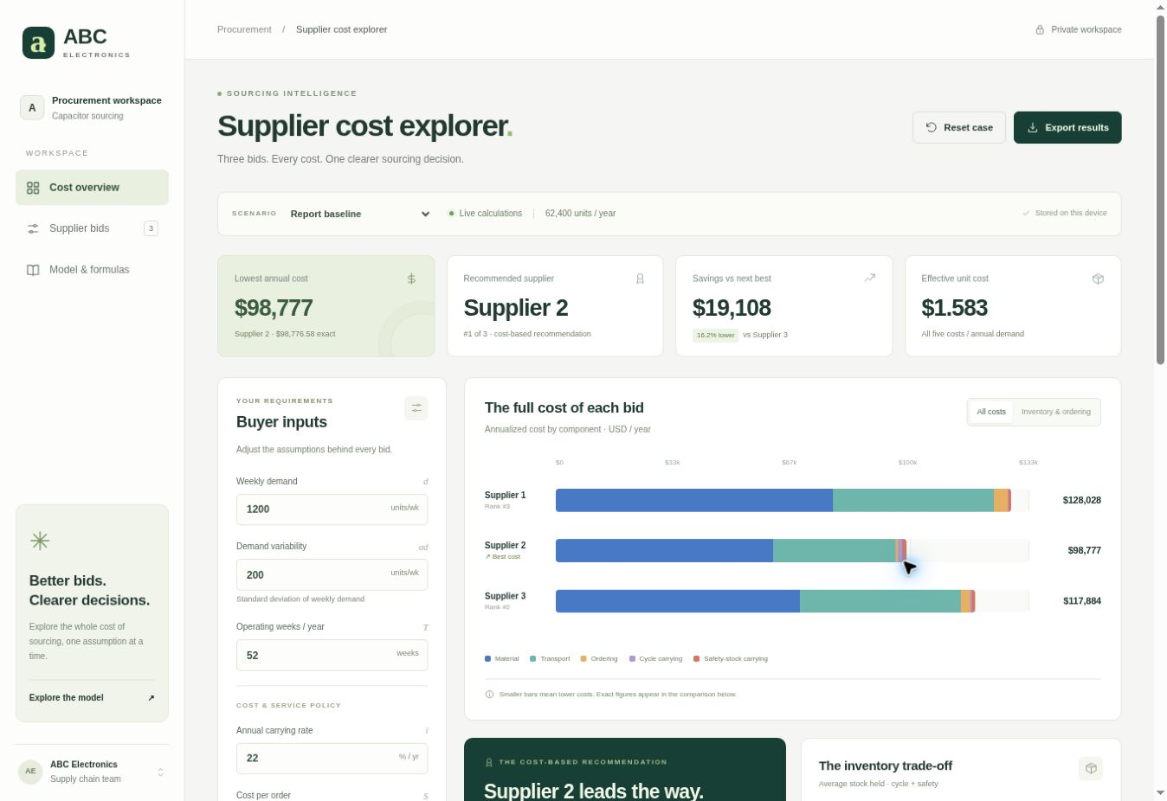
Supplier Cost Explorer
Working alpha for transparent supplier cost assessment
Alpha capabilities
Buyer and supplier input editors
Five annual cost components
Live rankings and scenarios
Worked formulas and CSV export
sourcing-alpha.connextium.xyz
ABC Electronics illustrative case, USD. Demonstration data. Alpha status does not establish commercial traction.
Finux Labs
07
Notes:
Actual product screenshot captured from the live alpha on October 31, 2026. The application models annual material, cycle-inventory carrying, safety-stock carrying, ordering and transport costs. It supports weight-based freight, billing floors, flat/included freight and price-only or landed inventory valuation. It explicitly exposes model assumptions. This alpha currently uses browser-local data. The screenshot displays an illustrative case, not Finux Labs revenue or customer spend. AI document ingestion and negotiation support remain planned.
Sources and assumptions
Finux Labs Supplier Cost Explorer, live alpha inspected October 31, 2026. https://sourcing-alpha.connextium.xyz/#workspace ; Calculation source https://github.com/SmartFinuxLabs/SupplierCostExplorer/blob/main/dist/model.mjs

Slide 8
The ABC Electronics cost assessment
Three supplier bids evaluated on the same demand and service assumptions
US$98,777
Supplier 2
lowest modeled annual cost
US$19,108
below Supplier 3
with more inventory and
a longer mean lead time
Illustrative annual costs in USD. 52 weeks, 95% cycle service, price-only inventory value. Supplier 3 freight: $7.25/100 lb.
Finux Labs
08
Notes:
Calculation source is the live alpha model. Exact totals: Supplier 1 $128,027.70, Supplier 2 $98,776.5816, Supplier 3 $117,884.326. Difference between Supplier 3 and Supplier 2 is $19,107.7444, or 16.2089% of Supplier 3 cost. Supplier 2 mean lead time is 7 weeks and average on-hand inventory is 10,986 units versus Supplier 3 at 4 weeks and 5,803 units. These are modeled comparisons, not negotiated or realized customer savings. Buyer inputs: 1,200 units weekly demand, demand SD 200 units, 52 weeks, carrying rate 22%, order cost $150, weight 10 lb, 95% cycle service. Safety stock rounds up to whole units. Freight baseline uses Supplier 3 $7.25 per 100 lb. Earlier notes quote $4.80, which yields Supplier 3 total $102,596.326. The application exposes both scenarios. Formula: annual demand D=dT; annual material Dc; cycle carrying (Q/2)ci; safety carrying SSci; ordering (D/Q)S; freight (D/Q)F. This case excludes unquoted charges, in-transit inventory and non-cost supplier factors.
Sources and assumptions
Finux Labs Supplier Cost Explorer, live alpha inspected October 31, 2026. https://sourcing-alpha.connextium.xyz/#workspace ; Calculation source https://github.com/SmartFinuxLabs/SupplierCostExplorer/blob/main/dist/model.mjs

Slide 9
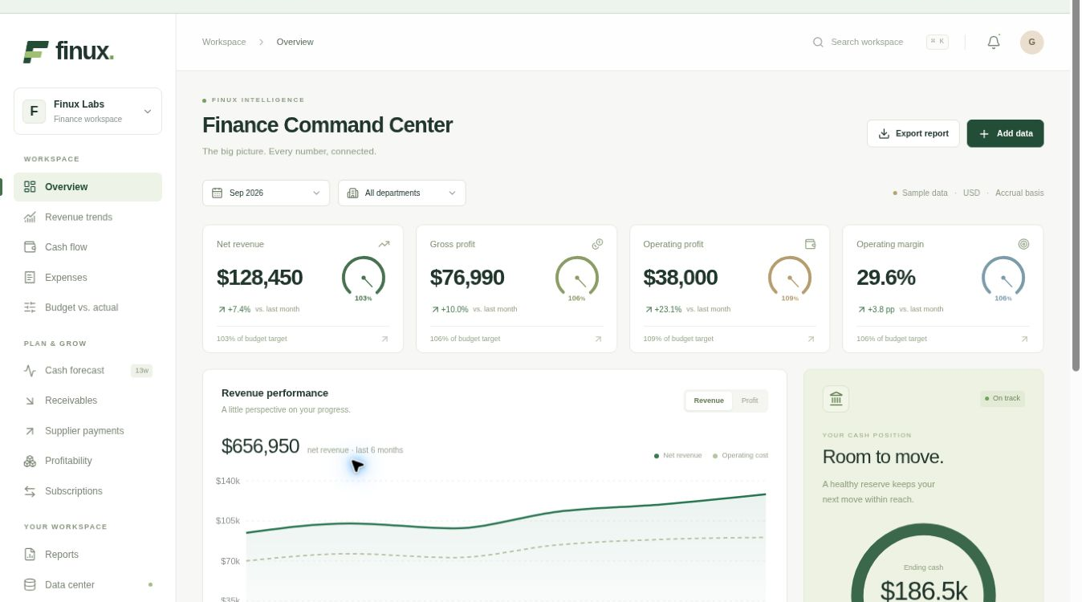
Finance Decision Intelligence
Working alpha for financial visibility and supplier payment planning
Alpha capabilities
Financial KPIs and reports
Cash forecasts and payables
Validated CSV imports
Planned connection:
sourcing scenarios in
cash planning.
fdi-alpha.connextium.xyz
Actual guest sample workspace. Displayed financial values are USD demonstration data, not Finux Labs results.
Finux Labs
09
Notes:
Actual Finance Decision Intelligence guest sample workspace captured October 31, 2026. Source implementation and guest UI show financial KPIs, profit-and-loss reports, cash ledger, 13-week cash forecast, accounts receivable, supplier payables, product profitability, subscription metrics and validated CSV import/export. All screenshot amounts are sample data in USD. These are not Finux Labs revenue, customer traction or audited company financials. The sourcing-to-finance connection is proposed. The two alpha applications currently operate separately; no production ERP integration, shared database or automatic posting between them is claimed.
Sources and assumptions
Finux Labs Finance Decision Intelligence, guest sample workspace inspected October 31, 2026. https://fdi-alpha.connextium.xyz/guest ; Implementation source https://github.com/SmartFinuxLabs/FinanceDecisionIntelligence/blob/main/app/finance-workspace.tsx

Slide 10
A focused Canadian entry market
Manufacturing and wholesale SMEs provide a starting universe, not a qualified customer list
85,785
Illustrative addressable model
5% meet the initial profile
≈4,289 potential accounts
US$1,500 annual subscription
Canadian manufacturing and wholesale
businesses with 1–499 employees
46,793 manufacturing SMEs
38,992 wholesale SMEs
≈US$6.4m / year
Annual-plan subscription scenario.
Usage fees remain unmodeled.
ISED, Key Small Business Statistics 2025, December 2024 counts. Fit rate and subscription value below are planning assumptions.
Finux Labs
10
Notes:
The industry counts remain unchanged. Manufacturing small businesses 44,440 plus medium businesses 2,353 = 46,793 SMEs. Wholesale small businesses 38,016 plus medium businesses 976 = 38,992 SMEs. Combined universe = 85,785 businesses with 1–499 employees, broader than the proposed 20–499 employee initial profile. The unvalidated 5% fit-rate assumption implies 4,289.25 potential accounts, shown as approximately 4,289. The revised annual subscription of C$1,500 yields C$6,433,875 annual subscription opportunity, shown as approximately C$6.4m. This is a modeled addressable scenario, not a measured TAM or sales forecast. It excludes transaction-count and transaction-value fees because rates, volume, value and fee combinations have not been validated. Monthly subscribers would pay C$150 per month, or C$1,800 over twelve months. Validate profile fit, willingness to pay and plan mix.
Sources and assumptions
ISED, Key Small Business Statistics 2025, Table 3, employer businesses as of December 2024. https://ised-isde.canada.ca/site/sme-research-statistics/en/key-small-business-statistics/key-small-business-statistics-2025

Slide 11
A focused position in an active market
Proposed focus: agent negotiation with traceable costs and a human approval step
Alternative | Established strength | Finux Labs’ proposed focus
Excel and Copilot | Flexible analysis inside familiar workbooks | A consistent supplier cost model with traceable assumptions
SAP Ariba | Broad sourcing workflow and AI agent capabilities | A narrow entry workflow for smaller procurement teams
Fairmarkit | Automation for repetitive sourcing events | Inventory, freight and cash trade-offs in buyer preparation
Finux Labs | Two working alpha tools | Agent negotiation with human review and finance checks
Competitor scope reflects official descriptions. Finux Labs’ dual-agent negotiation and finance connection remain planned.
Finux Labs
11
Notes:
Comparisons describe category focus, not a complete capability audit. Microsoft documents workbook analysis and data insights with Copilot in Excel. SAP describes sourcing-event creation, bid analysis and negotiation agents; negotiation-agent availability may require eligible adoption programs and base-product access. Fairmarkit documents auto-bundling, supplier matching/sending and auto-awarding for repetitive sourcing. No claim is made that competitors lack cost analysis, finance integration or explainability. Finux Labs proposes a focused workflow and must prove deployment effort, user adoption and differentiation in pilots. Finux Labs alpha functionality is sourced separately. Competitor pages accessed October 31, 2026.
Sources and assumptions
Microsoft, Get data insights with Copilot in Excel. https://support.microsoft.com/en-us/excel/copilot/data-insights-with-copilot-in-excel
SAP Ariba Sourcing Assistant. https://www.sap.com/use-cases/joule-assistant/sourcing-assistant ; SAP Sourcing Negotiation Agent, eligibility and availability vary. https://www.sap.com/products/spend-management/sourcing-negotiation-agent.html
Fairmarkit, Autonomous sourcing product documentation. https://docs.fairmarkit.com/buyers/autonomous-sourcing
Finux Labs Supplier Cost Explorer, live alpha inspected October 31, 2026. https://sourcing-alpha.connextium.xyz/#workspace ; Calculation source https://github.com/SmartFinuxLabs/SupplierCostExplorer/blob/main/dist/model.mjs
Finux Labs Finance Decision Intelligence, guest sample workspace inspected October 31, 2026. https://fdi-alpha.connextium.xyz/guest ; Implementation source https://github.com/SmartFinuxLabs/FinanceDecisionIntelligence/blob/main/app/finance-workspace.tsx
Revision: Finux Labs proposes a Buyer Procuring Agent and Supplier Agent, bounded negotiation, preliminary terms and explicit human review. This is a product focus, not a claim that competitors lack agent negotiation or approval controls.

Slide 12
Subscription and transaction fees to validate
Base pricing plus transaction-count and transaction-value fee options
US$1,200
US$1,500 / year
8-week paid pilot
or US$150 / month
One purchasing category
A scoped negotiation and outcome review
Workspace subscription
Usage fee basis | Calculation | Pricing status
Transaction count | Completed transactions × fee | Per-transaction fee to validate
Transaction value | Approved value × agreed rate | Value-based rate to validate
50 annual plans = US$75,000 subscription ARR
All prices USD. Usage rates and whether fees combine remain to validate. Pilot fees do not count as subscription ARR.
Finux Labs
12
Notes:
Updated founder-directed pricing: C$1,200 for an eight-week paid pilot, and a workspace subscription at C$1,500 per year or C$150 per month. Twelve monthly payments total C$1,800. Fifty annual-plan subscribers yield C$75,000 subscription ARR; fifty customers paying C$150 every month yield C$90,000 annualized subscription revenue if maintained for twelve months. These are illustrative calculations, not current customers, booked revenue or forecasts. Proposed usage fee models: transaction-count revenue = N × f, where N is the number of completed, human-approved transactions and f is the agreed per-transaction charge; transaction-value revenue = V × r, where V is the approved billable transaction value and r is the agreed rate. Neither rate is specified. Whether these options are alternatives, volume tiers or combined charges remains a customer-validation decision. Define the billable unit, completion trigger, value basis, returns/cancellations, caps and taxes in customer terms. Agent messages, counteroffers and draft revisions should not automatically count as separate commercial transactions. Pilot and implementation fees are one-off services and excluded from subscription ARR. Any recurring usage revenue should remain separately identified until contract terms and repeatability support the chosen reporting treatment. Low base pricing makes onboarding effort, AI cost per negotiated transaction, paid usage conversion and support cost important pilot measurements. No margins or break-even result are claimed.

Slide 13
Three paid pilots establish the first proof
A founder-led entry through Canadian manufacturing and distribution networks
3
Recruit
Founder outreach to buyers
and ERP advisors.
Run
Real quotations and agent limits.
A buyer-approved baseline.
paid Canadian pilots
targeted within 18 months
Measure
Pricing rounds and staff time.
Finance-verified outcomes.
Pilot scope: one buyer, a willing supplier,
one category and a finance reviewer.
Convert
Paid renewals and references.
A repeatable onboarding process.
Finux Labs
13
Notes:
Three paid pilots is a target, not current customer traction. Recruitment channels are proposed and no association, ERP vendor or manufacturer partnership is claimed. Each pilot should have written scope, authorized data access, a procurement owner and a finance reviewer. Measure median minutes from quote receipt to reviewed comparison, percentage of required fields completed, discrepancies against buyer-reviewed calculations, negotiation-preparation time, and any verified commercial difference versus a documented baseline. Separate price changes, order timing, working capital release, freight costs and service changes. Do not claim a percentage saving before a buyer validates baseline, scope, volume and implementation. The pilot should also track onboarding hours, AI cost per event and customer willingness to renew.
Sources and assumptions
Revision: pilots should include a willing supplier as well as the buyer and measure both organizations’ negotiation effort. Agent access and mandates require organizational authorization. The eight-week pilot price is now C$1,200. Measure the number of pricing rounds, staff minutes, elapsed time to preliminary agreement, human revision rate, total-cost implications and billing-unit economics. Three pilots remain a target, not achieved traction.

Slide 14
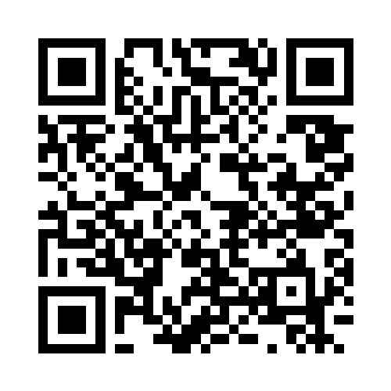
Founder experience and execution plan
Ju He (Terence), founder and builder · juhe.terence@gmail.com
10+ years
Months 1–6
Quotation extraction and review · Reproducible cost comparisons
Live Pitch Deck
Enterprise application development and integration across banking, supply chain finance, insurance and e-commerce
Months 7–12
Buyer and Supplier Agent negotiation · Human review and first paid pilots
• Trade Finance, Procurement, Enterprise
• Cloud, Agentics, Agents Engineering
• B.C.-based development
Scan camera or tap below to view presentation
Months 13–18
Three paid pilots and renewal tests · Initial recurring revenue target
Open Online Deck ↗
Contact: juhe.terence@gmail.com
Finux Labs
14
Notes:
Founder background is user-provided: Ju He (Terence), based in Richmond, British Columbia, has more than ten years of application development and enterprise integration experience across financial services and e-commerce, including roles at CIBC, Central 1, ADESA/Kars Global and BMO. Technical experience includes Java/Spring, Python, TypeScript/React, enterprise messaging, data analysis and cloud/container platforms. This supports building finance-aware procurement systems, but is not a claim of prior procurement department leadership or established sales relationships. The plan assumes a founder-led team, one core engineer with hiring paced to cash and specialist procurement support. Procurement advisor recruitment and customer validation remain milestones. Timing, pilot counts and revenue are targets, not achieved results.
Sources and assumptions
Revision: months 7–12 now target a prototype of Buyer Procuring Agent and Supplier Agent negotiation with preliminary agreements and human review. Recruitment of participating suppliers, evaluation of agent compliance with mandates and cost per approved transaction are milestones. These are planned capabilities, not delivered functionality.

Slide 15
An 18-month plan for US$220,000
An 18-month Pre-seed plan for agent-assisted negotiation and three paid Canadian pilots
US$220k
Use of funds | US$
Founder and engineering | 132,000
Procurement and pilots | 20,000
Cloud, AI and tools | 13,000
Customer acquisition | 22,000
Legal and security | 11,000
Contingency | 22,000
Total | 220,000
18 months
≈US$12,200 monthly budget
Target: three paid pilots
and initial recurring revenue.
Government R&D support may extend runway, subject to eligibility and approval. The base plan excludes unapproved assistance.
Finux Labs
15
Notes:
The C$550,000 target and allocation are approved planning instructions from the founder, not committed investment. Allocation: founder compensation, AI engineering and integration development C$330,000; procurement expertise and pilot delivery C$45,000; cloud, AI and development tools C$30,000; customer acquisition and partnerships C$50,000; legal, accounting, privacy and security C$25,000; contingency C$70,000. Total C$550,000. Dividing by eighteen months gives C$30,555.56 monthly including contingency, displayed as approximately C$30,600. This assumes a lean founder-led delivery model with one core engineer and specialist contractors, rather than a fully staffed department. Revenue and government support are excluded from base runway. NRC IRAP eligibility depends on incorporation, Canadian operations, technical project merit and commercial capacity. SR&ED requires eligible technological advancement and systematic investigation; ordinary AI use does not automatically qualify. No grant award, tax refund, investor terms, valuation or equity percentage is represented as secured. The funding is intended to deliver a pilot-ready AI assistant, three paid Canadian pilots and initial recurring revenue, all targets.
Sources and assumptions
NRC IRAP, Financial support for technology innovation. https://cnrc.canada.ca/en/support-technology-innovation/financial-support-technology-innovation
CRA, What work is eligible for SR&ED. https://www.canada.ca/en/revenue-agency/services/scientific-research-experimental-development-tax-incentive-program/sred-eligibility.html
Revision: the C$550,000 ask and budget allocations remain unchanged. The product scope now explicitly includes Buyer Procuring Agent and Supplier Agent negotiation, preliminary agreements and a human review/approval step. Pricing hypotheses are C$1,200 per eight-week pilot and C$1,500 per year or C$150 per month, with transaction-count/value fee options. The base runway still excludes unapproved grants and forecast customer revenue.

Slide 16
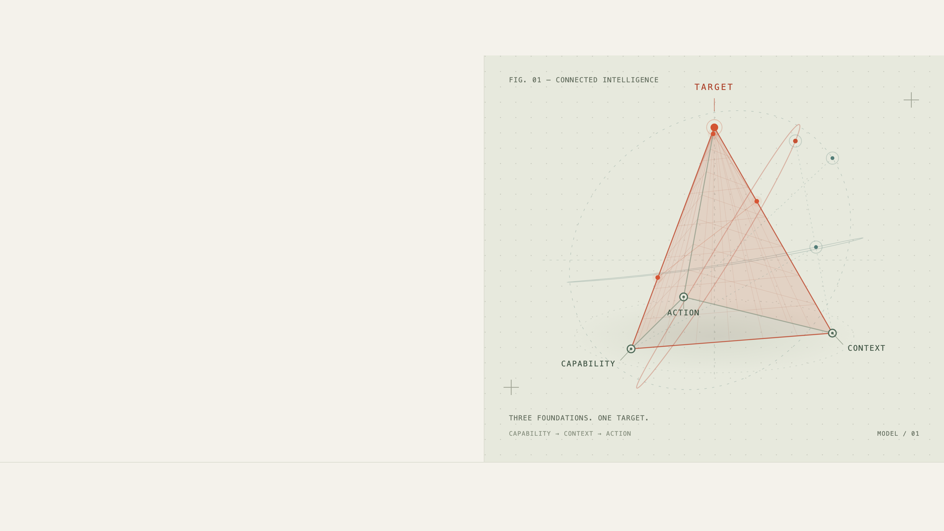
● NOVEMBER 02—03, 2026 / THE NEST, UBC
Procurement ai in
AI Summit
Vancouver 2026
[ Agentic Procurement ↗ ] [ Dual-Agent Negotiation ] [ Vancouver, BC ]
Explore Summit Programme ↗
Finux Labs
Connected Intelligence · AI Summit Vancouver 2026 · Connextium Event Companion
16

