Slide 1
Project 2:
Credit Card Customer Classification
Fiona Lee
MACS 30100

Slide 2
Task
Goal: Classify existing customers of the bank who would be interested in a recommended credit card
Tasks
Data preprocessing
Build different classification models
Predict customers’ intents of owning a recommended credit card

Slide 3
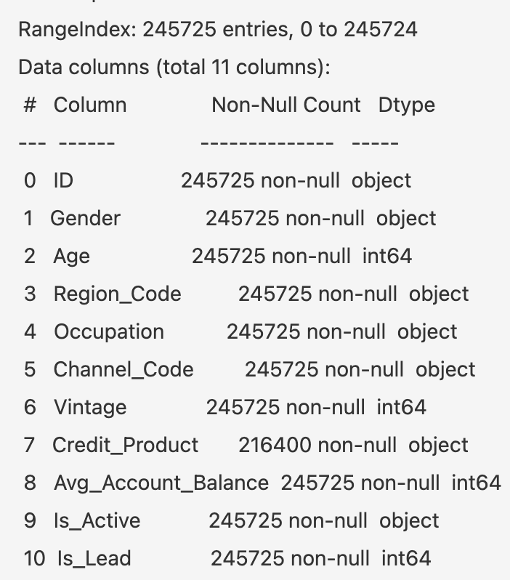
Data
Data size: 245725 rows, 11 columns
4 numerical, 7 categorical
Train : test = 7: 3
Feature space: 3 numerical, 5 categorical
Target: Is_Lead
Distribution:
187437 negative, 58388 positive
Data preprocessing
Imputation on Credit_Product
Numerical: StandardScalar
Categorical: OneHotEncoder
Data source (Kaggle): https://www.kaggle.com/sajidhussain3/jobathon-may-2021-credit-card-lead-prediction
Notes:
Numerical: Age, Vintage, Avg_account_balance
Categorical: Gender, Occupation, Channel_code, Creidt_Product, and Is_active
Feature space: as highlighted in orange boxes on the right side
Target: as highlighted in red box on the right side
Imputation:10% of the dataset contain missing values in Credit_Product. Instead of directly filling missing values with mode (which is No), I filled them with a new category call “unknown”. Because first, the ratio of existing No vs Yes is about 2:1, adding 10% more No instances may make the dataset deviate from real situation, and I also wonder whether missing data about customers active credit product would influence the classification in their intents of credit card.
Numerical
Categorical

Slide 4
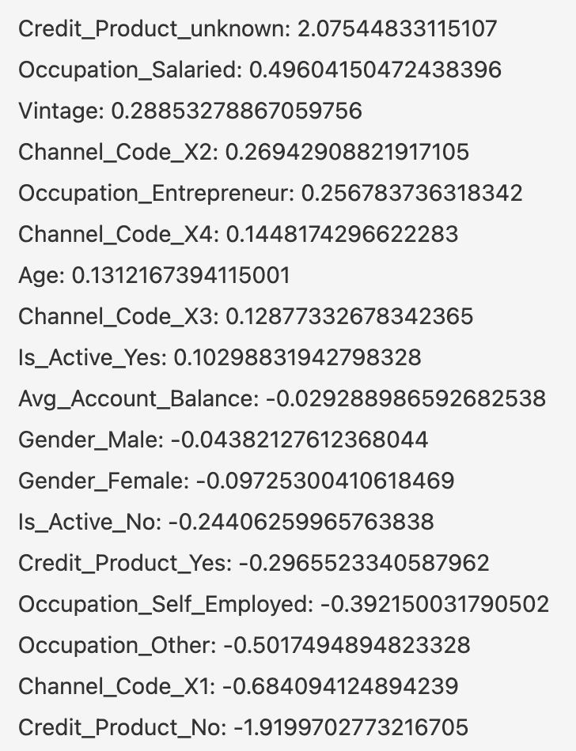
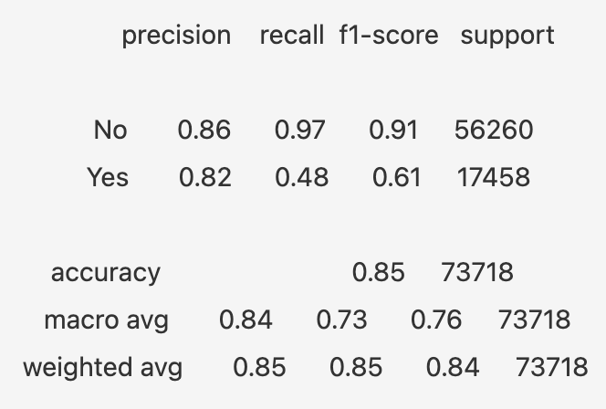
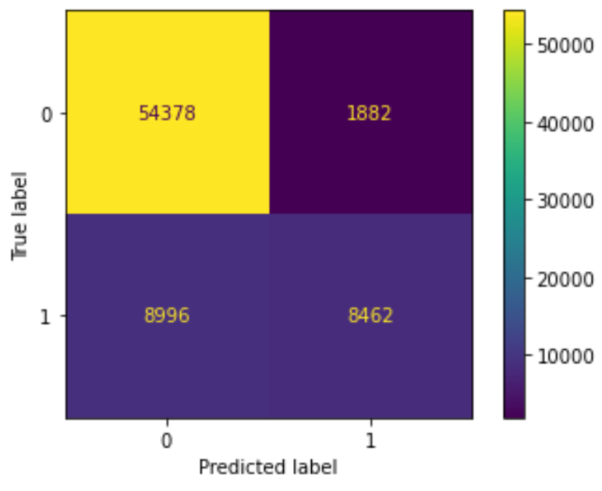
Logistic Regression
Parameters:
Random_state = 42
Accuracy = 0.8524
Top feature: Credit_Product_unknown
Notes:
Next, I train 4 supervised ML model to predict whether customers are interested in the recommended credit card.
Credit_Product_unknown: whether a customer has data about owning active credit products

Slide 5
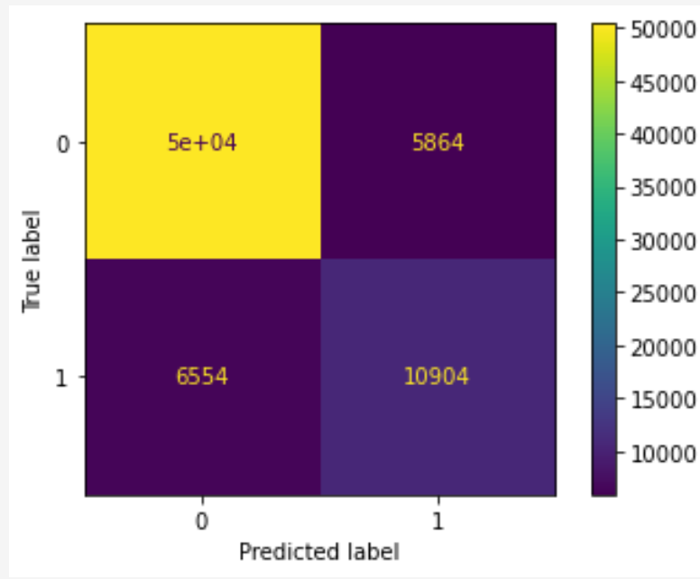
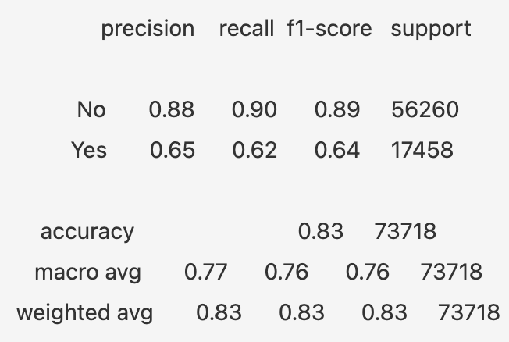
Gaussian Naive Bayes Classifier
Parameters as default
Accuracy = 0.8315
Notes:
Lower accuracy than logistic regression
NB is doing better in classifying true positive and true negatives, but it has a bigger number in false positives

Slide 6
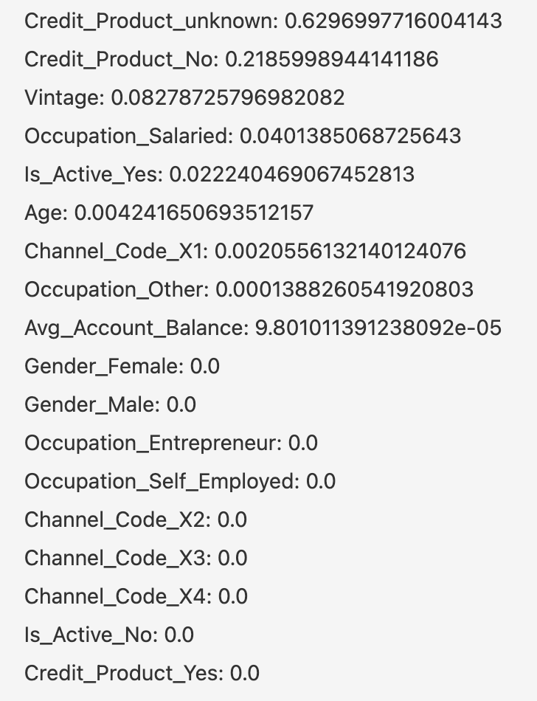
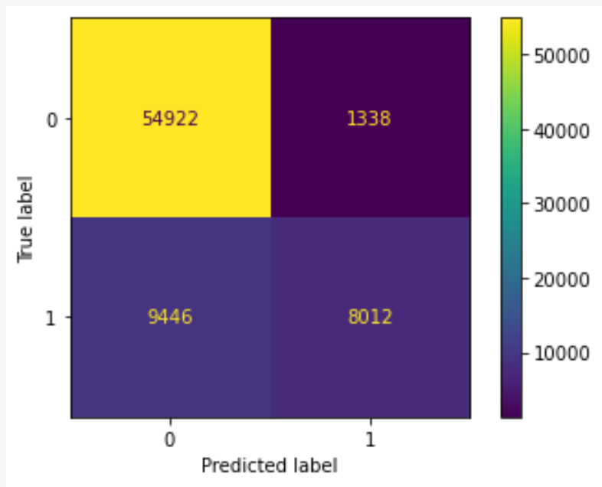
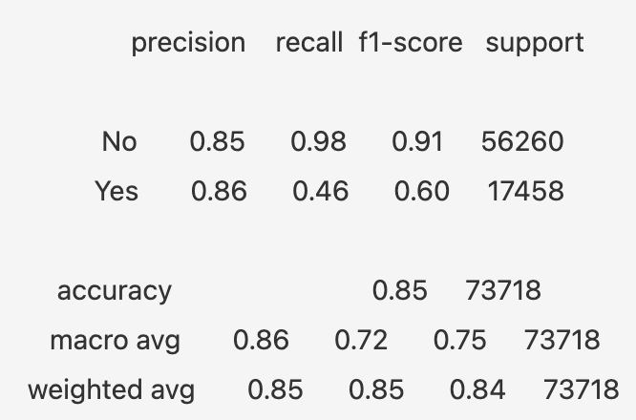
Decision Tree Classifier
Parameters:
Criterion = entropy, Max_depth = 4
Random_state = 42
Accuracy = 0.8537
Top feature: Credit_Product_unknown
Notes:
Accuracy is slightly better than logistic regression
A bunch of features have coefficients = 0
It has a similar tendency as logistic regression that it could not correctly classify originally positive cases, so that for customers who are interested in the credit card, DT classifier tends to classify them as not interested, which can make the bank miss their potential customers

Slide 7
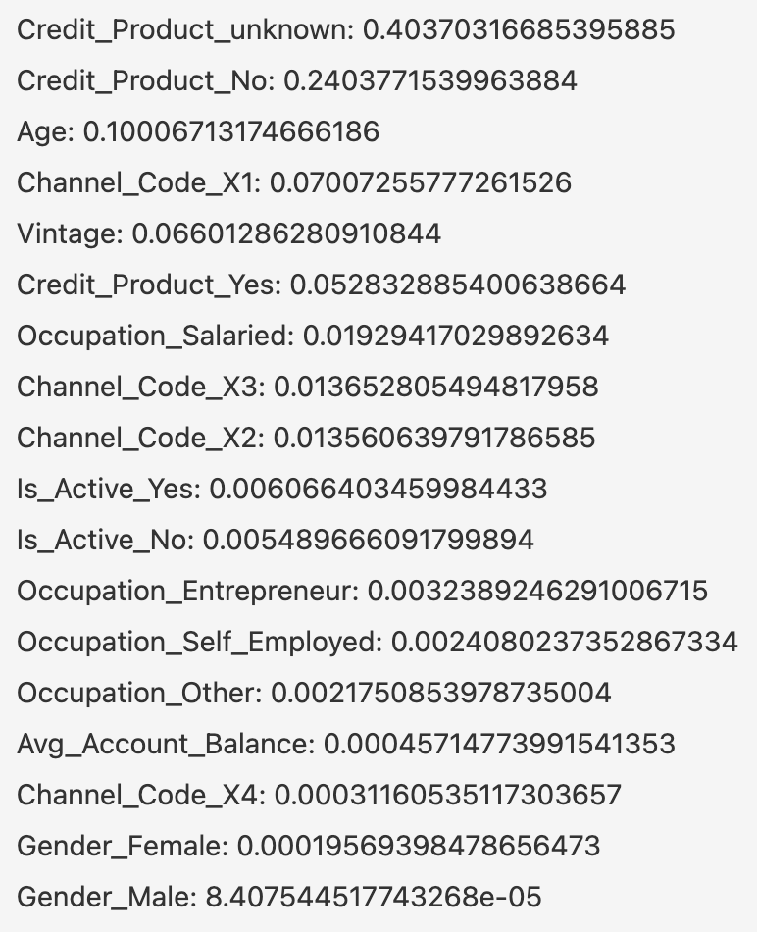
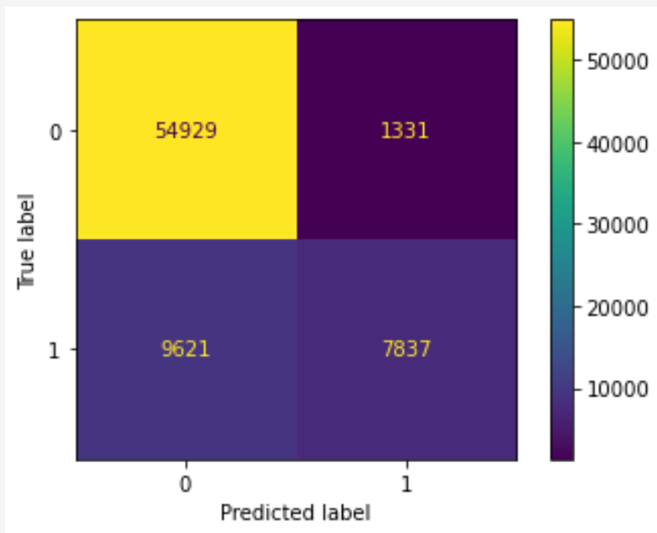
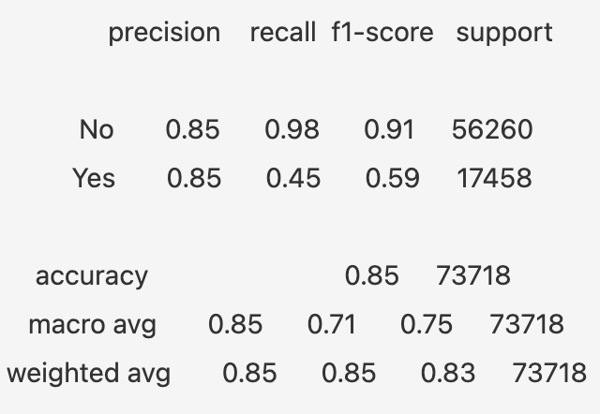
Random Forest Classifier
Parameters:
Criterion = entropy, Max_depth = 4
Random_state = 42
Accuracy = 0.8514
Top feature: Credit_Product_unknown
Notes:
Accuracy is slightly lower than decision tree
it performs even worse than DT to correctly identify potential customers and classify them into positive class

Slide 8
Compared with KMeans
Motivation: how much the data can explain itself
Parameters:
N_clusters = 2
Random_state = 42
How accurate in “predicting”: 0.6187
Rand score: 0.5282
Notes:
Motivation: which means, whether the positive and negative instances in the training data can already form 2 clear clusters without any training labels. If the features themselves can correctly form 2 clusters, then either the 4 supervised models are supposed to perform well, or more information and features are needed for those 4 models to capture the patterns.
Since there are 2 classes, I can calculate how accurate KMeans model clusters the datapoints. I first assign 2 clusters as positive and negative classes, and compare the cluster class with the actual label. About 62% of the test datapoints are correctly clustered.
I also looked at the rand score that measures the similarity between two clusters by considering all datapoints, where rand score = 1 is a perfect match.

Slide 9
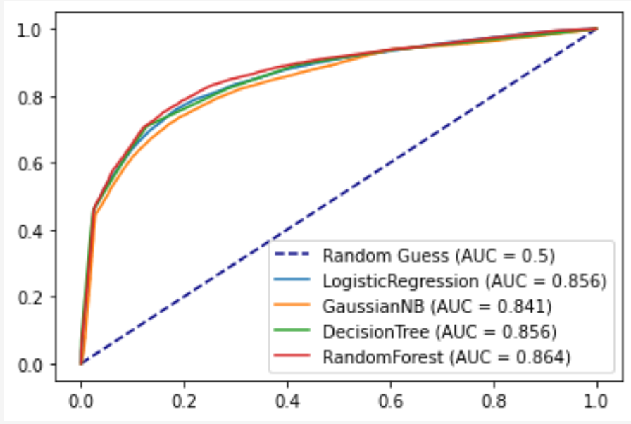
AUC score/ROC curve
Notes:
RF > LR ~ DT > GNB

Slide 10
Error Analysis
Selected 30 false positives and false negatives based on the 4 models’ predictions
Findings:
Rely on Credit_Product_unknown too much
Naive Bayes model relies on Is_Active_Yes a lot
Notes:
Models may rely on Credit_Product_unknown feature too much such that they can even ignore the effect of other influential features, such as having a salaried occupation
Whether a customer is an active customer over the past 3 months seem be an important feature for Naive bayes model, so in the misclassified cases, Naive Bayes tend to make classifications with the same pattern as the Is_Active_Yes feature
Overall, the 4 supervised models performed really well in predicting customers who are interested in the recommended credit card of this bank, and the bank can rely on this data and build Naive Bayes model to identify potential customers for the credit card, because NB classifies fewest interested customers into negative class, so that the bank is less likely to miss their target potential customers.

