Slide 1
Project 1:
Regression Analysis on Udemy online course data
Fiona Lee
MACS 30300

Slide 2
Task
Goal: to predict popularity based on features of Udemy online course
Tasks
Data preprocessing
Build different regression models
Predict number of subscribers

Slide 3
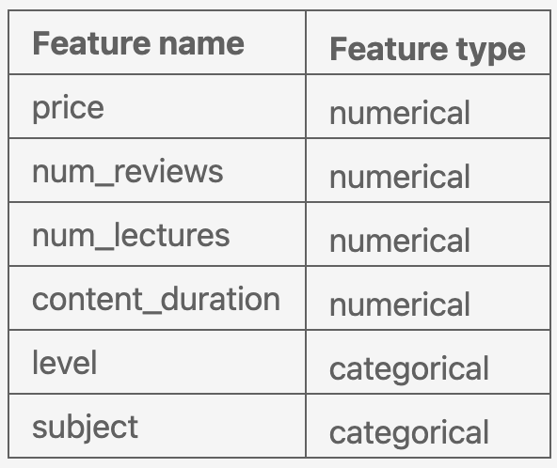
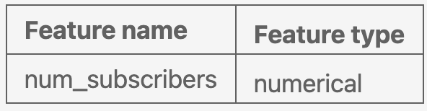
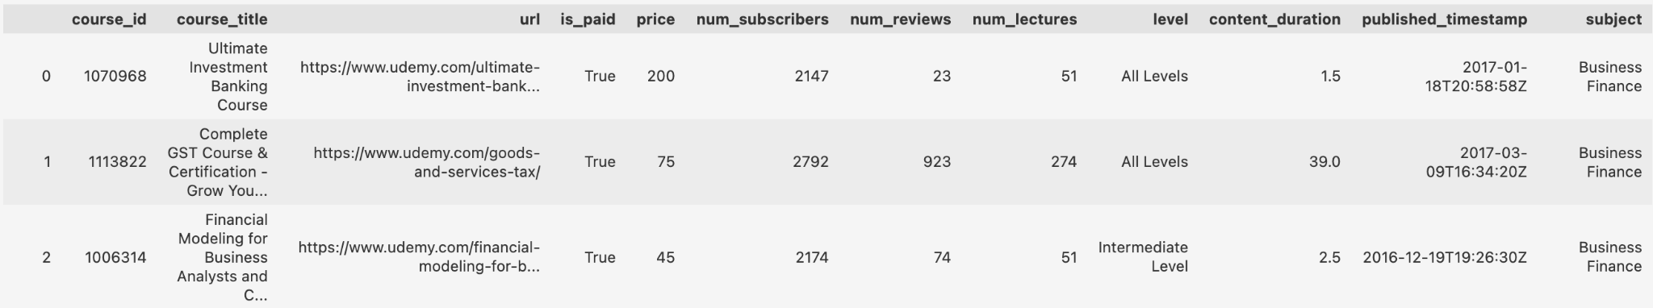
Data
Data size: 3678 instances, 12 columns
6 numerical features, 2 categorical, 2 textual, 1 boolean, 1 timestamp
Split training and testing datasets randomly with a 70:30 ratio
Feature space
6 features in total: 4 numerical, 2 categorical
Target: 1 numerical feature
Data source (Kaggle): https://www.kaggle.com/andrewmvd/udemy-courses
Notes:
Data source: Kaggle

Slide 4
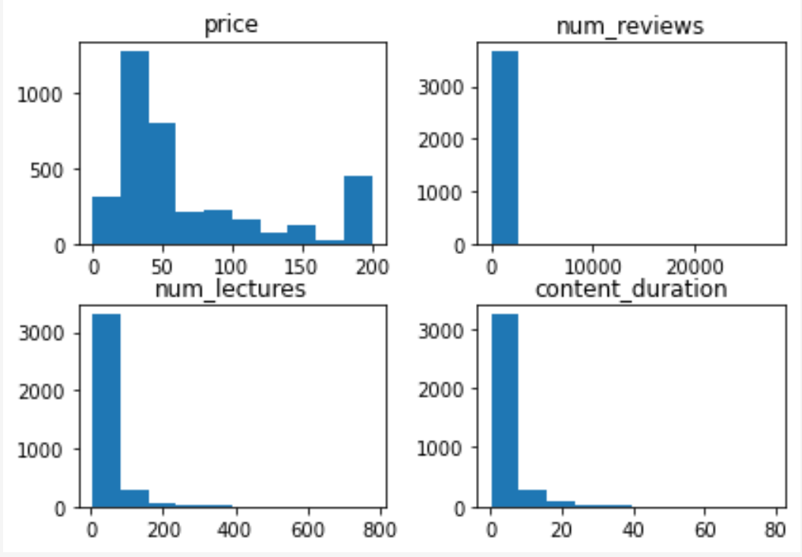
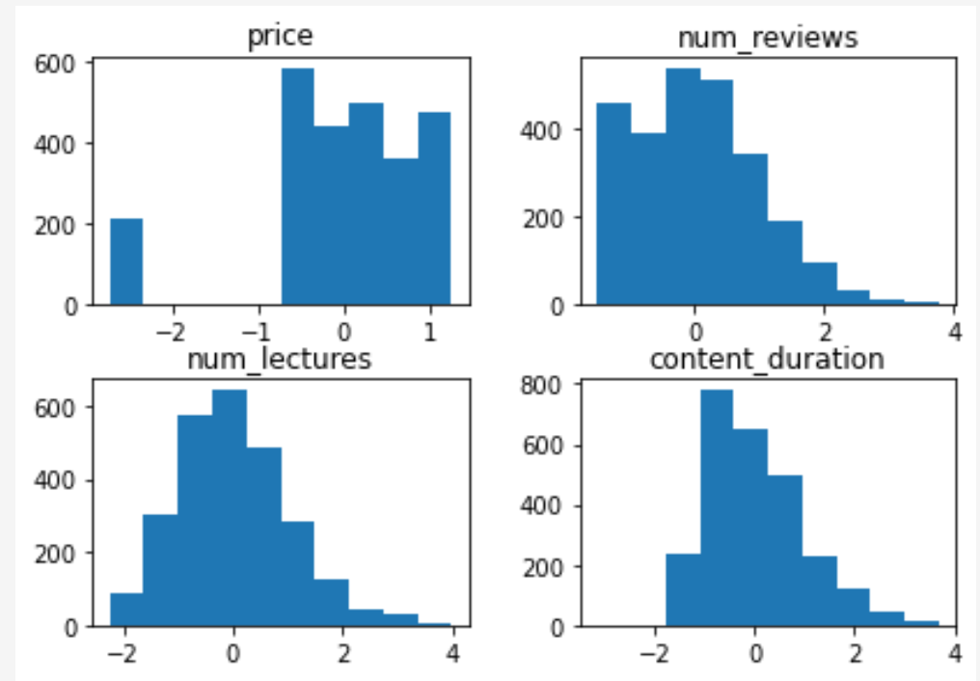
Data
Distribution
Numerical features show right skewness
Data preprocessing
Cleaning: drop 0 lecture course
Numerical features: log transformation for skewness, scale for standardization
Categorical features: OrdinalEncoder for ordinal “levels”, OneHotEncoder for “subjects”
Notes:
Levels: All Levels, Beginner level, intermediate level, expert level
Subjects: 'Graphic Design', 'Business Finance', 'Web Development', 'Musical Instruments'

Slide 5
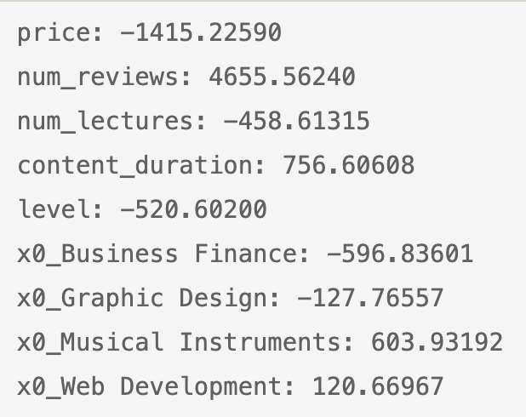
Ridge Regression
Polynomial Regression
Parameters:
fit_intercept = True
Random_state = 42
Predict testing set: score = 0.28479
Top feature: num_reviews
Parameters:
PolynomialFeatures: degree = 2, including_bias = True
Ridge Regression: fit_intercept = True, random_state = 42
Predict testing set: score = 0.53844
Creates 55 features, max coefficient = 3352.75
Notes:
Because of the multicollinearity between features, for example, num_lectures can be correlated with course duration

Slide 6
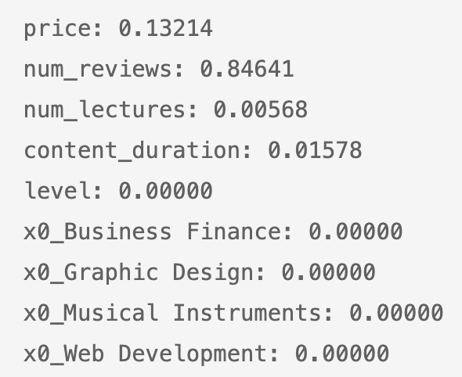
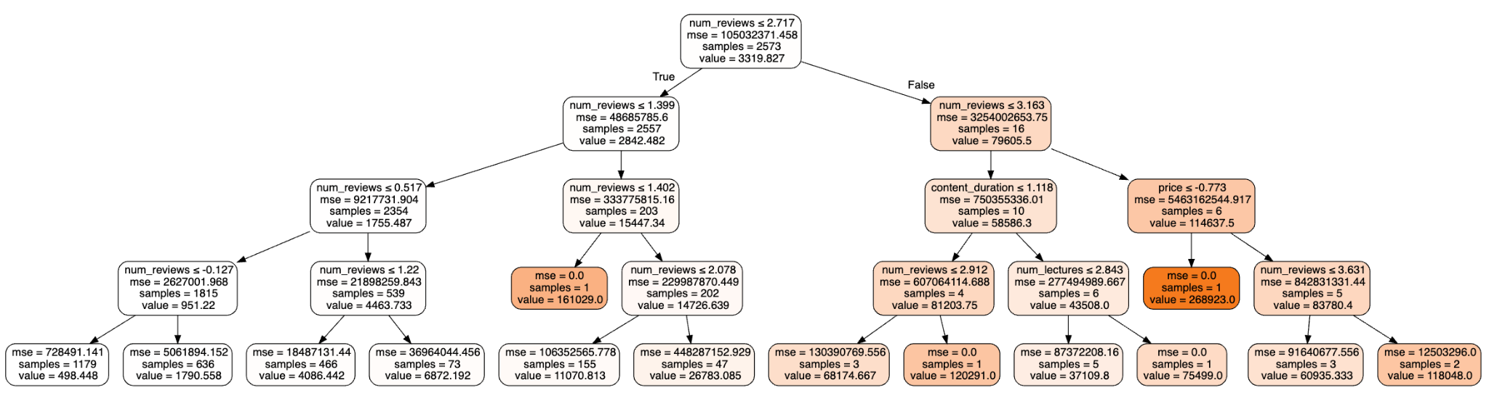
Decision Tree Regressor
Parameters:
Random_state = 42
Max_depth = 4 (2**4 = 16 > 9 = number of features)
Predict testing set: score = 0.579997
Top feature: num_reviews
Num_reviews, content_duration, price, num_lectures
Notes:
Much smaller coefficients, but many are close to 0

Slide 7
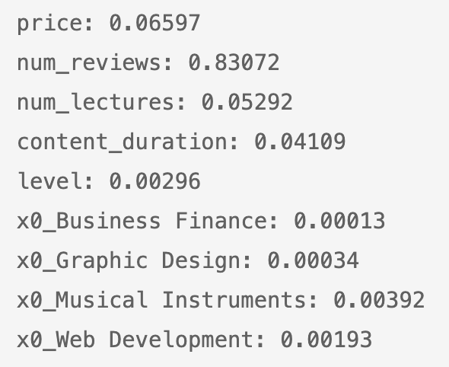
Random Forest Regressor
Parameters:
Random_state = 42
Max_depth = 4 (2**4 = 16 > 9 = number of features)
Predict testing set: score = 0.63318
Top feature: num_reviews

Slide 8
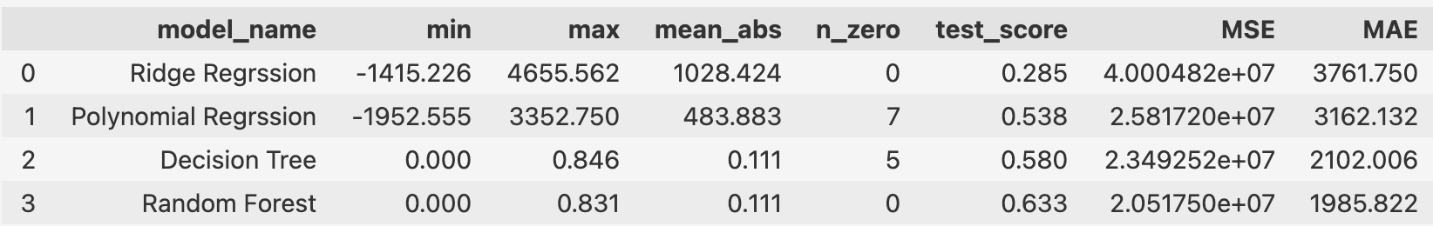
Models performance
Notes:
Large norms in coefficients → large absolute values in min and max coef
MSE and MAE are generally big → data does not fit these models so well
As test score increases, MSE and MAE decrease accordingly

Slide 9
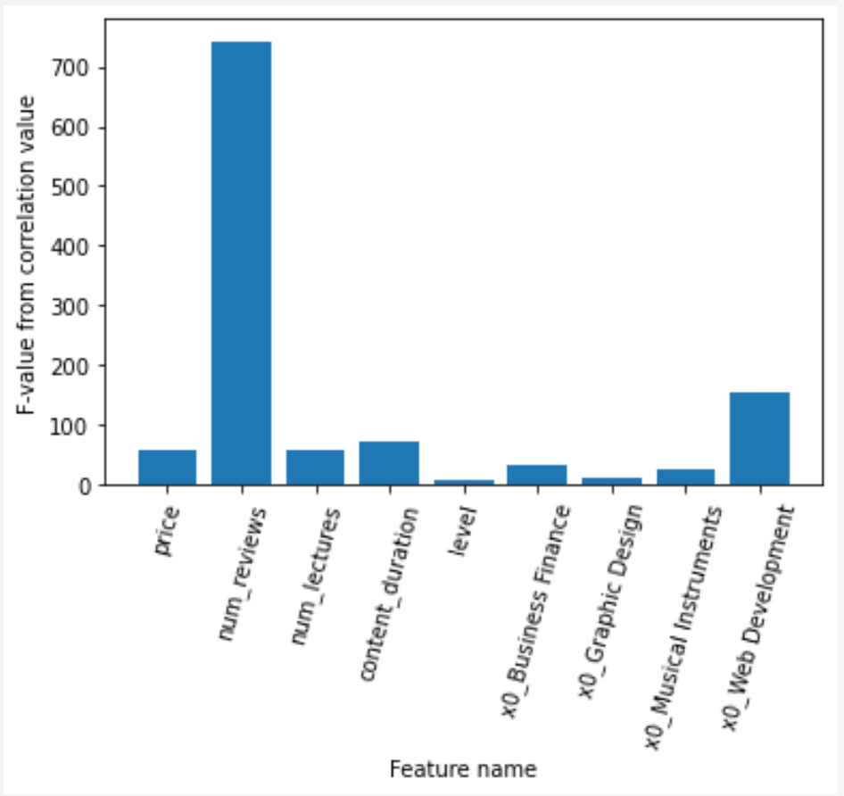
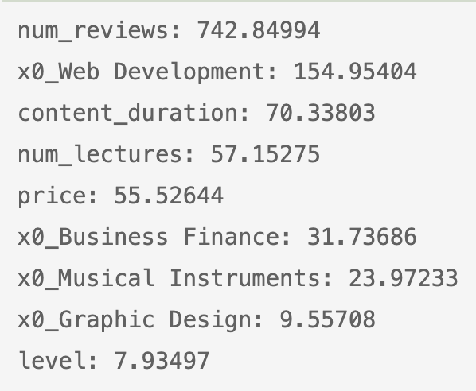
Feature Selection
SelectKBest and f_regression to select features that have strong correlation with target variable
Retrain Decision Tree Regressor
Top 3 features, max_depth = 2
Score on test set = 0.40093
F-value from correlation value

Slide 10
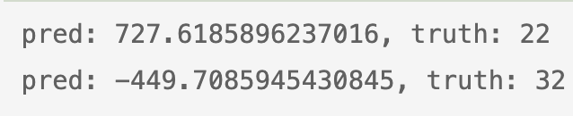
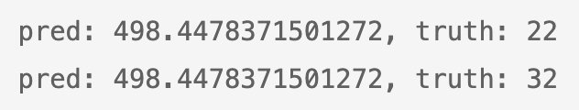
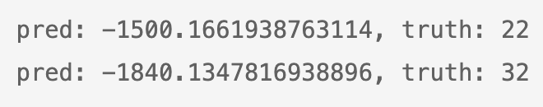
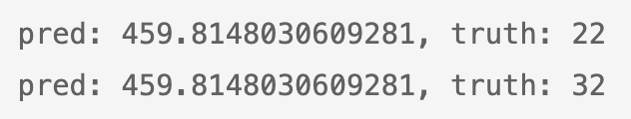
Error Analysis
Take first two instances from the testing set
Ridge Regression
Decision Tree Regressor
Polynomial Regression
Random Forest Regressor
Notes:
Print out the predicted value and the true value of the target variable
All models are poor at predicting the right values
Ridge and poly have relatively big norms
For decision tree and random forest, two instances are predicted with same values. This can be caused by the same value in num_reviews, which is the most powerful predictor in the models.
Overall, due to limitation in time and knowledge, the 4 models in this project fail to accurately predict the num_subscribers based on the features in the dataset. Improvements in data preprocessing can potentially increase model performance, and I would also recommend taking different approaches in modeling to find the best fit model on this dataset.

