Slide 1
冒險故事
(VTube Studio)
Notes:
今天是我期待已久的日子，

Slide 2
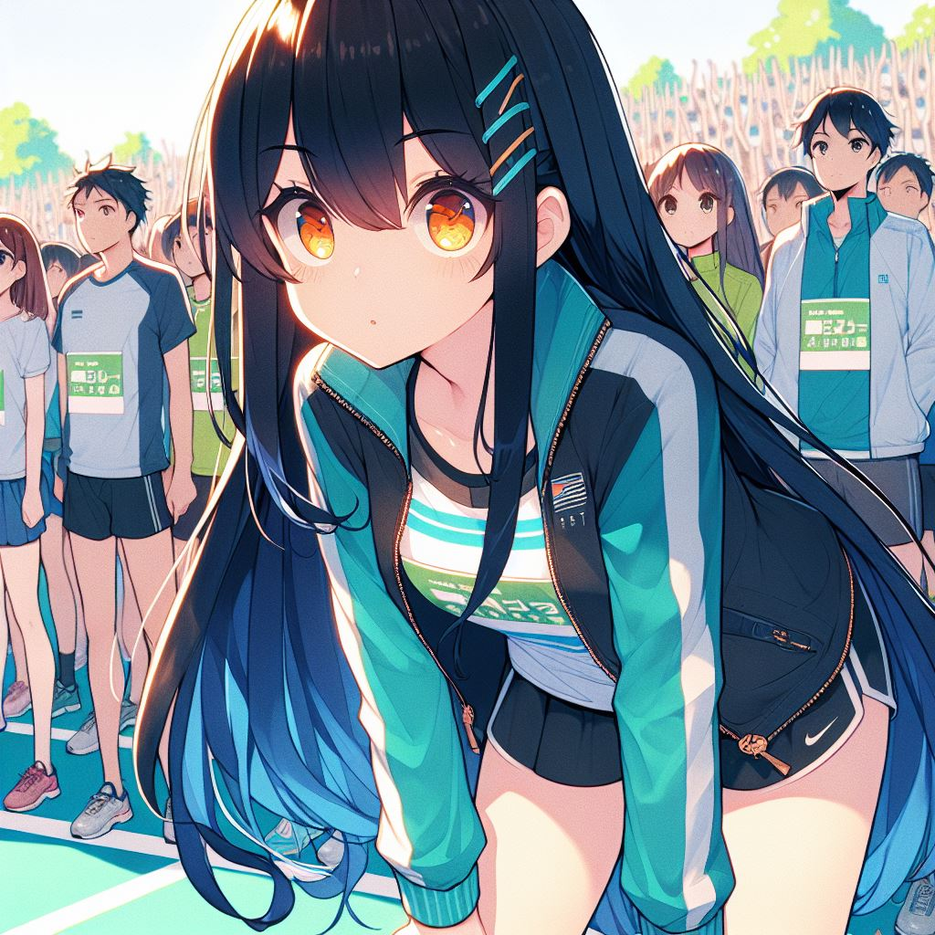
1.目標
Notes:
generate a Japanese anime style scene. A girl Stand on the starting line ready for marathon. She feel Feeling both excited and nervous. The girl’s appearance with long straight black hair reaching her waist, with dark blue gradient wavy tips. She has short slanted bangs and bright orange-yellow eyes. She is wearing a teal and white sports jacket, a black shirt, white shorts. The noisy crowd and enthusiastic cheers nearby.
我一直以來的夢想是完成人生中的第一場馬拉松。挑戰自己的極限，證明自己能夠做到。我站在起跑線上，內心既興奮又緊張，

Slide 3
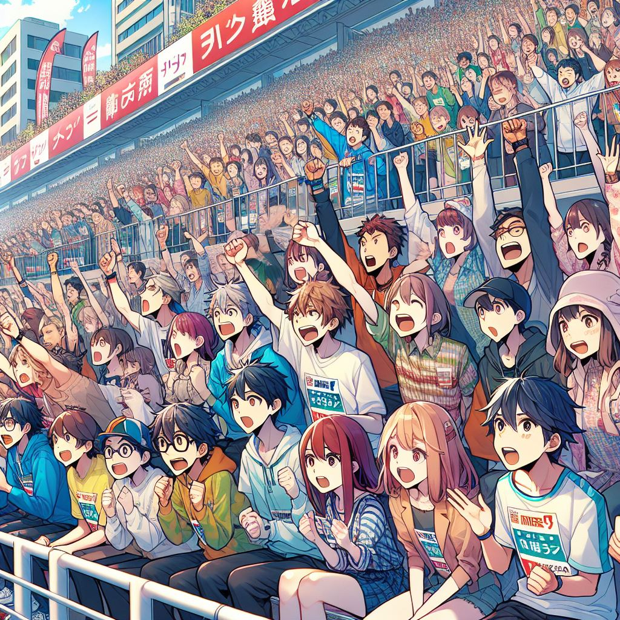
1.目標
Notes:
generate a Japanese anime style scene. Noisy crowds and enthusiastic cheers beside the marathon track. focus more on audience.
耳邊是喧鬧的人群和熱烈的加油聲，我知道，這場比賽不僅僅是對體能的考驗，更是對意志力的巨大挑戰。

Slide 4
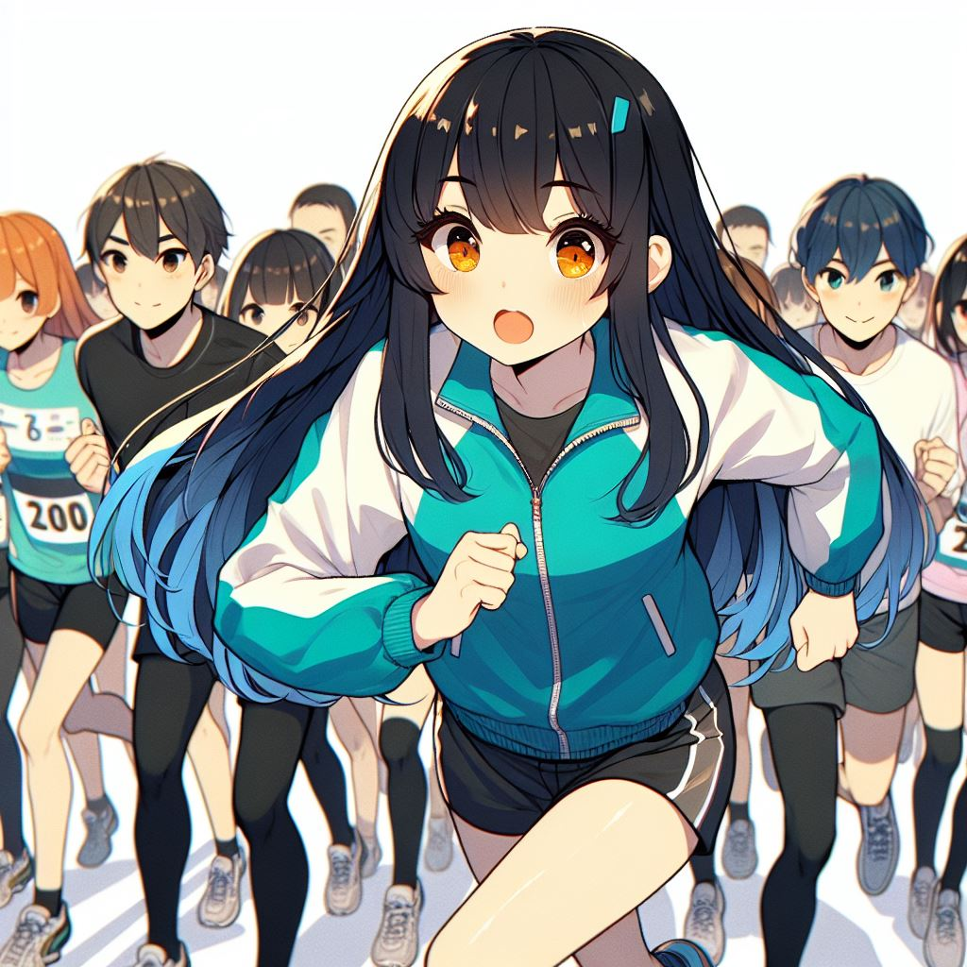
2.阻礙
Notes:
generate a Japanese anime style scene. The marathon start. All contestants start to runing. A girl start runing feel Feeling both excited. The girl’s appearance with long straight black hair reaching her waist, with dark blue gradient wavy tips. She has short slanted bangs and bright orange-yellow eyes. She is wearing a teal and white sports jacket, a black shirt, white shorts.
比賽開始後，前幾公里跑得很順利，我的腳步輕盈，呼吸也很平穩。我一直保持著穩定的速度，心裡默念著「保持節奏」，想著只要按這個步伐，42公里一定沒問題。然而，沒過多久，

Slide 5
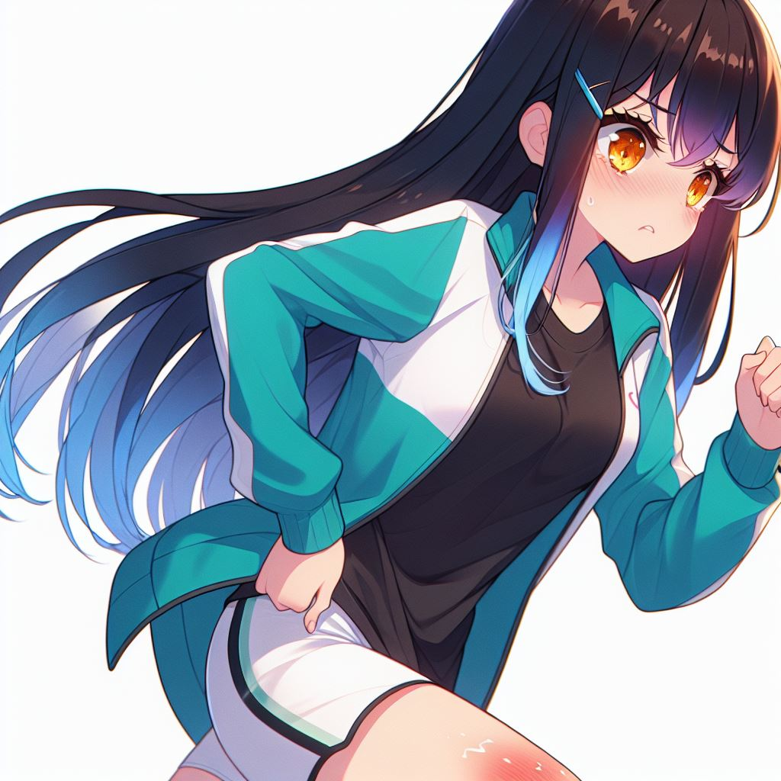
2.阻礙
Notes:
generate a Japanese anime style scene. A girl start to feel her right knee hurt in the marathon. She endure the pain continue runing but the pain is getting more and more obvious. The girl’s appearance with long straight black hair reaching her waist, with dark blue gradient wavy tips. She has short slanted bangs and bright orange-yellow eyes. She is wearing a teal and white sports jacket, a black shirt, white shorts.
大約在第15公里時，我的右膝蓋突然開始隱隱作痛，每一步都像針刺一樣疼。我試著忽略這種感覺，但隨著里程數的增加，疼痛越來越明顯，開始擾亂我的思緒。

Slide 6
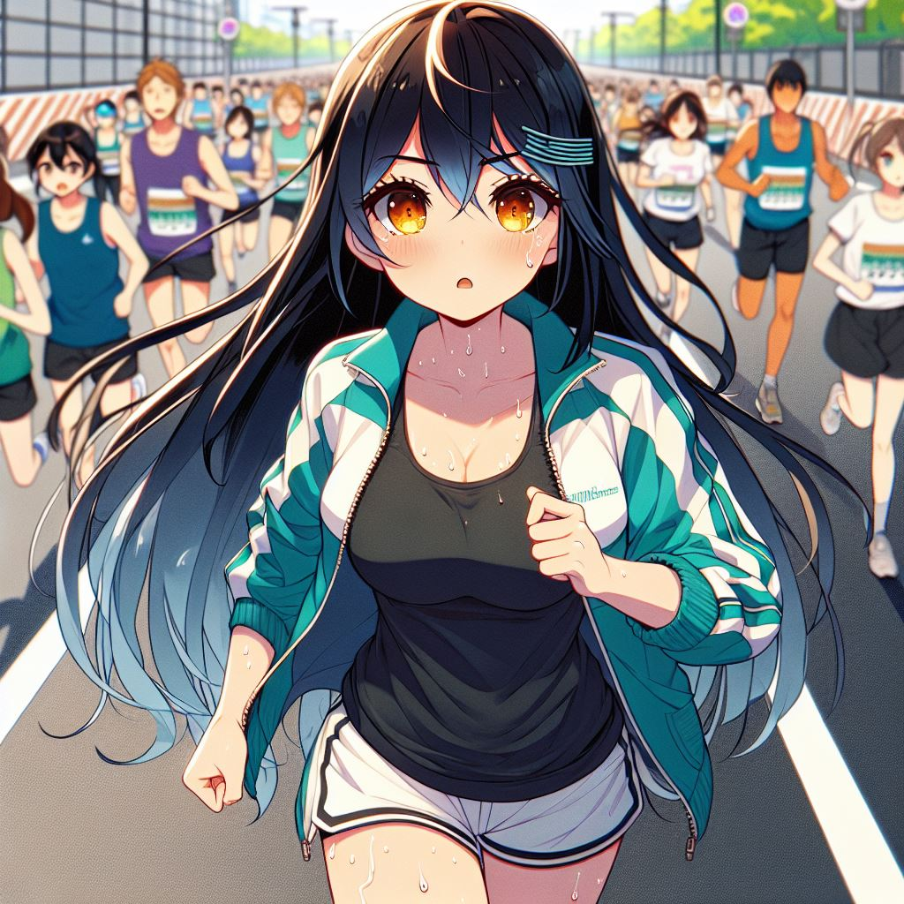
3.努力
Notes:
generate a Japanese anime style scene. A girl endure the pain continue runing in the marathon. She control her breath to be calm. Some sweat on her face. The girl’s appearance with long straight black hair reaching her waist, with dark blue gradient wavy tips. She has short slanted bangs and bright orange-yellow eyes. She is wearing a teal and white sports jacket, a black shirt, white shorts. Backgroud is on the road. The players around her start to surpassed her.
我不想放棄，我開始減慢速度，改變步伐，盡量不讓膝蓋承受太大的壓力。同時，我加強呼吸控制，把注意力集中在每一個呼吸上，讓自己保持冷靜。

Slide 7
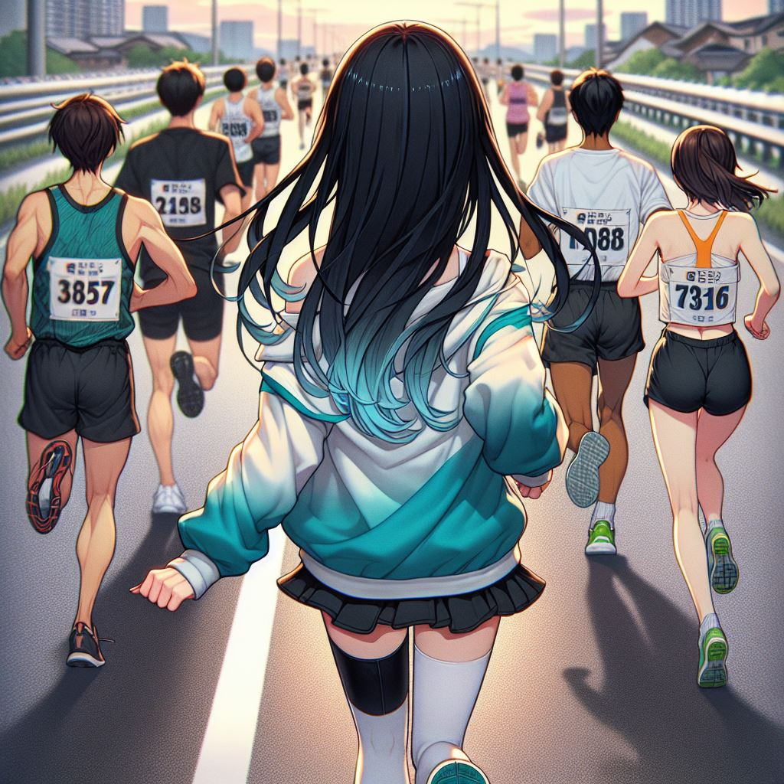
3.努力
Notes:
generate a Japanese anime style scene. A girl continue runing in the marathon. some players surpassed her. A man run before the girl. seen then from back. Backgroud is on the road. The girl’s appearance with long straight black hair reaching her waist, with dark blue gradient wavy tips. She has short slanted bangs and bright orange-yellow eyes. She is wearing a teal and white sports jacket, a black shirt, white shorts.
身邊的選手一個個超過我，但我告訴自己，

Slide 8
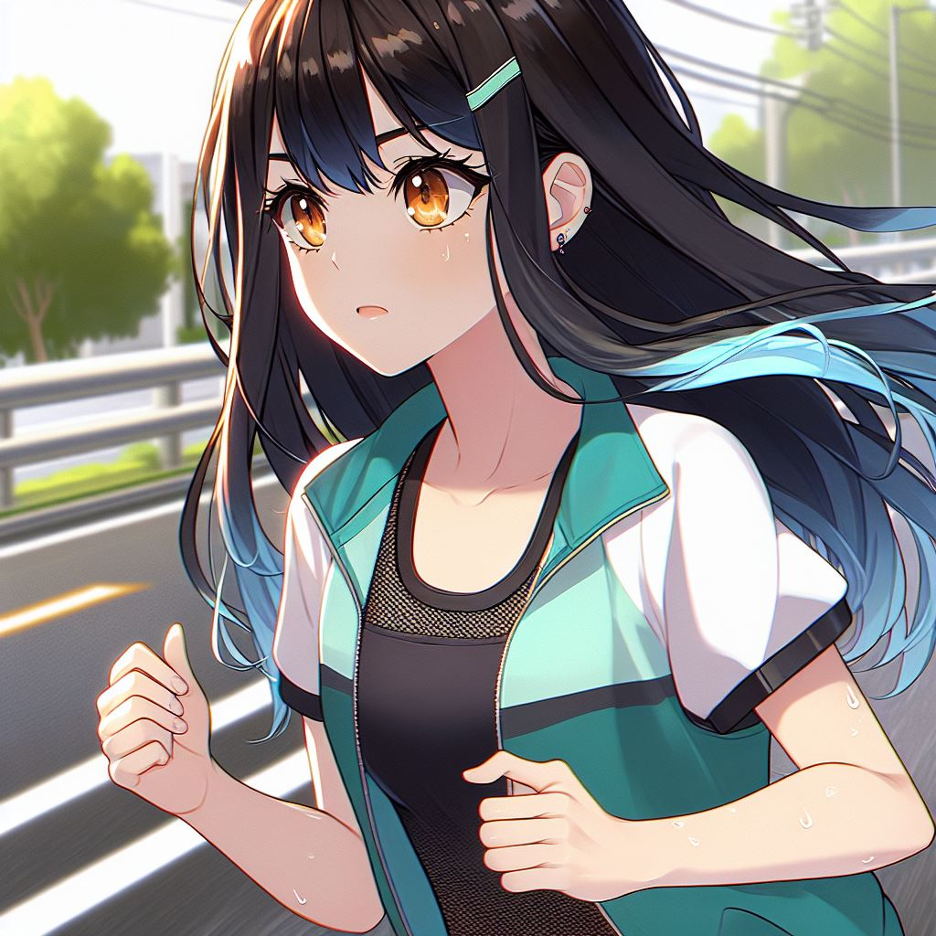
3.努力
Notes:
generate a Japanese anime style scene. A girl endure the pain continue runing in the marathon. She control her breath to be calm. The girl’s appearance with long straight black hair reaching her waist, with dark blue gradient wavy tips. She has short slanted bangs and bright orange-yellow eyes. She is wearing a teal and white sports jacket, a black shirt, white shorts. Backgroud is on the road. focus on her aspirated.
這不是與他人競爭，而是與自己較量。每一公里，我都在為自己而跑。

Slide 9
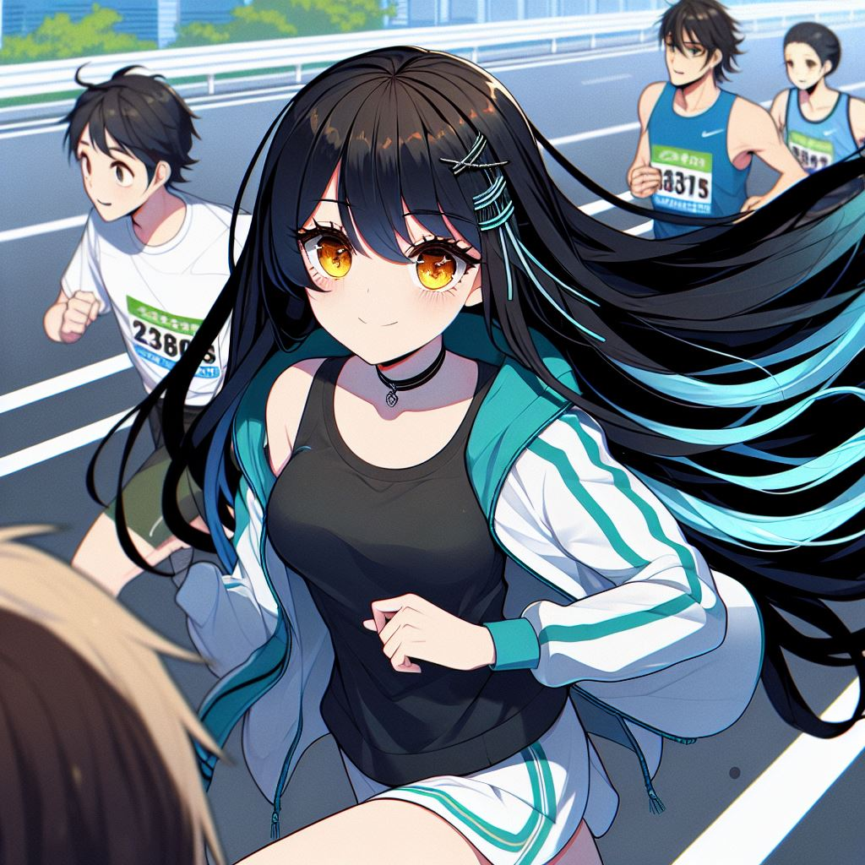
4.結果
Notes:
generate a Japanese anime style scene. A girl continue runing in the marathon. some players surpassed her. A man run before the girl. The girl’s appearance with long straight black hair reaching her waist, with dark blue gradient wavy tips. She has short slanted bangs and bright orange-yellow eyes. She is wearing a teal and white sports jacket, a black shirt, white shorts. Backgroud is on the road.
到了25公里，我感覺膝蓋的疼痛減輕了一些，我逐漸恢復了信心，開始稍微加速。正當我以為一切都在好轉時，意外發生了。

Slide 10
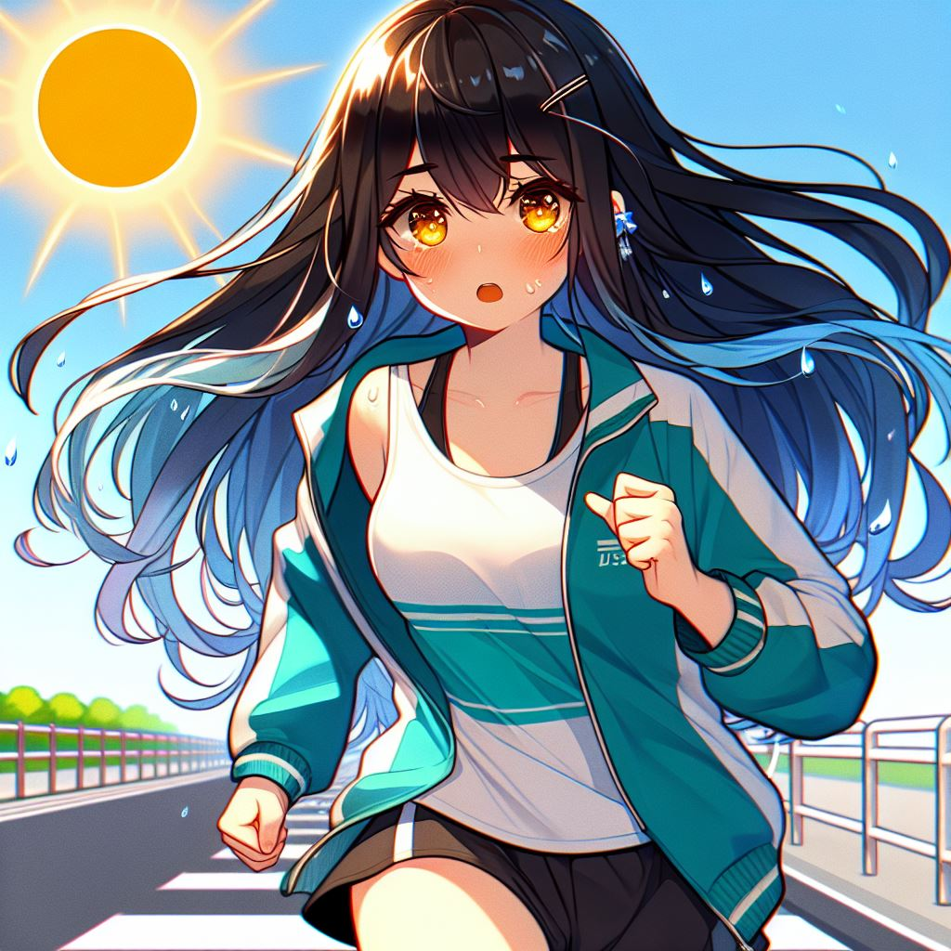
5.意外
Notes:
generate a Japanese anime style scene. A girl continue runing in the marathon. The weather is getting hot, and the sun above my head is scorching me mercilessly. The girl’s appearance with long straight black hair reaching her waist, with dark blue gradient wavy tips. She has short slanted bangs and bright orange-yellow eyes. She is wearing a teal and white sports jacket, a black shirt, white shorts. Backgroud is on the road.
天氣突然變得炎熱起來，體力急劇消耗，我的身體開始發出疲倦的信號。我一度覺得自己快要支撐不住了。

Slide 11
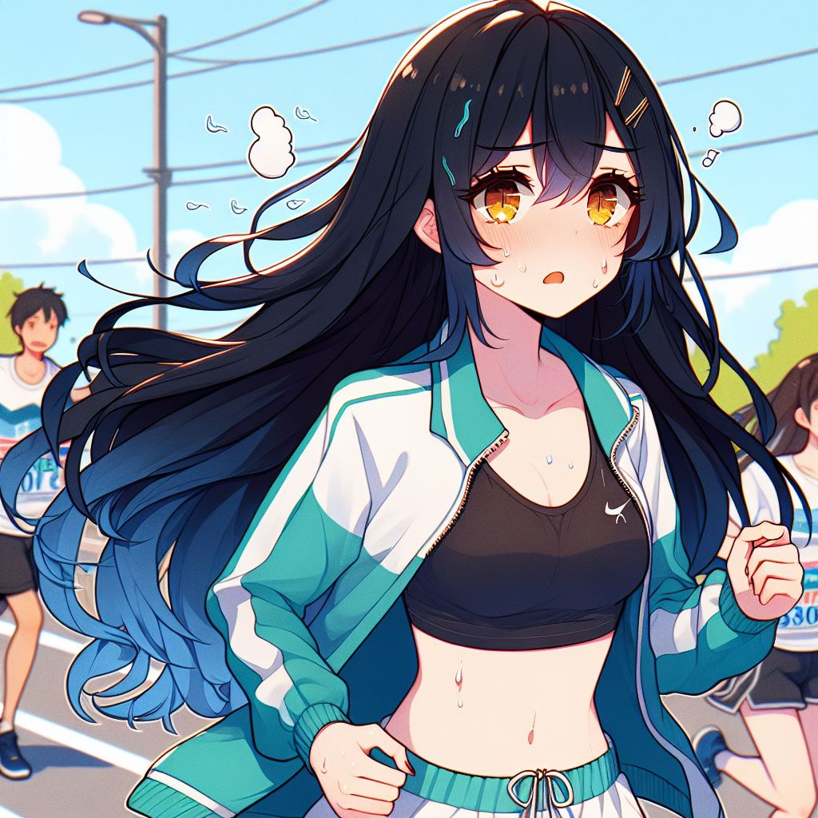
5.意外
Notes:
generate a Japanese anime style scene. A girl continue runing in the marathon. The weather is getting hot, She was struggling to think whether to give up.
The girl’s appearance with long straight black hair reaching her waist, with dark blue gradient wavy tips. She has short slanted bangs and bright orange-yellow eyes. She is wearing a teal and white sports jacket, a black shirt, white shorts.
Backgroud is on the road , and some contestants behide.
此時，我面臨了一個關鍵的轉彎點——我可以選擇停下來，放棄這場比賽，保護自己不受更大的傷害。

Slide 12
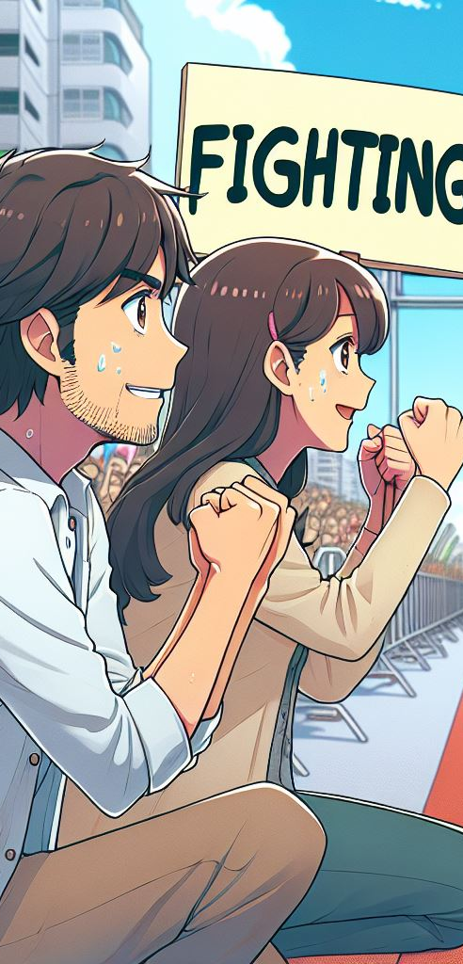
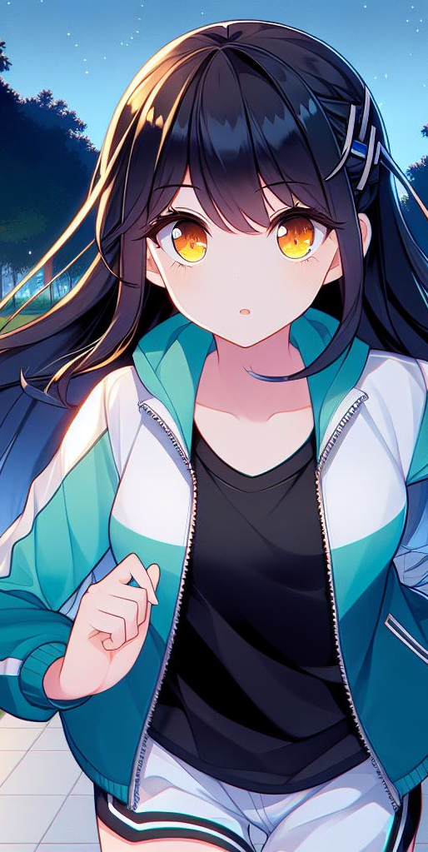
5.意外
Notes:
generate a Japanese anime style scene. A girl practice runing in the park. She is very hardworking at night. The girl’s appearance with long straight black hair reaching her waist, with dark blue gradient wavy tips. She has short slanted bangs and bright orange-yellow eyes. She is wearing a teal and white sports jacket, a black shirt, white shorts.
generate a Japanese anime style scene. Mom and dad wait beside the marathon track finish line cheering for me and waves a handmade sign that says 'Fighting!' in bright colors.
但我想起了過去幾個月的艱苦訓練，還有那些支持我的家人朋友，他們都在等著我完成這個目標。我不能輕言放棄。

Slide 13
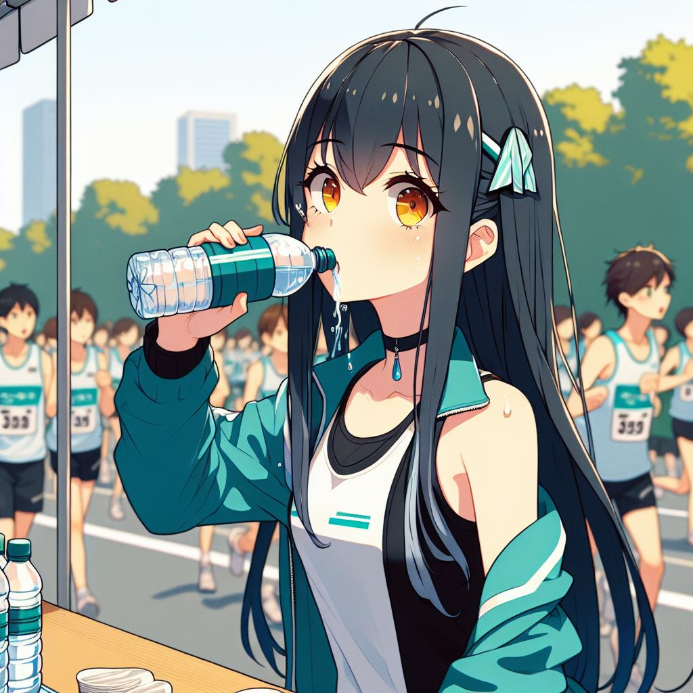
6.轉彎
Notes:
generate a Japanese anime style scene. A girl drink water at supply station in the marathon. some contestants keep running. The girl’s appearance with long straight black hair reaching her waist, with dark blue gradient wavy tips. She has short slanted bangs and bright orange-yellow eyes. She is wearing a teal and white sports jacket, a black shirt, white shorts. Backgroud is on the road.
於是，我決定改變策略，放慢速度，利用每個補給站喝水、補充能量，並且不斷告訴自己「再堅持一點」。

Slide 14
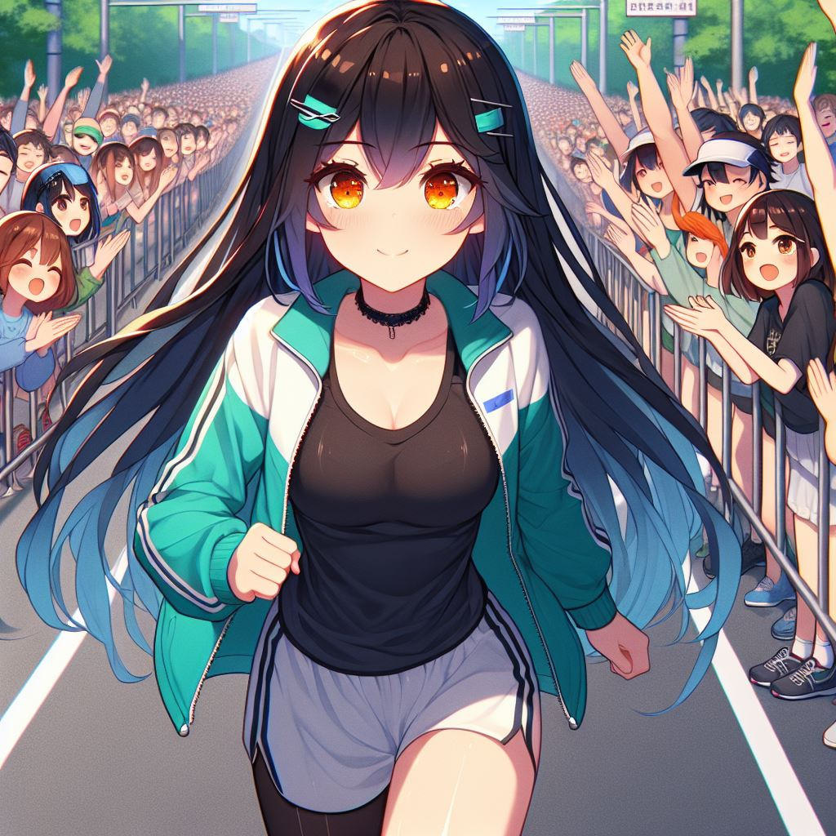
6.轉彎
Notes:
generate a Japanese anime style scene. A girl continue runing in the marathon. The girl’s appearance with long straight black hair reaching her waist, with dark blue gradient wavy tips. She has short slanted bangs and bright orange-yellow eyes. She is wearing a teal and white sports jacket, a black shirt, white shorts. Backgroud is on the road. The cheers and enthusiastic applause from the audience on the roadside gave me great strength. focus on audience
每當我感覺體力不支時，路邊觀眾的加油聲和熱情的鼓掌聲都給了我極大的力量，支持我一步一步向終點邁進。

Slide 15
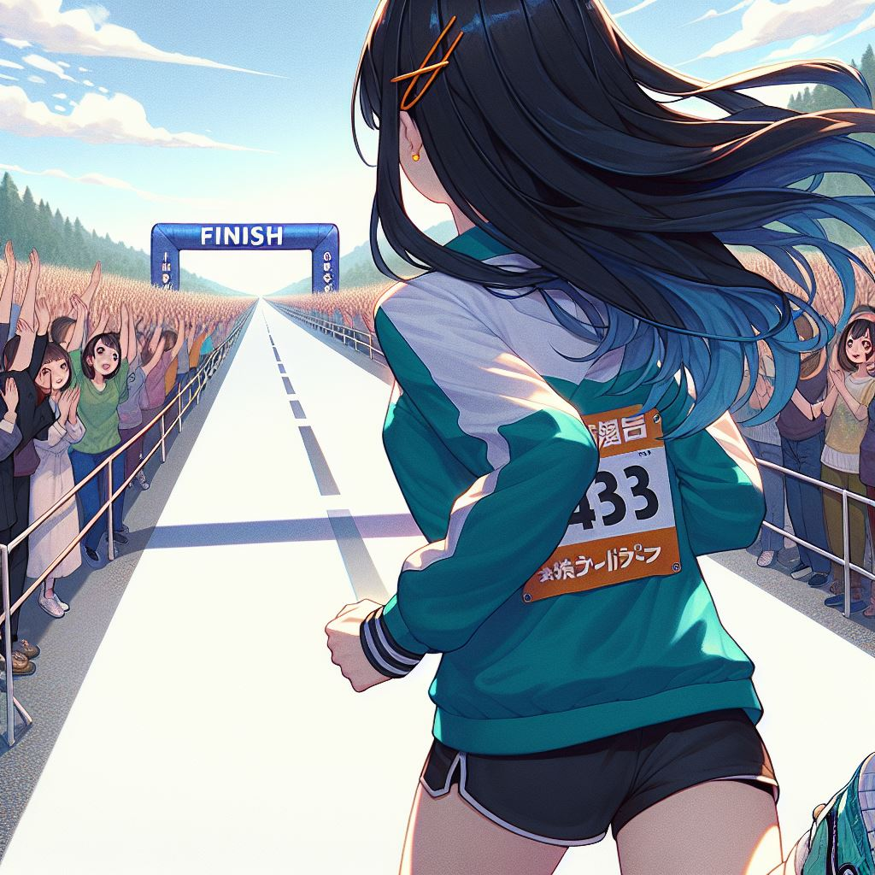
7.結局
Notes:
generate a Japanese anime style scene. A girl continue runing in the marathon. Seening the finish line from the girl behind. The girl’s appearance with long straight black hair reaching her waist, with dark blue gradient wavy tips. She has short slanted bangs and bright orange-yellow eyes. She is wearing a teal and white sports jacket, a black shirt, white shorts. Backgroud is on the road. The cheers and enthusiastic applause from the audience on the roadside. focus on audience.
當我看到終點線的那一刻，我心中充滿了無比的激動和欣慰。儘管速度比我預想的慢了很多，但我最終還是完成了這場馬拉松。

Slide 16
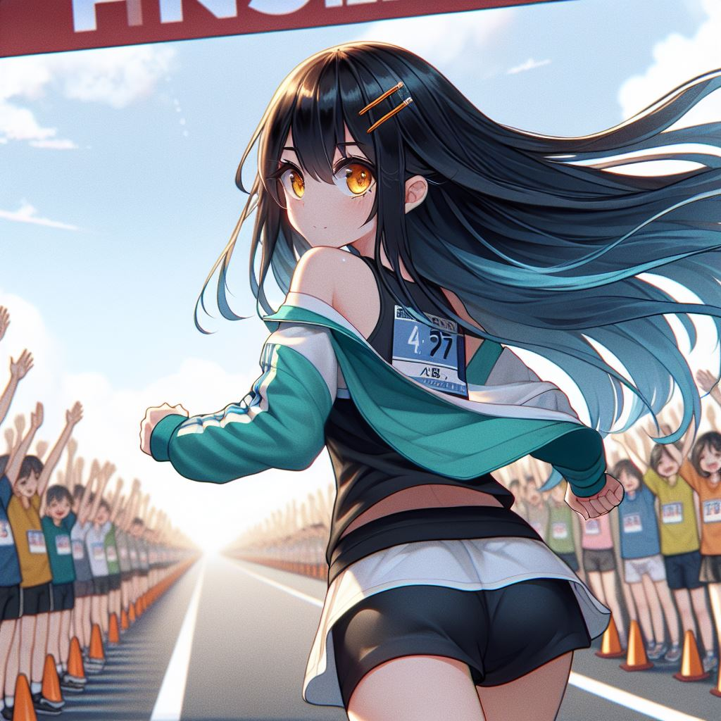
7.結局
Notes:
generate a Japanese anime style scene. A girl continue runing in the marathon. Seening the finish line from the girl behind. The girl’s appearance with long straight black hair reaching her waist, with dark blue gradient wavy tips. She has short slanted bangs and bright orange-yellow eyes. She is wearing a teal and white sports jacket, a black shirt, white shorts. Backgroud is on the road. The cheers and enthusiastic applause from the audience on the roadside.
我的結局沒有以最快的速度衝過終點，但我帶著微笑跑過了終點，心裡充滿了自豪和滿足。

Slide 17
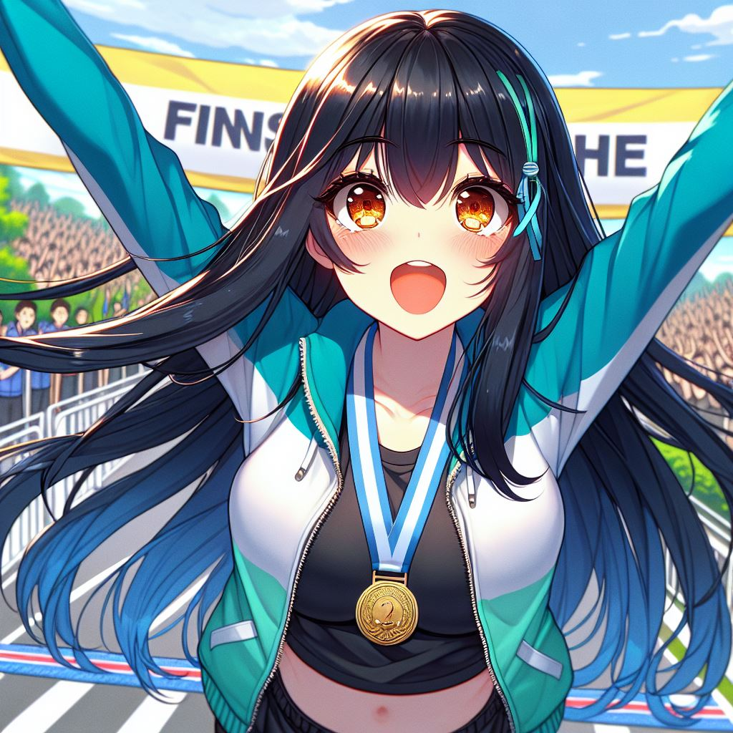
7.結局
Notes:
generate a Japanese anime style scene. A girl so excited and happy after run through finish line with a finisher's medal around his neck.
The girl’s appearance with long straight black hair reaching her waist, with dark blue gradient wavy tips. She has short slanted bangs and bright orange-yellow eyes. She is wearing a teal and white sports jacket, a black shirt, white shorts. Backgroud is on the road. The cheers and enthusiastic applause from the audience on the roadside.
我實現了自己的目標，不僅完成了一場馬拉松，更體驗到了挑戰自我的喜悅與成就感。

