Slide 1
自我介紹
(Nizima Live)
Notes:
哈囉 大家好，今天來做自我介紹，我是今年剛升上大一的大學生

Slide 2
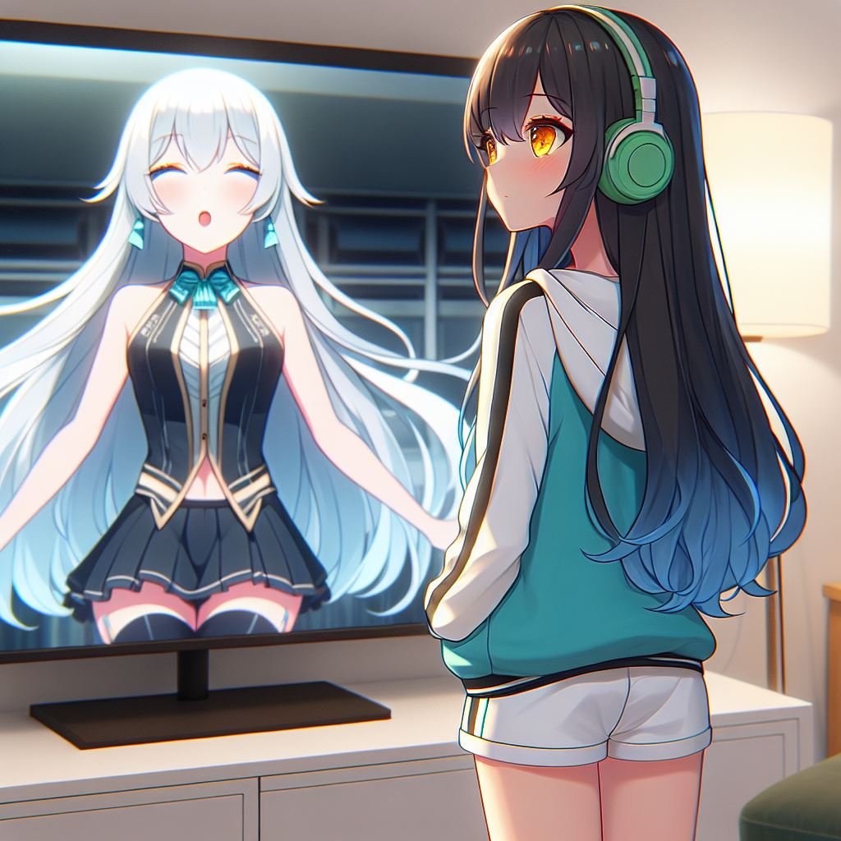
1.目標
Notes:
Generate a Japanese anime style scene. A girl stand in front of TV.She is watching white hair idol dancing on the TV. The girl’s appearance with long straight black hair reaching her waist, with dark blue gradient wavy tips. She has short slanted bangs and bright orange-yellow eyes. She is wearing a teal and white sports jacket, a black shirt, white shorts, and green over-ear headphones around her neck.
我很喜歡電視上唱唱跳跳的偶像。在上了大學後，我想試著參加學校的舞蹈比賽，把我對音樂和跳舞的熱愛展示給大家看。

Slide 3
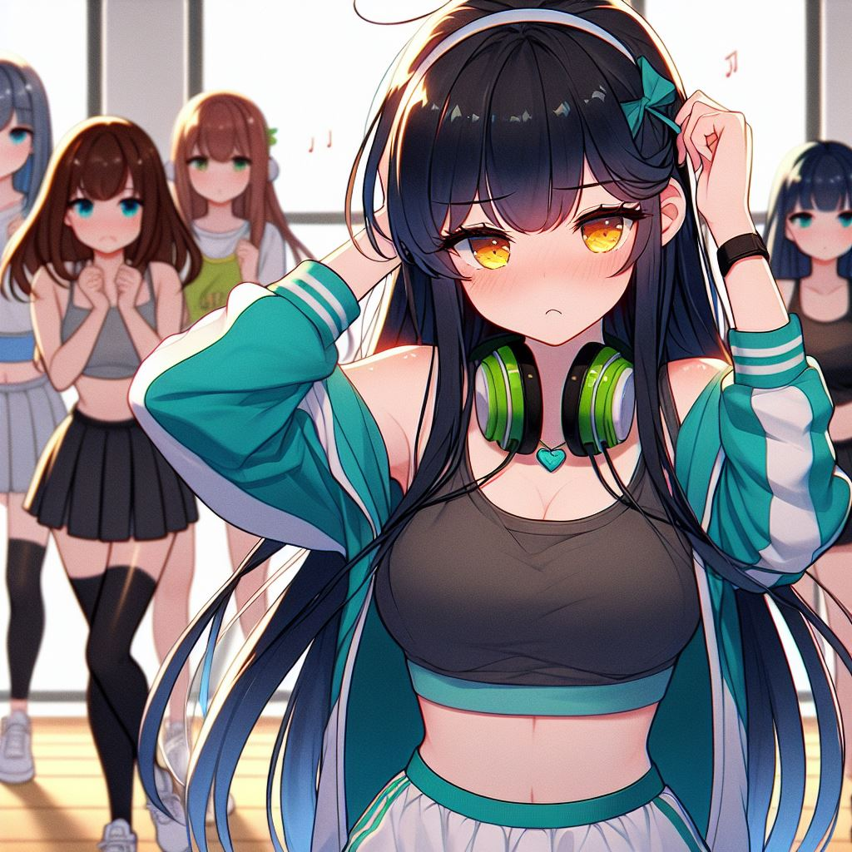
2.阻礙
Notes:
Generate a Japanese anime style scene. A girl practice dancing, but she poor performance. She is frustrated. The girl’s appearance with long straight black hair reaching her waist, with dark blue gradient wavy tips. She has short slanted bangs and bright orange-yellow eyes. She is wearing a teal and white sports jacket, a black shirt, white shorts, and green over-ear headphones around her neck. There are other girls and boys behind also dancing.
但事情並不那麼順利。我的舞蹈技術並不夠好。每次排練時，我總是跟不上節奏，動作也顯得僵硬。我開始懷疑自己是不是根本不適合跳舞。

Slide 4
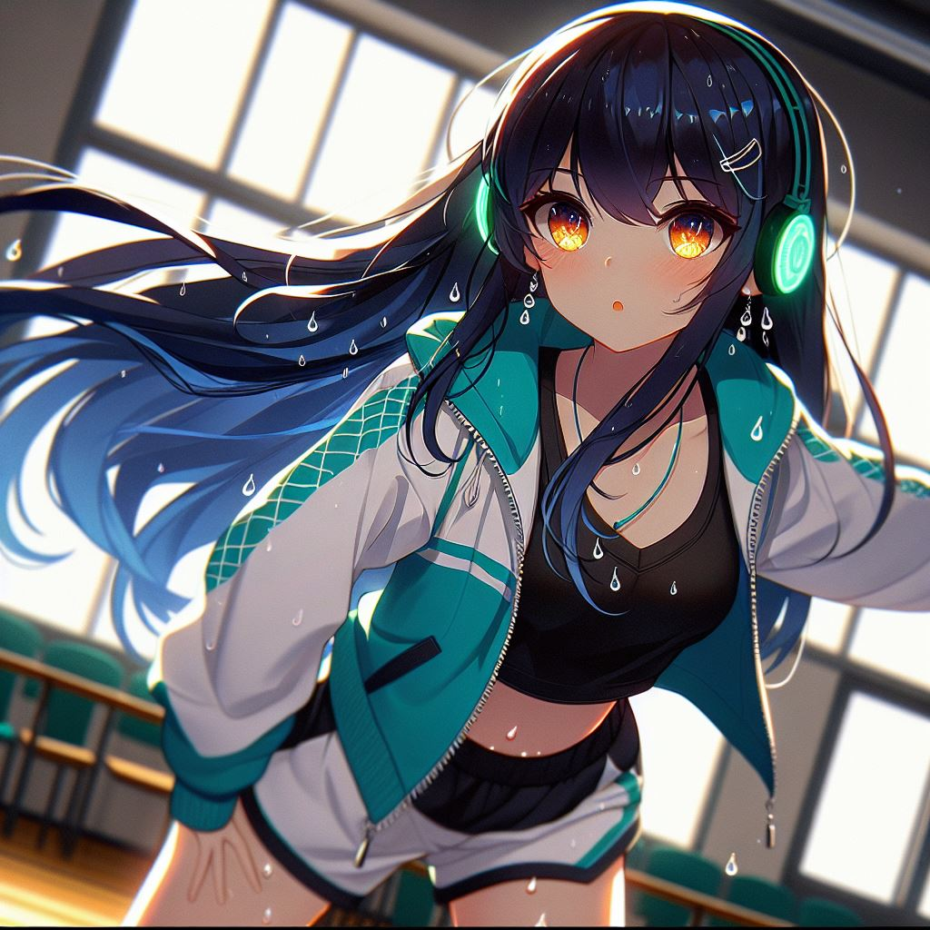
3.努力
Notes:
Generate a Japanese anime style scene. A girl practice dancing so hard lonely in the dancing classroom at night. There are more sweat on her face. The girl’s appearance with long straight black hair reaching her waist, with dark blue gradient wavy tips. She has short slanted bangs and bright orange-yellow eyes. She is wearing a teal and white sports jacket, a black shirt, white shorts, and wearing a green over-ear headphones.
但是，對音樂和舞蹈的熱愛讓我無法放棄。於是，我每天放學後一個人在練舞室裡反覆練習，對著鏡子一遍一遍糾正動作。

Slide 5
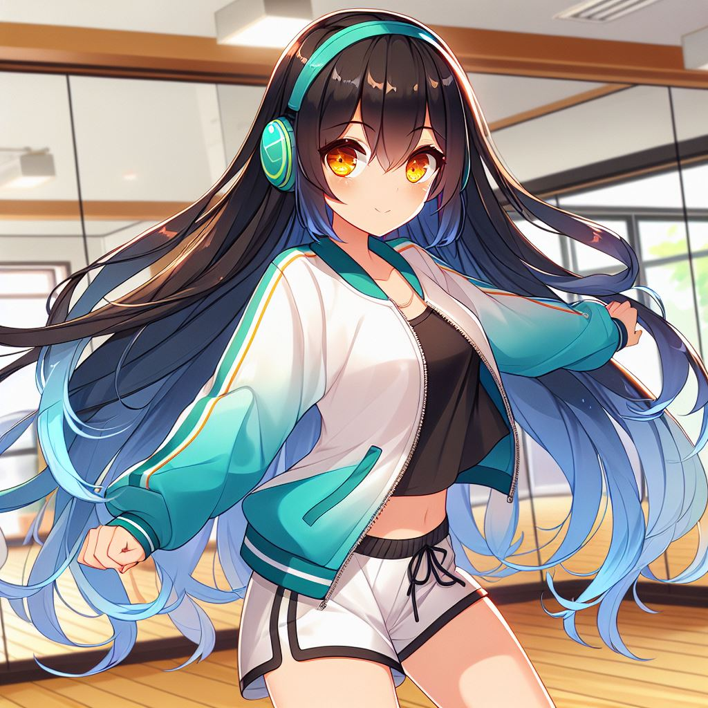
4.結果
Notes:
Generate a Japanese anime style scene. A girl dancing very beautiful in the dancing classroom. She feel confidence. The girl’s appearance with long straight black hair reaching her waist, with dark blue gradient wavy tips. She has short slanted bangs and bright orange-yellow eyes. She is wearing a teal and white sports jacket, a black shirt, white shorts, and wearing a green over-ear headphones.
隨著日子一天天過去，我的舞步終於越來越流暢。排練時，我開始能跟上音樂節拍，舞步也變得自信起來。

Slide 6
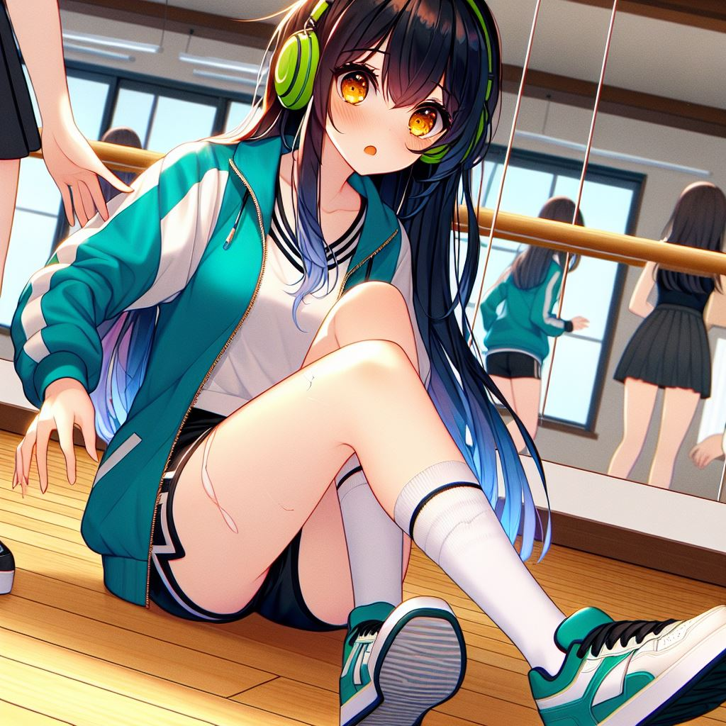
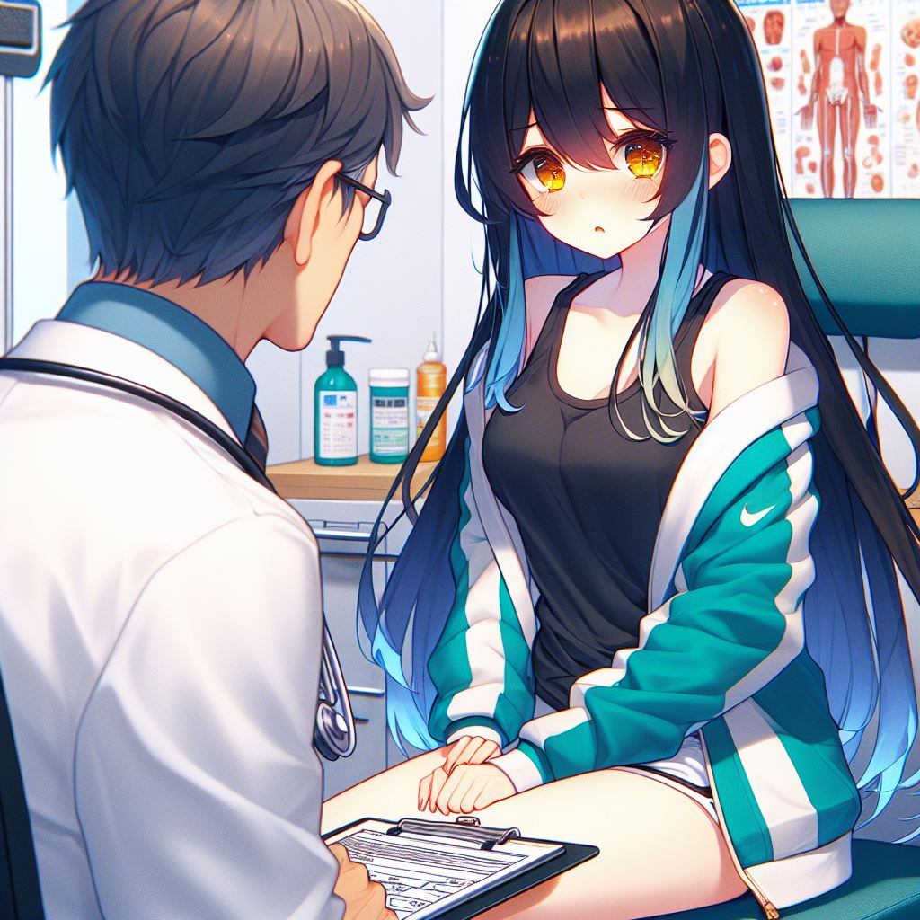
5.意外
Notes:
Generate a Japanese anime style scene. A girl fall while dancing and hurt her ankle. The girl’s appearance with long straight black hair reaching her waist, with dark blue gradient wavy tips. She has short slanted bangs and bright orange-yellow eyes. She is wearing a teal and white sports jacket, a black shirt, white shorts, and wearing a green over-ear headphones.
Generate a Japanese anime style scene. A girl sit on a chair and a doctor is talking to the girl. She hurt her ankle and be sad.The girl’s appearance with long straight black hair reaching her waist, with dark blue gradient wavy tips. She has short slanted bangs and bright orange-yellow eyes. She is wearing a teal and white sports jacket, a black shirt, white shorts.
但是在比賽前幾天，一次的練習中不小心扭到了腳踝，醫生建議我休息幾天。當下我擔心這次比賽的夢想要破滅了。

Slide 7
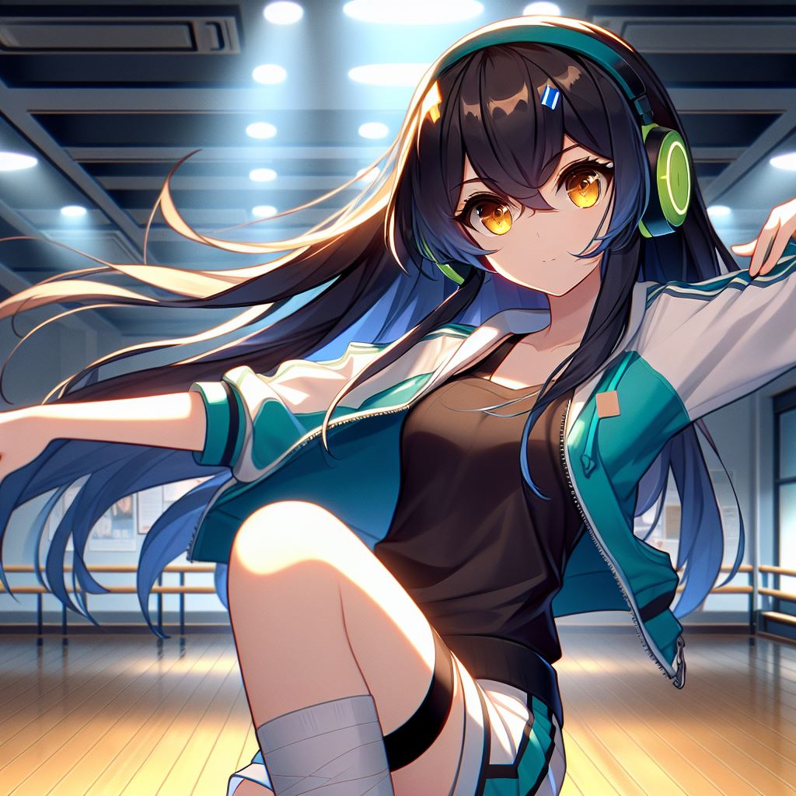
6.轉彎
Notes:
Generate a Japanese anime style scene. A girl practice dancing so hard lonely in the big dancing classroom at night. There is a bandage on the ankle. The girl’s appearance with long straight black hair reaching her waist, with dark blue gradient wavy tips. She has short slanted bangs and bright orange-yellow eyes. She is wearing a teal and white sports jacket, a black shirt, white shorts, and wearing a green over-ear headphones.
可是我不想輕易放棄。我重新調整了舞步，找了些輕盈的動作來代替原來難度較大的部分。即使腳踝還有點痛，我還是努力讓自己適應這個新版本的舞蹈。

Slide 8
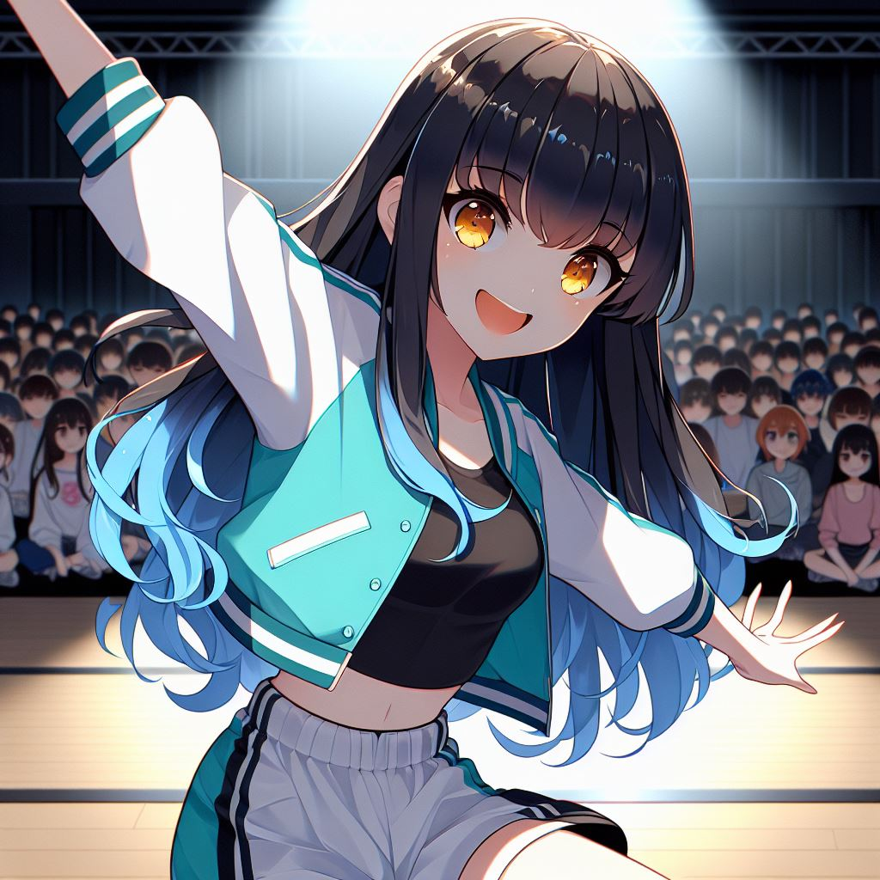

7.結局
Notes:
Generate a Japanese anime style scene. A girl is so happy and focus dancing on the stage for dance competition. The audience sit under be no light. The girl’s appearance with long straight black hair reaching her waist, with dark blue gradient wavy tips. She has short slanted bangs and bright orange-yellow eyes. She is wearing a teal and white sports jacket, a black shirt, white shorts.The girl has some sweat on her face.
Generate a Japanese anime style scene. A girl is so happy on the stage after dancing end for dance competition. The audience applauded. The girl’s appearance with long straight black hair reaching her waist, with dark blue gradient wavy tips. She has short slanted bangs and bright orange-yellow eyes. She is wearing a teal and white sports jacket, a black shirt, white shorts.The girl has some sweat on her face.
比賽那天，伴隨著音樂開始跳舞。我投入了全部的熱情。當最後一個音符響起時，台下響起了掌聲。那一刻，我知道，無論結果如何，我已經成功了，因為我戰勝了自己，也實現了對音樂和跳舞的熱愛。
以上是我的自我介紹，謝謝大家！

