Slide 1

FRIDATING
Fiona Nicdao, Josh Honig, Drew Patterson, Hannah Serio
Friend Dating Database

Slide 2

FRIDATING
Allows like-minded individuals to connect and form lasting friendships!
Each user can create an account
Accounts can manage and/or RSVP to events
Account contains a biography, location, interests, etc.
Social events facilitate friendships moving from messaging to real-life
An account can match with other accounts
Accounts can message their matches
Two accounts are considered a match when both users accept the status
A chat is created when two accounts match to allow messaging between users
Each user manages their subscription
Users manage their subscription type and payment methods

Slide 3
ER Model
users
account
subscription
event
chat
payment Method
message
---LINK---

Slide 4
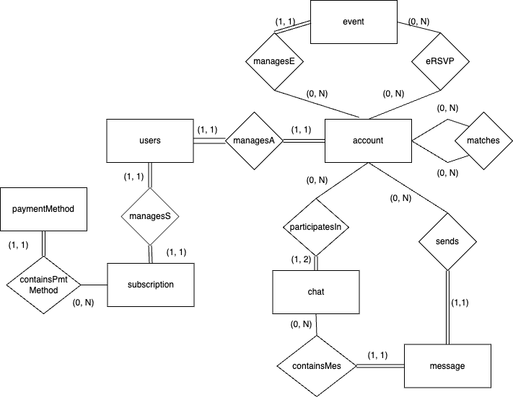
ER Model
---LINK---

Slide 5
Relational Schema
event(evtID, evtType, evtDateStart, evtDateEnd, evtName, evtDetails, evtLocGPS, evtLocRange,
evtManager)
foreign key (evtManager) references account(actID)
eRSVP(actID, evtID, response, rsvDate)
foreign key (actID) references account(actID)
foreign key (evtID) references event(evtID)
subscription(subID, subTier, subPrice, outstandingBalance, nextDueDate, annualBilling, userID)
foreign key (userID) references users(usrID)
paymentMethod(pmtID, subID, pmtType, num, cvv, expiration, pmtStreetAddr, pmtCity,
pmtState, pmtZipcode, androidPay, applePay, payPal)
foreign key (subscription) references subscription(subID)
matches(actID1, actID2, mchDate, compatabilityScore, act1status, act2status)
foreign key (actID1) references account(actID)
foreign key (actID2) references account(actID)
users(usrID, username, email, passwordHash, passwordSalt, MFAtoken)
account(actID, bio, firstName, lastName, actStreetAddress, actCity, actState, actLocGPS,userID)
foreign key (userID) references users(usrID)
accountInterests*(actID, interest)
foreign key (actID) references account(actID)
accountPhotos*(actID, photo)
foreign key (actID) references account(actID)
chat(chatID, chtIsActive, chtLastMesTimestamp)
participatesIn(actID, chatID, startDate)
foreign key (actID) references account(actID)
foreign key (chatID) references chat (chatID)
message(mesID, mesText, mesDate, chatID, senderID)
foreign key (chatID) references chat(chatID)
foreign key (senderID) references account(actID)
Notes:
Description of relational model

Slide 6

ORM
Fiona Nicda, Josh Honig, Drew Patterson, Hannah Serio
Friend Dating Database
Object-Relational Mapping

Slide 7
subscription
Subscription tier
Tier price*
Billing mode*
Due date*
User ID
Payment Methods
paymentMethod
Type
Card Information
Number
CVV
Expiration
Billing Address
3rd Party Information
Subscription
subscription
(0,N)
(1,1)
payment Method
*if paid
Notes:
Josh’s classes created

Slide 8
# Class created by Josh
class Subscription(Base):
__tablename__ = "subscription"
subid: Mapped[uuid.UUID] = mapped_column(UUID(as_uuid=True), default=uuid.uuid4, primary_key=True)
subtier: Mapped[str] = mapped_column(String(64))
subprice: Mapped[Numeric] = mapped_column(Numeric, nullable=True)
outstandingbalance: Mapped[Numeric] = mapped_column(Numeric, nullable=True)
nextduedate: Mapped[datetime] = mapped_column(DateTime(timezone=False), nullable=True)
annualbilling: Mapped[Optional[bool]]
userid: Mapped[uuid.UUID] = mapped_column(ForeignKey("user.userID"))
paymentmethods: Mapped[List["paymentmethod"]] = relationship(
back_populates="subscription", cascade="all, delete-orphan"
)
def __repr__(self) -> str:
return f"""Subscription(
id={self.subid!r}, subtier={self.subtier!r}, subprice={self.subprice!r},
nextduedate={self.nextduedate!r}, annualbilling={self.annualbilling!r},
userid={self.userid!r})"""
# Class created by Josh
class paymentmethod(Base):
__tablename__ = "paymentmethod"
pmtid: Mapped[uuid.UUID] = mapped_column(UUID(as_uuid=True), default=uuid.uuid4, primary_key=True)
subid: Mapped[uuid.UUID] = mapped_column(ForeignKey("subscription.subid"))
pmttype = mapped_column(Enum(payment_type))
num: Mapped[Numeric] = mapped_column(Numeric, nullable=True)
cvv: Mapped[Numeric] = mapped_column(Numeric, nullable=True)
expiration: Mapped[str] = mapped_column(String(16), nullable=True)
pmtstreetaddr: Mapped[str] = mapped_column(String(128), nullable=True)
pmtcity: Mapped[str] = mapped_column(String(64), nullable=True)
pmtstate: Mapped[str] = mapped_column(String(64), nullable=True)
pmtzipcode: Mapped[str] = mapped_column(String(64), nullable=True)
androidpay: Mapped[str] = mapped_column(String(128), nullable=True)
applepay: Mapped[str] = mapped_column(String(128), nullable=True)
paypal: Mapped[str] = mapped_column(String(128), nullable=True)
subscription: Mapped["Subscription"] = relationship(back_populates="paymentmethods")
def __repr__(self) -> str:
return f"""paymentMethod(
pmtid={self.pmtid!r}, subid={self.subid!r}, pmtType={self.pmttype!r},
num={self.num!r}, cvv={self.cvv!r}, expiration={self.expiration!r},
pmtstreetaddr={self.pmtstreetaddr!r}, pmtcity={self.pmtcity!r},
pmtstate={self.pmtstate!r}, pmtzipcode={self.pmtzipcode!r},
androidpay={self.androidpay!r}, applepay={self.applepay!r}, paypal={self.paypal!r})"""

Slide 9
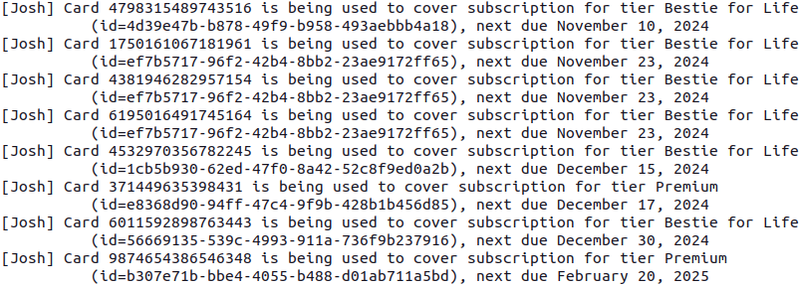
Credit Cards for Each Subscription
# Query and output by Josh
# This query shows which credit cards are being used to cover which non-free-tier subscriptions.
statement = (
select(paymentmethod)
.join(paymentmethod.subscription)
.where(
Subscription.subtier != "Free" and
paymentmethod.pmttype != payment_type.thirdParty
)
.order_by(Subscription.nextduedate)
)
for record in session.scalars(statement):
print(f"""Card {record.num} is being used to cover subscription with id={record.subid}""")
Notes:
Josh’s Query / output

Slide 10
users
User ID
Username
Email
Passwordhash
Passwordsalt
MFAtoken
subscription
Subscription tier
Tier price*
Billing mode*
Due date*
User ID
Payment Methods
users
(1,1)
(1, N)
Before
After
(1,1)
(1,1)
subscription
*if paid

Slide 11
# Class created by Drew; Defining User class/table
class Users(Base):
__tablename__ = "users"
usrid: Mapped[uuid.UUID] = mapped_column(UUID(as_uuid=True), default=uuid.uuid4, primary_key=True)
username: Mapped[str] = mapped_column(String(32))
email: Mapped[str] = mapped_column(String(96))
passwordhash: Mapped[str] = mapped_column(String(256))
passwordsalt: Mapped[str] = mapped_column(String(256))
mfatoken: Mapped[str] = mapped_column(String(64))
subscription: Mapped[List["Subscription"]] = relationship("Subscription", back_populates="user")
def __repr__(self) -> str:
return f"User(id={self.userID!r}, username={self.username!r}, email={self.email!r})"

Slide 12
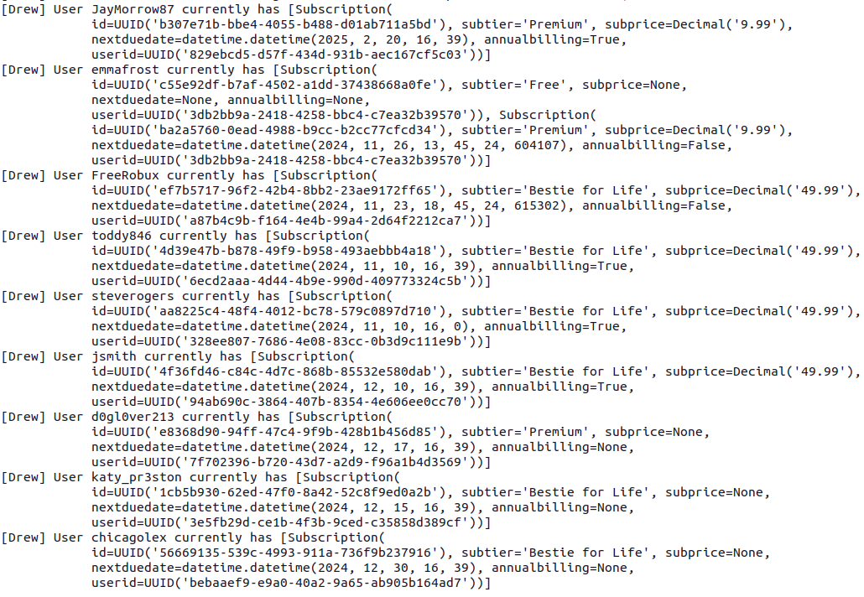
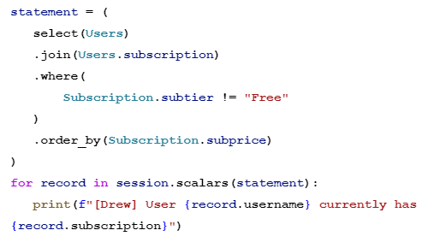
Subscription Information of Paid Users
Notes:
Josh’s Query / output

Slide 13
Classes Created by Fiona
# Classes created by Fiona & Hannah
class Chat(Base):
__tablename__ = "chat"
chatid: Mapped[uuid.UUID] = mapped_column(UUID(as_uuid=True), default=uuid.uuid4, primary_key=True)
chtisactive: Mapped[bool]
chtlastmestimestamp: Mapped[datetime] = mapped_column(DateTime(timezone=False))
# Relationships
participants: Mapped["ParticipatesIn"] = relationship("ParticipatesIn", back_populates="chat")
# Reference to messages
messages : Mapped[List["Message"]] = relationship(
back_populates="chat", cascade="all, delete-orphan"
)
def __repr__(self) -> str: #represent the object as a string
return f"Chat (id = {self.id!r}, chatIsActive{self.chtisactive!r}, chtLastMesTimestamp{self.chtlastmestimestamp!r})"
# Class created by Fiona
class Message(Base):
__tablename__ = "message"
mesid: Mapped[int] = mapped_column(primary_key=True, autoincrement=True)
mestext: Mapped[str] = mapped_column(String(200))
mesdate : Mapped[datetime] = mapped_column(DateTime(timezone=True))
chatid : Mapped[uuid.UUID] = mapped_column(UUID(as_uuid=True), ForeignKey("chat.chatid"))
senderid: Mapped[uuid.UUID] = mapped_column(UUID(as_uuid=True), ForeignKey("account.actid"))
chat : Mapped["Chat"] = relationship(back_populates="messages")
def __repr__(self) -> str :
return f"Message(id={self.id!r}), mesText={self.mestext!r}, mesDate={self.mesdate!r}"
chat
Chat*
Chat ID
Chat is active
Chat last message timestamp
Participants Relationship
Reference to Messages
Message
Message ID
Message text
Message Date
Chat ID (FK)
Sender ID (FK ActID)
Reference to Chat
(0,N)
ContainsMes
(1,1)
message
*Worked with Hannah for the Chat entity for the ORM
Notes:
Drew’s classes created

Slide 14
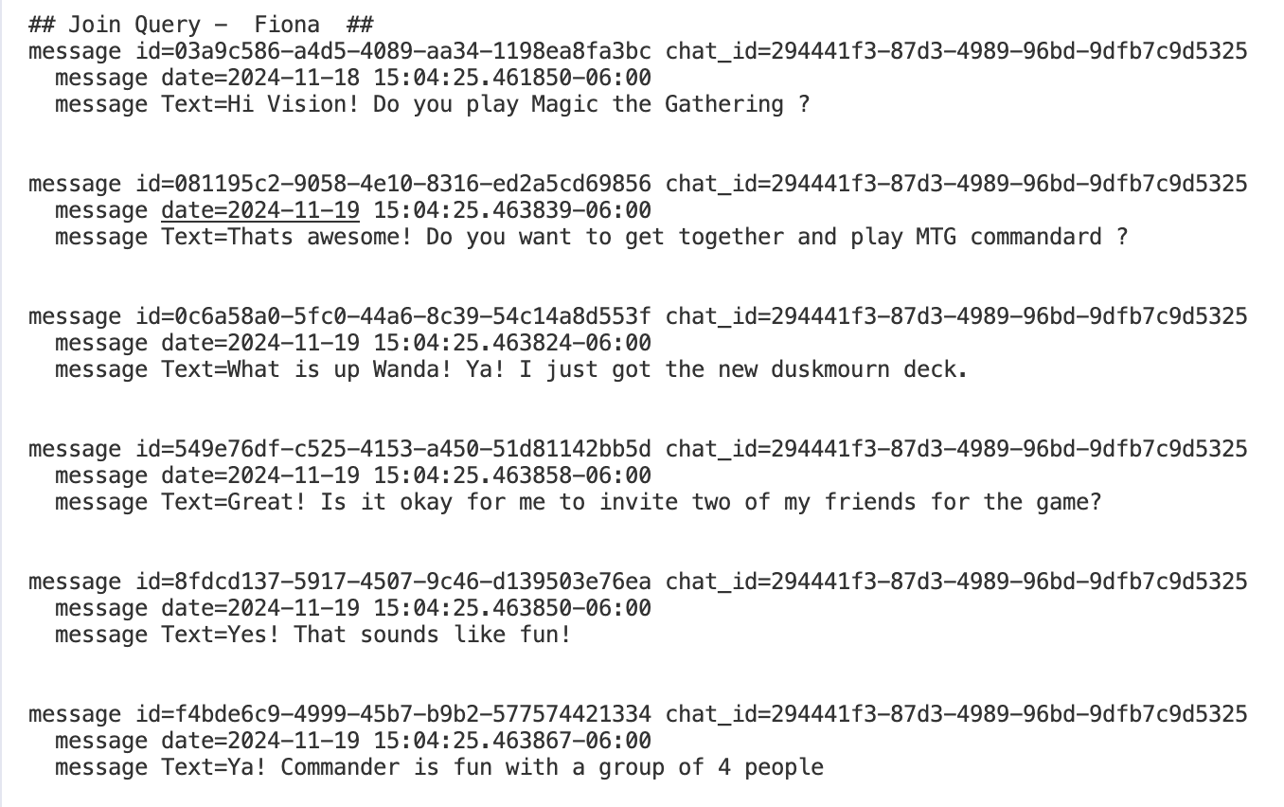
Join Query: Messages in a Chat
looks at a specific chat that IS active and is using the chat id for a specific chat.
It will print out the conversation (messages) are between the user_accounts.
stmt = (
select(Message)
.join(Message.chat)
.where(Chat.chtisactive == True)
.where(Chat.chatid == uuid.UUID("294441f3-87d3-4989-96bd-9dfb7c9d5325"))
.order_by(Message.chatid)
.order_by(Message.mesid)
)
for record in session.scalars(stmt) :
print(f"""[Fiona] message id={record.mesid} chat_id={record.chatid}
message date={record.mesdate}
message Text={record.mestext} """)
Notes:
Drew’s Query / output

Slide 15
Classes Created by Hannah
# Classes created by Hannah
class Account(Base):
__tablename__ = "account"
actid: Mapped[uuid.UUID] = mapped_column(UUID(as_uuid=True), default=uuid.uuid4, primary_key=True)
bio: Mapped[str] = mapped_column(String(300))
firstname: Mapped[str] = mapped_column(String(32), nullable=False)
lastname: Mapped[str] = mapped_column(String(32))
actstreetaddress: Mapped[str] = mapped_column(String(128), nullable=False)
actcity: Mapped[str] = mapped_column(String(64), nullable=False)
actstate: Mapped[str] = mapped_column(String(64), nullable=False)
actlocgps_x: Mapped[float] = mapped_column(Float, nullable=False)
actlocgps_y: Mapped[float] = mapped_column(Float, nullable=False)
userid: Mapped[str] = mapped_column(Integer, ForeignKey("users.usrid"), nullable=False)
participates_in: Mapped["ParticipatesIn"] = relationship("ParticipatesIn", back_populates="account")
def __repr__(self) -> str:
return f"Account(id={self.actID!r}, firstName={self.firstname!r}, lastName={self.lastname!r})"
# Classes created by Hannah
class ParticipatesIn(Base):
__tablename__ = "participatesin"
actid: Mapped[uuid.UUID] = mapped_column(UUID(as_uuid=True), ForeignKey("account.actid", ondelete="CASCADE", onupdate="CASCADE"), primary_key=True)
chatid: Mapped[uuid.UUID] = mapped_column(UUID(as_uuid=True), ForeignKey("chat.chatid", ondelete="CASCADE", onupdate="CASCADE"), primary_key=True)
startdate: Mapped[datetime] = mapped_column(DateTime(timezone=False), nullable=True)
# Relationships
account: Mapped["Account"] = relationship("Account", back_populates="participates_in")
chat: Mapped["Chat"] = relationship("Chat", back_populates="participants")
def __repr__(self) -> str: return f"ParticipatesIn(actID={self.actid!r}, chatID={self.chatid!r})"
account
Account ID
Bio
First name
Last name
Street address
City
State
GPS location
User ID
participatesIn
Account ID
Chat ID
Chat start date
Before:
(0,N)
participatesIn
(1,2)
account
chat
(0,N)
(1,1)
After:

Slide 16
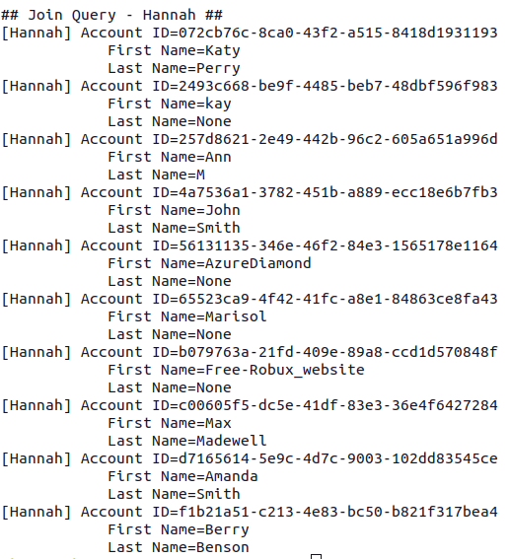
Accounts participating in > 1 chat
print("\n## Join Query - Hannah ##")
stmt = (
select(Account)
.join(ParticipatesIn, Account.actid == ParticipatesIn.actid)
.group_by(Account.actid)
.having(func.count(ParticipatesIn.chatid) > 1)
.order_by(Account.actid)
)
for record in session.scalars(stmt):
print(f"""[Hannah] Account ID={record.actid}
First Name={record.firstname}
Last Name={record.lastname}""")
Notes:
Hannah’s Query / output

Slide 17
THANK YOU
Brought to you by
The Matchmakers

