Slide 1
Cerebrovascular Disease in Scotland Statistics and Modeling
Fiona Carson
February 2023
Notes:
Brief
discharge and mortality data and investigate the effects of demographics on the types of CVD
Also to see if it is possible predict future discharge and mortality rates

Slide 2

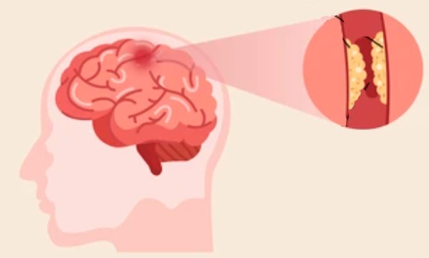

Introduction – Cerebrovascular Disease
CVD - problems with the blood vessels supplying the brain
Four types of CVD in the Public Health Scotland data
Stroke - area of brain is deprived of blood supply because of a blockage
Transient ischaemic attach (TIA) - “mini-stroke”, symptoms generally last less than 24 hours
Subarachnoid haemorrhage (SAH) - rupture of a blood vessel beneath the membrane covering the brain (type of brain haemorrhage)
Other CVD – incidences which don’t fall into above categories
Blood clot
Fatty deposits
Haemorrhage

Slide 3
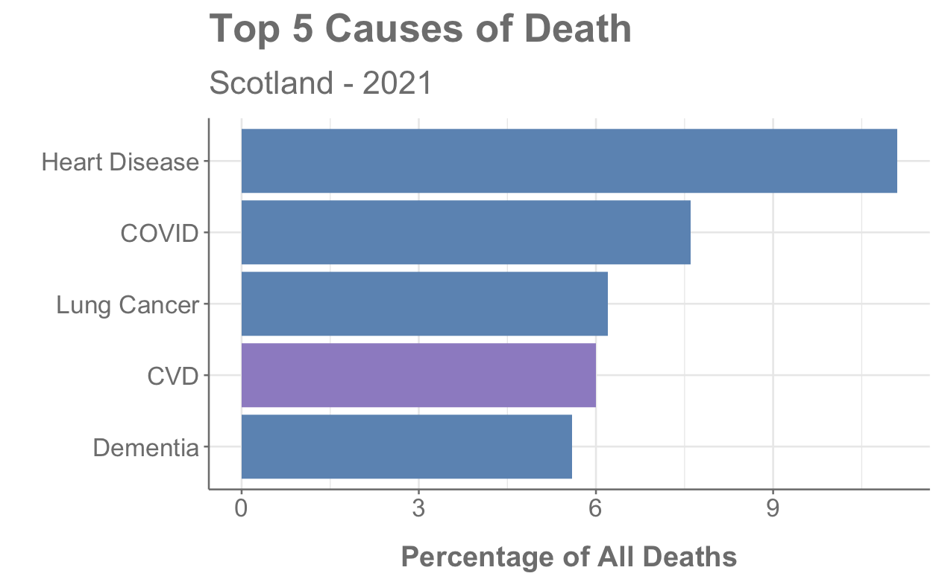
Introduction – CVD in Scotland
3826 deaths in Scotland in 2021 where CVD was underlying cause
130,000 people living in Scotland have survived a stroke or TIA
>50% of stroke survivors are under 75
References: https://www.scotpho.org.uk/population-dynamics/deaths/data/most-frequent-causes/
British Heart Foundation - Global Heart & Circulatory Disease Factsheet Feb 2023
Notes:
LEAD IN - CVD is a leading cause of death in Scotland
Nearly 4000 deaths in 2021
130,000 is 2.4% of population

Slide 4
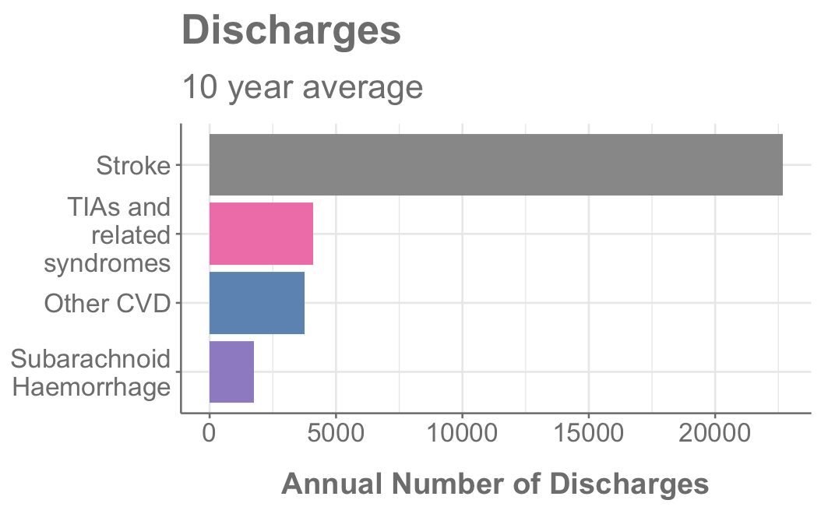
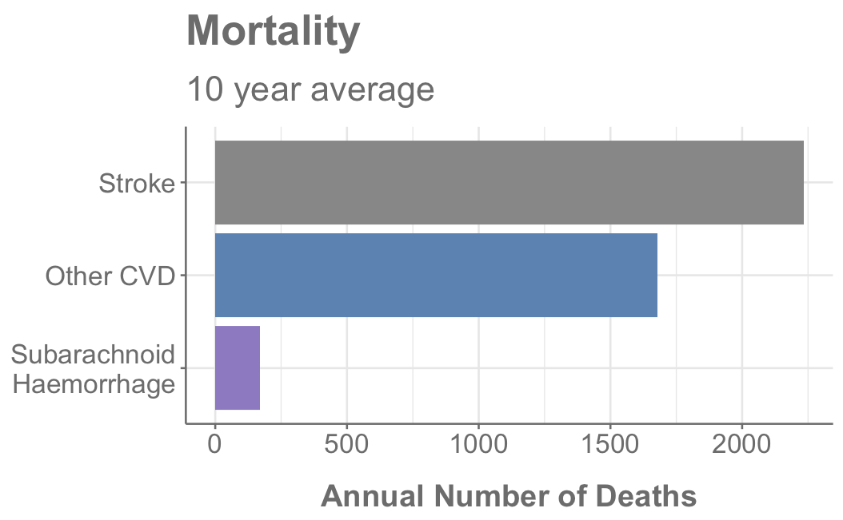
Most Common Type of CVD
Stroke is most common type of CVD
TIAs are included in “Other CVD” for mortality data
Notes:
LEAD IN - So I’ve mentioned the different types of CVD that exist but what is the most common.
In terms of discharge data - stroke is by far the most common
It is also the most common type of CVD in terms of number of deaths
Other CVD
Other CVD also has a high mortality rate
This category includes something called “sequelae of CVD”
Sequelae – consequence of CVD incident
perhaps this accounts for the high number of deaths

Slide 5
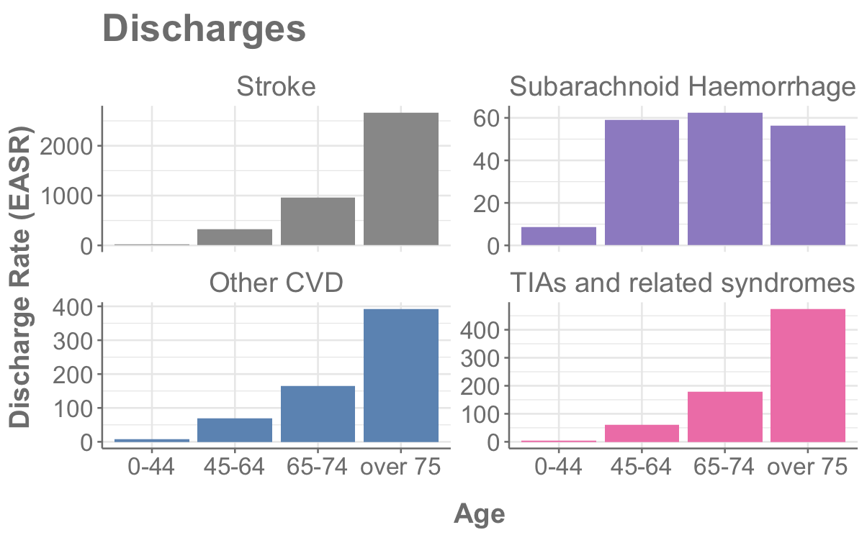
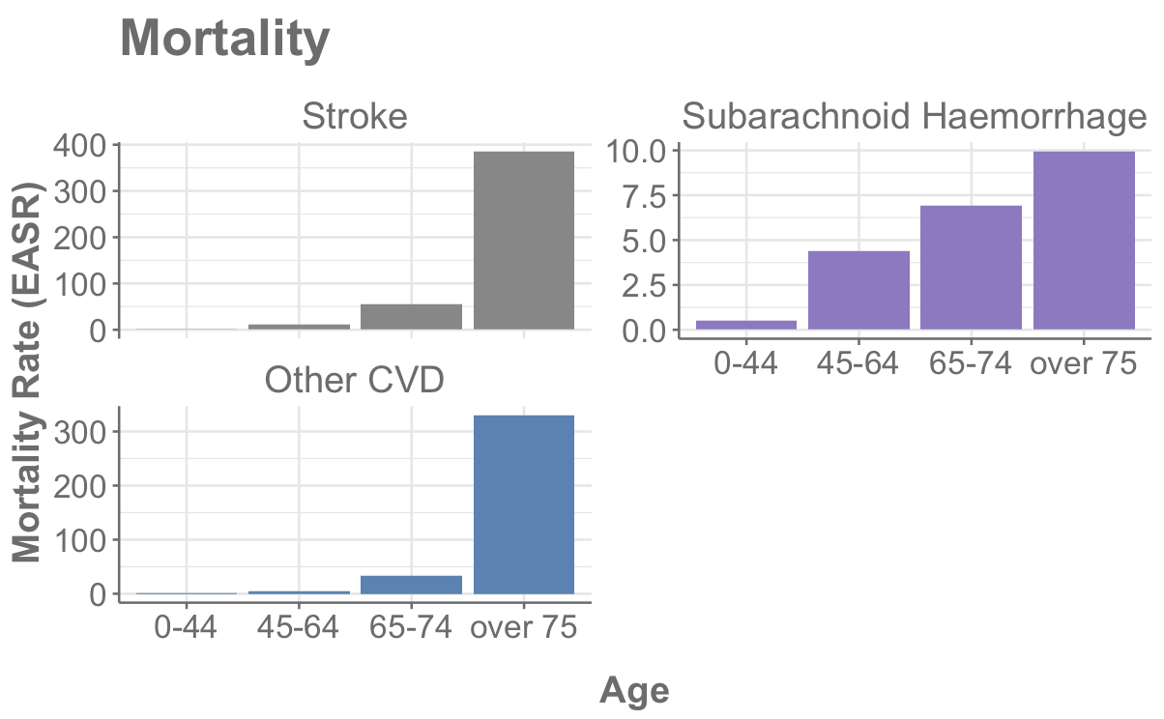
Type of CVD by Age
Stroke, TIAs and Other CVDs discharge rates increase with age
Subarachnoid haemorrhage affects younger age groups at a similar level to over 75s
Chance of survival is better for younger age groups
Notes:
LEAD IN – if we break down the data further into different age groups
For most categories the discharges increase with age
but SAH affects younger age groups at a similar level to over 75s
Mortality data shows that the chance of survival is better for younger age groups – which is what we would expect.

Slide 6
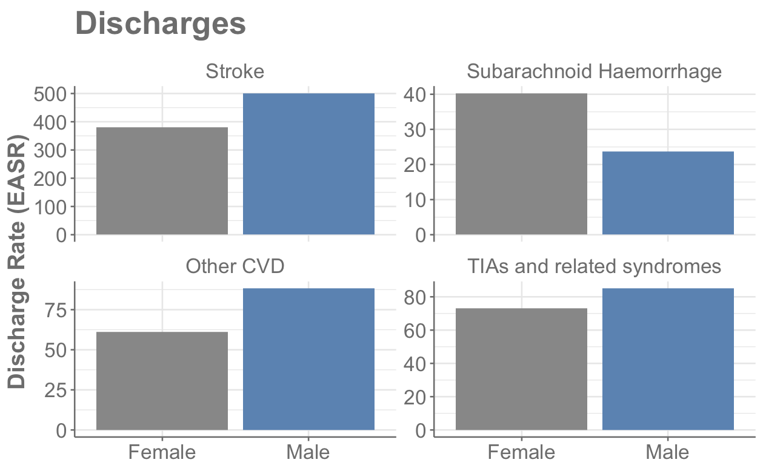
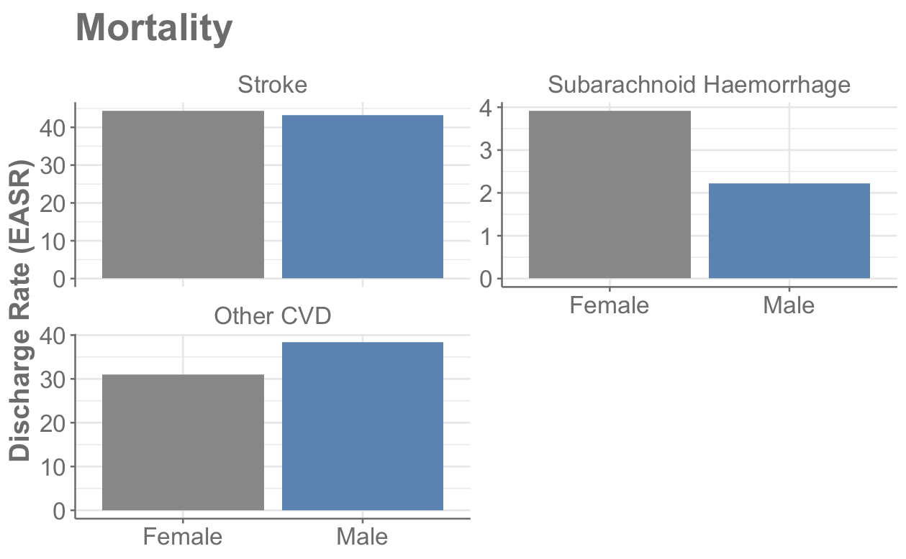
Type of CVD by Sex
Subarachnoid haemorrhage – only type of CVD with female predominance
Reproductive factors and hormonal influences
Variation in wall shear stress
?
References: https://www.ahajournals.org/doi/10.1161/01.STR.0000105933.16654.B4 & https://www.frontiersin.org/articles/10.3389/fneur.2012.00078/full
Notes:
LEAD IN – if we look at the data broken down by sex
It is again subarachnoid heamorrhage which shows a different pattern.
SAH is the only type of CVD with female predominance
Another result that popped up from this data was a peak in male deaths from SAH in 2020 - COVID

Slide 7
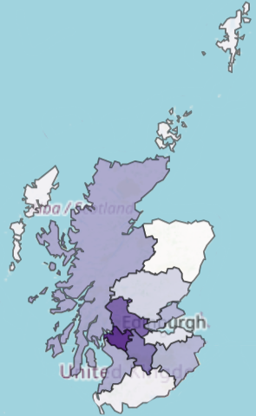
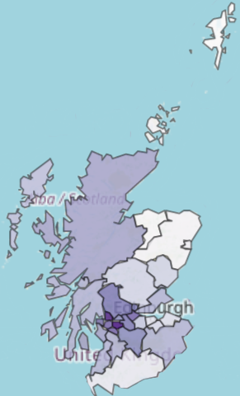

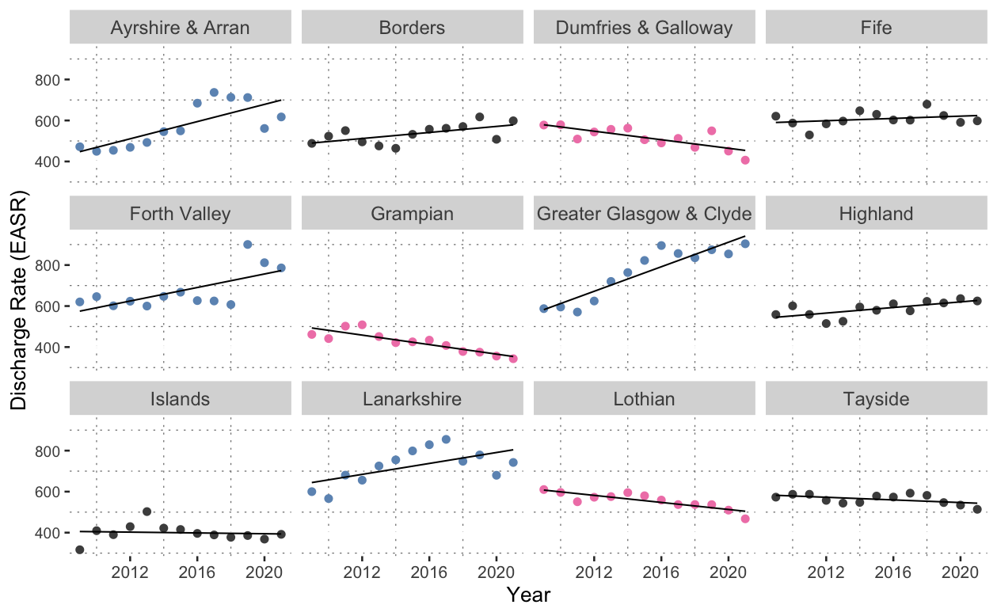

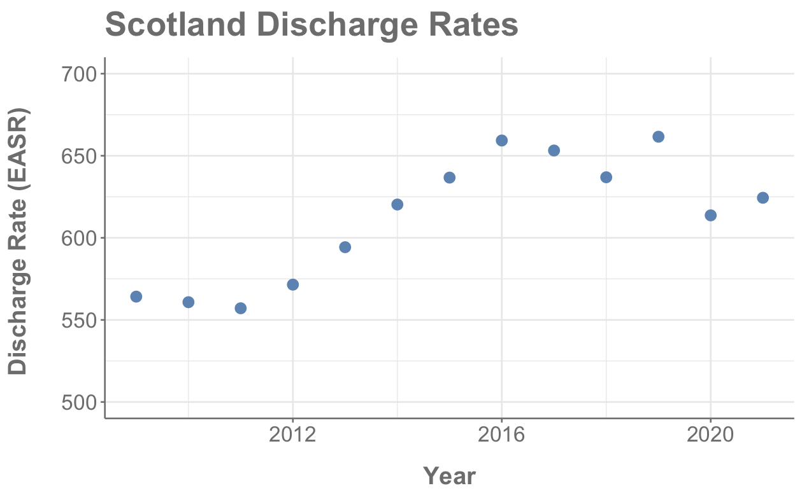
Discharges by Health Board
2021 Data
Discharges - Complicated statistic
Less people dying
Higher number of discharges
More people suffering CVD incident
Notes:
MAP
So what do discharges numbers look like by health board
The darker the colour the more discharges – data has been standardised to account for difference in health board size (Orkney is <2% size of Glasgow)
Glasgow is dominating and Grampian, Island and Dumfries have lower numbers of discharges.
Health Board Graphs
Some are going up some are going down
There are a lot of complicated factors feeding in to these numbers

Slide 8
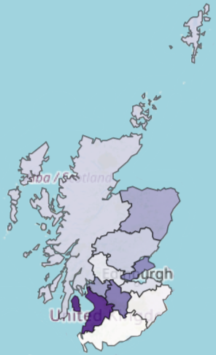
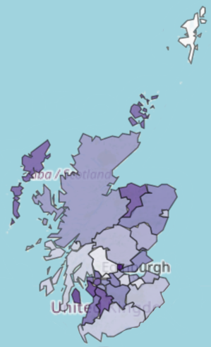
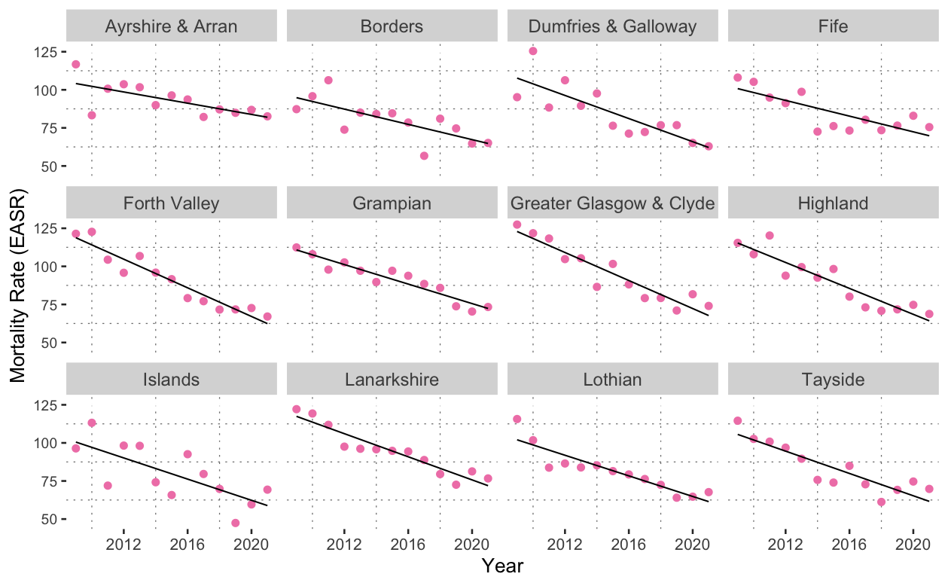
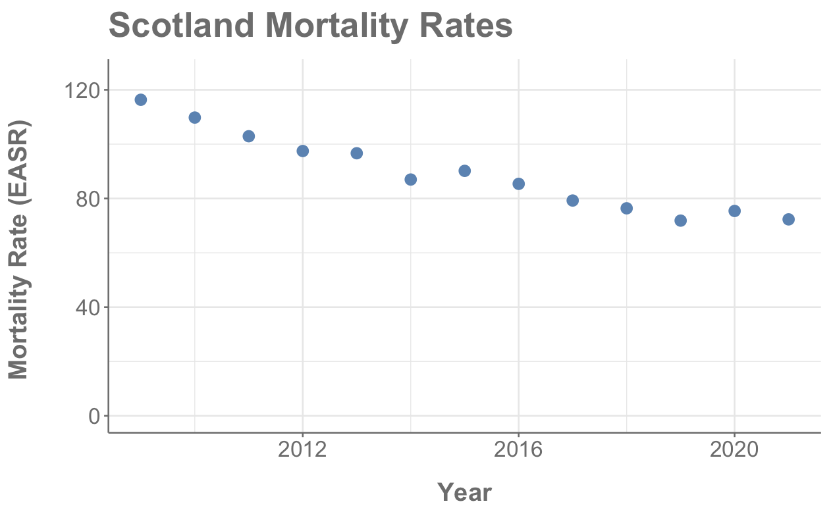
Mortality by Health Board
2021 Data
Mortality generally decreasing for all demographics
Some instances of rates going up but these are for categories with mortality rates < 10

Slide 9
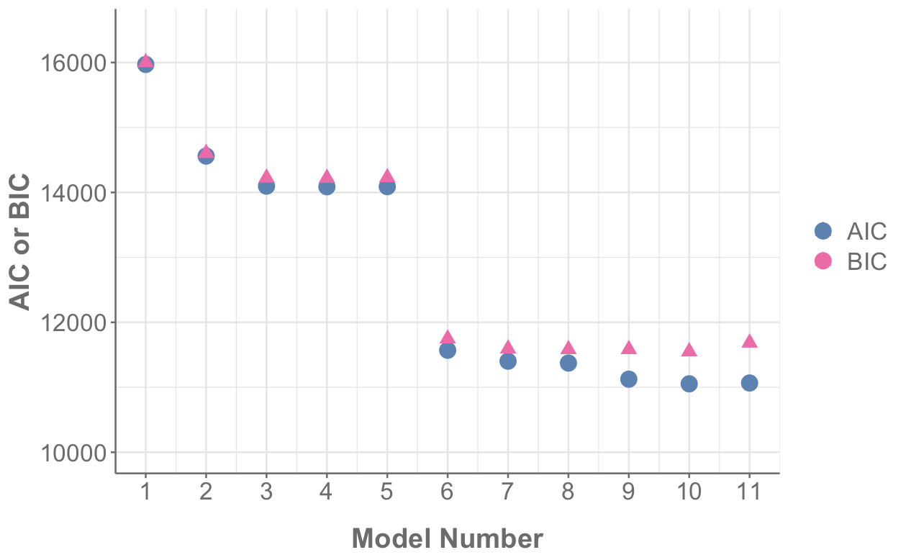
Multiple Linear Regression- AIC and BIC
age
year : health board
Model
log(mortality rate)
~ age
year : diagnosis
Akaike information criterion (AIC) and Bayesian information criterion (BIC)
Measures how well model fits data but penalizes the model in proportion to the number of parameters
BIC penalizes more than AIC for additional parameters
Want AIC and BIC to be as low as possible
diagnosis
+ diagnosis
year : sex
+ health board
health board
+ year
year : age
+ sex
diagnosis : age : sex
+ diagnosis : age
year
+ diagnosis : sex
sex
age : health board
+ age : sex
Adjusted R² 0.84
+ age : health board
diagnosis : age
+ diagnosis : age : sex
+ year : diagnosis
diagnosis : sex
age : sex
+ year : age
+ year : health board
+ year : sex

Slide 10
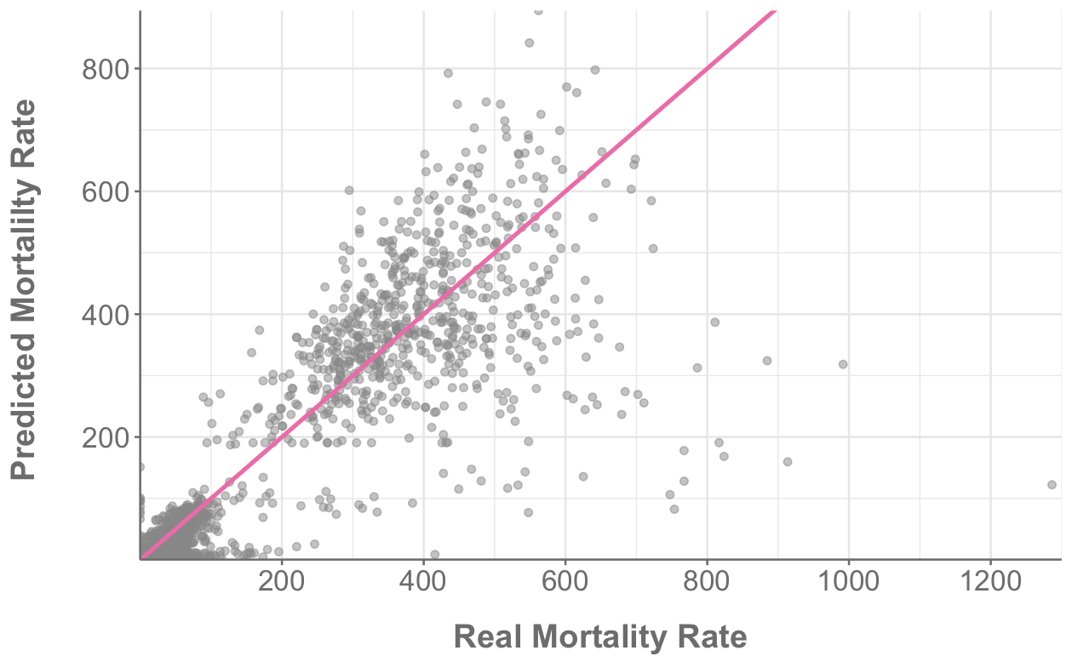
Real vs Model Predicted Values
Adjusted R² | Amount of variance explained by model adjusted for number of predictors in model. Closer to 1 is better. | 0.84
Residual standard error (RSE) | Standard deviation of residuals. This is in same units as mortality rate. Smaller is better. | 0.85
Mortality rates < 10 causing the model issues (evidence from density plots)
Notes:
Adjusted R2 – already talked about
RSE – skewed by the amount of low data

Slide 11
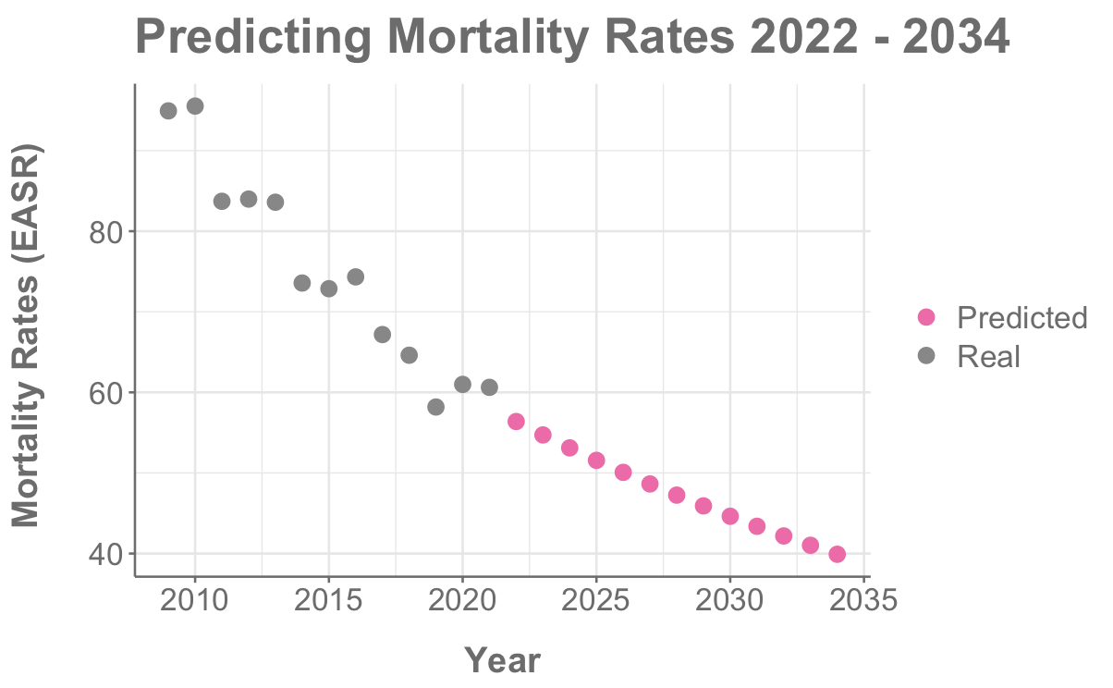
Can We Predict the Future?
Notes:
Had 13 years of data
Predicted on next 13 years

Slide 12
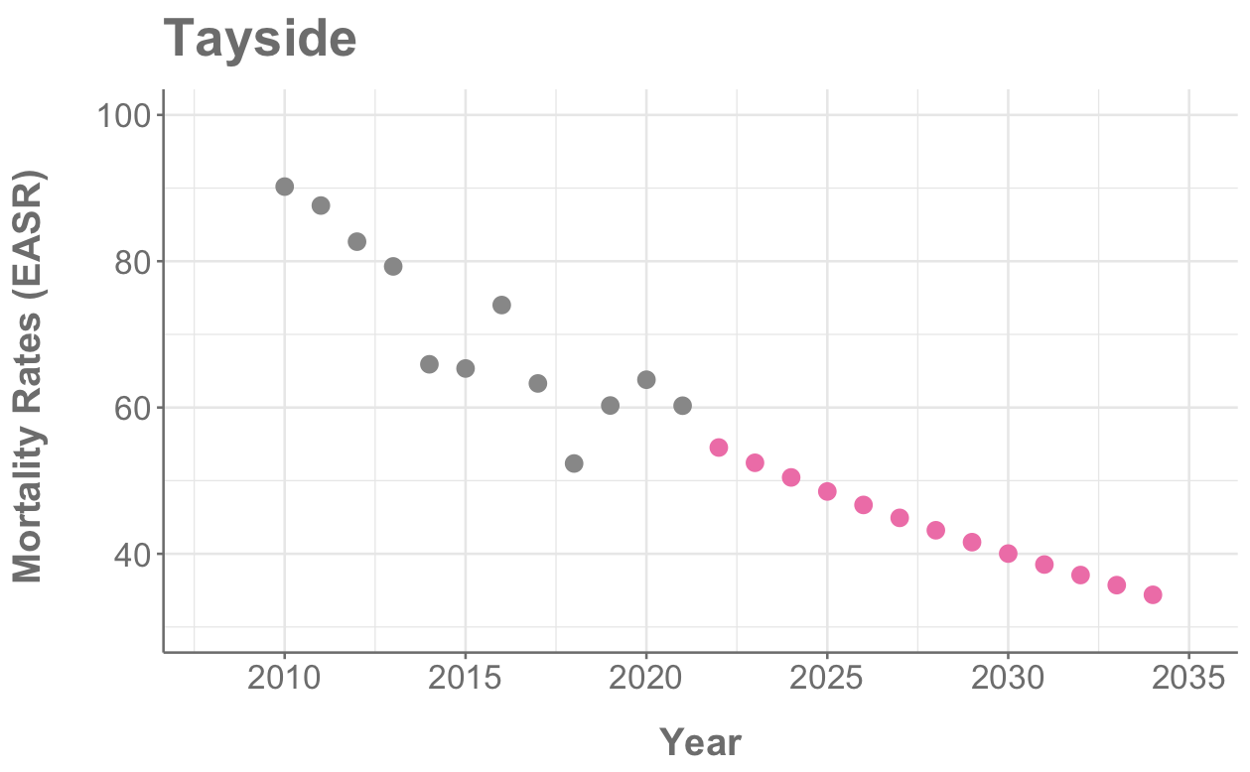
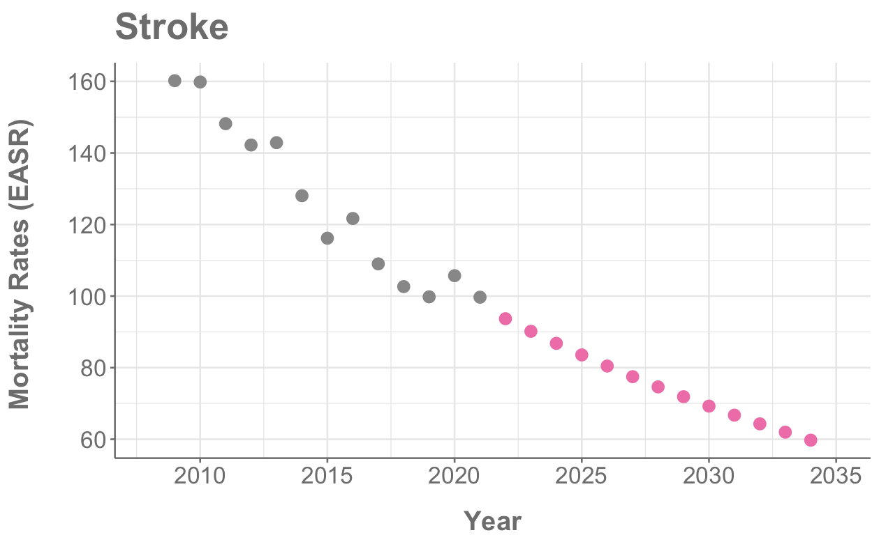
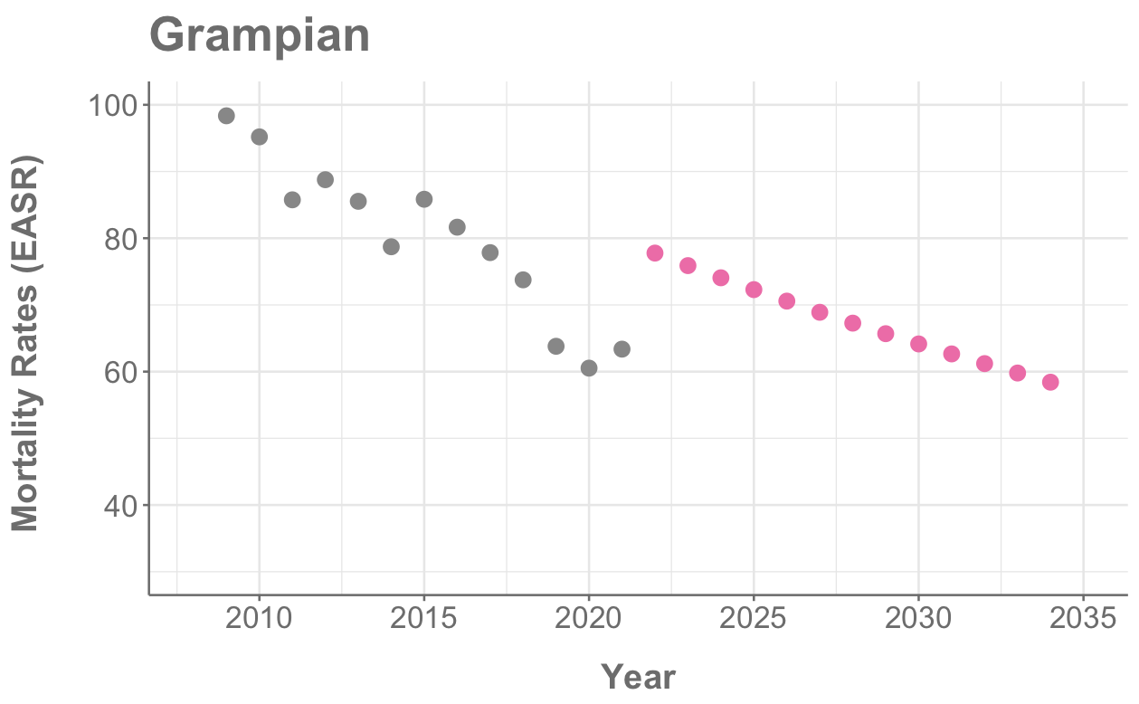
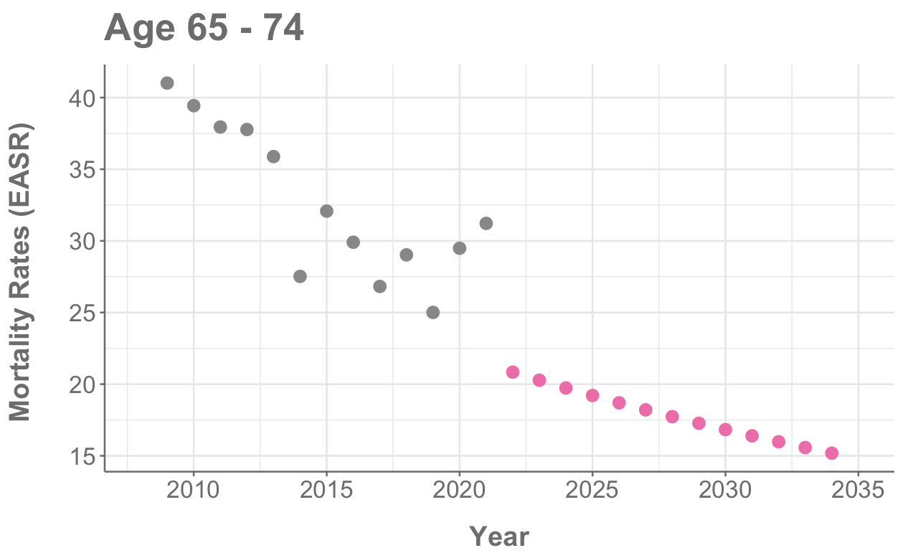
Predicting the Future
Model good at predicting most categories…
…but not all

Slide 13
Issues Encountered & Potential Model Improvements
Issues
Predominance of low or zero data
Only 13 years of data (13 data points)
Insignificance of year in models
Trying to predict on very high (e.g. stroke) and very low (e.g. SAH) data
Outliers at high values
Potential improvements
Split data into high and low mortality rates
Group islands together
Group emergency and transfer admission type

Slide 14
Conclusions
Stroke is the most common type of CVD in Scotland
CVD generally predominates in older age groups, except for subarachnoid haemorrhage (SAH)
SAH is the only type of CVD with female predominance
Discharge rates are increasing for some health boards and decreasing for others
Mortality rates are decreasing for all demographics and areas (except some with very low values)
Multiple linear regression model on mortality data (R² = 0.84)
Good prediction on existing data
Predictions for future years look promising

Slide 15
Future Work
Test model improvements
Investigate neural networks for forecasting
Relate mortality rates to deprivation levels

Slide 16
Thank You For Listening!

Slide 17
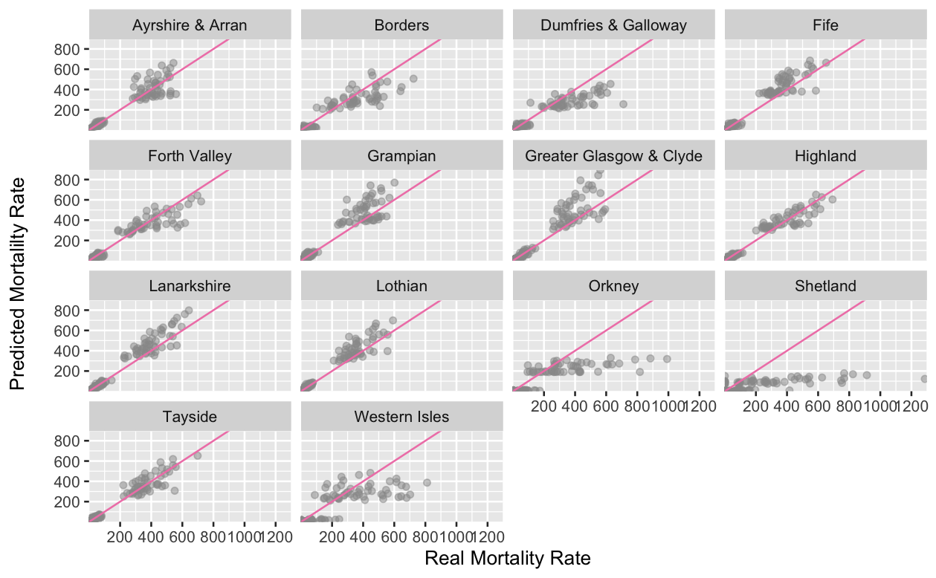
Appendix 1 – Model Predictions by HB

Slide 18
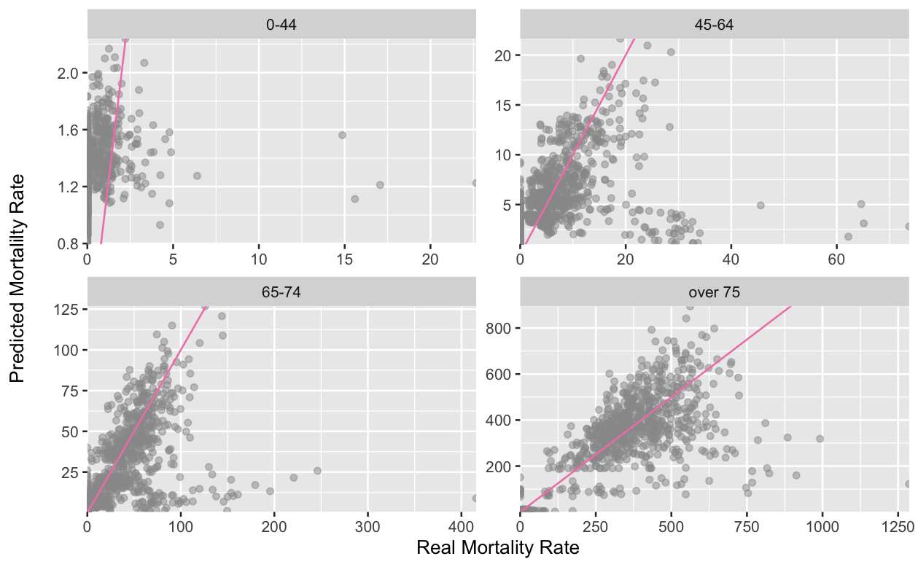
Appendix 1 – Model Predictions by Age

Slide 19
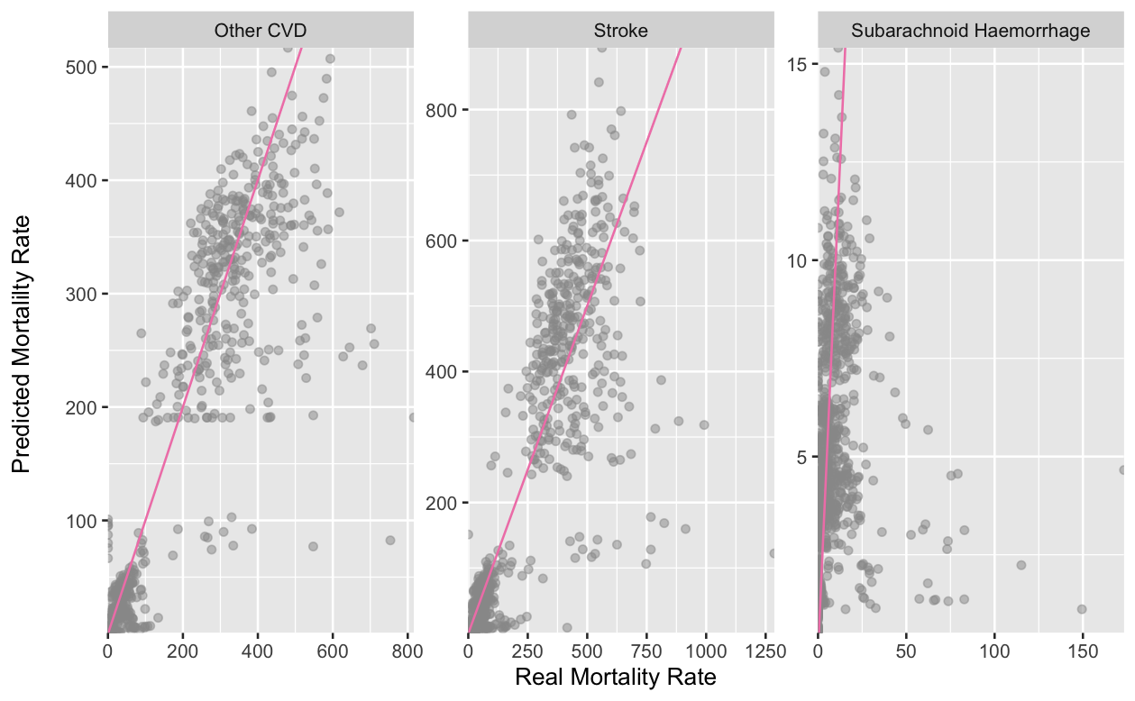
Appendix 1 – Model Predictions by CVD Type

Slide 20
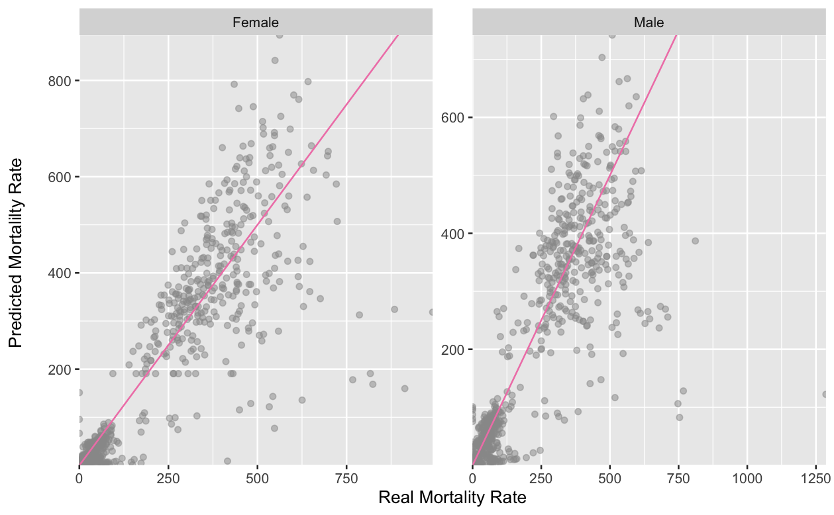
Appendix 1 – Model Predictions by Sex

Slide 21
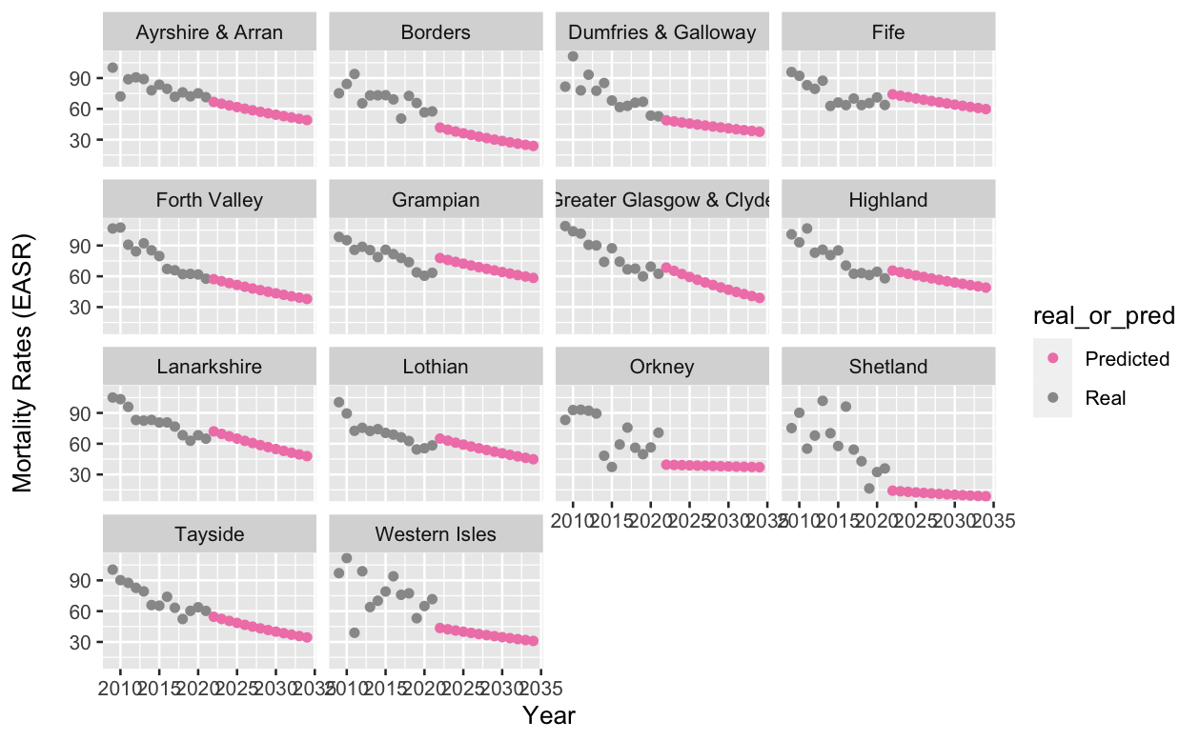
Appendix 2 – Future Predictions by HB

Slide 22
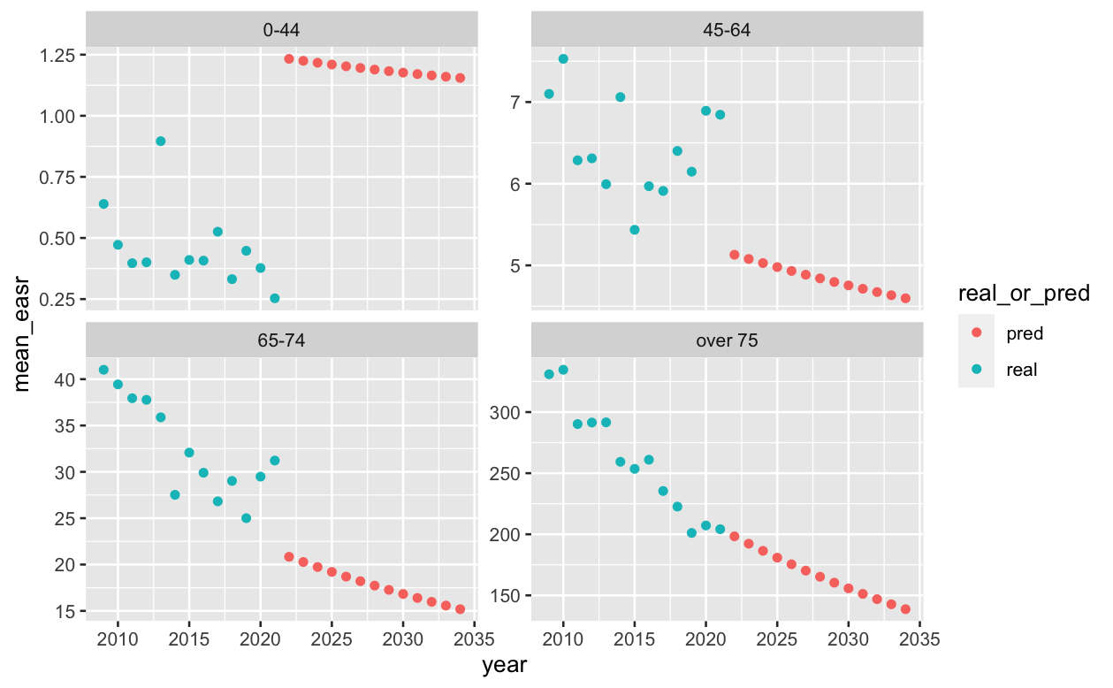
Appendix 2 –Future Predictions by Age

Slide 23
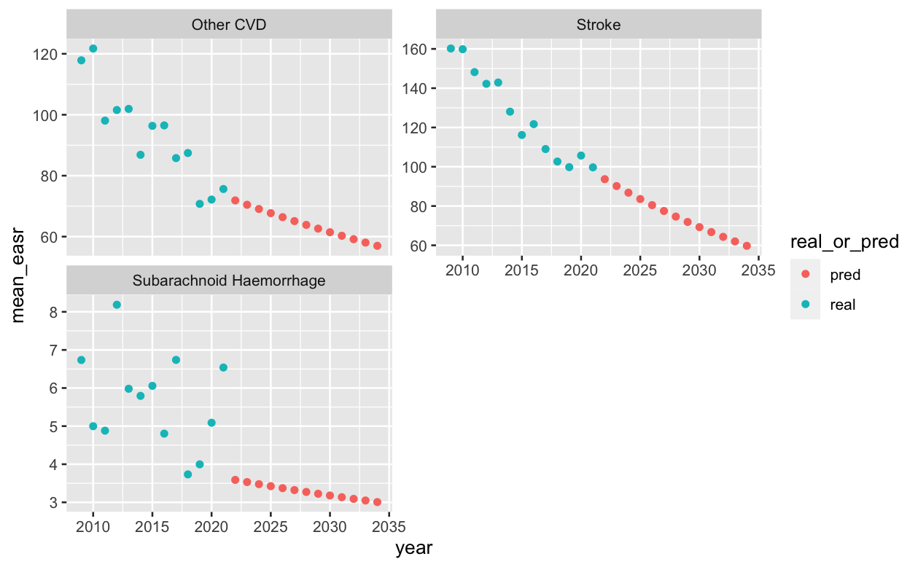
Appendix 2 – Future Predictions by CVD Type

Slide 24
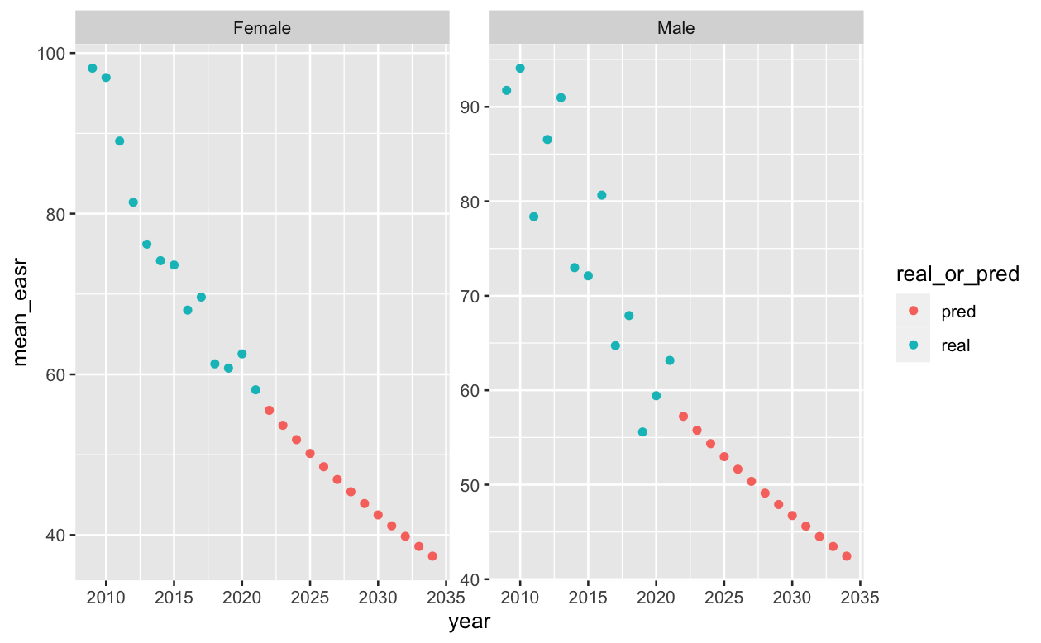
Appendix 2 – Model Predictions by Sex

Slide 25
Appendix 2 – R² in CVD Field
https://quantifyinghealth.com/r-squared-study/
Analyzed the content of 43,110 randomly chosen research papers from PubMed to learn more about R-squared.
The average value of R-squared in medical research is 0.499
An Introduction to Statistical Learning by Gareth James et al.
In typical applications in biology, psychology, marketing, and other domains, we would expect only a very small proportion of the variance in the response to be explained by the predictor, and an R2 value well below 0.1 might be more realistic!
https://statisticsbyjim.com/regression/how-high-r-squared/
Any study that attempts to predict human behaviour will tend to have R-squared values less than 0.5
However, if you analyse a physical process and have very good measurements, you might expect R-squared values over 90%.

Slide 26
Appendix 3 – CVD Data
4368 rows of data
Discharges
Mortality
Health Board
Council
Health Board
Council
Raw Values
Crude Rates
EASR
Raw Values
Crude Rates
EASR
Raw Values
Crude Rates
EASR
Raw Values
Crude Rates
EASR
Raw data – number of discharges
Crude rates – discharges per 100,000 population
EASR – discharges adjusted to European Standard Population to account for age and sex differences in different places
Year (2009 to 2021)
Age
Sex
Diagnosis
Admission Type (Discharges only)
Includes the “COVID years”!!
2009
2018
2021

Slide 27
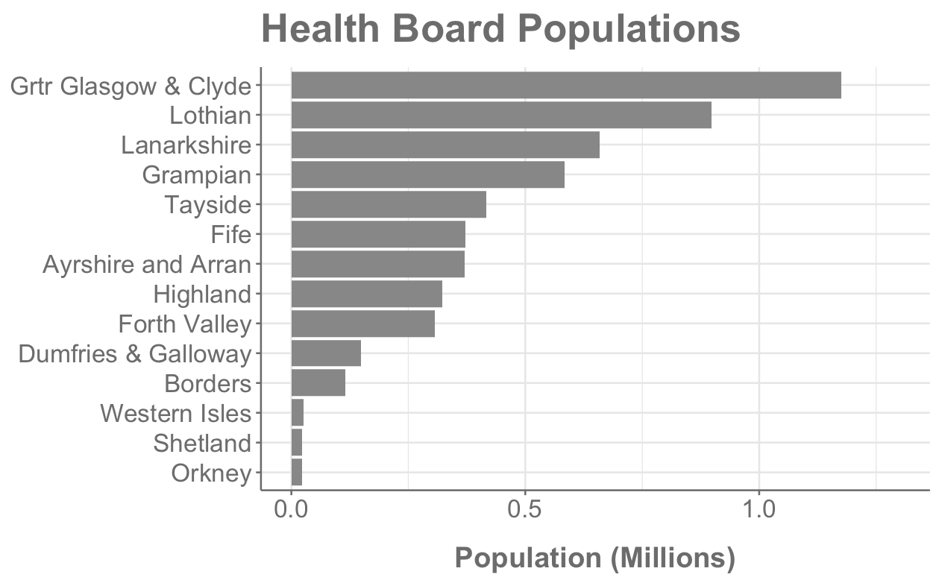
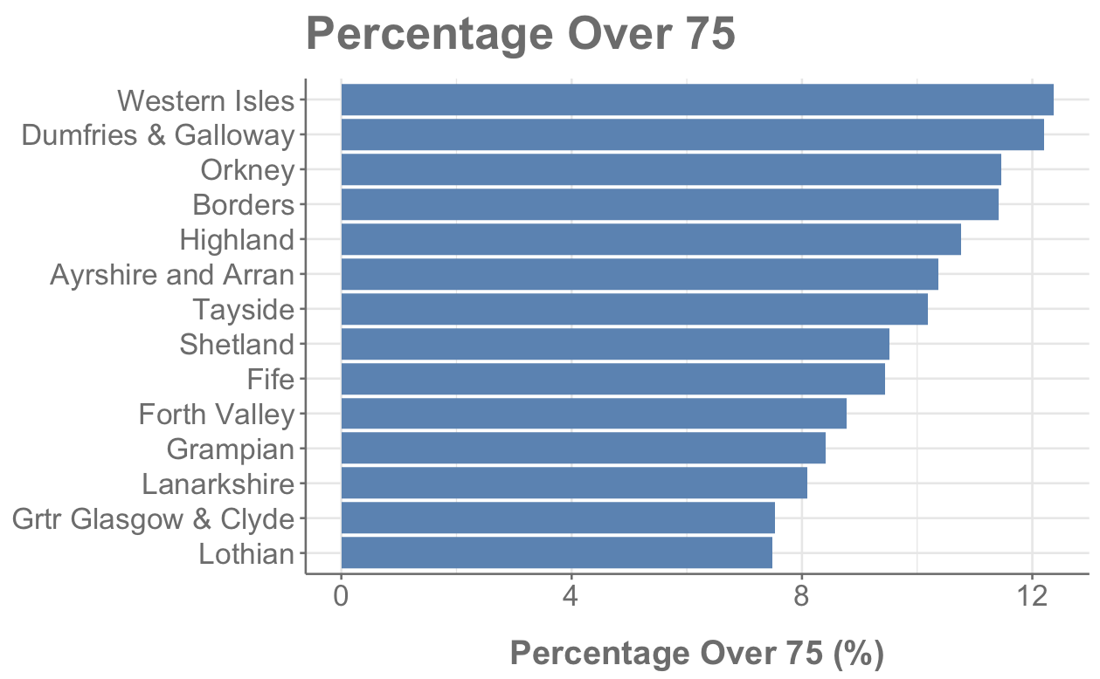
Appendix 4 - Health Board Information
Glasgow largest at 1,174, 980
Orkney smallest at 22,190
Orkney is < 2% size of Glasgow
More rural areas have higher percentage of over 75s
We are reporting EASR values so these differences are accounted for

Slide 28
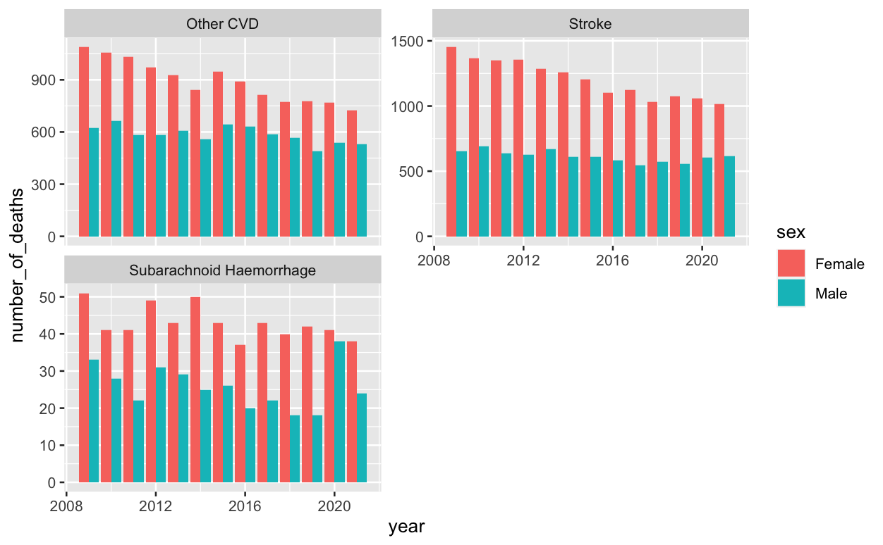
Appendix 5 - Mortality by Sex, CVD Type and Year
Shows pronounced spike in number of deaths for men in 2020

Slide 29
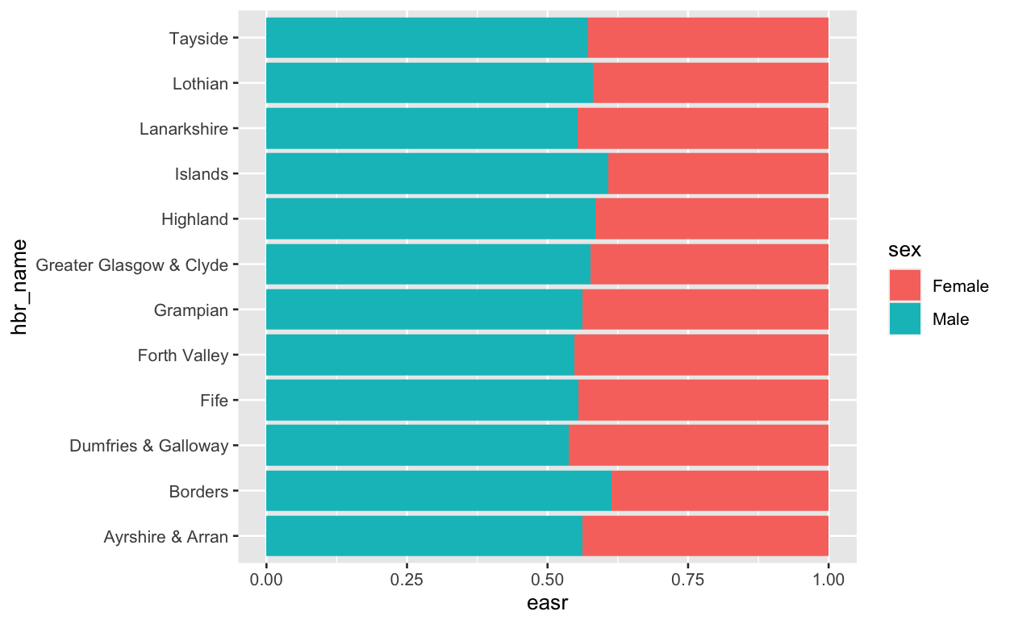
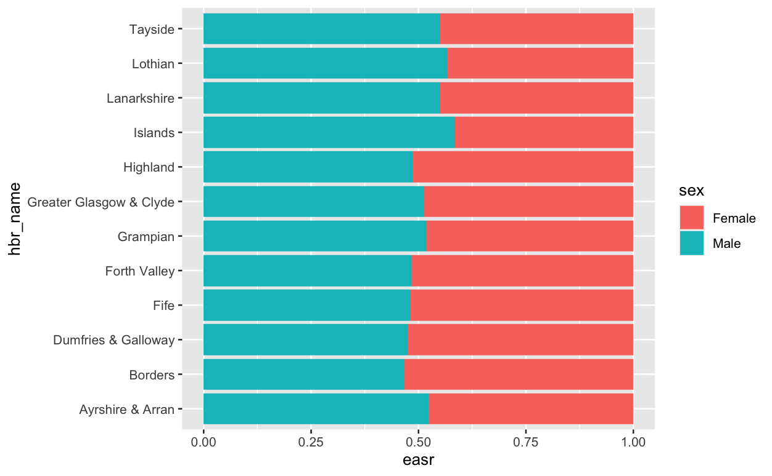
Appendix 6 – Over 75s by Health Board

Slide 30
The (Long!) Journey to a “Beautiful” Model
Multiple Linear Regression (Manual)
Variable engineering
R² = 0.31
Mortality Data
Not enough time
Interactions
R² = 0.97
Neural Networks
Random Forest
Probably not ideal tool
Useless prediction
ARIMA
13 data points = not enough
Notes:
Mention glmulti
Built models on both sets of data – discharge and mortality but only going to discuss mortality model

