Slide 1
Cerebrovascular Disease in Scotland Statistics and Modeling
Fiona Carson
February 2023

Slide 2

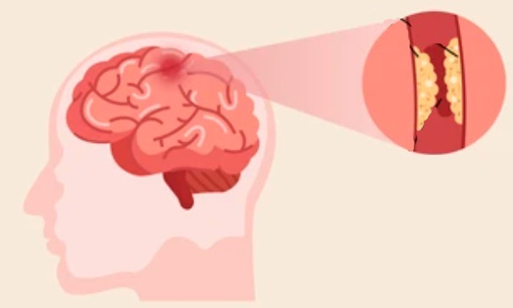

Introduction – Cerebrovascular Disease
CVD - problems with the blood vessels supplying the brain
Four types of CVD in the PHS Data
Stroke - area of brain is deprived of blood supply because of a blockage
Transient ischaemic attach (TIA) - “mini-stroke”, symptoms generally last less than 24 hours
Subarachnoid haemorrhage (SAH) - rupture of a blood vessel beneath the membrane covering the brain (type of brain haemorrhage)
Other CVD – incidences which don’t fall into above categories
Blood clot
Fatty deposits
Haemorrhage

Slide 3
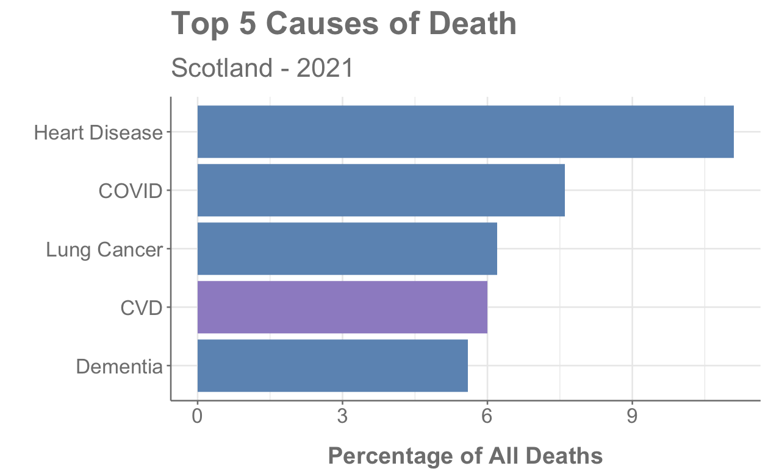
Introduction – CVD in Scotland
3826 deaths in Scotland in 2021 where CVD was underlying cause
130,000 people living in Scotland have survived a stroke or TIA
>50% of stroke survivors are under 75
References: https://www.scotpho.org.uk/population-dynamics/deaths/data/most-frequent-causes/
British Heart Foundation - Global Heart & Circulatory Disease Factsheet Feb 2023
Notes:
130,000 is 2.4% of population

Slide 4
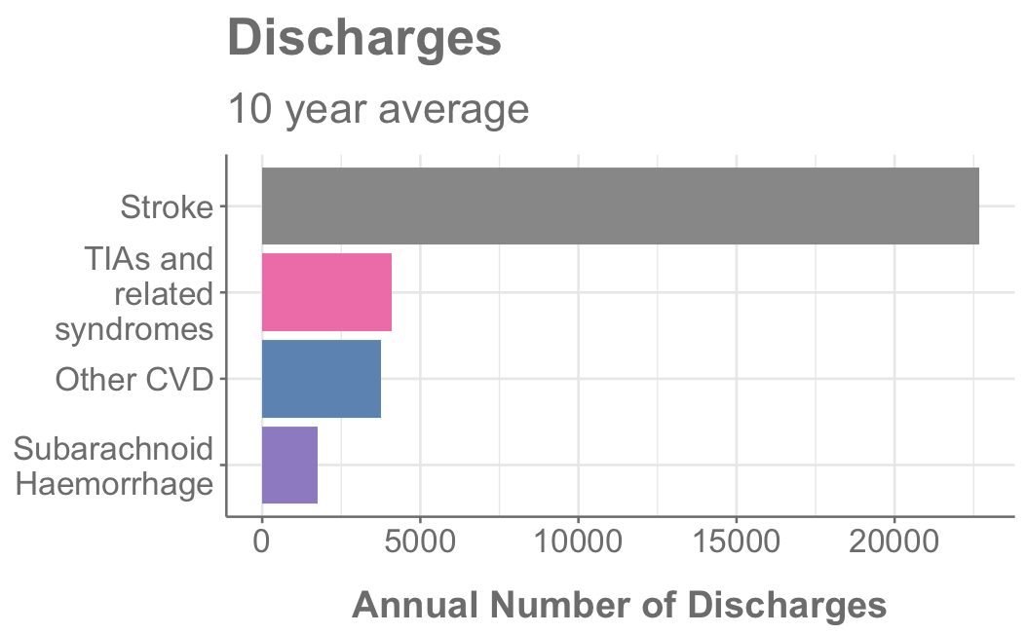
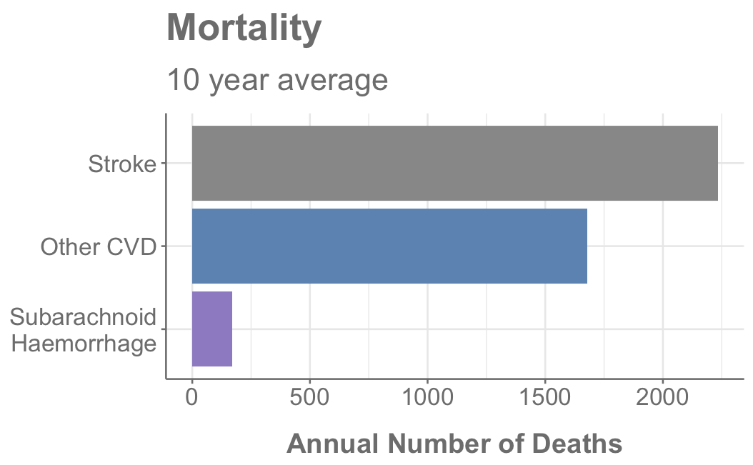
Most Common Type of CVD
Stroke is most common type of CVD
TIAs are included in “Other CVD” for mortality data
Notes:
So I’ve mentioned the different types of CVD that exist but what is the most common.
In terms of number of discharges stroke is by far the most common
It is also the most common type of CVD in terms of number of deaths
The mortality data categorised TIAs under Other CVD
That could be why Other CVD is so high but this category also includes something called “sequelae of CVD”
Sequelae – consequence of previous disease or injury
perhaps this accounts for the high number of deaths

Slide 5
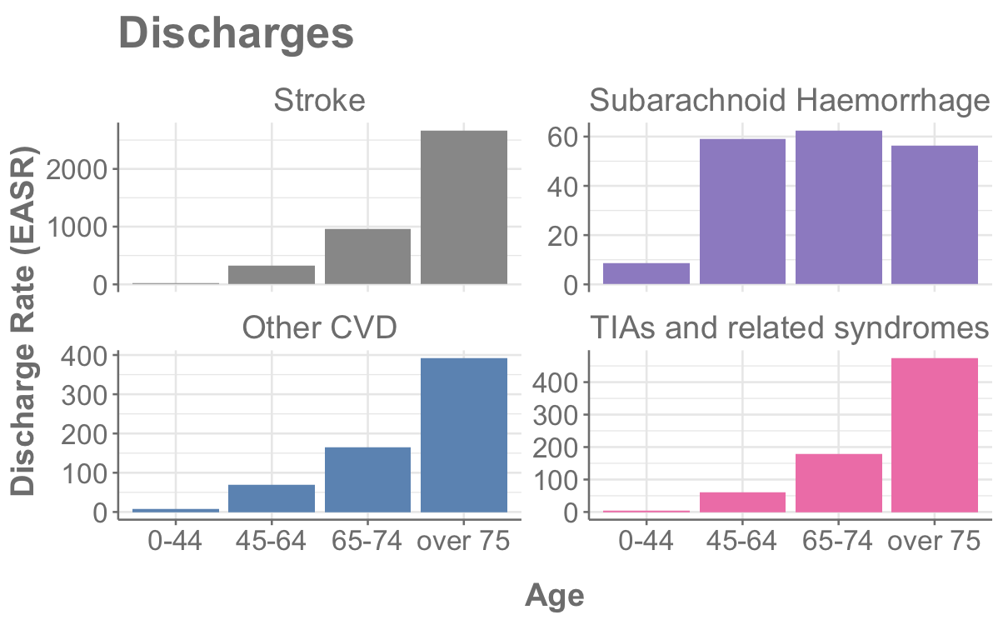
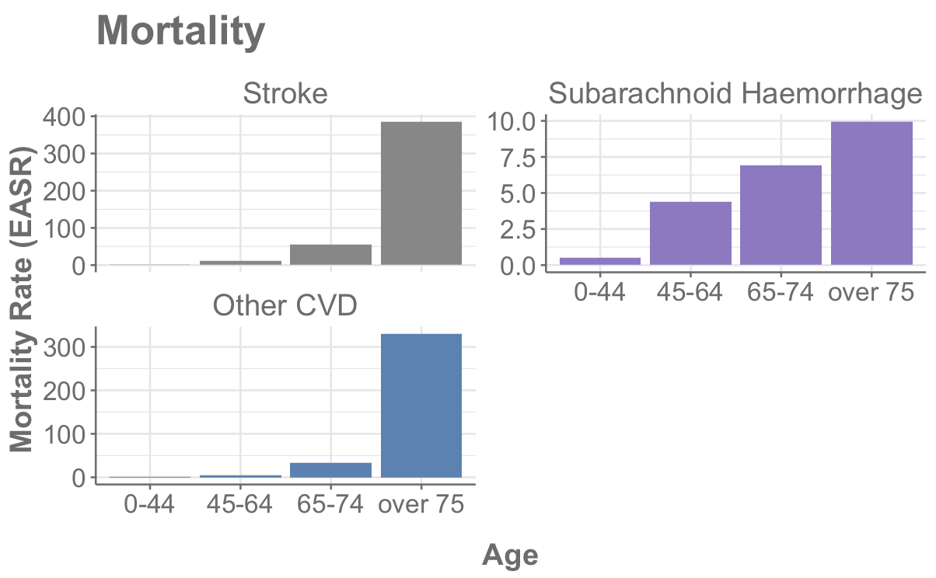
Type of CVD by Age
Stroke, TIAs and Other CVDs increase with age
Subarachnoid haemorrhage affects younger age groups
Mortality data shows that chance of survival is better for younger age groups
Notes:
LEAD IN
For most categories the discharges increase with age as you might expect
but SAH affects younger age groups
Mortality data follows a similar trend for all categories but it appears that more younger people survive
LEAD IN – I’m going to go on to discuss how CVD affects different age groups, sex and
It is important to note at this point that I’ll be showing easr values from now on. What are these?
This means the data is reported per 100,000 people and adjusted for age and sex.

Slide 6
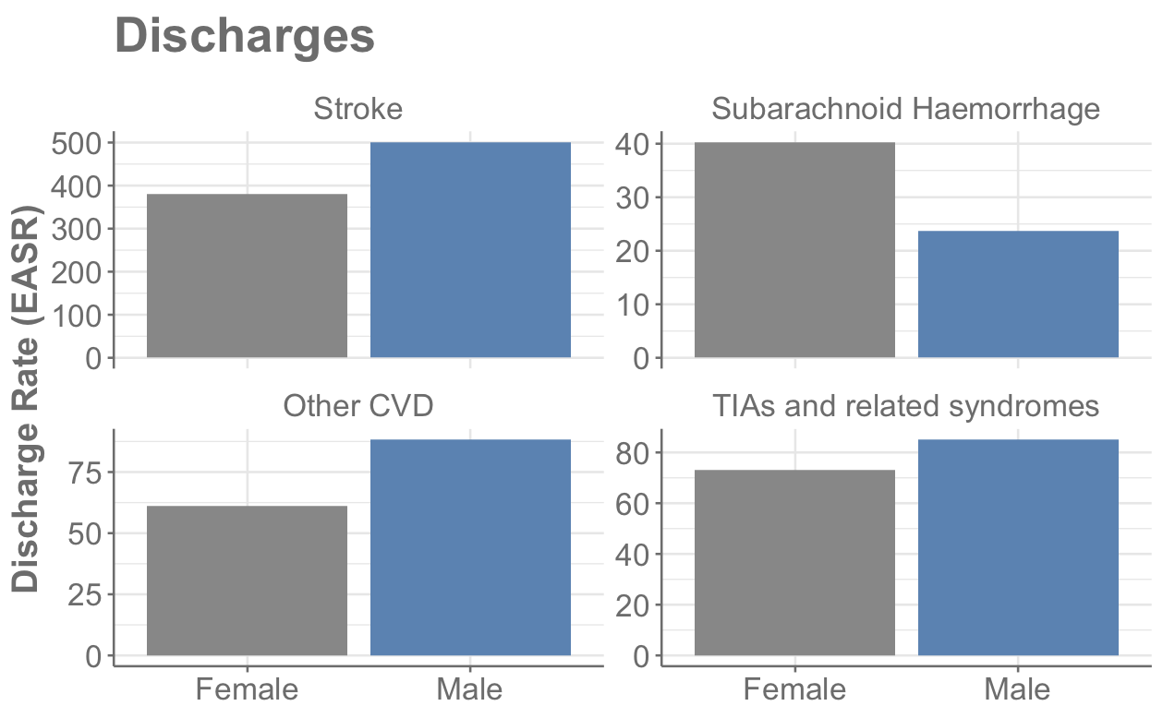
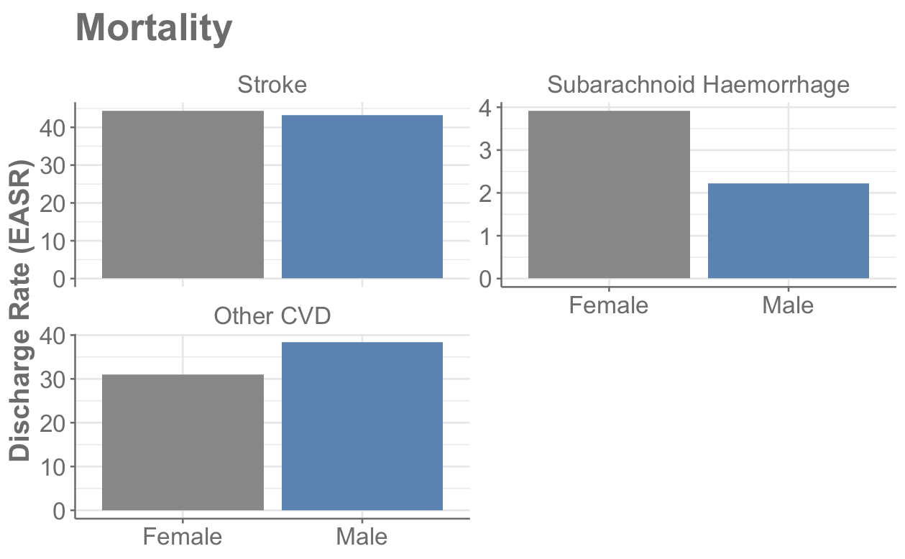
Type of CVD by Sex
Subarachnoid haemorrhage – only type of CVD with female predominance
Reproductive factors and hormonal influences
Variation in wall shear stress
?
References: https://www.ahajournals.org/doi/10.1161/01.STR.0000105933.16654.B4 & https://www.frontiersin.org/articles/10.3389/fneur.2012.00078/full
Notes:
LEAD IN – I’m going to go on to discuss how CVD affects different age groups, sex and
It is important to note at this point that I’ll be showing easr values from now on. What are these?
This means the data is reported per 100,000 people and adjusted for age and sex.
Nothing too striking about the discharge data but I wanted to show the

Slide 7


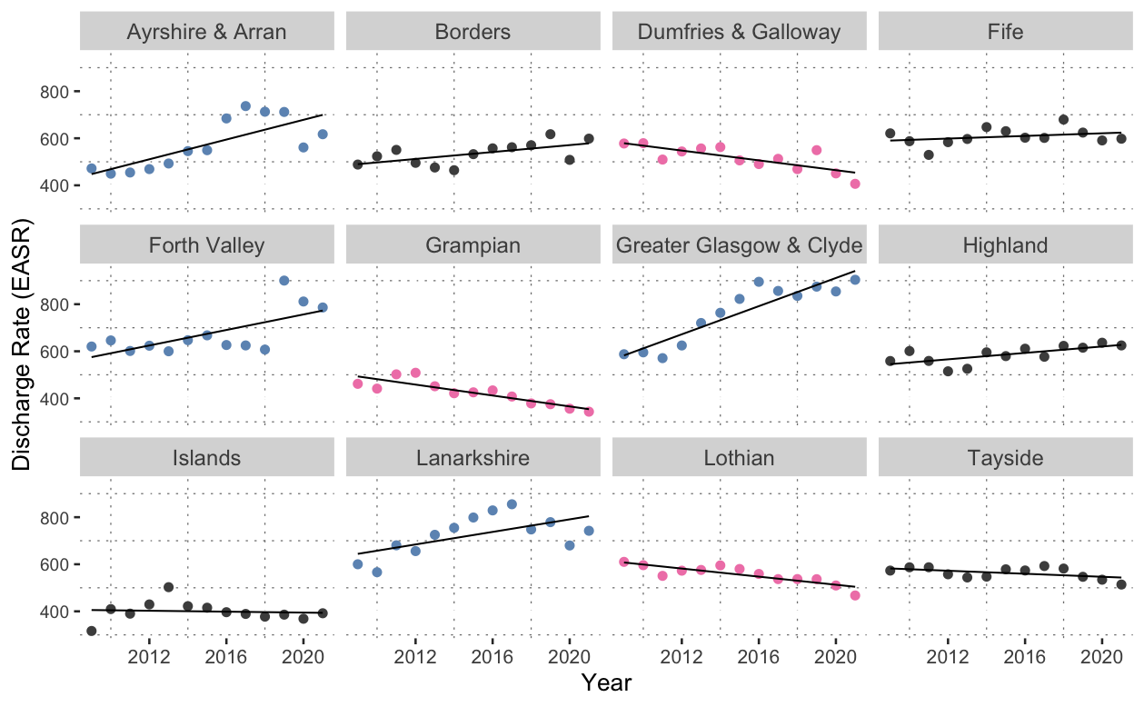
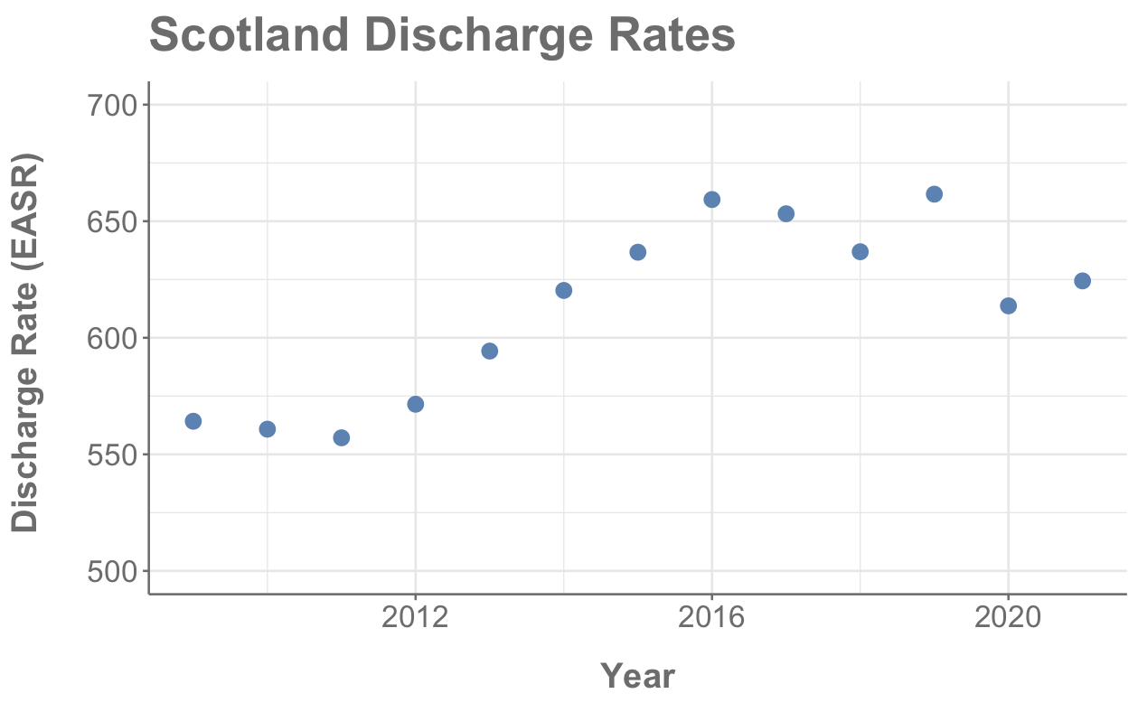
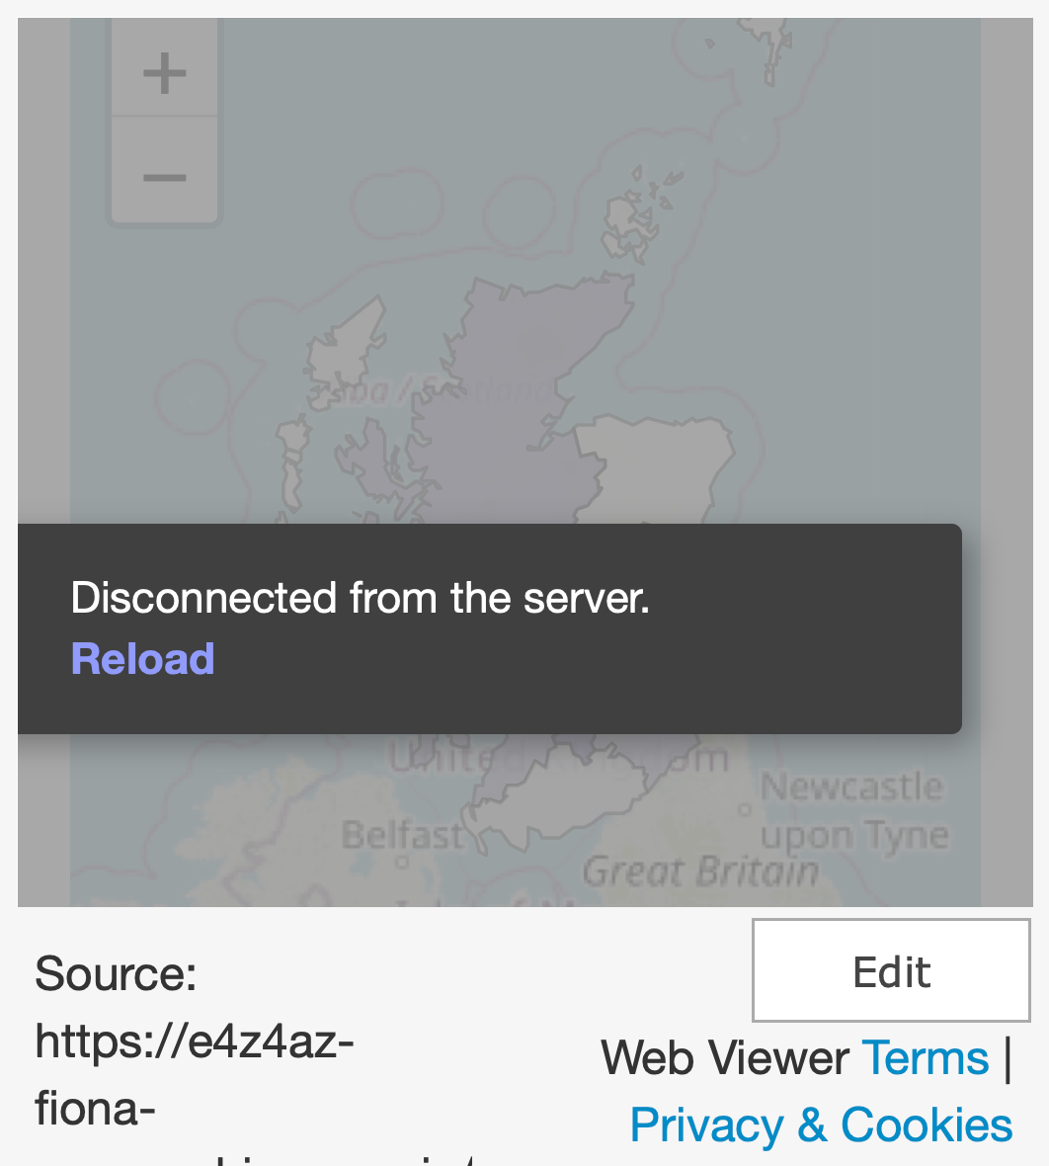
Discharges by Health Board
2021 Data
Discharges - Complicated statistic
Less people dying, more being discharged
More people suffering CVD incident
Notes:
So what do discharges numbers look like by health board
The darker the colour the more discharges – data has been standardised to account for difference in health board size (Orkney is <2% size of Glasgow)
Glasgow is dominating and Grampian, Island and Dumfries have lower numbers of discharges.
From PHS report:
“Over the past ten years, there was an increase in the adjusted discharge rate for stroke in all deprivation quintiles. The rate in the most deprived quintile increased by 39% compared to 21% in the least deprived quintile.”

Slide 8
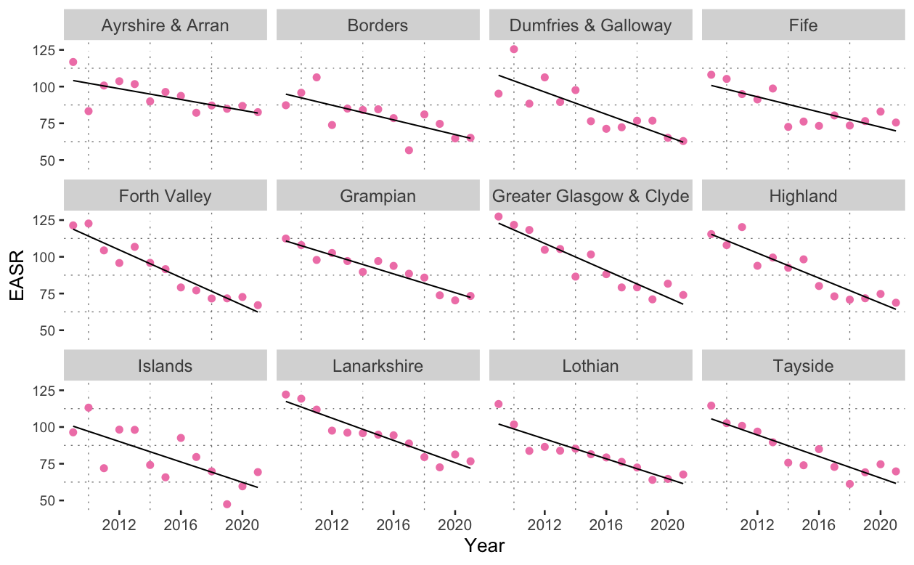
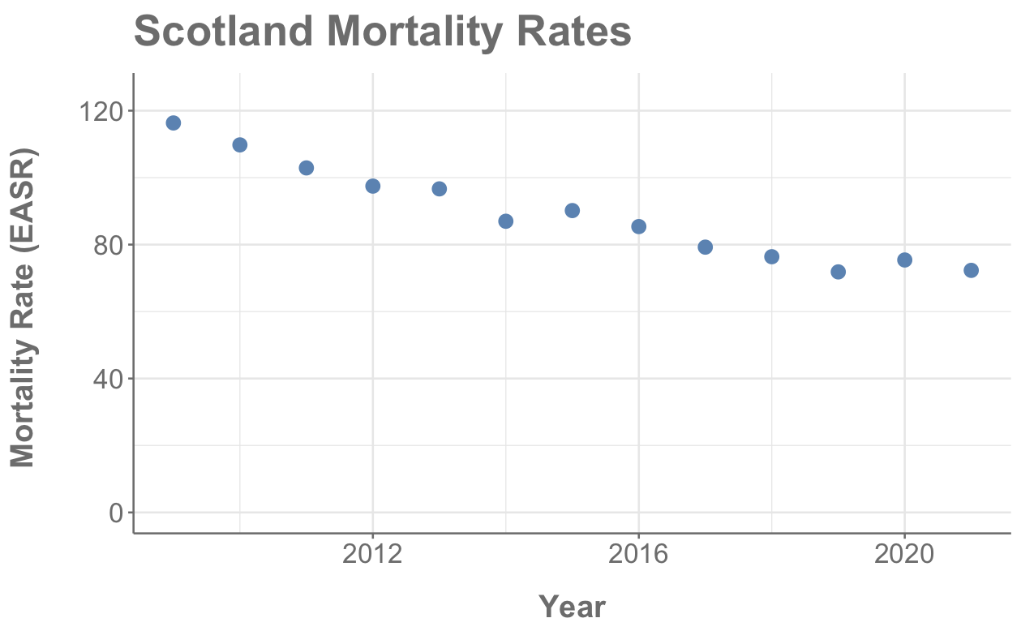

Mortality by Health Board
Mortality generally decreasing for all demographics
Some instances of rates going up but these are for categories with mortality rates < 10

Slide 9
The (Long!) Journey to a “Beautiful” Model
Multiple Linear Regression (Manual)
Variable engineering
R² = 0.31
Mortality Data
Not enough time
Interactions
R² = 0.97
Neural Networks
Random Forest
Probably not ideal tool
Useless prediction
ARIMA
13 data points = not enough
Notes:
Mention glmulti
Built models on both sets of data – discharge and mortality but only going to discuss mortality model

Slide 10
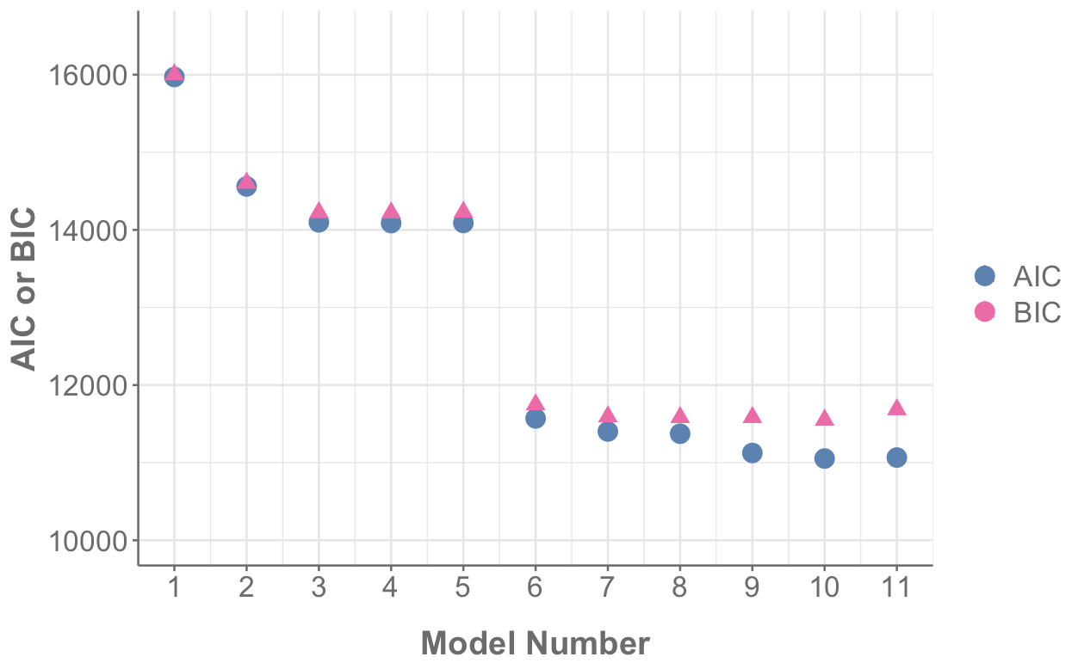
Model Building - AIC and BIC
age
year : health board
Model
log(mortality rate)
~ age
year : diagnosis
+ diagnosis
Akaike information criterion (AIC) and Bayesian information criterion (BIC)
Measure of model performance that accounts for model complexity
Combines a term for how well model fits data with a term that penalizes the model in proportion to the number of parameters
BIC penalizes more than AIC for additional parameters
Want AIC and BIC to be as low as possible
diagnosis
year : sex
+ health board
health board
+ year
year : age
+ sex
diagnosis : age : sex
+ diagnosis : age
year
+ diagnosis : sex
sex
age : health board
+ age : sex
Adjusted R² 0.84
+ age : health board
diagnosis : age
+ diagnosis : age : sex
+ year : diagnosis
diagnosis : sex
age : sex
+ year : age
+ year : health board
+ year : sex

Slide 11
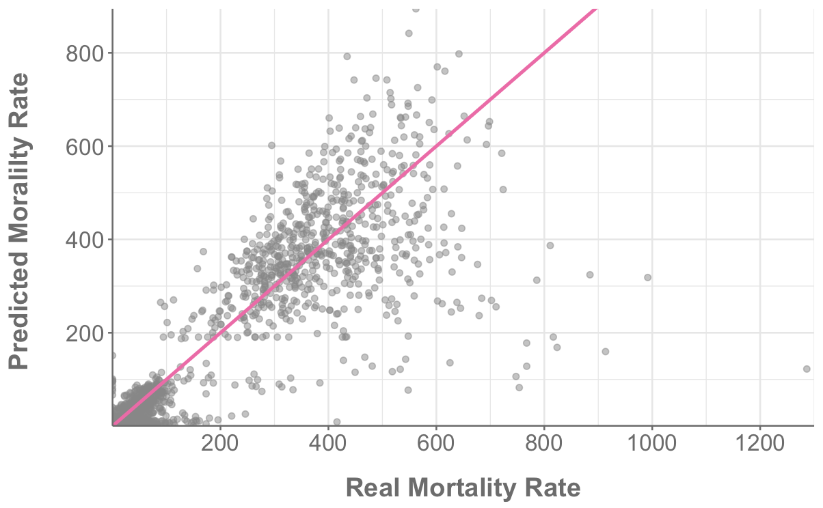
Real vs Model Predicted Values
Mortality rates < 10 causing the model issues (evidence from density plots)
R² | 0.85
Adjusted R² | 0.84
RMSE | 0.85

Slide 12
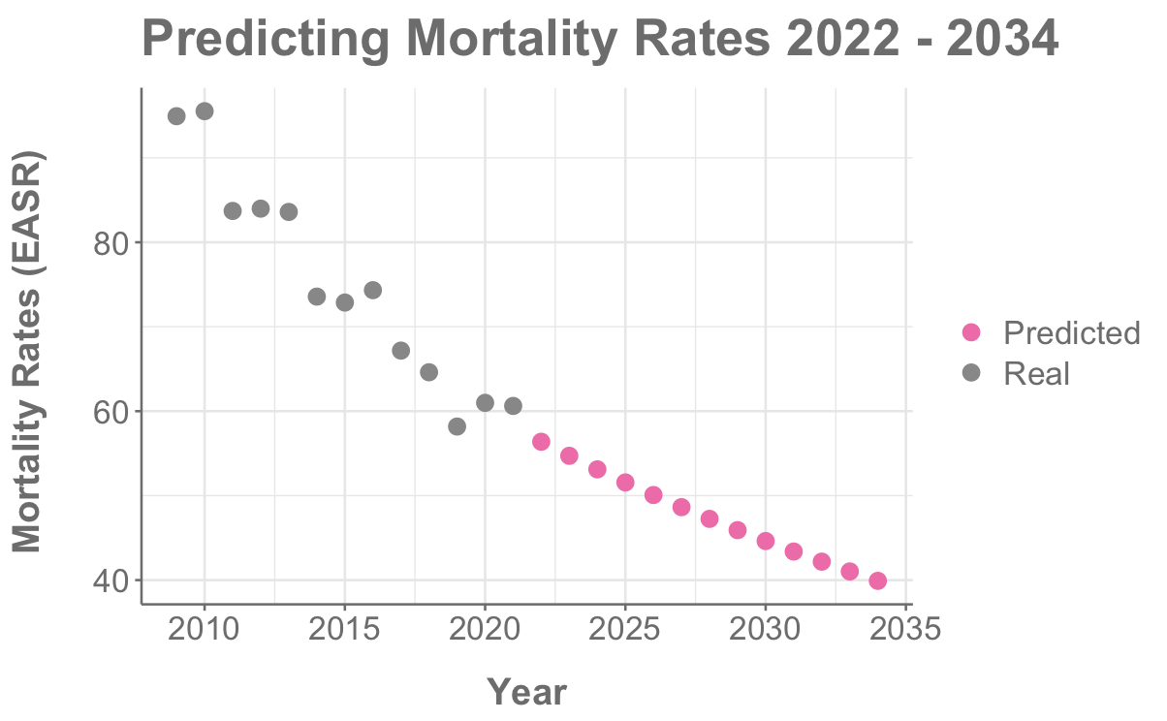
Can We Predict the Future?

Slide 13
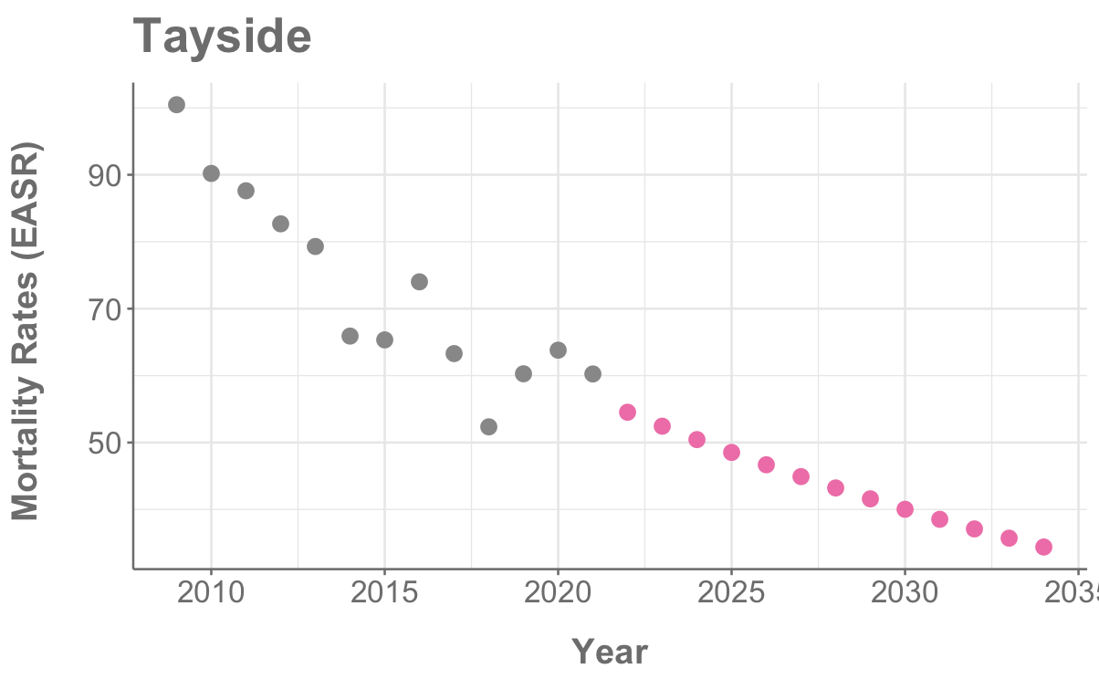
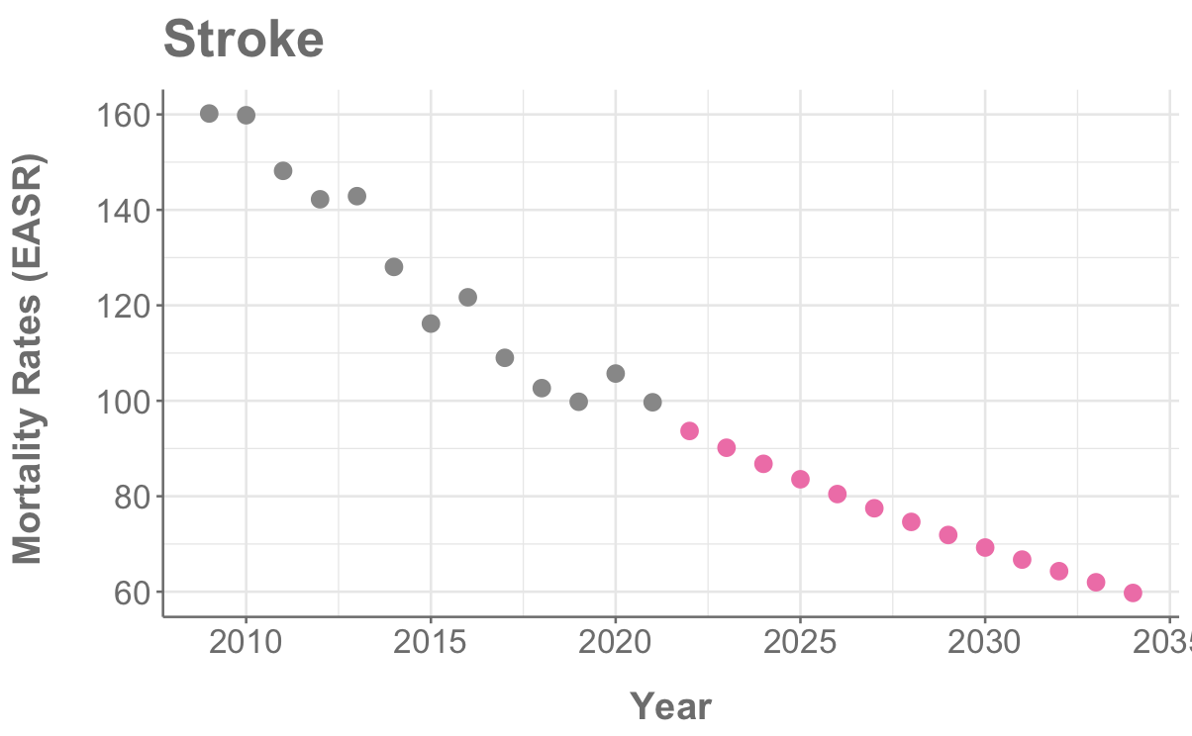
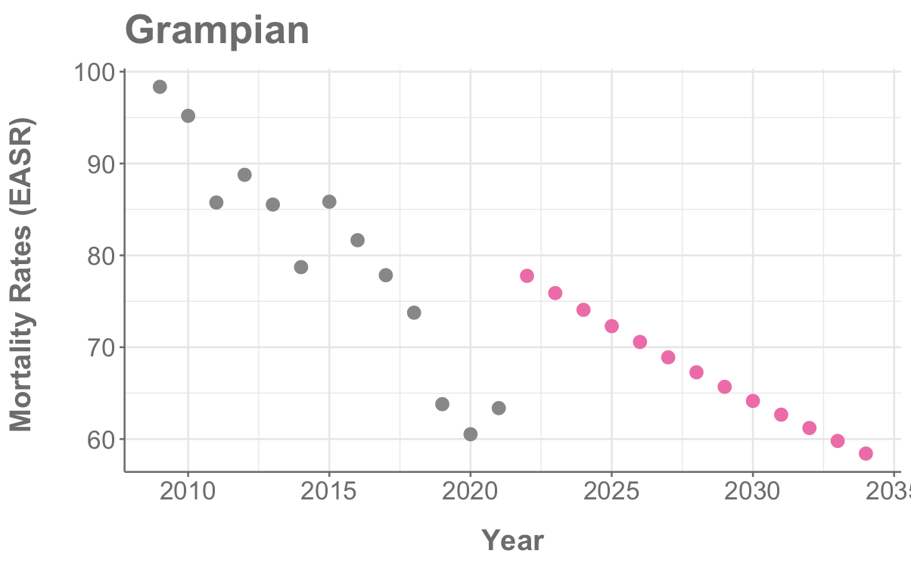
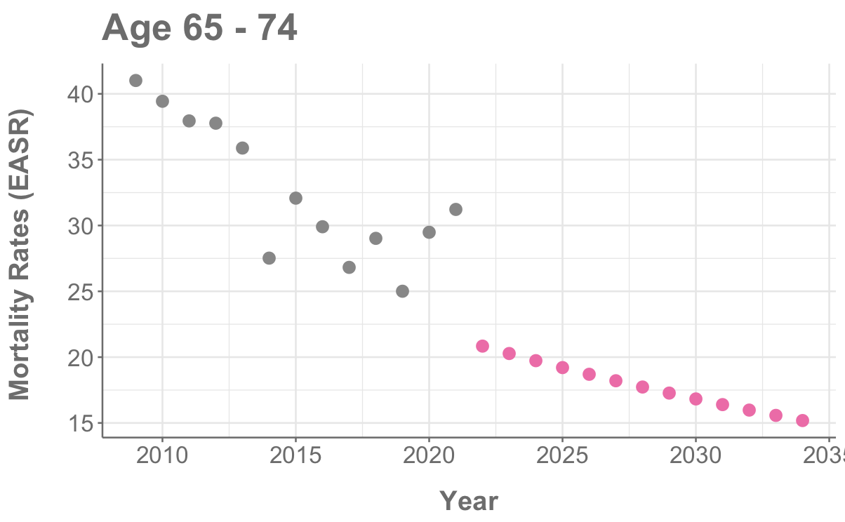
Predicting the Future
Model good at predicting most categories…
…but not all

Slide 14
Issues Encountered & Potential Model Improvements
Issues
Predominance of low or zero data
Only 13 years of data (13 data points)
Insignificance of year in models
Trying to predict on very high (e.g. stroke) and very low (e.g. SAH) data
Potential improvements
Split data into high and low mortality rates
Group islands together
Group emergency and transfer admission type

Slide 15
Conclusions
Stroke is the most common type of CVD in Scotland
CVD generally predominates in older age groups, except for subarachnoid haemorrhage (SAH)
SAH is the only type of CVD with female predominance
Discharge rates are increasing for some health boards and decreasing for others
Mortality rates are decreasing for all demographics and areas (except some with very low values)
Multiple linear regression model on mortality data (R² = 0.84)
Good prediction on existing data
Predictions for next 13 years look promising

Slide 16
Future Work
Test model improvements
Investigate neural networks for forecasting
Relate mortality rates to deprivation levels

Slide 17
Appendix 1 – Model Information
Test-train split – didn’t do because of the nature of the data – only have one row per year per “category”. Tried holding back later years but predictions were bad because of covid effects.
What if we train model on years before covid – up to 2019?
Logged discharge and deaths
glmulti -

Slide 18
Appendix 2 – R² in CVD Field
https://quantifyinghealth.com/r-squared-study/
analyzed the content of 43,110 randomly chosen research papers from PubMed to learn more about R-squared.
The average value of R-squared in medical research is 0.499, which means that the average linear regression model explains 49.9% of the outcome variance.
In typical applications in biology, psychology, marketing, and other domains, we would expect only a very small proportion of the variance in the response to be explained by the predictor, and an R2 value well below 0.1 might be more realistic!
An Introduction to Statistical Learning by Gareth James et al.
https://statisticsbyjim.com/regression/how-high-r-squared/
Any study that attempts to predict human behavior will tend to have R-squared values less than 50%.
However, if you analyze a physical process and have very good measurements, you might expect R-squared values over 90%.
Use prediction intervals to access precision
https://statisticsbyjim.com/regression/how-high-r-squared/

Slide 19
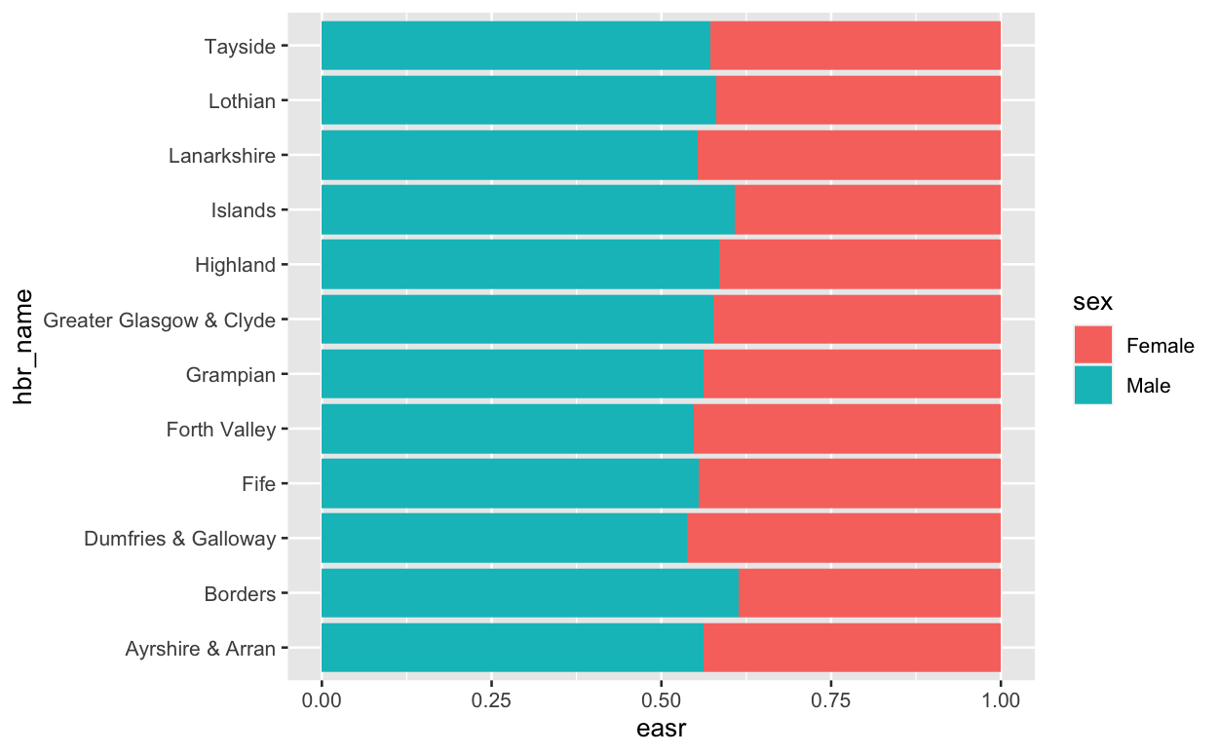
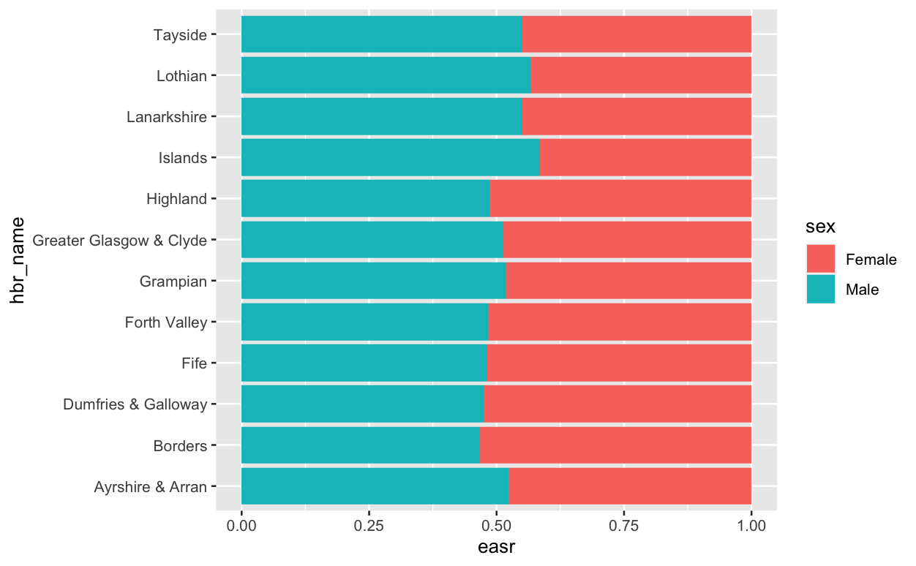
Looked at dischrages and deaths by sex and health board but nothing interesting popped up
Could do statistics on this – is the increase in borders significant??
What about age and health board – don’t the more deprived health boards have higher numbers.

Slide 20
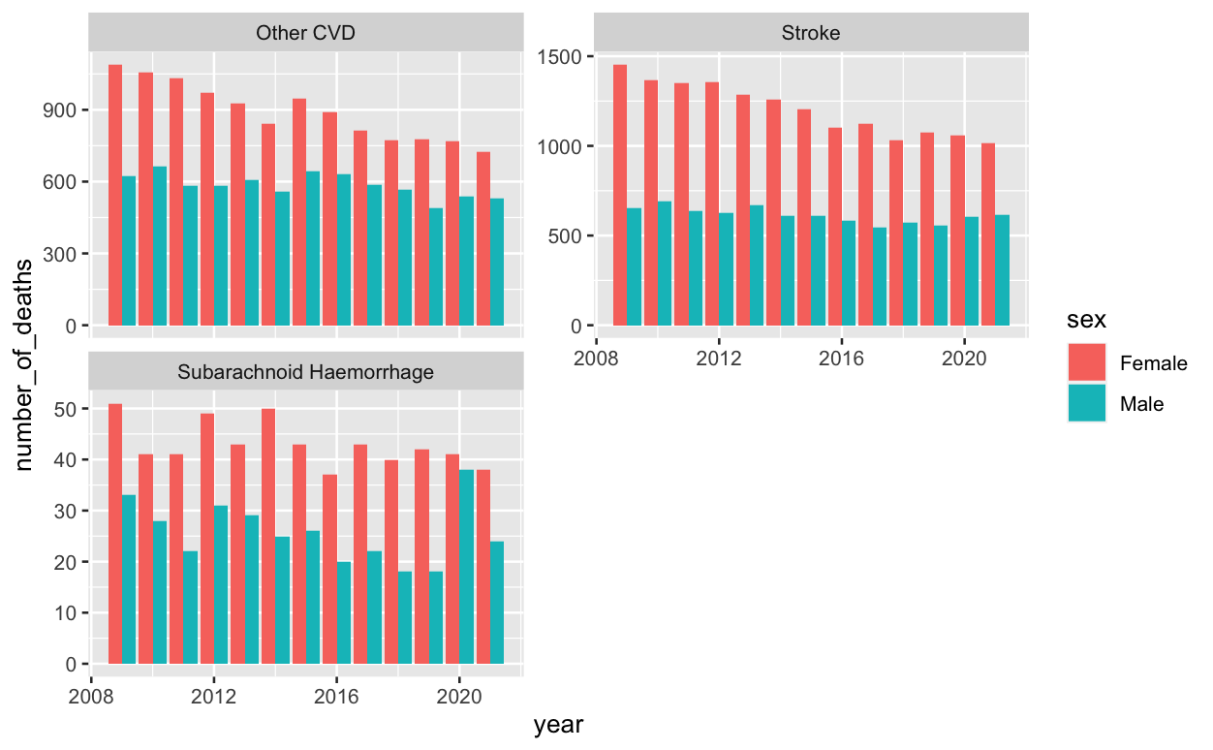
Mortality by Sex
Shows pronounced spike in number of deaths for men in 2020. Not sure if this is interesting enough to spend time on

Slide 21
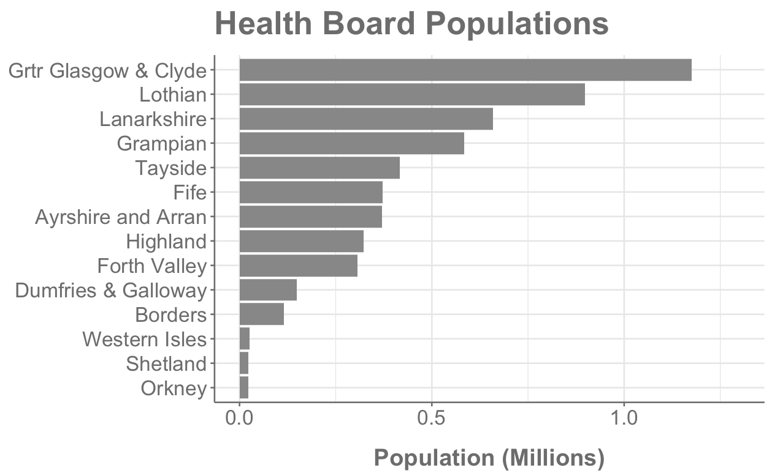
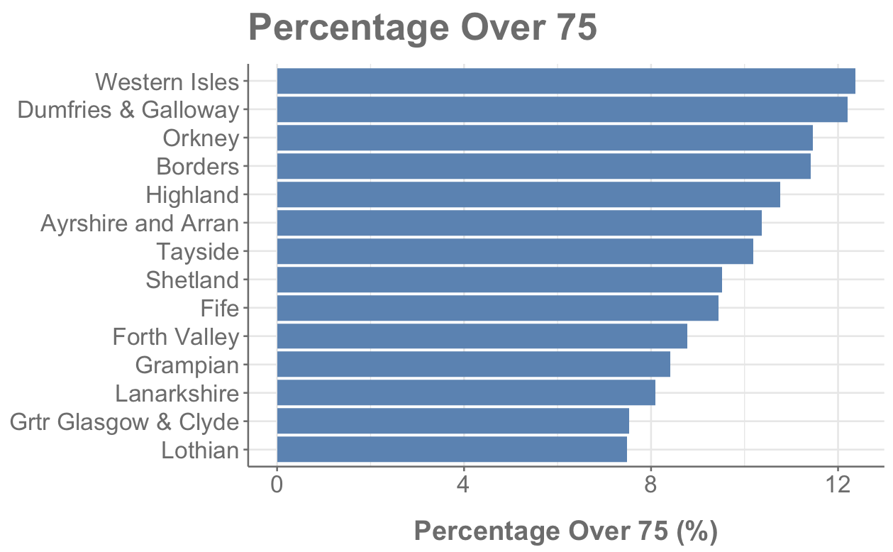
Health Board Information
Glasgow largest at 1,174, 980
Orkney smallest at 22,190
Orkney is < 2% size of Glasgow
More rural areas have higher percentage of over 75s
We are reporting EASR values so these differences are accounted for

Slide 22
Introduction – CVD Data
Discharges
Mortality
Health Board
Council
Health Board
Council
Raw Values
Crude Rates
EASR
Raw Values
Crude Rates
EASR
Raw Values
Crude Rates
EASR
Raw Values
Crude Rates
EASR
Year (2009 to 2021)
Age
Sex
Diagnosis
Admission Type (Discharges only)
EASR – discharges adjusted to European Standard Population to account for age and sex differences in different places
4368 rows of data
Notes:
One patient can have more than one discharge from hospital within a given time period.
Figures on discharges provide an indication of hospital usage for the diagnosis and treatment of cerebrovascular disease in either an inpatient or day case setting but exclude activity relating to outpatients.
Looked at incidences but it is not as relevant as I thought as it screens out anyone who has had any stroke related admission in the last 10 years.
Incidence data was sources from excel files related to the PHS Stroke report but these only sub-categorised cerebrovascular disease and stroke.

Slide 23
Introduction – CVD Data
Includes the “COVID years”!!
Data from PHS Scotland
Discharges
Mortality
Raw data – number of discharges
Crude rates – discharges per 100,000 population
EASR – discharges adjusted to European Standard Population to account for age and sex differences in different places
2009
2018
2021
}
Health Board and Council Area
Year vs financial year made it difficult to directly compare datasets
Discharges
Complicated statistic
less people dying, more being discharged
more people suffering CVD
References: https://www.scotpho.org.uk/population-dynamics/deaths/data/most-frequent-causes/
British Heart Foundation - Global Heart & Circulatory Disease Factsheet Feb 2023
Notes:
One patient can have more than one discharge from hospital within a given time period.
Figures on discharges provide an indication of hospital usage for the diagnosis and treatment of cerebrovascular disease in either an inpatient or day case setting but exclude activity relating to outpatients.
Looked at incidences but it is not as relevant as I thought as it screens out anyone who has had any stroke related admission in the last 10 years.
Incidence data was sources from excel files related to the PHS Stroke report but these only sub-categorised cerebrovascular disease and stroke.

Slide 24
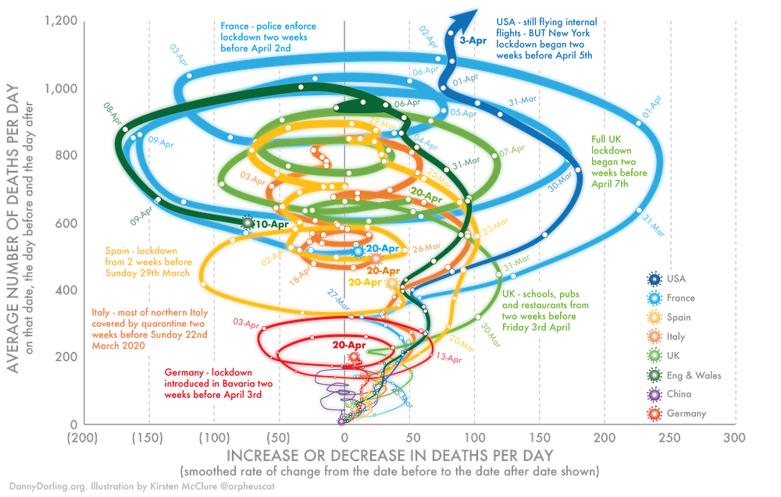
https://www.google.com/url?sa=i&url=https%3A%2F%2Ftheconversation.com%2Fthree-charts-that-show-where-the-coronavirus-death-rate-is-heading-137103&psig=AOvVaw0_3uQRiHl9VkVurSQsCgd8&ust=1676730548894000&source=images&cd=vfe&ved=0CA8QjRxqFwoTCLDm5ZfinP0CFQAAAAAdAAAAABAE

