Slide 1
Cerebrovascular Disease in Scotland Statistics and Modeling
Fiona Carson
February 2023

Slide 2
Outline
Introduction
Cerebrovascular disease (CVD)
Relevant statistics
Data
Types of CVD – discharge and mortality data
Age
Sex
Geographic area
Can we predict future CVD rates?
Could put logos for R packages used on relevant page

Slide 3

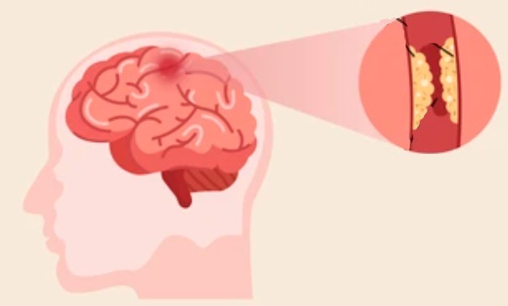

Introduction – Cerebrovascular Disease
Result of problems with the blood vessels supplying the brain
Types of CVD in the PHS data
Stroke - area of brain is deprived of blood supply because of a blockage usually by fatty deposits or a blood clot
Transient ischaemic attach (TIA) - temporary form of stroke (“mini-stroke”), symptoms generally last less than 24 hours
Subarachnoid haemorrhage - a leak of blood caused by the rupture of a blood vessel beneath the membrane covering the brain (type of brain haemorrhage)
Other CVD – incidences which don’t fall into above categories
Blood clot
Fatty deposits
Haemorrahage
Notes:
Cerebrovascular disease (CVD) - condition that develops as a result of problems with the blood vessels supplying the brain.

Slide 4
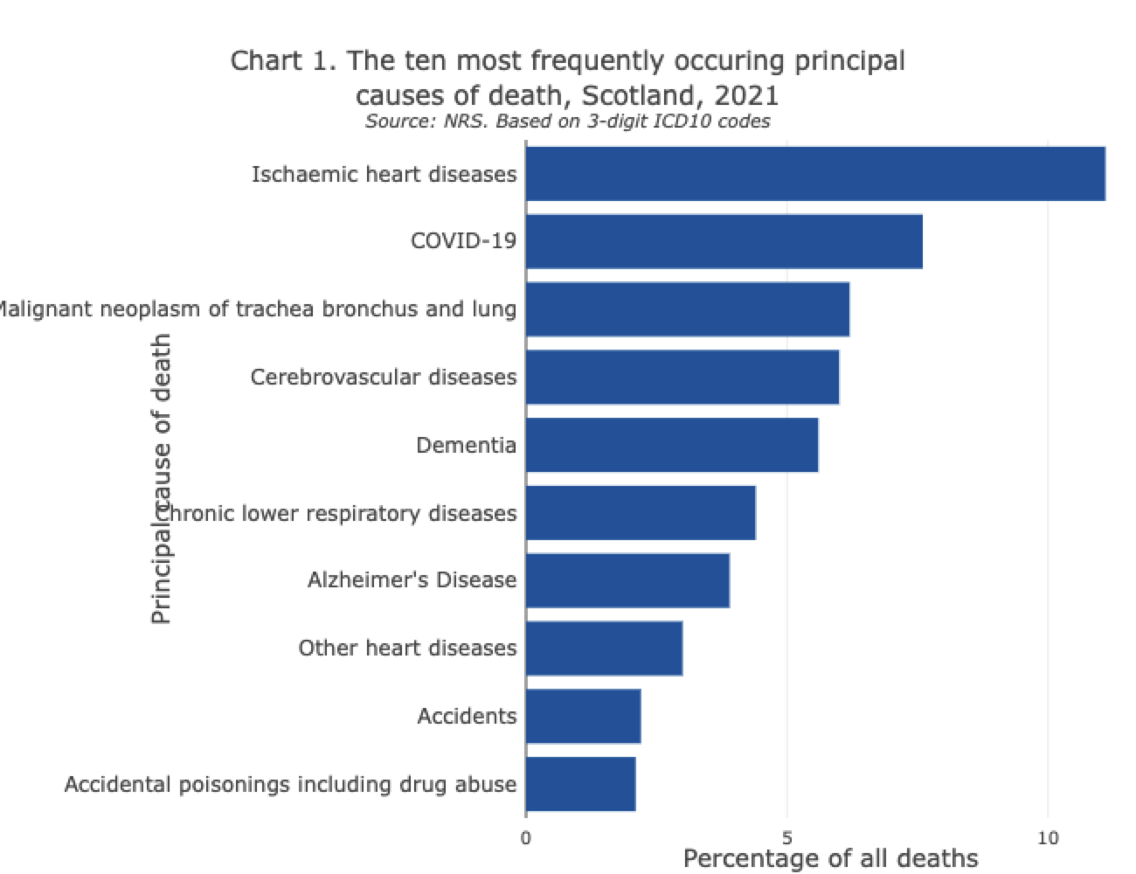
Introduction – CVD in Scotland
130,000 people living in Scotland have survived a stroke or TIA
>50% of stroke survivors are under 75
Prevalence rates for stroke in most deprived areas of Scotland are more than twice those in the least deprived areas
Also have .csv with leading death rates by council area – could show some of most deprived council areas have it as higher cause of death
References: https://www.scotpho.org.uk/population-dynamics/deaths/data/most-frequent-causes/
British Heart Foundation - Global Heart & Circulatory Disease Factsheet Feb 2023
Notes:
130,000 is 2.4% of population

Slide 5
Introduction – CVD Data
Includes the “COVID years”!!
2009
2018
2021
Data from PHS Scotland
Discharges
Mortality
Raw data – number of discharges
Crude rates – discharges per 100,000 population
EASR – discharges adjusted to European Standard Population to account for age and sex differences in different places
}
Health Board and Council Area
Discharges
Complicated statistic
less people dying, more being discharged
more people suffering CVD
Notes:
One patient can have more than one discharge from hospital within a given time period.
Figures on discharges provide an indication of hospital usage for the diagnosis and treatment of cerebrovascular disease in either an inpatient or day case setting but exclude activity relating to outpatients.
Looked at incidences but it is not as relevant as I thought as it screens out anyone who has had any stroke related admission in the last 10 years.
Incidence data was sources from excel files related to the PHS Stroke report but these only sub-categorised cerebrovascular disease and stroke.

Slide 6
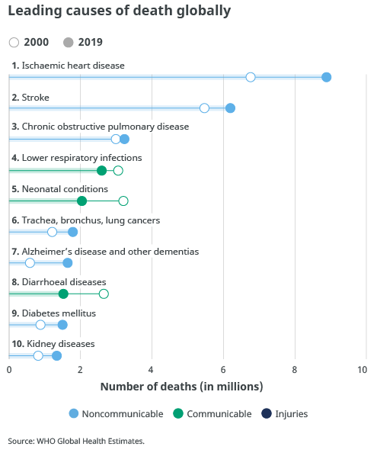
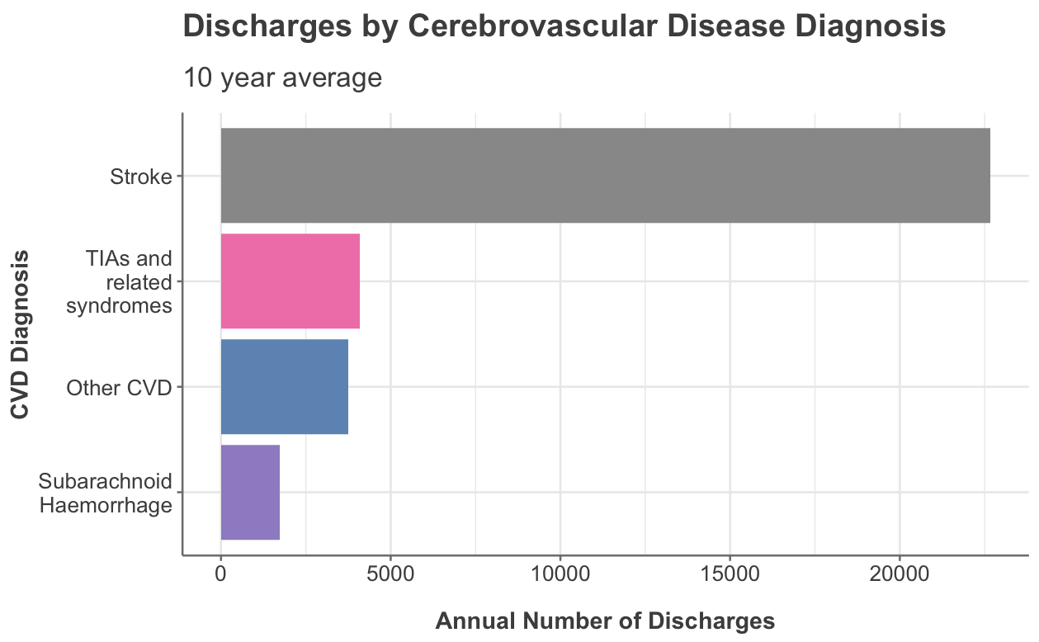
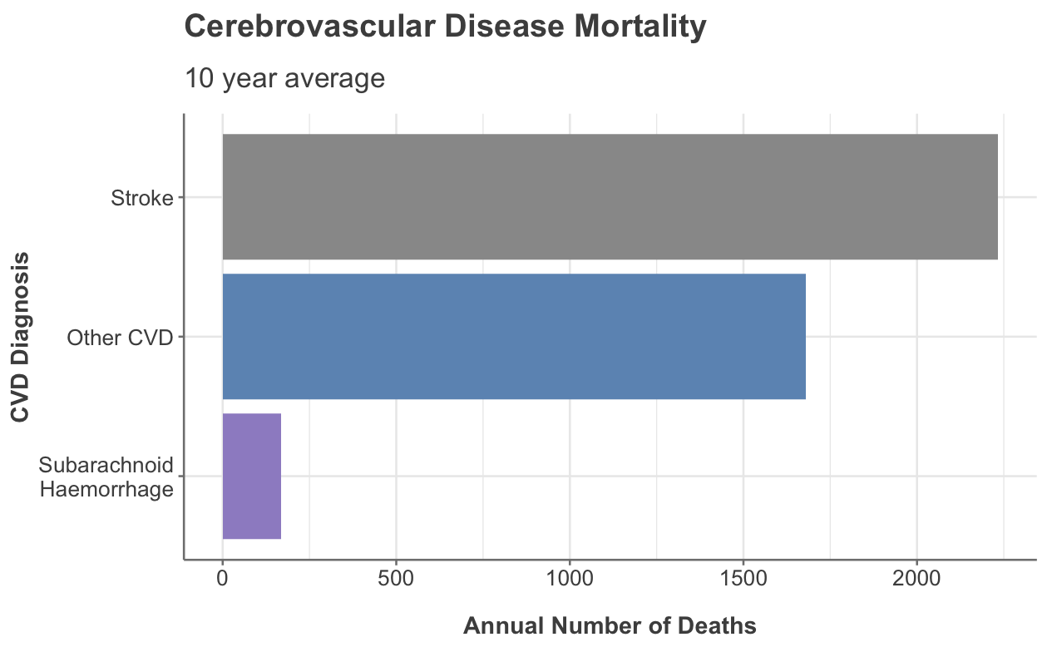
Most Common Type of CVD
Interesting way to display data
3826 deaths in Scotland in 2021 where CVD was underlying cause
TIAs are included in ‘Other CVD’ for mortality data
The raw values have been used (no population or age standardisation)
Notes:
Other CVD includes “sequelae of CVD” – perhaps this accounts for the high number of deaths

Slide 7
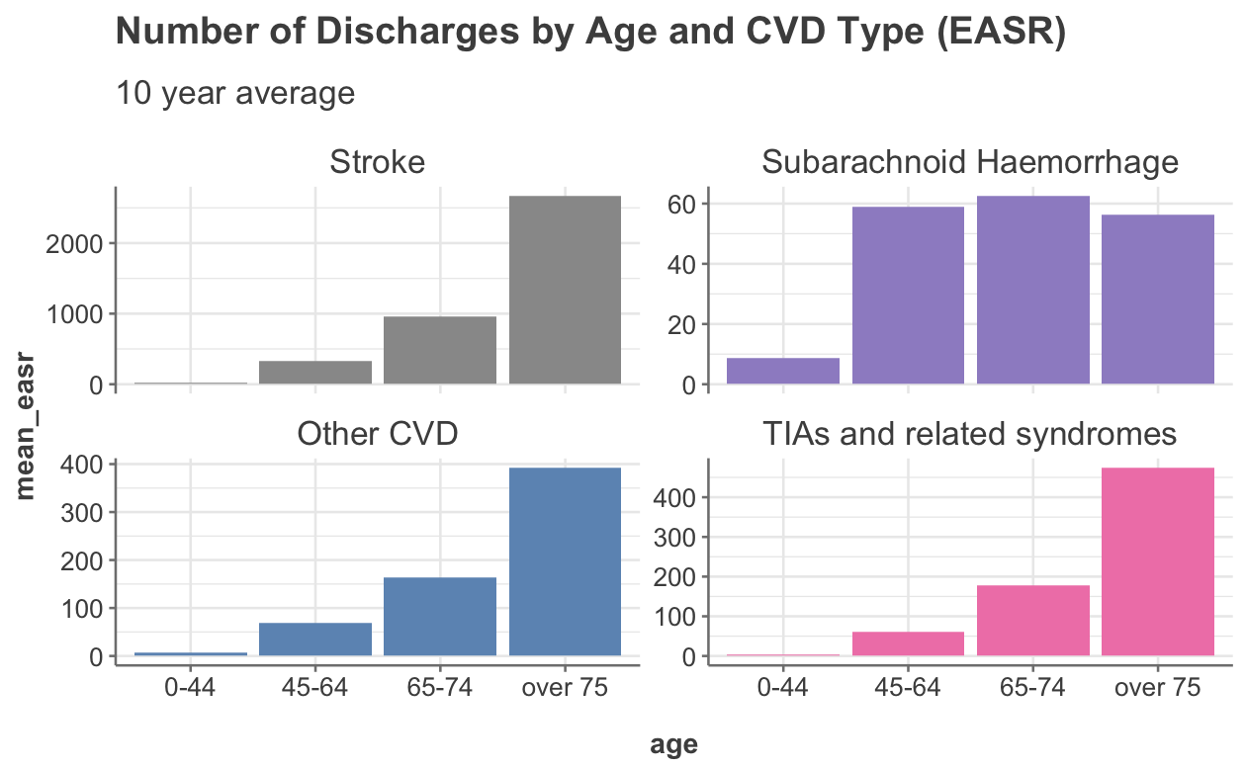
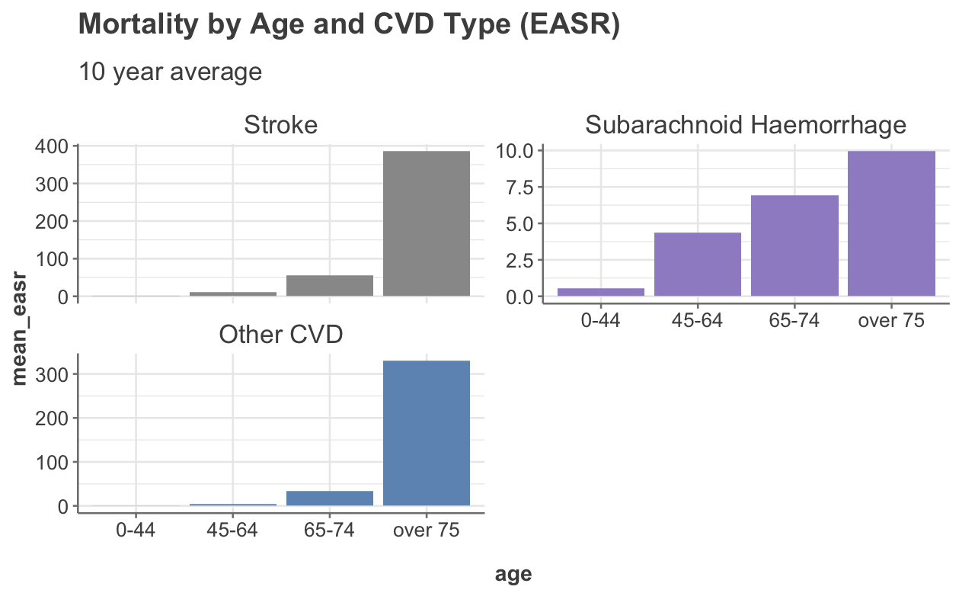
Type of CVD by Age
Number of discharges is a complicated statistic - want it to be going up as it means people aren’t dying but more discharges also means more incidents in the first place.
Looked at incidence data – shows same pattern
Now we are looking at EASR data

Slide 8
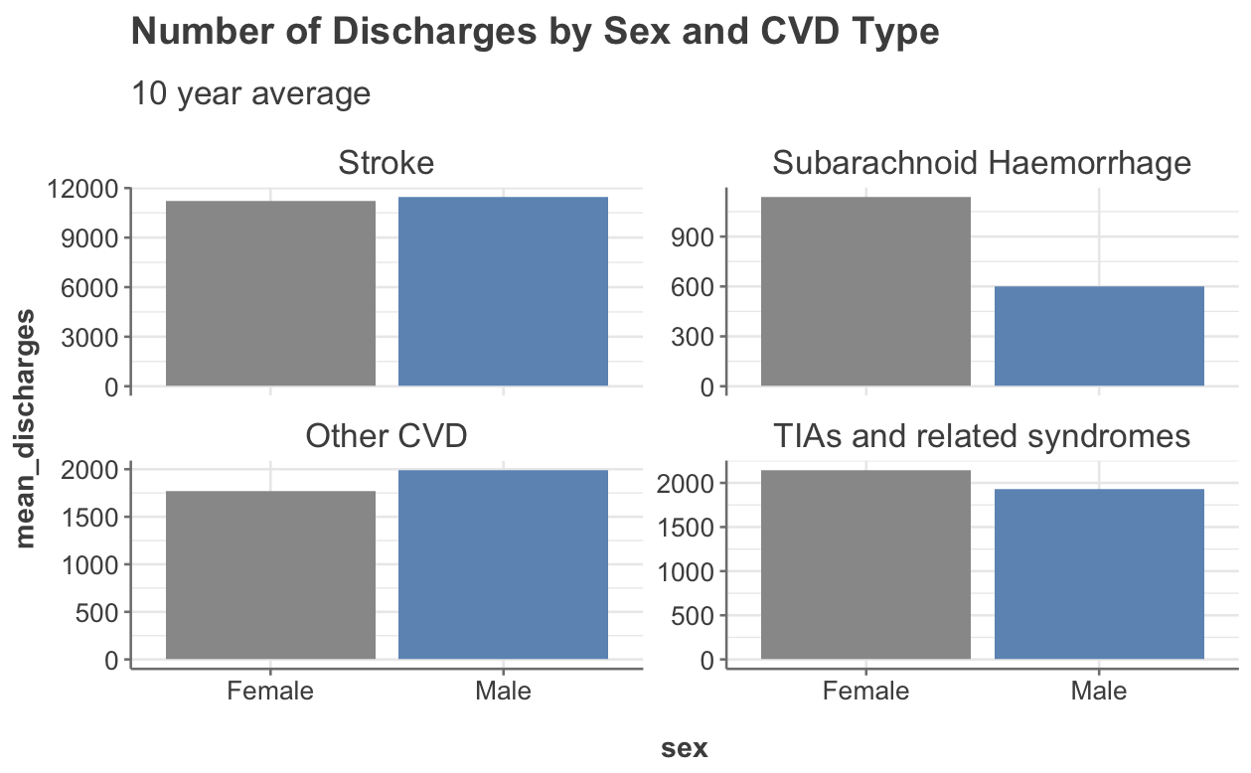
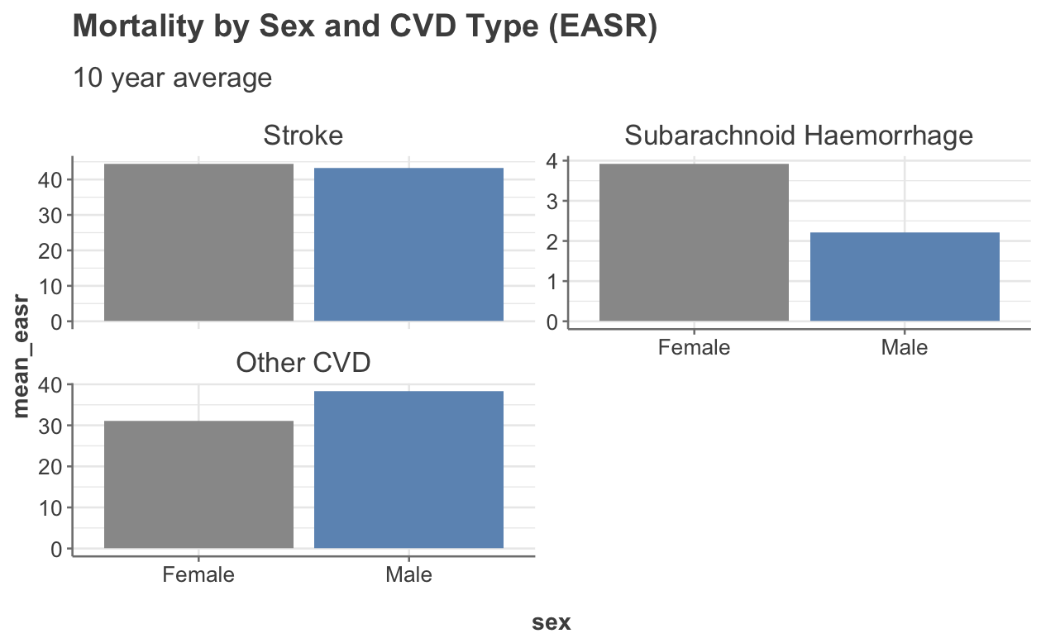
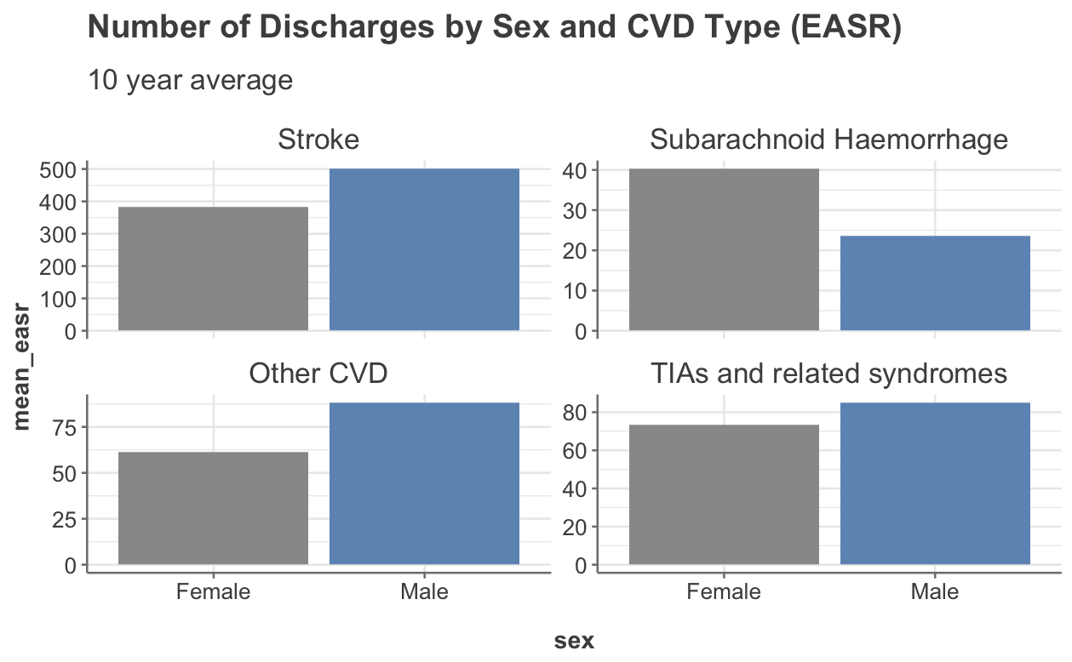
Type of CVD by Sex
https://www.ahajournals.org/doi/10.1161/01.STR.0000105933.16654.B4
SAH - only type of stroke with female predominance - suggesting reproductive factors may pay a role in ethology.
-primarily affects those < 60 yrs old
- carries high morbidity and mortality rate
https://www.frontiersin.org/articles/10.3389/fneur.2012.00078/full
result of both hormonal influences and variation in wall shear stress.

Slide 9
The above slide on sex is the one to run statistics on if there is time.

Slide 10
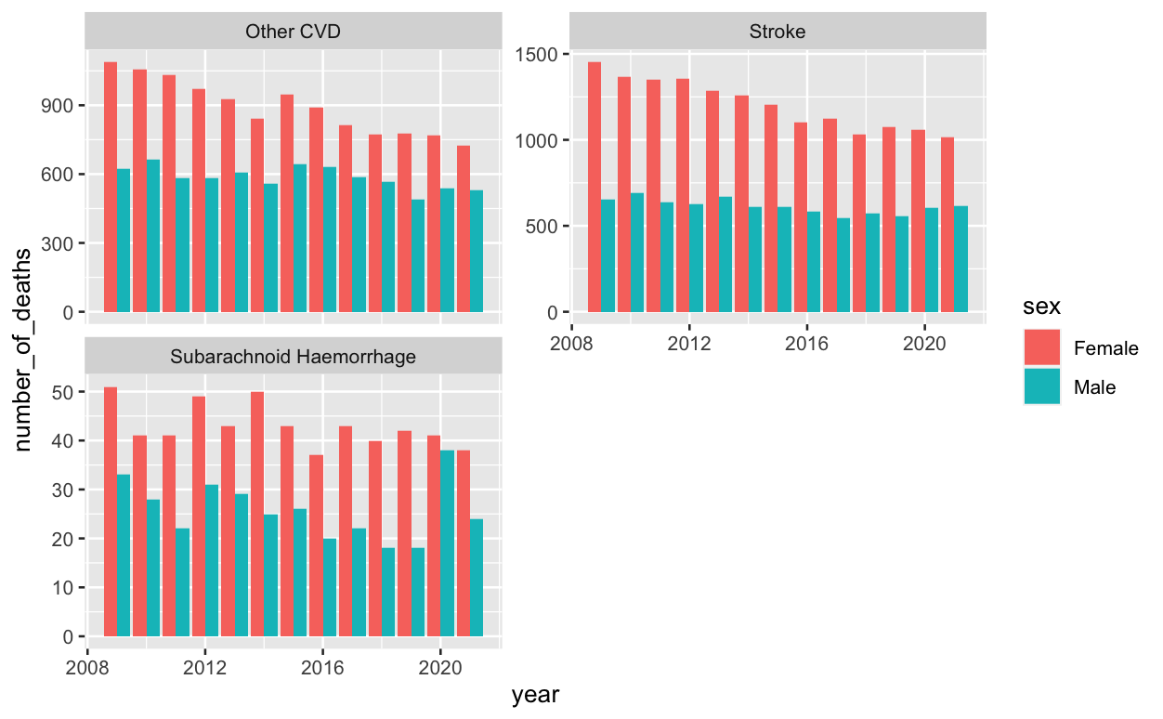
Mortality by sex
Shows pronounced spike in number of deaths for men in 2020. Not sure if this is interesting enough to spend time on.

Slide 11
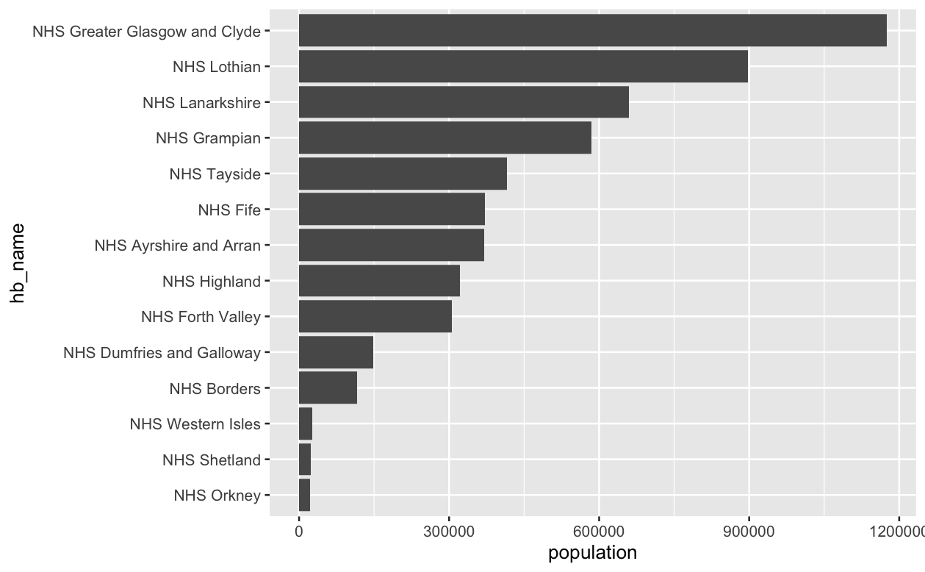
Health Board Information
Health board size
Health board population age distribution
Shetland smallest at 22190
Glasgow largest 1174980
Shetland is <2% size of glasgow

Slide 12
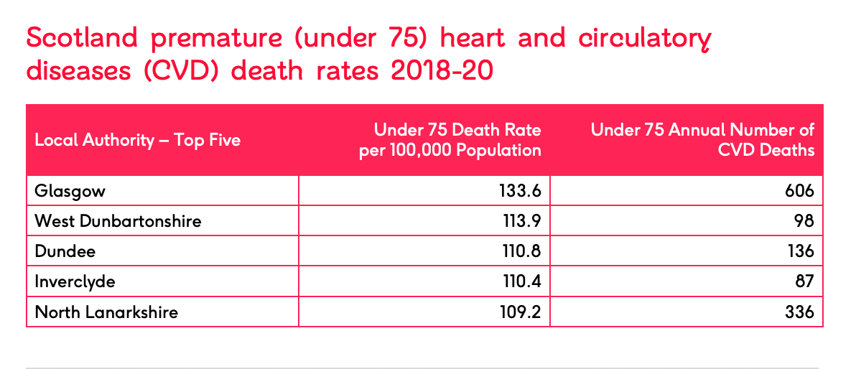
Health Board Age Structure
Could put in something about age structure but we are mostly reporting easr so is it really relevant??
Possible to create something similar

Slide 13
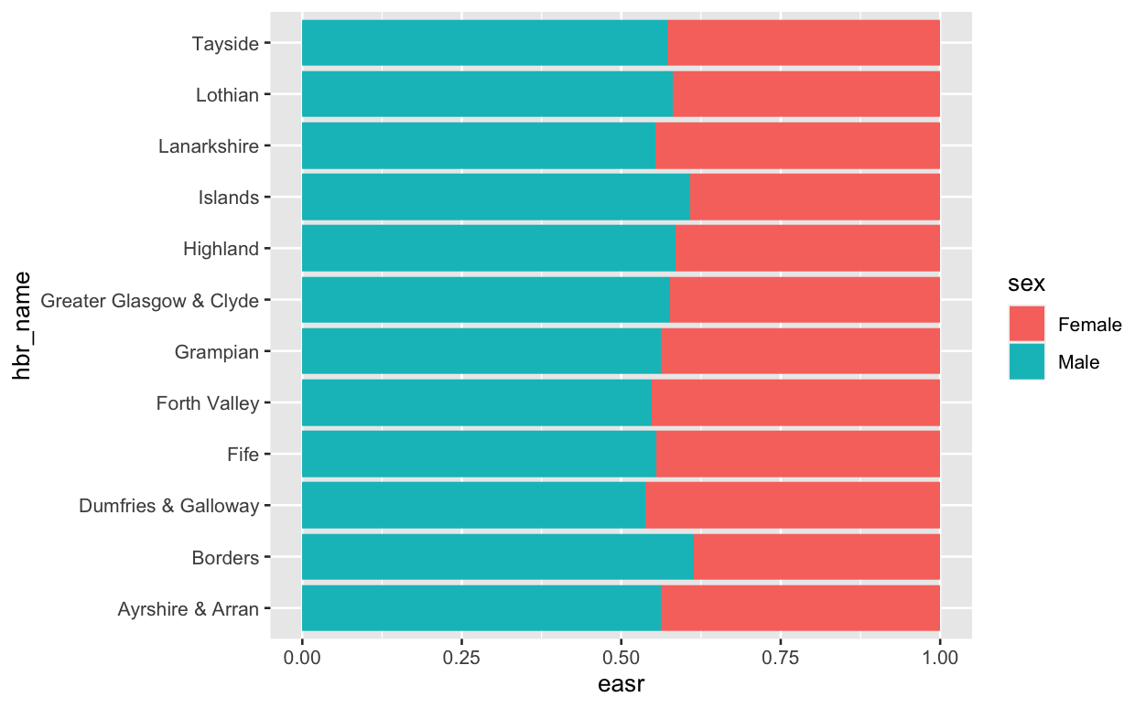
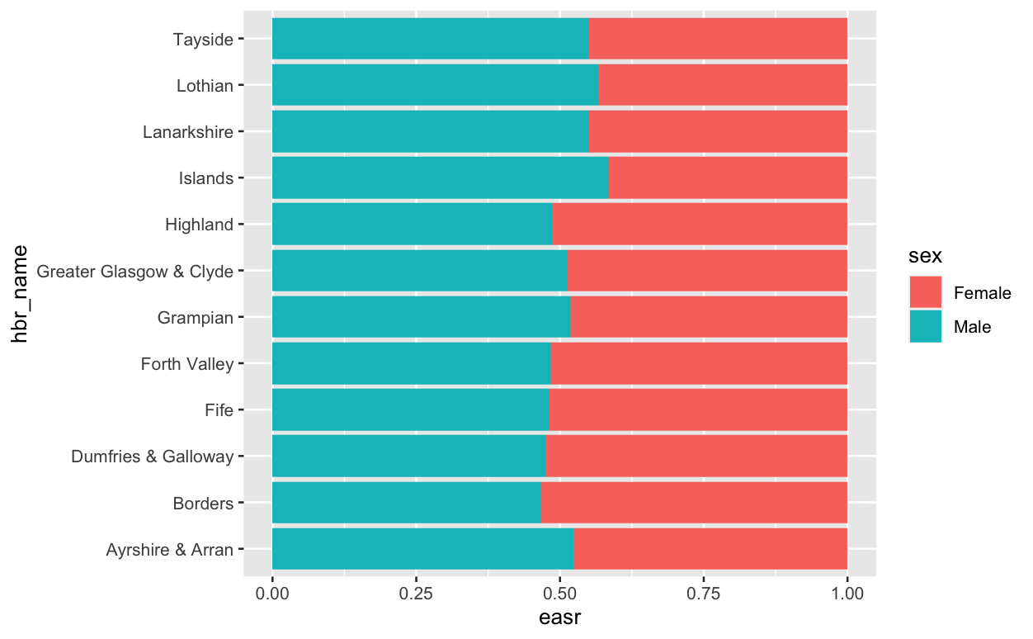
Looked at dischrages and deaths by sex and health board but nothing interesting popped up
Could do statistics on this – is the increase in borders significant??

Slide 14
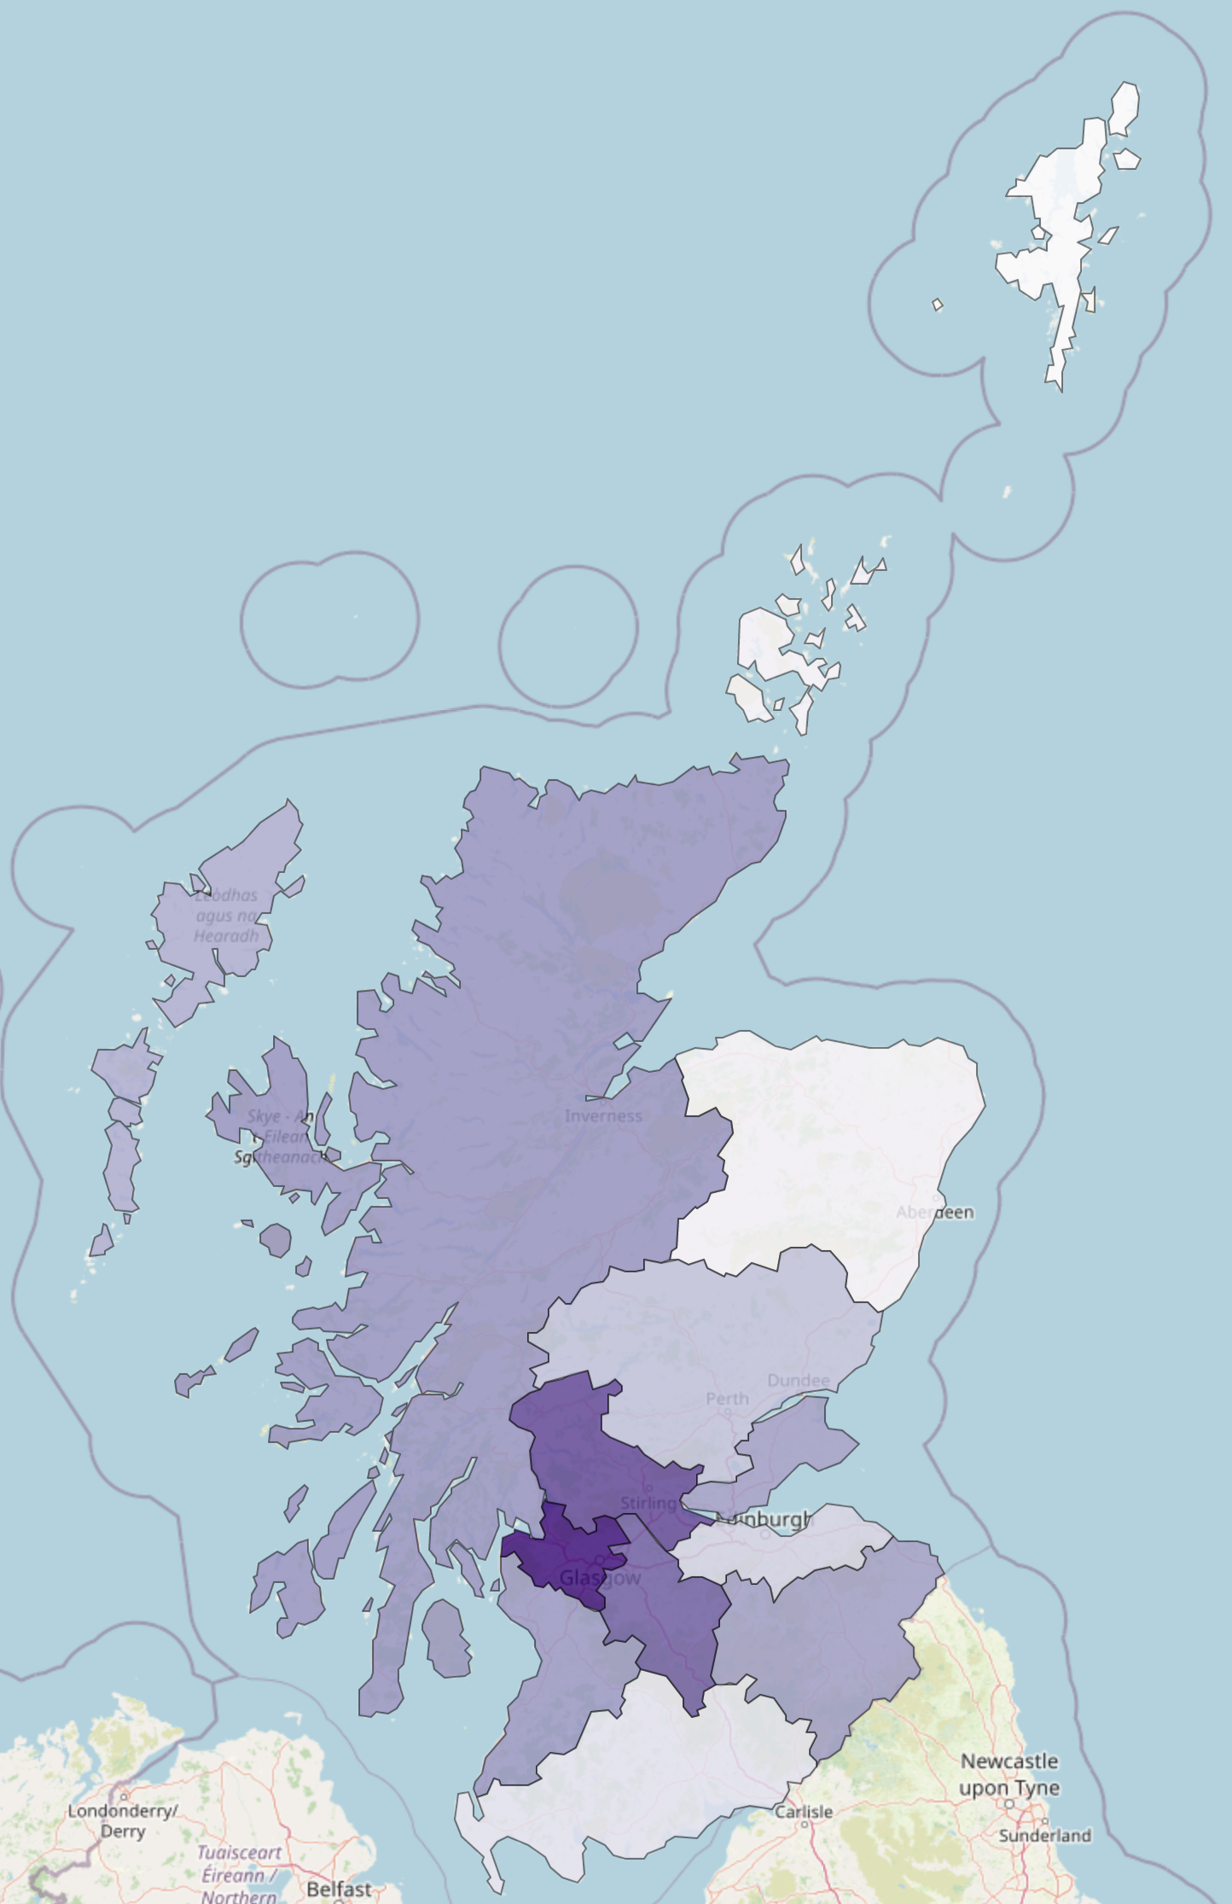
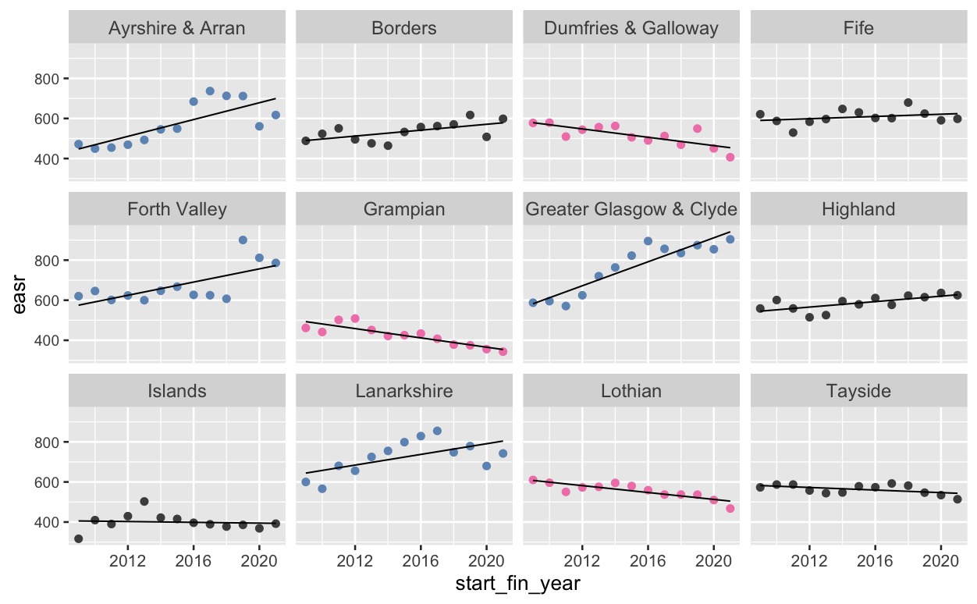

Discharges or Deaths by Health Board
Possible to create something similar
I think there is a rough relationship here where the darker colours are the ones going up and lighter are going down

Slide 15
Anything we can do to look at national average and compare which health boards and regions are higher or lower?

Slide 16
Council Areas
Also have .csv with leading death rates by council area

Slide 17
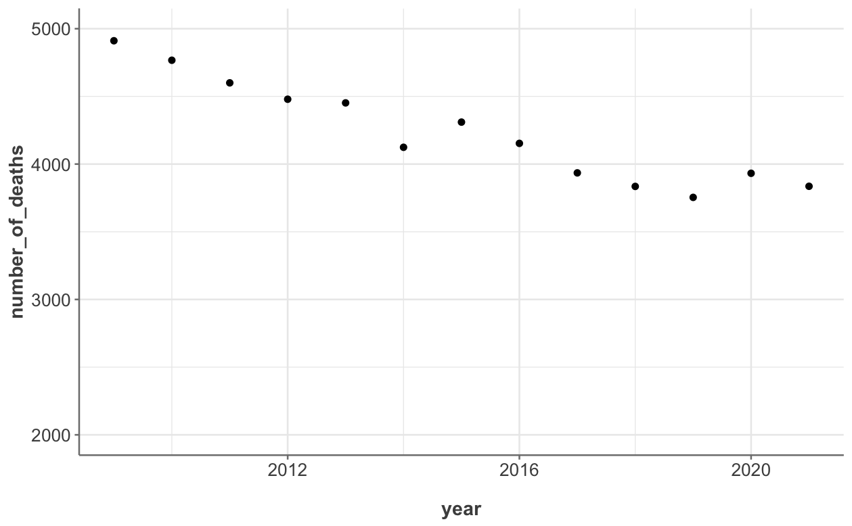
Overall Headline - Mortality Rates
Mortality rates are coming down

Slide 18
The Journey to a ‘Beautiful’ Model
Multiple linear regression - R2 = 31%
Model built using just the health board and year is promising. This was built on totals of the discharges for each health board though and some boards show no significance so does this mean we can estimate them?
Random forest - R2 = 97% but useless prediction
ARIMA
Neural networks

Slide 19
What do we want to model – if we use raw values we need to account for future changes in age structures of the population . This would have been interesting but maybe not necessary given we have easr numbers.
But I think using EASR numbers means you can’t predict levels by health board because everything is standardized – or maybe easr revels true differences??
Options for modelling –
Numbers at council level were too low to form pattern
Predicting future values is going to be influenced by change in age structure but not if we use easr values – then they can be converted back (I think – check this_
Lets try 2 models – acitivty-hb-easr and mortality-hb-easr
Raw Values | Crude Rates | EASR
Number of Discharges
Number of Deaths
Health Board
Council
Health Board
Council

Slide 20
Built 2 models
discharges – health board – easr
deaths – health board – easr
Test-train split – didn’t do because of the nature of the data – only have one row per year per “category”. Tried holding back later years but predictions were bad because of covid effects.
What if we train model on years before covid – up to 2019?
Logged discharge and deaths
Added interactions – took R2 from 0.63 to 0.79

Slide 21
Add AIC graph

Slide 22
R2
https://quantifyinghealth.com/r-squared-study/
analyzed the content of 43,110 randomly chosen research papers from PubMed to learn more about R-squared.
The average value of R-squared in medical research is 0.499, which means that the average linear regression model explains 49.9% of the outcome variance.
In typical applications in biology, psychology, marketing, and other domains, we would expect only a very small proportion of the variance in the response to be explained by the predictor, and an R2 value well below 0.1 might be more realistic!
An Introduction to Statistical Learning by Gareth James et al.
https://statisticsbyjim.com/regression/how-high-r-squared/
Any study that attempts to predict human behavior will tend to have R-squared values less than 50%.
However, if you analyze a physical process and have very good measurements, you might expect R-squared values over 90%.
Use prediction intervals to access precision
https://statisticsbyjim.com/regression/how-high-r-squared/

Slide 23
Future Work
Look at stroke risk factors and build model
Relate rates to deprivation levels in certain areas

Slide 24
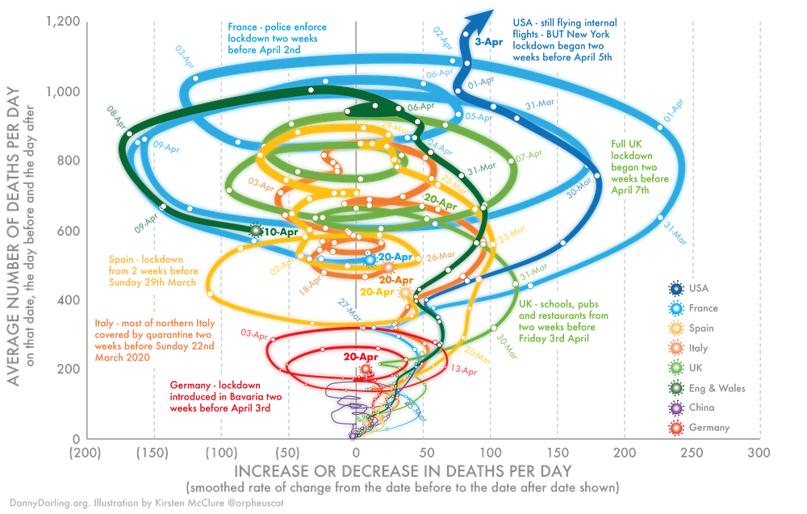
https://www.google.com/url?sa=i&url=https%3A%2F%2Ftheconversation.com%2Fthree-charts-that-show-where-the-coronavirus-death-rate-is-heading-137103&psig=AOvVaw0_3uQRiHl9VkVurSQsCgd8&ust=1676730548894000&source=images&cd=vfe&ved=0CA8QjRxqFwoTCLDm5ZfinP0CFQAAAAAdAAAAABAE

