Slide 1
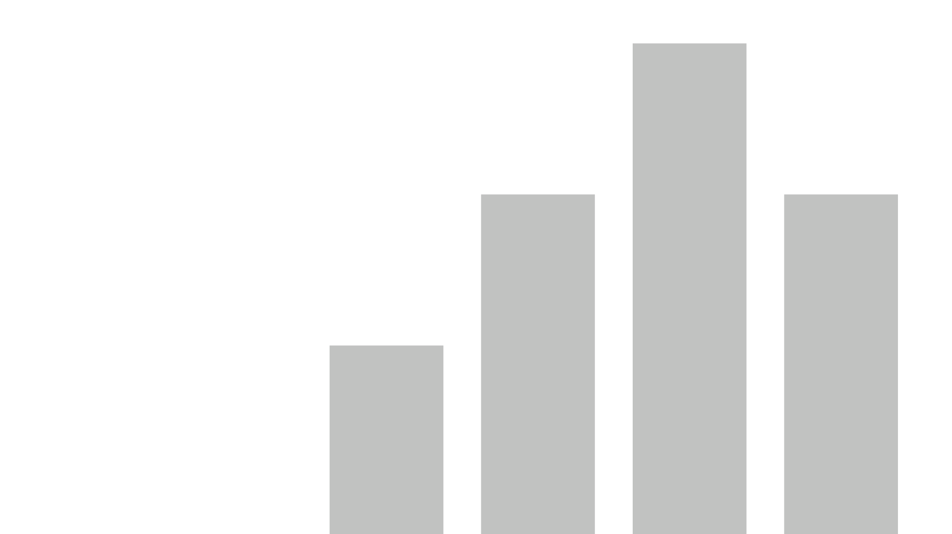


aemr.2
View in Power BI
Last data refresh:
7/5/2021 8:23:24 PM UTC
Downloaded at:
7/5/2021 8:38:40 PM UTC

Slide 2
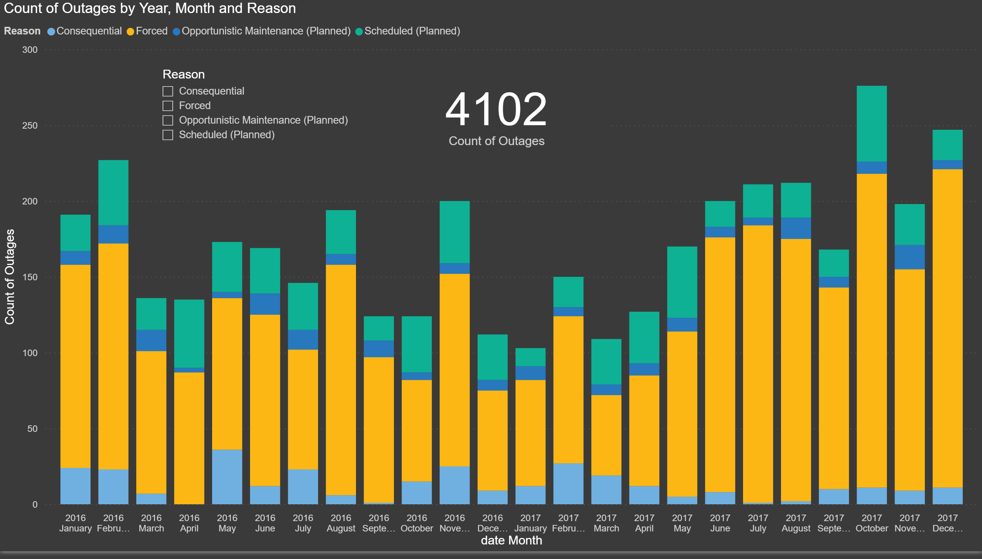
Count by Reason and Month
Notes:
actionButton
No alt text provided.
columnChart
No alt text provided.
slicer
No alt text provided.
card
No alt text provided.

Slide 3
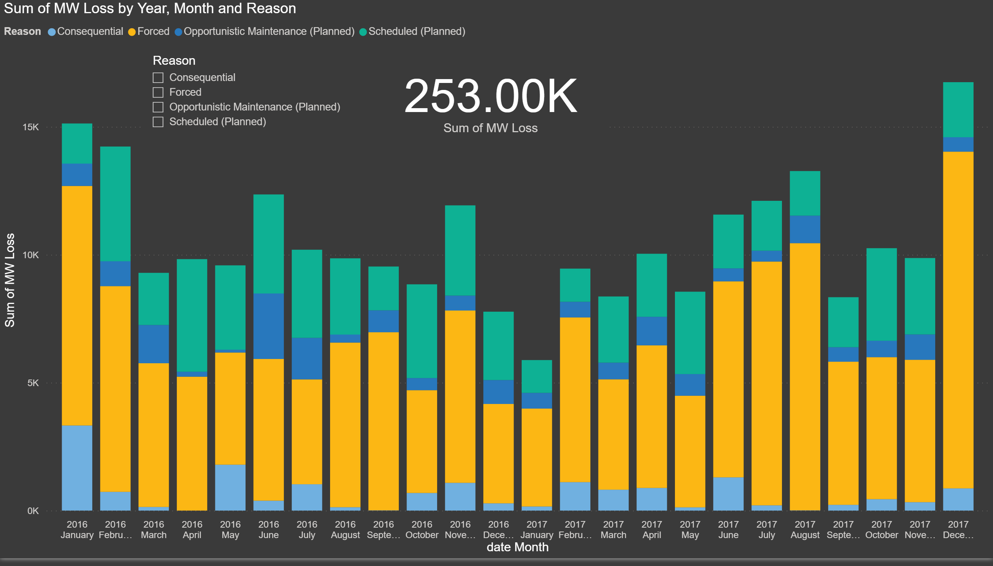
MW Loss by Reason and Month
Notes:
actionButton
No alt text provided.
columnChart
No alt text provided.
slicer
No alt text provided.
card
No alt text provided.

Slide 4
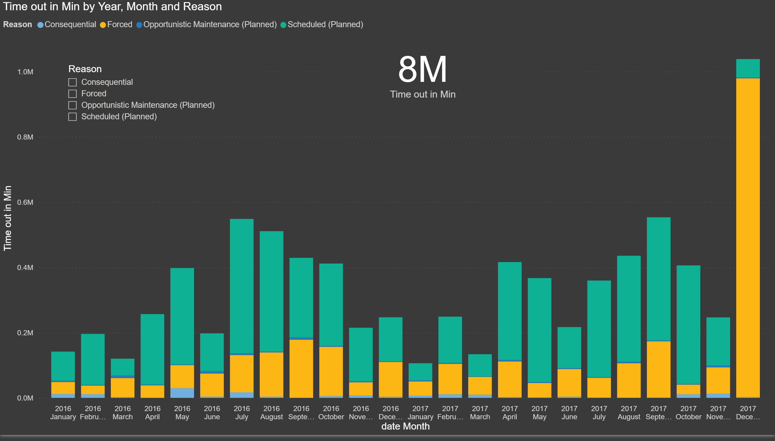
Time Down by Reason and Month
Notes:
actionButton
No alt text provided.
columnChart
No alt text provided.
card
No alt text provided.
slicer
No alt text provided.

Slide 5
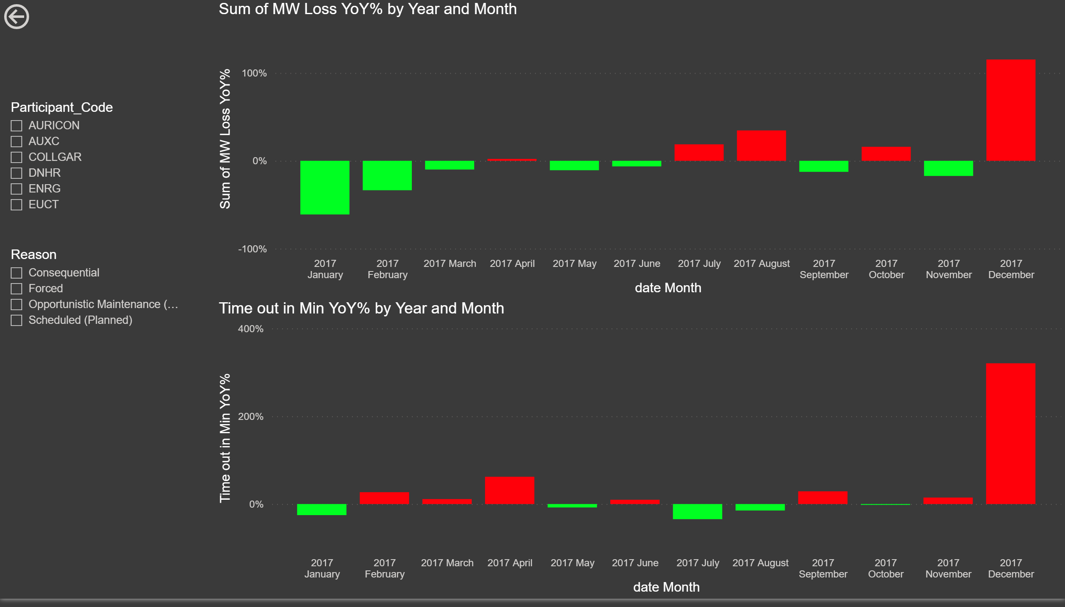
YoY Change
Notes:
actionButton
No alt text provided.
slicer
No alt text provided.
slicer
No alt text provided.
columnChart
No alt text provided.
columnChart
No alt text provided.

Slide 6
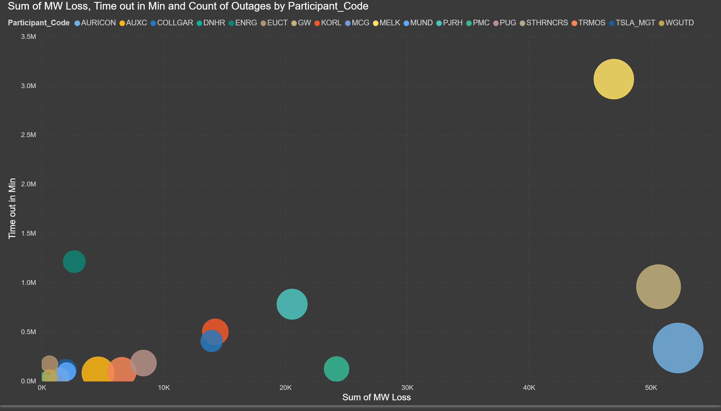
Total Bubbles
Notes:
scatterChart
No alt text provided.

Slide 7
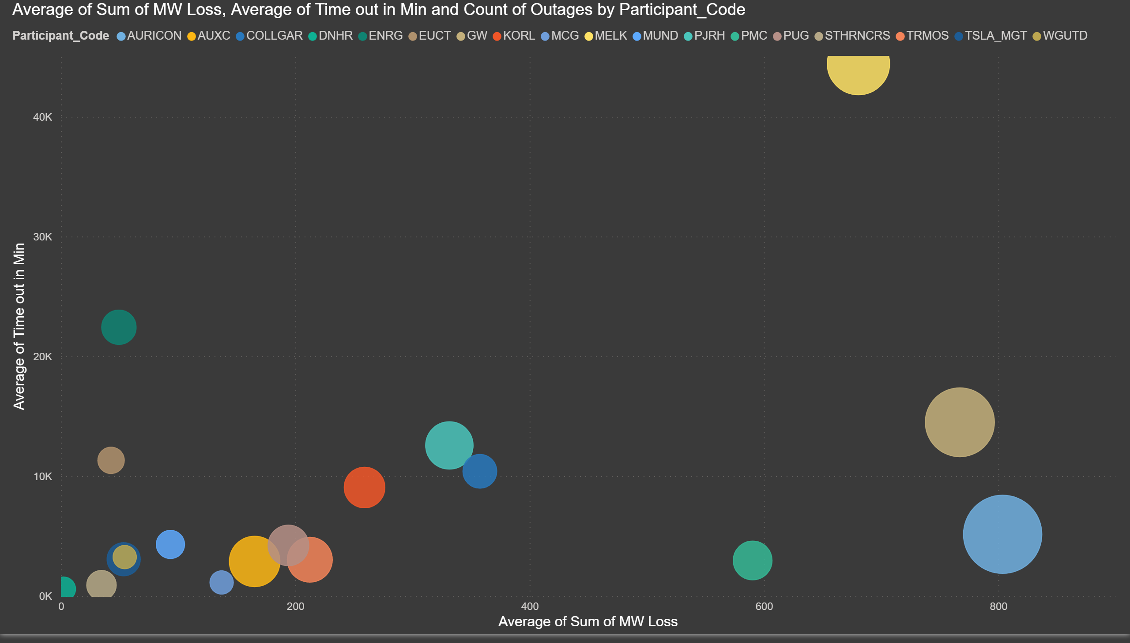
Average Bubbles
Notes:
scatterChart
No alt text provided.

Slide 8
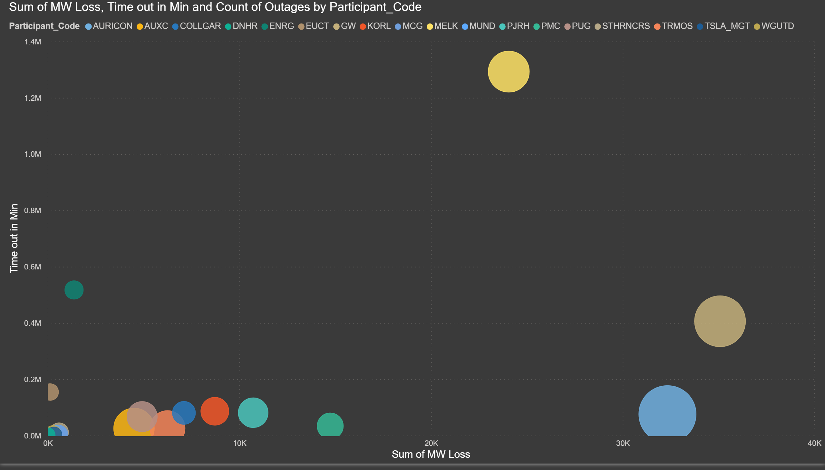
Total Forced Bubbles
Notes:
scatterChart
No alt text provided.

Slide 9
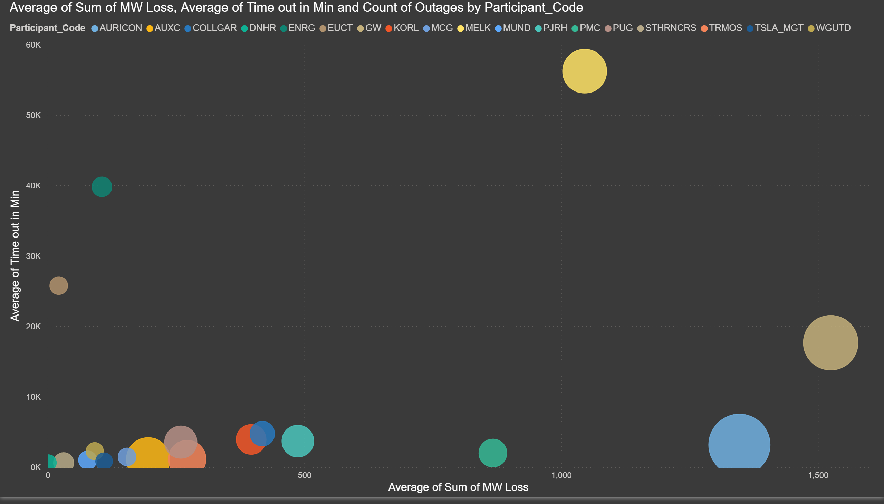
Average Forced Bubbles
Notes:
scatterChart
No alt text provided.

Slide 10
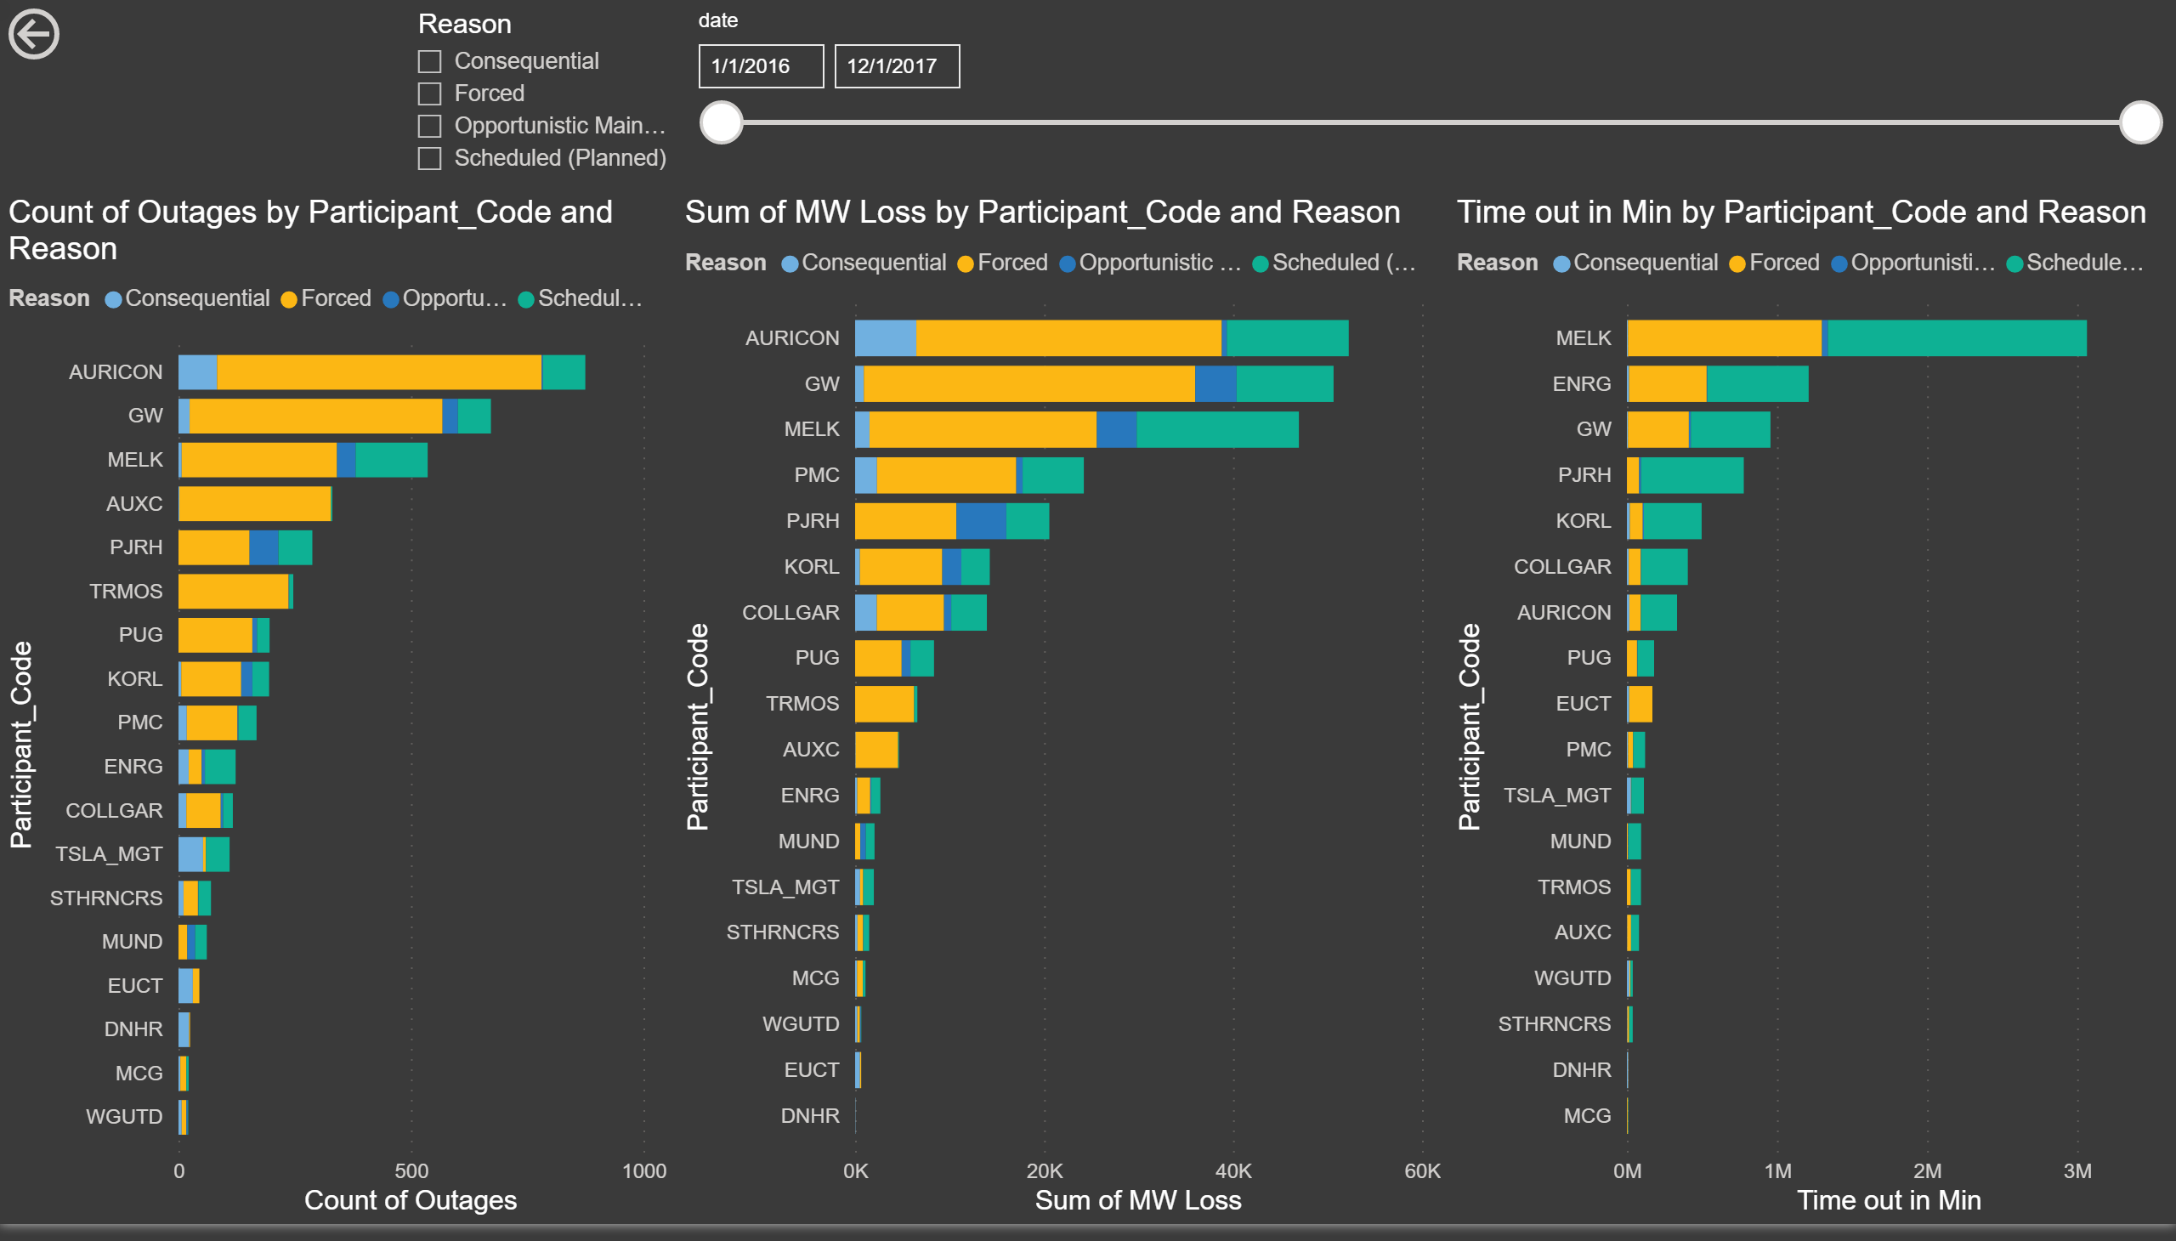
Month Totals Page
Notes:
barChart
No alt text provided.
actionButton
No alt text provided.
barChart
No alt text provided.
barChart
No alt text provided.
slicer
No alt text provided.
slicer
No alt text provided.

Slide 11
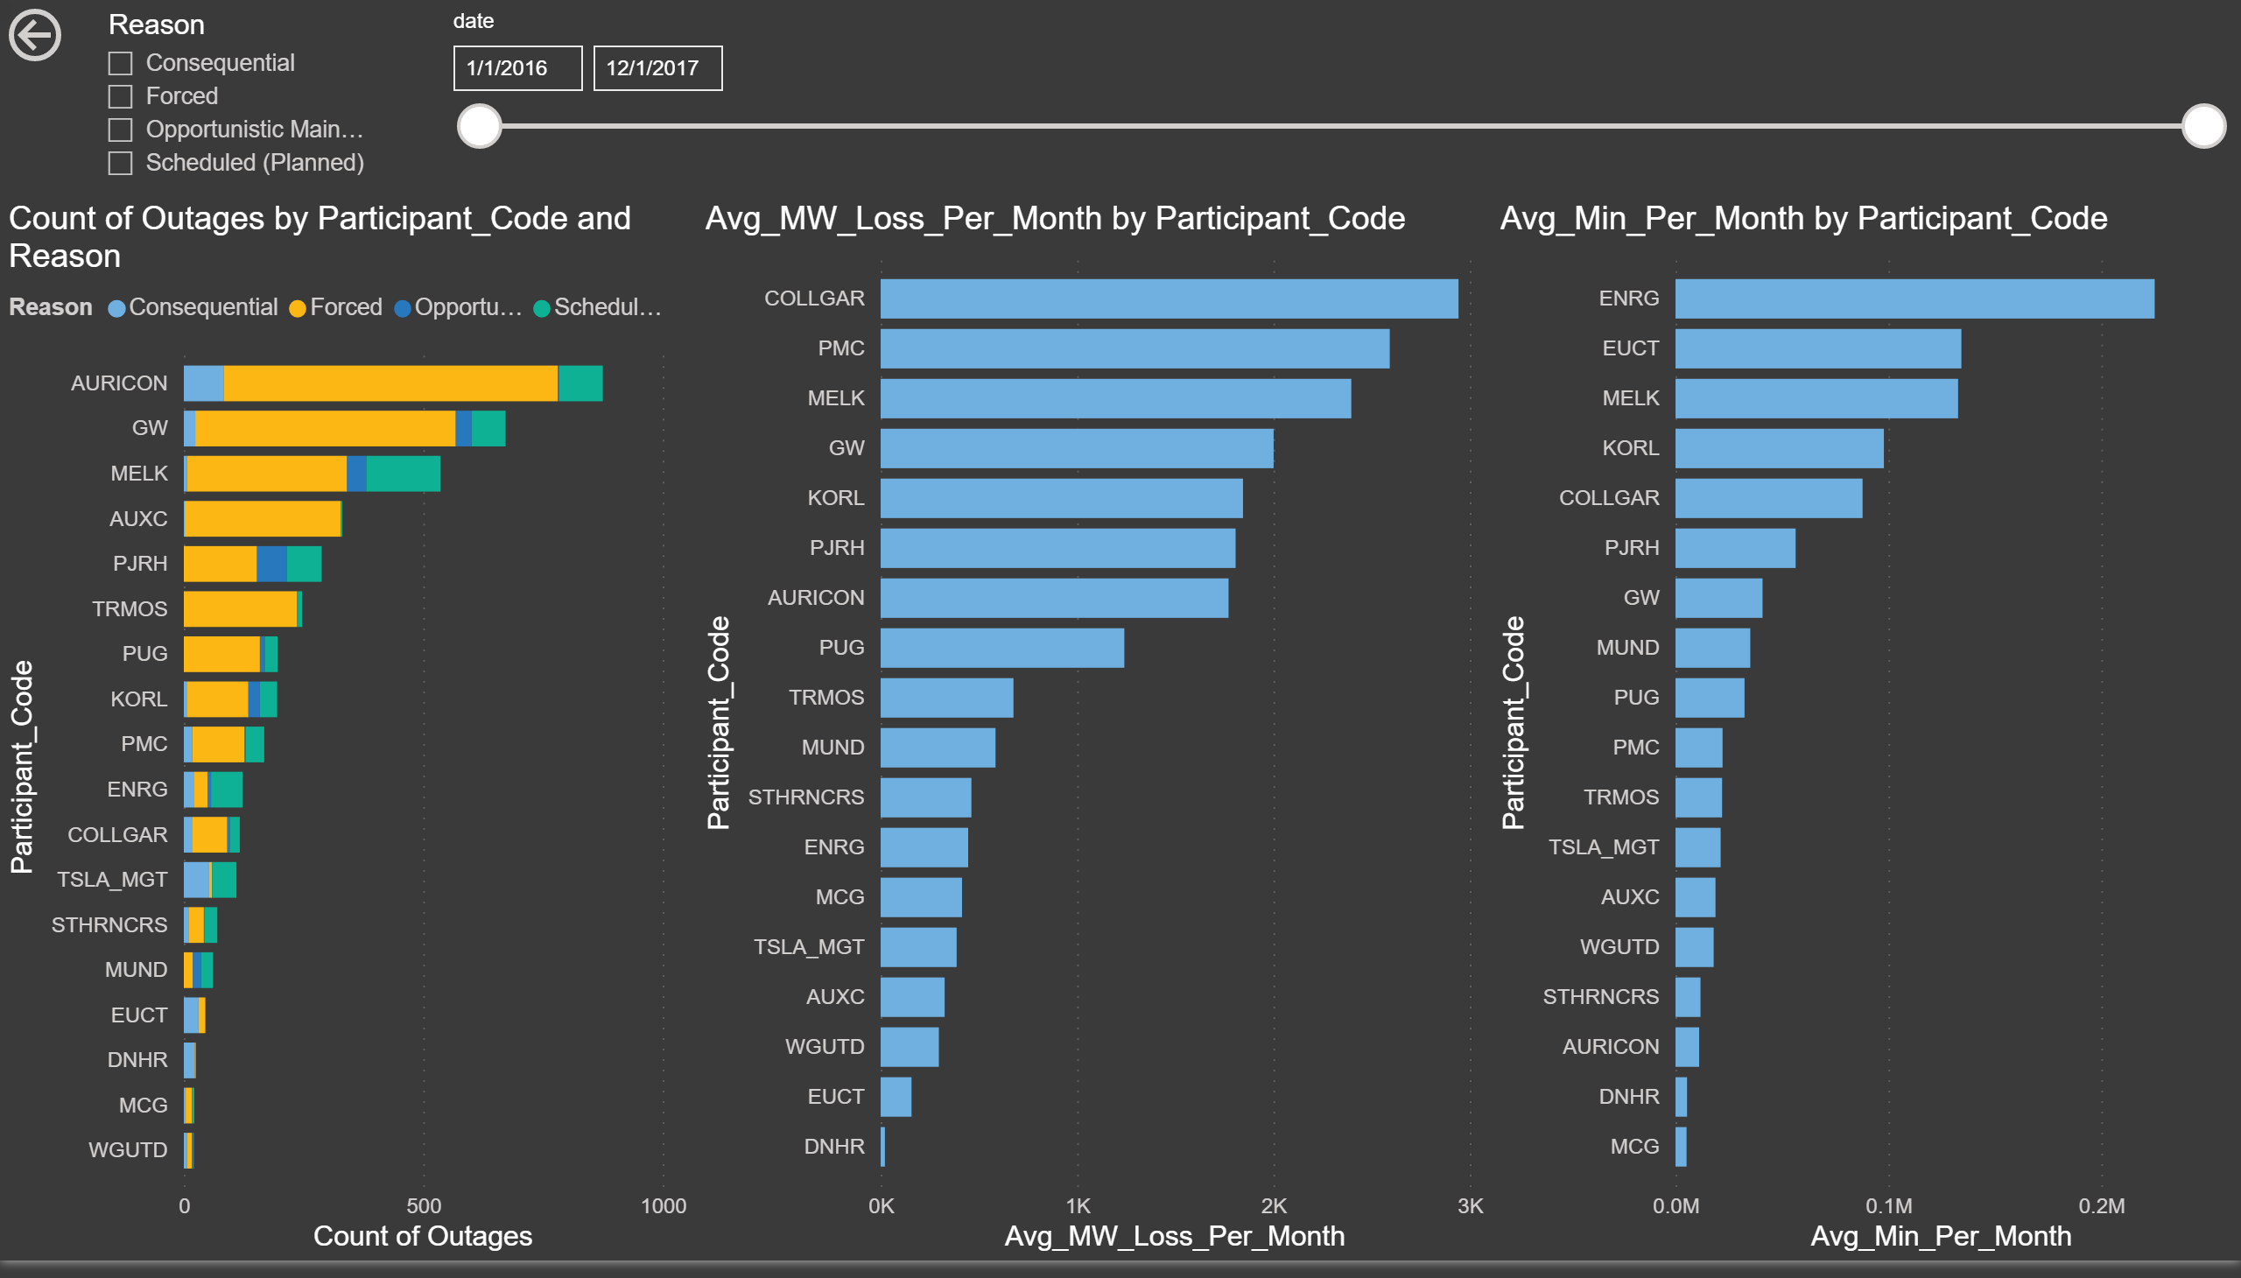
Month Avg Page
Notes:
barChart
No alt text provided.
actionButton
No alt text provided.
barChart
No alt text provided.
barChart
No alt text provided.
slicer
No alt text provided.
slicer
No alt text provided.

Slide 12
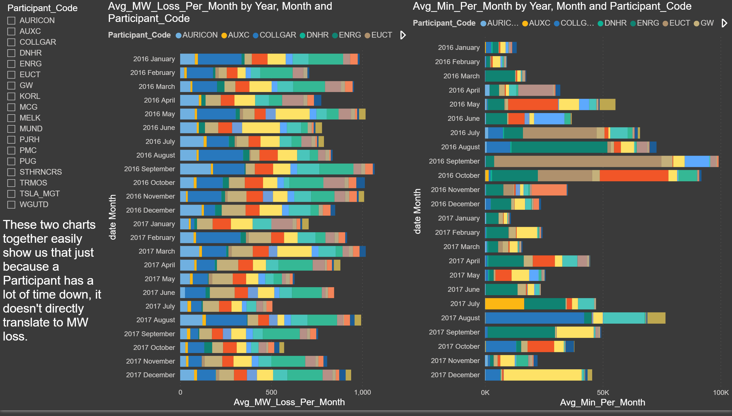
Avg Per Month
Notes:
barChart
No alt text provided.
textbox
No alt text provided.
slicer
No alt text provided.
barChart
No alt text provided.

Slide 13
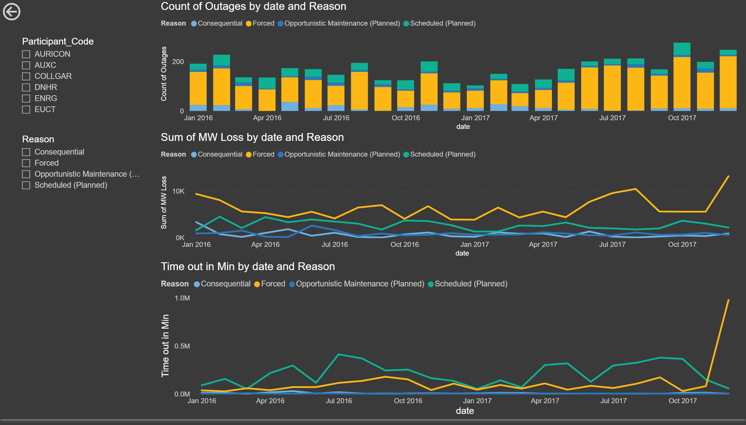
Participant Page
Notes:
actionButton
No alt text provided.
slicer
No alt text provided.
slicer
No alt text provided.
lineChart
No alt text provided.
lineChart
No alt text provided.
columnChart
No alt text provided.

Slide 14
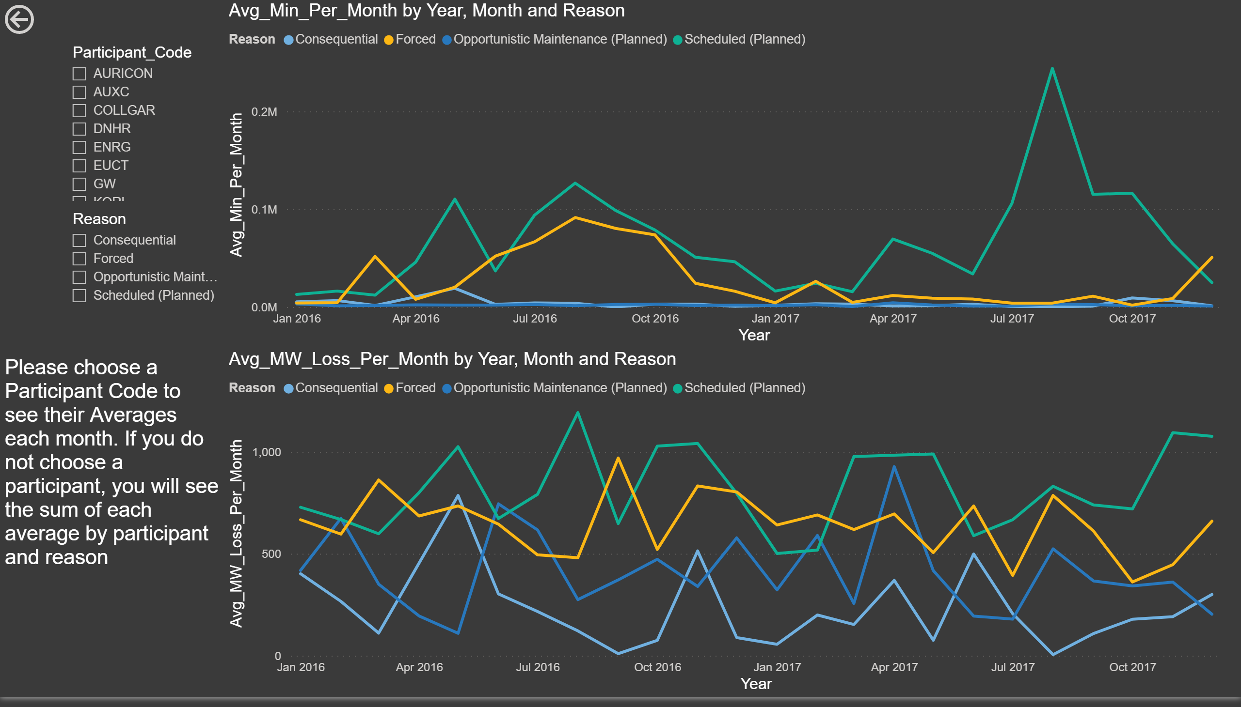
Average per Month by Participant and Reason
Notes:
actionButton
No alt text provided.
textbox
No alt text provided.
slicer
No alt text provided.
slicer
No alt text provided.
lineChart
No alt text provided.
lineChart
No alt text provided.

