Slide 1
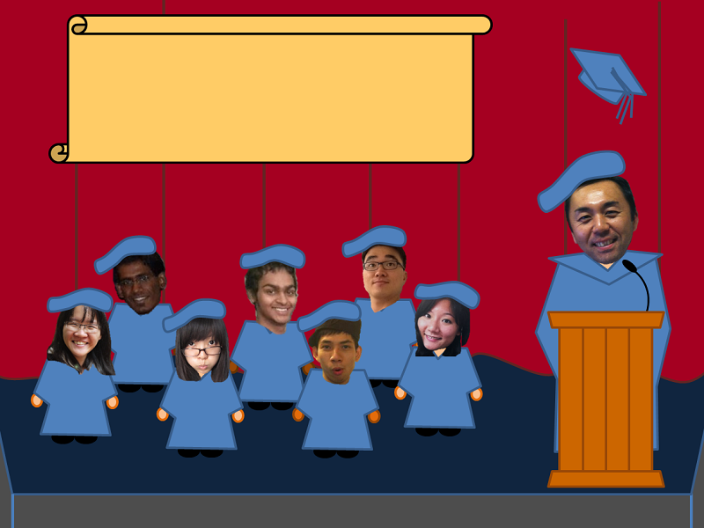
CMU Adventure
Survivors

Slide 2
CMU Adventure
This is a game to give you an experience in CMU
Navigate through a bird’s-eye view
Try mini-games:
Gear up
CAD quiz
Soji is coming to class
The Scotland yard
Chase the shuttle to go home.
Ending the game with your graduation.

Slide 3
Story introduction
Goal: To finish at least 3 mini-games and go home
Game start
State: Main game
Move to highlighted buildings
Enter game
State: Selected mini-games
Yes/no
Game ends
3 or more mini-games completed?
Update score class
Yes
State: Select shuttle game
Fail
Pass
Game End
State: Go home and graduate

Slide 4
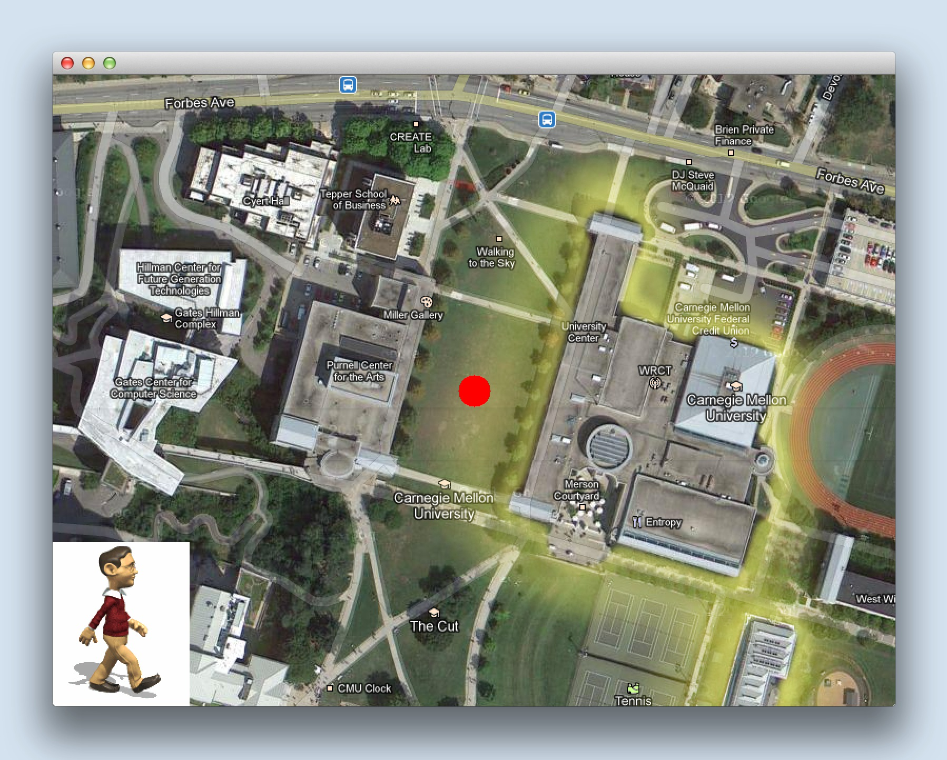
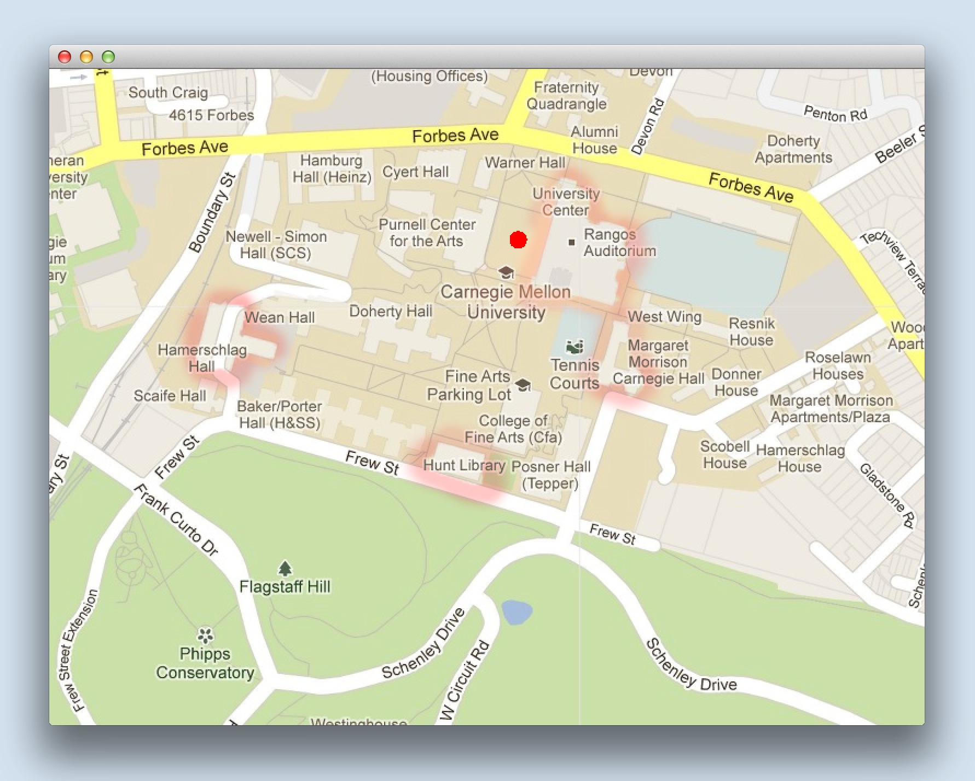
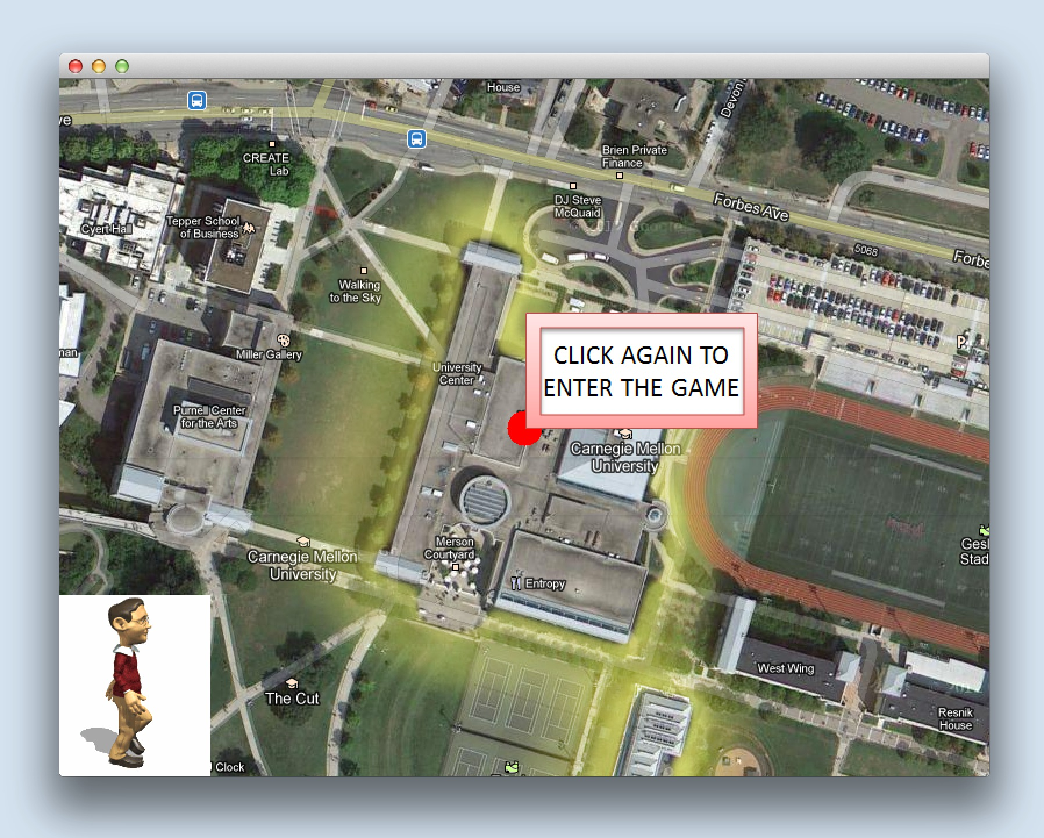
Navigation & Interface
We are moving on the
google map!
When you click “M” button
Just click the pink button!
Enjoy your CMU adventure!

Slide 5
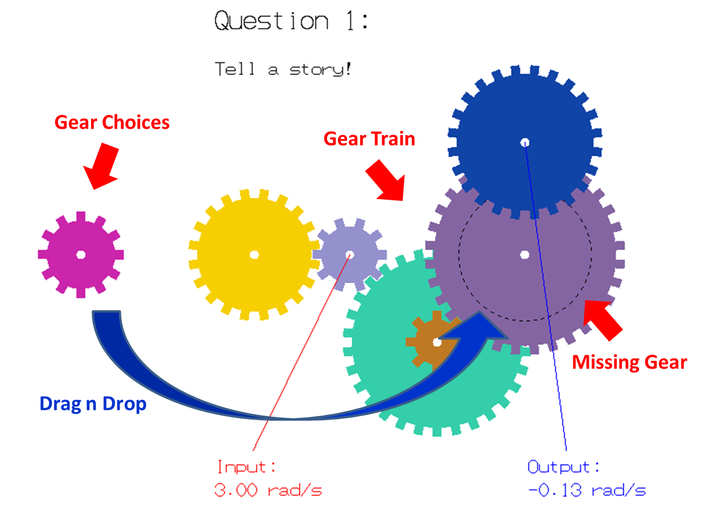
Gear up!
Mechanics of Machine
Learn gear ratio through play!
Put in the missing gears.
Interface: Drag & Drop
Gear train animation when solved correctly.
Solve 3 out of 4 gear train problem to passed.

Slide 6
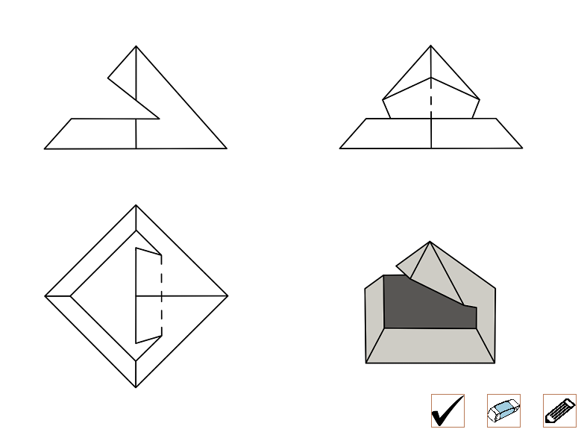
CAD quiz
Test your geometry and spatial sense
Goal
Fill in the missing lines in technical drawings
No hints!
Click to draw ends of line
Model

Slide 7
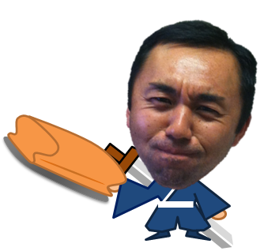
Soji is coming to class~
Story
class + project deadline
= DREAMLAND?
Challenge
In 2 minutes,
1. Answer 5/10 questions correctly
2. Catch 10/20 dusters

Slide 8
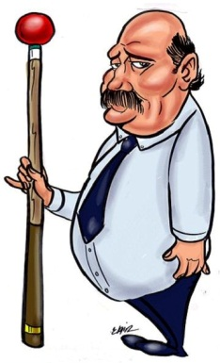
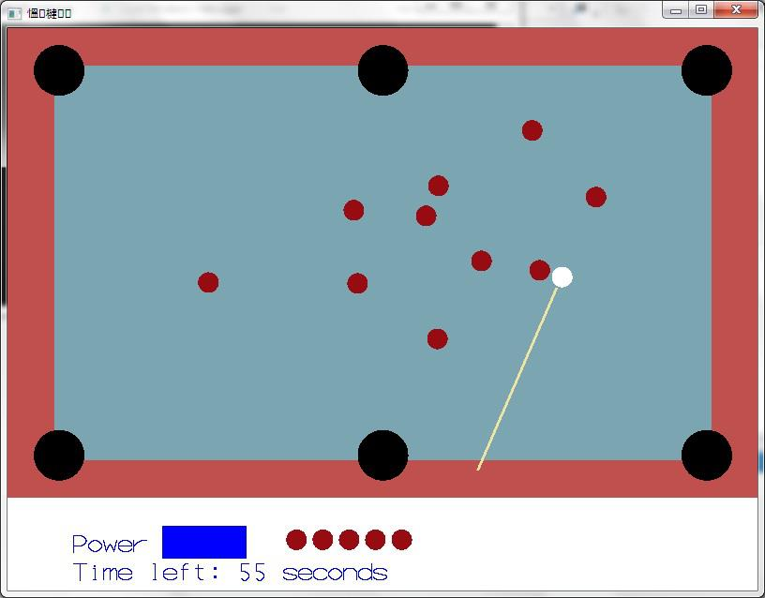
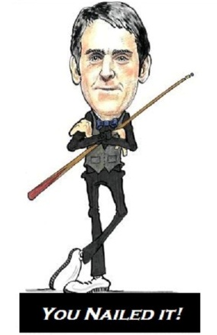
The Scotland yard!! The game: pool/snooker (Actually, snooker balls on a pool table)
Goal: Pocket all the balls in 120 seconds.
Difficulty: Very Hard
Reason : Real Physics and no visual aids to gameplay
The Gameplay:
Point and hit – that’s it!
Best Strategy – Use your eyes and some common sense!
Only help available – A count-down timer on screen
The Physics:
Drawing the cue
Providing a range of power
Setting the initial cue ball velocity
Collisions – of balls and the table→ restitution
Deceleration→ Always opposite to direction of movement of the ball (There are 16 balls moving in 16 different direction)
The irony – The University Centre and this mini-game is the toughest place in our ‘CMU Adventure’.

Slide 9
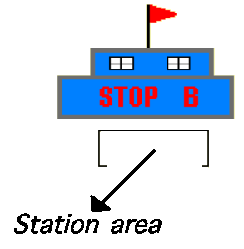
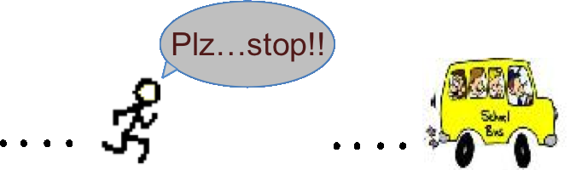
Chasing the shuttle
•Goal: Catch the shuttle
•Rule:
–Need to Catch the shuttle
inside the station
–Can’t touch bad guy
(or you will die!)

Slide 10
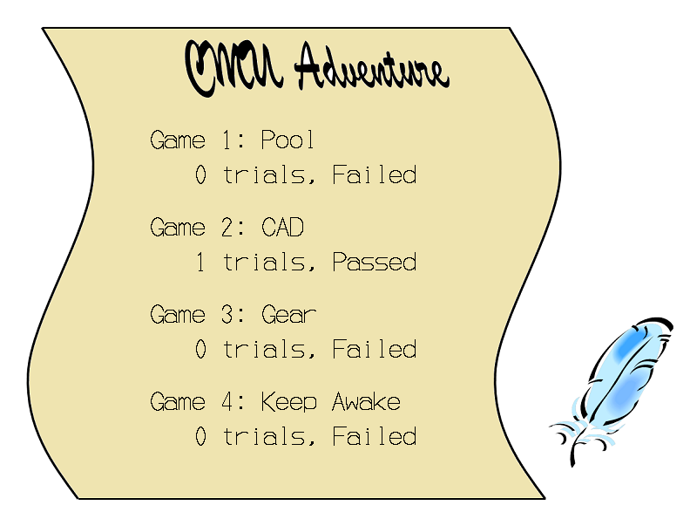
Score card

Slide 11
CMU Adventure
Survivors

