Slide 1
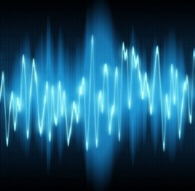
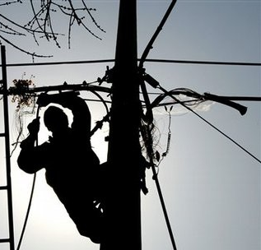
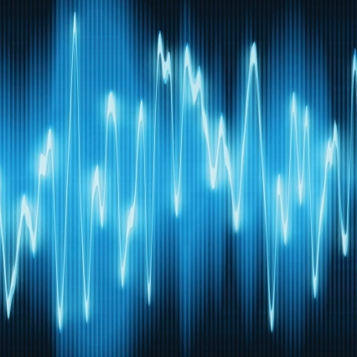
Frequency Division Multiplexing
(a fundamental application of digital signal processing)
A Project for
APPM 4350: Fourier Series and Boundary Value Problems
Nicholas Vanderweit
Fiona Pigott
Krishan Patel

Slide 2
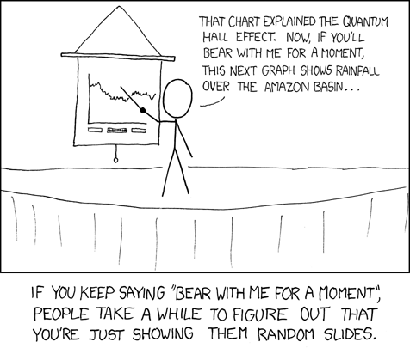
Plan.
Develop the mathematics behind digital signal processing
Demonstrate Frequency Division Multiplexing
Discuss real-world applications
Image source: www.xkcd.com/365

Slide 3
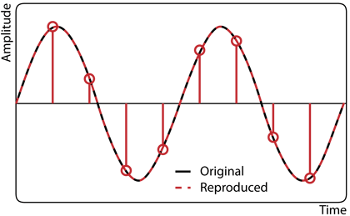
Nyquist-Shannon Sampling Theorem
Any bandwidth limited function with the cutoff frequency Ω can be reconstructed exactly from samples taken at sampling frequency f_{s} > 2Ω.
  A function is bandwidth limited if:
Image source: http://www.widex.pro/en/innovations/analysingsound/samplingrate/

Slide 4
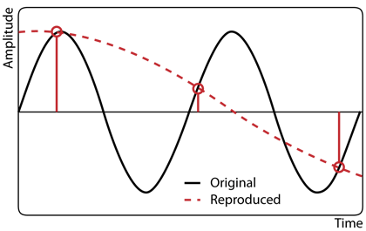
Importance
The Nyquist Sampling Theorem demonstrates how to use discrete samples to model continuous functions with frequencies < f_{s}/2
Most signals are nearly band limited—meaning that most of the important information is within a certain band.
  Ex: a human voice usually only ranges between 60 and 7000 Hz, so f_{s} > 1400 Hz would accurately sample a voice
Downsampling, sampling a signal below its cutoff frequency, results in aliasing
Image source: http://www.widex.pro/en/innovations/analysingsound/samplingrate/

Slide 5
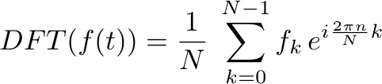

Discrete Fourier Transform
The DFT takes a set of discrete samples f_{k} of the time-domain function f(t) and produces a set of discrete samples of the Fourier transform of f(t).
For some band limited f(t) with a period of T₀ equal to some integer multiple N of the inverse sampling frequency 1/f_{s}:
The Riemann sum of the Fourier transform with N intervals is:

Slide 6
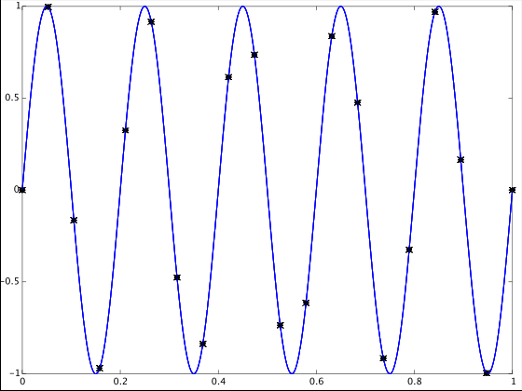
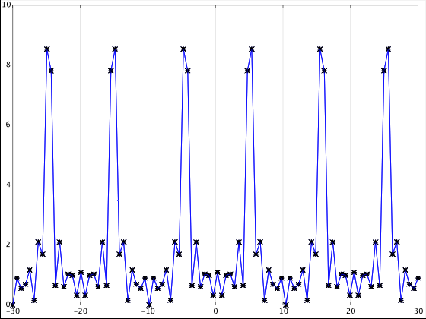
Periodicity of the DFT
In formulating the DFT, we assumed the function to be periodic on T₀, with T₀ = N/f_{s}.
Then the DFT is also periodic on N samples.
f_{s} = 20Hz, so the period of the DFT is 20Hz
1 period
Amplitude
Power
Time (s)
Frequency (Hz)

Slide 7


Reality Condition
For all Fourier transforms of all real-valued functions:
For an even, real valued function:
Important information
Redundant information can be recognized and thrown out
Power
Frequency (Hz)

Slide 8
Fast Fourier Transform
A Fast Fourier Transform (FFT) is and efficient implementation of the discrete Fourier transform and its inverse.
Computing the DFT the naïve way requires O(n²) operations. FFTs reduce the time complexity to O(n log(n))
Most commonly used FFT is the Cooley-Tukey algorithm, which is a type of divide-and-conquer algorithm
  Relies on the symmetry properties of the DFT to break the transform into smaller problems over smaller intervals
  Base-2 case: an N element DFT is split into two N/2 element DFTs, of the even-indexed and the odd-indexed terms

Slide 9
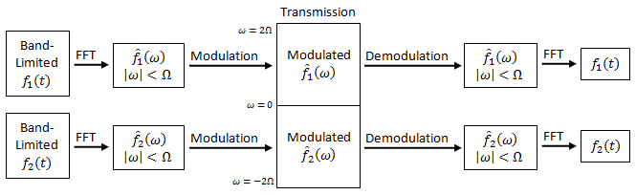
Frequency Division Multiplexing
(finally)

Slide 10
Our Implementation
& Demonstration
2 voice samples
  Cutoff frequency of a human voice ~7000Hz
Sampling at f_{s} > 2(7000Hz)
  f_{s} = 8000Hz
Bandwidth of “transmitted” signal = 16000Hz
GNU Octave implementation (an open-source MATLAB© alternative)

Slide 11
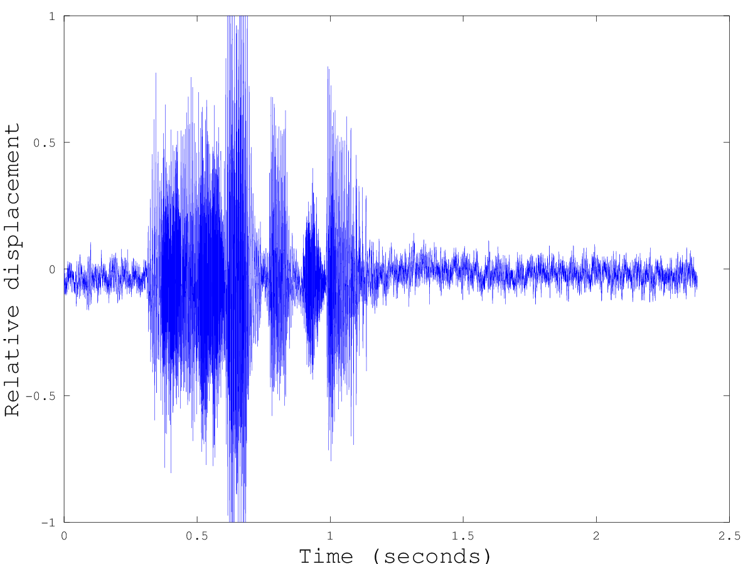
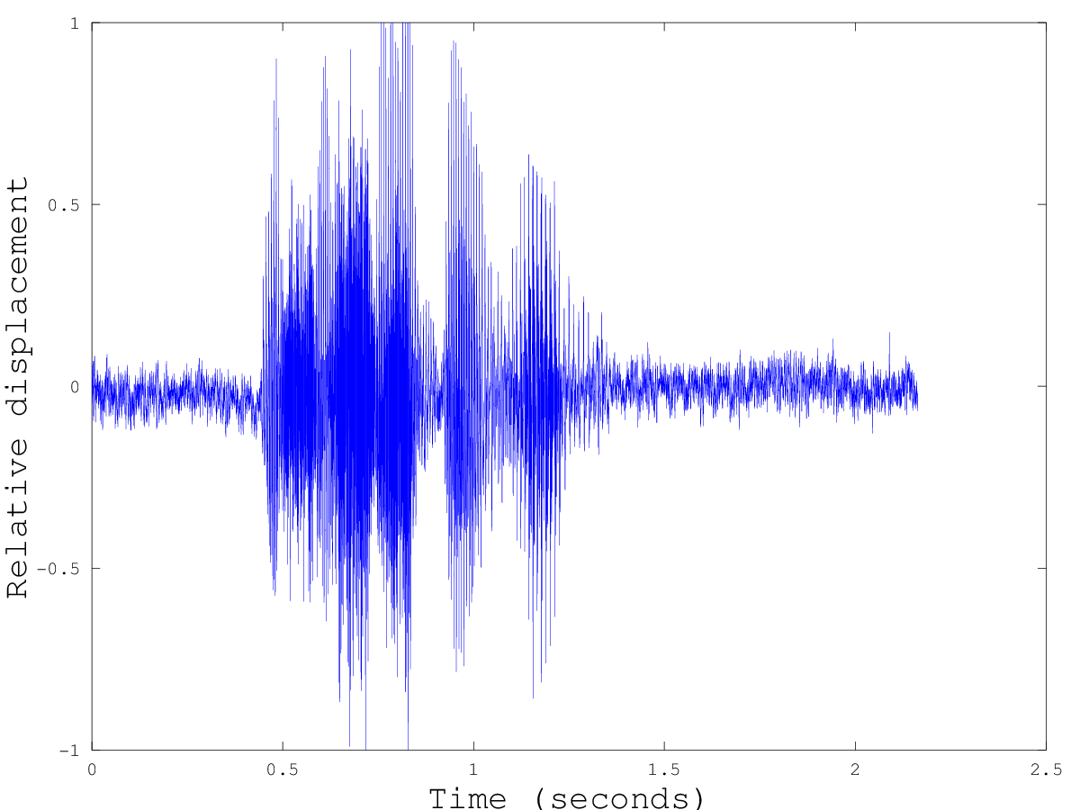
The original two sound files
Take the Fourier Transform

Slide 12
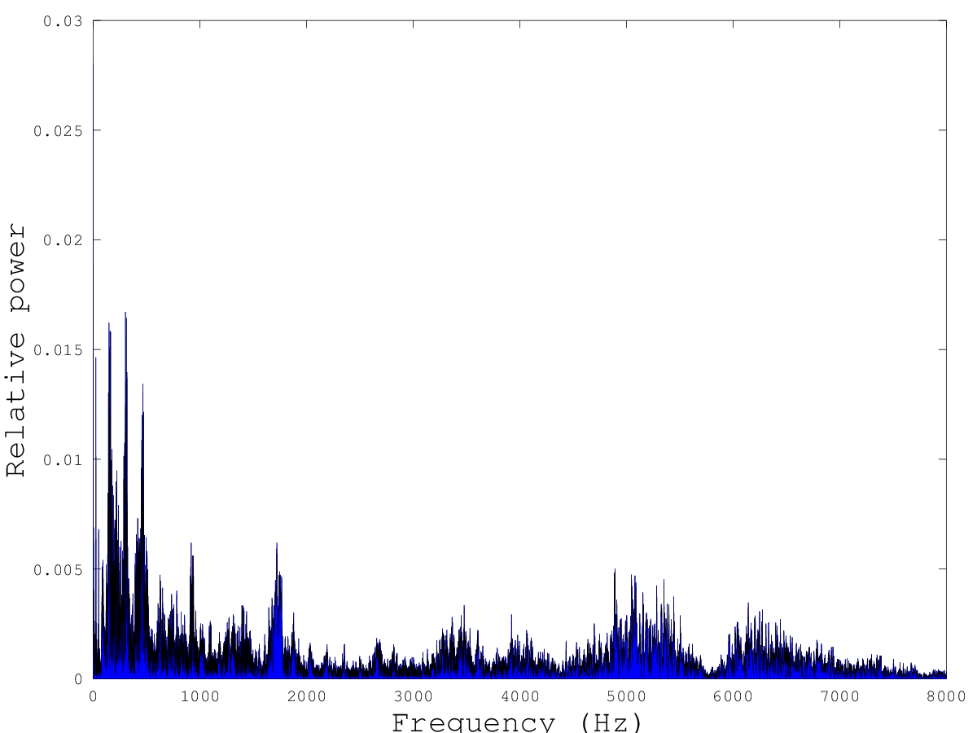
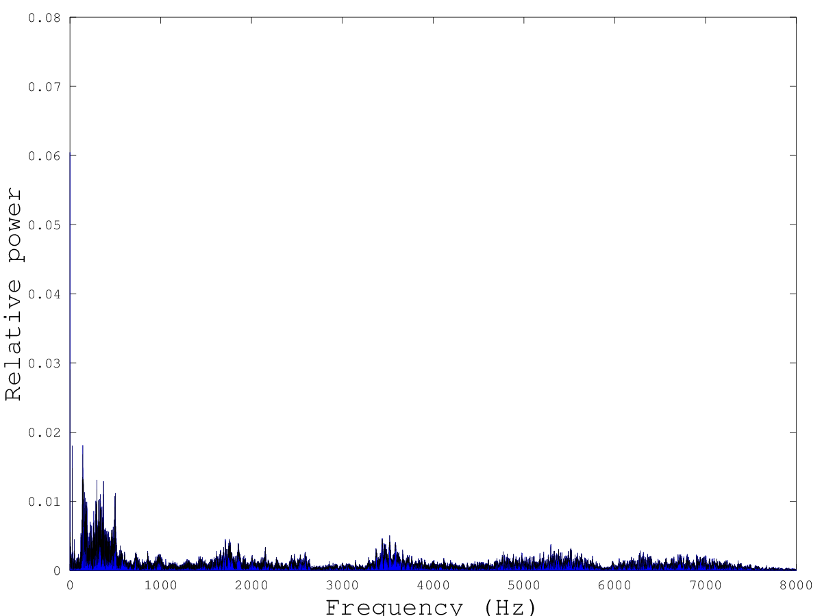
The data in the frequency domain
Modulate, concatenate and take the inverse transform of the signals

Slide 13
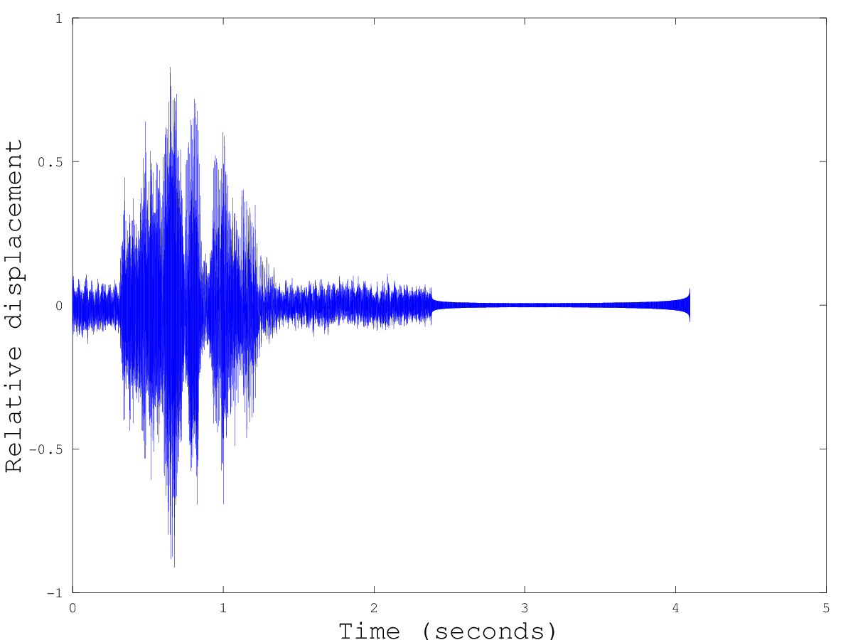
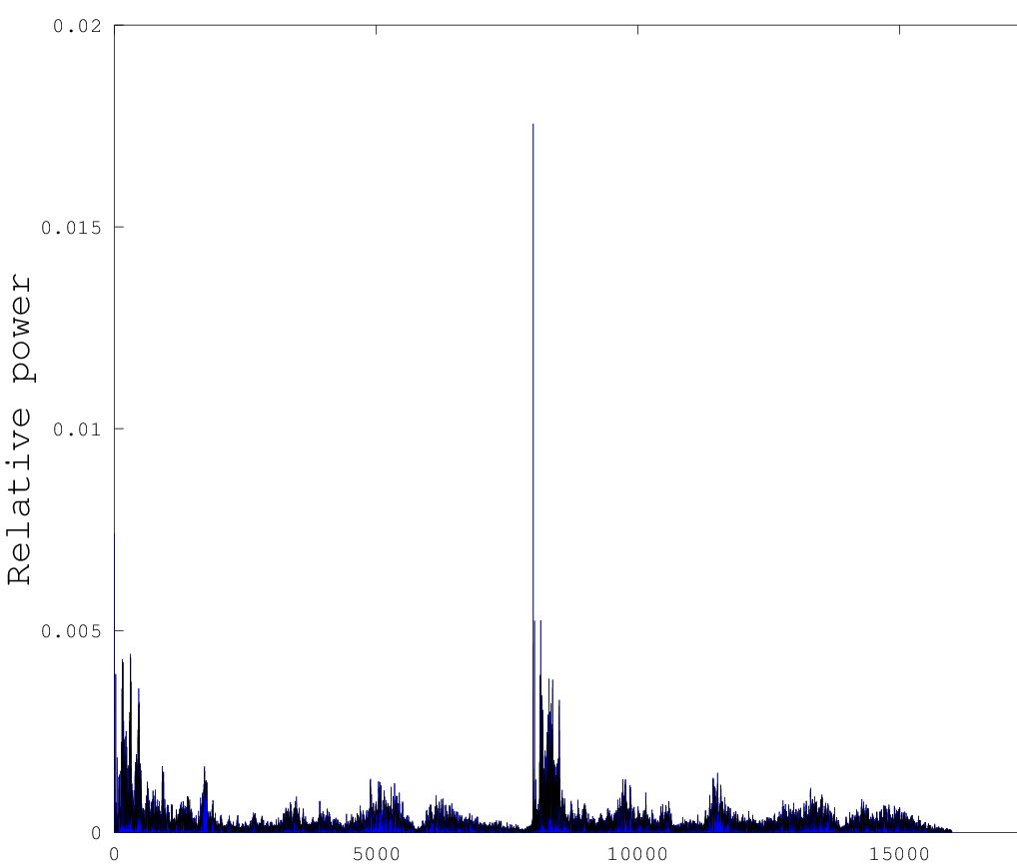
One time-domain signal with twice the bandwidth, ready for transmission
Time domain transmission
Frequency domain
1st Signal
2nd Signal
Fourier
Transform
8000Hz
Demodulate & Separate the Signals

Slide 14
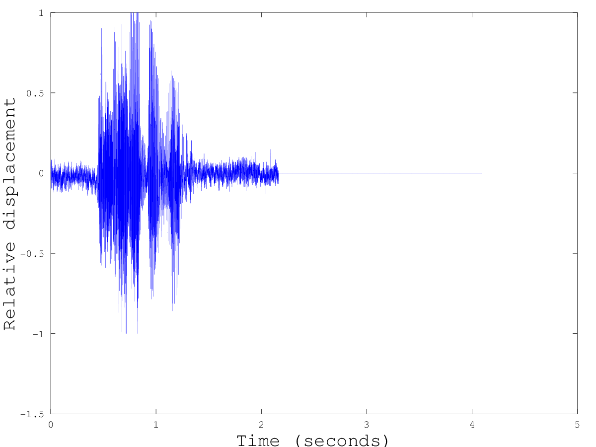
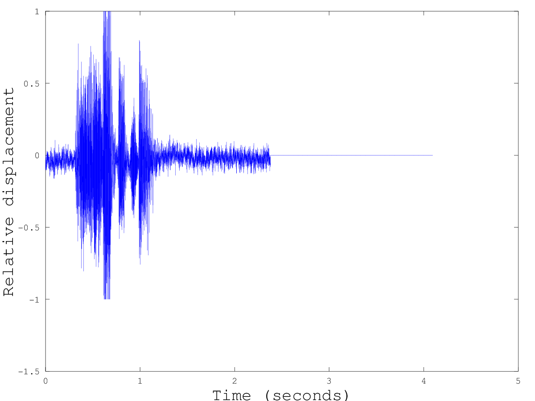
The received signals
Ta-da!

Slide 15
A Broader Perspective
Telephone system
  Use digital FDM to send multiple signals over the same analogue phone line
Radio
  Use analogue FDM to transmit multiple channels over the air at once
    Each station uses its own frequency bandwidth & your radio demodulates on the receiving end
Real FDM uses buffer frequency bands to prevent analogue noise from the electronics /air /phone line etc from causing the signals to mix

Slide 16
Extension of Principles
Human audio-visual perception is bandwidth limited, which allows for various forms of data compression filtering out less perceptible data.
Recent experimentation with signal transmission (including using different wavelength lasers to send multiple signals over one fiber optic cable) makes use of FDM principles.
Converting sounds and images into the frequency domain helps re- searchers to identify materials, chemicals, distinct voices, and detect edges.
Synthesizers and auto-tuners analyse audio signals in the frequency domain and then frequency-shift those signals.
Image manipulation software selects for and changes only certain frequencies in an image.

