Slide 1
HiLo Project Update
Now with new and improved analyses!

Slide 2
Research Objective #1
“First, we will determine how fish species richness, abundance, and biomass vary with habitat variables such as depth, tidal current speed, habitat complexity, and slope using linear mixed effect models.”

Slide 3
Research Objective #1
Coefficient plots

Slide 4
Research Objective #2
“Second, we will explore how community composition varies with tidal current speed and depth using non-metric multidimensional scaling plots (NMDS).”

Slide 5
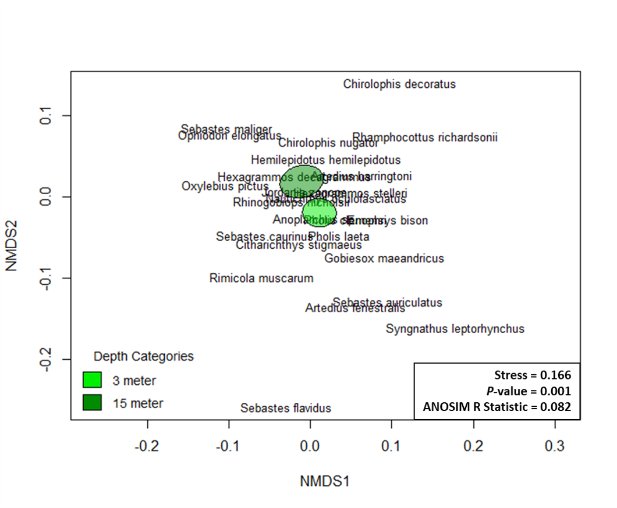
Research Objective #2

Slide 6
Research Objective #3
“Third, we will explore how the observed species life history usage vary by depth. Individual fish lengths will be used as an indicator for life history stage.”

Slide 7
Research Objective #3
Mixed effect model partial-pooling plot

Slide 8
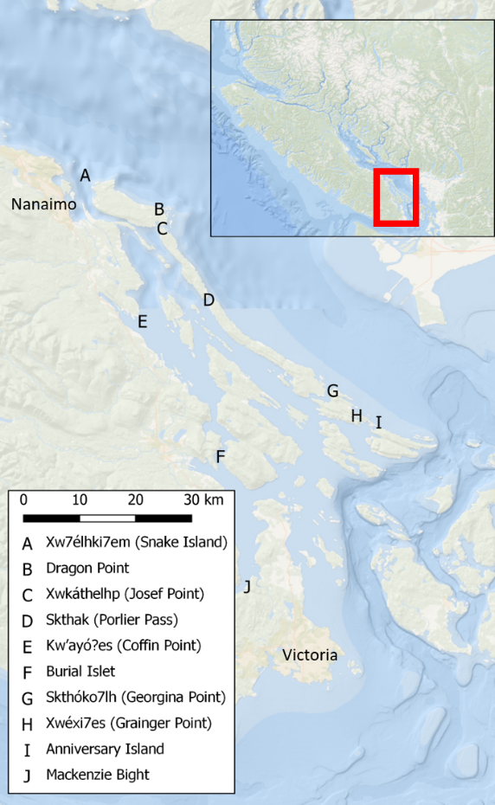
Additional Figures
Figure 1: Map of survey sites within the Southern Gulf Islands BC Canada. Hul’q’umin’um’ site names are used when they could be found in the literature.

Slide 9
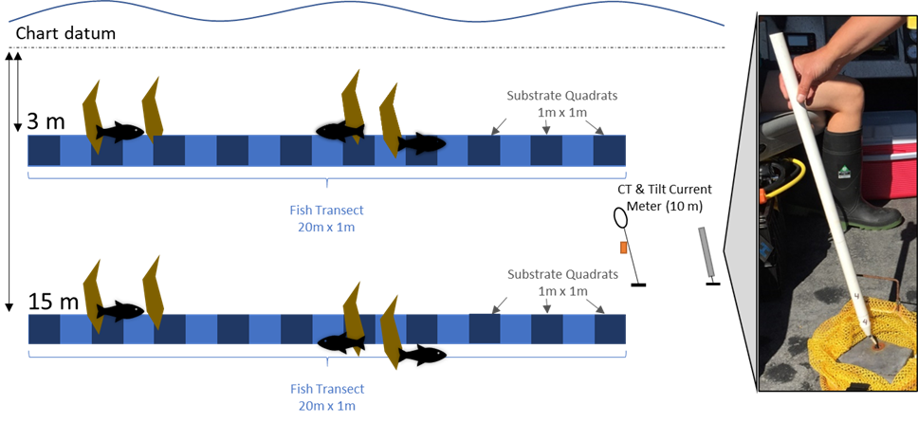
Additional Figures
Figure 2: Schematic of fish and benthic data collection protocol. Fish and benthic characteristics were measured at 3 meter and 15 meter depth contours (below chart datum) at each of the 10 sites. Fish were counted and measured in a 1 meter width along the 20 meter long transect (light blue rectangle). Substrate characteristics were recorded in 1 m2 quadrats every 2 meters (10 quadrats per 20 meter long transect, dark blue squares). Sites were surveyed multiple times from October 2019 to March 2020 resulting in replicate transects at each depth. Current, temperature, and salinity data were continuously recorded at 10 meter depth from 16 December 2019 to 26 January 2020 using Tilt Current Meters from Lowell Instruments, LLC and conductivity and temperature loggers from Star Oddi.

Slide 10
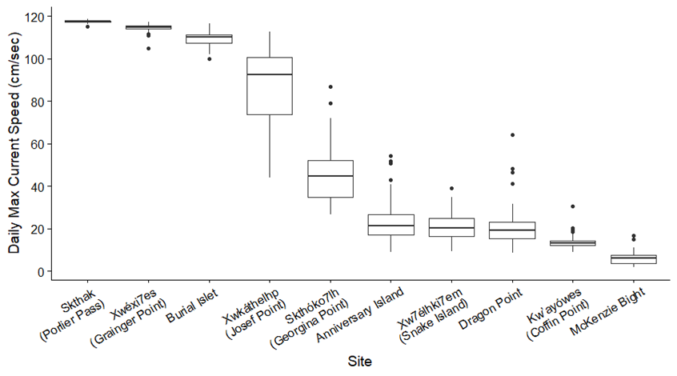
Additional Figures
Figure 3: Daily maximum current speeds at each site presented as boxplots, indicating the median and quartiles with whiskers extending to 1.5 times the interquartile range.

Slide 11
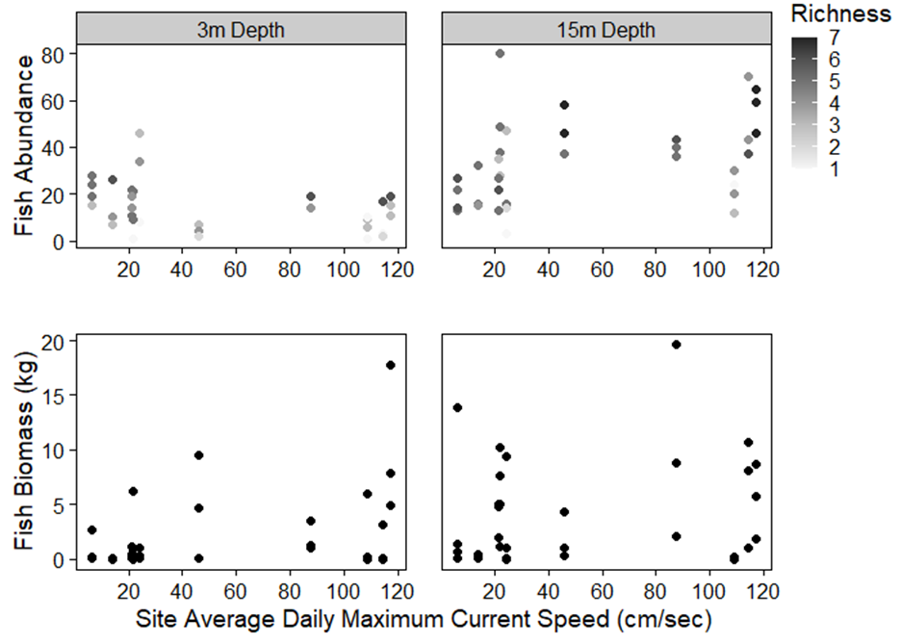
Additional Figures
Figure 4: Individual transect fish abundance (top row) and biomass (bottom row) at each site average daily maximum current speed. Grey shaded circles in the abundance plots represent the transect species richness (via colour) and abundance (via vertical position), black circles in the biomass plot represent transect biomass. The number of replicate transects at each site and depth were inconsistent due to site sampling logistic limitations.

Slide 12
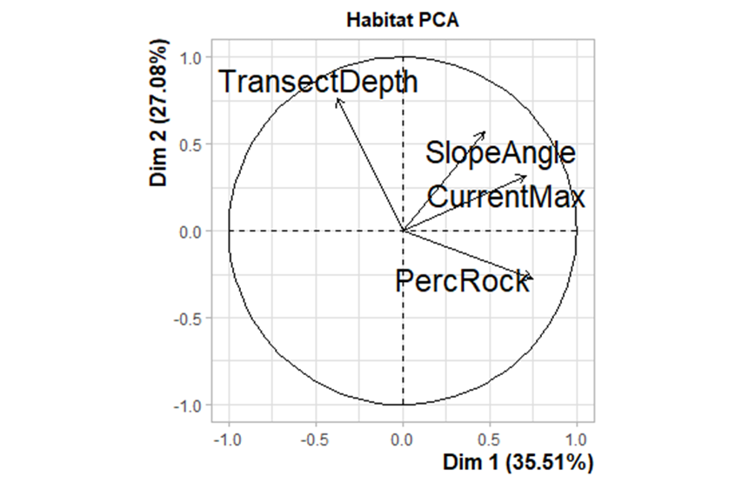
Additional Figures
Did we want to use this PCA plot at all? I think the model results explain these patterns more fully.

