Slide 1
Hi-Lo Analysis Update
Tentative title: Depth is a primary driver of nearshore fish biodiversity in the Salish Sea

Slide 2
Research objectives
Overall objective: Can abiotic variables be used as a proxy for identifying high biodiversity areas for conservation initiatives
1. Determine how fish species richness, abundance, and biomass varies with depth, tidal current speed, habitat complexity (% rock as a proxy), and slope
2. Examine how fish community composition varies with these variables
3. Determine if abiotic variables influence life history traits such as fish size and if these patterns vary with species

Slide 3
Research objective 1
Determine how fish species abundance, biomass, and richness varies with depth, tidal current speed, habitat complexity, and slope
Analysis:
- 3 sets of linear mixed effects models (with site as a random effect), one for each response
- 15 candidate models in each set

Slide 4
Fish abundance
logLik AIC dLogLik dAIC df weight
Lm13.ab.var -268.2 550.5 27.4 0.0 7 0.4828
Lm7.ab.var -270.1 552.1 25.6 1.7 6 0.2105
Lm15.ab.var -268.2 552.3 27.5 1.9 8 0.1910
Depth + Current + % Rock
Depth + % Rock
Depth + Current + % Rock +slope
Lm7.ab <- lme(Abundance ~ TransectDepth + PercRock, random = ~ 1 | Site, data = data, weights = varExp(form = ~fitted(.)),method = "ML")
Lm13.ab <- lme(Abundance ~ TransectDepth + CurrentMax + PercRock, random = ~ 1 | Site, data = data, weights = varExp(form = ~fitted(.)),method = "ML")
Lm15.ab <- lme(Abundance ~ CurrentMax + TransectDepth + SlopeAngle + PercRock, random = ~ 1 | Site, data = data, weights = varExp(form = ~fitted(.)),method = "ML")

Slide 5
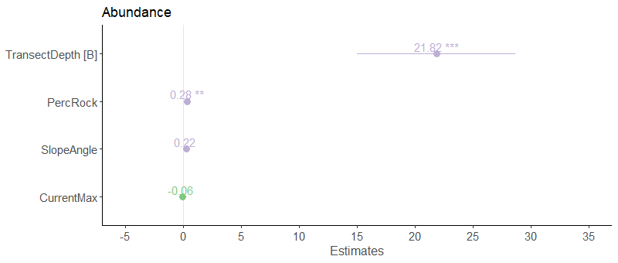

Slide 6
Fish biomass
logLik AIC dLogLik dAIC df weight
Lm1.bio -95.9 199.9 574.6 0.0 4 0.2708
Lm6.bio -95.5 201.0 575.0 1.1 5 0.1524
Lm5.bio -95.6 201.1 575.0 1.2 5 0.1471
Lm7.bio -95.6 201.1 575.0 1.2 5 0.1469
Depth + Current + % Rock
Depth + Current
Depth + Slope
Depth + % rock
Lm1.bio <- lme(log10(Biomass) ~ TransectDepth, random = ~ 1 | Site, data = data, method = "ML")
Lm5.bio <- lme(log10(Biomass) ~ TransectDepth + CurrentMax, random = ~ 1 | Site, data = data, method = "ML")
Lm6.bio <- lme(log10(Biomass) ~ TransectDepth + SlopeAngle, random = ~ 1 | Site, data = data, method = "ML")
Lm7.bio <- lme(log10(Biomass) ~ TransectDepth + PercRock, random = ~ 1 | Site, data = data, method = "ML")

Slide 7
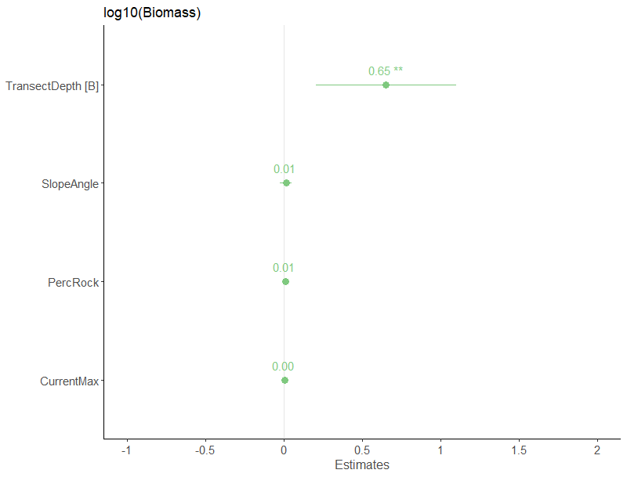

Slide 8
Fish richness
logLik AIC dLogLik dAIC df weight
Lm7.r -122.2 254.5 7.4 0.0 5 0.2786
Lm1.r -123.4 254.8 6.2 0.3 4 0.2414
Lm13.r -122.1 256.2 7.5 1.7 6 0.1173
Depth + % Rock
Depth
Depth + Current + % Rock
Lm7.r <- lme(Richness ~ Depth + % Rock, random = ~ 1 | Site, data = data, method = "ML")
Lm1.r <- lme(Richness ~ Depth, random = ~ 1 | Site, data = data, method = "ML")
Lm13.r <- lme(Richness ~ Depth + Current + % Rock, random = ~ 1 | Site, data = data, method = "ML")

Slide 9
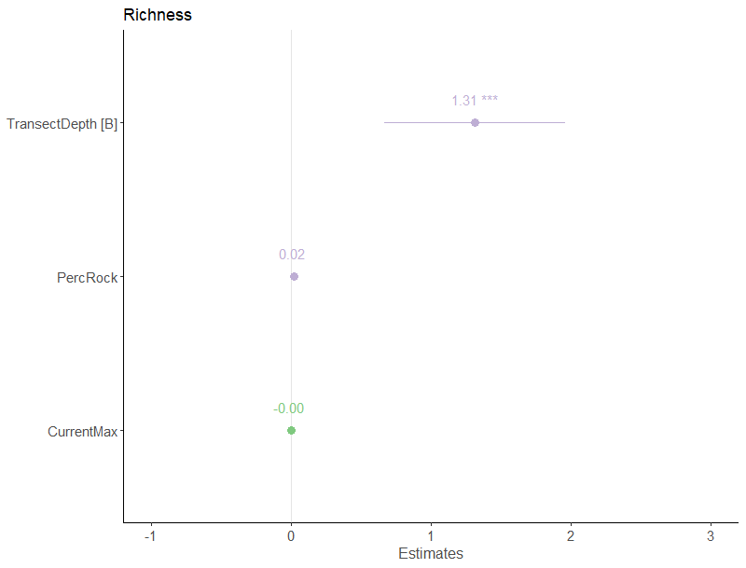

Slide 10
Research Objective 2
Examine how fish community composition varies with depth
Analysis:
- non-metric multidimensional scaling plots (NMDS)

Slide 11
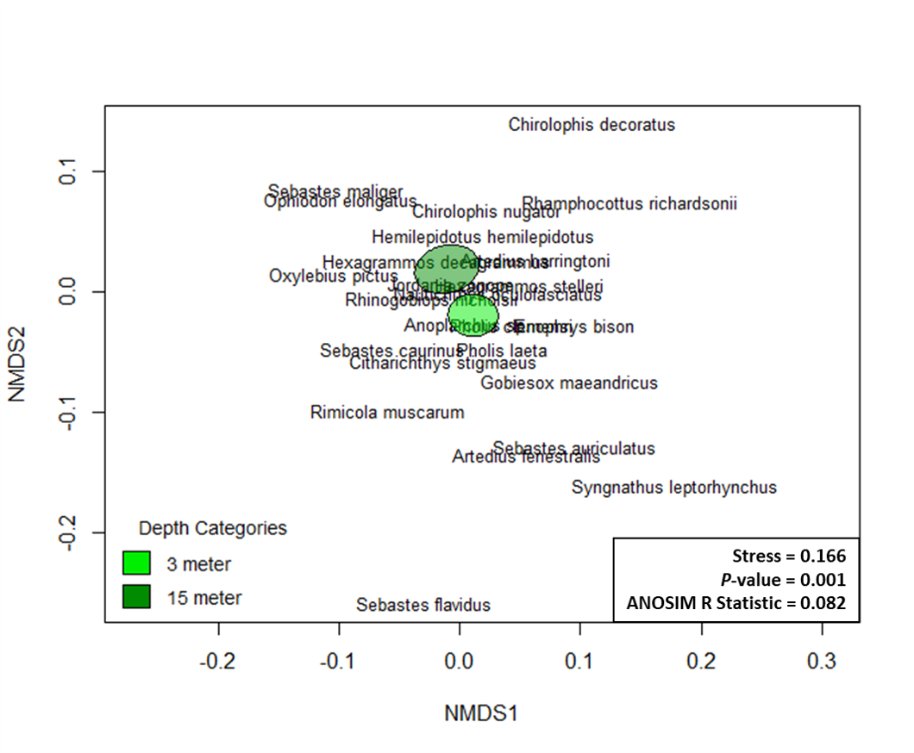

Slide 12
Research Objective 3
Determine how depth influences life history traits such as fish size and how this varies with species
Analysis:
Mixed effects model with partial pooling by species (fitting species as a random effect with random slope and intercept) to determine overall effect of depth on fish size by comparing to a null model
Can look at individual fish coefficients as well from model

Slide 13
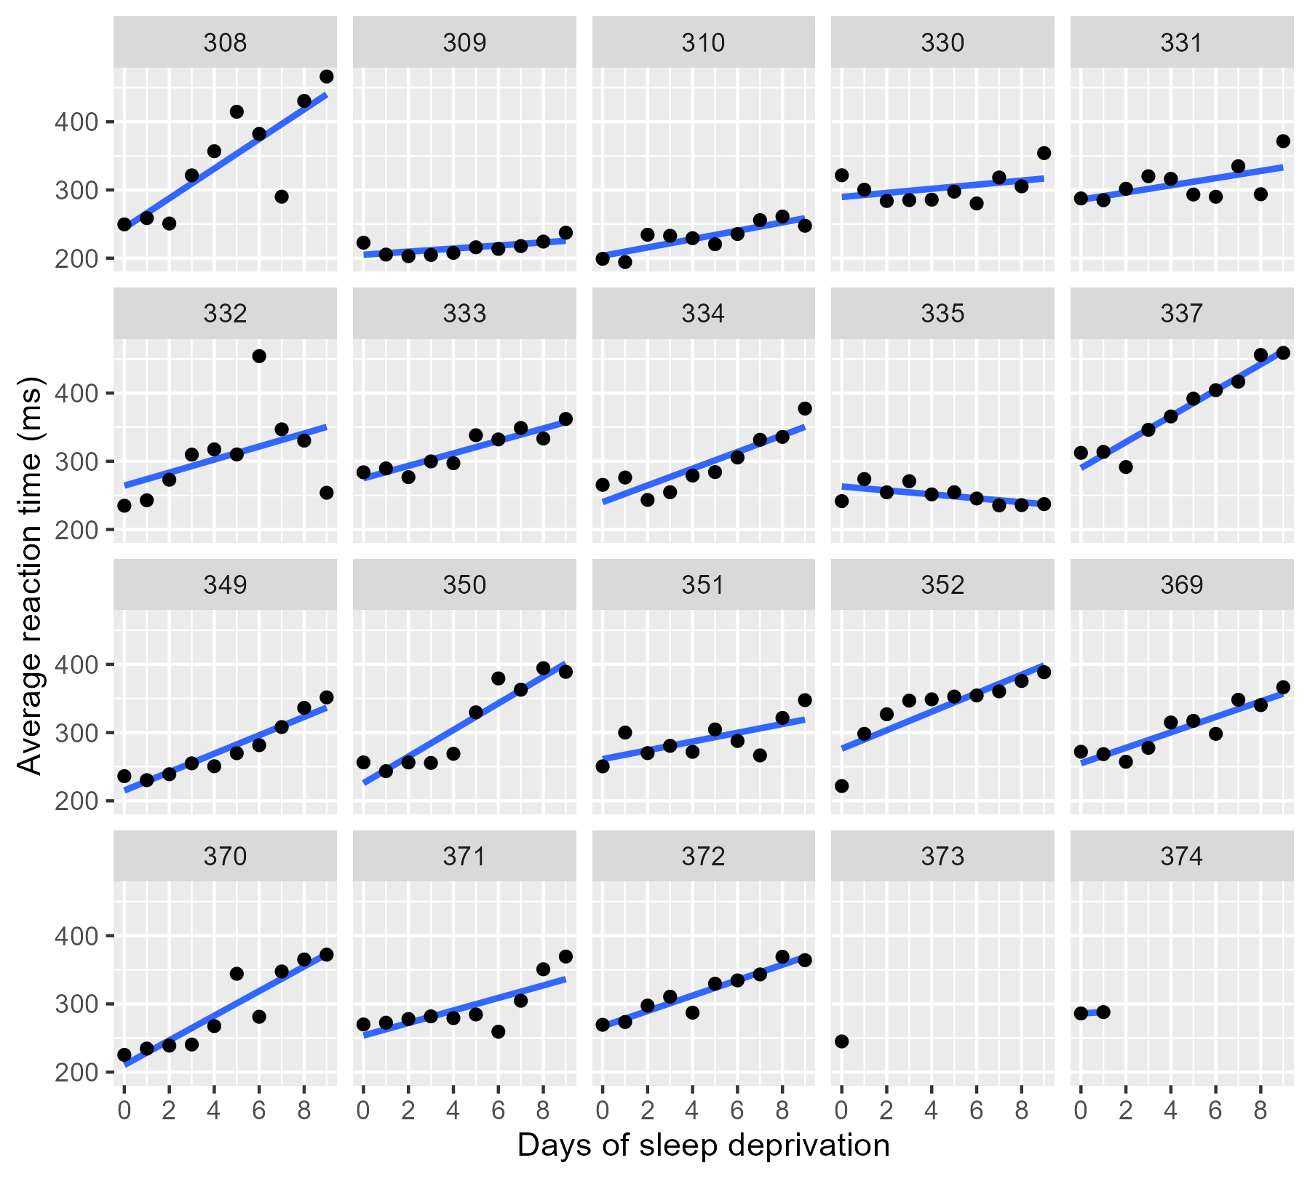

Slide 14
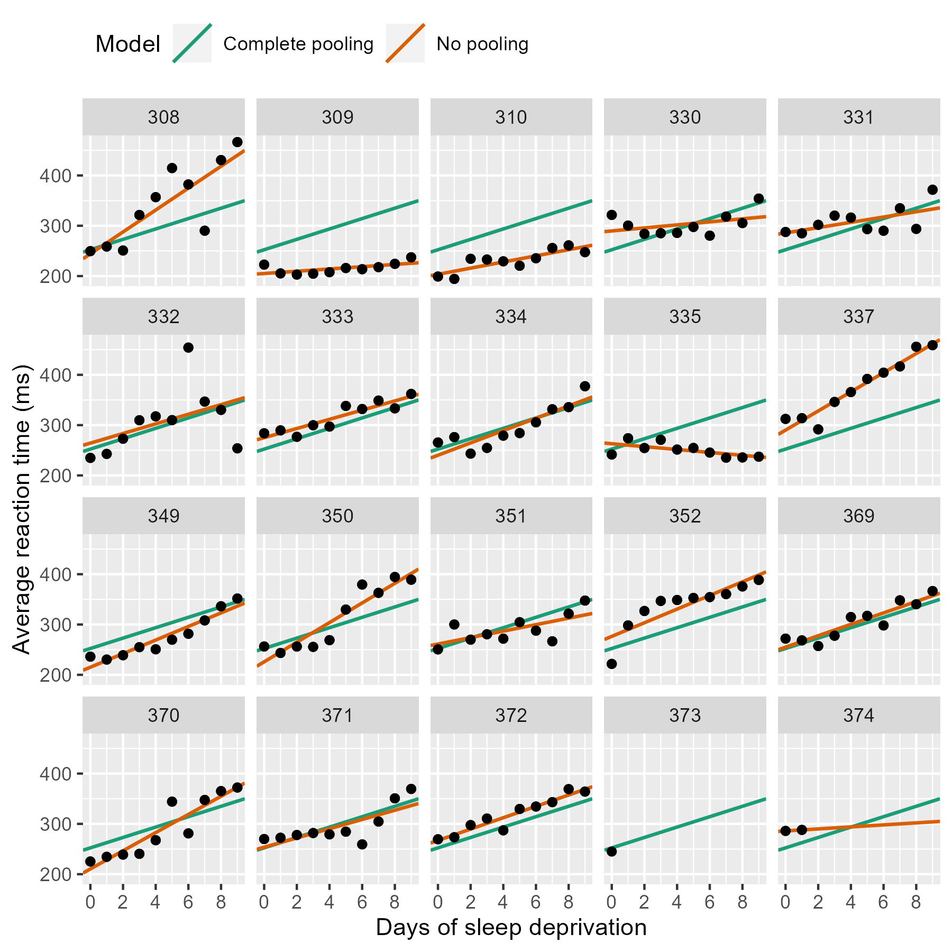

Slide 15
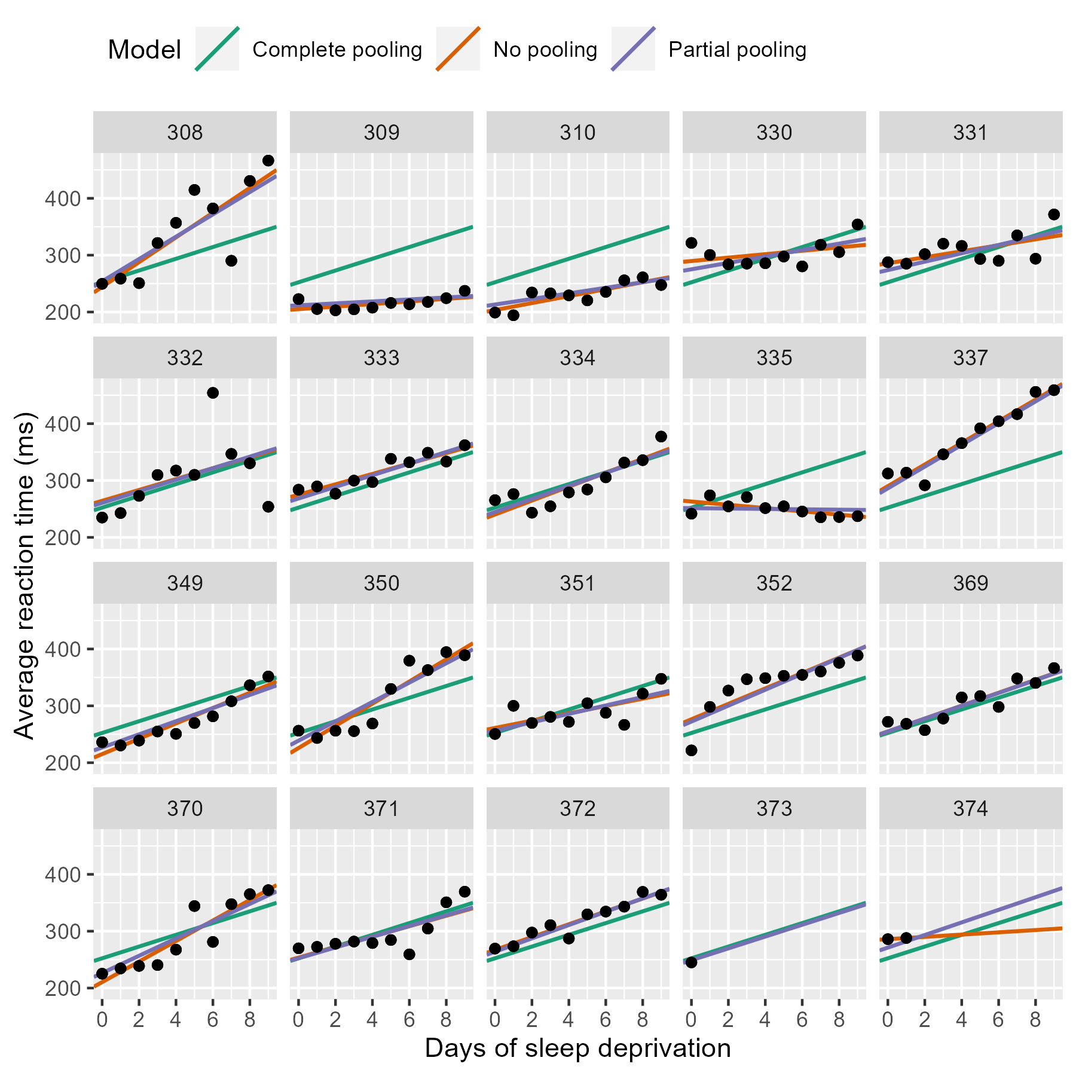

Slide 16
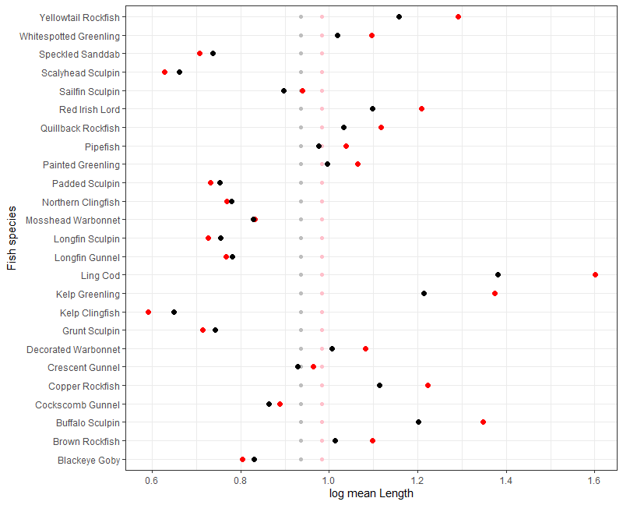
3 m
15 m
3 m overall
15 m overall

Slide 17
New Current measures….
- how do we want to handle these?
- our thought is to forge ahead as is and then include a comparison in the supplement

Slide 18
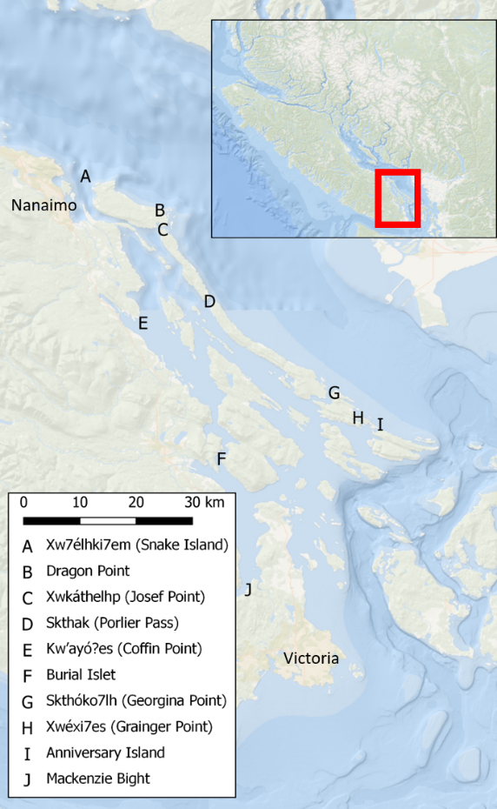
Additional Figures
Figure 1: Map of survey sites within the Southern Gulf Islands BC Canada. Hul’q’umin’um’ site names are used when they could be found in the literature.

Slide 19
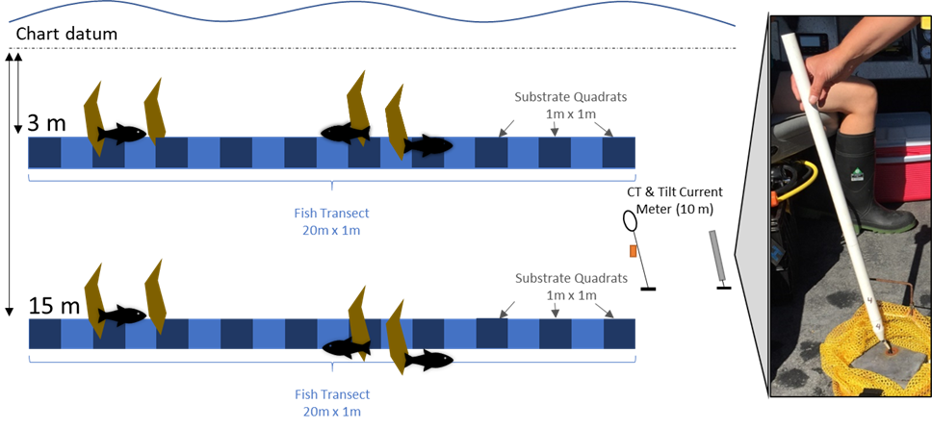
Additional Figures
Figure 2: Schematic of fish and benthic data collection protocol. Fish and benthic characteristics were measured at 3 meter and 15 meter depth contours (below chart datum) at each of the 10 sites. Fish were counted and measured in a 1 meter width along the 20 meter long transect (light blue rectangle). Substrate characteristics were recorded in 1 m2 quadrats every 2 meters (10 quadrats per 20 meter long transect, dark blue squares). Sites were surveyed multiple times from October 2019 to March 2020 resulting in replicate transects at each depth. Current, temperature, and salinity data were continuously recorded at 10 meter depth from 16 December 2019 to 26 January 2020 using Tilt Current Meters from Lowell Instruments, LLC and conductivity and temperature loggers from Star Oddi.

Slide 20
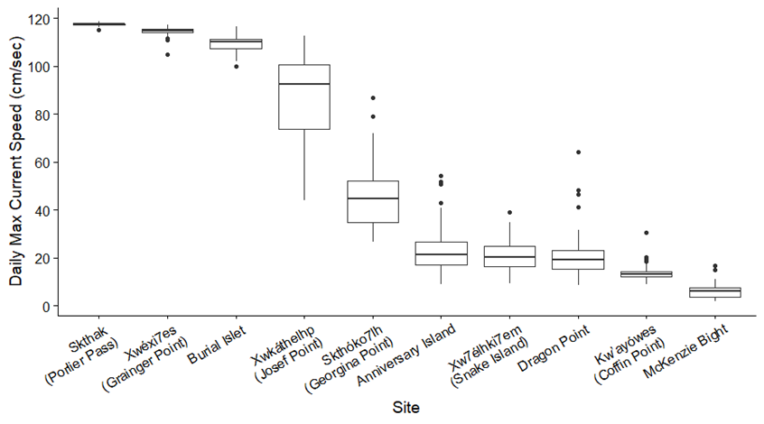
Additional Figures
Figure 3: Daily maximum current speeds at each site presented as boxplots, indicating the median and quartiles with whiskers extending to 1.5 times the interquartile range.

Slide 21
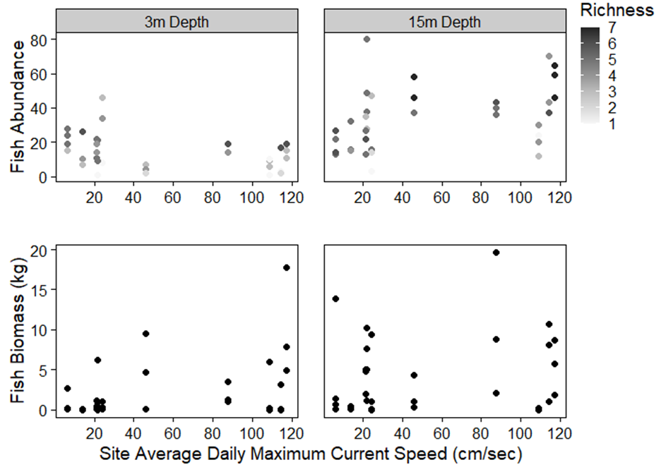
Additional Figures
Figure 4: Individual transect fish abundance (top row) and biomass (bottom row) at each site average daily maximum current speed. Grey shaded circles in the abundance plots represent the transect species richness (via colour) and abundance (via vertical position), black circles in the biomass plot represent transect biomass. The number of replicate transects at each site and depth were inconsistent due to site sampling logistic limitations.

