Slide 1


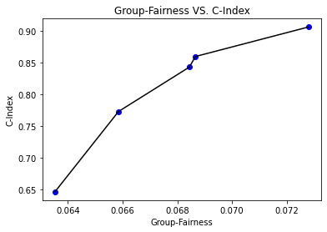
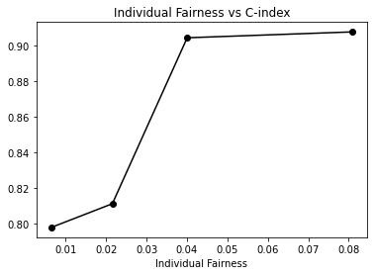
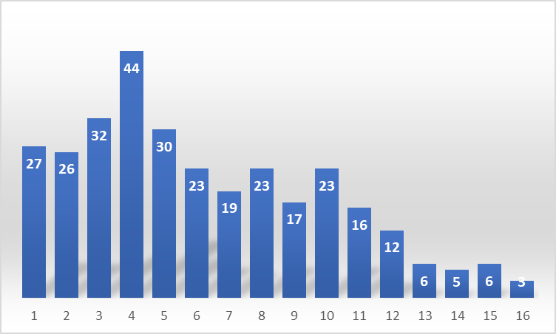
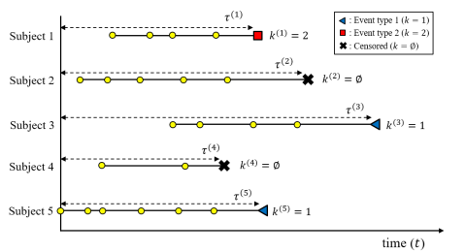
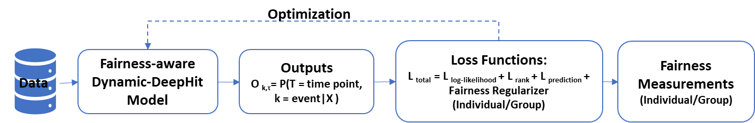
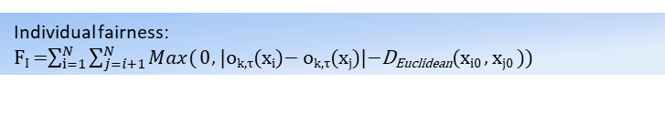
Fair Dynamic Survival Prediction on Longitudinal Electronic Health Record
Xin Huang, Xiangyang Meng
Department of Information Systems, University of Maryland, Baltimore County
Introduction
Dataset
Experiment Results
The longitudinal record in an EHR enables doctors to trend labs over multiple encounters for a more holistic and longitudinal overview of their patient’s health. Joint analysis of longitudinal data and survival outcomes is necessary to obtain unbiased inference when the two outcomes are correlated.
Cox proportional hazards model, a statistical model, can prioritize the process of providing care to the ones in need of treatments. However, the cox model doesn’t consider the time varying covariates when fitting for individual and practical treatment questions. Dynamic-DeepHit flexibly incorporates the available longitudinal data comprising various repeated measurements², but fair treatment on different group of patients (gender, race…) remains unexplored.
pbcseq: Mayo Clinic Primary Biliary Cirrhosis, sequential data, two events,
312 randomized patients|15 features| 1~16 sequential measurements
T = 156 (weeks) | Delta T = 12 | Delta T = 36 | Delta T = 60
Original
C-Index | 0.948882 | 0.929326 | 0.91657
BRIER-SCORE | 0.082197 | 0.104873 | 0.117934
Group Fairness | 0.064016 | 0.064859 | 0.06711
Individual Fairness | 0.018866 | 0.0173635 | 0.048403
With Group Fair Metric
C-Index | 0.939297 | 0.923575 | 0.920046
BRIER-SCORE | 0.080842 | 0.102076 | 0.114453
Group Fairness | 0.061551 | 0.058288 | 0.066522
With Individual Fair Metric
C-Index | 0.942492 | 0.923575 | 0.920046
BRIER-SCORE | 0.081845 | 0.104302 | 0.116512
Individual Fairness | 0.002008 | 0.0025195 | 0.019375
Patient measurements frequencies
Distribution.
Illustration of survival data with longitudinal measurements where subjects are aligned.²
Proposed Methods
Goal
We aim to develop a fairness-aware dynamic survival model for longitudinal EHR, to reduce bias, provide a fair prioritization process, and promote fair treatment on certain individuals or demographic groups equally.
Contribution
Accomplishment
Fairness metric for time varying covariates:
Individual fairness based on Cumulative Incidence Function: F(t) = P(T<=t)).
Group fairness based on CIF.
Implemented individual and group fairness metrics to evaluate the dynamic survival analysis with time dependent covariates.
Incorporated fairness constraint in loss function to optimize fairness-aware dynamic survival prediction.
Related Work
¹Kamrun Naher Keya, Rashidul Islam, Shimei Pan, Ian Stockwell, and James Foulds. Equitable Allocation of Healthcare Resources with Fair Survival Models. SIAM Int. Conference on Data Mining (SDM), 2021.
²C. Lee, etc, "Dynamic-DeepHit: A Deep Learning Approach for Dynamic Survival Analysis With Competing Risks Based on Longitudinal Data," IEEE Trans. on Biomedical Engineering. 2020
Group fairness:
F_{G} = Max _{a∈A} |E[o_{k,τ}(a)] − E[o_{k,τ}(x)]|
Future Work
Implement ranking-based fairness metric for dynamic survival analysis with competitive risks
Apply the fairness metrics to more dynamic survival models and conduct more experiments on diverse datasets.
Improve in leveraging a combination of loss functions to achieve a more efficient accuracy-fairness trade-off.
Fairness-aware loss in dynamic prediction model:
Total Loss = Log-likelihood Loss + Ranking Loss + Prediction Loss
+Individual/Group Fairness Regularizer

