Slide 1
Heterogeneous Graph Attention Networks on EHR

Slide 2
MIMIC iii dataset

Slide 3
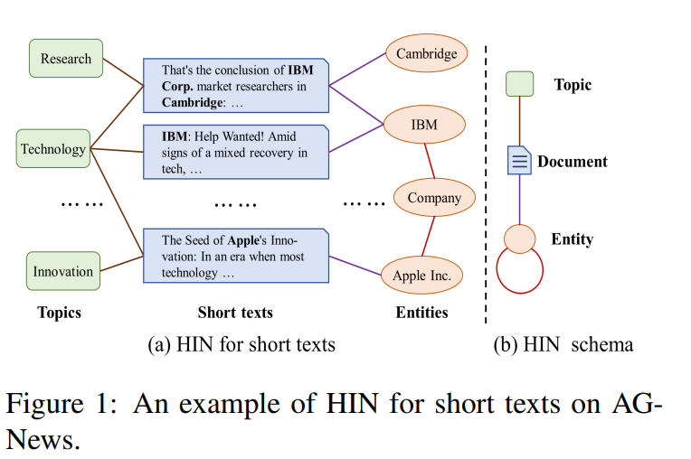
Nodes:
Topics
Short texts
Entities
Edges
Text-Topic
Text-Entity

Slide 4
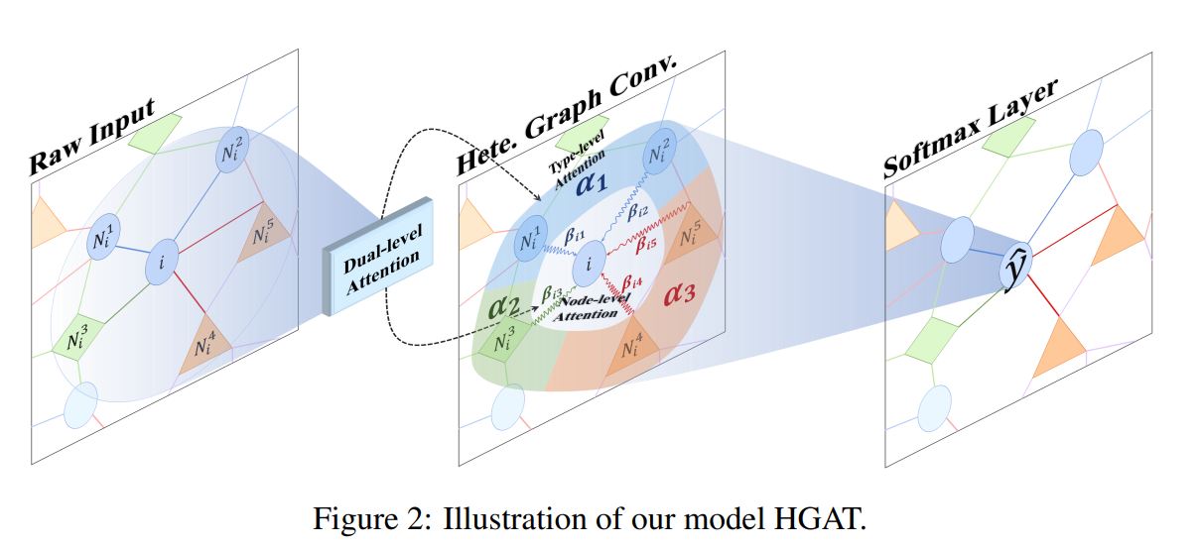
Heterogeneous Graph Attention Network(HGAT)
Heterogeneous Graph
Dual Level attention:
Type level attention
Node level attention

Slide 5
Why dual level attention?
Given a specific node, different types of neighboring nodes may have different impacts on it. Dual-level attention can capture both node level and type level.

Slide 6
Propose to embed the HIN for HER based on dual level attention mechanism.
Captures the importances of duffernt neighboring nodes and different nodes types
Notes:
每一种类型的邻居就会共享一个权重，这一类对节点i来说是多少，

Slide 7
'gendera','hypertensive','atrialfibrillation', 'CHD with no MI', 'diabetes’, 'deficiencyanemias','depression’, 'Hyperlipemia', 'Renal failure', 'COPD’, 'outcome'
['heart rate', 'Systolic blood pressure', 'Diastolic blood pressure','Respiratory rate', 'temperature', 'SP O2', 'Urine output','hematocrit', 'RBC', 'MCH', 'MCHC', 'MCV', 'RDW', 'Leucocyte','Platelets', 'PT', 'INR', 'NT-proBNP', 'Creatinine', 'Urea nitrogen','glucose', 'Blood potassium', 'Blood sodium', 'Blood calcium','Chloride', 'Anion gap', 'Magnesium ion', 'Bicarbonate','age','EF']
Clusters
“Topic”
“Text”
“Entity”

Slide 8
Model architecture
Heterogeneous graph
Heterogeneous types of nodes are projected into a common space.
Dual level attention captures the key information and reduce noisy information
Node-level attention
Type-level attention

Slide 9
Supervised learning

Slide 10
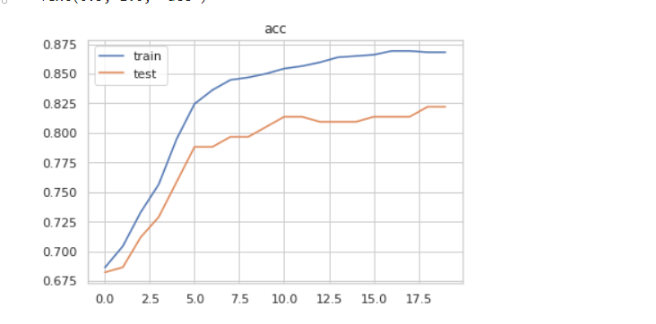
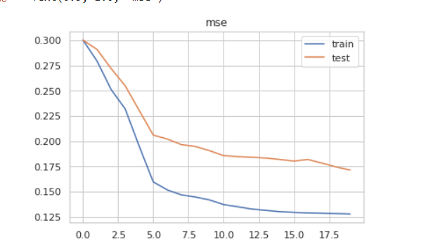
Model Performance

Slide 11
Semi-supervised learning
Pseudo labeling
Use label dataset as train set for our model.
Predict on unlabeled data and use predicted label as ‘label’
Train model on full dataset (data truly labeled + data pseudo labeled )

Slide 12
Reference
Linmei, H., Yang, T., Shi, C., Ji, H., & Li, X. (2019, November). Heterogeneous graph attention networks for semi-supervised short text classification. In Proceedings of the 2019 Conference on Empirical Methods in Natural Language Processing and the 9th International Joint Conference on Natural Language Processing (EMNLP-IJCNLP) (pp. 4821-4830).

