Slide 1

Title Provide an executive summary for the parking citations for the different LA DOT (Department of Transport) districts. Team Celts: David Mathews Scott McEachern Fiona Weston

Slide 2
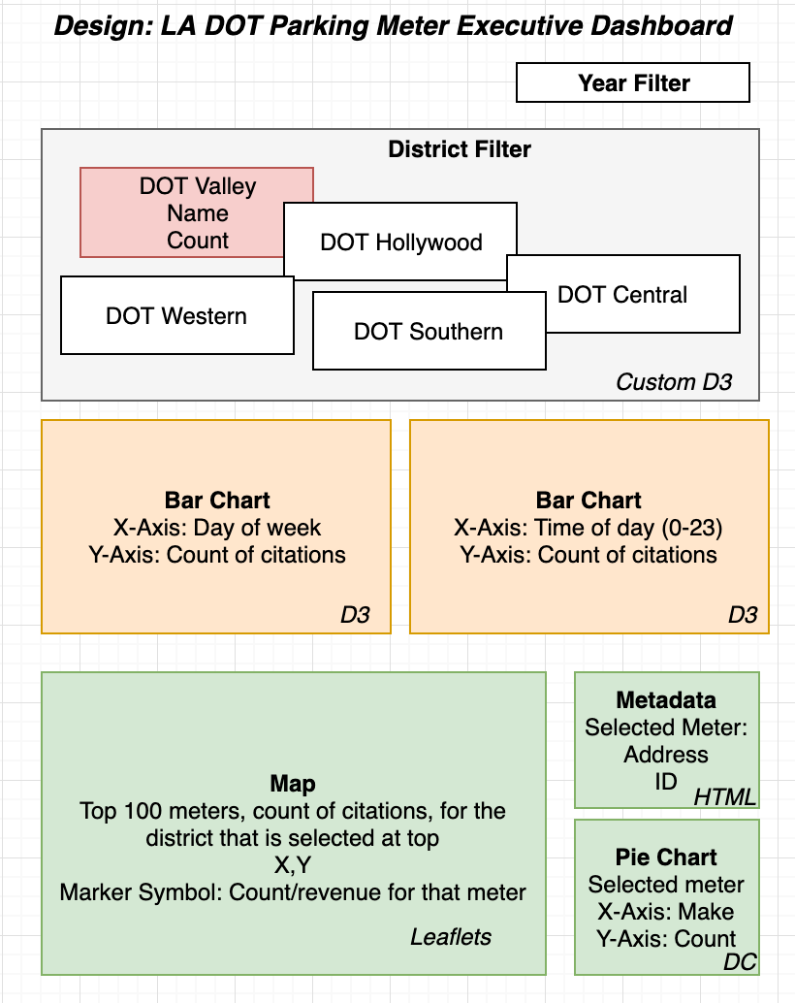
Use Interactive means to tell this story through visualizations
Drop Down: Select the Year
Textboxes: Select the District
Visualizations:
1)Bar Charts: To show relevant numbers.
2)Map to show physical locations

Slide 3

DEMO

Slide 4
Architecture Overview
External Libraries
mapbox-gl
d3
bootstrap
Server with RESTful Endpoints
Data Preparation
Endpoints
Flask
Client Application
getAgencies
Jupyter Notebook
HTML
Call endpoints
getAgencyDetails
getMeterDetails
Generated database
CSS
CSV
JS
SQLite

Slide 5
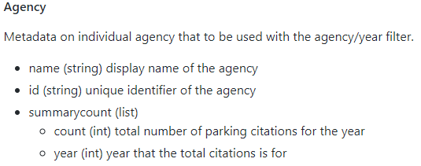
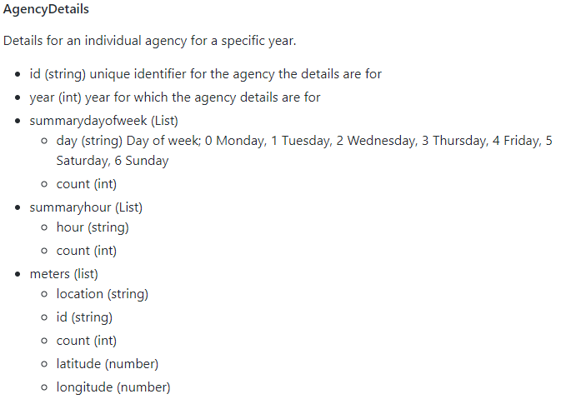
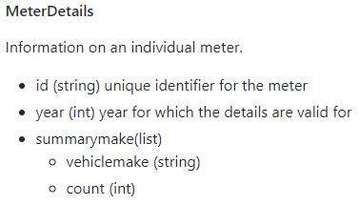
DTO’s: Data transfer Object diagram:

Slide 6
Source Data
Los Angles parking citation data from Kaggle website
https://www.kaggle.com/cityofLA/los-angeles-parking-citations
1.3 GB CSV file
9.3 million records
Required to prepare data for fast interaction with website
Used Jupyter Notebook to prepare data
Load in CSV, transform and then export to SQLite

Slide 7
Transformation
Filter for “meter expired” citation type
Group by DOT District and year
Calculate day of week, time of day and determine top 100 parking meters
Coordinates in state plane coordinate system
Example: 6451860.6, 1890192.1
Mapbox requires Lat/long and found Python library (pyproj) to project coordinates
Done during transformation to improve performance

Slide 8
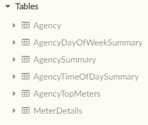
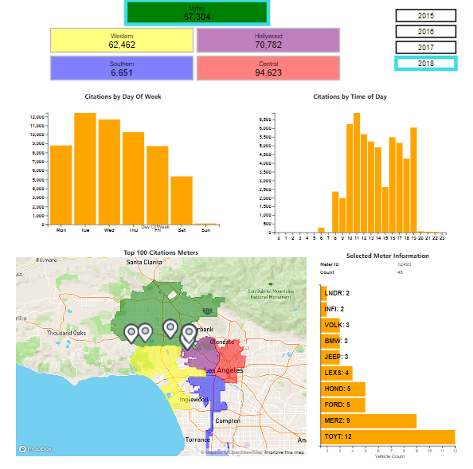
Endpoints
SQLite DB
Flask App
Visualization
REST End Points
Agency: region id, summary counts by year
AgencyDetails: region id, year, summarized counts by day of week, hour of day, and meter list
MeterDetails: meter id, year, summary count by vehicle make

Slide 9
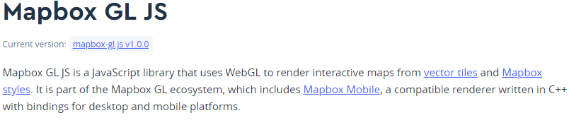

MAP
GeoJSON for District Boundaries
Mapbox GL Library:
Uses vector tiles
Concise syntax
Begins as “map” object
“map” object exposes methods to add markers, fire events, etc.
GeoJSON:
Polygon boundaries of DOT districts

Slide 10
Demonstration and Summary

Slide 11
Questions?

