Slide 1
Title Provide an executive summary for the parking citations for the different LA DOT (Department of Transport) districts.
Fiona

Slide 2
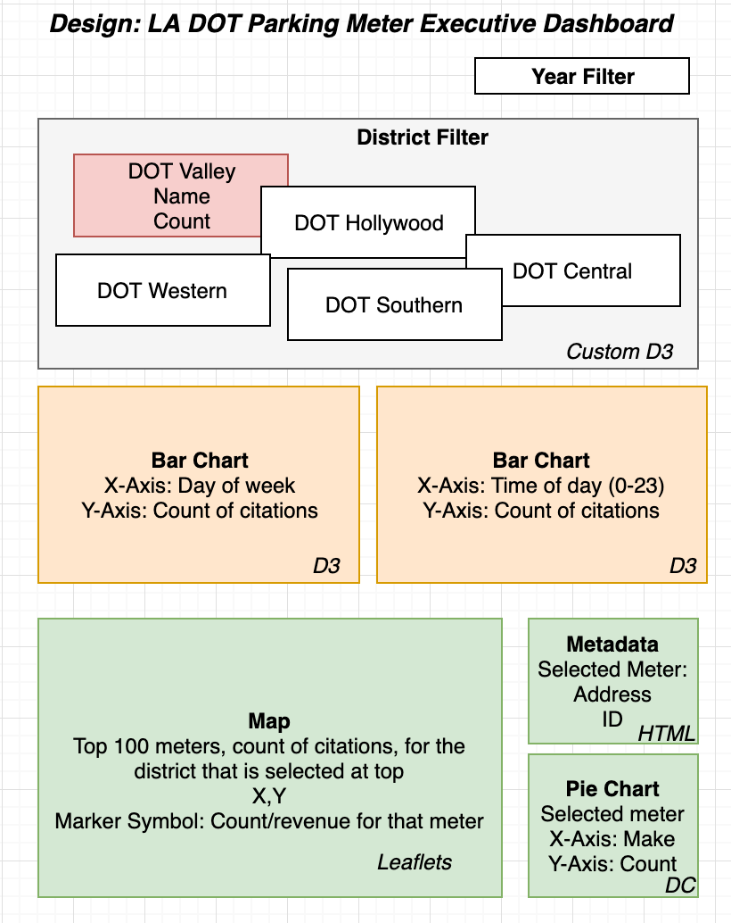
Original Plan: Fiona

Slide 3
DEMO Identify each component Fiona

Slide 4
Code Approach
External Libraries
mapbox-gl
d3
bootstrap
Server with RESTful Endpoints
Data Preparation
Endpoints
Flask
Client Application
getAgencies
Jupyter Notebook
HTML
Call endpoints
getAgencyDetails
getMeterDetails
Generated database
CSS
CSV
JS
SQLite

Slide 5
DTO’s: Data transfer Object diagram: David

Slide 6
Source Data
Los Angles parking citation data from Kaggle website
https://www.kaggle.com/cityofLA/los-angeles-parking-citations
1.3 GB CSV file
9.3 million records
Required to prepare data for fast interaction with website
Used Jupyter Notebook to prepare data
Load in CSV, transform and then export to SQLite

Slide 7
Transformation
Filter for “meter expired” citation type
Group by DOT District and year
Calculate day of week, time of day and determine top 100 parking meters
Coordinates in state plane coordinate system
Example: 6451860.6, 1890192.1
Mapbox requires Lat/long and found Python library (pyproj) to project coordinates
Done during transformation to improve performance

Slide 8
Endpoints
DAvid

Slide 9
Key visualizations
MAP coustom JS
Separated logic into JS
DAvid

Slide 10
Last DEMO
Fiona

