Slide 1
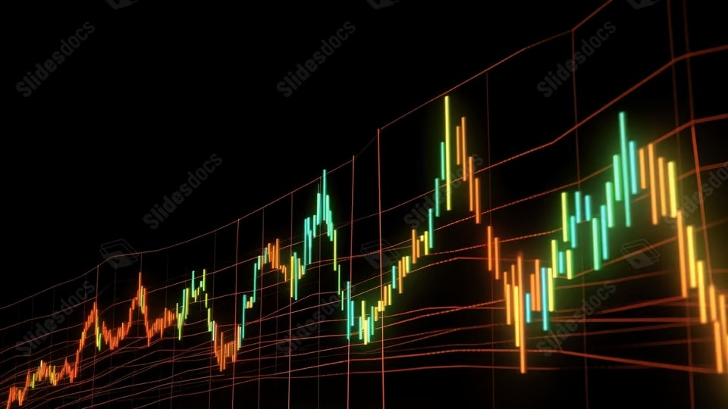
Portfolio Performance Overview
Last updated on the 03 January 2026 at 01:07 PM

Slide 2
Trade Plan and Brokerage Overview
Total Portfolio: $100,912.96 (-888.53) Total Brokerage: $99.00 Net Invested: $101,272.23 (-763.97)
Security | Current | Target | Change | Last Price | Brokerage | Cash Flow
A200 | 21 | 21 | 0 | $145.21 | $0.00 | $0.00
IEU | 97 | 96 | -1 | $101.61 | $11.00 | -$101.61
IJP | 6 | 6 | 0 | $120.85 | $0.00 | $0.00
IOO | 43 | 42 | -1 | $187.91 | $11.00 | -$187.91
IVV | 103 | 102 | -1 | $68.31 | $11.00 | -$68.31
MTUM | 25 | 25 | 0 | $28.75 | $0.00 | $0.00
MVW | 55 | 57 | 2 | $38.14 | $11.00 | $76.28
QHAL | 55 | 55 | 0 | $53.17 | $0.00 | $0.00
QLTY | 165 | 164 | -1 | $32.92 | $11.00 | -$32.92
QUAL | 83 | 82 | -1 | $61.81 | $11.00 | -$61.81
SMH | 1 | 1 | 0 | $558.97 | $0.00 | $0.00
Security | Current | Target | Change | Last Price | Brokerage | Cash Flow
SMLL | 1117 | 1117 | 0 | $4.68 | $0.00 | $0.00
SPY | 1 | 1 | 0 | $1,022.97 | $0.00 | $0.00
VAS | 27 | 27 | 0 | $108.26 | $0.00 | $0.00
VDHG | 103 | 103 | 0 | $74.00 | $0.00 | $0.00
VGE | 98 | 97 | -1 | $89.68 | $11.00 | -$89.68
VGS | 55 | 55 | 0 | $153.21 | $0.00 | $0.00
VLU | 0 | 0 | 0 | $317.54 | $0.00 | $0.00
VLUE | 189 | 188 | -1 | $33.50 | $11.00 | -$33.50
VMIN | 116 | 117 | 1 | $62.98 | $0.00 | $62.98
VSO | 66 | 67 | 1 | $77.21 | $11.00 | $77.21
VVLU | 41 | 41 | 0 | $79.98 | $0.00 | $0.00
Cash: -359 AUD

Slide 3
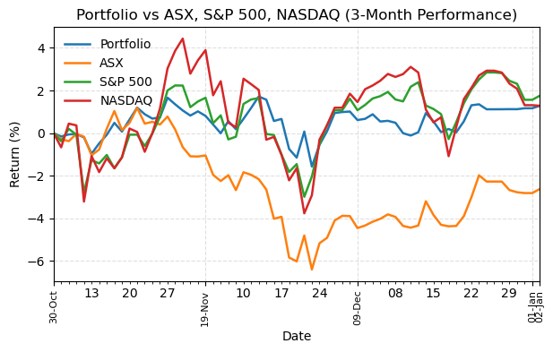
Portfolio Performance
Return Summary
 | 3M | 6M | 12M | 3Y
Portfolio | 1.91% | 9.73% | 16.14% | 39.18%
ASX | -1.28% | 2.80% | 7.11% | 24.88%
S&P 500 | 2.35% | 10.32% | 16.39% | 78.29%
NASDAQ | 2.57% | 14.10% | 20.36% | 122.06%

Slide 4
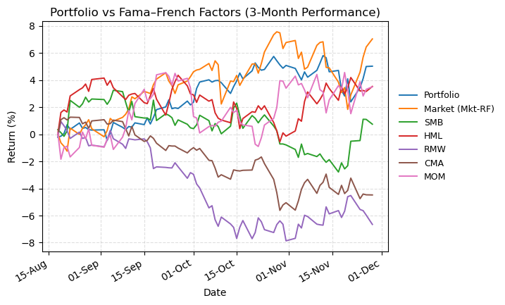
Fama–French Benchmarks vs Portfolio
Return Summary
 | 3M | 6M | 12M | 3Y
Portfolio | 4.50% | 12.71% | 18.03% | 38.45%
Market (Mkt-RF) | 6.29% | 17.25% | 15.43% | 48.96%
SMB | -1.94% | 1.93% | -10.60% | -16.82%
HML | -0.17% | 0.77% | 0.17% | -5.00%
RMW | -6.44% | -9.65% | -9.85% | -8.55%
CMA | -5.33% | -4.00% | -5.63% | -12.92%
MOM | 3.86% | 1.22% | 4.86% | 30.01%

Slide 5
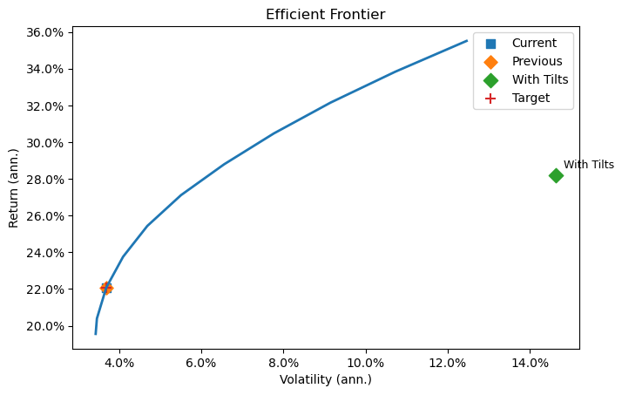
Efficient Frontier
Point | Vol (ann.) | Return (ann.)
Current | 3.68% | 22.05%
Previous | 3.68% | 22.05%
With Tilts | 14.59% | 28.15%
Target | 3.69% | 22.08%
Factor | With Tilts | Without Tilts | Target | With - Target | Without - Target
Mkt-RF | 0.685 | 0.050 | 0.885 | -0.200 | -0.835
SMB | -0.046 | -0.003 | -0.035 | -0.011 | 0.032
HML | 0.199 | 0.086 | 0.394 | -0.195 | -0.308
RMW | -0.081 | 0.016 | -0.126 | 0.045 | 0.142
CMA | 0.088 | -0.057 | 0.100 | -0.012 | -0.157
MOM | -0.020 | 0.047 | -0.099 | 0.079 | 0.146

