Slide 1
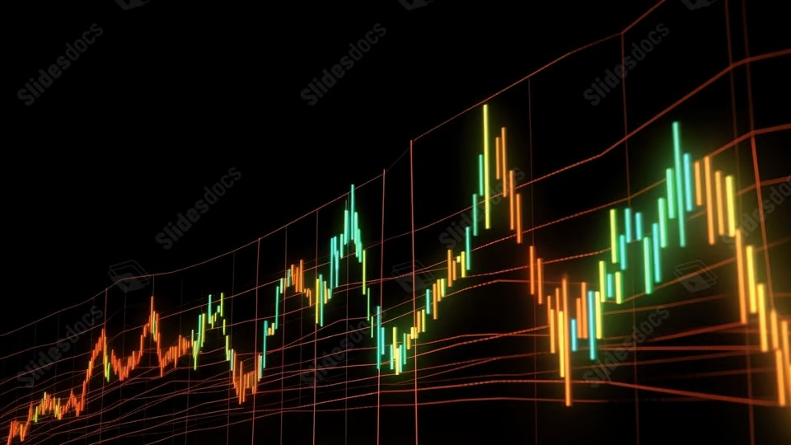
Portfolio Performance Overview
Last updated on the 03 January 2026 at 02:30 PM

Slide 2
Trade Plan and Brokerage Overview
Total Portfolio: $100,865.37 Total Brokerage: $44.00 Net Invested: $101,068.80
Security | Current | Target | Change | Last Price | Brokerage | Cash Flow
A200 | 21 | 21 | 0 | $145.21 | $0.00 | $0.00
IEU | 96 | 96 | 0 | $101.61 | $0.00 | $0.00
IJP | 6 | 6 | 0 | $120.85 | $0.00 | $0.00
IOO | 42 | 42 | 0 | $187.91 | $0.00 | $0.00
IVV | 102 | 102 | 0 | $68.31 | $0.00 | $0.00
MTUM | 25 | 25 | 0 | $28.75 | $0.00 | $0.00
MVW | 57 | 57 | 0 | $38.14 | $0.00 | $0.00
QHAL | 55 | 55 | 0 | $53.17 | $0.00 | $0.00
QLTY | 164 | 164 | 0 | $32.92 | $0.00 | $0.00
QUAL | 82 | 82 | 0 | $61.81 | $0.00 | $0.00
SMH | 1 | 1 | 0 | $558.97 | $0.00 | $0.00
Security | Current | Target | Change | Last Price | Brokerage | Cash Flow
SMLL | 1117 | 1113 | -4 | $4.68 | $11.00 | -$18.72
SPY | 1 | 1 | 0 | $1,022.97 | $0.00 | $0.00
VAS | 27 | 27 | 0 | $108.26 | $0.00 | $0.00
VDHG | 103 | 102 | -1 | $74.00 | $11.00 | -$74.00
VGE | 97 | 97 | 0 | $89.68 | $0.00 | $0.00
VGS | 55 | 55 | 0 | $153.21 | $0.00 | $0.00
VLU | 0 | 0 | 0 | $317.54 | $0.00 | $0.00
VLUE | 188 | 187 | -1 | $33.50 | $11.00 | -$33.50
VMIN | 117 | 117 | 0 | $62.98 | $0.00 | $0.00
VSO | 67 | 66 | -1 | $77.21 | $11.00 | -$77.21
VVLU | 41 | 41 | 0 | $79.98 | $0.00 | $0.00
Cash: -203 AUD

Slide 3
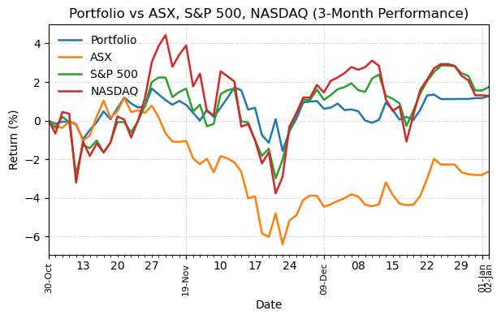
Portfolio Performance
Return Summary
 | 3M | 6M | 12M | 3Y
Portfolio | 1.91% | 9.72% | 16.13% | 39.18%
ASX | -1.28% | 2.80% | 7.11% | 24.88%
S&P 500 | 2.35% | 10.32% | 16.39% | 78.29%
NASDAQ | 2.57% | 14.10% | 20.36% | 122.06%

Slide 4
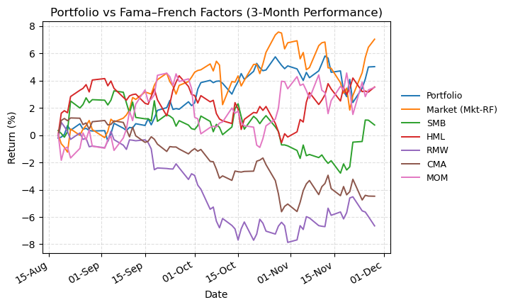
Fama–French Benchmarks vs Portfolio
Return Summary
 | 3M | 6M | 12M | 3Y
Portfolio | 4.50% | 12.71% | 18.02% | 38.46%
Market (Mkt-RF) | 6.29% | 17.25% | 15.43% | 48.96%
SMB | -1.94% | 1.93% | -10.60% | -16.82%
HML | -0.17% | 0.77% | 0.17% | -5.00%
RMW | -6.44% | -9.65% | -9.85% | -8.55%
CMA | -5.33% | -4.00% | -5.63% | -12.92%
MOM | 3.86% | 1.22% | 4.86% | 30.01%

Slide 5
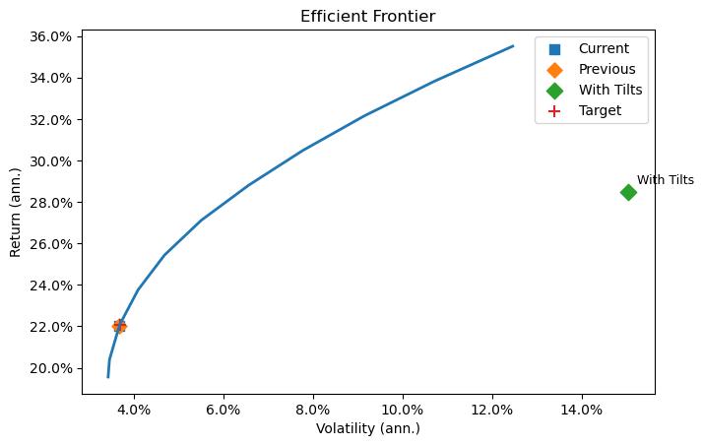
Efficient Frontier
Point | Vol (ann.) | Return (ann.)
Current | 3.68% | 22.01%
Previous | 3.68% | 22.02%
With Tilts | 14.99% | 28.41%
Target | 3.69% | 22.08%
Factor | Tilted Portfolio | Target Tilt | Optimised Portfolio
Mkt-RF | 0.685 | 0.885 | 0.050
SMB | -0.037 | -0.035 | -0.003
HML | 0.217 | 0.394 | 0.086
RMW | -0.079 | -0.126 | 0.016
CMA | 0.098 | 0.100 | -0.057
MOM | -0.012 | -0.099 | 0.047

