Slide 1
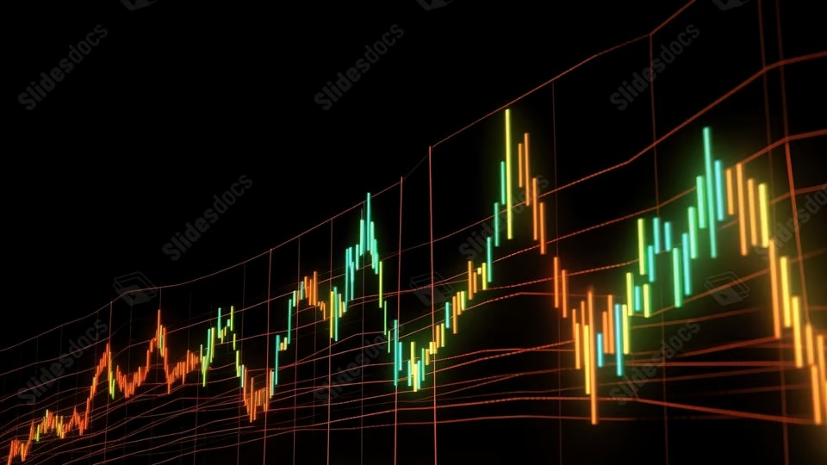
Portfolio Performance Overview
Last updated on the 19 March 2026 at 06:36 PM

Slide 2
Trade Plan and Brokerage Overview
Total Portfolio: $139,526.64 Total Brokerage: $198.00 Net Invested: $139,811.05
Security | Current | Target | Change | Last Price | Brokerage | Cash Flow
A200 | 36 | 38 | 2 | $143.15 | $11.00 | -$286.30
IEU | 129 | 131 | 2 | $94.54 | $11.00 | -$189.08
IJP | 18 | 13 | -5 | $118.60 | $11.00 | $593.00
IOO | 59 | 60 | 1 | $171.35 | $11.00 | -$171.35
IVV | 130 | 128 | -2 | $62.73 | $11.00 | $125.46
MTUM | 77 | 81 | 4 | $27.14 | $11.00 | -$108.56
MVW | 65 | 61 | -4 | $36.52 | $11.00 | $146.08
QHAL | 76 | 82 | 6 | $52.03 | $11.00 | -$312.18
QLTY | 163 | 159 | -4 | $30.19 | $11.00 | $120.76
QUAL | 101 | 102 | 1 | $57.21 | $0.00 | -$57.21
SMH | 7 | 7 | 0 | $590.51 | $0.00 | $0.00
Security | Current | Target | Change | Last Price | Brokerage | Cash Flow
SMLL | 1668 | 1719 | 51 | $4.18 | $11.00 | -$213.18
SPY | 0 | 0 | 0 | $992.14 | $0.00 | $0.00
VAS | 48 | 51 | 3 | $106.02 | $11.00 | -$318.06
VDHG | 147 | 150 | 3 | $71.34 | $11.00 | -$214.02
VGE | 116 | 118 | 2 | $85.11 | $11.00 | -$170.22
VGS | 72 | 71 | -1 | $141.75 | $11.00 | $141.75
VLUE | 408 | 400 | -8 | $33.35 | $11.00 | $266.80
VMIN | 118 | 115 | -3 | $64.90 | $11.00 | $194.70
VSO | 106 | 108 | 2 | $68.98 | $11.00 | -$137.96
VVLU | 96 | 92 | -4 | $76.29 | $11.00 | $305.16
[x] With Tilts [ ] Optimised (No Tilts) | Trade plan
Cash: -284 AUD

Slide 3
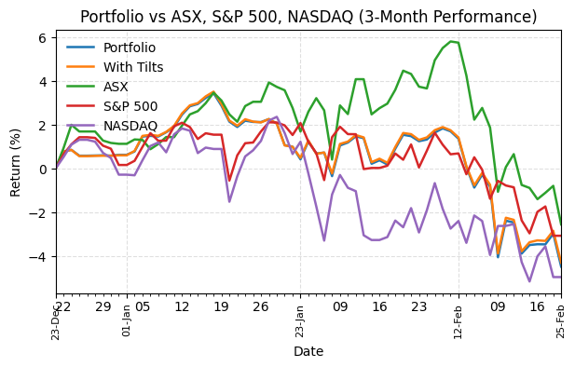
Portfolio Performance
Return Summary | 3M | 6M | 12M | 3Y
Portfolio | -4.48% | -1.56% | 11.05% | 22.46%
With Tilts | -4.30% | -1.14% | 12.18% | 24.36%
ASX | -0.32% | -2.03% | 9.37% | 23.09%
S&P 500 | -2.21% | -0.11% | 17.99% | 69.14%
NASDAQ | -3.71% | -1.42% | 26.56% | 90.47%

Slide 4
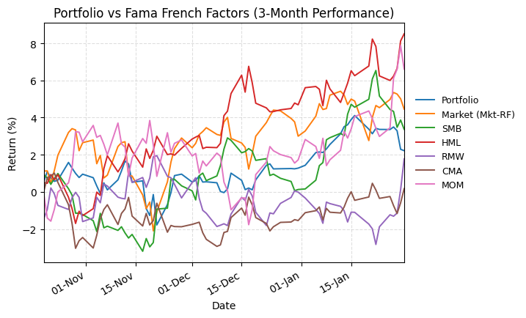
Fama French Benchmarks vs Portfolio
Return Summary | 3M | 6M | 12M | 3Y
Portfolio | 1.21% | 9.62% | 16.33% | 29.67%
Market (Mkt-RF) | 1.09% | 10.22% | 16.61% | 38.85%
SMB | 4.57% | 4.89% | -3.37% | -5.74%
HML | 10.38% | 8.23% | 8.09% | 7.15%
RMW | 1.80% | -4.61% | -7.50% | -6.40%
CMA | 3.31% | -3.23% | -0.46% | -8.42%
MOM | 3.26% | 9.01% | 8.46% | 19.37%

Slide 5
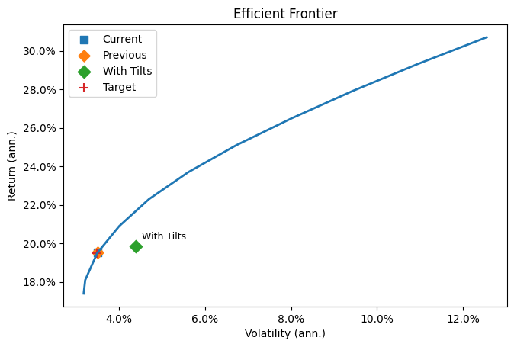
Efficient Frontier
Portfolio | Volatility | Return
Current | 3.51% | 19.53%
Previous | 3.51% | 19.54%
Optimised | 3.50% | 19.50%
With Tilts | 4.34% | 19.82%
Target | 3.50% | 19.50%
Factor | Achieved Tilt | Target Tilt
Mkt-RF |  | 0.215
SMB |  | 0.014
HML |  | 0.192
RMW |  | 0.095
CMA |  | 0.011
MOM |  | 0.072

