Slide 1
AI-Powered Programming Quiz Application.
Fionn McGoldrick
G00422349
Supervisor:
Douglas Mota Dias

Slide 2
Context & Objectives
Context:
Many beginners struggle with long programming tutorials and lectures.
Platforms like LeetCode focus on advanced problems and can be difficult for beginners.
Objectives:
Create short beginner friendly programming challenges
Use AI to adapt difficulty and give instant feedback
Measure success through user progress and completed challenges
Why this is interesting
I have experienced these difficulties myself and seen them affect other students.

Slide 3
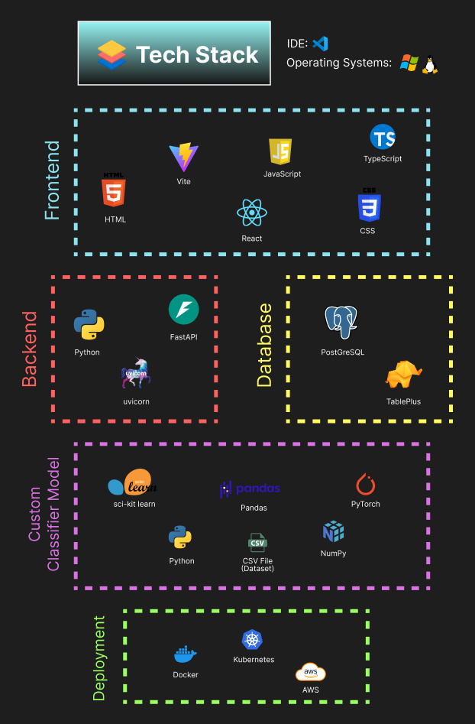
Technologies & System Architecture
Frontend uses React with TypeScript to build an interactive and reliable user interface. Vite for faster development experience.
Backend uses Python with FastAPI because it is fast and easy to connect with AI features.
PostgreSQL is used to store user data and learning progress safely. I had not used it. Supports clear relationships between data such as users lessons and results.
Python is used for AI logic because it has strong support for machine learning tools.
Docker is used to make deployment simple and consistent across systems.

Slide 4

Development & Deployment
Current Implemented Features:
Registering users to PostGreSQL (Set up with TablePlus).
Logging in validation.
AI responses from Ollama local models and OpenAI API.
Quiz Generation and correct / incorrect functionality.

Slide 5
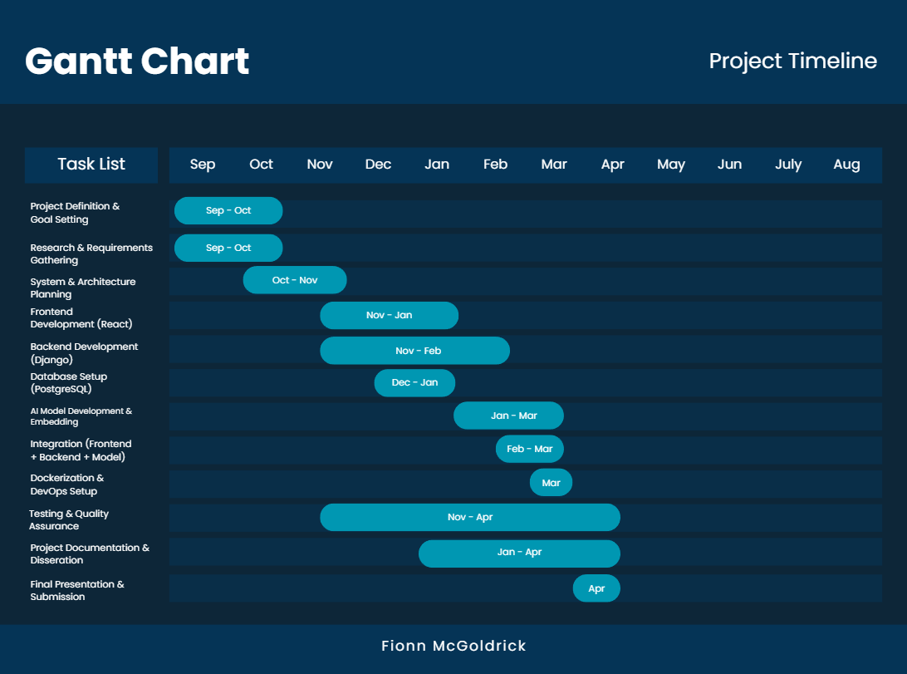
Work Plan

