Slide 1


Integrating Large Language Models into Programming Education: Opportunities, Challenges, and Learning Impacts
Research Methods In Computing & IT.
Computing & Applied Physics.
Fionn McGoldrick
G00422349

Slide 2
Why This Topic Matters (Context & Problem)
Cognitive Overload
Programming education has had long-standing challenges.
Recent LLM tools have entered classrooms rapidly.
However, we need to understand the educational impact.
Traditional Obstacles in Education
Limited feedback and support
Limited / Delayed Feedback

Slide 3
Methodology
Searching
Inclusion or exclusion Criteria
Thematic Coding
Theme Generation
  ACM, IEEE, MDPI, arXiv.
Inclusion Criteria:
Relevance to LLMs in programming education.
Focus on programming, feedback and adaptive learning.
Methodological soundness.
Exclusion Criteria:
Absence of peer review or formal archive status, opinion pieces, and non-academic commentary.
A lack of direct relevance.
Insufficient methodological detail (e.g. anecdotal reports).

Slide 4
Applications of LLMs
Code Generation
Code Explanation
Debugging Support
Automated Feedback

Slide 5
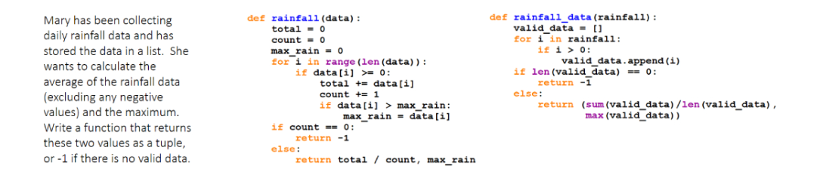
Code Generation
Finnie-Ansley, J., Denny, P., Becker, B. A., Luxton-Reilly, A. & Prather, J. (2022). The Robots Are Coming: Exploring the Implications of OpenAI Codex on Introductory Programming.
LLMs can turn natural language prompts into working code.
Most effective when students analyse, not copy, generated solutions.
Notes:
5

Slide 6
Debugging, Explanation, and Feedback
LLM Feature | What it Provides | Educational Benefit | Limitation
Debugging | Error identification | Fixing errors faster | May hide reasoning
Explanation | Concept breakdown | Helps novices understand | Risk of inaccuracies
Feedback | Personalised comments | Enables personalised feedback to be delivered at scale | Over-reliance risk

Slide 7
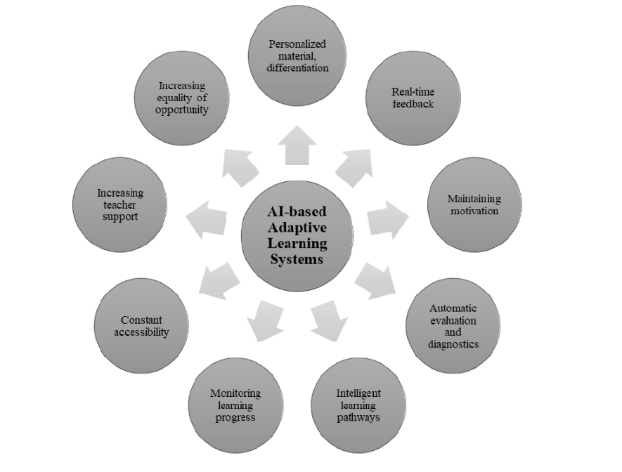
Benefits & Opportunities
On-demand support
Key Benefits
Accessibility Equity
Personalisation
Gyonyoru, I. K. K. (2024). The Role of AI-based Adaptive Learning Systems in Digital Education. Journal of Applied Technical and Educational Sciences
Engagement gains

Slide 8
Challenges & Limitations
Challenge | Evidence from Studies
Over-reliance | Lower grades with heavy LLM use (Jošt et al.)
Hallucination | Incorrect but confident code (Kasneci et al.)
Academic integrity | AI-generated solutions issues
Bias & transparency | Limited explainability

Slide 9
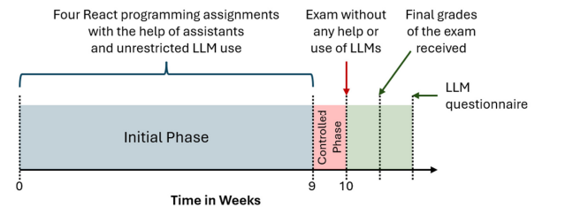
Negative Learning Outcomes Associated with LLM Dependence
Results:
Heavy LLM usage led to lower grade overall.
Most harmful: relying on LLMs for code generation.
Also harmful: using LLMs for lots of debugging.
Least harmful: using LLMs for extra explanations.
Students who used LLMs more frequently across all tasks showed a downward grade trend.
Jošt, G., Taneski, V. & Karakatič, S. (2024). The Impact of Large Language Models on Programming Education and Student Learning Outcomes.

Slide 10
Impact on Learning Outcomes
Data derived from: Jacobs (2024); Deriba (2023); Leinonen (2022); Jošt et al. (2023); Kasneci (2023); Yousef (2025);
Short-Term Improvements: LLMs boost immediate performance by helping students fix errors faster, understand syntax quickly, and complete tasks more efficiently.
Long-Term Concerns: But heavy reliance can weaken problem-solving skills, lower exam scores, and reduce independent debugging ability.
Mixed Outcomes: Some studies show benefits only when use is guided. Unguided use leads to shallow understanding and misconceptions.

Slide 11
Future Research Direction
Reducing Hallucinations
Accessibility Issues
LLM Reliability & Integration
Equity, Ethics & Integrity
IDE-Integrated Tutors
Integrity Guidelines
Adaptive Personalisation Systems
Difficulty Adjustment
My Literature Review
Independent Problem-Solving
Long Term Learning
Dependent Skills
Concept Retention

Slide 12
References
Deriba, F. G., Sanusi, I. T., & Sunday, A. O. (2023). Enhancing Computer Programming Education using ChatGPT: A Mini Review. In Proceedings of the 23rd Koli Calling International Conference on Computing Education Research (Koli Calling '23). ACM.
Finnie-Ansley, J., Denny, P., Becker, B. A., Luxton-Reilly, A., & Prather, J. (2022). The Robots Are Coming: Exploring the Implications of OpenAI Codex on Introductory Programming. In Proceedings of the 24th Australasian Computing Education Conference (ACE '22), February 14–18, 2022, Virtual Event, Australia (pp. 10–19). ACM. https://doi.org/10.1145/3511861.3511863
Gyöngyörű, I. K. K. (2024). The Role of AI-based Adaptive Learning Systems in Digital Education. Journal of Applied Technical and Educational Sciences, 14(2), Article 380. https://doi.org/10.24368/jates380
Jošt, G., Taneski, V., & Karakatič, S. (2024). The Impact of Large Language Models on Programming Education and Student Learning Outcomes. Applied Sciences, 14(10), 4115. https://doi.org/10.3390/app14104115
Kasneci, E., Seßler, K., Küchemann, S., Bannert, M., Dementieva, D., Fischer, F., Gasser, U., Groh, G., Günnemann, S., Hüllermeier, E., Krusche, S., Kutyniok, G., Michaeli, T., Nerdel, C., Pfeffer, J., Poquet, O., Sailer, M., Schmidt, A., Seidel, T., Stadler, M., Weller, J., Kuhn, J., & Kasneci, G. (2023). ChatGPT for Good? On Opportunities and Challenges of Large Language Models for Education. Learning and Individual Differences, 103, 102274. https://doi.org/10.1016/j.lindif.2023.102274
Leinonen, J., Hellas, A., Sarsa, S., Reeves, B., Denny, P., Prather, J., & Becker, B. A. (2023). Using Large Language Models to Enhance Programming Error Messages. In Proceedings of the 54th ACM Technical Symposium on Computer Science Education V. 1 (pp. 563–569). ACM.

Slide 13
THANK YOU.
Questions welcome.
Research Methods In Computing & IT.
Engineering & Computing.
Fionn McGoldrick G00422349

