Slide 1
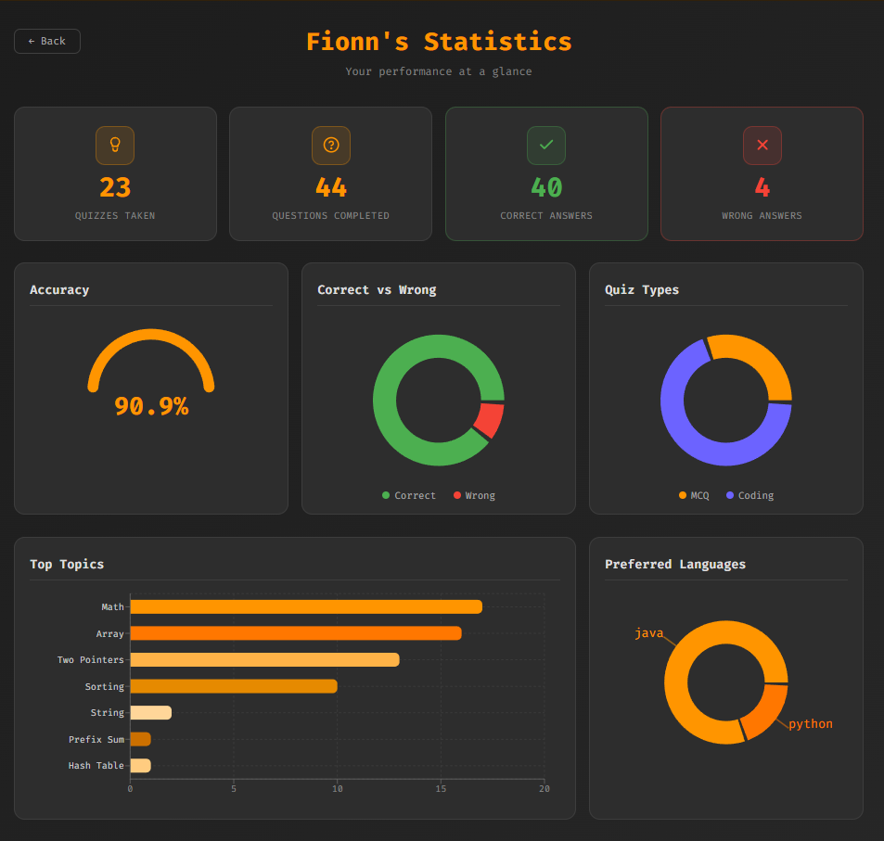
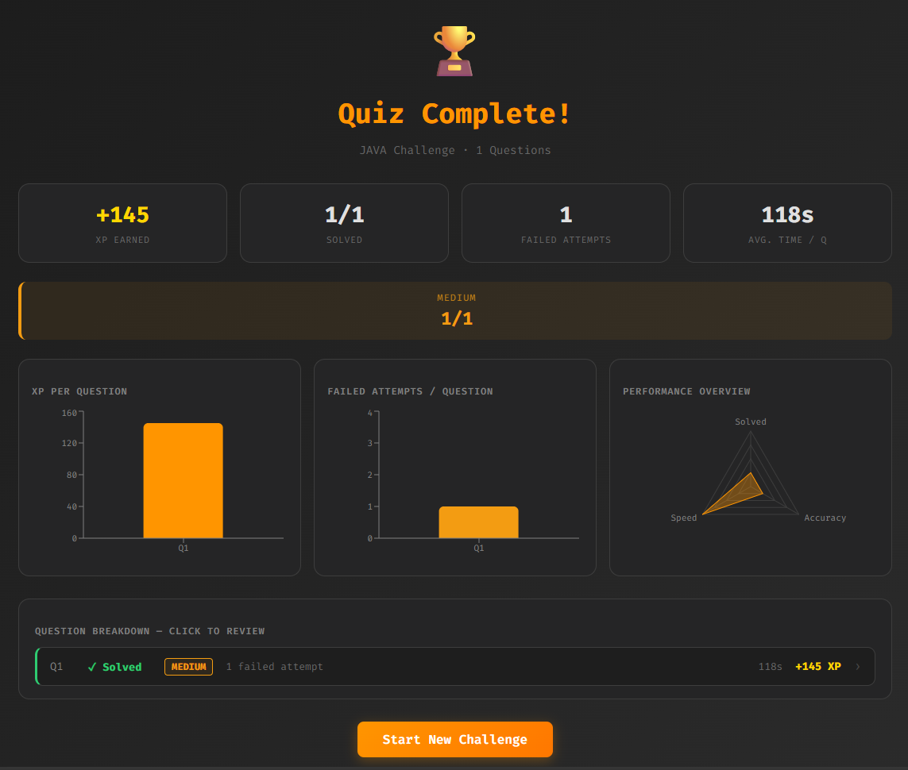


















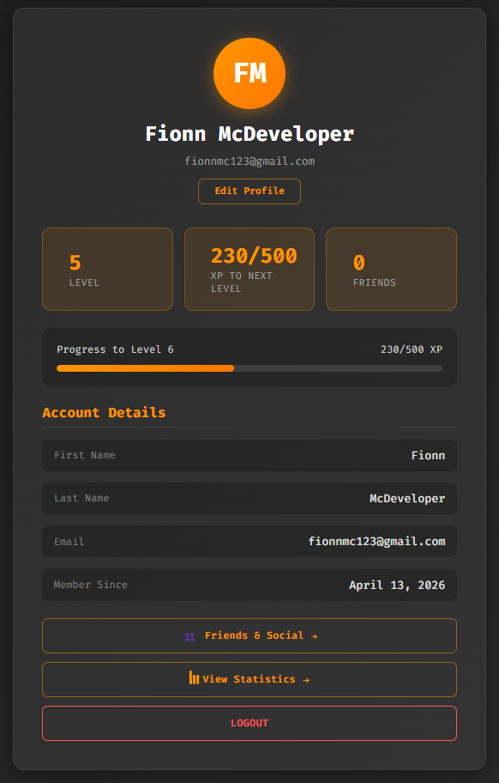








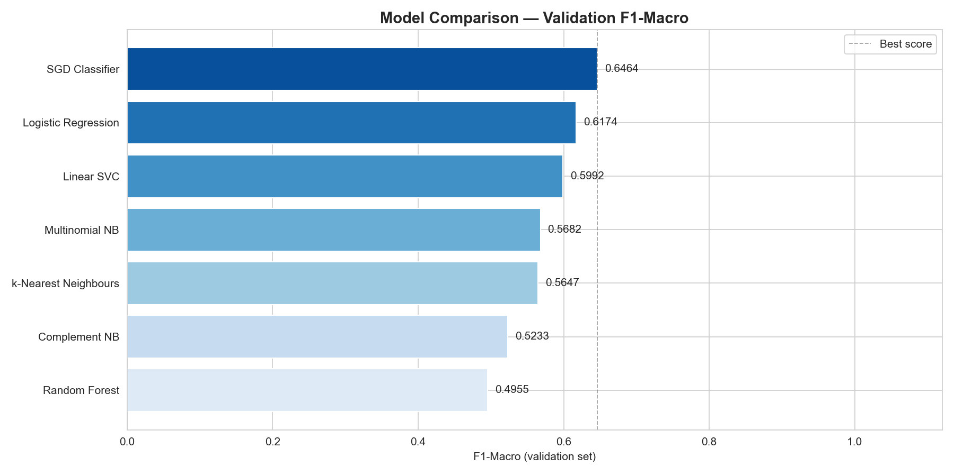

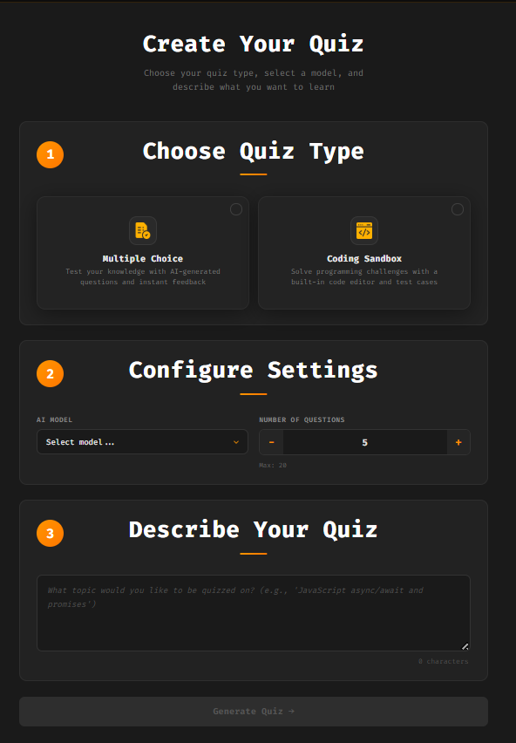
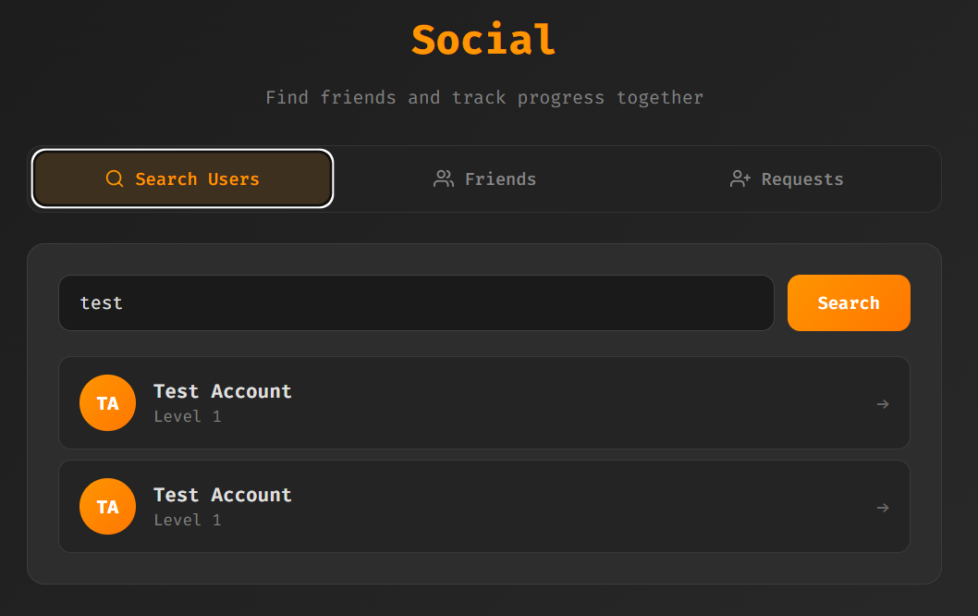

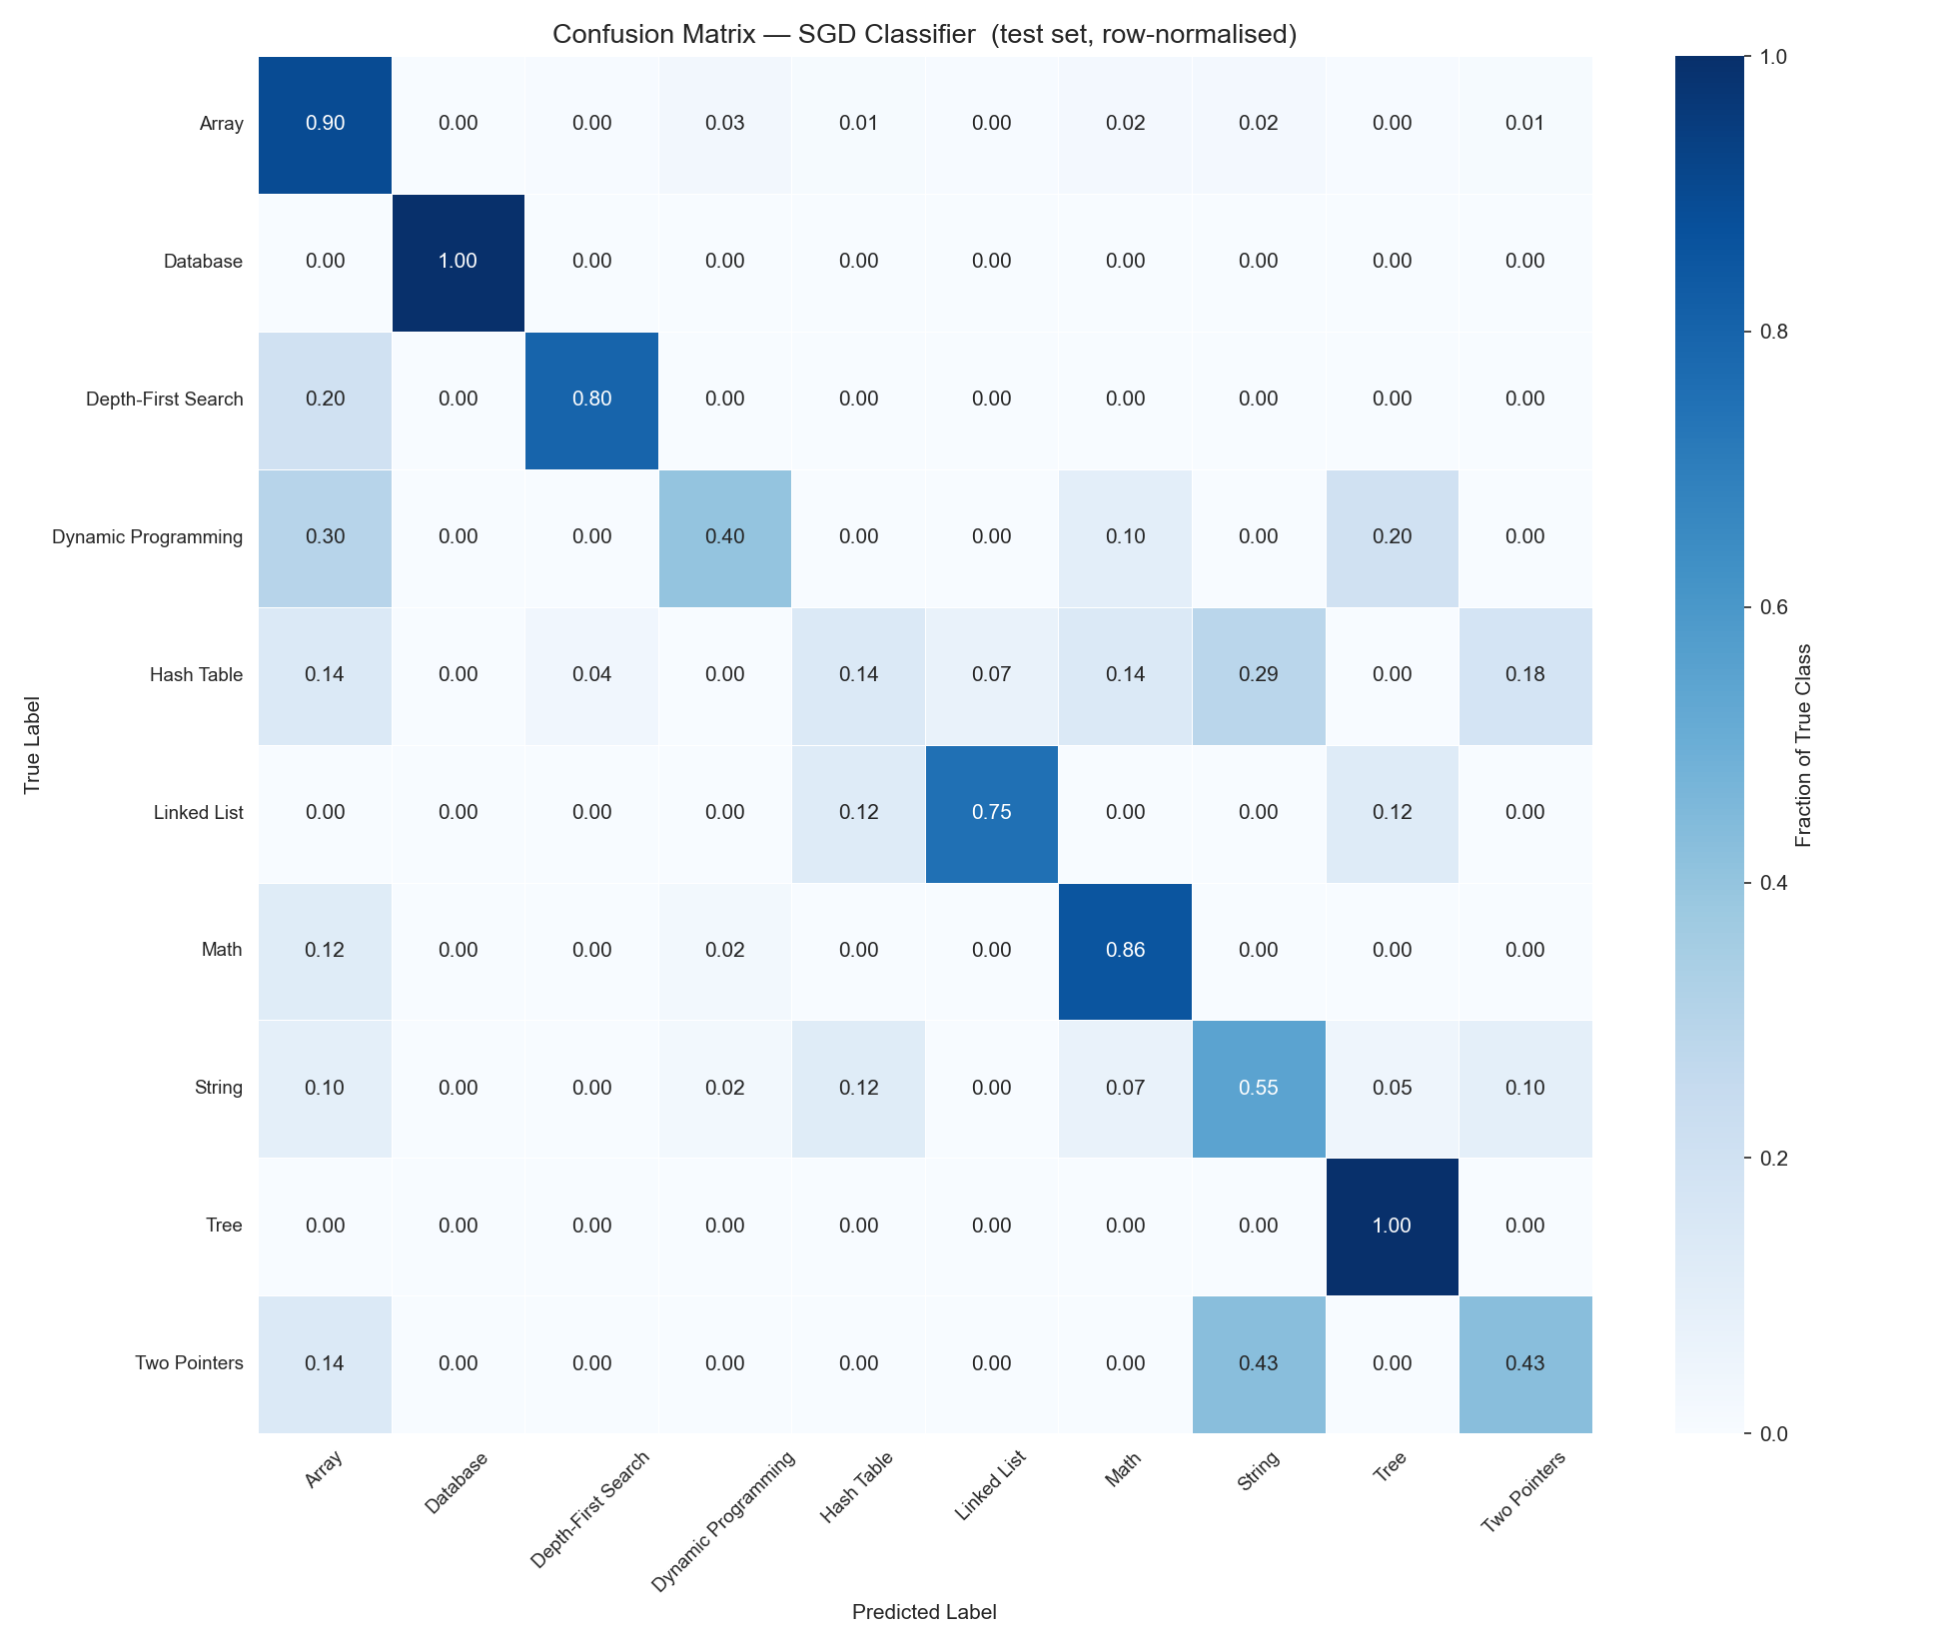
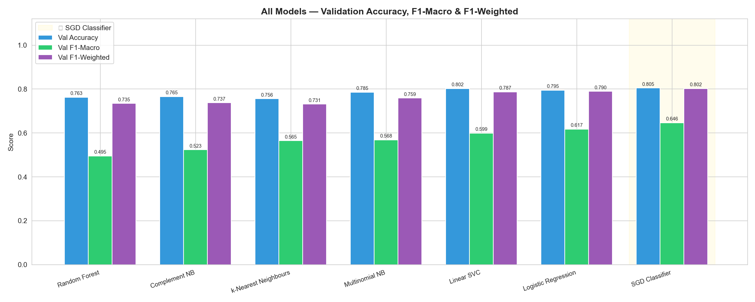
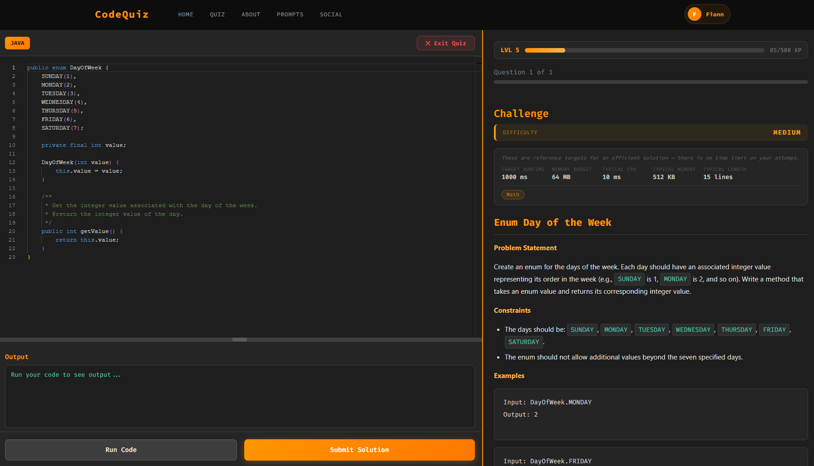
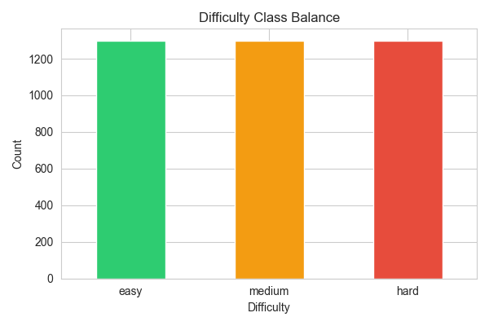
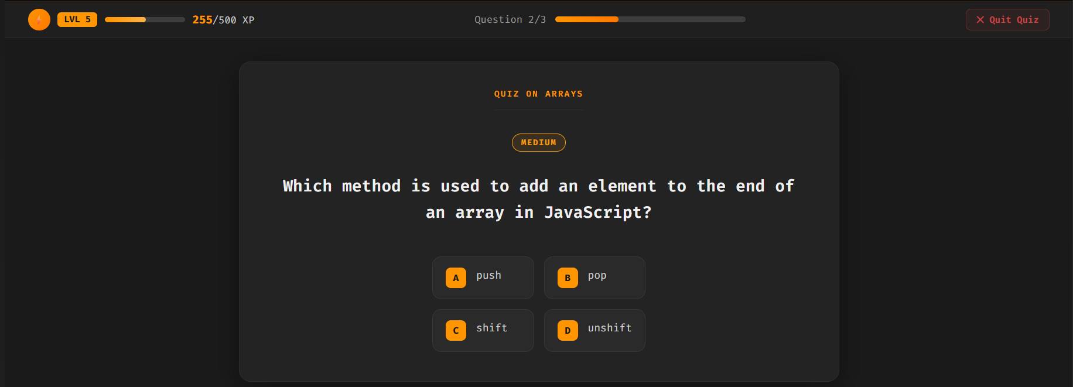
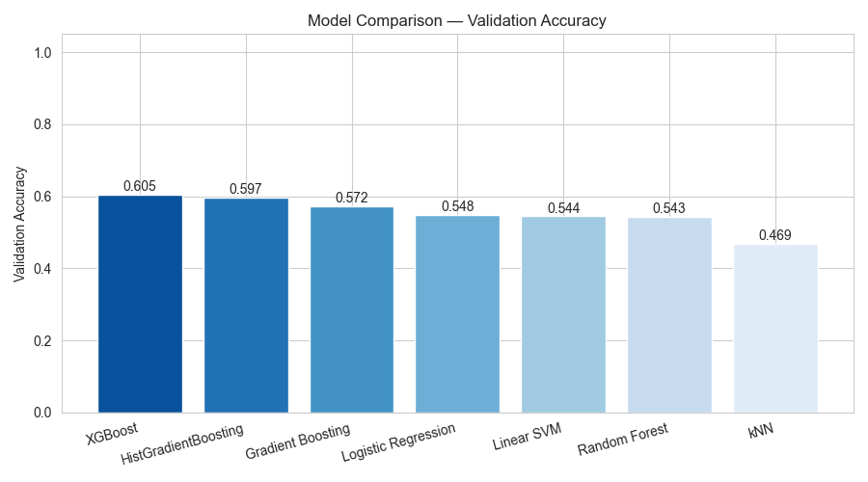
Code Quiz: An AI-Driven Platform for Adaptive Code Assessment and Gamified Learning
Fionn McGoldrick | Atlantic Technological University (ATU Galway)
GitHub: https://github.com/fionnmcgoldrick123/programming-quiz-app
Introduction & Motivation
Performance Tracking and Statistics
Topic Tag Classifier
LLM-generated quizzes with real-time ML difficulty prediction and topic tagging.
Training Data: Leetcode Dataset
LeetCode problem dataset, title plus problem description plus topic tags per row
Tags appearing in fewer than 60 problems excluded, leaving 10 classes
Motivation
Array
String
Math
Hash Table
Table
Dynamic Programming
Binary Search
Recursion
Graph
Linked List
App Tracks User …
Title + description combined
HTML removed (regex)
TF-IDF (word 1–3, char 3–5)
Word n-grams → phrases
Char n-grams → code tokens
Education cost
Static platforms
Unstructured
AI output
Personalised
learning
Difficult platforms
Features
Tech Stack
Strongest
Topics
Accuracy
History
Programming
Preferences
Frontend
Backend
Database
Machine Learning
Gamification & Social
FeatureUnion concatenates word and char TF-IDF outputs into one feature matrix
Sublinear TF scaling and English stop word removal applied to word vectoriser
Personal user accounts
Preprocessing
Persistent User-Specific
Data Displayed
60
20
20
Training
Infrastructure
User Account Customisation
Train
Validation
Test
All models wrapped in OneVsRestClassifier for multi-label support
AI Quiz Generation
Level & Current
XP Visible
User Driven AI Quiz Configuration
SGD Classifier
MCQ + Coding
AI Models: GPT-4o, Llama
Question Limit: 20
Topic Prompt
Generate on Submit
Add Friends
View Accounts
Search Users
Coding Sandbox Interface
Difficulty Classifier
Future Work
Training Data: IBM CodeNet Dataset
Open Source
Improve Models
User billing system
4,000+ problems
Acceptance rate → difficulty
Balanced 3 classes
Conclusion
27 features + TF-IDF
CPU, memory, code size
Text stats: words, sentences
Keyword flags (DP, graphs, etc)
Word + char n-grams
Achieved:
Monaco Editor (syntax highlighting)
ML difficulty badge
Runtime, memory, CPU, length
Topic tag badge
Markdown problem + examples
Run | Submit (test cases)
Features
Full stack AI quiz platform
Live ML inference
Difficulty from 27 features
Topic tagging (13 classes)
Code execution (5 languages)
XP, social, persistence
Numeric branch: median imputation then standard scaling
Text branch: FeatureUnion of word and char TF-IDF vectorisers
Preprocessing
References
MCQ Interface
60
20
20
IBM Research. Project CodeNet: A Large-Scale AI for Code Dataset. 2021.
OpenAI. GPT-4o-mini Technical Report. openai.com
Meta AI. Llama 3.1: Open Foundation Models. ai.meta.com
Pedregosa et al. Scikit-learn: Machine Learning in Python. JMLR, 2011.
Chen & Guestrin. XGBoost: A Scalable Tree Boosting System. KDD, 2016.
Microsoft. Monaco Editor. github.com/microsoft/monaco-editor
Training
Train
Validation
Test
7 models benchmarked with RandomizedSearchCV, cv=5, scoring on F1-macro
ML predicted difficulty badge per question
Four answer options A, B, C, D buttons
Question progress tracker
Acknowledgements
XGBoost
A special thank you to my project supervisor Douglas Mota Dias, and to ATU for their support and resources.

