Slide 1
CANVASsing New Possibilities:
Linear Chat Versus Collabora-ve Responsive Wri-ng
How Alternative Online Discussion Forums Could Benefit
Collaborative Written Argumentation
▪ Date
Michael B. Sherry, University of South Florida, mbsherry@usf.edu
Kimberly DeFusco, University of South Florida, defusco@usf.edu
Glenn Smith, University of South Florida, glenns@usf.edu
Notes:
Mike

Slide 2
Online Discussions: Students
Prior research online discussions
Interactions that promote students’ social engagement (Chen, Chang, Ouyang, & Zhou, 2018; Morueta, Lopez, Gomez, & Harris, 2016) )
Quality of student contributions to online discussions, including higher-order thinking and argumentation skills (Beers, Boshuizen, Kirschner, & Gijselaers, 2005; Felton et al., 2019; Pena-Shaff & Nicholls, 2004; Weinberger & Fisher, 2006)
Notes:
Kim
Previous research on online discussions has examined student participation,
particularly what types of interactions promote social engagement
and how to foster quality student contributions that demonstrate higher-order thinking and argumentation skills

Slide 3
Online Discussions: Dialogism
Research on dialogic discussions has found
Communal inquiry as students develop arguments and negotiate their social positions (Wegerif, 2019)
“It is not possible to study collaborative interaction independently...from the conceptual and material tools that mediate that interaction” (Arvaja and Hämäläinen, 2021, p. 2)
Notes:
Mike
Recent research about online discussions has drawn on a framework that has long been applied to face-to-face discussions: Bakhtinian dialogism.
Dialogic discussions involve communal inquiry, multiple interpretations, and negotiation of participants' social positions
In applying this framework to online discussions, Arvaja and Hamalainen note that “It is not possible to study collaborative interaction independently...from the conceptual and material tools that mediate that interaction”

Slide 4
Prior research has made it possible now to examine
How the design of online forums enables or inhibits collaborative argumentation
How does the online forum design shape student’s development of ideas?
How does the online forum design shape students’ negotiation of social interactions?
Notes:
Glenn

Slide 5
Theoretical Framework: Dialogic Discourse
In academic and public discourse beyond the classroom, participants can:
Interpret, cite, respond, disagree, deliberate, and develop ideas (Parker, 2001; Sherry, 2021)
Pose questions that are open-ended, inviting higher-order thinking (O-HOT) (Nystrand et al., 1997; Sherry, 2017)
Respond with uptake of what others have already written or said (Collins, 1982; Cambridge Review Trust, 2017)
Notes:
Mike
We note that dialogic discourse appears more often in domains beyond the classroom (such as academic research or media journalism):
for example, in academic discourse, we interpret, cite, respond, disagree, deliberate, and develop ideas (as we’re doing here today)
We also pose questions that are open-ended and invite higher-order thinking (O-HOT) and respond to what others have already written or said.

Slide 6
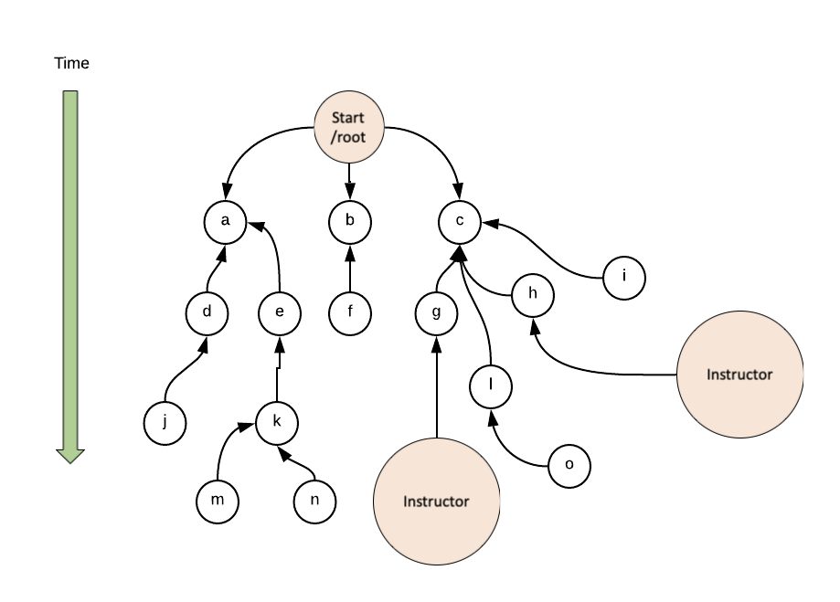
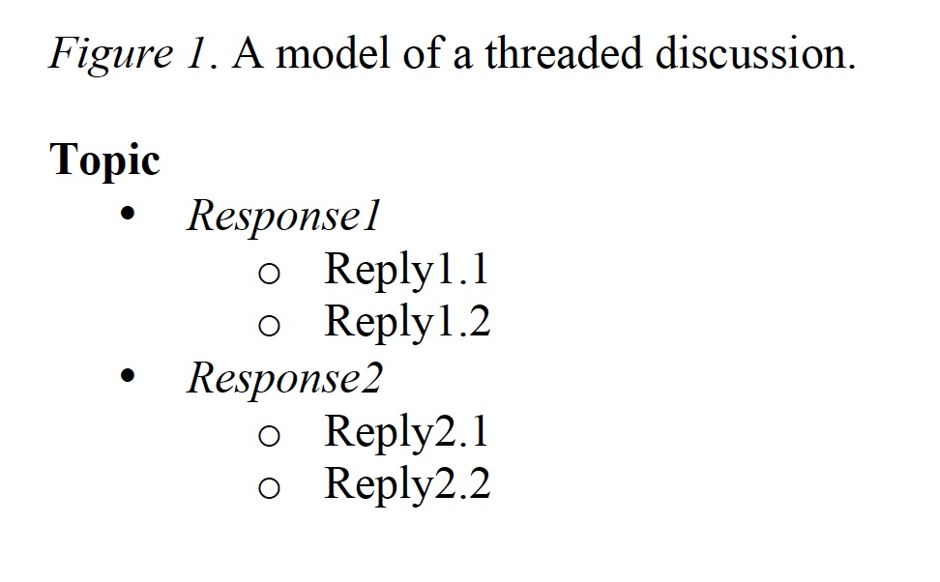
Theoretical Framework: Dialogic Discourse
Typical “threaded” discussion forums can limit students’ uptake because of hierarchy (Hewitt, 2001; Sherry, 2017; Sun & Gao, 2017).
Notes:
Glenn

Slide 7
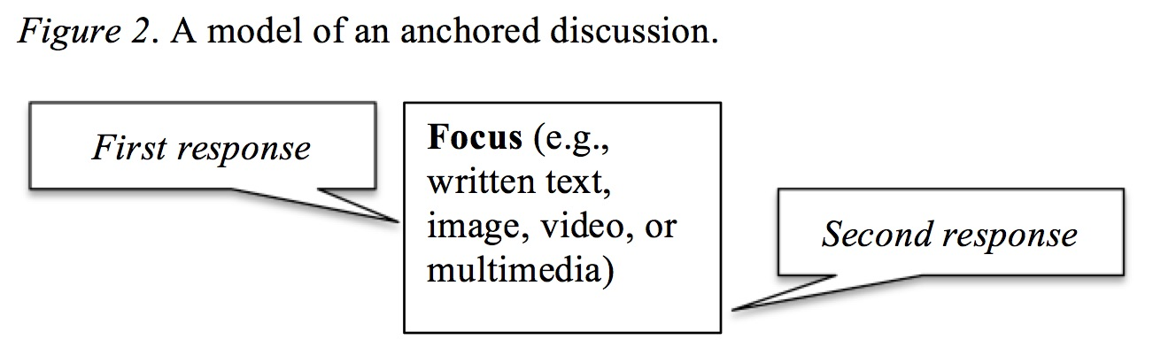
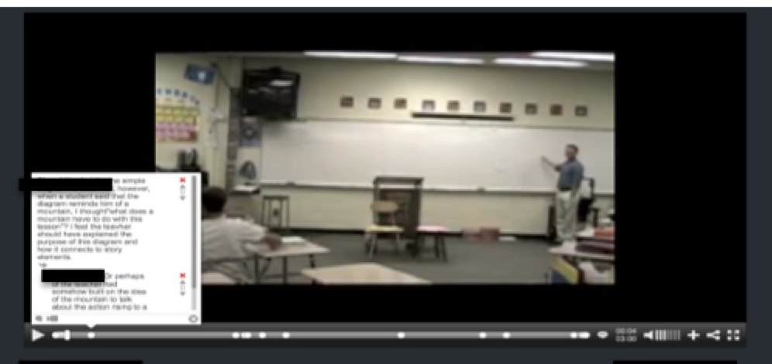
Theoretical Framework: Dialogic Discourse
Alternative “anchored” discussion forums can limit students’ uptake because of isolation (Sherry, 2017; Sun & Gao, 2017).
Notes:
Mike
The other common type of online discussion is an “anchored” discussion forum in which participants comment on a central text like a reading or a video.
This type of forum can also limit uptake because students’ posts can be spread across from the text and isolated from each other: as you can see below the video, even when comments cluster around a moment, they may not include uptake of what others have already posted.

Slide 8
Method: Qualitative Discourse Analysis
Our analysis of different types of forums aims to
Explore how the design enabled and inhibited participation in different, highly contextualized ways (e.g., Wegerif, 2016; Nichols & Stornaiuolo, 2019)
Reveal what is possible, rather than what is probable with an aim to offering generative (rather than generalizable) insights (e.g., Sherry & Tremmel, 2012)
Notes:
Kim
When designing our methods, our intent was to expand on the exploration of how the design allows for deeper conversation, including true collaboration where meaning is built together. And, of course, with the lens of looking not at what's "better" but what's possible in online discussion engagement

Slide 9
Method: Alternative Types of Online Forums
Embedded: interactive eBook
Non-hierarchical: linear chat-style discussions
Purposeful: culminating in Collaborative REsponsive Writing (CREW)
Notes:
Glenn

Slide 10
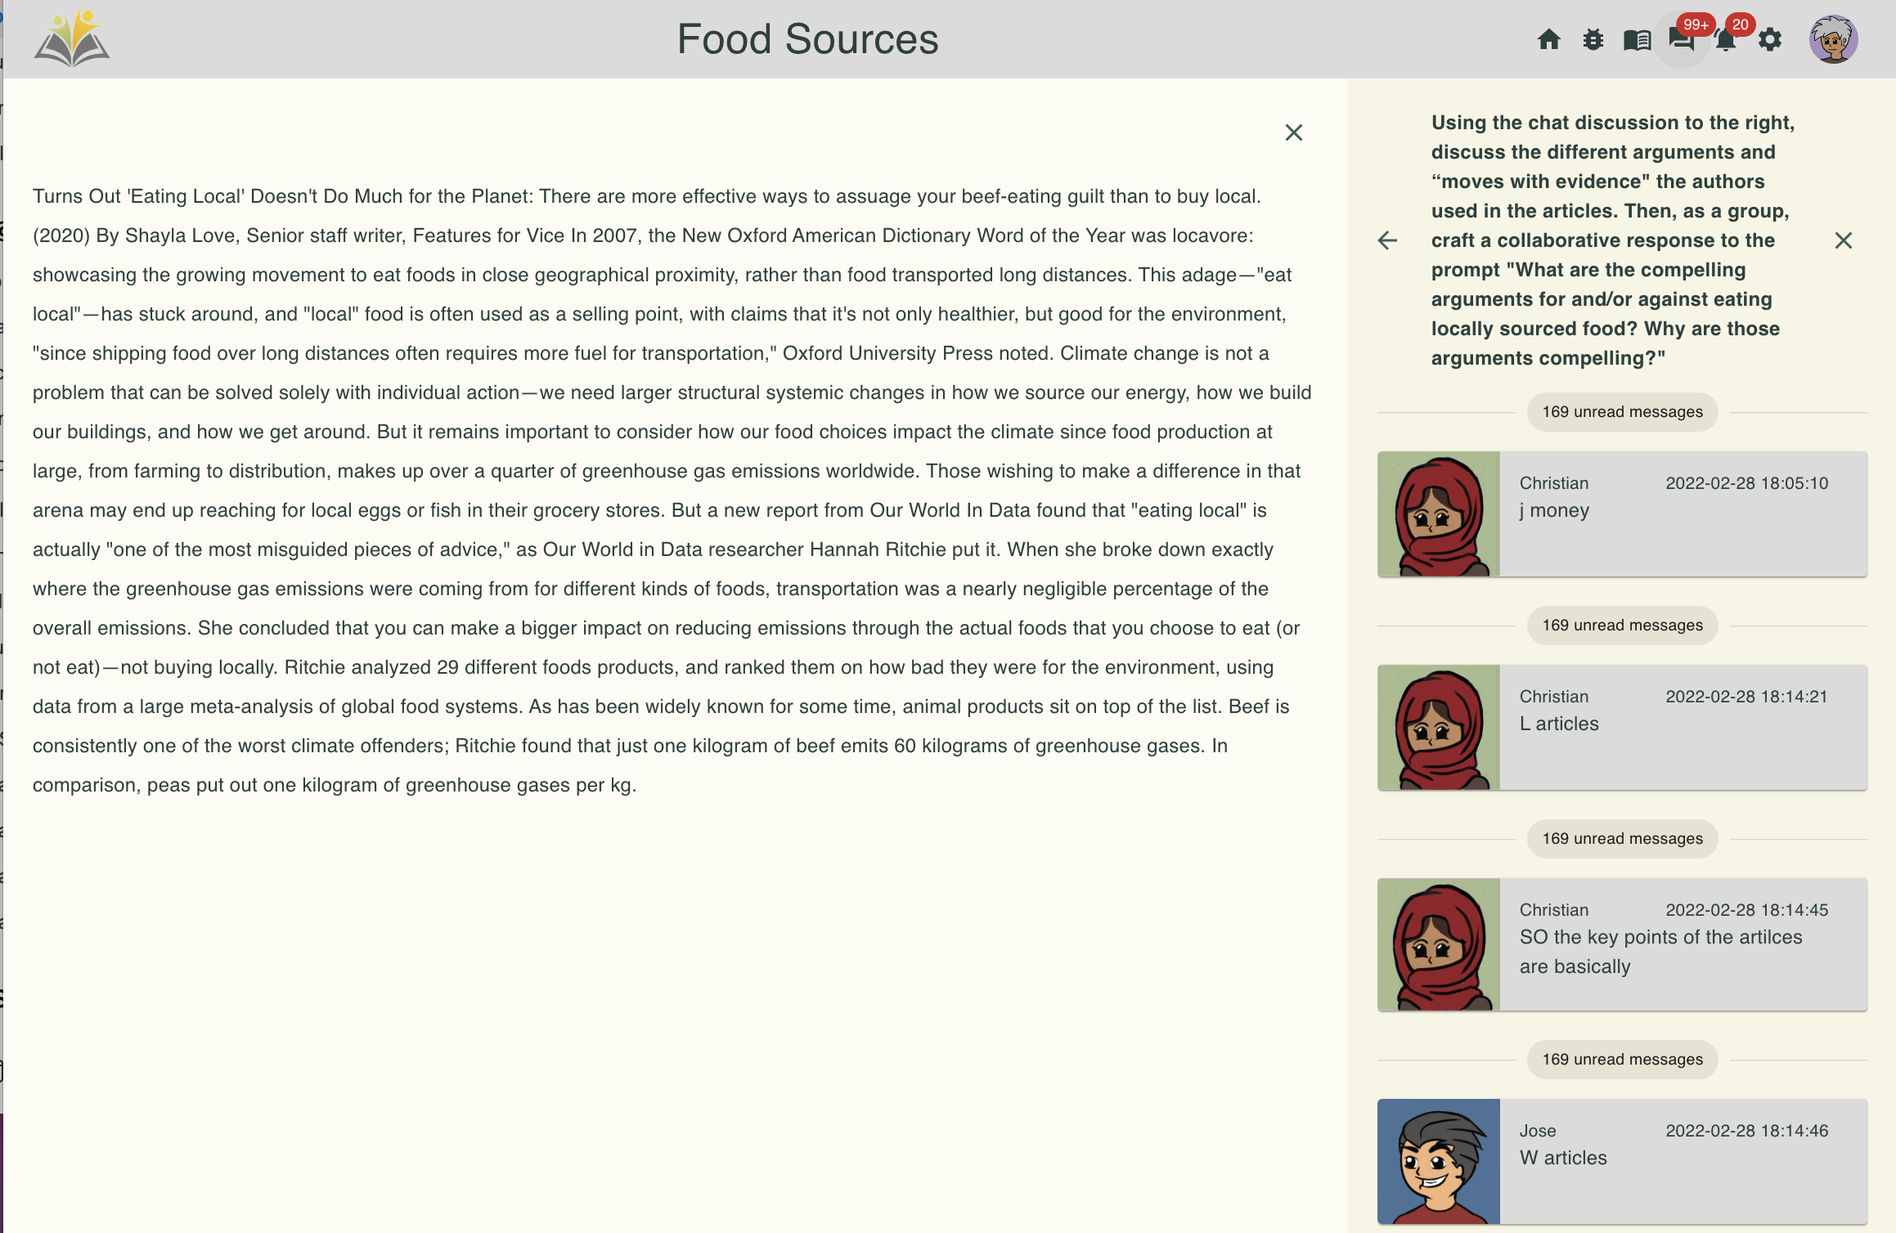
Method: Linear Chat Embedded in Ebooks
Notes:
Glenn

Slide 11
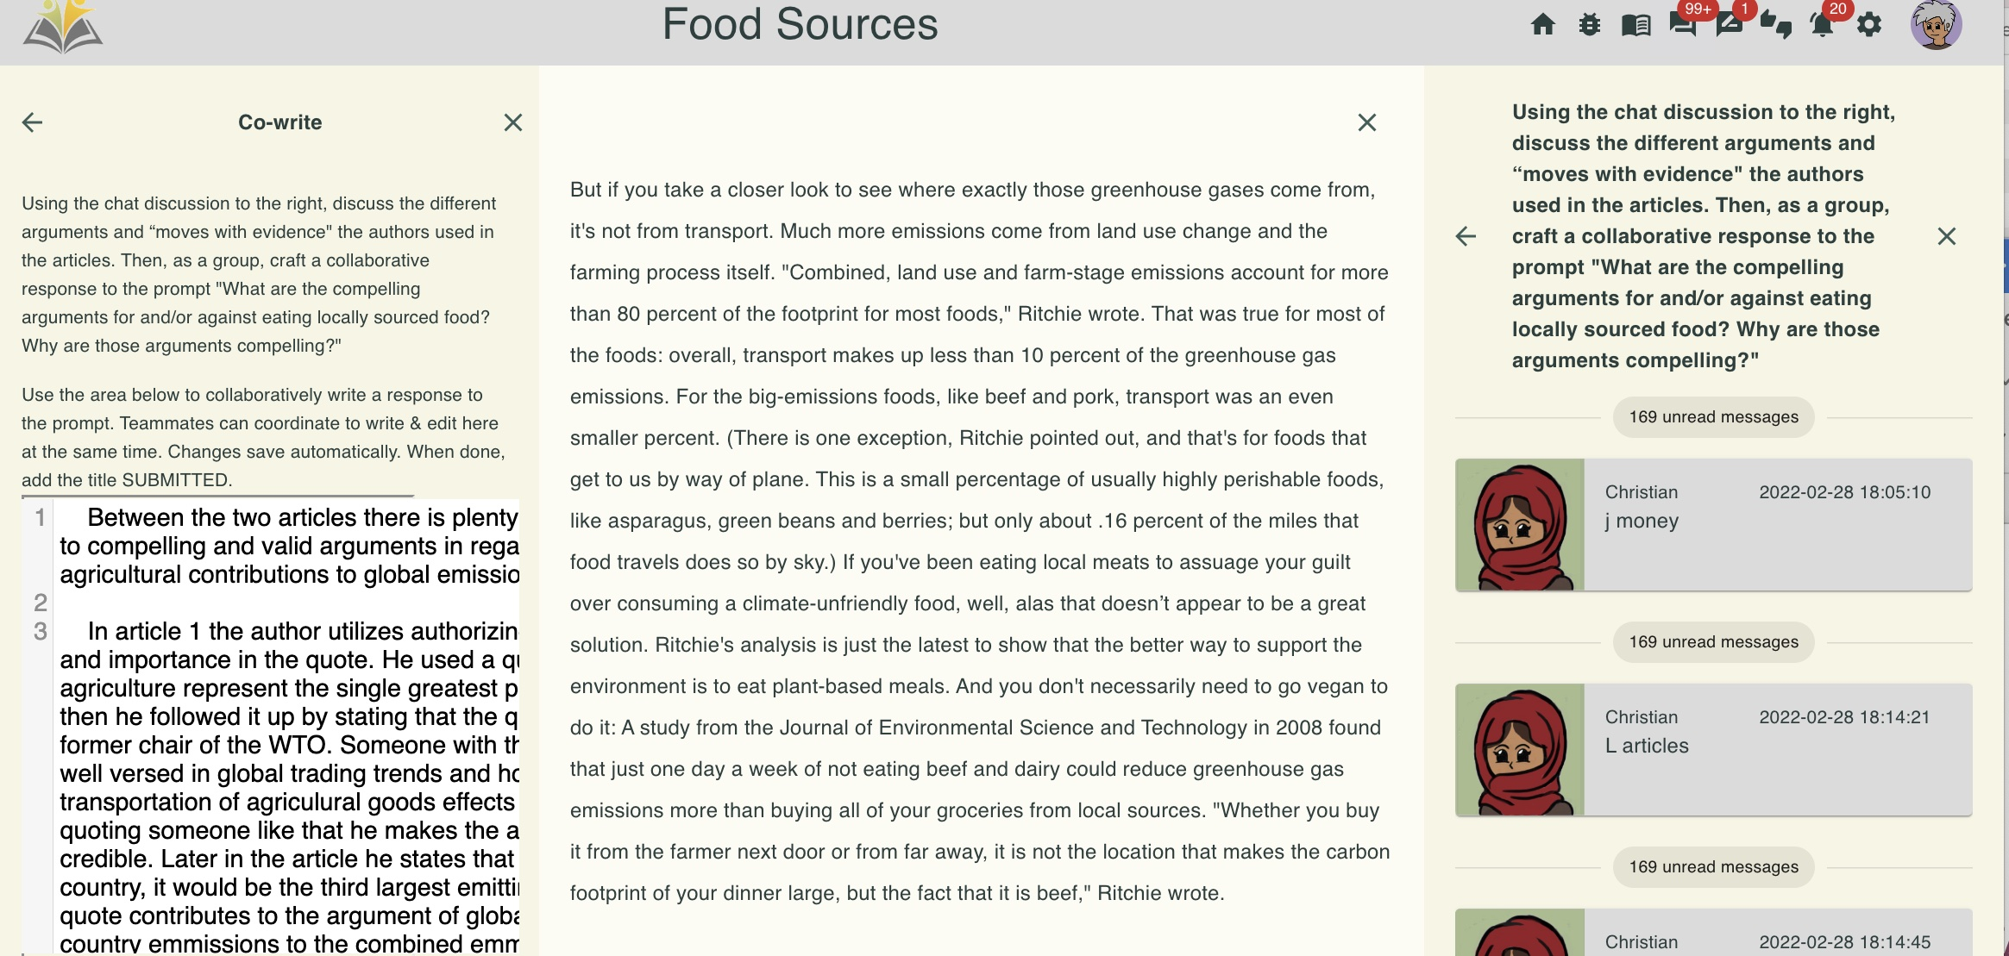
Method: Collaborative Responsive Writing (CREW)
Notes:
Glenn

Slide 12
Method: Site & Participant Selection
Southern US Public HS
NWP certified teacher and C3WP participant
Groups of 2-5 students
Focus here on "period 6" (six book clubs)
(n= total period six 19 Chat, Crew 20)
Notes:
Kim
Our research took place in a Southern US Public HS
The teacher was a certified National Writing Project teacher consultant
Who had participated in the College, Career, and Community Writers Program
From which content in the instructional unit was drawn
Our analysis focuses on online conversations among groups of 2-5 students
In period 6, six book clubs participated in Chat and CREW discussions

Slide 13
Method: Site & Participant Selection
Grade 10 media literacy unit “Making Moves with Evidence” focused on
CAP Protocol
(e.g., Credibility, Authorship, Perspective)
Purposes for using evidence
Extending: put your own spin on the concept
Illustrating: use text as example of your point
Authorizing: invoke the expertise of the author
Countering: noting the limits of a text, arguing up against the text
Notes:
Kim
These 10th grade students participated in a media literacy unit called "Making Moves with Evidence"
Using what their teacher called "the CAP protocol" to evaluate sources
They also practiced using evidence for different purposes:
Extending: put your own spin on the concept
Illustrating: use text as example of your point
Authorizing: invoke the expertise of the author
Countering: noting the limits of a text, arguing up against the text

Slide 14
Method: Data Sources
2 online discussions on separate days
3 readings each time
"Fast Fashion" and "Food Waste/Pollution"
6 chat & 6 CREW + collaborative compositions
Period 6: 1163 posts (657 chat; 506 CREW)
CREW Prompt:
Using the chat discussion to the right, discuss the different arguments and “moves with evidence' the authors used in the articles.
Then, as a group, craft a collaborative response to the prompt 'What are the compelling arguments for and/or against eating locally sourced food? Why are those arguments compelling?’ Use the area below to collaboratively write a response to the prompt.
Notes:
Kim
During this unit, students participated in two online discussions (preceded by a practice with the platform)
For each, they read 3 readings
The first (Chat) discussion focused on "Fast Fashion"
The second (CREW) discussion focused on Food Waste and Pollution
Data generated included 6 chat and 6 CREW discussions + collaborative compositions
For a total of 1163 posts (657 chat, 506 CREW)

Slide 15
Method: Data Analysis (Argumentation)
Collaborative, qualitative coding
Uptake (Affirm, Elaborate, Disagree)
Dialogic Spells (3 or more related posts)
Maximo | I understand the main issue behind the food waste and pollution from processing all the food. however I don't get how the food waste is bad in terms of pollution, if the food is bio degradable then how is it bad if its wasted. is it leaving the chemical preservatives to seep into the ground or is it creating methane from the rotting.
Jenna | 👏👏
Ella | yeah its doing those and also because how the article said an entire 3rd of all food is wasted or lost that means other food can't biodegrade quickly enough so it ends up not being sustainable and now we have to figure out ways to make it sustainable again
Ella | max do u want to write the 2nd thesis?
Notes:
Mike
To analyze our data, we used collaborative, qualitative coding
For instance, we coded students "uptake" of the text or of what others had already posted
To affirm, elaborate, or disagree
And noted when this uptake extended to dialogic spells—chains of 3 or more related posts
As in this example:
Max took up details from the article but countered with questions based on his own prior knowledge.
Jenna affirmed with emojis, and Ella elaborated by citing the article
Before inviting Max to add a counter-argument to their composition
We coded these elements because uptake and collaborative refinement of ideas are hallmarks of academic and literate discourses these discussions sought to foster

Slide 16
Method: Data Analysis (Social Interactions)
Collaborative, qualitative coding
Negotiation of “tangles” (interruptions and repair)
Nicolas | What would you guys think is a good overview of what the arguments are for both articles
Taywun | These articles are arguing against the consumption of local food sources with the use of relevant facts to make them compelling. (Intro Sentence? Maybe)
Daniella | i think the first articles thesis is that the way people produce and consume local food is the biggest contributor to greenhouse gas emissions
Taywun | Yeah Maybe we put that idea in there
Nicolas | you guys can change the answer too if you want to write something in there
Daniella | and that the government contradicts itself in trying to be more eco friendly and the author does this by countering
Daniella | yuh
Nicolas | solid
Taywun | Ok
Notes:
Kim
Sometimes we'll see an interruption or break in the thread. Sometimes the interruption is a true interruption. Sometimes, we see how students navigate the repair – 2 separate conversations at the end yuh, solid, OK not clear who those are for

Slide 17
Findings: Linear chat (Period 6: n=657)
Uptake of text and of prior student posts
High ratio of uptake to number of turns (72%)
Disagreement-->dialogic spells
(three or more related posts)
Post
Reply1
Reply2
Laura | 'The government is out of step with the public who are shocked by the fact that we are sending 300,000 tonnes of clothes a year to incineration or landfill. Urgent action must be taken to change the fast fashion business model which produces cheap clothes that cost the earth.' Mary Creagh, British Member of Parliament. That quote has a statistic
Joshua | yea but it doesn't talk about how it's destroying our environment
Nathan | how is it destroying the environment
Joshua | just because we waste over 108 billion pounds of food per year in the US doesn't mean we should ban food and starve people
Laura | yeah it does. sending 300,000 tons of clothes a year to incineration or landfills is destroying the environment
Joshua | you know they burn that stuff right?
Laura | ya that's bad for the environment
Notes:
Glenn
Chat discussions included uptake of the text and of other students' posts
In a high ratio of uptake to turns: 72%
Disagreement often led to dialogic spells (chains of 3 or more related posts)
As in this example:
Laura quoted an article about fast fashion—300,000 tons of clothes thrown away or burned each year in the UK
Josh countered that food waste "doesn't mean we should ban food and starve people"
Prompting further exchanges about how to address this problem

Slide 18
Findings: Linear chat (Period 6: n=657)
Uptake of text and of prior student posts
High ratio of uptake to number of turns (72%)
Dialogic spells sometimes blocked by tangles
disagreement-->float on to new quote
Post
Reply1
Reply2
Laura | ya that's bad for the environment
Nathan | burning still hurts the environment
Nathan | plus burning them is a waste
Laura | that person's quote was trying to show us the impact throwing our clothes to landfills has so that we realize that we need to reuse our clothes
Joshua | and if that bad for the environment, then wildfires are, but wait national parks arnt allowed to stop wild fires unless if it harms private property because its a 'cycle of life' just like you farting
Joshua | can you do anyting about it no.
Nathan | ya you should just donate youre old clothes thats what i do
Joshua | if we have to get rid of old clothes, just put them in wildfires Easy solution
Nathan | Let's just talk abt another one
Post
Reply1
Reply2
Notes:
Mike
Although disagreement in Chat discussions often led to dialogic spells
It also produced tangles
Interruptions in a chain of related posts
When students shied away from disagreement
By "floating" on to a new quote

Slide 19
Findings: Collaborative Responsive Writing (CREW)
(Period 6: n=506)
Uptake of text and of prior student contributions
High ratio of uptake to number of turns (81%)
Overcame tangles and
remained in dialogue in order to
compose collaborative writing
Post
Reply1
Post
3 Types of discussion
3 Types of discussion
Reply2
Reply3
Collaborative Writing in response to the prompts
Notes:
Glenn

Slide 20
Findings: Collaborative Responsive Writing (CREW)
(Period 6: n=506)
Ella | Max u write the second thesis?
Maximo | I don't think I can because I'm still pretty confused on the entire article, it's obvious the pollution is from the production and waste of the food but I don't see how else people can increase the sustainability of agriculture especially in the meat industry. since with so many companies using land for their own livestock and vegetation how can the demand of more products just be lowered.
Jenna | darn
Ella | 👀i did it
Maximo | also with the actual idea of supply and demand, if you take into account the need to find efficient ways to grow and process food to maintain the sustainability then it seems almost impossible.
Jenna | 😂
Maximo | what
Ella | honestly for the reasons it is bad you could just make a general statement on sustainability and how it doesn't matter where the food is from, it's still the actual production of that food that is hurting the environment
Jenna | ya
Ella | because the argument that it's better if its local makes sense but for some food it's only better because the transportation distance is smaller
Ella | yeah that thesis is good though (⊙_(⊙_⊙)_⊙)(｡･∀･)ﾉﾞ🐱‍👓✔😃
Maximo | you are right about the local food being better because of the process to get it there
Ella | ok. so now someone either cole or jenna you have to say why both of those arguments are compelling
Post
Reply1
Post
3 Types of discussion
3 Types of discussion
Reply2
Reply3
Collaborative Writing in response to the prompts
Notes:
Kim
In this CREW discussion, Max balked at contributing to collaborative writing
Because he expressed confusion and disagreed with the article's framing of the problem and potential solutions regarding food waste
Jenna and Ella's initial responses ("darn" and emoji eyes) seemed leery of this disagreement
Max's elaboration prompted crying emoji from Jenna
But the group persisted through this disagreement
Perhaps because of the required collaborative writing
In the CREW forum

Slide 21
Findings: Collaborative Responsive Writing (CREW)
Ella​ | yeah that thesis is good though (⊙_(⊙_⊙)_⊙)(｡･∀･)ﾉﾞ🐱‍👓✔😃​
Maximo​ | you are right about the local food being better because of the process to get it there​
Ella​ | ok. so now someone either cole or jenna you have to say why both of those arguments are compelling​
Post
Reply1
Post
3 Types of discussion
The compelling arguments that agree that eating locally sourced food is better environmentally are the ideas that long-distance shipping creates a need for more fuel, that local food is healthier, and that because agriculture methods are taking a toll on the world's health, eating locally will have better long-term impacts on the environment as a whole.
The compelling arguments that are against the idea that eating locally sourced food is better environmentally are that the benefits for eating locally sourced foods are very misleading. The problem is not buying your food non-local, it’s buying big-emission foods in general.
Reply2
Reply3
Collaborative Writing in response to the prompts
Notes:
Mike
In their final collaborative composition
Ella, Max, and Jenna produced writing that affirmed and elaborated the compelling arguments from the articles but also countered with opposing ideas based on their group's discussion

Slide 22
Discussion
Previous research: alternative types of forums can support or limit participation (Adams & Wilson, 2020; Arvaja and Hämäläinen, 2021)
The design of two alternative types of forums supported and
limited collaborative argumentation
High uptake (72-81%), disagreement-->dialogic spells
But sometimes tangles as students floated to other quote
CREW forum's focus on collaborative writing may have encouraged students to resolve disagreement to compose together
Notes:
Kim
Prior research has suggested that alternative types of discussion forums can support or limit student participation
We found that Chat and CREW forums, as alternatives,
Produced high levels of uptake
Disagreement that might not have occurred
if different perspectives had been isolated into separate threads
Led to dialogic spells when threads tied together in Chat and CREW
But also sometimes led to tangles
When students avoided disagreement and "floated" to another quote

Slide 23
Discussion
Prior research: platforms are not "neutral"; disagreement can cause participants to "talk past each other" (Nichols & Stornaiuolo, 2019; Tannen, 1998; Sherry, 2014)
We propose:
Threaded forums: separate conflicting perspectives
Chat forums: create tangles when students float past disagreement
CREW forums (requiring collaborative composing): encourage participants to resolve tangles and negotiate disagreement
Notes:
Mike
Previous studies of both online and face-to-face discussions have found that disagreement can cause participants to "talk past each other"
We wonder who benefits, if typical threaded and chat forums can separate conflicting perspectives or encourage participants to avoid disagreement
CREW forums in requiring collaborative composing encourage participants to persist through disagreement

