Slide 1
TF IDF
Taufiqurrahman

Slide 2
Please light the candle
This suitcase is super light
He’s a light sleeper
Notes:
Ini untuk manusia dan beda peletaka kalimat beda makna

Slide 3
15 | 9 | 20 | 3
19 | 21 | 8 | 18 | 9
7 | 1 | 9 | 17
Notes:
Tapi bagi computer semuanya hanyalah urutan angka

Slide 4
Please light the candle
This suitcase is super light
He’s a light sleeper
15 | 9 | 20 | 3
19 | 21 | 8 | 18 | 9
7 | 1 | 9 | 17
Notes:
Ini untuk manusia dan beda peletaka kalimat beda makna

Slide 5
So how can we make the computer know the same word but with a different meaning?
Notes:
Ini untuk manusia dan beda peletaka kalimat beda makna

Slide 6
Word embedding count vectors

Slide 7
King = [0.9, 0.1, 0.7, 0.2, 0.5]
Queen = [0.8, 0.2, 0.7, 0.3, 0.5]
Man = [0.6, 0.1, 0.2, 0.8, 0.3]
Woman = [0.5, 0.2, 0.2, 0.9, 0.3]

Slide 8
King = [0.9, 0.1, 0.7, 0.2, 0.5]
Queen = [0.8, 0.2, 0.7, 0.3, 0.5]
Man = [0.6, 0.1, 0.2, 0.8, 0.3]
Woman = [0.5, 0.2, 0.2, 0.9, 0.3]
Capturing their similarities and
differences
King = [0.9, 0.1, 0.7, 0.2, 0.5]
Man = [0.6, 0.1, 0.2, 0.8, 0.3]
Queen = [0.8, 0.2, 0.7, 0.3, 0.5]
Woman = [0.5, 0.2, 0.2, 0.9, 0.3]

Slide 9
One hot encoding
TF–IDF
Word2Vec
BERT
GPT
Notes:
Ada banyak jenis word embedding dengan berbagai tipe dan size

Slide 10
Count vectors | Neural networks | Transformers
One hot encoding | Word2Vec | BERT
TF–IDF | GloVe | GPT
Bag of words | FastText | Sentence transformers

Slide 11
Term Frequency-Inverse Document Frequency

Slide 12

Method that tell us how important a word is to a document

Slide 13
Topic Modelling
Notes:
Sekarang kita liat yang paling sering digunakan tf idf

Slide 14
📄 Data science
📄 Tech
📄 Sports
📄 Politics
Notes:
Bagaimana kita tahu dokumen ini membahas hal tersebut

Slide 15
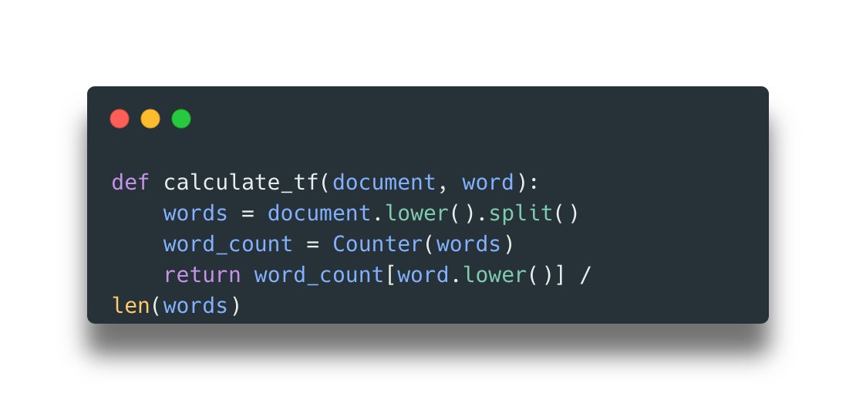
Notes:
Hitung berapa kali kata tersebut disebutkan dalam dokumen kemudian hasilnya dibagi ama jumlah kata yang ada di dokumen

Slide 16
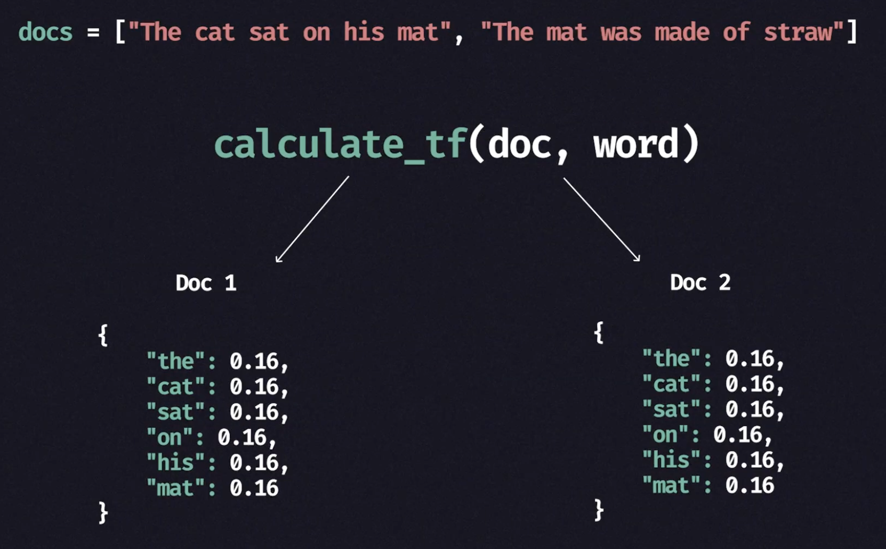
Notes:
Kemudian dapatlah kita term frequency text tersebut dari dokumen

Slide 17
The, is, of, and, but, or, yet, so, because, although
Low impact words
Notes:
Ini Adalah masalah karena tidak ada arti dan artinya sedikit

Slide 18
The cat sat on his mat
The cat sat on his mat
Notes:
Kita harus mengurangi impact dari kata tersebut dan menaikkan impact dari kata yang jarang

Slide 19
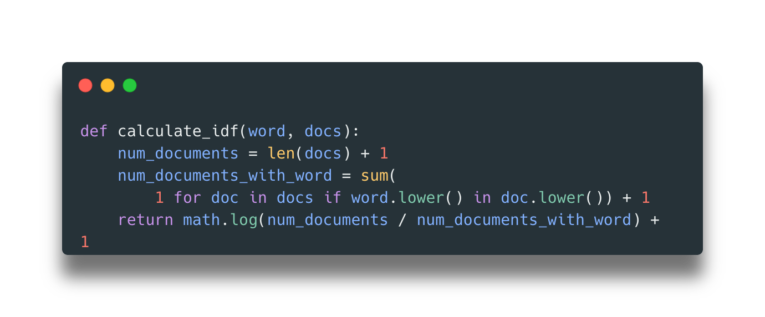
This is our IDF score
Notes:
Jadi kita ga hitung satu dokumen aja tapi kita hitung dokumen lainnya yang kira kira ada kata tersebut

Slide 20
docs = ["The cat sat on his mat", "The mat was made of straw"]
calculate_idf(word, docs)
{
"the": 1.0,
"cat": 1.4,
"sat": 1.4,
"on": 1.4,
"his": 1.4,
"mat": 1.0,
"was": 1.4,
"made": 1.4,
"of": 1.4,
"straw": 1.4
}

Slide 21
{
"the": 1.0,
"cat": 1.4,
"sat": 1.4,
"on": 1.4,
"his": 1.4,
"mat": 1.0,
"was": 1.4,
"made": 1.4,
"of": 1.4,
"straw": 1.4
}
{
"the": "common",
"cat": "rare",
"sat": "rare",
"on": "rare",
"his": "rare",
"mat": "common",
"was": "rare",
"made": "rare",
"of": "rare",
"straw": "rare"
}
Notes:
Lower score menunjukkan common, higher score nunjukkan rare

Slide 22
