Slide 1
Ouroboros - A Proof of stake consensus algorithm
T. Tejasree
CB.EN.P2CYS20033

Slide 2
Introduction
“Ouroboros” is the name of Cardano’s Proof of Stake consensus algorithm.
Rather than relying on miners to solve computationally complex equations to create new blocks, proof of stake selects participants to create new blocks based on the stake they control in the network.

Slide 3
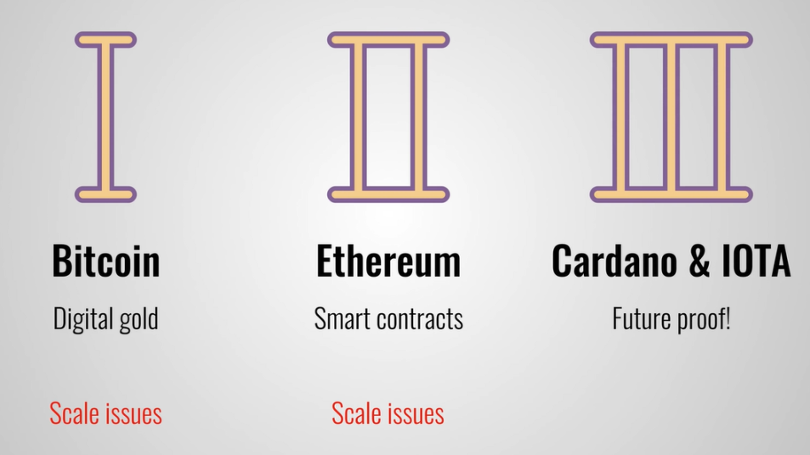
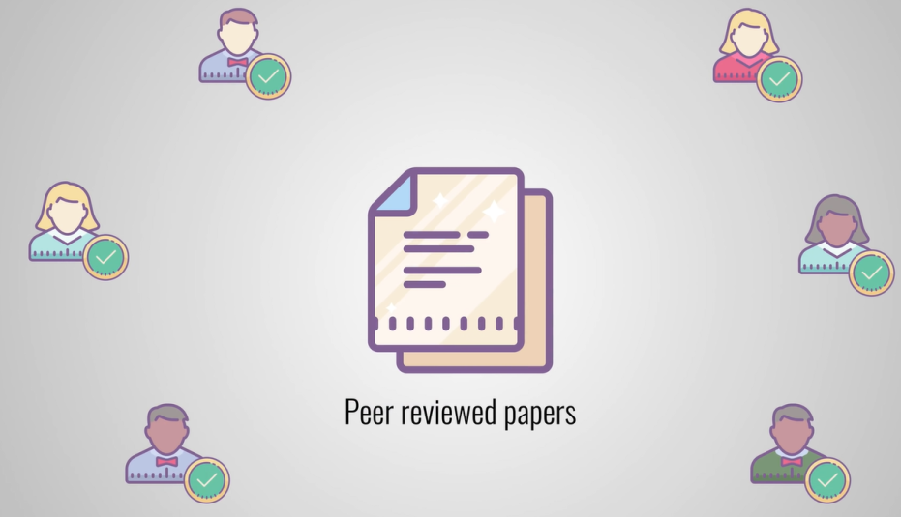
Introduction
The first blockchain protocol to be based on peer-reviewed research.
September 2017.
Founder of Cardano - Charles Hoskinson

Slide 4

Versions
Ouroboros Classic -2017
Ouroboros Praos – Apr 2018
Ouroboros Genesis – Oct 2018
Ouroboros Chronos – Oct 2021

Slide 5
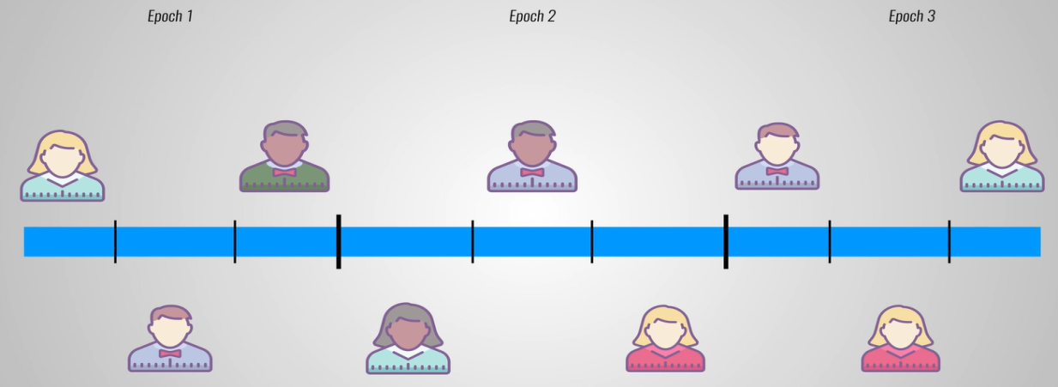
Working
Time is divided into epochs
Each epoch is divided into slots.
Slot is period of time in which a block can be created.
1 Slot = 20 sec
1 Epoch = 21,600 slots = 5 days

Slide 6
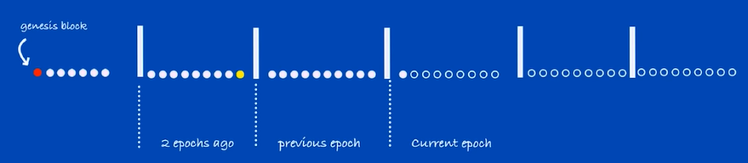
Working
Stakeholders register to
Global clock : Time
Global Random Oracle : Operational
Network: Synchronized

Slide 7
Working – Staking Procedure
Am I a slot leader?
Verifiable random function input
Random Oracle – hash of 2/3 random values of previous epoch
Stake distribution – Current epoch -2

Slide 8
Working
Verifiable random function output
Random value
Proof/ certificate

Slide 9
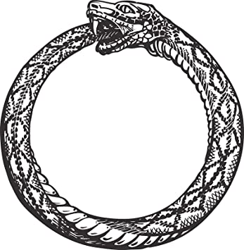
Slot Leader duties
Collect transactions for his slot
Sign them with his secret key
Include proof and random value V
Generate new secret key – Key evolving signature
Broadcast new block

Slide 10
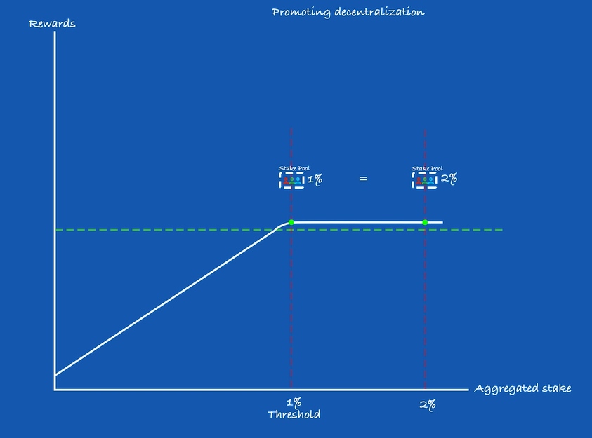
Rewards
Rewards are epoch based
Reward = transaction fees + funds from ADA reserve

Slide 11
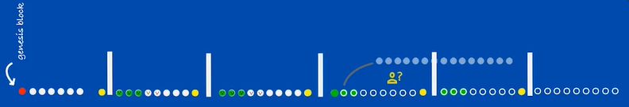
Genesis Vs Chronos
Genesis
Deals with the problem of client joining the protocol, you want him to synchronize with the correct blockchain
Chain selection rule: Pick the densest chain
Time given by global clock
VRF to ensure randomness for slot leader selection

Slide 12
Genesis Vs Chronos
Chronos
Removes global clock
POS joint clock
VRF or slot leader election
Synchronization beacons

Slide 13
Pros & Cons
Pros
Fast transactions
Secure
Cheap gas fee
Eco friendly
Cons
Still in development

Slide 14
References
https://iohk.io/en/research/library/
Ouroboros genesis: Composable proof-of stake blockchains with dynamic availability.
Christian Badertscher, Peter Gazi, Aggelos Kiayias, Alexander Russell and Vassilis Zikas
Ouroboros chronos: Permissionless clock synchronization via proof-of-stake.
Christian Badertscher, Peter Gaz, Aggelos Kiayias, Alexander Russell,Vassilis Zikas, et al.

Slide 15
THANK YOU

