Slide 1


POINT N CLICK:
A GLOVE-BASED
CURSOR CONTROL DEVICE
Presented by Camron Ong

Slide 2
OVERVIEW
Introduction
Methodology
Original Interface
Results&Discussion
Redesign
Conclusion

Slide 3


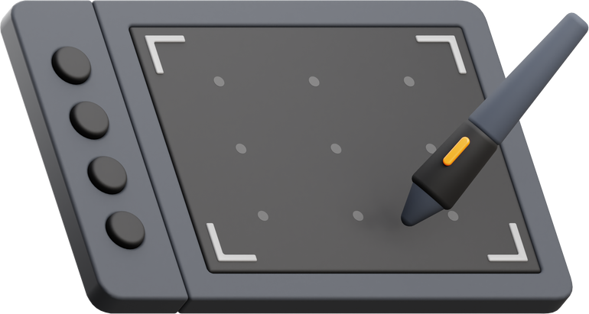

INTRODUCTION
Many Popular Devices for Computer Interaction/Usage
Mouse
Trackpad
Pen Tablet
VR Glove

Slide 4
INTRODUCTION
Many Popular Devices for Computer Interaction/Usage
2D Surface
Can be small and Limited in Size
Virtual Reality

Slide 5
INTRODUCTION
Limitations in/for...
presentations
some creative work
hands-free computer navigation
mobility limitations within users

Slide 6

OBJECTIVE
Create an alternative interface without reliance on physical surfaces
Still be lightweight and portable
Operate without requiring extensive calibration or external hardware apart from the glove and any receivers
Handle/simulate/send mouse-like inputs to the computer
Latency should be generally low to allow smooth input-to-feedback translation
Work in general computer navigation

Slide 7
QUESTIONS
Does the proposed glove-based pointer provide the necessary functionality for general computing and accessibility purposes?
How does the device’s usability compare to traditional input methods and the previous version in terms of accuracy, reliability, and ease of use?
How does the device perform compared to the original?
Is the system intuitive for users?

Slide 8
ORIGINAL INTERFACE
Golden standard used for moving the pointer across the 2D screen
Wireless mice also allows for a interacting at a distance.
Traditional mice require a flat surface, usually flat, underneath the mouse to function properly
Can be troublesome when standing at a distance
Presenting from a distance
Can require both a clicker and a pointer, or simply “using the computer from a distance”
Mouse

Slide 9

ORIGINAL INTERFACE
Glove-based pointer control, created as an alternative to CheerPod
Focused on translating hand movements to mouse movements
Innovative, but it turned out to be slower then the CheerPod
Lacked some functionalities
Wired
Point n Move

Slide 10
PROPOSED IMPROVEMENTS AND REDESIGNED INTERFACE
Extend Point n Move
Direct pointer manipulation
Mouse-like clicking capabilities
Improved sensors
Also address the limitations of traditional mice,
Flat surface to function efficiently
This project

Slide 11
PROPOSED IMPROVEMENTS AND REDESIGNED INTERFACE
Gesture recognition will allow users to move the cursor to predefined screen areas by pointing
Mouse-like interactions ensures a more familiar user experience, making the glove a viable alternative to the mouse as well
Better sensing for more accurate tracking
This project

Slide 12
INITIAL SETUP
Arduino Pro Micro
MPU-6050
MPU-9250 (or HMC5883L)
Infrared transmitters and receivers
Capacitive touch sensors, specifically the TTP223B
HC-05 Bluetooth Module
ESP32 board

Slide 13
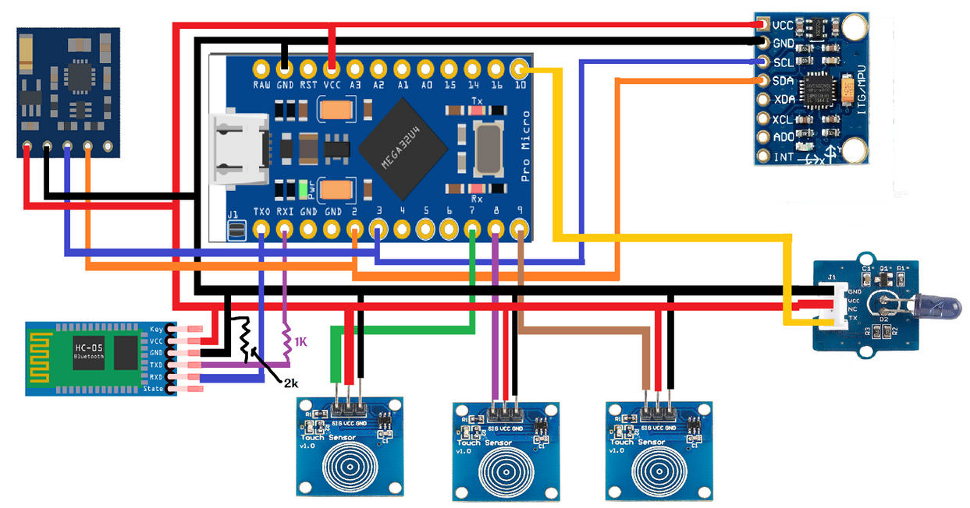
INITIAL SETUP
Arduino Pro Micro controller
(top-middle) connected to the HMC5883L compass (top-left), MPU-6050 (top-right),
Bluetooth module (bottom left),
IR Emitter (middle-right),
and the Capacitive Touch Sensors (Bottom-row).

Slide 14
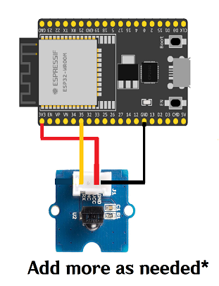
INITIAL SETUP
ESP32-WROOM (top) connected with an
IR Receiver.
Multiple Receivers will be added as necessary.

Slide 15
DESIGN ITERATIONS
Preliminary testing of each iteration was conducted and was used as the basis for improvements made on the firmware and hardware choices or designs in the project

Slide 16

DESIGN ITERATIONS
Touch capacitive sensors
Initial prototype had intended for three capacitive touch sensors
Initially set up on a breadboard and could be tested individually - felt okay
When attached to the glove, having the three side-by-side felt unnatural.
The sensors themselves were too large

Slide 17

DESIGN ITERATIONS
Gyroscope and Accelerometer
Ideally, this would be fixed by adding a magnetometer and manually adding fusion functions for the three devices
Popular Attitude and Heading Reference System (AHRS) libraries that do this such as Mahony and Madgwick require a lot of storage space on the Arduino Pro Micro.
Alternative could be to manually implement a lightweight version
Led to difficulties in program implementation and integration.
Thus, a small alternative of simply re-setting the MPU based on the magnetometer's readings after a set period of time was opted for

Slide 18
FINAL SETUP
MPU-6050 plus a stand-in HMC5883L
MPU-9250 and other similar boards, were generally being phased out
Getting a fake 9250 was also common
Two capacitive touch sensors
Space limitations as discussed earleir
Needed to be customized via shielding one side due to unintentional tapping
IR Transmitter
IR Receivers
Bluetooth module
Easier upgrading to a full wireless solution
Referring to the removal of the wire connecting the glove to the PC

Slide 19
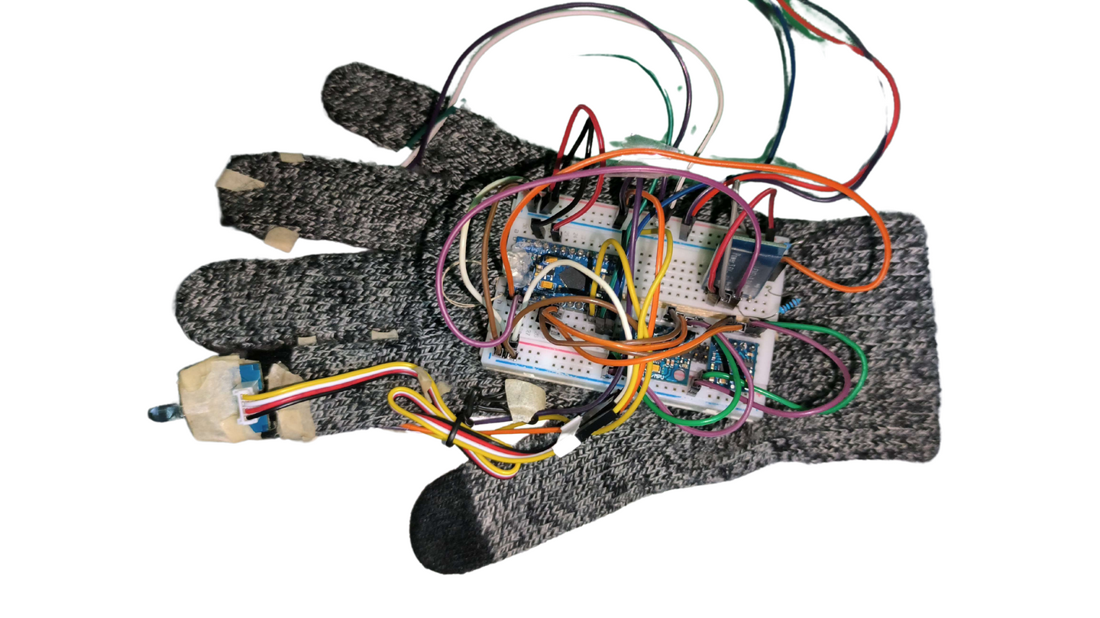
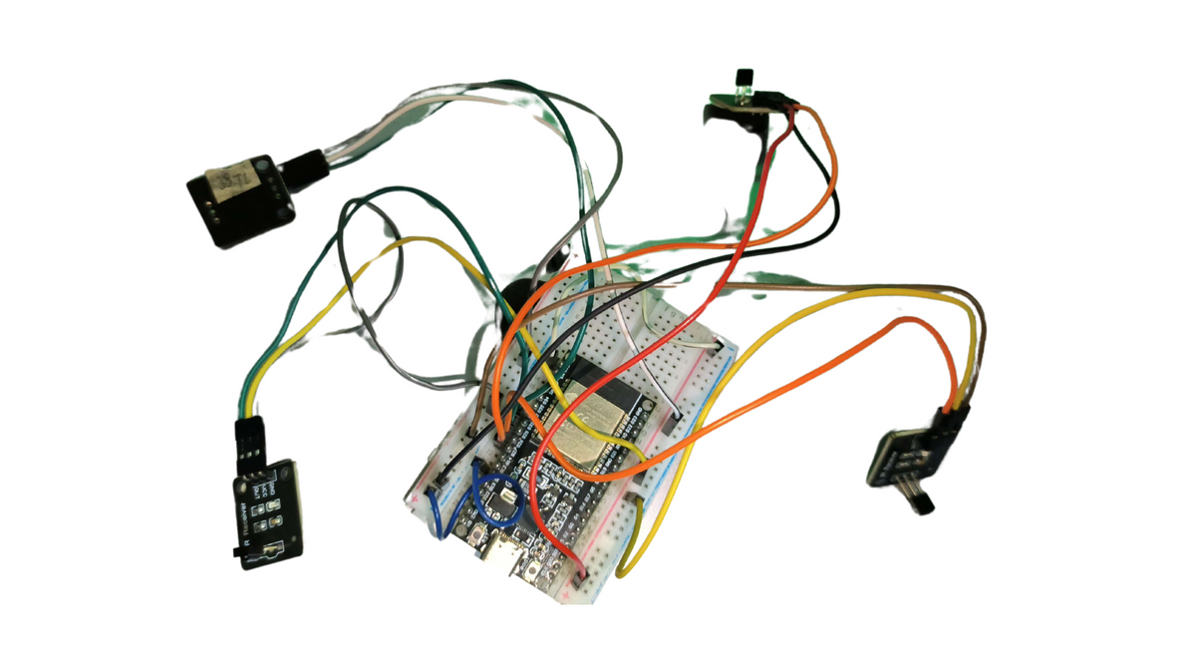
FINAL SETUP
Final Glove (left) and Receiver setup (right)

Slide 20
FIRMWARE
Mouse: Allows certain boards to control cursor movement of the connected computer. Positioning is based on the relative position of the cursor rather than the absolute position.
I2C Device Lib.: A collection of classes for streamlined communication for I2C devices. This library was specifically used to interface the MPU6050 with the microcontroller. Technically, the library also supports the HMC5883L.
Adafruit HMC5883 Unified: A sub-library that interfaces and abstracts data from the HMC5883L. This was chosen over the I2C Device Library version because sensor readings are converted into standardized units, thus leading to more simplified integration.

Slide 21
HARDWARE
Arduino Pro Micro: Main microcontroller for processing sensor inputs and controlling the mouse pointer.
ESP32-WROOM: Bluetooth and WiFI capable microcontroller. Handles IR receiver signals and transmits data to the Pro Micro via Bluetooth.
TTP223B: Touch capacitive sensors that detect touch-based gestures to simulate mouse clicks.
HMC5883L: A magnetometer used to help correct drift in hand orientation tracking.
MPU6050: A 6-axis motion sensor used for tracking hand movement and angle.
IR Transmitter: Mounted on the glove to send signals
IR Receivers: Placed around the screen to detect IR signals and determine pointing direction.

Slide 22
SCOPE AND LIMITATIONS
Left and right-click inputs
Scrolling and actions like dragging will not be considered due to hardware design limitations and choices
The testing facility will also be created to match only these features
manipulating the mouse pointer
selecting/clicking on a target
Wireless data transmission will be implemented for the IR setup, a full wireless device will also be out of scope for the project
Moving to a wireless solution would require additional design considerations and could affect usability, such as requiring on-board power and charging
As well as requiring a larger re-design and implementation

Slide 23
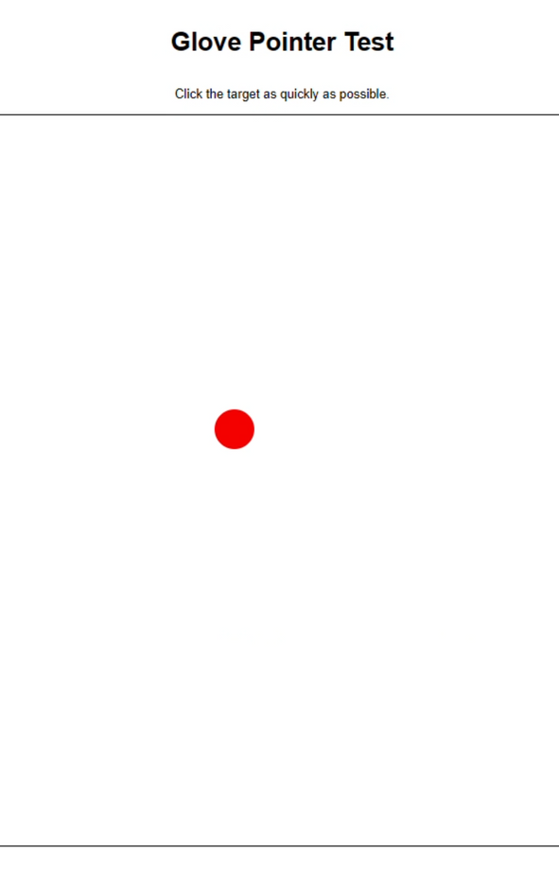
METHODOLOGY
Experimental Design
General-purpose testing facility was created to evaluate the proposed glove design
Replicate general computer usage
User would move their mouse across the screen to navigate and click through buttons at random distances and from a set of shapes
Similar to Fitts' Law
Each test consists of five trials or shapes to click through.

Slide 24
METHODOLOGY
Experimental Design
A 13-inch MacBook Pro (2017)
Screen resolution of 1440 x 900
The mouse sensitivity is set to 4/10
Trackpad sensitivity was set to 6/10
Room lights were also kept on during the tests
Users sat at a comfortable distance
10 participants were involved in the study
Each participant would do the task about five times each
(1) baseline mouse
(2) the final version of the glove
(3) final glove with additional instructions + drift change

Slide 25
METHODOLOGY
Metrics (Per Trial)
Total time (TT)
Distance (D)
Button size (W) and shape
Fitts’ Law: MT, ID, and Throughput
Missed Clicks
Hover time
Correction time
Delay between entering and clicking
first entry
most recent entry
Full cursor
Velocity
Total overshooting time,
Length of the path taken
Ratio of path taken to distance
Extra movement

Slide 26
METHODOLOGY
Modelling
Regression (OLS) for Total Time
Poisson Regression for Error Count

Slide 27
RESULTS AND DISCUSSION
51 sessions, resulting in 255 trials for the mouse
61 sessions were recorded, totaling 305 trials for the glove
51 sessions, totaling 255 trials for glove 2
Two glove sessions had to be removed due to minor bugs caused by the random-target generator of the testing facility
Trials with optimal path ratios higher than 15, along with error counts greater than 10, were also removed (due to test mistake and hardware mistake respectively)
The final counts of each was 250 for the mouse and 292 for glove 1, and 246 for glove 2

Slide 28
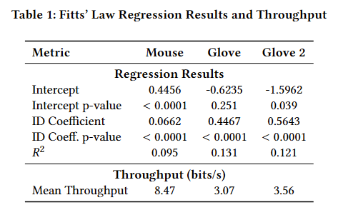
ID AND TT
Harder task = more time
Higher coefficient for mouse means ID affects it more
R-squared is pretty low for both
Difference in Throughput

Slide 29
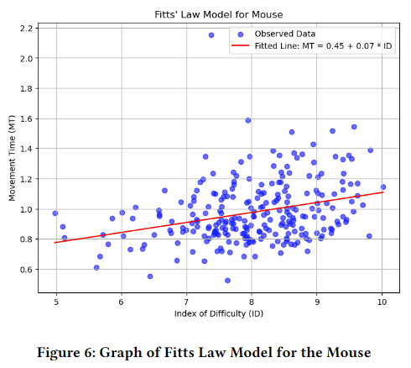
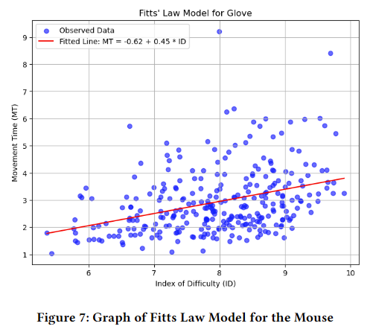
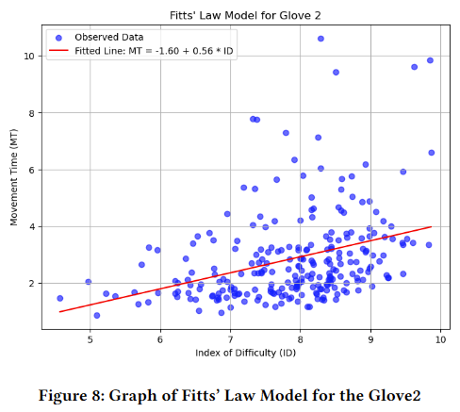
ID AND TT

Slide 30
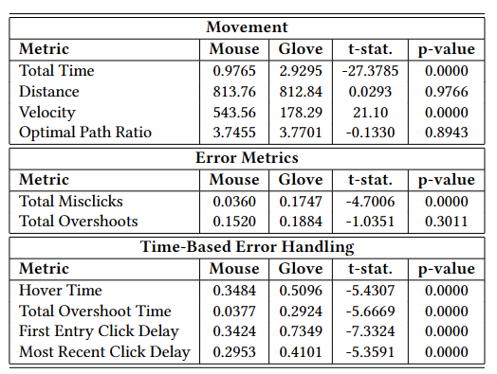
T-TEST FOR METRICS
Total Time and Velocity is better for mouse
Movement efficiency remained similar
Glove introduced significantly more misclicks and required longer adjustment times before users could complete a trial
The glove-based input method may be functional, but its current form results in greater difficulty

Slide 31
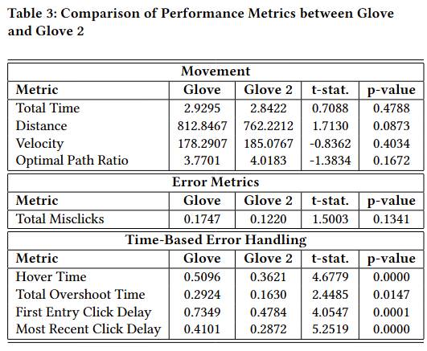
T-TEST FOR METRICS
Total Time, Distance, Velocity, Optimal Path Ratio, and Total Misclicks are all generally better to a small extent, but not significantly,
Hover Time, Overshoot Time, and the two Click Delays are all significant
Could indicate that the users were more experienced with the glove
The performance of Glove 2 versus the mouse is likely still not close

Slide 32
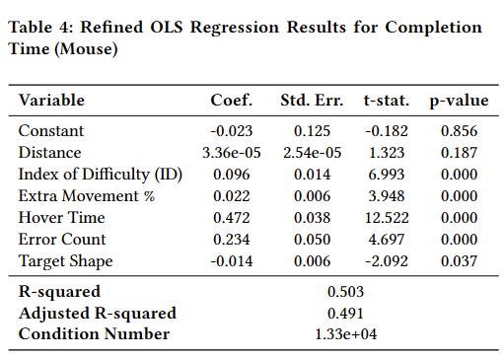
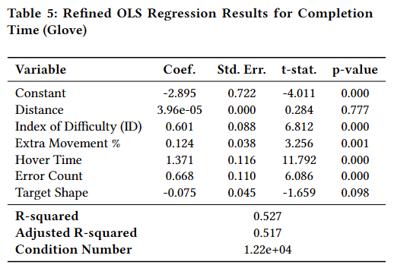
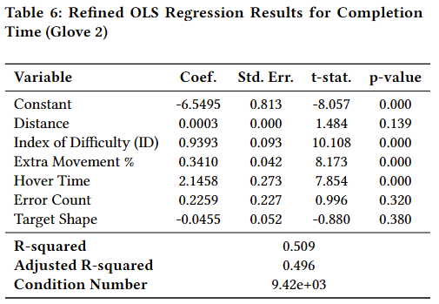
MODELS
ID, Extra Movement %, Hover Time, and Error Count – Significant except for Glove 2
Hover Time has a much larger effect in the glove models
time increases due to more hovering, which is caused by delays in user mouse click input.
Extra Movement & errors is also more influential in the glove models

Slide 33
MODELS
R-square may be due to multicollinearity (shown by high condition number) or other unmeasured factors

Slide 34
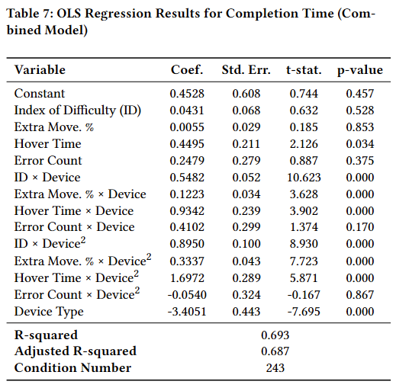
MODELS
Affirms earlier findings
Higher R-square could be due to more varianced data and lower multicollinearity

Slide 35
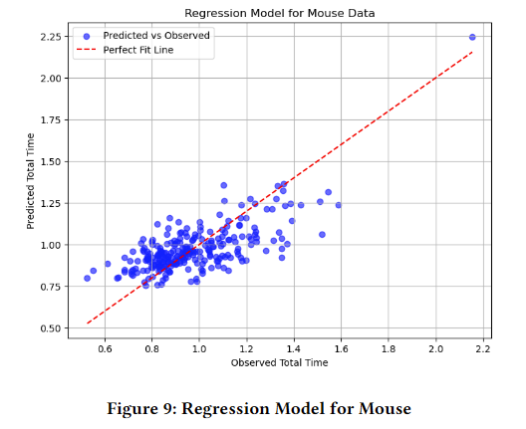
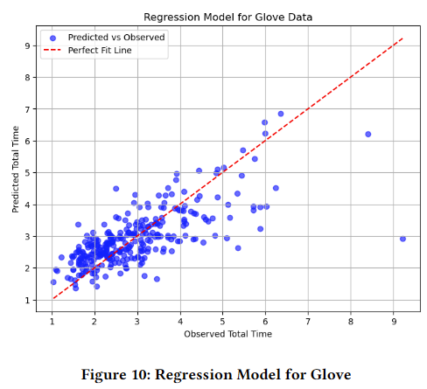
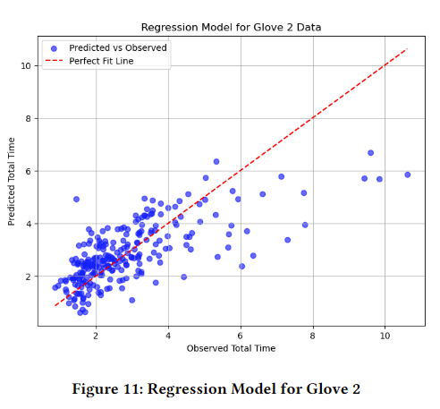
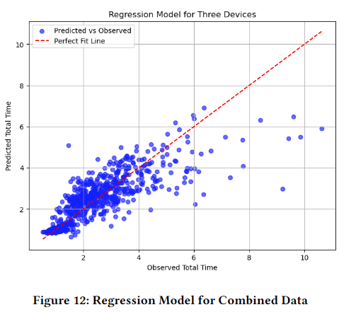

Slide 36
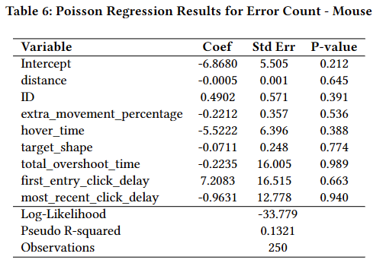
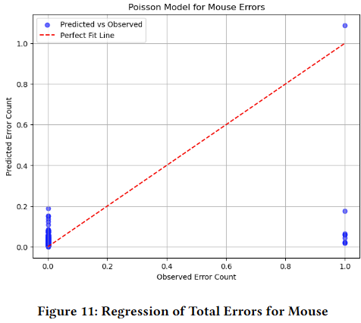
MODELS
Calculated pseudo-R-squared is very low, at 0.132
None of the variables are statistically significant
There is also instabilities for the overshoot time and clicking delays, as the standard errors calculated were at 12 and 16.
Poor performance may be due to the very low count of trials with errors: only 9 out of 250

Slide 37
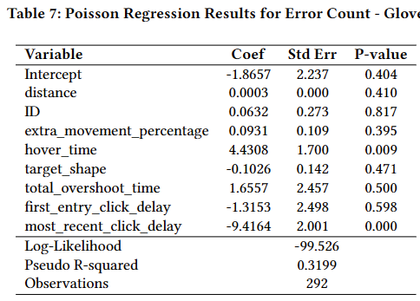
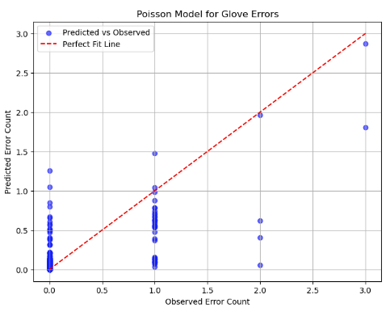
MODELS
Models the misclicks better, with a pseudo-R-square of about 0.320.
The hover time and the most recent click delay are the most significant
(Technically related, and equal in many cases)
9 out of 292 had misclicks

Slide 38
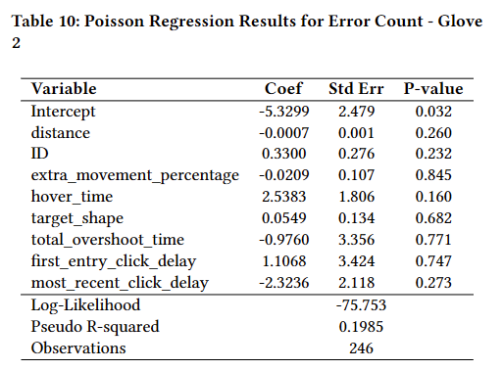
MODELS
Slightly worse, with a pseudo-R-square of about 0199.
None are particularly significant
30 out of 246 had misclicks

Slide 39

PERFORMANCE INSIGHTS
The glove is functional for general computer navigation that involves pointer manipulation and simple target selection.
In terms of accuracy, speed, and ease of use it falls short compared to the traditional mouse in all measured aspects.
Further refinements could enhance its overall performance and user experience.
Likely that users would require some time to adjust to the glove’s movement and input method
Users also largely preferred to use the normal hand movements and gestures to move the pointer rather than using the IR setup
Some drift still occurs, largely due to several hardware limitations.
While this does not have much direct impact on short-form tests, long form usage of the glove would definitely require anti-drift mechanisms for better user experience.

Slide 40



RECOMMENDATIONS
Moving to full wireless
ESP32 connected to the glove
Pro Micro connected with the computer
Swapping the two boards could also improve or eliminate the effects of drift on the MPU
ESP32 has more flash storage
AHRS libraries could be implemented properly
Proper fusion and calibration between the MPU and magnetometer
Using a proper 9-axis module (though many have been phased out already)
Reducing the size of the touch sensor or area could be investigated
Metallic sheets wrapped around the fingertips or something similar
Adding more IR receivers and improving the IR locations/translation, and adding hand tilt recognition that responds with it
Increasing the number of trials and potentially diversifying the testing facility
Conducting a qualitative assessment

Slide 41
CONCLUSION
RQ1 - The glove was capable of the task.
RQ2 and RQ3 - The glove performed worse in all aspects compared to standard input methods, but has improved over the previous iteration as the glove can now perform clicks, move instantaneuosly to set positions, and has hardware ready for improvements.
RQ4 - Possibly less intuitive or requires some time to familiarize self with the device
The glove's performance does not yet match that of a traditional mouse and has many areas for improvement
That said, this study demonstrates its potential as a feasible alternative in specific contexts. It can cater to niche scenarios where traditional mice may be impractical, such as hands-free or non-in-person environments.

Slide 42
ACKNOWLEDGEMENTS
I would like to thank the DLSU Center for Automation Research (CAR) laboratory for their assistance in providing insights, tools, and solutions to several hardware-based difficulties and issues encountered during the designing phase of the project.
I would also like to thank the previous researchers of Point n Move, who created the initial version of the glove, for being easy to contact and providing the exact model specifications, along with passing on the physical glove, the code that was outputted from the project, and the extra materials that were leftover from their study.

Slide 43
REFERENCES
Cheerdots. n.d. CheerPod Instruction Book.
S. B. Dy, R. J. O. Encinas, D. J. L. Go, K. C. C. Lasala, B. A. Y. Lu, M. M. Manlises, and J. A. Deja. 2024. Point n Move: Designing a Glove-Based Pointing Device. arXiv preprint arXiv:2412.00501 (2024).
Paul M Fitts. 1954. The information capacity of the human motor system in controlling the amplitude of movement. Journal of Experimental Psychology 47, 6(1954), 381–391.
I. S. MacKenzie. 1989. A note on the information-theoretic basis for Fitts’ law. Journal of Motor Behavior 21 (1989), 323–330.
Paul Roback and Julie Legler. n.d. Beyond Multiple Linear Regression: Chapter on Poisson Regression. https://bookdown.org/roback/bookdown-BeyondMLR/ch-poissonreg.html
G. A. F. Seber and Alan J. Lee. 1989. Linear Regression Analysis. Vol. Series in Probability and Statistics. Wiley.

Slide 44
Thank You
For your attention

