Slide 1
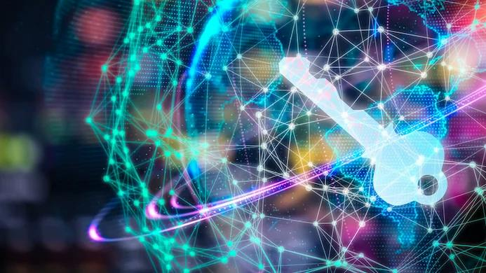

Week 2
Introduction to IoT
Part 1
DCS, SMCS
Internet of Things
IoT
Faisal Iradat

Slide 2
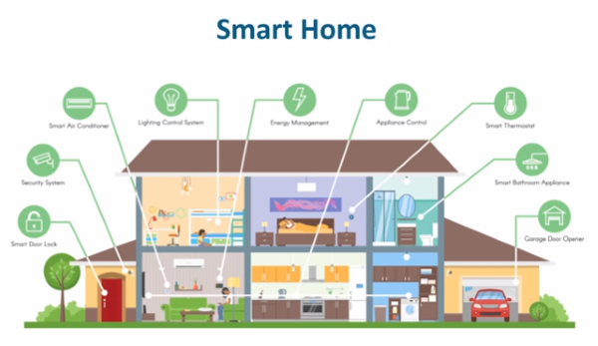
IoT Applications in Business (1)
Smart Homes Industry
IoT technology allows for the automation and control of various household functions, from smart thermostats to smart security systems

Slide 3
IoT Applications in Business (2)
Benefits
The ability it gives homeowners to automate and control various aspects of their homes. It can allow them to adjust the thermostat, check security cameras, and turn off appliances.
Improves the convenience and comfort of living in a smart home, but it also helps to save energy and money.
Use Case
A well-known example of IoT in smart homes is Nest. This company offers a range of smart home products such as thermostats, security cameras, and smoke detectors.

Slide 4
IoT Applications in Business (3)
Assets Management
loT offers real-time monitoring and tracking of assets. This can help increase utilization and decrease downtime.
Benefits
Predictive Maintenance:
IoT devices gather data on the utilization and performance of assets, which can be evaluated to predict maintenance needs, thereby reducing the possibility of unplanned downtime.
Inventory Management:
IoT-enabled devices attached to assets can help in real-time tracking and visibility. This can reduce the need for manual inventory management and reduce the likelihood of lost or stolen assets.
Asset Monitoring:
IoT technology can be used to keep tabs on assets in real time. This can help alert any unusual activity and allow for prompt response to potential problems.
Use Case
AirDroid Business is an example of an IoT application in Asset Management. By utilizing Android devices, the software provides real-time monitoring and management capabilities for devices, enabling organizations to track and monitor their Android mobile devices effectively.

Slide 5
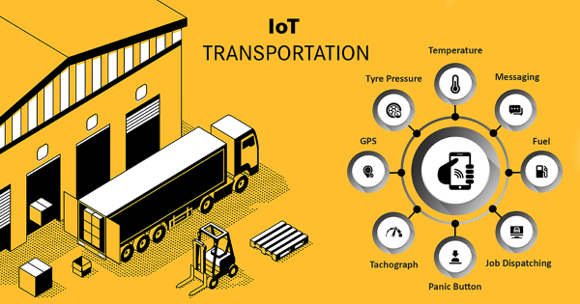
IoT Applications in Business (4)
Transportation & Freight Monitoring
Real-time tracking and monitoring of vehicles and cargo. This provide valuable insights on transportation routes, traffic patterns, and delivery times. Logistics and costs are also reduced.

Slide 6
IoT Applications in Business (5)
Benefits
Optimizing logistics and increasing efficiency
Real-time monitoring of cargo and vehicles
Reducing the risk of theft or loss
Improving safety through monitoring and controlling the movement of vehicles and cargo
Use Case
DHL, a global logistics and transportation company, has implemented IoT technology in the form of smart sensors to monitor the temperature, humidity, and location of their cargo in real-time.
With IoT DHL improved the accuracy of delivery times, ensure the safety of perishable goods, and optimize logistics..

Slide 7
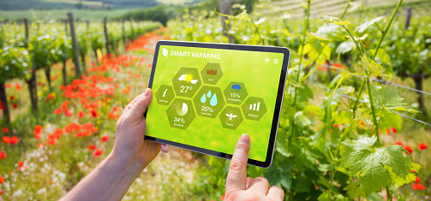
IoT Applications in Business (6)
Agriculture
IoT technology has been used in agriculture to enhance the growth of crop yields, improve efficiency, and reduce costs. Some examples of IoT applications in agriculture include precision farming, soil monitoring, and weather forecasting.

Slide 8
IoT Applications in Business (7)
Benefits
IoT in agriculture can help farmers make data-driven decisions, better the quality of crops optimize irrigation and fertilization, and increase crop yields.
Use Case
Companies like John Deere, a leading agricultural equipment manufacturer, have implemented IoT. Their utilization has helped farmers increase their equipment’s work rate and productivity. This IoT application is a prime example of how technology can be used to improve the agriculture industry.

Slide 9
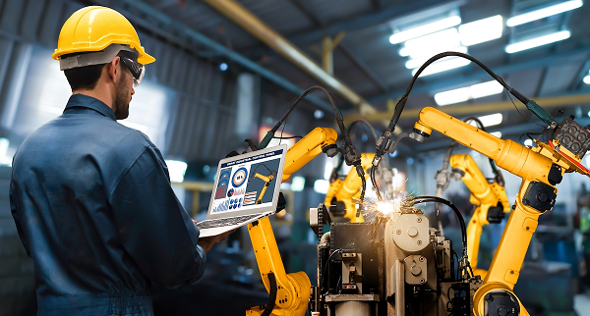
IoT Applications in Business (8)
Manufacturing
IoT technology is revolutionizing the manufacturing industry! It improves efficiency, reduces costs, and increases productivity. IoT can be applied in various areas of the manufacturing process, including supply chain management, inventory control, predictive maintenance, and quality control.

Slide 10
IoT Applications in Business (9)
Benefits
By integrating IoT into the manufacturing process, companies can gain real-time visibility into their operations, enabling them to make data-driven decisions and improve overall performance. IoT can also help to reduce downtime and increase safety on the factory floor.
Use Case
In the manufacturing industry, one of the most notable Internet of things examples is GE Appliances. The company successfully implemented IoT to optimize its supply chain and improve inventory management, resulting in reduced inventory costs and increased efficiency in the production process. This ultimately led to higher profits for the company.

Slide 11
IoT Applications in Business (10)
Healthcare
Checking on patients from far away, using technology for doctor appointments, and connecting medical devices.
Benefits
Allowing patients to receive better care while spending less time in the hospital.
Helping prevent illnesses and improve the overall health.
Lowering healthcare costs by catching diseases early, reducing the number of times patients have to go back to the hospital, and making the healthcare system more efficient.
Use Case
Medtronic, a company that successfully implemented IoT in the healthcare sector. They developed an IoT-enabled diabetes management system that allows patients to monitor their glucose levels in real-time and receive personalized insulin dosing recommendations. This has helped to improve the health outcomes of patients with diabetes and reduce the burden on healthcare systems.

Slide 12
https://www.nutrisense.io/

Slide 13
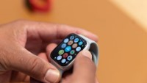

Slide 14
IoT Applications in Business (11)
Retail
The Internet of Things (IoT) revolutionizes the retail industry by connecting various devices and systems to improve customer experience and optimize operations. Some examples of IoT applications in retail include:
Smart shelves that track inventory levels and automatically reorder products.
Electronic price tags that can be updated remotely.
RFID-enabled shopping carts that track customer movements in the store.
Digital kiosks that provide product information and recommendations.
Benefits
Improved customer service and experience
Increased efficiency and cost savings
Better inventory management and restocking,
Enhanced security and loss prevention.
Use Case
Walmart. By using RFID, Walmart can also more accurately track the movement of products through their supply chain, helping to identify areas where they can improve efficiency.

Slide 15
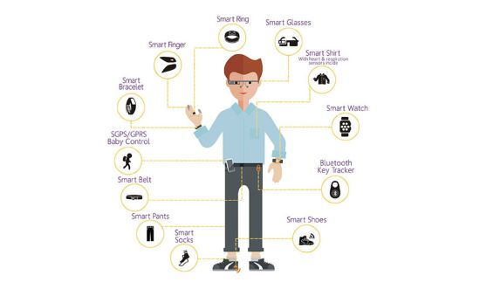
IoT Applications in Business (12)
Wearables
The Internet of Things (IoT) is expanding the capabilities of wearable technology. IoT enables real-time tracking of fitness and health data and remote control of other devices.

Slide 16
IoT Applications in Business (13)
Benefits
IoT wearables bring many benefits, including:
Improved health and fitness tracking
Better communication with friends and family
Remote control of other devices
Use Case
FitBit

Slide 17
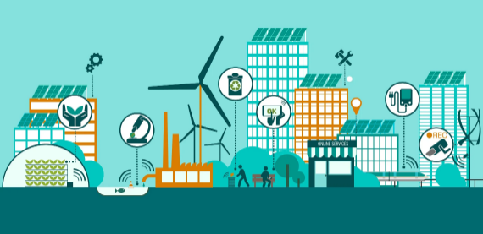
IoT Applications in Business (14)
Smart City
Smart lightning, for energy consumption and costs. Other applications of IoT in smart cities include traffic management, waste management, and air quality monitoring.

Slide 18
IoT Applications in Business (15)
Benefits
IoT-enabled smart cities offer a variety of benefits such as:
Improved energy efficiency
Better traffic management
Improved air quality
Use Case
CityIQ developed by Siemens.

Slide 19
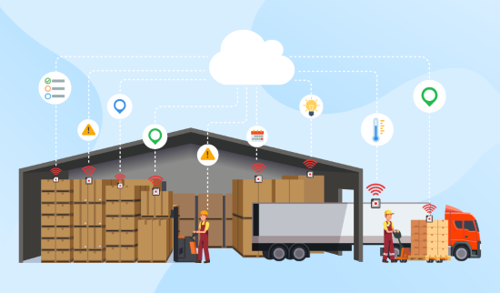
IoT Applications in Business (16)
Smart Supply Chain
Helps in keeping track of inventory, logistics and transportation, and making their supply chain operations better.

Slide 20
https://www.youtube.com/watch?v=HTLBd8FRGFU

Slide 21
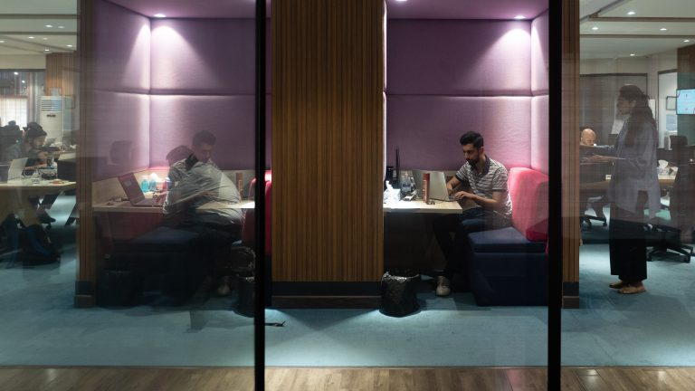
In the week he joined, Raja was told that Gul would be coming to the Karachi office for a visit. Raja dressed smartly on the day, only to find Gul casually sitting on a beanbag in the game room, playing a PS4.

Slide 22
IoT Applications in Business (17)
Benefits
IoT in supply chains can also help with better inventory management, shipment tracking and optimized supply chain operations.
Real-time monitoring can prevent stockouts and overstocking, saving money and making customers happier. Improved logistics and faster deliveries are other benefits of IoT in supply chains.
Use Case
IoT software examples can help different industries, like the Smart Supply Chain. GE Transportation uses software called Predix to track their trains in real time, making their use more efficient and reducing downtime.

Slide 23
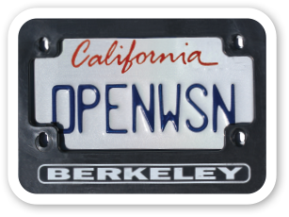
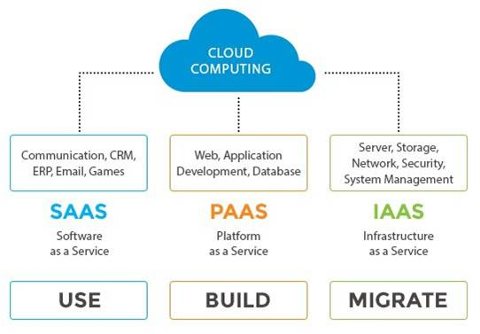
IoT Enabling Technologies (1)
Wireless sensor network (https://openwsn.atlassian.net)
Cloud Computing

Slide 24
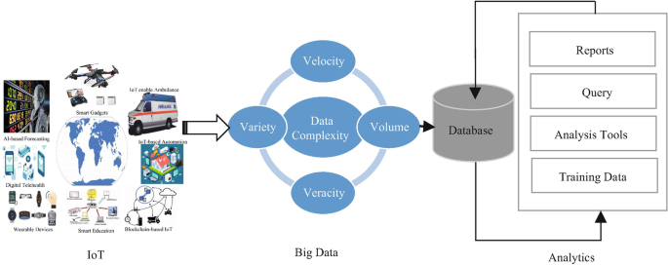
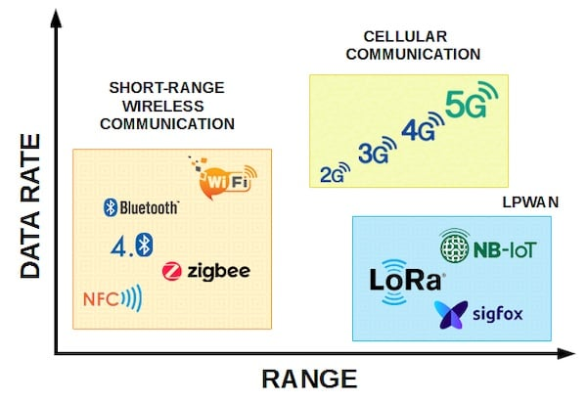
IoT Enabling Technologies (2)
Big Data Analytics
Communications Protocol

Slide 25
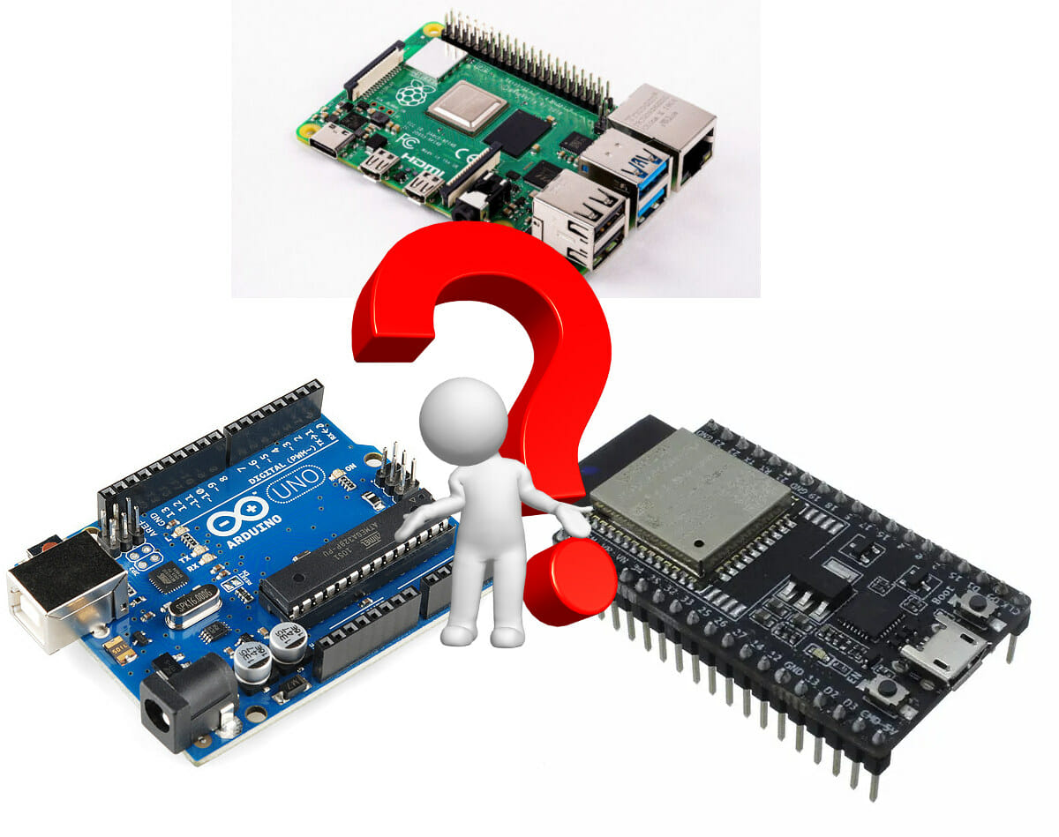
IoT Enabling Technologies (3)
Embedded Systems

Slide 26
Architecture
There are 7 parts to the IoT architecture:
Device Layer
This is the bottom part and it has all the real-life things and sensors that make up the IoT. These can be simple or complex.
Communication Layer
This part makes sure that all the devices and systems can talk to each other. It uses special ways of sending information and connecting.
Network Layer
This part takes care of keeping, working on, and managing the data that the IoT devices and systems make.
Data Processing Layer
This part looks at the data and figures out what it means. It uses special computer programs and tools to do this.
Application Layer
This part has all the apps and services built on top of the platform part. Some examples are monitoring and controlling things and using data to predict when things need fixing.
Business Layer
This part talks about how the IoT can make money and what value it brings.
Security Layer
This is the top part and it makes sure that the data, devices, and network are safe from bad people trying to break in.

Slide 27
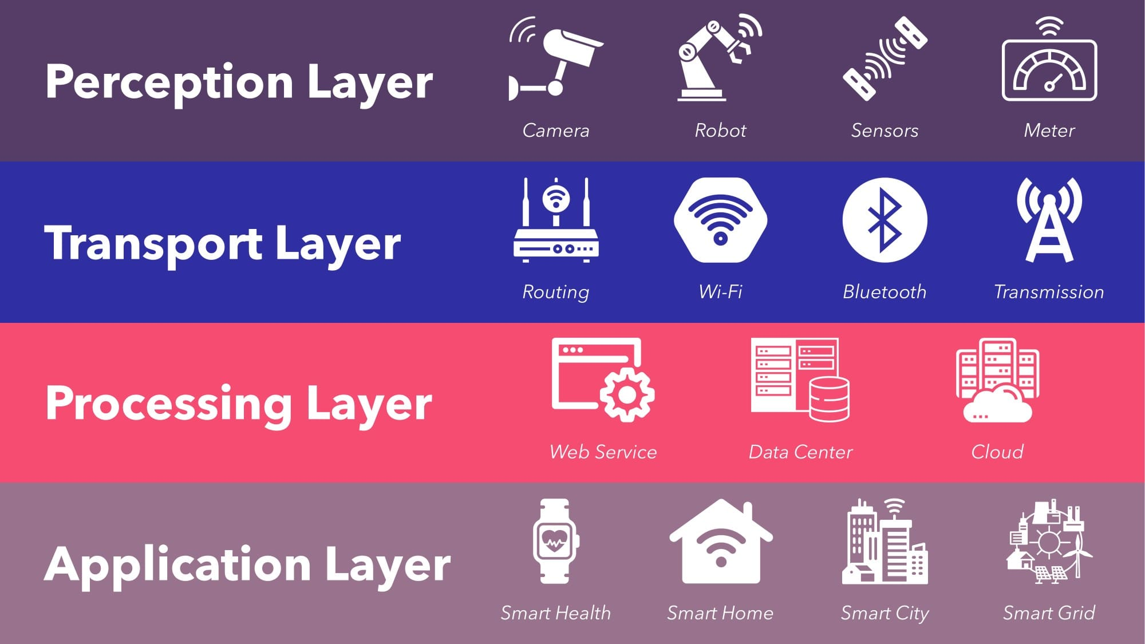
Architecture

Slide 28
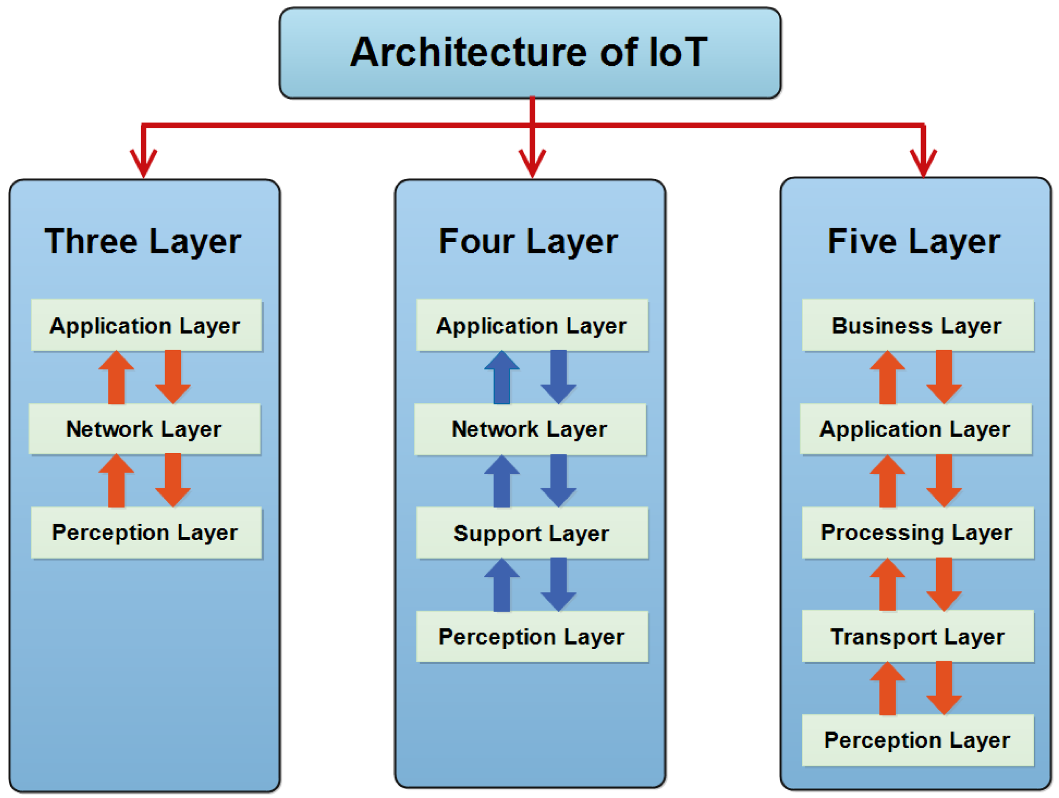
Architecture

Slide 29
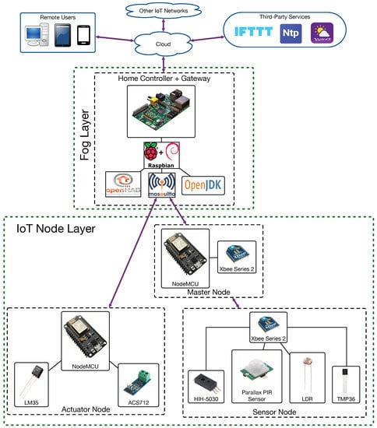

Slide 30
https://www.iotlab.eu/

