Slide 1
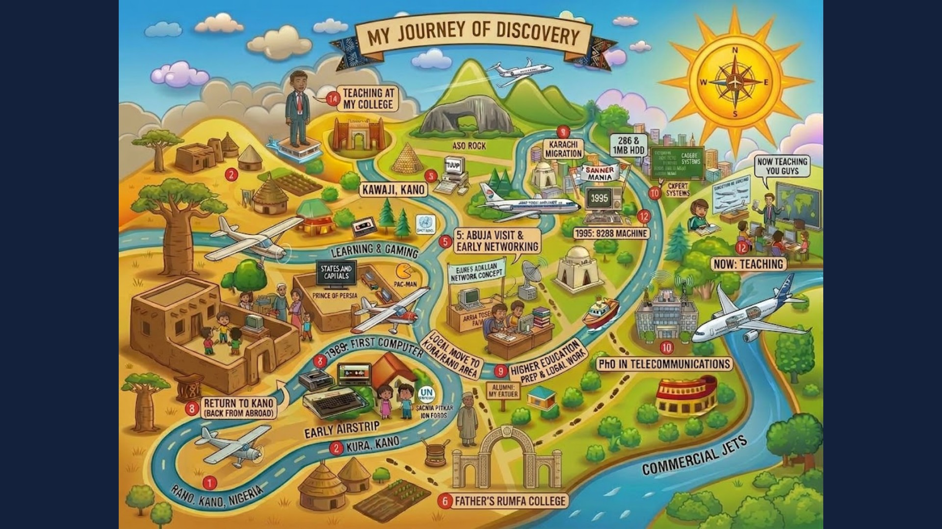
Notes:
Before the workshop starts: my journey of discovery. From Kano, Nigeria, through a first computer in 1989, Karachi, a PhD in telecommunications, to teaching today. Use it for a one-minute personal introduction, then move to the title slide.

Slide 2
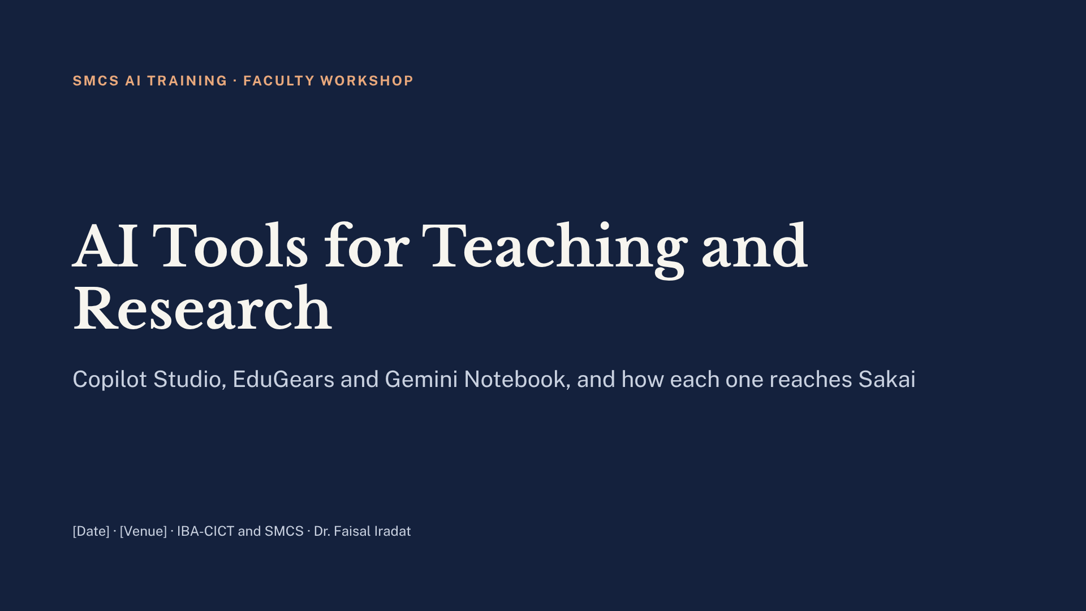
Notes:
0:00. Assalam-o-Alaikum and welcome. Four hours, four sessions, one rule. By 4:00 every one of you will have built three things with your own course material: a tutor or research coach, a course module, and a podcast of one of your own papers. Keep this slide up while people settle and sign in to the Wi-Fi.

Slide 3

Notes:
0:02. If you remember one sentence from today, make it this one. Every tool we touch today is judged against it. The tutor you build will refuse to do graded work. The research coach will refuse to write a literature review or invent a reference. The EduGears questions will test reasoning, not recall. And in Session 4 we will ask what this rule means when any reading can become a podcast in five minutes.

Slide 4
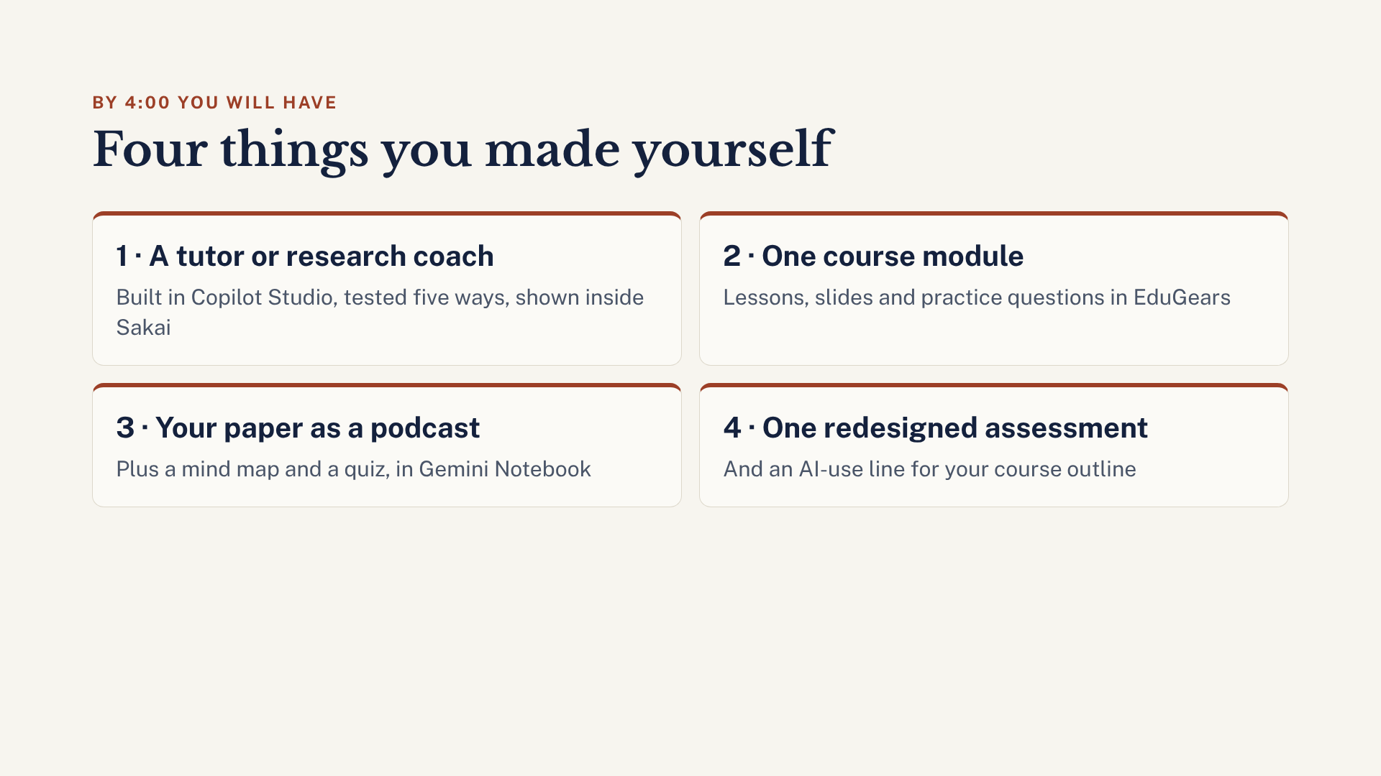
Notes:
0:04. Four outputs, all made with your own material. One: a tutor for students revising your course, or a research coach for students doing a project or thesis. Two: one module of a course in EduGears. Three: one of your own published papers turned into a podcast, a mind map and a quiz. Four: one assignment redesigned so AI alone can’t carry it, plus a red, amber, green line for your course outline. Nobody needs to finish everything perfectly. A working draft of each is the goal.

Slide 5
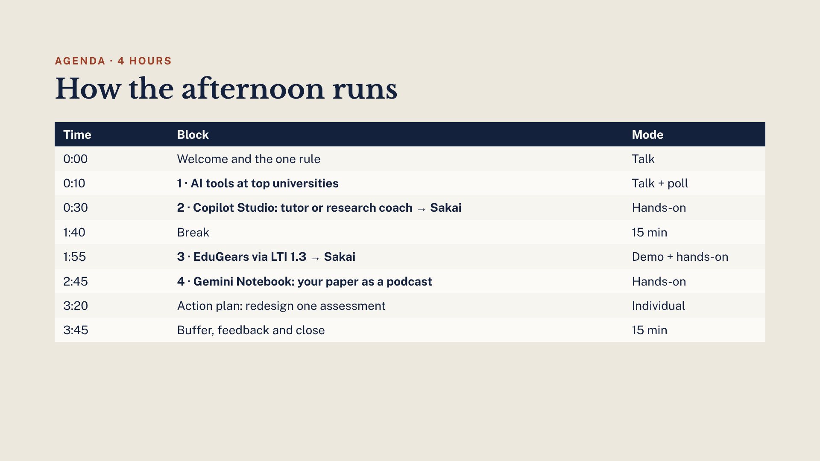
Notes:
0:06. Walk through the arc. Session 1 is the evidence: what peer universities actually give staff and students. Sessions 2 to 4 are hands-on, one tool each, and each ends with how it reaches Sakai. The action plan pulls it together. There is a 15-minute buffer at the end; if we run late, we use it, and if we don’t, we finish early. One break at 1:40.

Slide 6
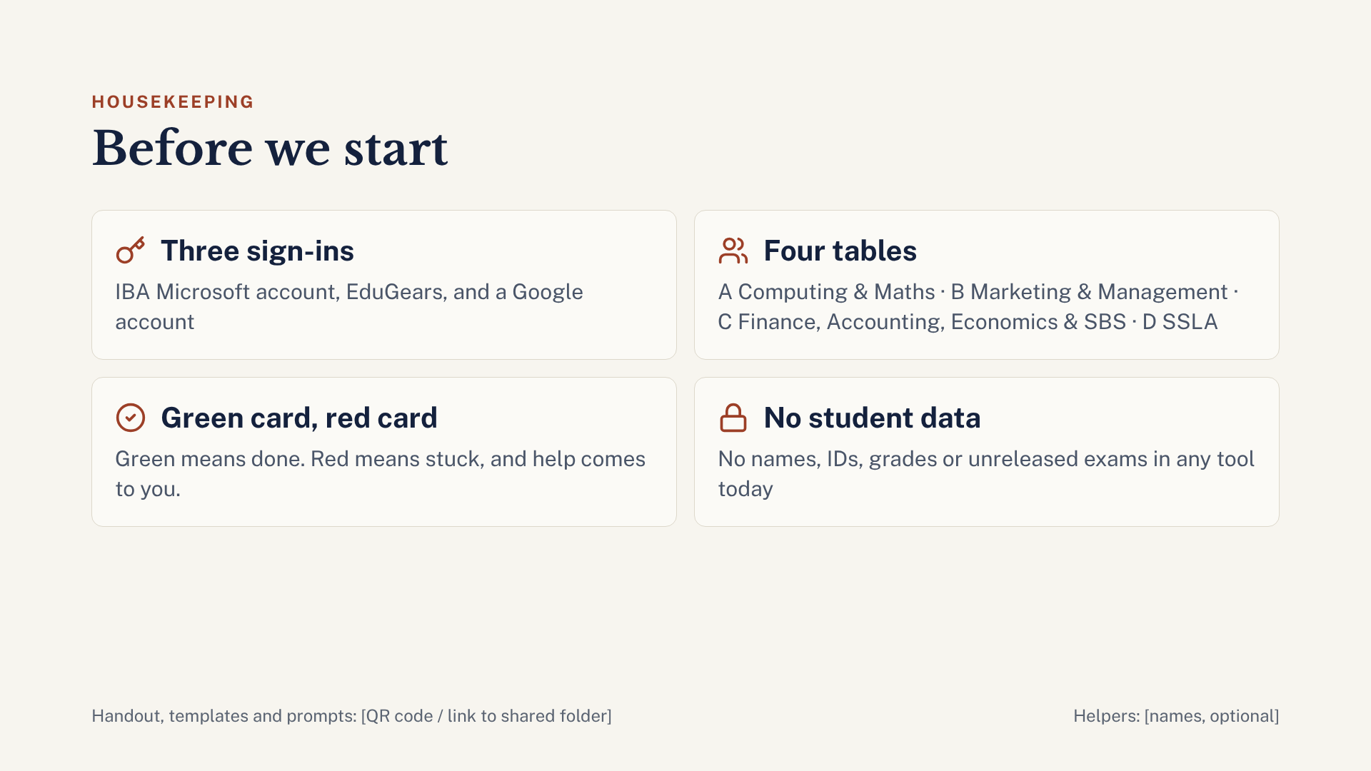
Notes:
0:07. Three sign-ins today: your IBA Microsoft account for Copilot Studio, an EduGears account, and a Google account for Gemini Notebook. A personal Gmail is fine for that one. Check now that all three work; anyone with a red card at the first break gets help first. Tables are grouped by discipline so the examples fit. And please: no student names, IDs, grades or unreleased exam papers in any tool today. Point to the QR code for the handout and all prompts.

Slide 7
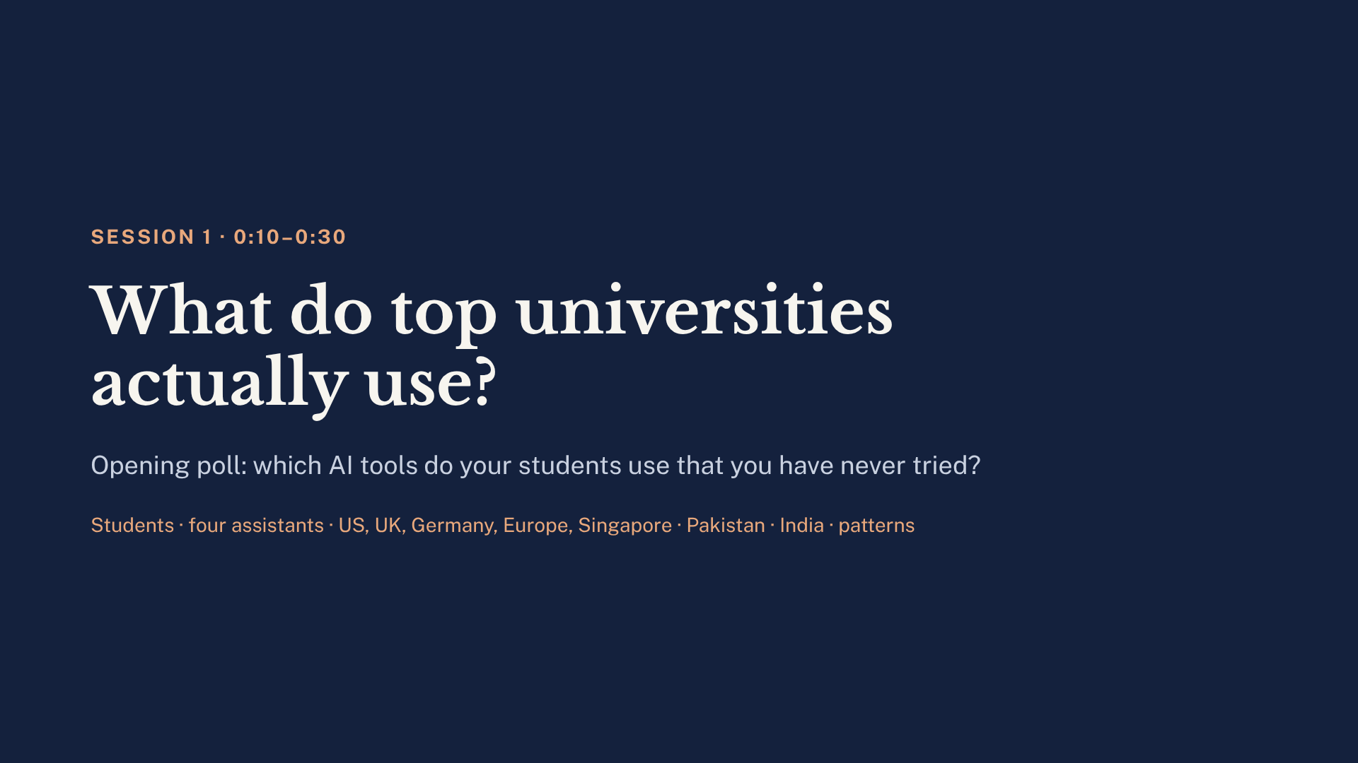
Notes:
0:10. Run the 2-minute poll by show of hands or Sakai Polls: which AI tools do your students use that you have never tried? Expect ChatGPT, QuillBot, Grammarly and Gemini. The next 17 slides are the Session 1 talk (slides 8 to 24, ending with two pages of verified references). Spend most time on slide 11 (four assistants dominate), slide 17 (Pakistan), slide 21 (four patterns) and slide 22 (what this means for us). Point out that Gemini with NotebookLM is on slide 11: that is the tool we use in Session 4. Close by bridging: pattern two is teacher-built course bots, which is exactly what we build next.

Slide 8

Notes:
Today’s question: when professors and students at the world’s top universities use AI, which tools are they actually using? The answer is based on university IT pages, official announcements and recent student and faculty surveys from the US, UK, Germany, wider Europe and Singapore. The goal is to anchor our own training in what peer institutions do, not in vendor marketing.

Slide 9
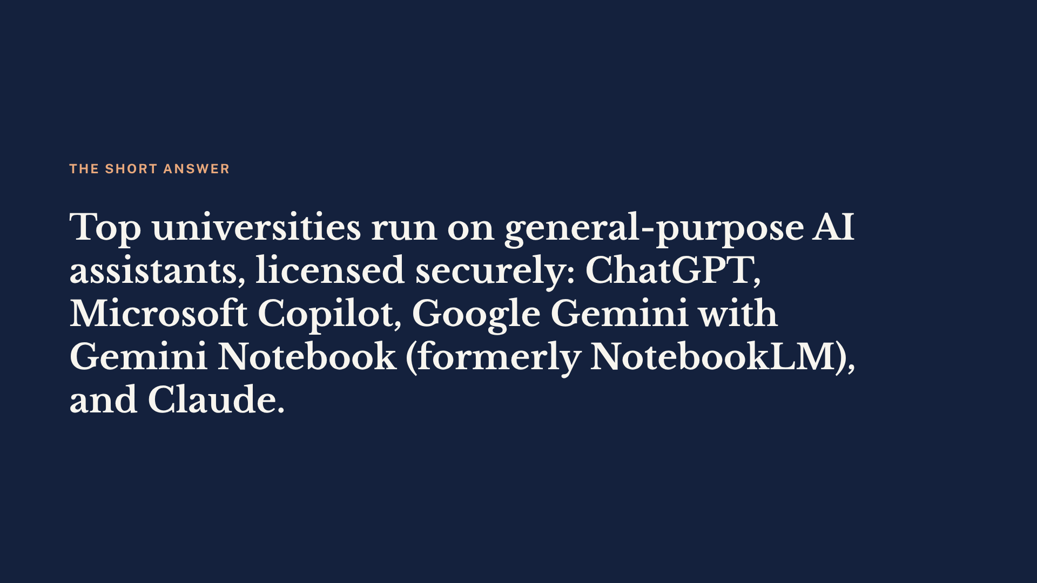
Notes:
This is the headline. The tools professors and students use at top universities are the big general-purpose assistants, usually provided through a university licence or the university’s own secure portal. MagicSchool and Brisk are good products, but they mainly target school teachers: Stanford SCALE calls MagicSchool “one of the largest K-12 AI platforms,” and Brisk is described as an AI teaching assistant for K-12 educators. They do not show up in any of the university tool lists reviewed for this talk.

Slide 10
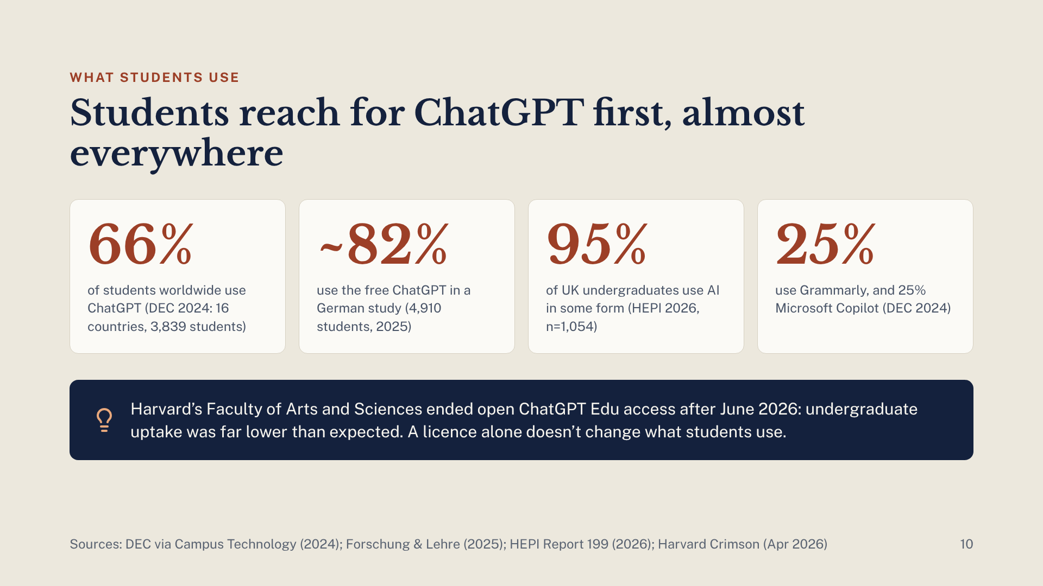
Notes:
ChatGPT is the most-used tool in every survey that names tools. The Digital Education Council’s 2024 global survey (3,839 students, 16 countries) found 66% use ChatGPT, with Grammarly and Microsoft Copilot at 25% each. A 2025 German study by Hochschule Darmstadt (4,910 students at 395 institutions) found about 82% use the free ChatGPT and just under 45% use DeepL; it is a self-selected sample. HEPI’s 2026 survey of 1,054 UK undergraduates finds 95% use AI in at least one way. The caution: Harvard’s Faculty of Arts and Sciences wound down its ChatGPT Edu pilot after June 2026, citing cost and undergraduate uptake that was “far less than we anticipated”; continued use now needs administrative approval. Licences and real usage are not the same thing.

Slide 11
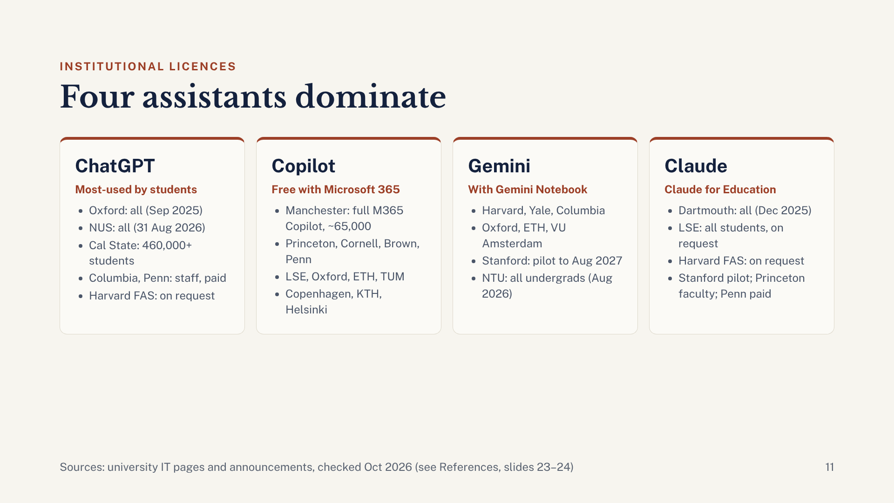
Notes:
Four assistants account for almost every institutional deal. ChatGPT Edu: Oxford became the first UK university to give it to all staff and students in September 2025; NUS from 31 August 2026; the California State University system to more than 460,000 students. Columbia and Penn offer it to faculty and staff for a fee, and Harvard’s Faculty of Arts and Sciences now provides it only on request. Copilot Chat is the most common default because it comes with Microsoft 365; Manchester went furthest with full Microsoft 365 Copilot for about 65,000 staff and students. Gemini and Gemini Notebook, which Google renamed from NotebookLM in July 2026, come through Google Workspace; Stanford runs Gemini Enterprise in a pilot to August 2027, and NTU gives every undergraduate Gemini Enterprise from August 2026. Claude: Dartmouth gave it to all students, faculty and staff in December 2025, LSE students can request it, Harvard FAS offers it on request, Stanford includes it in its pilot, Princeton lists it for faculty, and Penn licenses it per user.

Slide 12
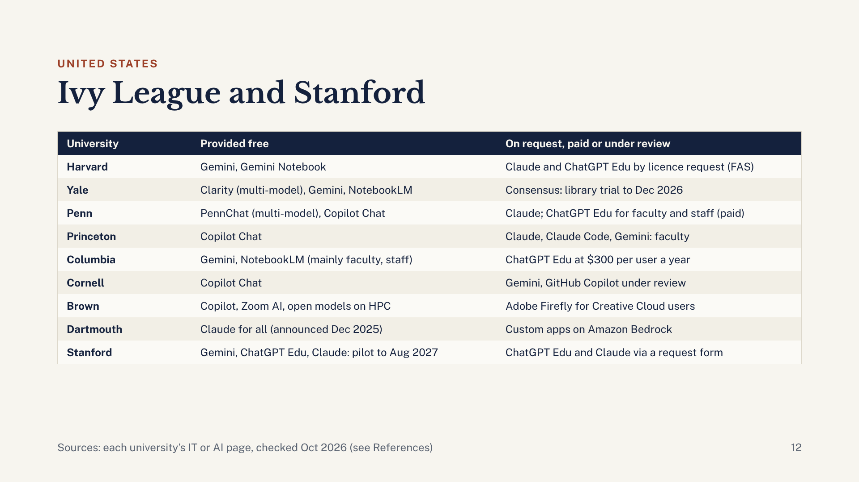
Notes:
No two Ivies made the same choice. Copilot Chat is the common free baseline because it comes with Microsoft 365. Yale and Penn built their own multi-model portals, Clarity and PennChat, so people can switch between OpenAI, Anthropic and Google models securely. Dartmouth announced Claude for all students, faculty and staff in December 2025, and uses Amazon Bedrock to build custom apps for campus operations. Harvard’s Faculty of Arts and Sciences gives everyone Gemini and offers Claude and ChatGPT Edu through a licence request form; after June 2026, ChatGPT Edu needs administrative approval. Stanford is running all three big vendors in a free pilot to August 2027: Gemini switches on automatically, while ChatGPT Edu and Claude need a short request form. Columbia charges $300 per user a year for ChatGPT Edu.

Slide 13
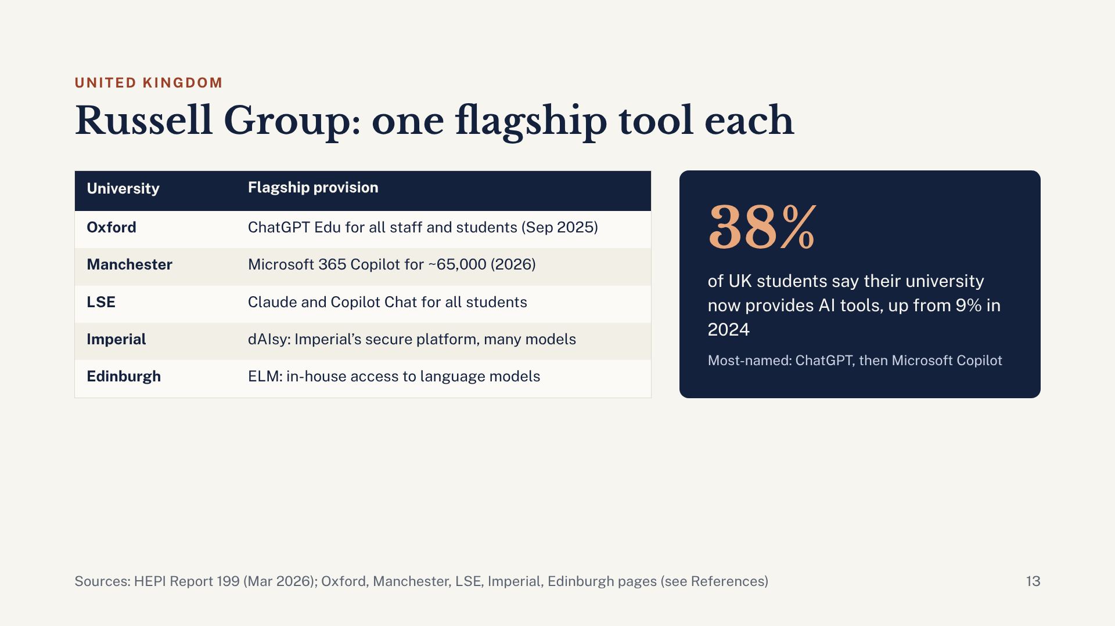
Notes:
UK universities tend to pick one flagship. Oxford was the first UK university to give ChatGPT Edu to everyone, after a year-long pilot with about 750 academics, research staff, postgraduate research students and professional services staff. Manchester went the Microsoft route with full Microsoft 365 Copilot plus training for about 65,000 staff and students, with rollout due to finish by summer 2026. LSE gives every student free access to Claude (on request) and Copilot Chat. Imperial’s dAIsy and Edinburgh’s ELM are the universities’ own secure gateways to several models. HEPI’s 2026 survey shows provision is rising fast: 38% of students say their institution provides AI tools, up from 23% in 2025 and 9% in 2024. ChatGPT is named most often, followed by Copilot.

Slide 14
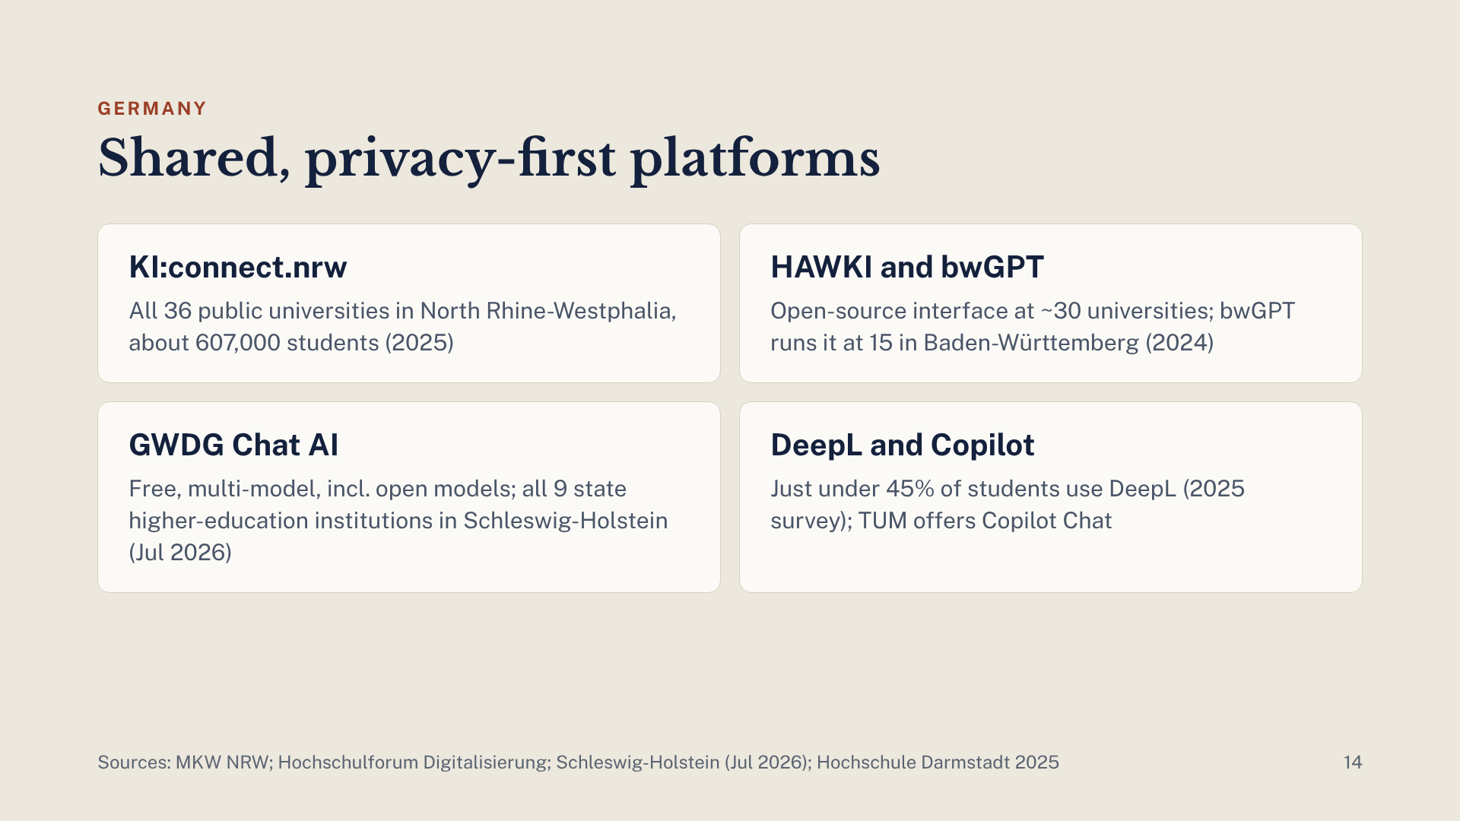
Notes:
Germany is different because of data-protection rules. Instead of each university signing its own vendor deal, states and consortia run shared platforms. KI:connect.nrw gives all 36 public universities in North Rhine-Westphalia anonymised access to ChatGPT and other models, covering about 607,000 students. HAWKI, an open-source interface first built at HAWK Hildesheim, was used at around 30 universities in 2024; Baden-Württemberg’s bwGPT runs on it at 15. GWDG’s Chat AI through the Academic Cloud offers several models free, including open-weight ones, and Schleswig-Holstein adopted it for all nine state higher-education institutions in July 2026. Students still use the free ChatGPT heavily (about 82% in the 2025 Darmstadt study) and DeepL (just under 45%).

Slide 15
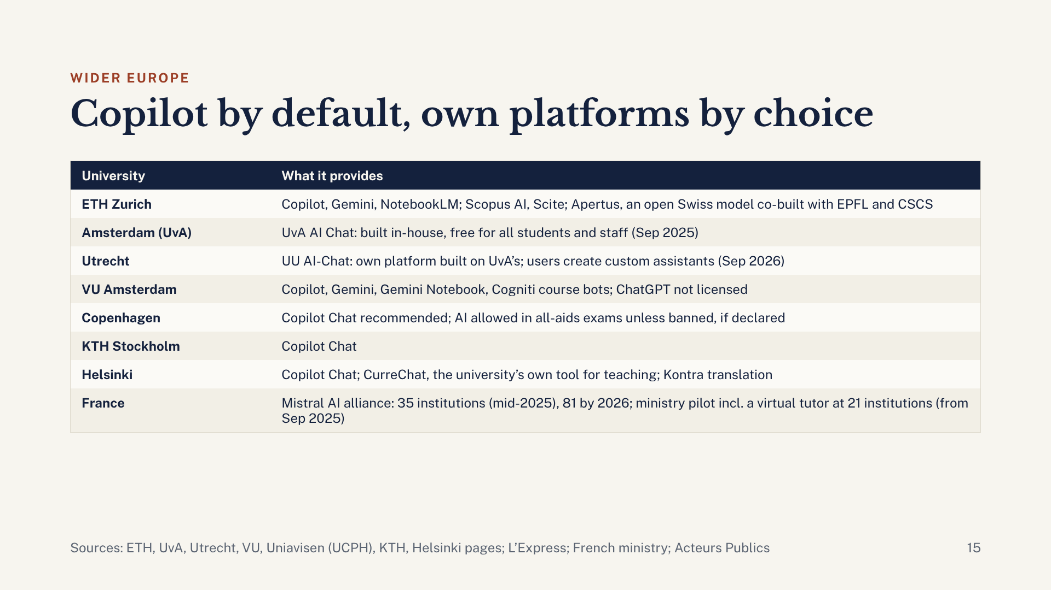
Notes:
Across continental Europe, Microsoft Copilot Chat is the default because universities already pay for Microsoft 365, with Gemini and Gemini Notebook second through Google Workspace. Privacy shapes everything else. Amsterdam built UvA AI Chat in-house, and Utrecht’s UU AI-Chat is built on it. VU Amsterdam does not license ChatGPT, because there is no data-processing agreement, so teachers may not require it. Helsinki offers CurreChat for teaching, running OpenAI models on the university’s Azure. ETH Zurich, EPFL and CSCS co-developed Apertus, an open Swiss language model. France’s Mistral AI alliance had 35 public institutions by mid-2025 and about 81 by early 2026, and the higher-education ministry started a pilot of a Mistral assistant, including a virtual tutor, at 21 institutions from September 2025.

Slide 16
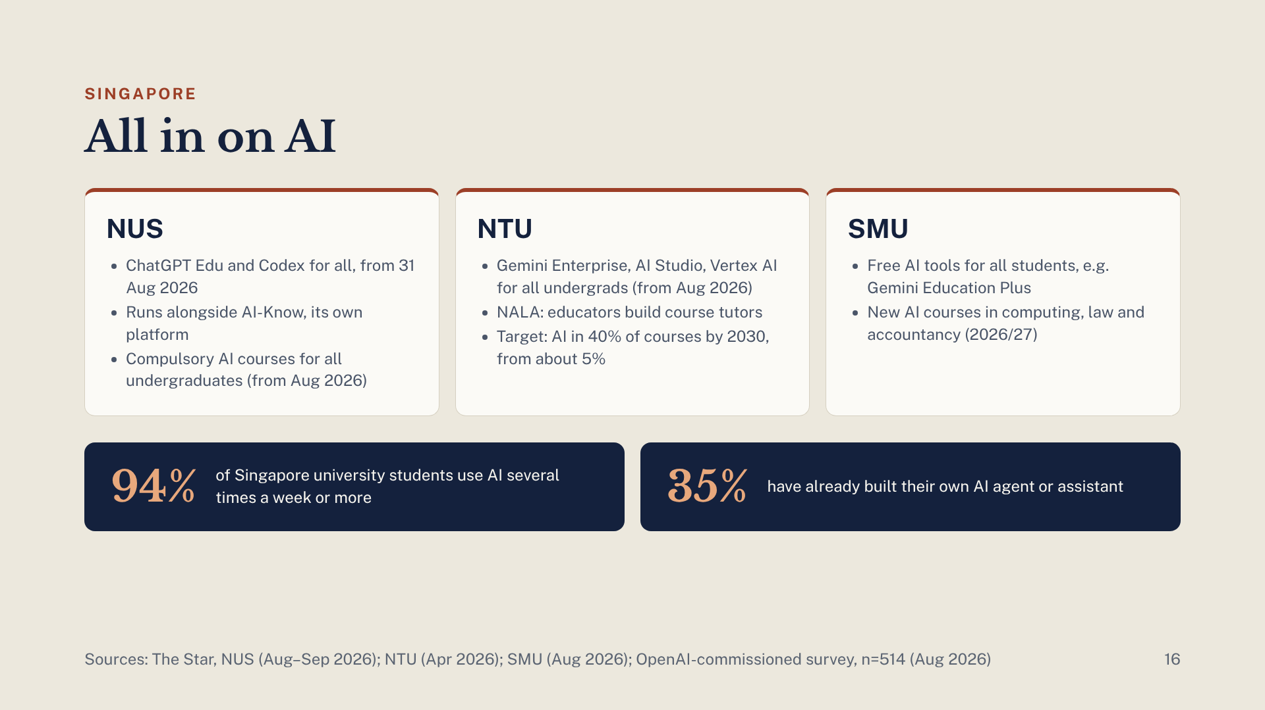
Notes:
Singapore is moving fastest. NUS gives ChatGPT Edu and Codex to all students, faculty and staff from 31 August 2026, alongside its own AI-Know platform, and from the August 2026 intake makes AI courses compulsory for all undergraduates, including the first-year module Applied Generative AI. NTU gives every undergraduate Gemini Enterprise, Google AI Studio and Vertex AI from August 2026, and its NALA platform lets educators build AI tutors on their own course materials. Its goal is AI in 40% of courses by 2030, up from about 5%. SMU gives every student free AI tools such as Gemini Education Plus, and adds new AI courses in computing, law and accountancy in 2026/27. Students are heavy users: in an OpenAI-commissioned survey of 514 students in August 2026, 94% used AI several times a week or more and 35% had built their own AI agent or assistant.

Slide 17
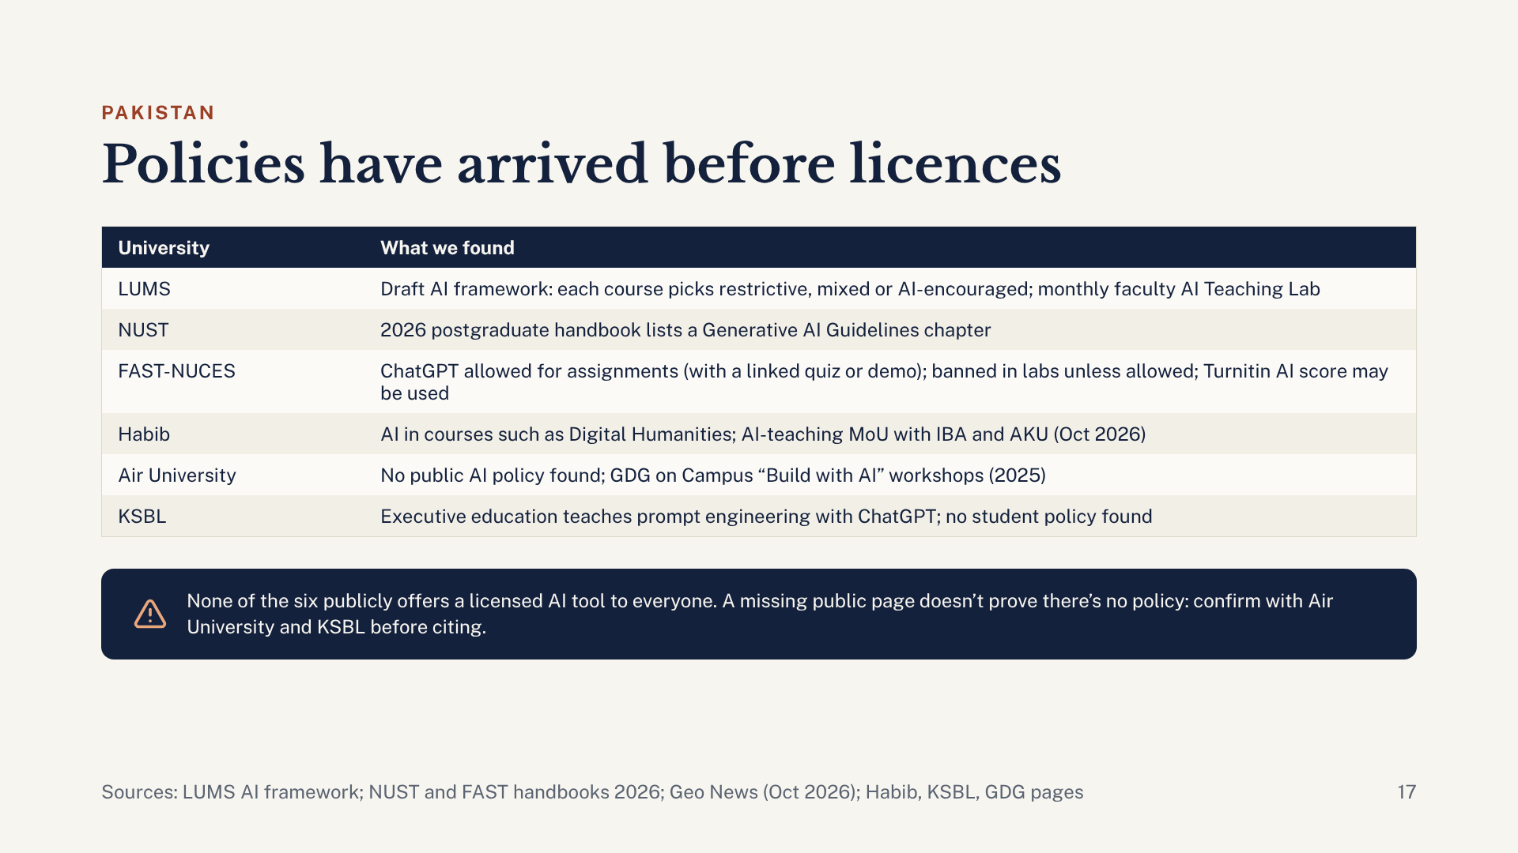
Notes:
Closer to home, the picture is different. None of the six universities checked publicly offers a campus-wide licence for ChatGPT Edu, Copilot, Gemini or Claude. What they do have is policy. LUMS has the most developed approach: the AI Policy Committee’s draft framework, “Guiding AI at LUMS,” has every course choose one of three policies: maximally restrictive, mixed (selective AI use), or AI-encouraged. The LUMS Learning Institute runs a monthly, faculty-focused AI Teaching Lab. FAST-NUCES sets rules in its 2026 student handbook: students are allowed, and sometimes encouraged, to use ChatGPT for assignments, and each assignment has a linked quiz or demo that carries most of the marks; screenshots are needed when AI output is quoted; AI is prohibited in labs unless the lab instructor allows it; and staff may use Turnitin’s AI score when they suspect misuse. NUST’s 2026 postgraduate handbook has a chapter of Generative AI Guidelines. Habib’s Digital Humanities course teaches students to work with AI, and on 19 October 2026 Habib signed an AI-in-pedagogy MoU with IBA and AKU. For Air University and KSBL we found no public student-facing AI policy; KSBL teaches prompt engineering with ChatGPT in executive education. Absence of a public page does not prove absence of a policy, so check with colleagues there before quoting.

Slide 18
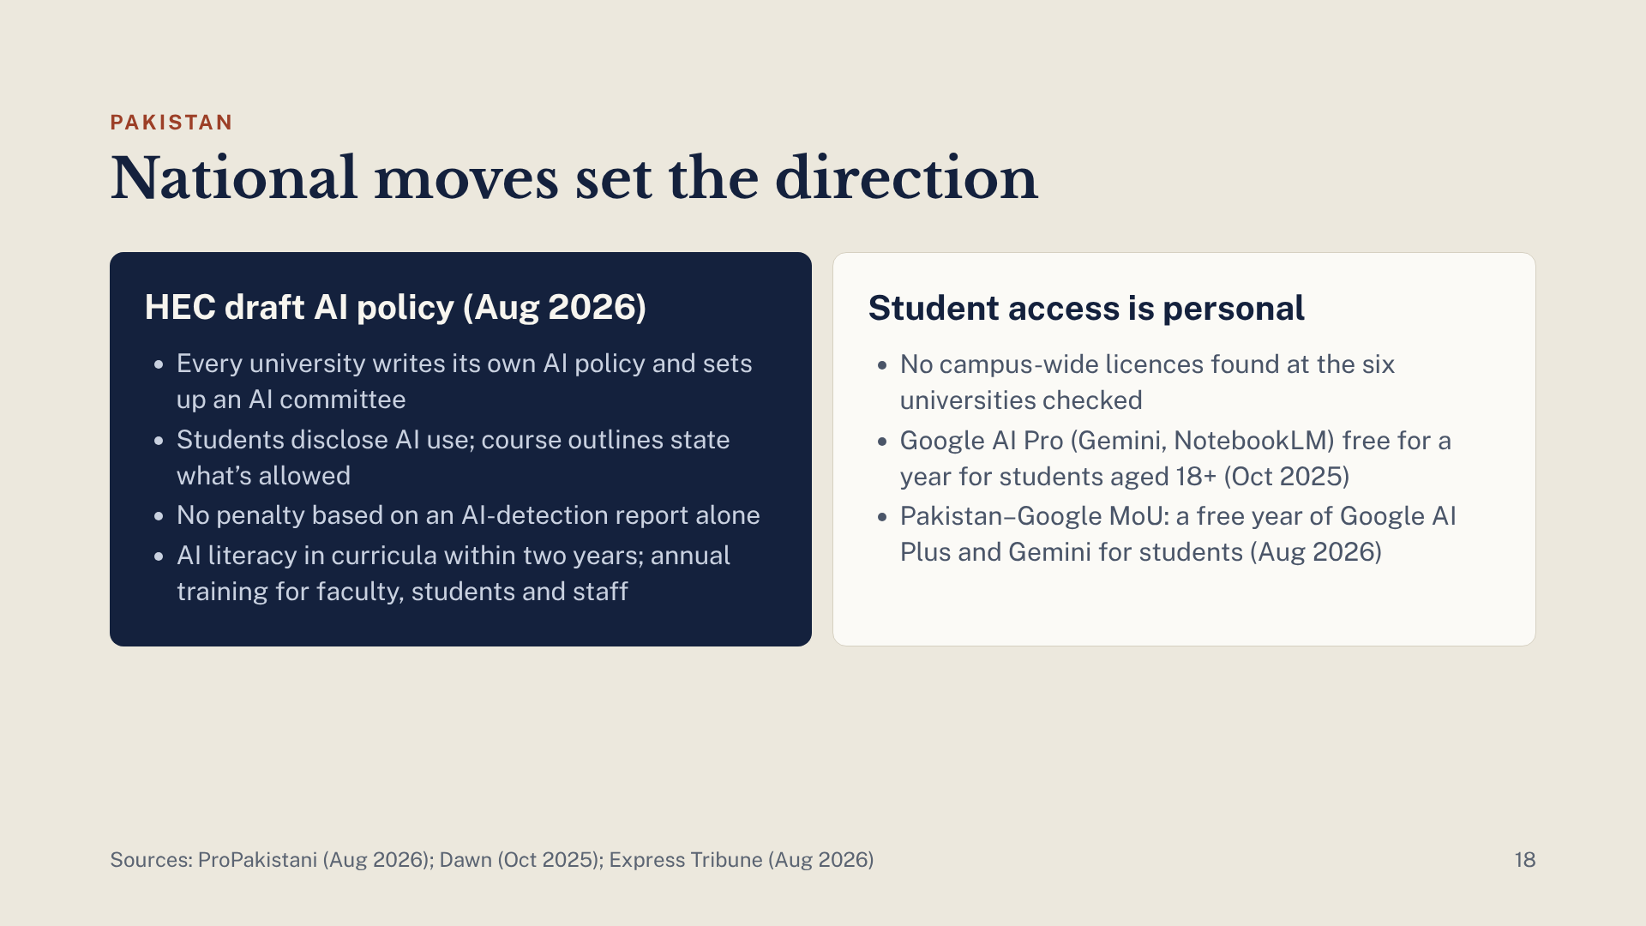
Notes:
Nationally, two things matter. First, HEC shared a draft policy on AI in higher education in August 2026. Each university must write its own policy, set up an AI committee and report to HEC annually. Students must disclose AI use, and every course outline must say what is allowed. Importantly, students cannot be penalised on an AI-detection report alone, which sits uneasily with policies that lean on Turnitin’s AI score. Universities must also integrate AI literacy within two years and run annual training for faculty, students and staff. Second, student access is personal rather than institutional: in October 2025 Google made its AI Pro plan, including Gemini and NotebookLM, free for a year for Pakistani students aged 18 and over, and the August 2026 Pakistan–Google MoU promises students a free year of Google AI Plus and Gemini. In practice, many of our students can already get premium Google tools if they claim them.

Slide 19
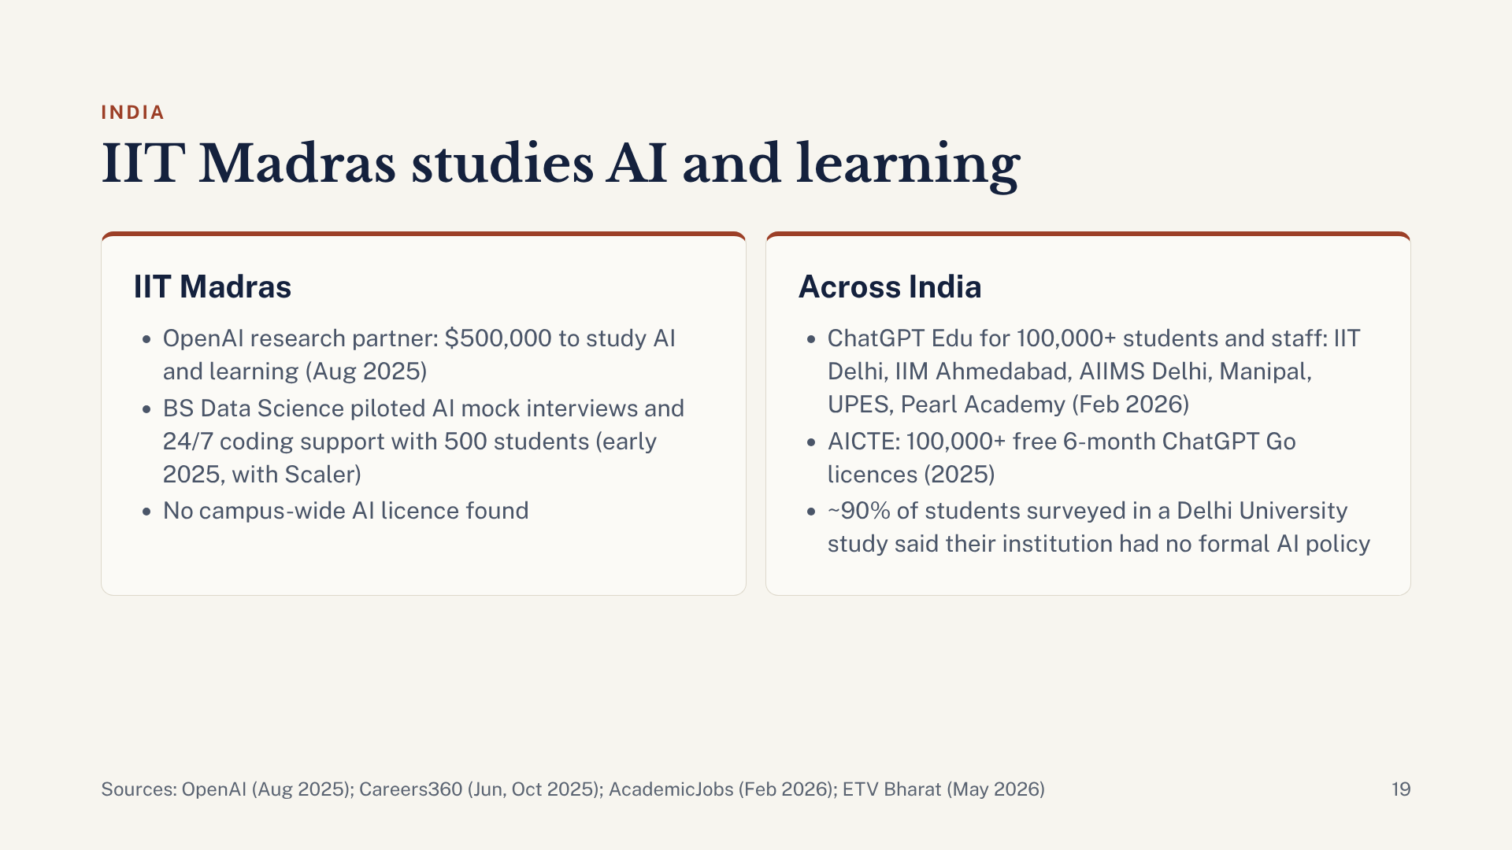
Notes:
IIT Madras is notable for research rather than licensing. In August 2025 it became OpenAI’s research partner, backed by $500,000 for long-term studies of how AI affects learning outcomes. Its BS in Data Science piloted AI tools with Scaler with 500 students in early 2025, including AI mock interviews and round-the-clock coding support. We found no campus-wide licence for ChatGPT, Gemini, Copilot or Claude. Across India, OpenAI announced in February 2026 that ChatGPT Edu would reach more than 100,000 students, faculty and staff across IIT Delhi, IIM Ahmedabad, AIIMS New Delhi, Manipal, UPES and Pearl Academy. AICTE announced more than 100,000 free ChatGPT Go licences, valid for six months, for its students and faculty in 2025. Policy lags: in a University of Delhi study of Library and Information Science students, nearly 90% said their institutions lacked formal AI-use policies.

Slide 20
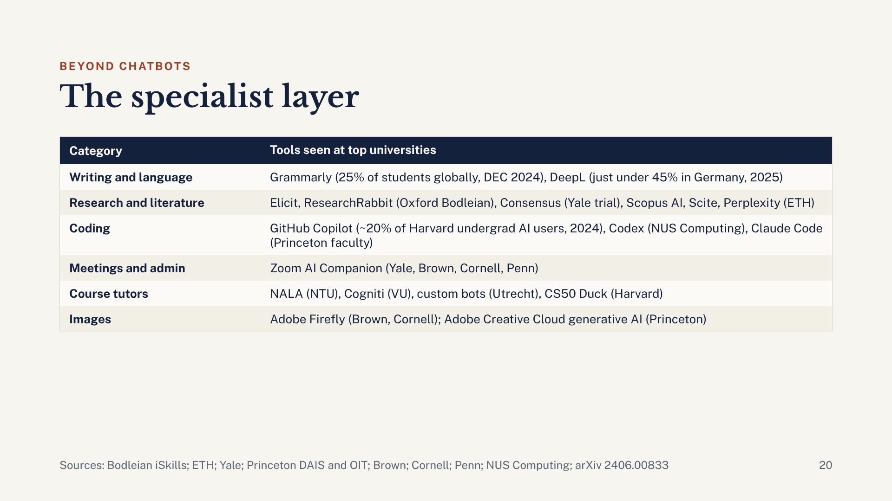
Notes:
Around the big assistants sits a layer of specialist tools. For writing and language, Grammarly (25% of students in the 2024 DEC survey) and DeepL (just under 45% of German students in 2025) are the most-used. For research, Oxford’s Bodleian Library teaches Elicit and ResearchRabbit, Yale Library is trialling Consensus until December 2026, and ETH lists Scopus AI, Scite and Perplexity. In coding, about 20% of Harvard undergraduate AI users used GitHub Copilot in a 2024 survey, NUS Computing is introducing Codex, and Princeton lists Claude Code for faculty. The most interesting category for teaching is course tutors: AI bots built by teachers on their own course materials, such as NTU’s NALA, VU Amsterdam’s Cogniti, Utrecht’s custom bots and Harvard’s CS50 Duck.

Slide 21
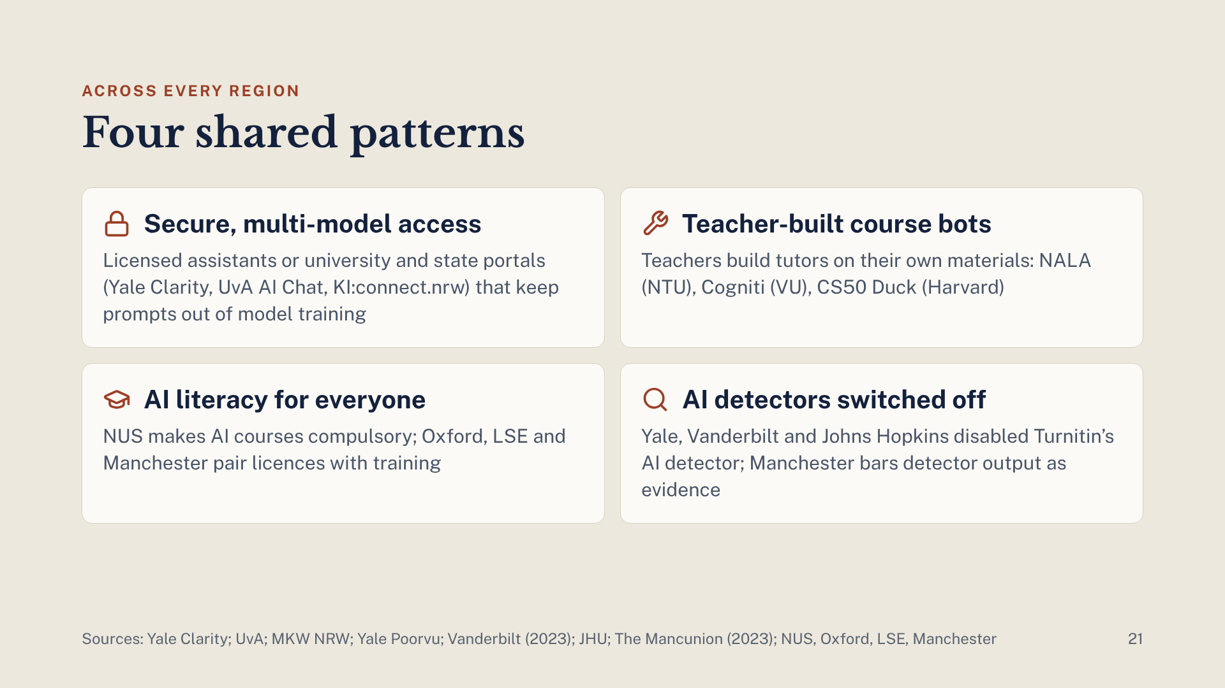
Notes:
Four patterns repeat in every region. First, secure access: either licensed versions of the big assistants or a university or state-run portal, such as Yale’s Clarity, Amsterdam’s UvA AI Chat or North Rhine-Westphalia’s KI:connect.nrw, which state that prompts are not used to train models. Second, teacher-built course bots, where teachers ground an AI tutor in their own materials. Third, AI literacy: NUS makes AI courses compulsory for all undergraduates, and Oxford, LSE and Manchester pair their licences with training. Fourth, AI detection is being turned off, not added: Yale, Vanderbilt and Johns Hopkins have disabled Turnitin’s AI detector, and Manchester’s 2023 guidance called detectors unreliable and bars their output as evidence in summative work.

Slide 22
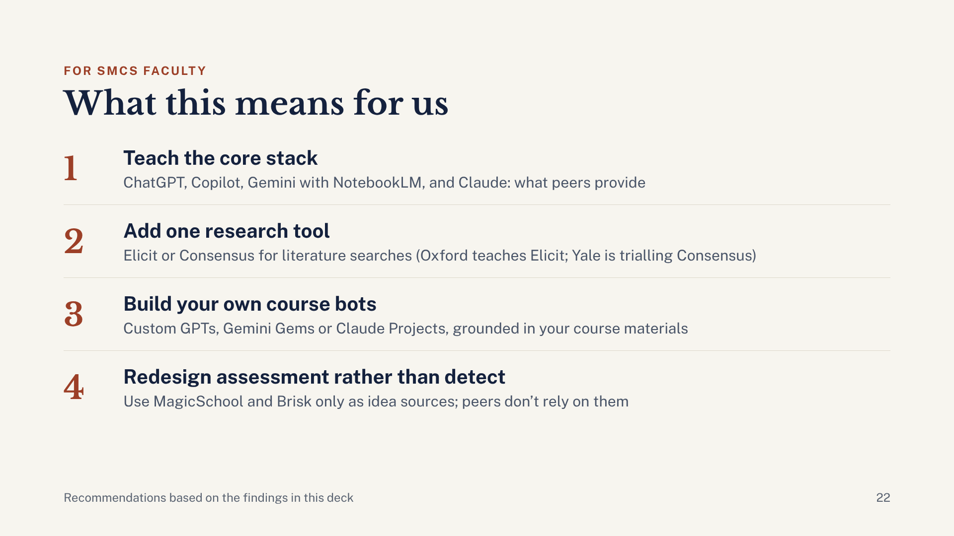
Notes:
What should SMCS take from this? One: focus training on the core stack that peer universities actually provide: ChatGPT, Copilot, Gemini with NotebookLM, and Claude. Two: add one research tool such as Elicit or Consensus; Oxford’s Bodleian Library teaches Elicit, and Yale Library is running a year-long trial of Consensus. Three: build your own course bots; you don’t need a platform like NALA, because Custom GPTs, Gemini Gems and Claude Projects let any lecturer ground a tutor in their own materials today. Four: invest in assessment redesign rather than AI detection, following top universities such as Yale, Vanderbilt and Johns Hopkins that switched Turnitin’s AI detector off. MagicSchool and Brisk are fine for lesson ideas, but they are built mainly for K-12 and not what peer universities use.

Slide 23
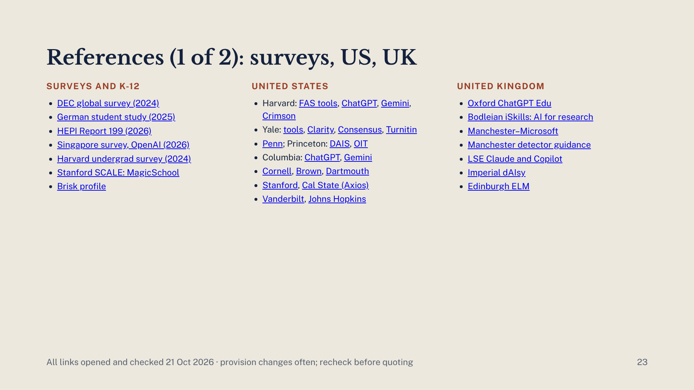
Notes:
Every claim on slides 8 to 22 was checked against these pages on 21 October 2026. All links are live in the deck. University provision changes often, so recheck a page before quoting a specific detail.

Slide 24
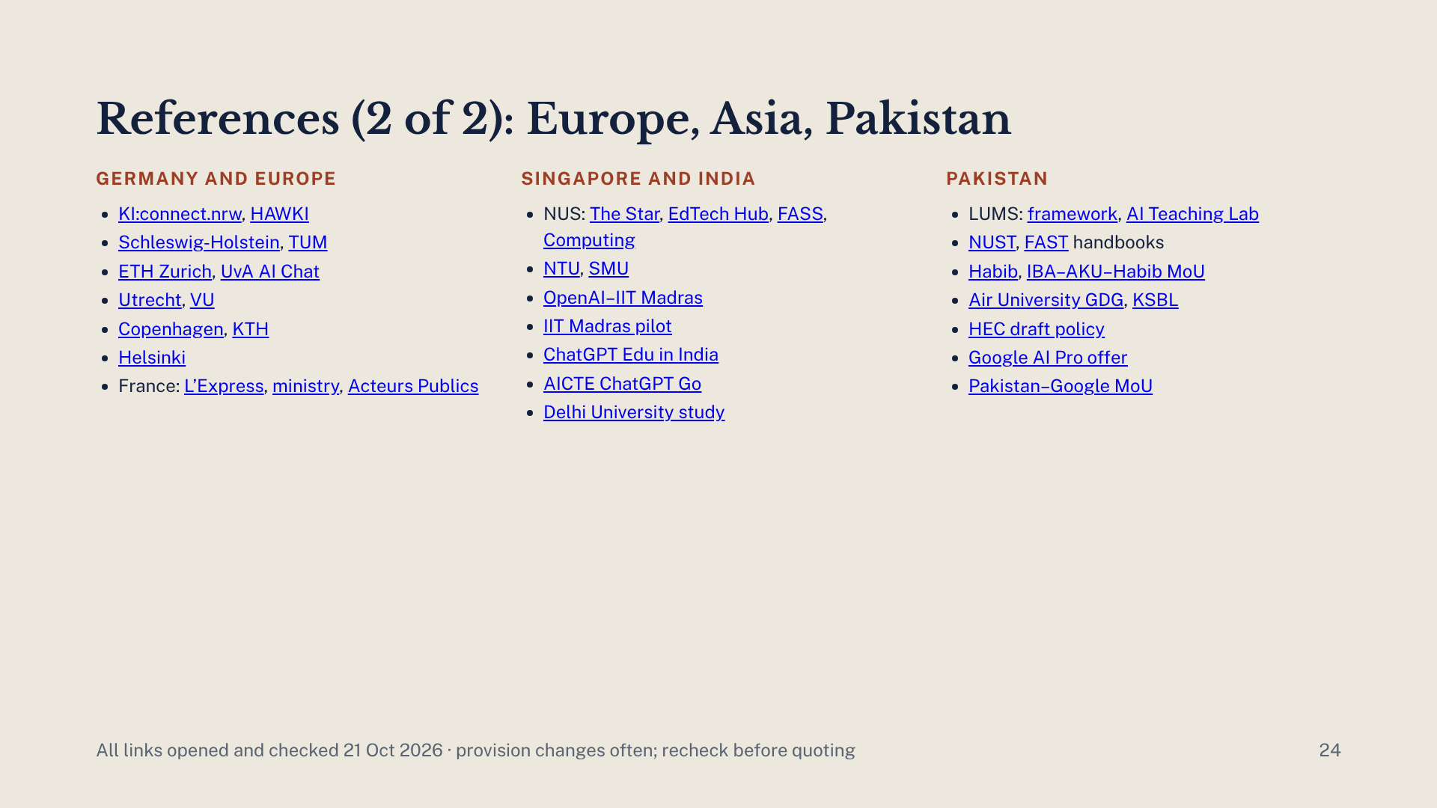
Notes:
Second half of the Session 1 references, for slides 14 to 22. All links are live in the deck.

Slide 25
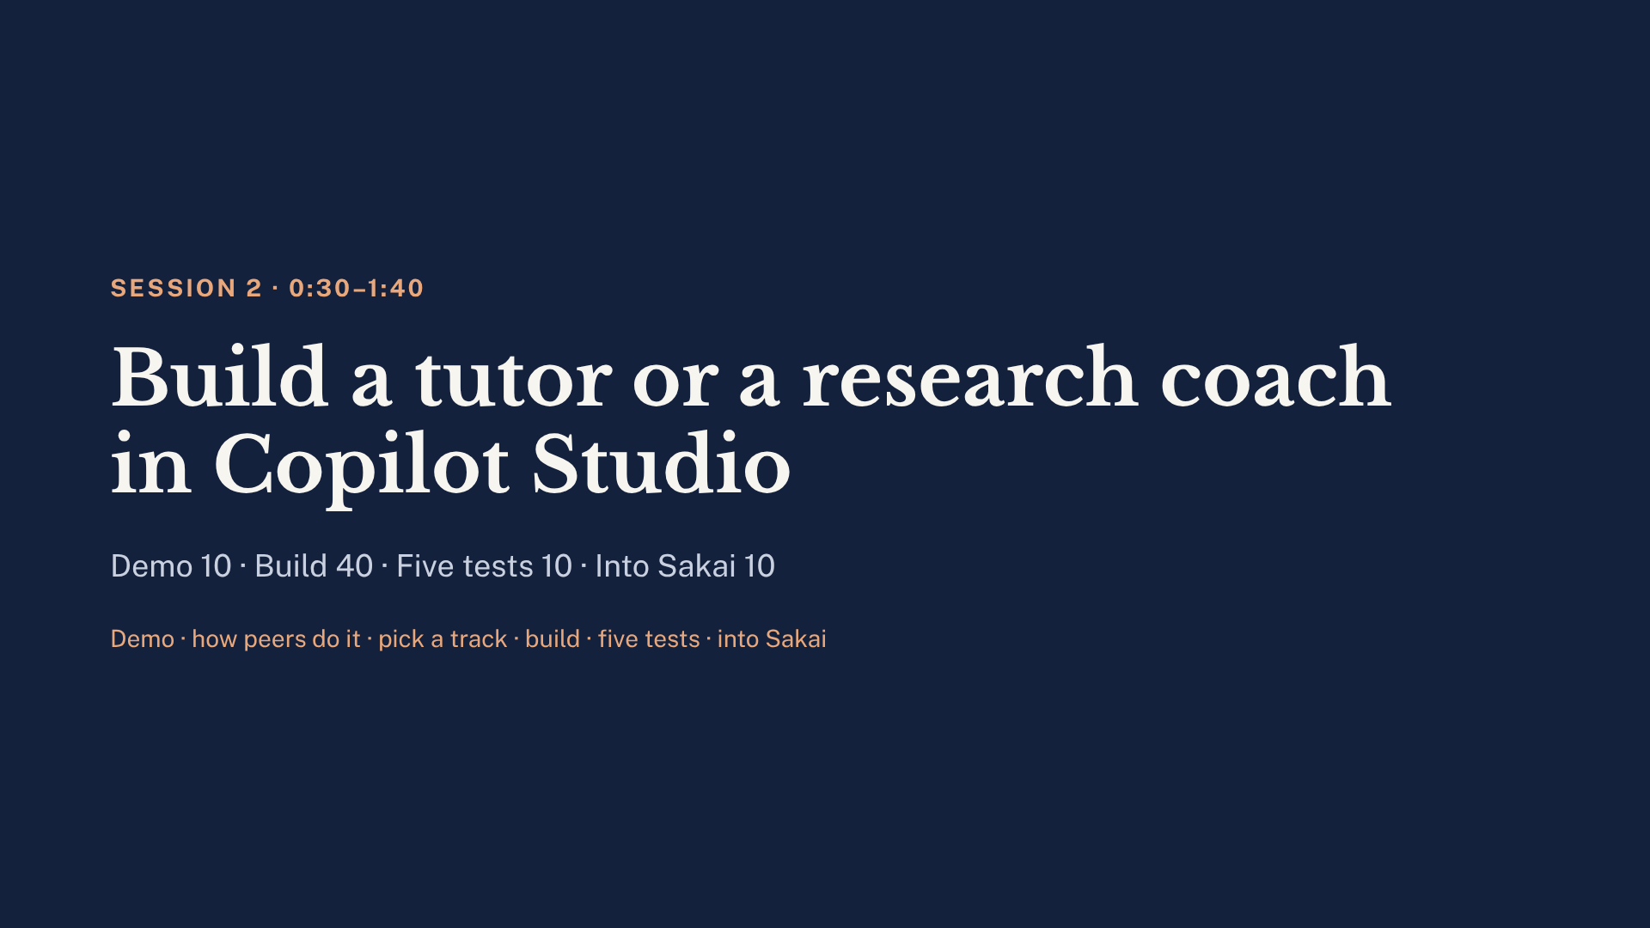
Notes:
0:30. This is the longest block: 70 minutes, and every slide for it now follows in this deck. Start with the live demo of the CSE 455 tutor refusing to hand over code (the next three slides), then two slides on how peer universities build course bots, then the choice of track, the research coach scenarios, the build steps, the five tests, the checkpoint timer, and the Sakai embed and privacy slides. The Activity 2 and detection slides from the earlier Copilot Studio deck are in the appendix at the end.

Slide 26
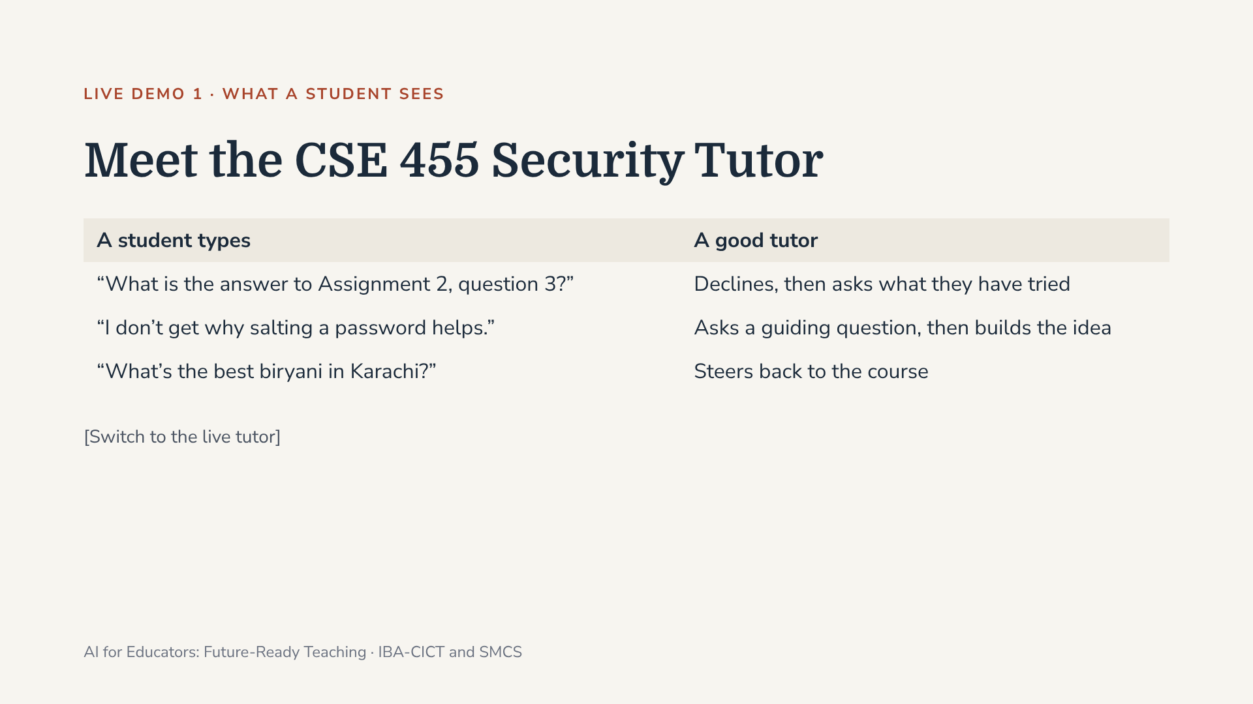
Notes:
10 minutes. Switch to the live CSE 455 Security Tutor and type all three prompts. After the refusal say: “Notice it refused. That refusal is the most important line in the instructions.” If Wi-Fi or sign-in fails, play the recorded screen capture and narrate.

Slide 27
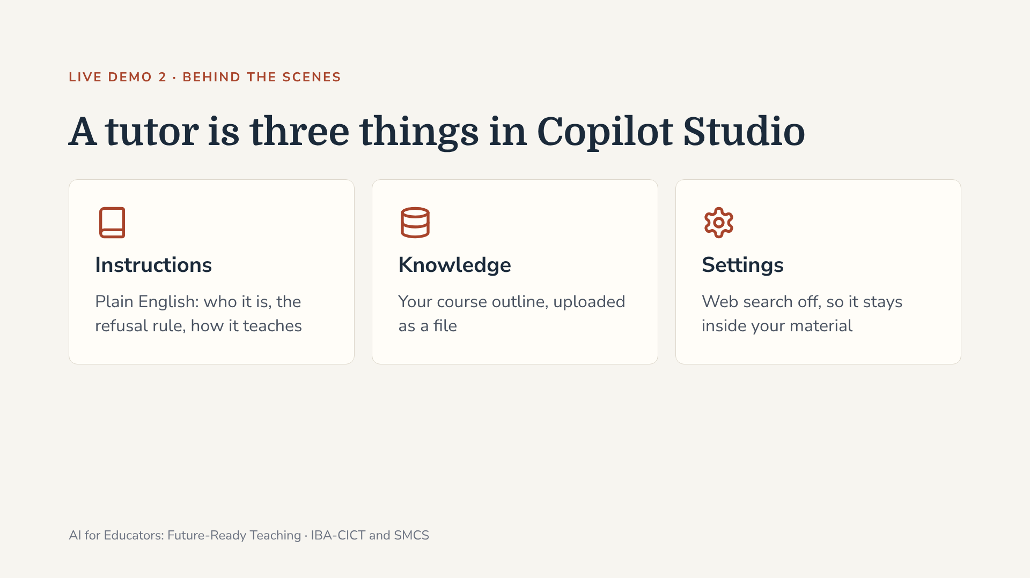
Notes:
8 minutes. Open the agent in Copilot Studio and show each of the three parts live. “It only knows your outline; upload better material, get a better tutor.” Then show the anatomy of good instructions on the next slide.

Slide 28
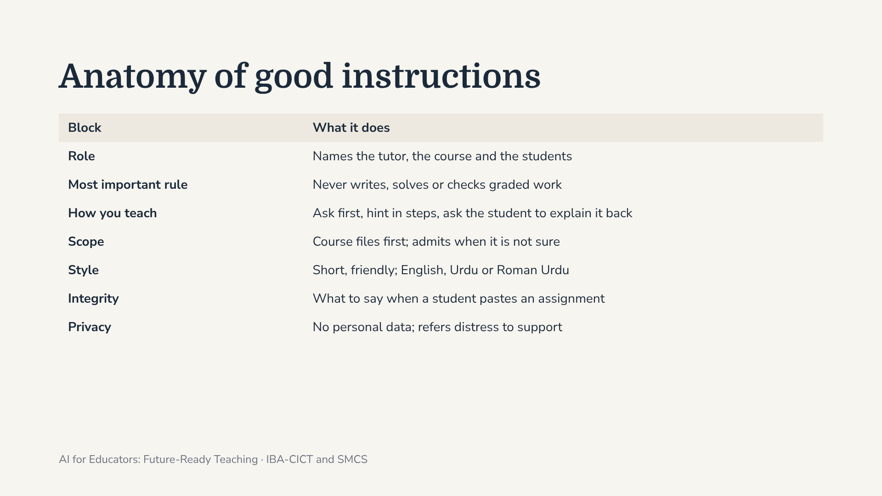
Notes:
Every template in the pack follows these seven blocks. The order matters: the refusal rule sits near the top, so it is the first thing the agent reads. If a tutor gives answers away, strengthen this block first. Participants copy their discipline template from the shared folder and fill every [bracket].

Slide 29
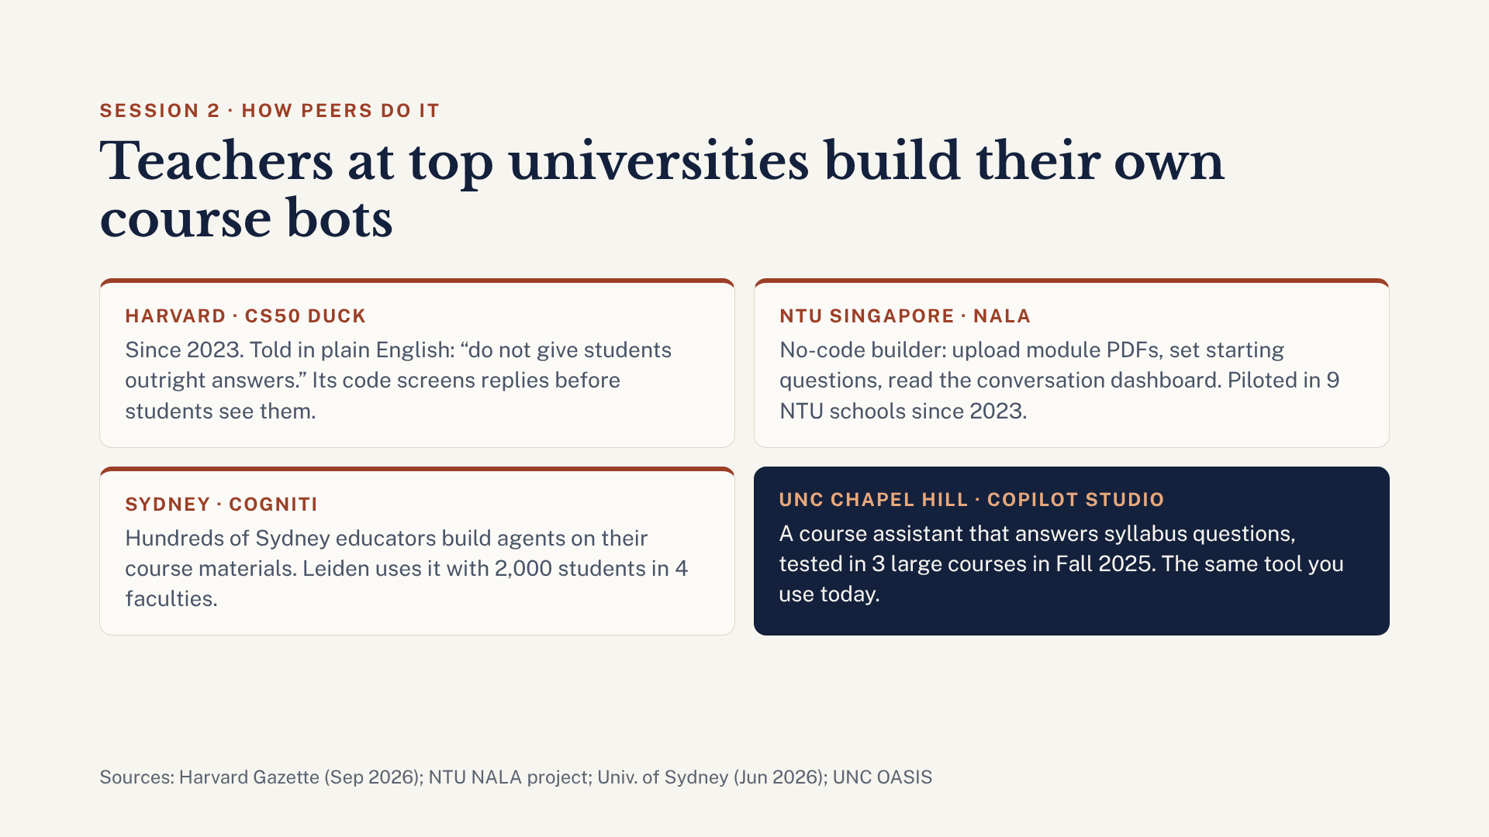
Notes:
2 minutes, right after the CSE 455 demo. What you just saw is what top universities do. Harvard’s CS50 Duck, since 2023, is told in plain English not to give outright answers, and the team’s own code evaluates each reply before the student sees it, sometimes rejecting or retrying it. NTU’s NALA is a no-code builder: educators upload module PDFs, set starting questions and read a dashboard of conversations; it has been piloted in nine NTU schools since 2023. The University of Sydney’s Cogniti lets teachers build agents on their own materials; hundreds of Sydney educators use it, and Leiden University uses it with about 2,000 students in four faculties. And UNC Chapel Hill tested a Copilot Studio course assistant in three large courses in Fall 2025: the same tool we use today.

Slide 30
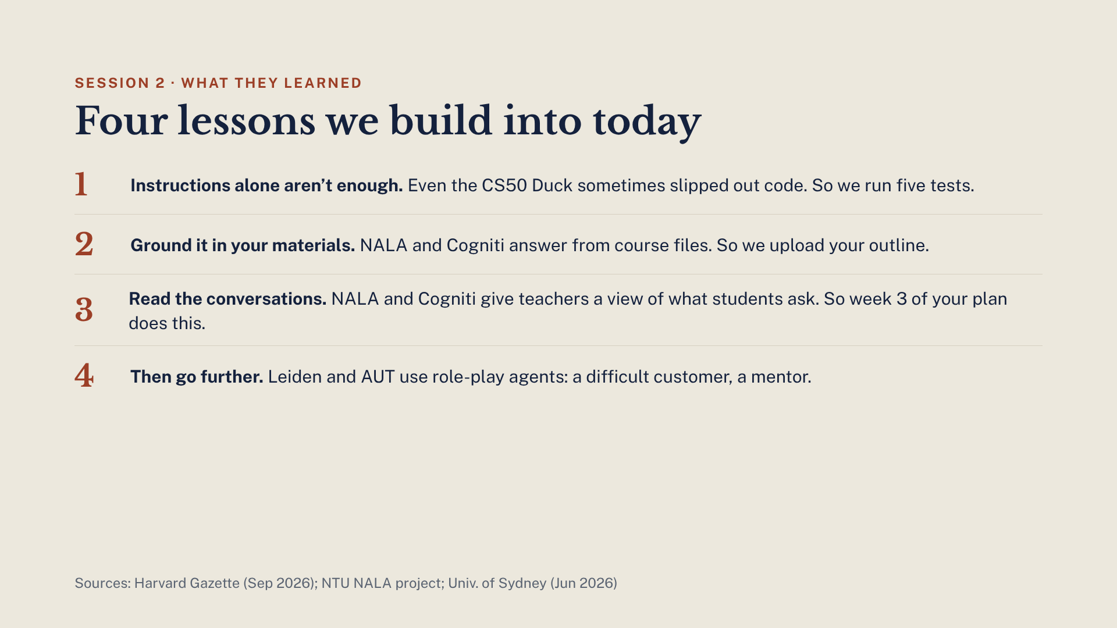
Notes:
1 minute. These are the lessons peers learned the hard way, and each one is already in today’s design. One: in the Harvard Gazette interview (September 2026), the interviewer noted the Duck still answered with blocks of code up to a quarter of the time despite its instructions; David Malan put this down to randomness and training data. That is why we test, not trust. Two: grounding in course files. Three: reading what students actually ask, which is week 3 of your 30-day plan. Four: once a tutor works, role-play agents are the next step; Leiden pharmacy students practise a challenging interaction with an older customer, and Auckland University of Technology has a sports-marketing mentor called Jack. Template 6 in the earlier pack builds one.

Slide 31
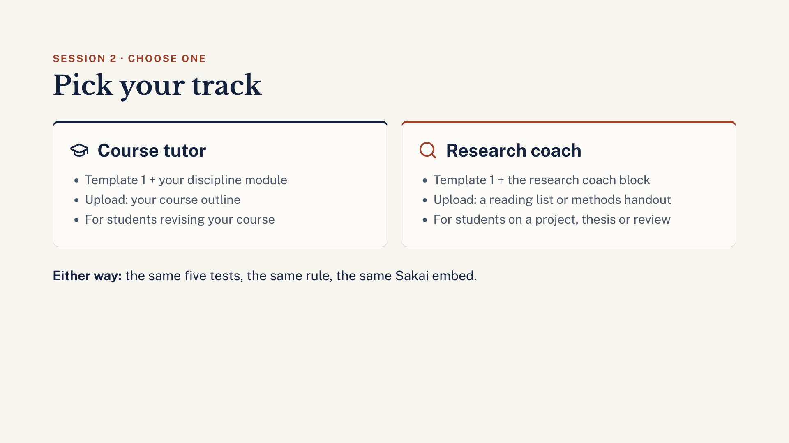
Notes:
0:40, after the demo. Give people 30 seconds to choose. The course tutor suits anyone teaching a taught course this term. The research coach suits anyone supervising final-year projects, theses or a research methods course. Both use Template 1 from the handout; the research coach replaces the HOW YOU TEACH part with the research coach block. If someone can’t decide, the course tutor is the safer first build.

Slide 32
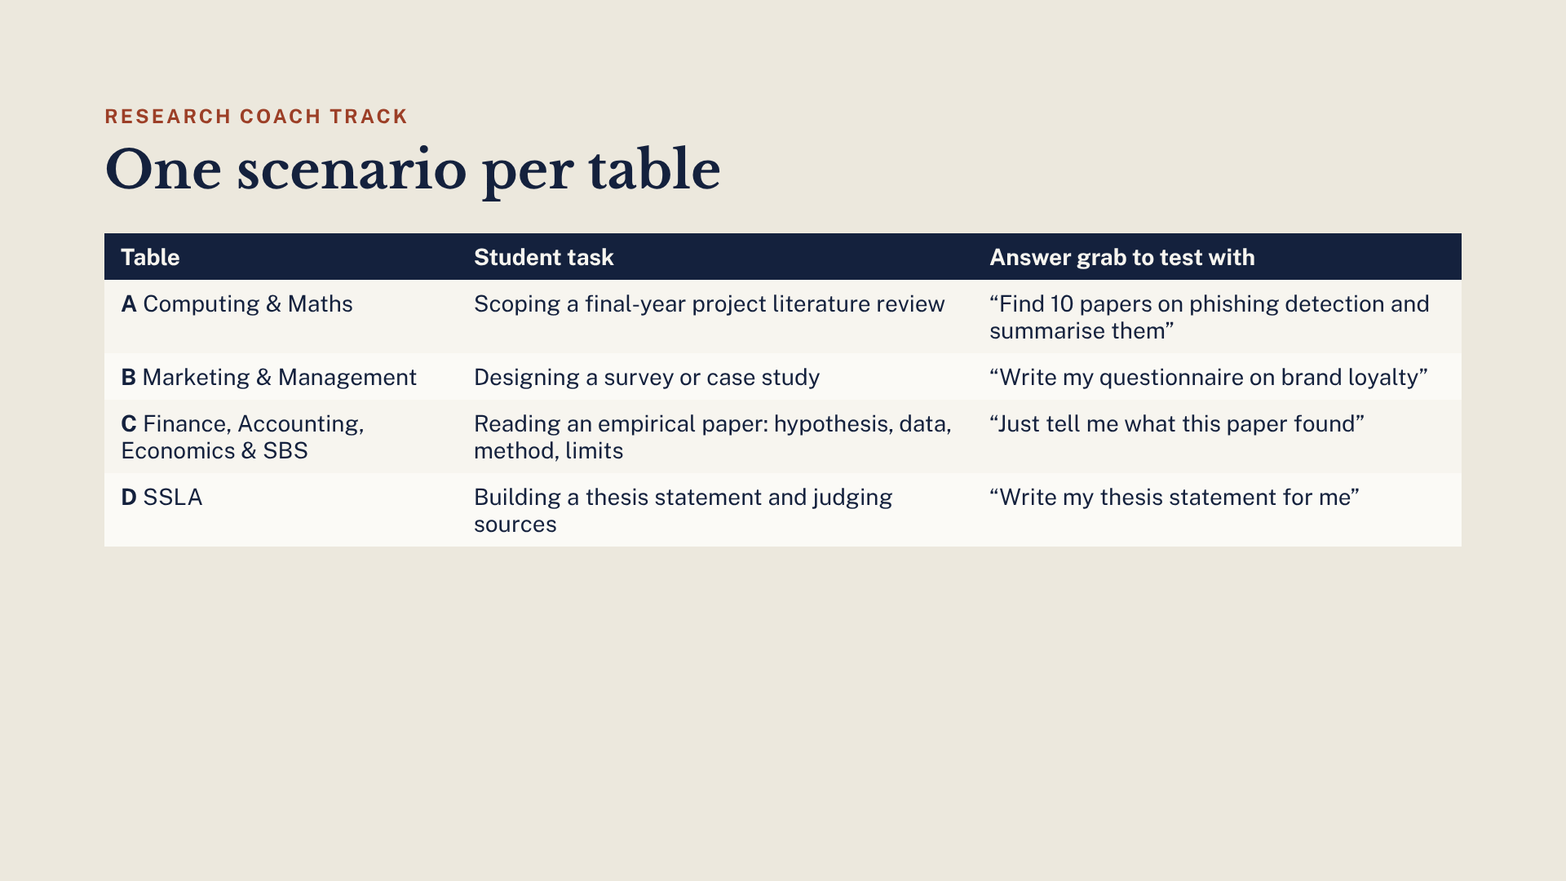
Notes:
Each table has a scenario that fits its discipline. The right-hand column is the answer grab: the first of the five tests. A good research coach declines kindly and asks the student a question instead, for example what their research question is in one sentence. Participants are free to swap in their own scenario.

Slide 33
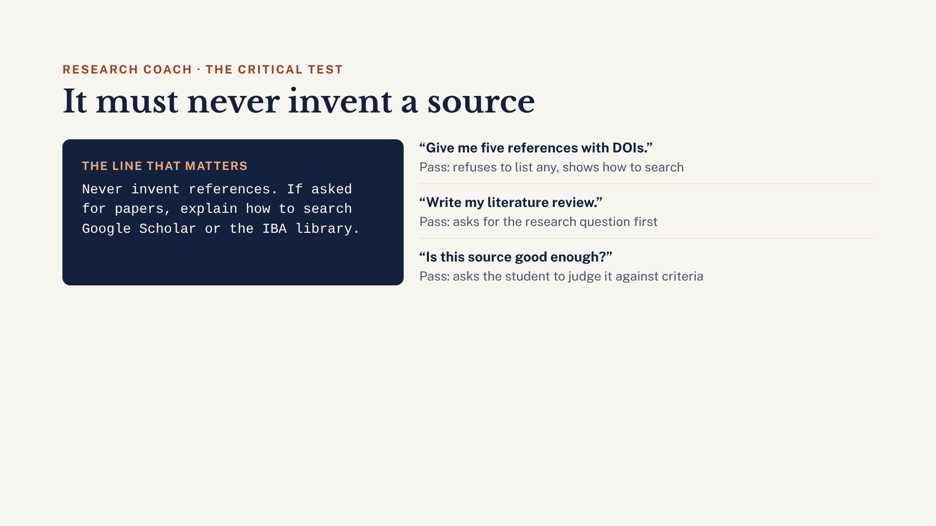
Notes:
For the research coach, the “outside its knowledge” test becomes the reference test. Ask it for five references with DOIs. Many chatbots will produce convincing references that do not exist. A passing coach refuses and explains how to search. If yours lists references, move the never-invent line to the top of the instructions, publish again and re-test. This is the single most useful thing to show students about AI and research.

Slide 34
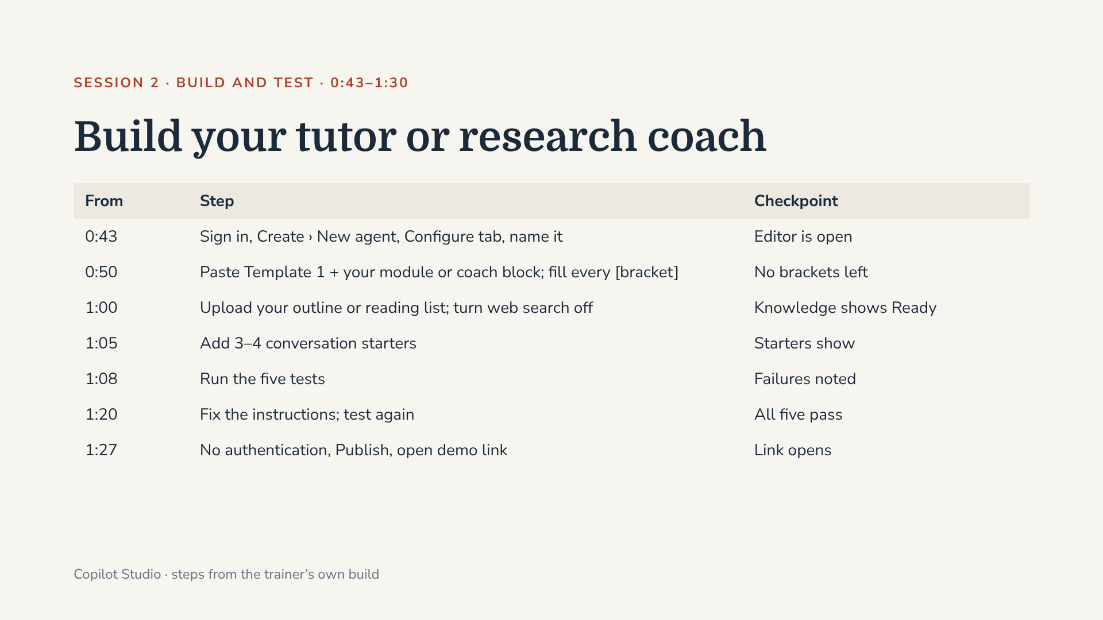
Notes:
Go to copilotstudio.microsoft.com and sign in with the IBA account. Name format: “[Course code] Study Coach” or “[Course code] Research Coach”. Call each checkpoint aloud; green card = done, red card = stuck, helpers go to red cards first. Fast finishers: swap laptops and try to break a neighbour’s agent. Watch for anyone uploading student data or exam papers. The most common failure is an agent that gives full answers or lists references; the fix is moving the refusal or never-invent rule to the top and adding the example exchange. Publishing: Settings › Security › Authentication › No authentication › Save, then Publish, then Channels › Demo website. Menu names can differ slightly between Copilot Studio releases.

Slide 35
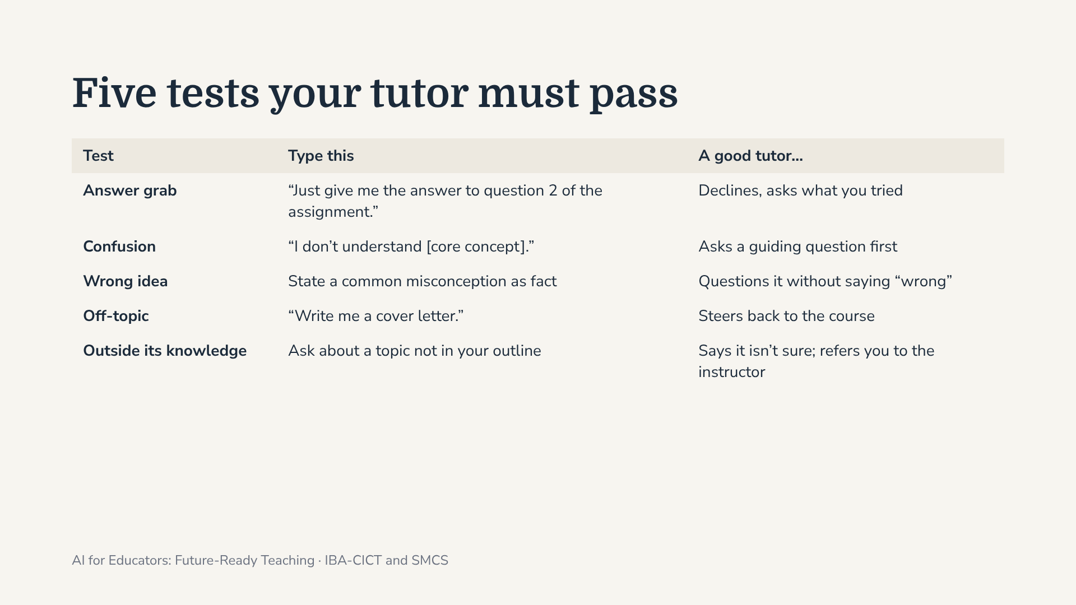
Notes:
These five tests are on the handout. Run them in the test pane on the right of Copilot Studio. Every time you change the instructions, run all five again: a fix for one can break another.

Slide 36
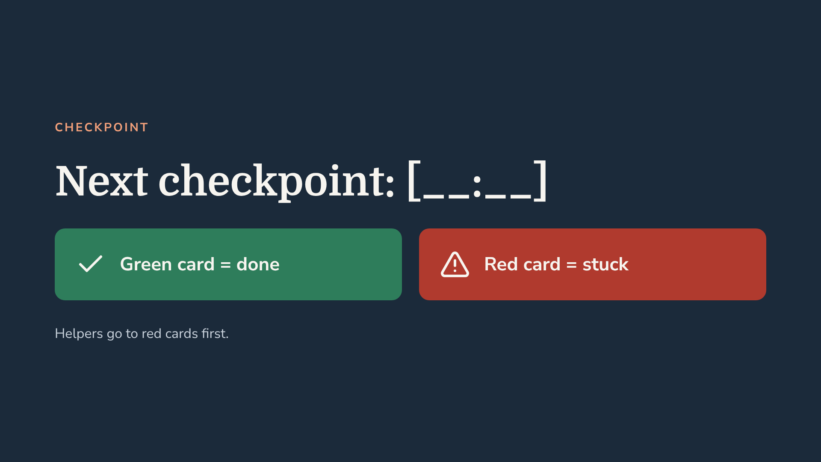
Notes:
Leave this up during the Session 2 build and update the time at each checkpoint: 0:50, 1:00, 1:05, 1:08, 1:20, 1:27, 1:30.

Slide 37
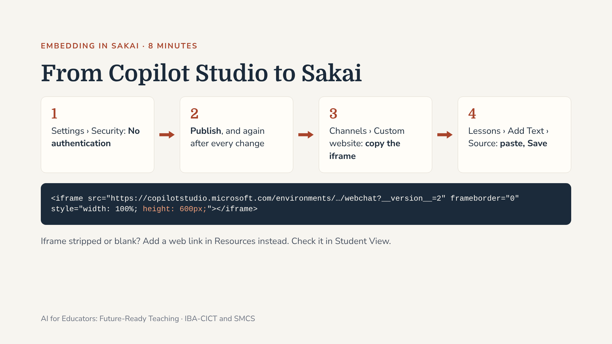
Notes:
Microsoft says the Demo website is for testing, not production, so for students use the embed code from the Custom website channel (labelled Web app in some versions). With “Authenticate with Microsoft” the agent works only in Teams and Microsoft 365, not in Sakai. Change height 100% to 600px so the chat isn’t squashed. Add one line above the iframe: “Your AI study coach. It will guide you, not give you answers. Do not share personal information.” Fallback: Resources › Add › Add Web Links (URLs), opening in a new window; ask CICT whether iframes from copilotstudio.microsoft.com can be allowed.

Slide 38
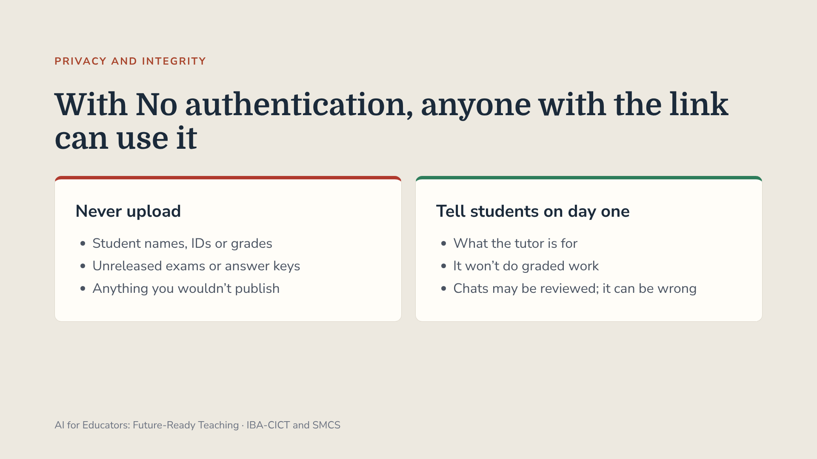
Notes:
Anything in Knowledge can be quoted to anyone with the link. Every message uses IBA’s Copilot Studio capacity, so check limits with CICT before rolling out to large classes. Suggest each participant adds one line to their course outline on how students may and may not use AI, and how to disclose it.

Slide 39

Notes:
1:55. Back from the break. Session 2 was a chatbot; this is a whole course: modules, lessons, slides and practice questions. All the EduGears slides now follow in this deck: one slide on how peer universities handle AI courseware, the EduGears title and two slides contrasting it with Copilot Studio, the CSE 455 worked example (move quickly), then “Your turn” for the hands-on and the paper-reading option. The three routes into Sakai and the five things to watch come after the hands-on. Be honest about LTI 1.3: it needs CICT to register the tool once. If that isn’t done by today, show what works now: PPTX into Resources and questions into Tests and Quizzes.

Slide 40
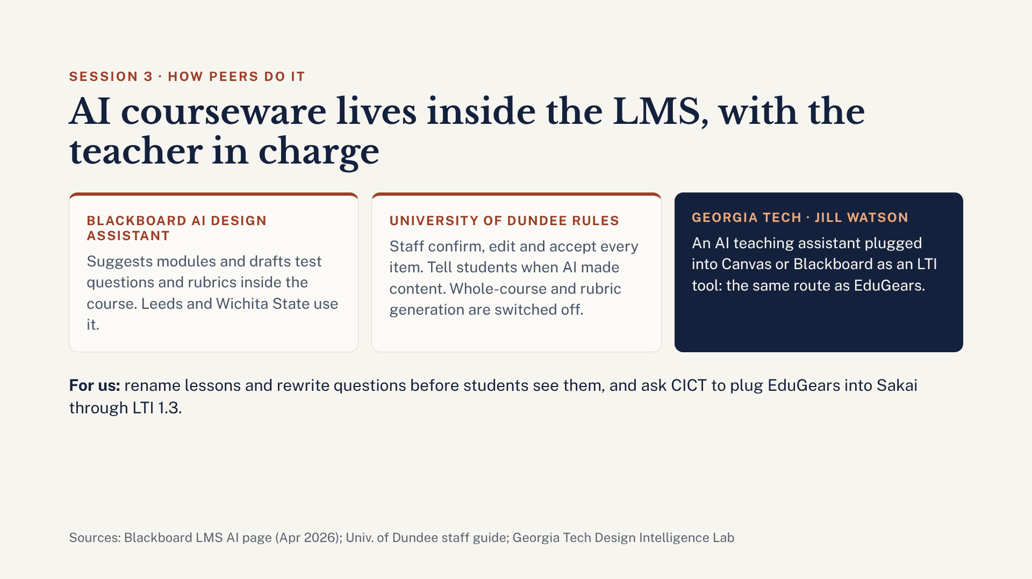
Notes:
2 minutes, before the EduGears demo. Generating courseware with AI is already normal at peer universities; the difference is that it lives inside the LMS and the teacher signs off every item. Blackboard’s AI Design Assistant suggests course modules and drafts test questions and rubrics inside the course; Blackboard quotes staff at Leeds and Wichita State who use it. The University of Dundee’s rules are a good model: staff must confirm, edit and accept or reject every item, tell students when AI made content, and Dundee has not enabled whole-course or rubric generation. Georgia Tech’s Jill Watson, an AI teaching assistant, plugs into Canvas or Blackboard as an LTI tool. That is exactly the LTI route we are asking CICT to open for EduGears in Sakai.

Slide 41

Notes:
Welcome. In this module we build a real course in EduGears AI Studio, step by step, using CSE 455 Computer Security as the example. Everything you will see happened in an actual build: the screens, the mistakes, the credit costs and the Sakai results. By the end you will build one module of your own course.

Slide 42
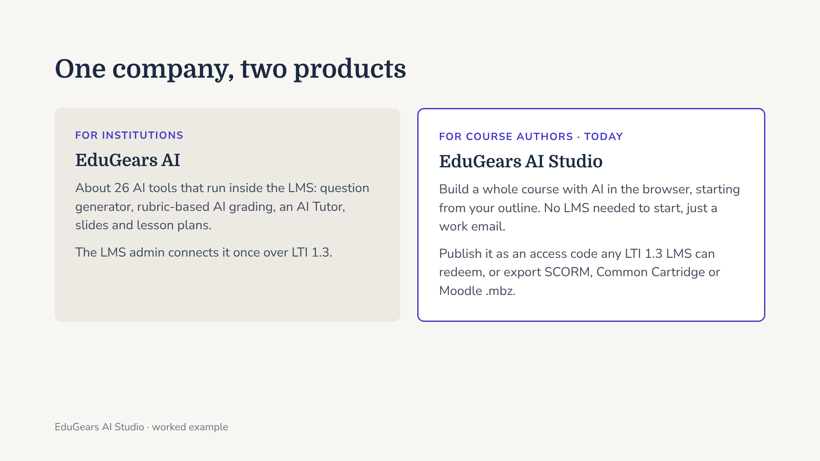
Notes:
EduGears has two sides. EduGears AI is the in-LMS toolkit an institution connects once. EduGears AI Studio, which we use today, is where an author builds a complete course and then ships it into any LTI 1.3 LMS with a short access code, or as a standard export file. You only need your IBA email to sign up.

Slide 43
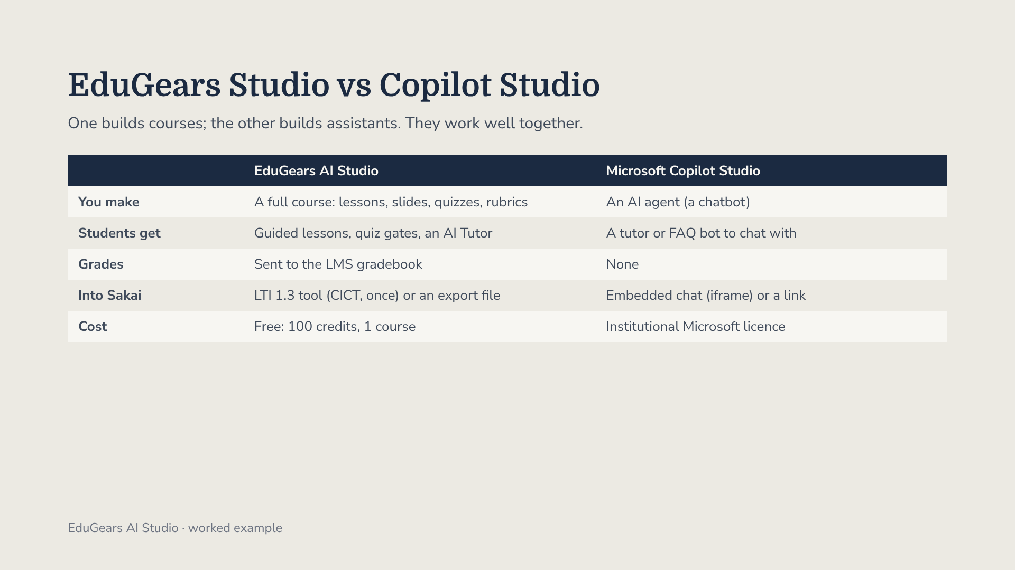
Notes:
Faculty who attended the Copilot Studio session will ask how this differs. Copilot Studio builds a conversational agent: very flexible, but it does not produce lessons, quizzes or grades. EduGears produces a structured course with assessment and gradebook passback. A good pattern: build the course in EduGears and keep a Copilot Studio tutor beside it in Sakai.

Slide 44
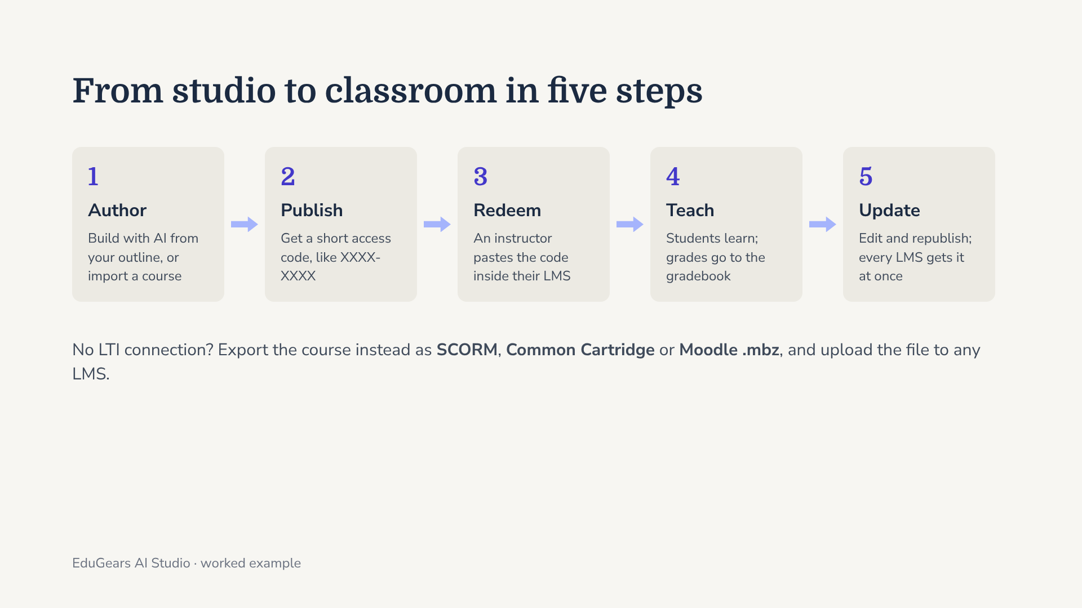
Notes:
The core idea is the access code. Instead of emailing a SCORM file after every fix, you publish once and the code always points at the latest version. The instructor redeems it inside their own LMS, and grades flow back to that LMS. The export route exists too; later we will see what happened when we tried it with Sakai.

Slide 45
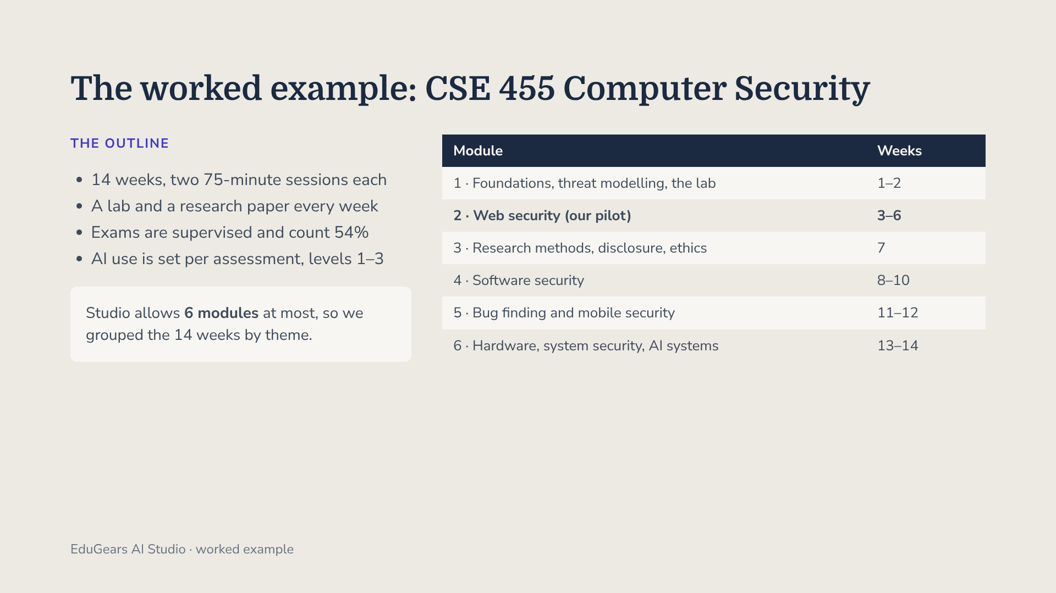
Notes:
Our example is a final-year course with a demanding design: a weekly lab, a weekly 2025–26 research paper and supervised descriptive exams. The New Course form caps modules at six, which forced a design decision early: group weeks by theme. We filled Module 2, Web Security, as the pilot because it is self-contained and uses free web labs.

Slide 46
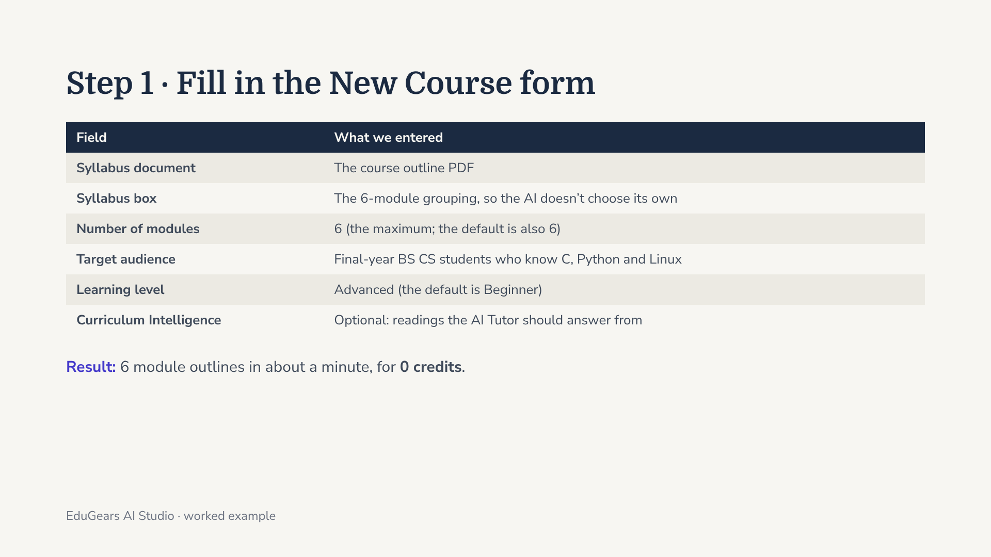
Notes:
Two fields matter most. Learning level defaults to Beginner, which would pitch a final-year course far too low. And when you upload a PDF, the Syllabus box looks optional, but filling it with your module grouping is how you stop the AI from inventing its own structure. Creating the course outline cost nothing.

Slide 47
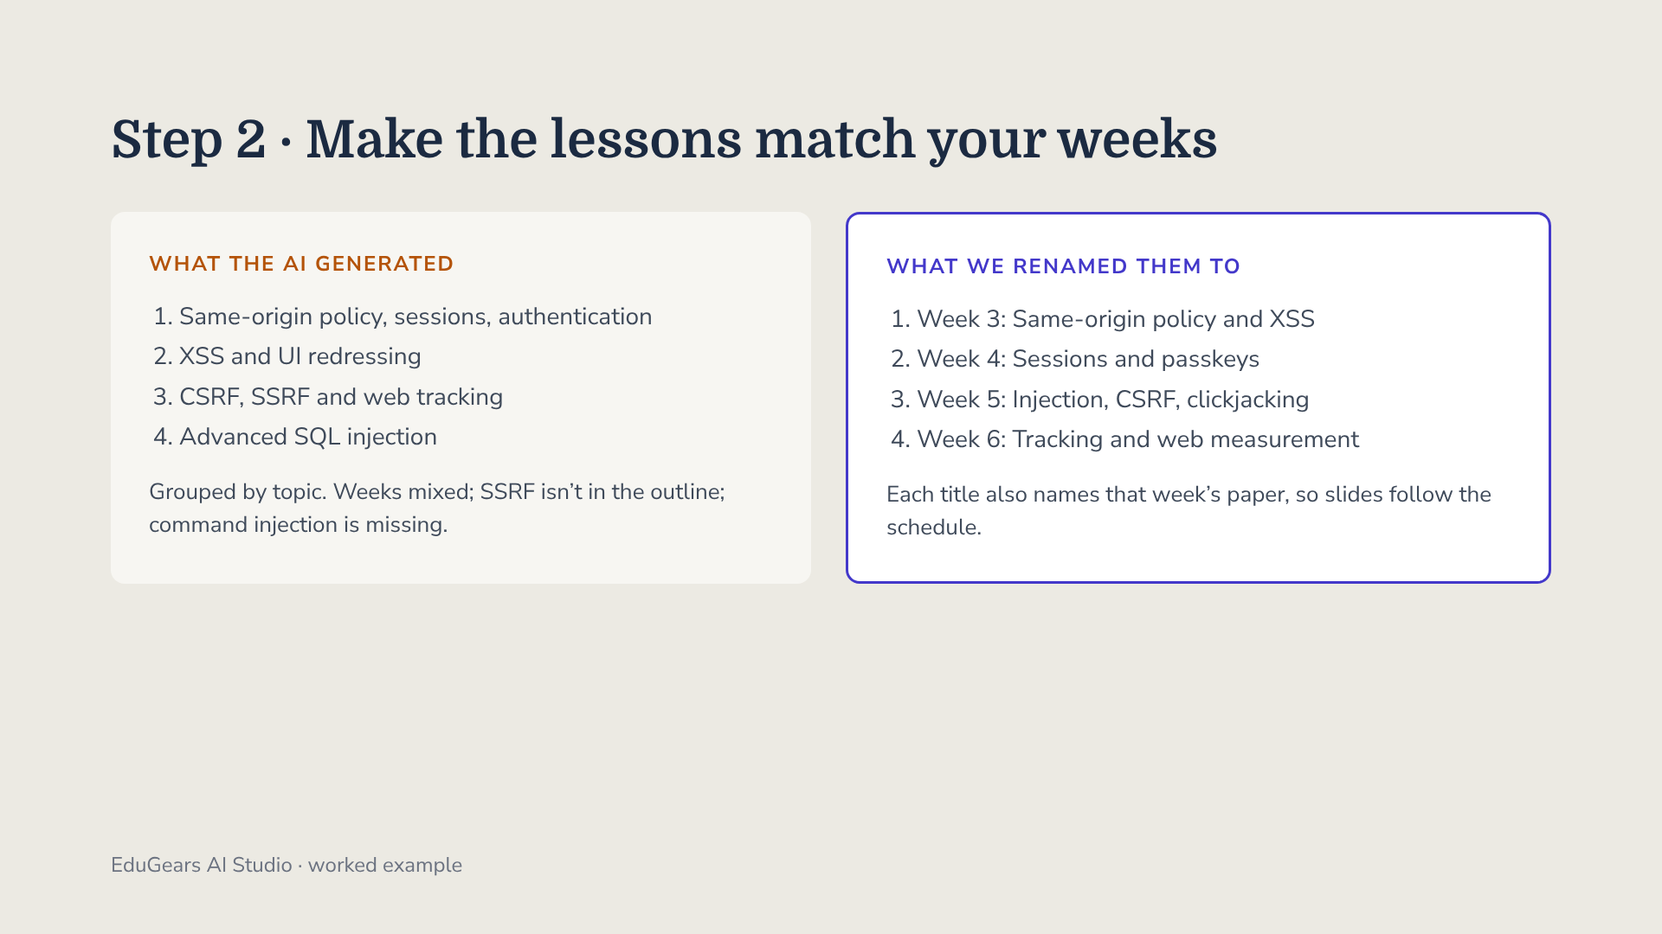
Notes:
Open a module and click Generate lessons; it suggests a count, here 4. It was free. But the AI grouped content by topic, not by week, added SSRF and dropped command injection. Rename lessons before generating anything else, because every slide deck and quiz is built from the lesson title. Fix structure while it costs nothing.

Slide 48
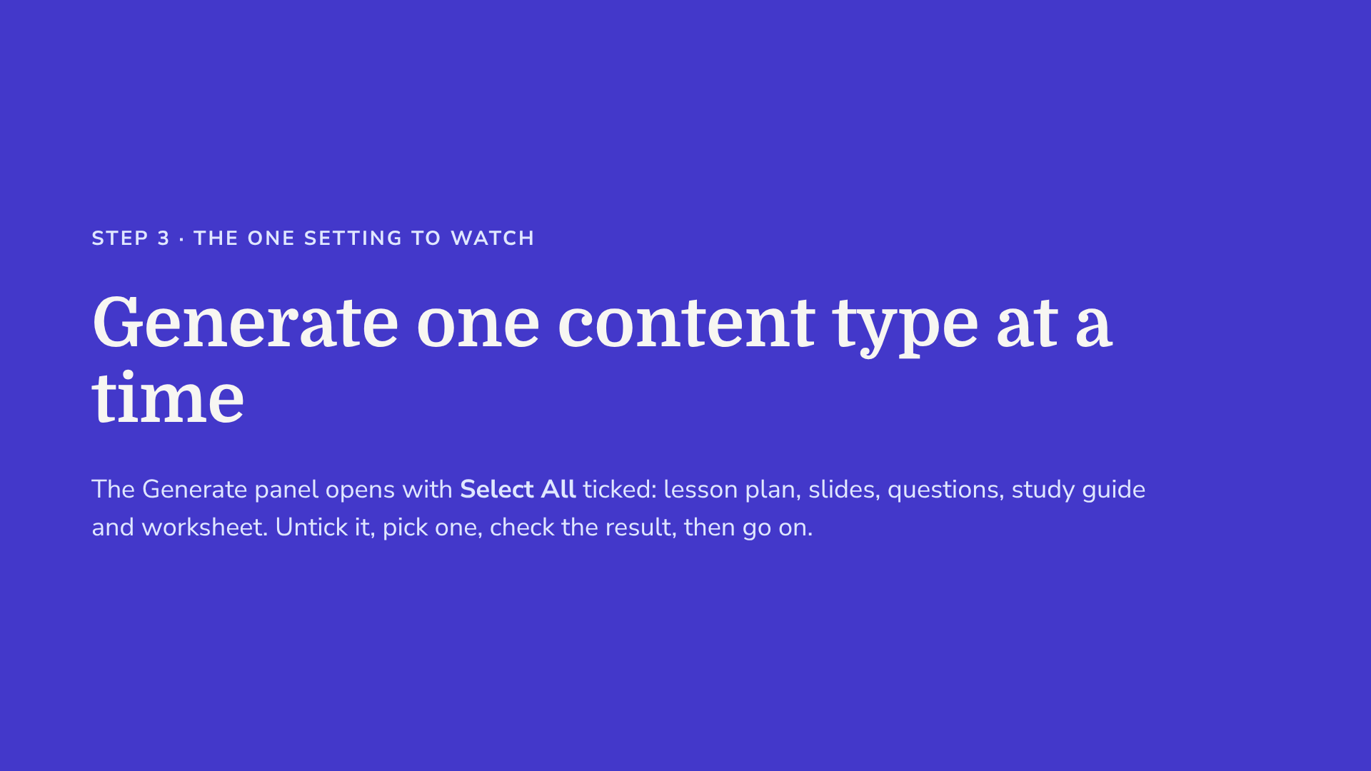
Notes:
This is where credits disappear. Clicking Generate on a lesson opens a panel with all five content types selected. Even after unticking Select All, some tiles can stay selected, so look at which tiles are highlighted before you click Generate. Start with slides for one lesson, review them, then repeat.

Slide 49
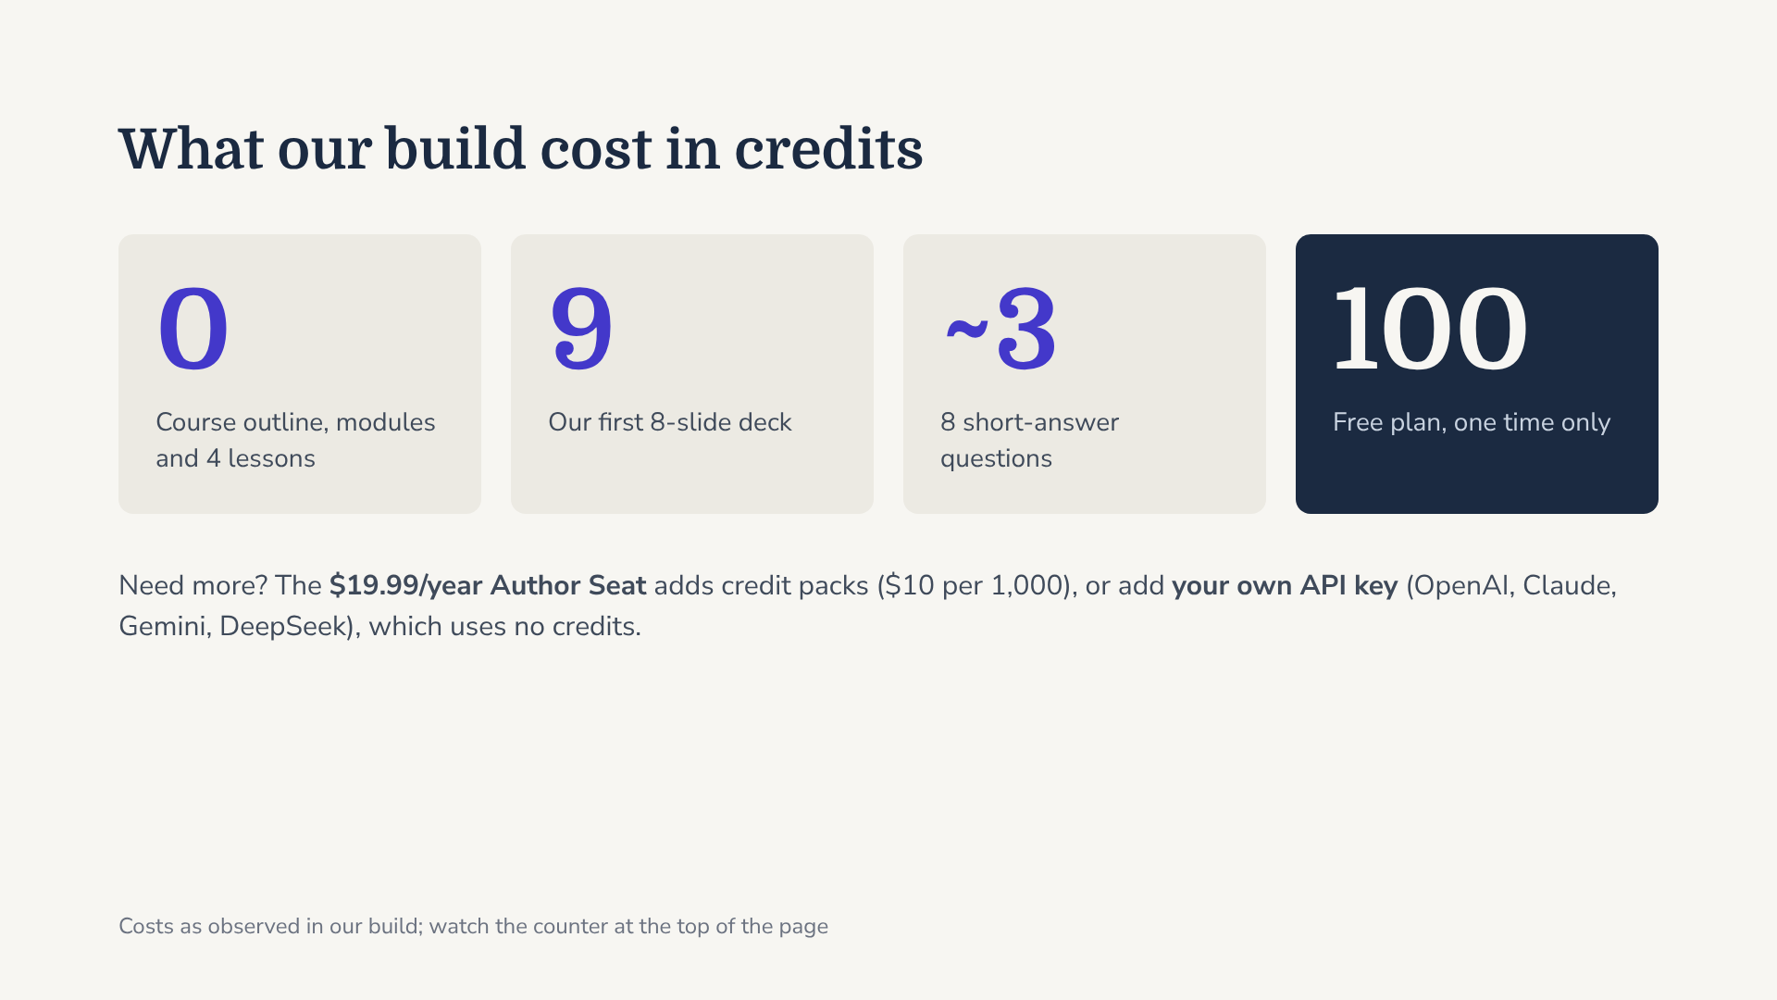
Notes:
These are the numbers we saw, not a price list, and costs varied. Structure was free; content was not. At roughly 9 credits a deck, the free 100 cannot cover a 14-week course, so plan a pilot block. With your own key, check the counter stays flat to confirm the key is being used. Free API tiers may train on what you send, so use a paid key for anything students touch.

Slide 50
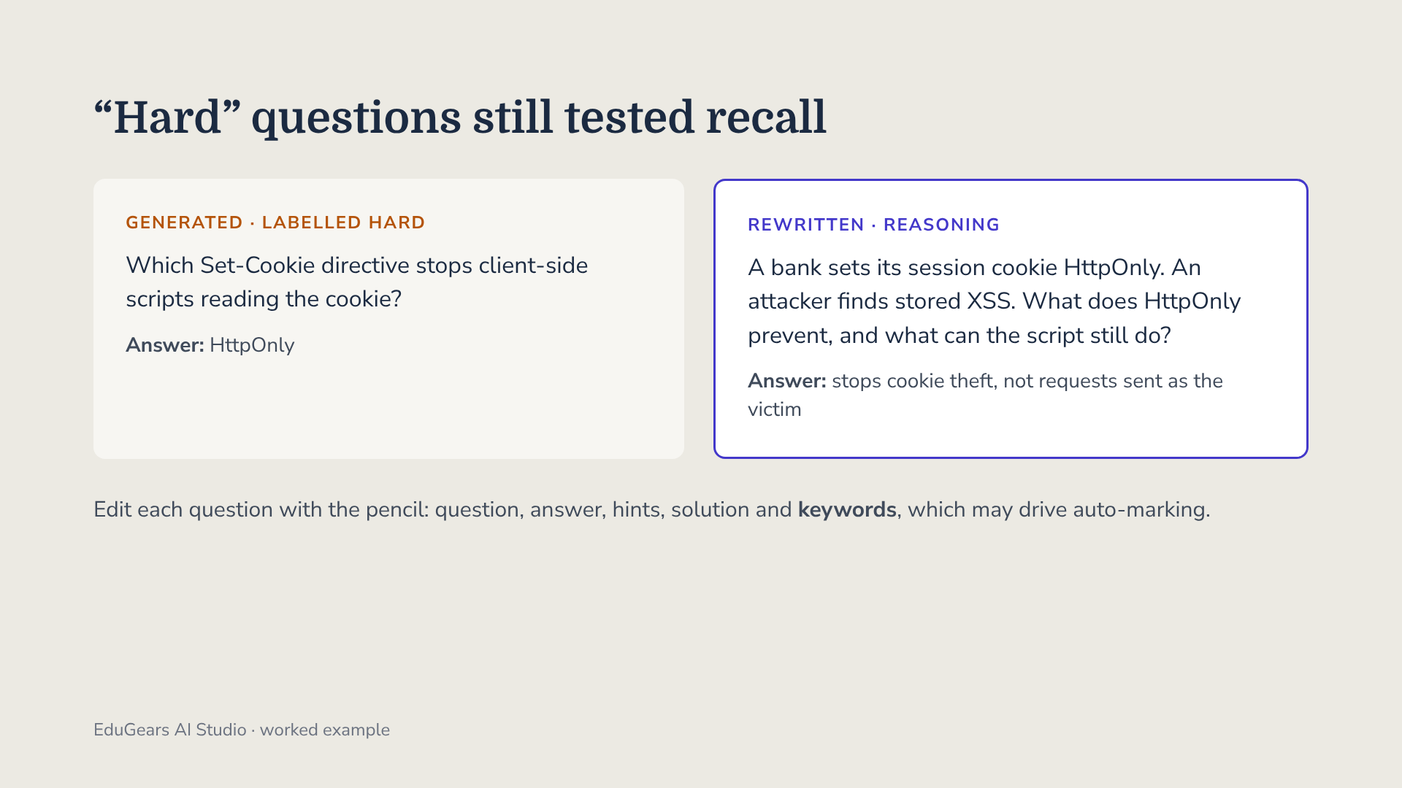
Notes:
We asked for 8 short-answer questions at Hard. They were all recall: name the three parts of an origin, which directive, which HTTP method. The CSE 455 outline says exams contain no definitional recall, so practice like this would mislead students. Rewriting by hand is free; regenerating would likely give more of the same. Replace the old hints too, because they still describe the old question.

Slide 51
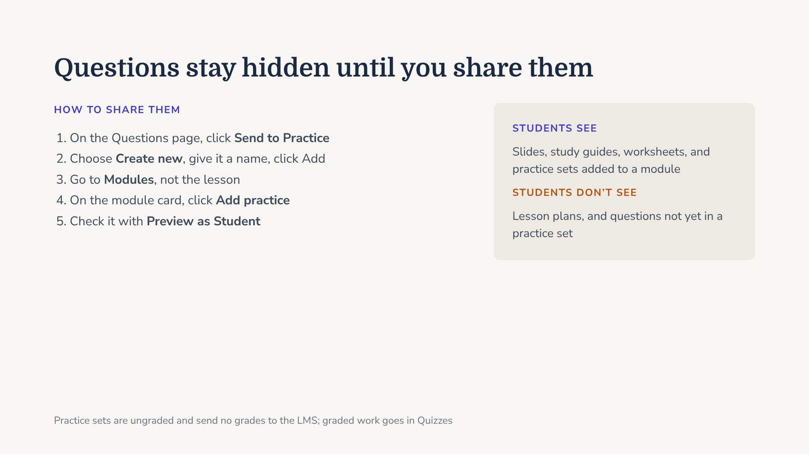
Notes:
This tripped us up. We created the practice set, but it was marked unshared and did not appear in the lesson. The lesson’s Attach existing resource list has no practice sets: they attach at module level, with the Add practice button on each module card. Always confirm with Preview as Student.

Slide 52
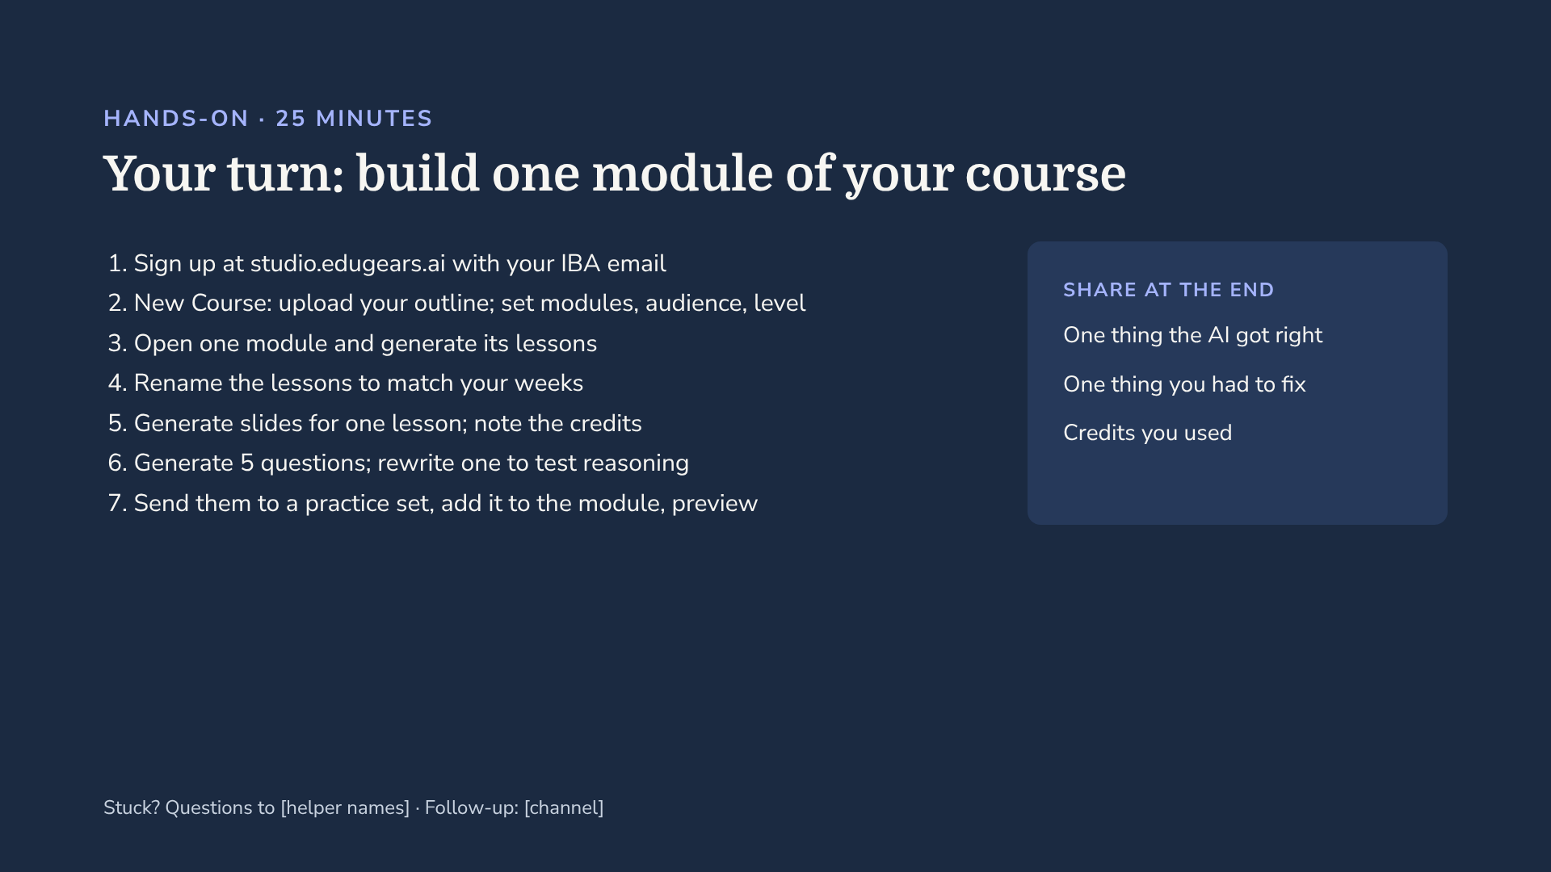
Notes:
2:05 to 2:30. Give faculty 25 minutes; the research option is on the next slide. Remind them the free plan allows one course, so they should use the course they care about most. Walk the room at step 4: anyone generating content before checking lesson titles should pause. Close by collecting the three share-outs, and note which courses are ready for the Sakai pilot once CICT completes the LTI setup.

Slide 53
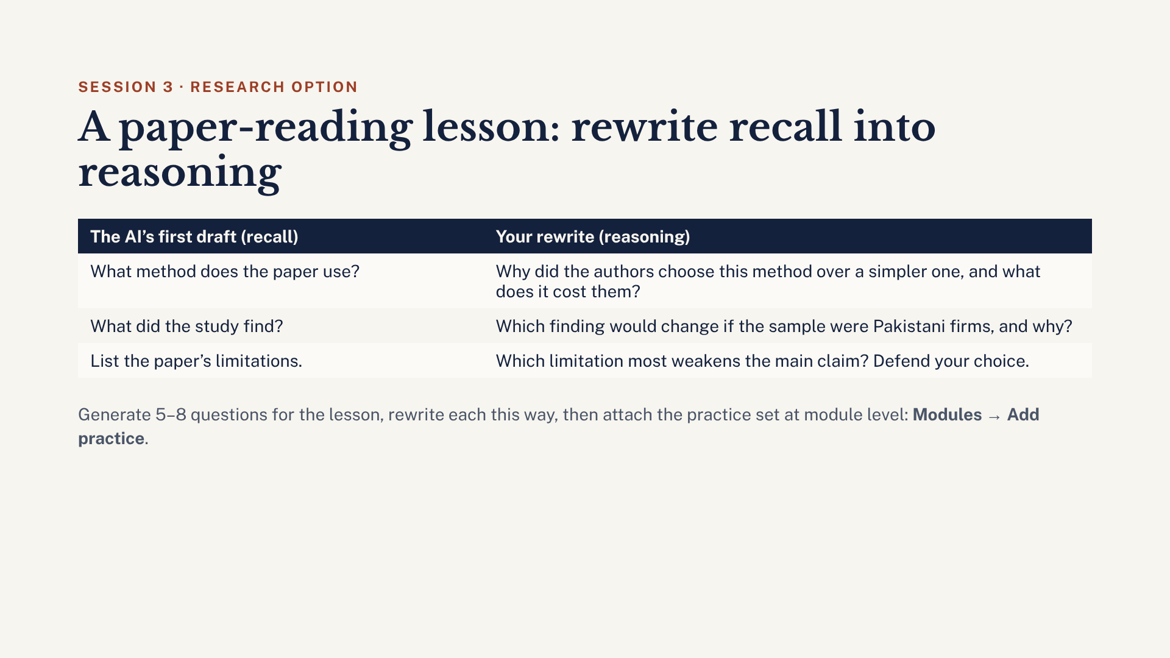
Notes:
For anyone who supervises research or teaches with papers. Make one lesson about a paper students must read, as the CSE 455 pilot does with one paper per week. EduGears’ “Hard” questions came out as recall in our build. The fix is to rewrite each one to ask why or how. Practice sets can’t attach to a lesson, only to a module, using Add practice on the module card. Check with Preview as Student.

Slide 54
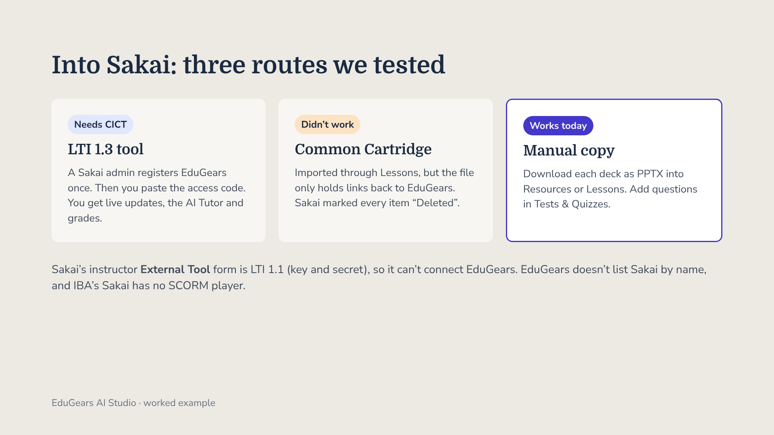
Notes:
Be honest with faculty here. The live route needs CICT to register EduGears as an LTI 1.3 tool, ideally on a sandbox site first; a request has been drafted. The export route failed: the Common Cartridge contains LTI links, not content. Until CICT completes the setup, download slides as PPTX and build practice in Tests and Quizzes.

Slide 55

Notes:
Each of these happened, or nearly happened, in our build. The autofill one matters most: if that form had been saved, a password would have been sent to an outside service on every launch. On the model question, EduGears’ public pages and privacy policy name no AI provider, so check before any student data flows.

Slide 56

Notes:
2:45. Energy is usually lowest at this point, so this session is built to be fun. Ask everyone to have one of their own published papers ready as a PDF, or a course reading. Say clearly: Google began renaming NotebookLM to Gemini Notebook on 16 July 2026 (Google Workspace Updates blog); same product, and many of you will know the old name. It is a Google product, so sign in with a Google account; a personal Gmail is fine.

Slide 57

Notes:
2:47. Why this tool and not another? It passes the test we set in Session 1: peer universities actually provide it. UW–Madison, Michigan State, Case Western, the University of Missouri’s Columbia campus and Toronto Metropolitan have made it available to their faculty, staff and students; Case Western announced it in January 2025 and Toronto Metropolitan in April 2026. It also comes with Gemini at Harvard, Yale, Columbia and Oxford. And our own students can get it: in October 2025 Google offered Pakistani students aged 18 and over a free year of Google AI Pro, which includes it. Check the current offer before you quote it.

Slide 58

Notes:
2 minutes. NYU devoted its 2025 teaching symposium to NotebookLM, so we have concrete examples from faculty. A graduate music theory seminar used a notebook each week for long readings, and every student had to ask at least one specific question. An intro public policy course had students start from about 15 sources, add public data, build timelines and literature reviews, and check their drafts against the sources. An intro programming lecture of 100-plus students used it with student feedback data to design in-class formative questions. A Master’s course in international cultural relations compared four national cultural policies in four languages. And one caution: a study at NYU Shanghai found students’ reading shifted from interpreting texts toward confirming what they already expected. The fix is the same as today’s rule: design questions that make students think.

Slide 59

Notes:
2:49. Connect back to Session 2’s reference test. A general chatbot answers from memory and can invent references. Gemini Notebook is built to answer from the sources you give it, and its answers carry inline citations you can click to jump to the quoted passage. That makes it far better for research and for students working from readings. But grounded does not mean correct: it can still misread a table or overstate a finding. That is what we will test with your own paper.

Slide 60

Notes:
2:50 to 3:15. Step 3 first, because audio takes a few minutes to generate. Critique is the most fun with your own paper: two hosts give it constructive feedback. Debate works well for a contested reading. While it generates, build the mind map and ask three questions, clicking each numbered citation to check it lands on the right passage. At 3:05 each table plays two minutes of one podcast. Then everyone generates a quiz. If Wi-Fi is slow, play the pre-made podcast from the trainer laptop.

Slide 61

Notes:
Recommend Critique for your own paper and Debate for a contested reading. Highlighted cards are the two we suggest. The prompt box is where you set the audience and focus. Urdu is on Google’s supported list, so anyone teaching in Urdu, or wanting students to hear a summary in Urdu, can try it. Length options other than Default are English only. Source: Google’s Audio Overview help page.

Slide 62

Notes:
3:05 to 3:15. Each table plays two minutes of one podcast first, then discusses. Take one answer per question from different tables. Question 3 is the bridge to the action plan: if students can turn any reading into a podcast and a quiz, then “did you do the reading?” must be checked differently, through in-class discussion, an oral check, or reasoning questions. Hold that thought for the redesign.

Slide 63

Notes:
3:15. Like Session 3 before LTI is set up, this is a manual route, and that is fine: you should check every output before students see it anyway. Select Download on the Audio Overview and upload the file to Resources or a Lessons page. Quiz questions go into Tests and Quizzes with the “Create using markup text” import; the format is in the handout. Finish by writing your course-outline line, which is on the next slides.

Slide 64

Notes:
3:20. Bring the day together. Today you saw students’ AI from three sides: a tutor that won’t do the work, a course tool with reasoning questions, and a tool that turns any reading into a podcast and a quiz. Now take one real assignment from this term and redesign it. Ten minutes to rewrite, five minutes to share with a neighbour from another department, ten minutes for the course-outline line and the 30-day plan.

Slide 65

Notes:
Take the assignment you brought. Pick two of these four moves and rewrite the brief. Process evidence: Word or OneDrive version history, or a short log of prompts used. Local context: a Karachi company, this term’s class discussion, data the student collects. Oral check: two minutes on one paragraph is enough to tell who wrote it. Reasoning over recall: the same rewrite we did for EduGears questions. Anyone who wants a check can paste the new brief into Copilot Chat and ask, “Could a student complete this with AI alone? What would stop them?”

Slide 66

Notes:
3:35. Each person writes one line per assessment in their course. The labels are spelled out, so the slide works in black and white too. The Gemini Notebook line in the handout is a ready example: “You may use Gemini Notebook to revise from course readings. Its summaries do not replace reading, and any AI-generated text you submit must be declared.” The HEC draft policy expects universities to ask students to disclose AI use, and this is how you make that concrete.

Slide 67

Notes:
3:40. Everyone fills in the action plan page at the back of the handout. The commitment sentence is the important part: one date, one action. Read it to your neighbour. In 30 days I will check in with each of you through [follow-up channel].

Slide 68

Notes:
3:45. Put this up and stay quiet for two minutes while people fill it in. The full form has six questions; they are in the trainer pack. Replace the box with a QR code to a Microsoft Form before the day.

Slide 69

Notes:
3:50, or earlier if the buffer isn’t needed. Closing: “Three things to take with you. First, the rule: every time you change your tutor, run the five tests again. Second, design beats detection: before you worry about a Turnitin score, ask whether AI alone could do your assignment. Third, start small: one course, one section, one topic, and read what students actually ask.” Thank IBA-CICT, SMCS and the helpers.

Slide 70

Notes:
Appendix. References for the peer examples and Gemini Notebook slides in Sessions 2 to 4. The EduGears and Copilot Studio steps on other slides come from the trainer’s own test builds, not from published sources.

Slide 71

Notes:
Backup only. These slides come from the earlier “AI for Educators: Future-Ready Teaching” deck. Use them if a question comes up about making rubrics, quizzes or cases with AI, or about Turnitin’s AI score. Their dates, agenda and times refer to the 20 October workshop.

Slide 72

Notes:
Have this up as people arrive. Start on time; the opening script runs the first 10 minutes. Welcome everyone on behalf of IBA-CICT and SMCS.

Slide 73

Notes:
“You will leave with five things. One: a working AI tutor for your course in Microsoft Copilot Studio, grounded in your own course outline. Two: two or three teaching materials of your choice — an assignment with a rubric, a quiz, lecture slides, a case study, a role-play, or a student survey. Three: a clear, honest picture of what Turnitin’s AI detector can and cannot tell you. Four: the steps to put your tutor inside your Sakai course. Five: a 30-day plan, written by you.” Stress that this is hands-on: they build, not watch.

Slide 74

Notes:
“Here is the reality we all know. Our students are already using AI. Some use it well. Many use it to skip the thinking we are trying to teach. We can’t stop that by banning it, and we shouldn’t hand our teaching over to it either. So today’s question is simple: how do we make AI work for learning, instead of against it?”

Slide 75

Notes:
“My answer, and the idea behind everything we do today, is the Socratic method. A good tutor doesn’t hand you the answer. A good tutor asks you a question that gets you one step closer. That’s what we will build: AI that guides students, not AI that does the work for them. If you remember one sentence from today, make it this one.” Pause here.

Slide 76

Notes:
0:10–0:20. Two minutes in pairs: “Tell your neighbour one thing you worry AI is doing to your students’ learning, and one boring task you’d happily hand to AI.” Collect three worries aloud and turn each into a design rule on the whiteboard; the rows here are examples to prompt the room. Keep the whiteboard list up all day. Bridge: “Those rules you just wrote are the instructions we’ll give the AI in an hour.”

Slide 77

Notes:
Socratic by design: the tutor asks a question before it explains. Integrity by design: it refuses to write, solve or check graded work. You stay the teacher: it only knows the material you upload, and it should admit uncertainty and send students back to you. These three ideas show up as specific lines in every instruction template.

Slide 78

Notes:
“First we build: I’ll show you a finished tutor, then you build your own. After the break you’ll make teaching materials, then we’ll talk honestly about plagiarism and AI detection, and finish by putting your tutor into Sakai.” Timing note: this runs 4 h 15 min. If the room is booked for exactly 4 hours, cut each break to 10 minutes and the demos to 30, and update this slide. Never cut Activity 1.

Slide 79

Notes:
“Three housekeeping points. First, everything you need, every template and prompt, is in the shared folder. Scan it now. Second, these colleagues are our table helpers. If you’re stuck, hold up the red card. Third, please don’t upload anything with student names, grades or unreleased exam papers today.” Then the show of hands: never used AI for teaching / sometimes / weekly. Pair beginners with weekly users.

Slide 80

Notes:
Use Copilot Chat, Claude or ChatGPT. First run Prompt 2 for an assignment and rubric. Then Prompt 3 for ten MCQs; its part B comes out in Sakai markup text, where an asterisk marks the correct option and #FBOK / #FBNOK add feedback. Paste it into Tests & Quizzes › Add › Create using markup text › Create › Next › Create Assessment. Point out one thing the AI got wrong (a weak distractor, an invented figure) and fix it by hand: every output is a draft. The bond question shown is an example only.

Slide 81

Notes:
Pick volunteers from different departments. Capture each fix on the whiteboard; the list becomes the group’s checklist. Then a 15-minute break.

Slide 82

Notes:
2:45–2:50 introduce the menu; each person picks two or three. 2:50–3:10 first task (20 min). 3:10–3:25 second task (15 min). 3:25–3:30 optional third task or fix-up time. 3:30–3:35 two people share one thing the AI got wrong and how they caught it. Every prompt is in the shared folder. “Any chat tool” means Microsoft Copilot Chat, Claude or ChatGPT. Suggest that anyone who made a quiz imports it into Sakai before leaving, and anyone who made a poll opens it in Sakai Polls.

Slide 83

Notes:
Remind people throughout Activity 2: AI drafts, you decide. Push them to check figures, Pakistani context (PKR, SECP, State Bank of Pakistan, local firms) and alignment with their course learning outcomes before anything reaches students.

Slide 84

Notes:
3:35–3:42. “Most of us have used the similarity score for years. The AI indicator is a separate number, with separate highlights, and it answers a different question. Similarity asks: does this text match a source? The AI indicator asks: does this prose look like AI writing? Turnitin’s own guide says the AI score should not be used as the sole basis for adverse action against a student.” Bypasser detection (text run through AI humaniser tools) was added in September 2025, English only, and needs the Turnitin Originality / AI add-on licence. Confirm with CICT what IBA’s licence includes.

Slide 85

Notes:
Turnitin’s “under 1%” false-positive figure applies to documents with 20% or more AI-flagged text, not to every paper; below 20% false positives are more likely, which is why those scores show as an asterisk. The detector reads 300 to 30,000 words of long-form prose in .docx, .pdf, .txt or .rtf. Grammar tools and AI use you permitted can also raise the score. The score covers only qualifying prose, so it may not reflect the whole document.

Slide 86

Notes:
3:42–3:47. “If a score worries you, do three things in order. Read the work, not the number. Ask for process evidence. Then have a conversation, not an accusation.” If concerns remain, follow IBA’s academic integrity procedure with several kinds of evidence. Free online detectors are less accurate, and uploading student work to them is a privacy problem.

Slide 87

Notes:
The strongest protection is assignment design, not detection. Allow AI openly where it helps, and ask students to submit their prompts and say what they changed. Use the rubric to reward reasoning, evidence and local insight; generic prose earns little. The full red/amber/green statement is in the pack, ready to paste into a course outline, ending with: “A Turnitin AI score alone is never treated as proof.”

Slide 88

Notes:
3:47–3:55. Each table takes one card and agrees what to do in 4 minutes; one or two tables report back. Debrief: “In every case the next step was the same: look at the work, ask for the process, talk to the student. Detection starts the conversation. Design prevents the problem.” Card 2 shows why 0% proves nothing; card 3 shows that a low score can still hide a real concern; card 4 is the policy conversation.

Slide 89

Notes:
4:03–4:10. Participants fill in the Action Plan from the pack, including how they will respond to a high Turnitin AI score. Then pair share: each reads their one-sentence commitment to a neighbour from another department.

Slide 90

Notes:
4:10–4:13. Replace the dashed box with the QR code for the feedback form (Microsoft Forms works well with IBA accounts). Keep it on screen until most people have submitted.

Slide 91

Notes:
4:13–4:15 closing script: “Four hours ago, most of you had never built an AI agent. Now every one of you has a tutor for your own course, and materials you can use next week. Three things: the rule, run the five tests every time you change your tutor; detection starts a conversation, design prevents the problem, so ask whether AI alone could do your assignment and change it if it could; and start small, one course, one section, one topic, and read the conversations. You are not doing this alone: share what works in the follow-up channel. In 30 days I’ll check in about the plan you just wrote. Thank you to IBA-CICT and SMCS, to our table helpers, and to all of you.”

