Slide 1
RDBMS
Elaboré par : Ichrak Guesmi

Slide 2
Plan
What is a RDBMS ?
Examples of RDBMS’ and their functionalities
MySQL
PostgreSQL
SQL SERVER
Comparison between the three RDBMS
Notes:
EXEMPLE : REDEMARRAGE APRES SINISTRE

Slide 3
What is a RDBMS ?
RDBMS : Relational DataBase Management System
The RDBMS manages incoming data, organizes it, and provides ways for the data to be modified or extracted by users or other programs.
The RDBMS is the most popular database system among organizations across the world. It provides a dependable method of storing and retrieving large amounts of data while offering a combination of system performance and ease of implementation.

Slide 4

Examples of RDBMS’ and their functionalities
MySQL:
My SQL is one of the most popular DataBase Management System .
My SQL store data in tables . Tables further store data in rows and colomns.
My SQL is available DataBase System .
My SQL can run on multiple plateforms such as Linux , Windows and Unix .
My SQL is highly Scalable DataBase System .

Slide 5
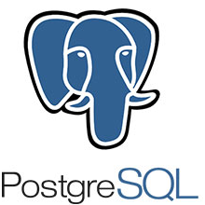
Examples of RDBMS’ and their functionalities
PostgreSQL:
PostgreSQL is an advanced, enterprise-class, and open-source relational database system. PostgreSQL supports both SQL (relational) and JSON (non-relational) querying
PostgreSQL has earned a strong reputation for its proven architecture, reliability, data integrity, robust feature set, extensibility, and the dedication of the open source community behind the software to consistently deliver performant and innovative solutions.

Slide 6

Examples of RDBMS’ and their functionalities
SQL server:
SQL SERVER is a relational database management system (RDBMS) developed by Microsoft. It is primarily designed and developed to compete with MySQL and Oracle database.
SQL Server follows a table structure based on rows, allowing connection of data and functions while maintaining the data’s security and consistency. Checks in the relational model of the server work to ensure that database transactions are processed consistently

Slide 7
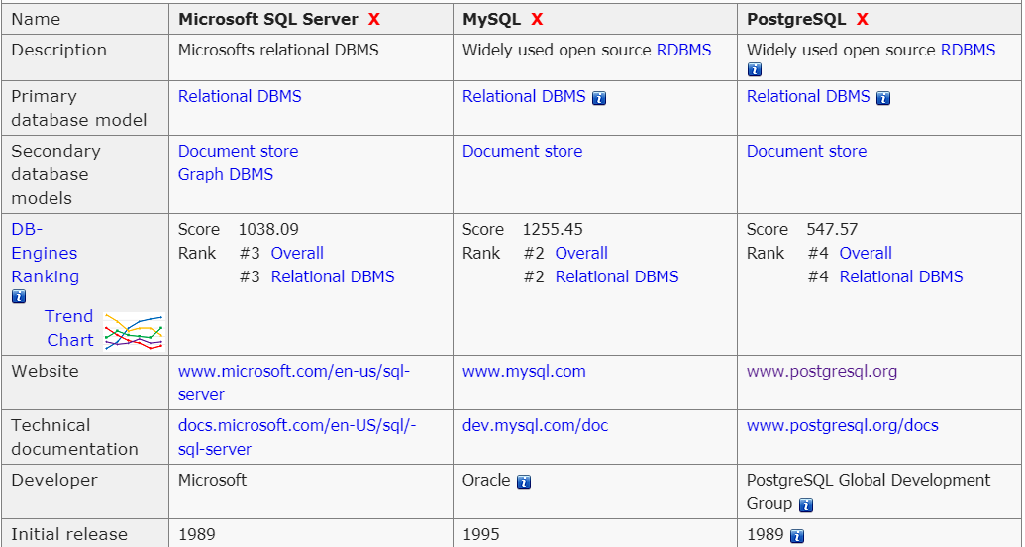
Comparison between the three RDBMS

