Slide 1
CCCisco competition – API Security Challenge
Classifi
Students:
Firas Naamneh
Ameer Masalha

Slide 2
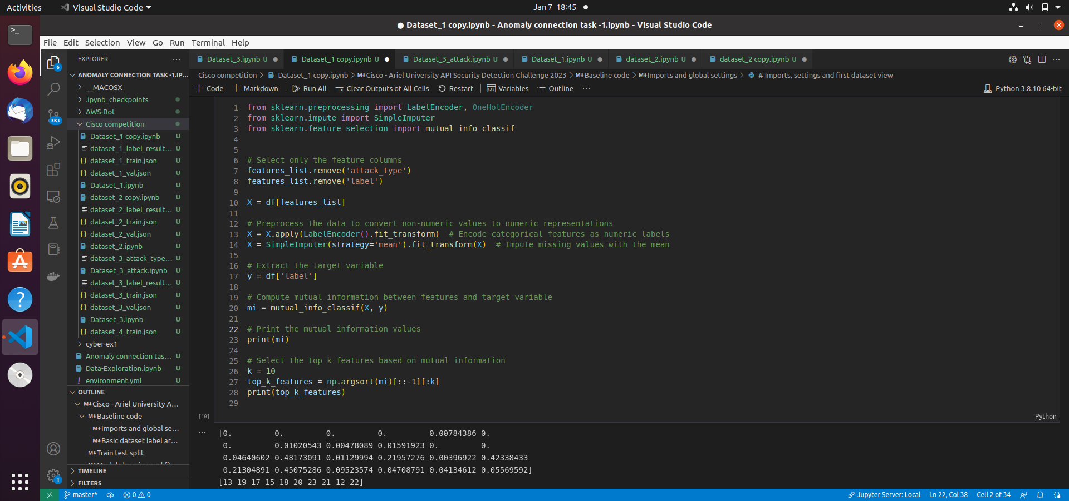
Feature Extraction – Choosing Top 10 Features
Presentation title

Slide 3
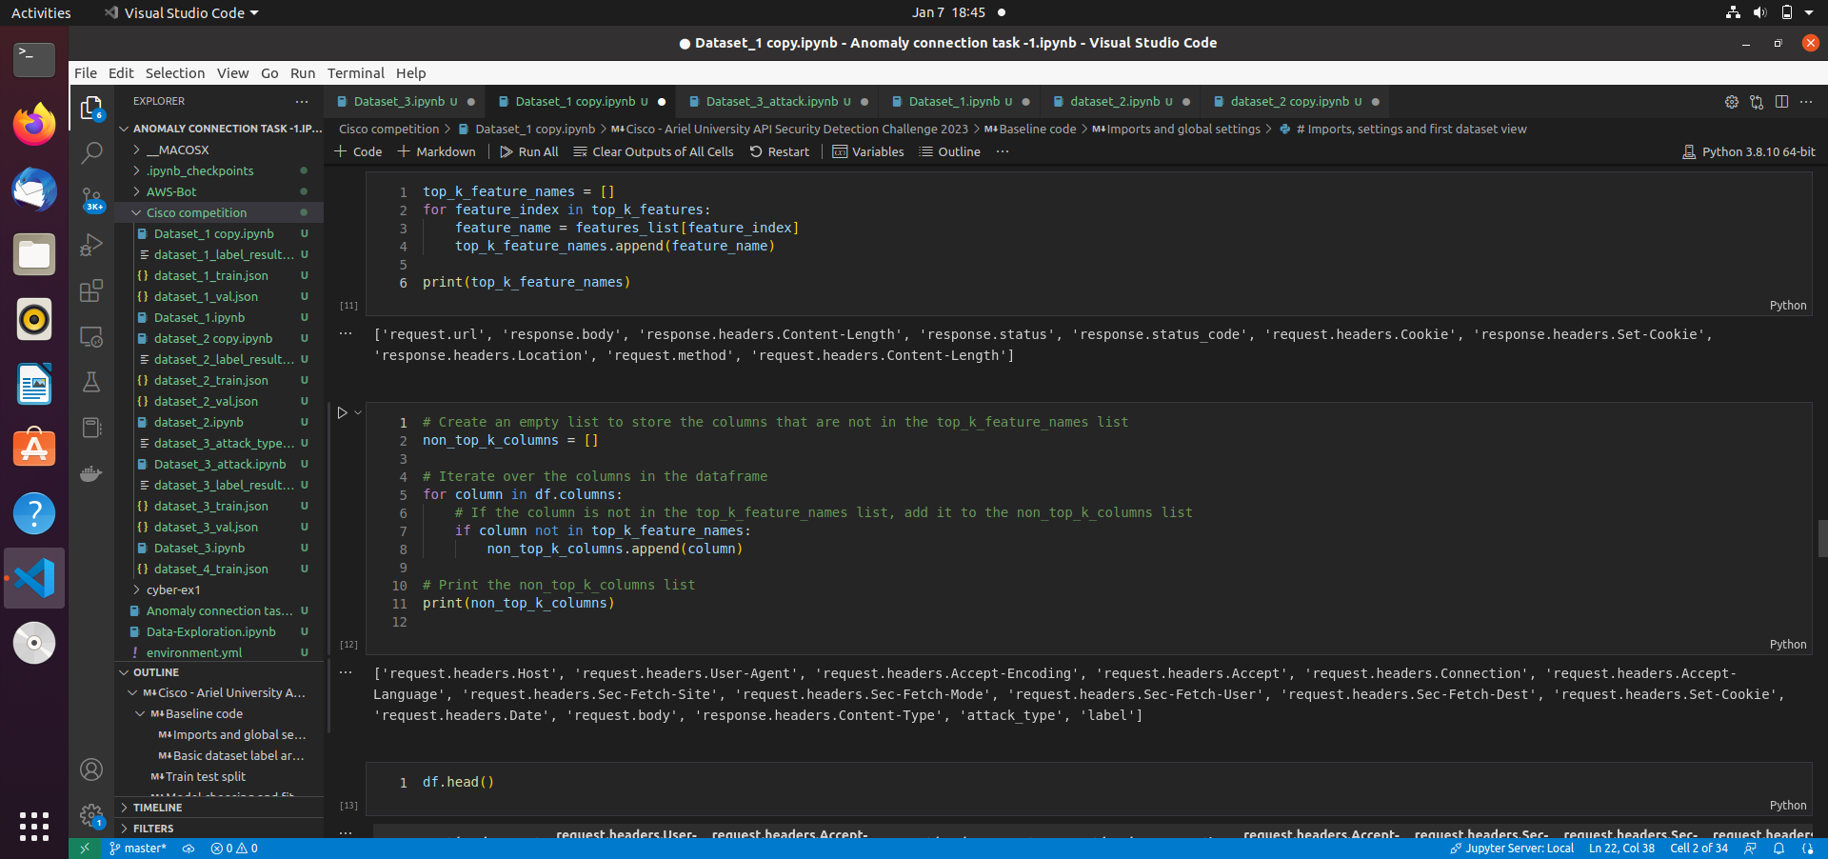
Choosing Features – Top 10 Features
Presentation title
2

Slide 4
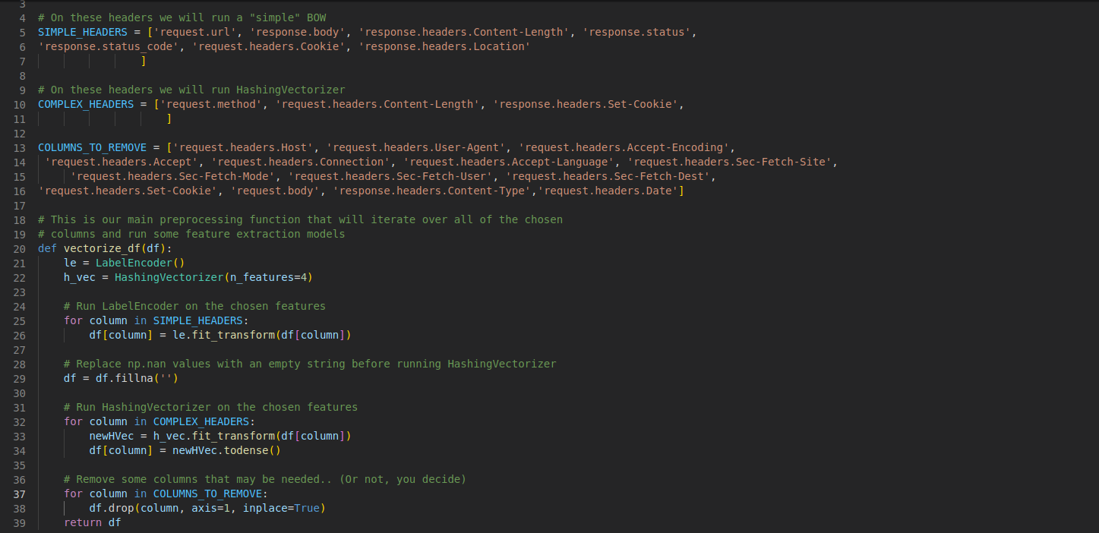
Choosing Simple , Complex Headers
Presentation title
3

Slide 5
Choosing Simple , Complex Headers
Presentation title
4

Slide 6
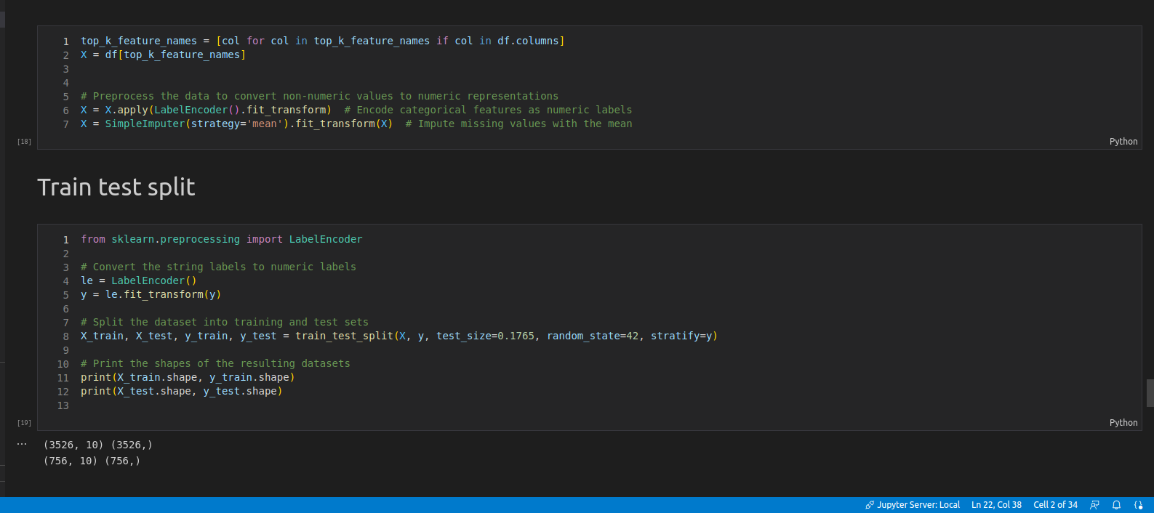
Train – Test Split
Presentation title
5

Slide 7
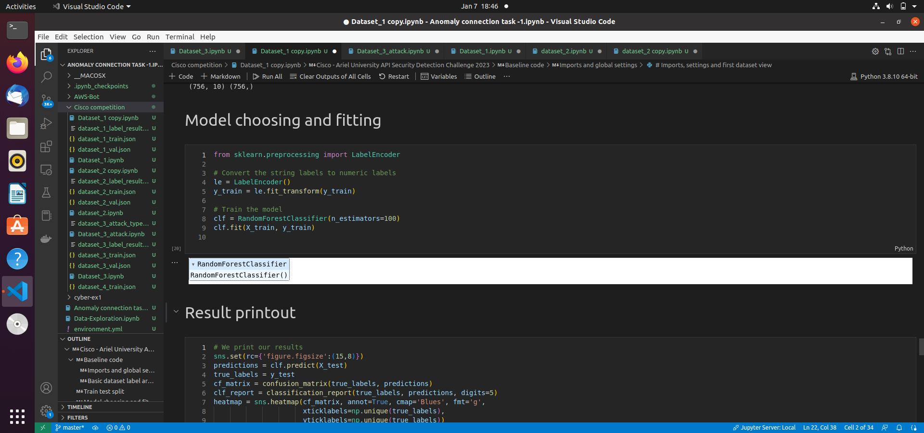
Choosing Model – Random Forest
Presentation title
6

Slide 8
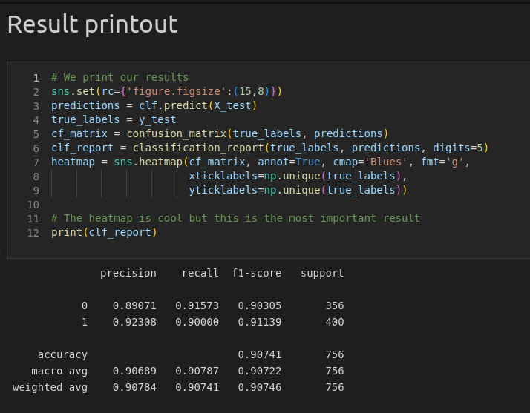
Results – Data Set 1
Presentation title
7

Slide 9
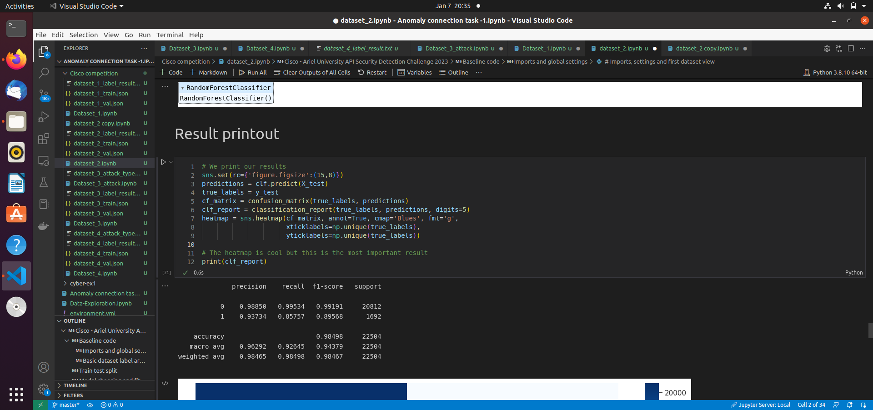
Results – Data Set 2
Presentation title
8

Slide 10
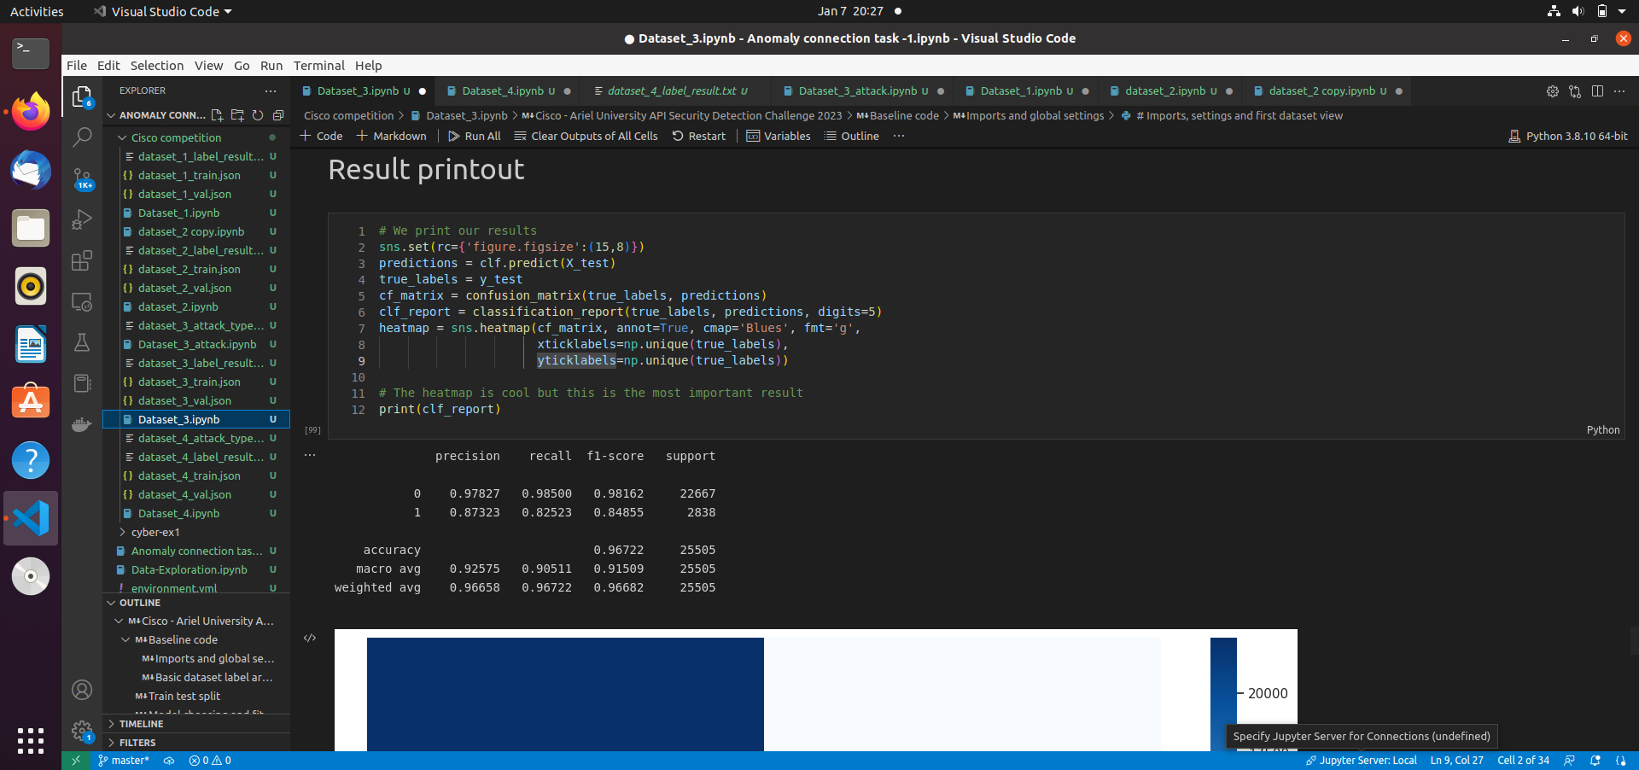
Results – Data Set 3 (label)
Presentation title
9

Slide 11
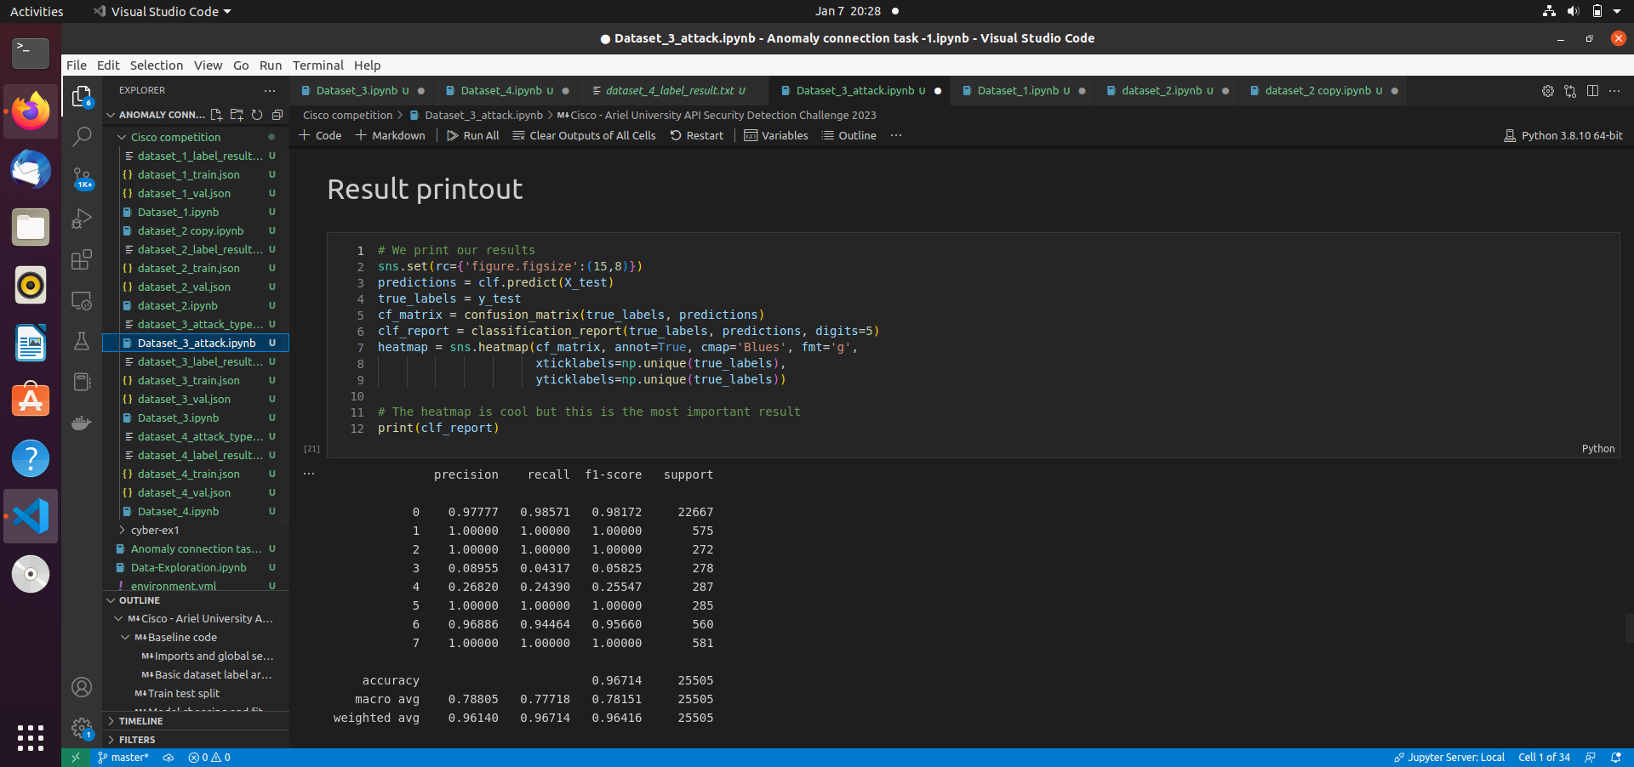
Results – Data Set 3 (attack_type)
Presentation title
10

Slide 12
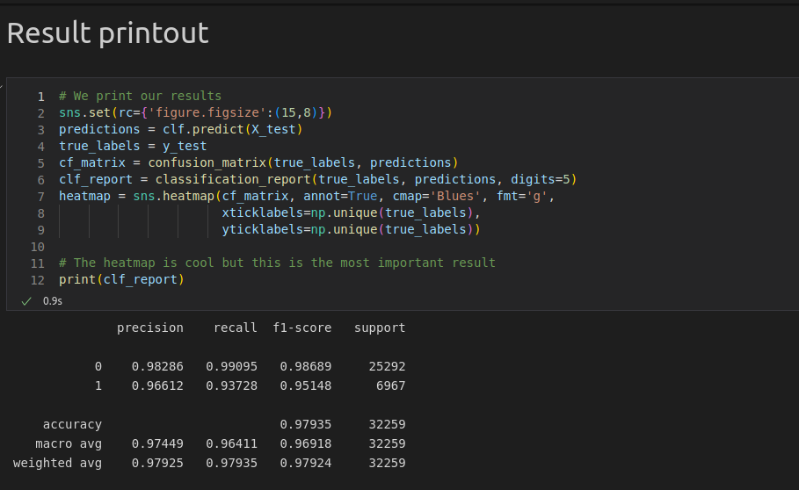
Results – Data Set 4 (label)
Presentation title
11

Slide 13
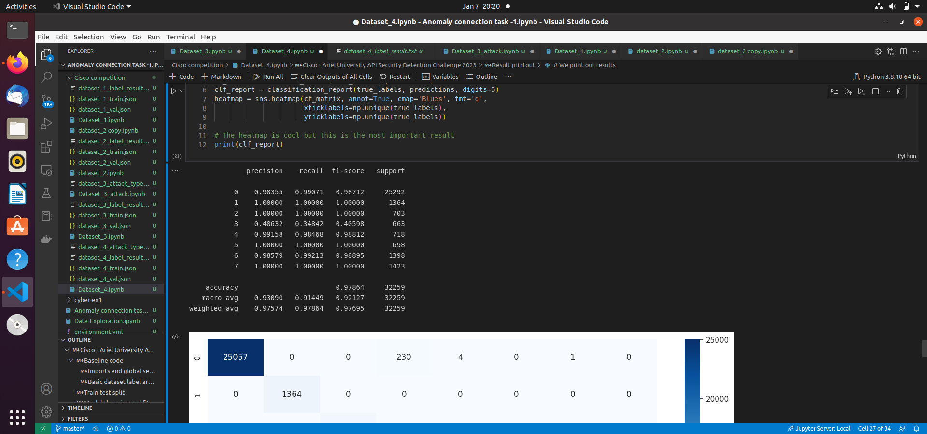
Results – Data Set 4 (attack-type)
Presentation title
10

Slide 14
Thank You
Presentation title
13

