Slide 1



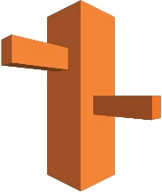
EC2
S3
Route 53

