Slide 1

SHA-256 Crypto Core Driver Implementation for Linux on RISC-V
July 2024
Master’s degree in Electronic Engineering
Professor: Stephano di Carlo
Authors(Group 14):
Firat Kagitci (s314487)
Berkay Demir (s308879)
Malaz Abdalla Osman Mohamed (s315390)
Zeyu Yang (s315346)
Shanchong Shang (s314324)

Slide 2
Introduction to SHA-256 Secure Hash Algorithm 256-bit
Part of the SHA-2 family, designed by NSA
Widely used in cryptographic applications

Slide 3
Key Characteristics SHA-256
Fixed Output Size: 256 bits (32 bytes)Deterministic: Same input yields the same hash
Preimage Resistance: Difficult to reverse-engineer input
Collision Resistance: Hard to find two inputs with the same hash
Avalanche Effect: Small changes in input cause large changes in output

Slide 4
Applications
Data Integrity:
Checksums: Verify data integrity during transmission/storage
File Verification: Ensure files are unaltered
Digital Signatures:
Authenticating documents
Used in TLS/SSL protocols for secure communications
Password Hashing:
Storing passwords securely
Blockchain Technology:
Ensuring transaction integrity in blockchain networks like Bitcoin

Slide 5
Implementation of the Driver
Device Driver (driver_sh.c)

Slide 6
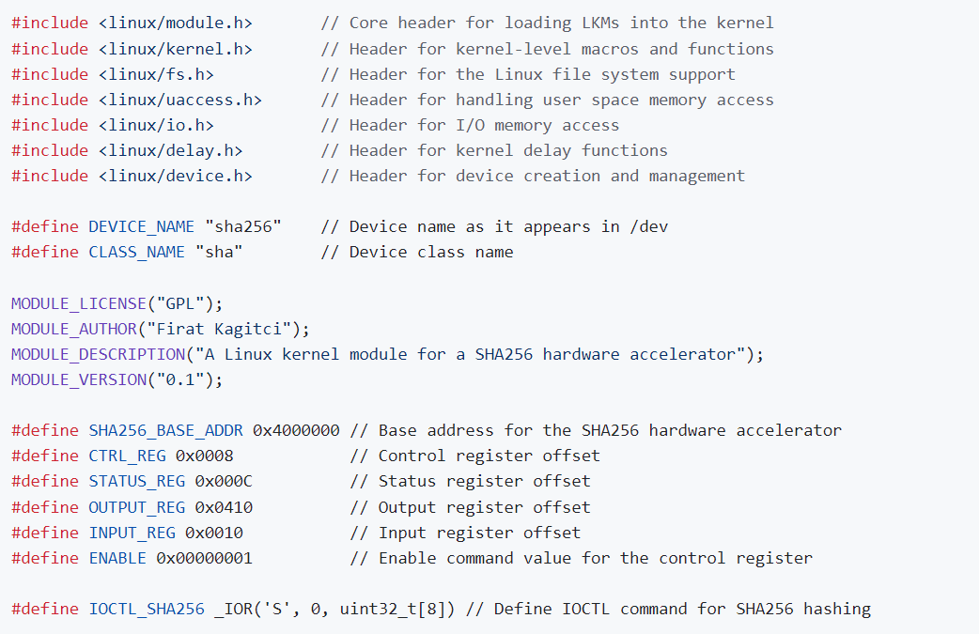
Implementation of the Driver
Registers of the device are defined
Driver module attributes are given

Slide 7
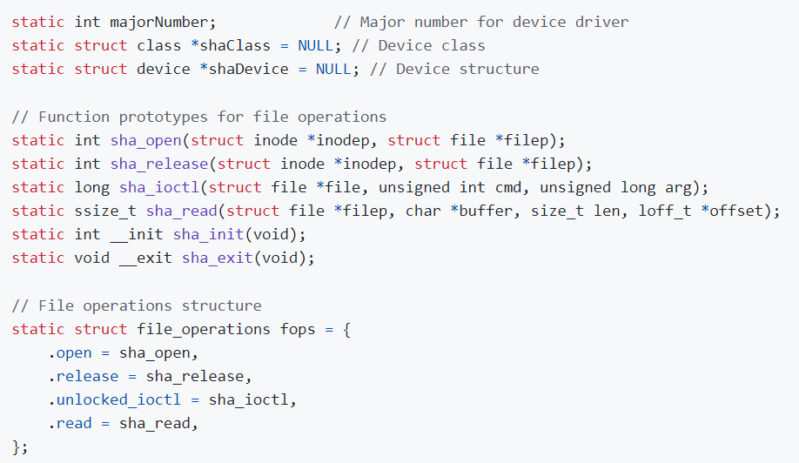
Implementation of the Driver
Function prototypes are defined and kernel functions are associated with the driver functions

Slide 8
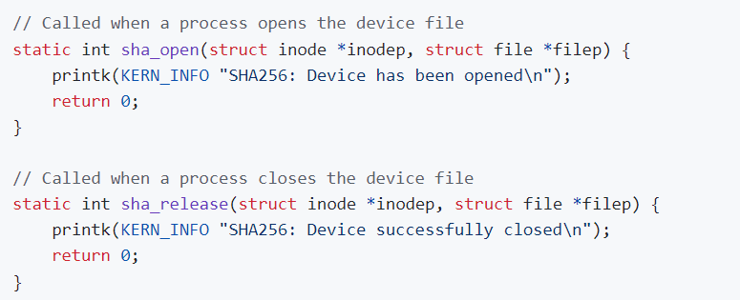
Implementation of the Driver
Open and release kernel functions are used but not implemented

Slide 9
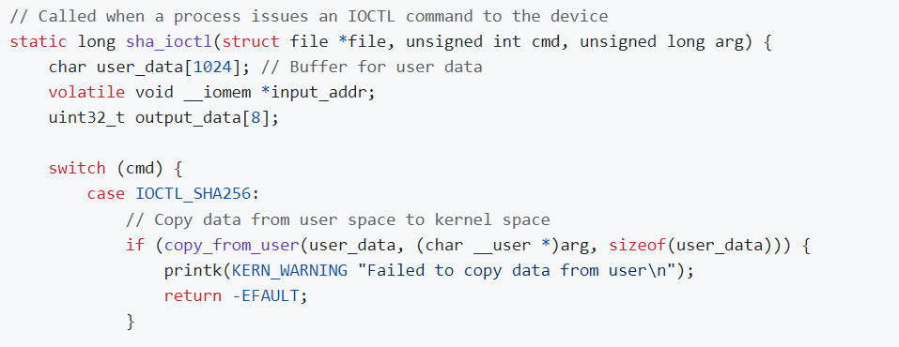
Implementation of the Driver
The sha_ioctl function in the driver code serves to handle custom commands from user space, particularly for initiating the SHA256 hashing process.
Copy Data from User Space: Uses copy_from_user to transfer data from the user space buffer to a kernel space buffer (user_data).

Slide 10
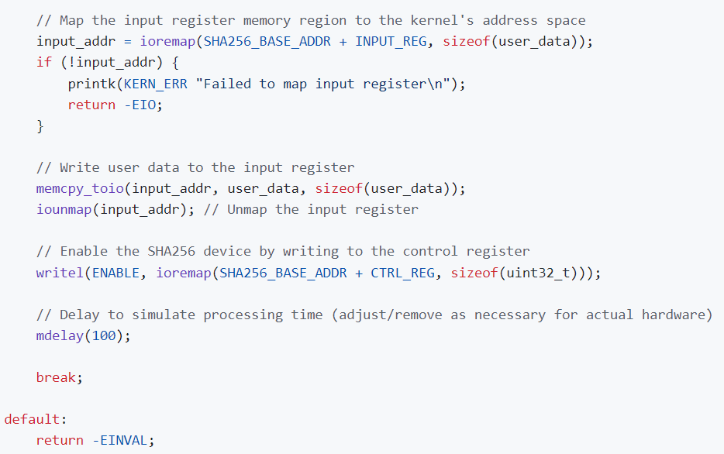
Implementation of the Driver
Map Input Register to Kernel Address Space: Uses ioremap to map the input register's memory region of the SHA256 hardware to the kernel's address space.
Write User Data to Input Register: Uses memcpy_toio to write the data from the kernel space buffer to the mapped input register memory region.
Unmap Input Register: Uses iounmap to unmap the previously mapped input register memory region from the kernel's address space.
Enable the SHA256 Device: Uses writel to write the ENABLE command to the control register of the SHA256 device to initiate the hashing process. Uses mdelay to introduce a delay simulating the processing time needed for the SHA256 hashing.

Slide 11
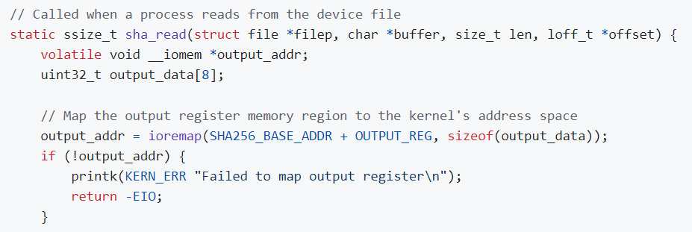
Implementation of the Driver
The sha_read function in the driver code handles reading the hash result from the SHA256 hardware accelerator and transferring it to user space.
Uses ioremap to map the output register's memory region of the SHA256 hardware to the kernel's address space.

Slide 12
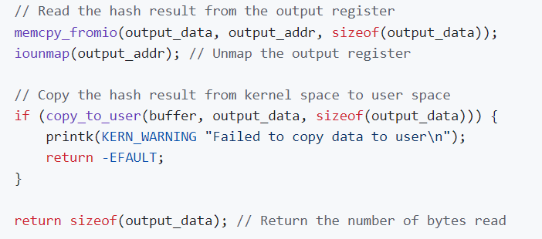
Implementation of the Driver
Read Hash Result from Output Register:
Uses memcpy_fromio to copy the hash result from the mapped output register memory region to a kernel space buffer (output_data).
Unmap Output Register:
Uses iounmap to unmap the previously mapped output register memory region from the kernel's address space.
Copy Data to User Space:
Uses copy_to_user to transfer the hash result from the kernel space buffer to the user space buffer provided by the user.

Slide 13
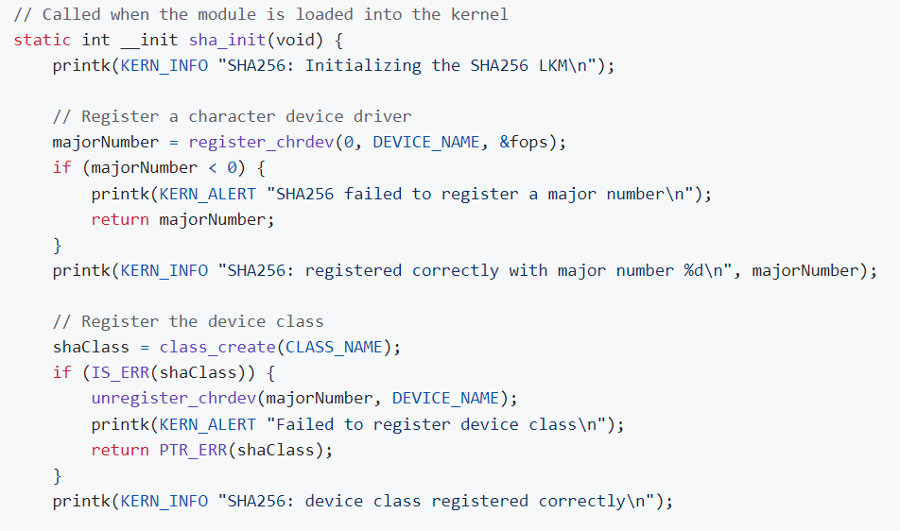
Implementation of the Driver
Initialization Function: sha_init is called when the module is loaded into the kernel.
Print Message: Logs the initialization message to the kernel.
Register Character Device:
Registers a character device driver.
Assigns a major number to the device.
Logs success or failure of the registration.
Register Device Class:
Creates and registers the device class.
Checks for errors during class creation.
Unregisters the character device if class creation fails.
Logs success or failure of the class registration.

Slide 14
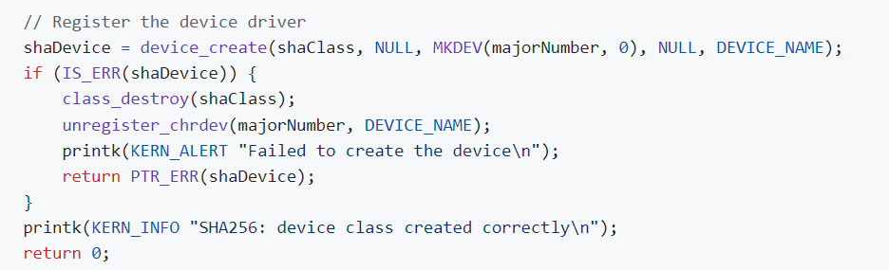
Implementation of the Driver
Create Device: device_create associates the device with class and major number.

Slide 15
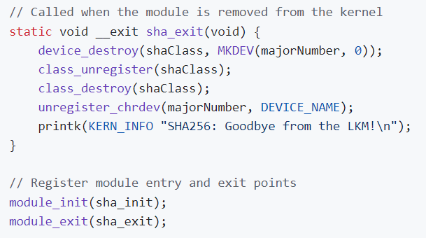
Implementation of the Driver
Module Exit Function: sha_exit is called when the module is removed.
Destroy Device: device_destroy removes the device.
Unregister and Destroy Class: class_unregister and class_destroy remove the device class.
Unregister Device: unregister_chrdev removes the character device driver.
Log Message: Prints a goodbye message.
Module Entry and Exit Points:
module_init(sha_init): Registers the initialization function.
module_exit(sha_exit): Registers the cleanup function.

Slide 16
Implementation of the Crypto-core Device
Crypto core device (crypto.c)

Slide 17
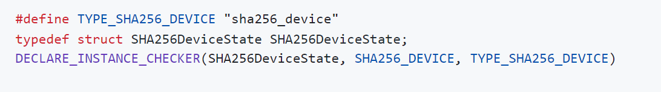
Implementation of the Crypto-core Device of the Driver
Here in the first line we are defining the macro named type_sha256_device to be renamed to sha256_device
The second line creates a data structure named state
In the third line, we are checking for the correctness of the program definitions before execution.
These declarations are for safe usage in the QEMU framework.

Slide 18
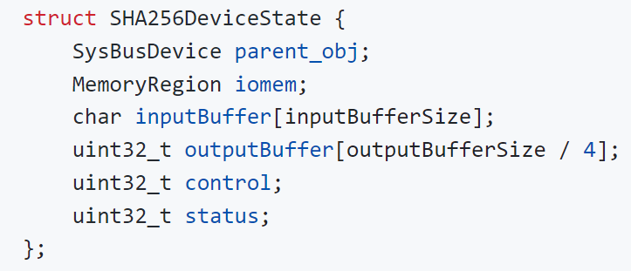
Device State Structure
iomem defines the memory-mapped I/O region for the device.
outputBuffer: holds the output coming from the digest.
control: start/stop the hashing.
status: check the status of the device. End of the hashing or still hashing.

Slide 19
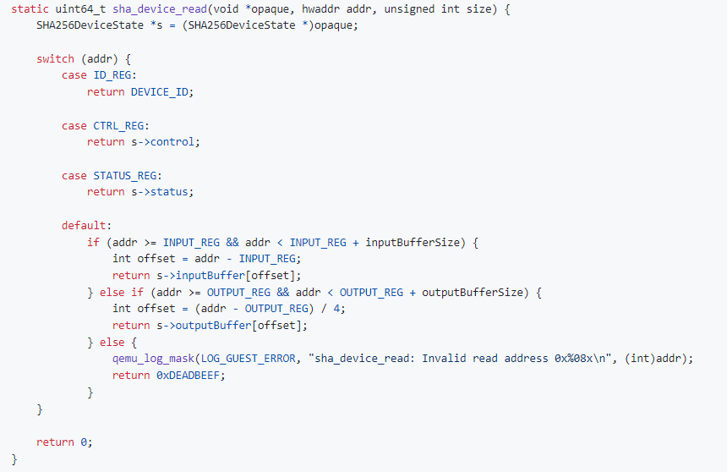
Device Read Function
Implementation of the Crypto-core Device of the Driver
Reads the device's registers and memory-mapped buffers based on the provided address.
Handles specific addresses for ID_REG, CTRL_REG, and STATUS_REG directly. (not used in this project)
Logs an error Handles ranges for input and output buffers by calculating the appropriate offset.
Returns a sentinel value (0xDEADBEEF) for invalid addresses.

Slide 20
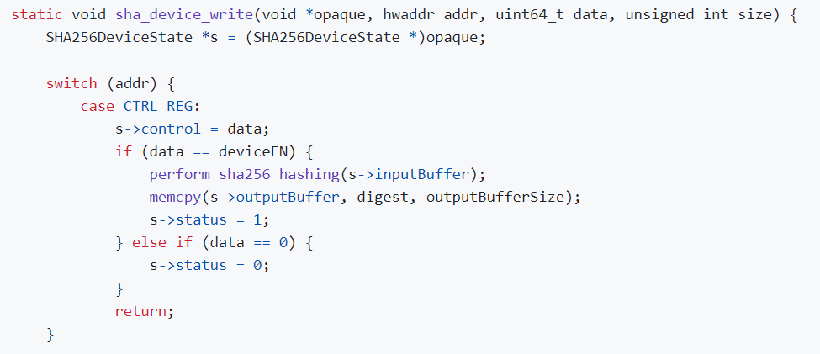
Device Control Operation
Implementation of the Crypto-core Device of the Driver
According to the address of the control register, we write data to the control register. If the data is equal to deviceEN, we perform hashing on the input buffer and copy the digest to the output buffer, setting the status register to 1 after the hashing has ended.

Slide 21
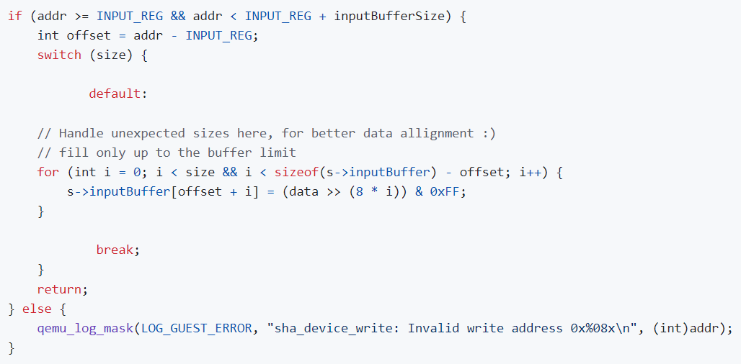
Device Write Operation
Implementation of the Crypto-core Device of the Driver
If the address falls within the buffer range, it calculates the offset to write data to the input buffer depending on the size of the data in bytes.

Slide 22
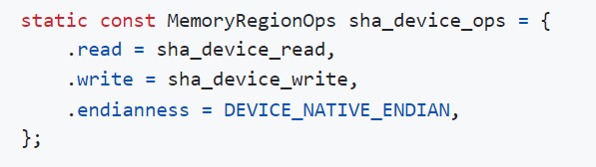
Device Memory Operation Assocation
Implementation of the Crypto-core Device of the Driver
Read Operation (sha_device_read): Handles how data is read from the device's memory region.
Write Operation (sha_device_write): Handles how data is written to the device's memory region.
Endianness (DEVICE_NATIVE_ENDIAN): Specifies that the device uses the native endianness of the host machine. Help correctly interpret the byte order of the data.

Slide 23
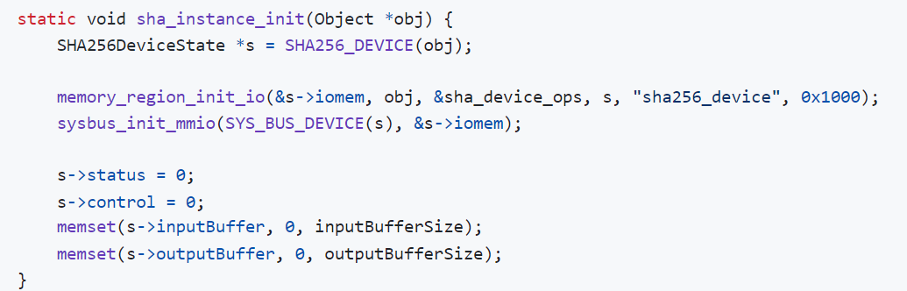
Device Initialization
Implementation of the Crypto-core Device of the Driver
Casts the generic object to a SHA256DeviceState structure.
Initializes an I/O memory region for the device.
Registers the initialized memory region with the system bus.
Initializes the control and status registers to 0.
Clears the input and output buffers by setting all bytes to 0.

Slide 24
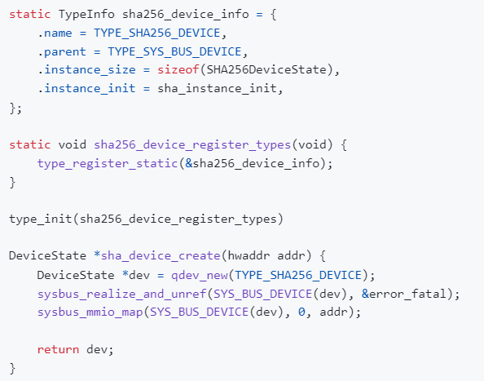
DevicE creation and registration
Here we initialize and provide data for the SHA256 device type.
Second method registers the device type to the QEMU.
Third method calls the function during the type initialization phase.
Last function creates and initializes an instance of the device by mapping the device's memory-mapped I/O to the address.

Slide 25
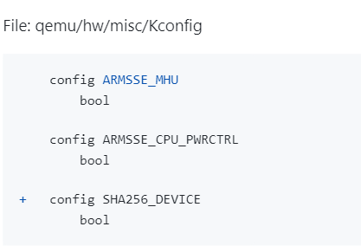
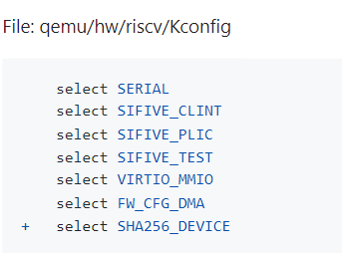
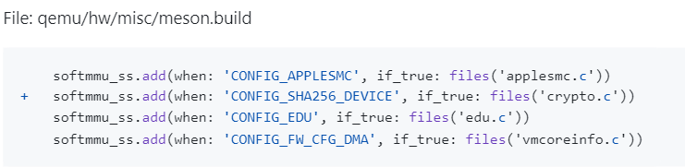
Qemu file configurations:
By selecting the device in Kconfig, virtual board in QEMU includes support when RISC-V cOnfiguration is selected.
By adding crypto inside meson, we let the meson know what to build when this symbol is used.

Slide 26
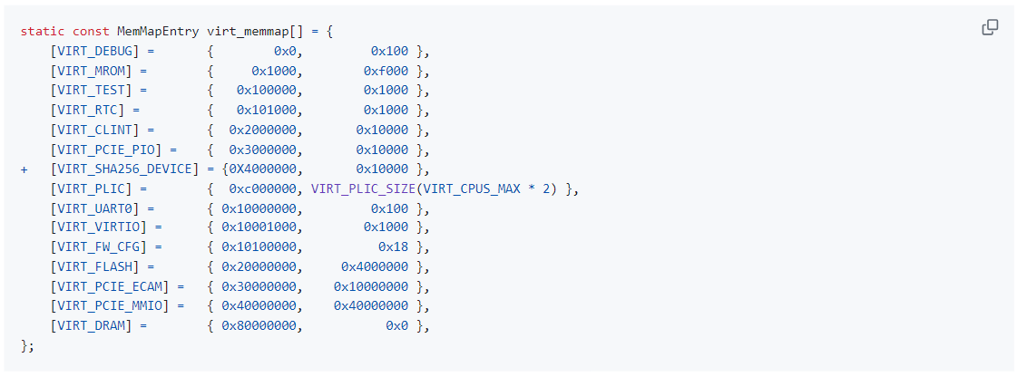

Addition to the virtual memory
Here, we assign a specific address and size for the device inside the memory map of the RISC-V virtual board.
Second part creates an instance of the device on the virtual board. It takes the first argument of the memory as base address and initializes the device at the memory location.

Slide 27
Sources and Repositories
https://github.com/firatkagitci/Kernel-Module-Development-for-RISC-V-Architecture-with-Buildroot-Linux-
https://sebastienbourdelin.com/2021/06/16/writing-a-custom-device-for-qemu/
https://embeddedinn.com/articles/tutorial/Adding-a-custom-peripheral-to-QEMU/
https://medium.com/@matanbach44/hello-world-device-in-qemu-ae69b02872f4
https://github.com/B-Con/crypto-algorithms/blob/master/sha256.c

