Slide 1
IBM Capstone Project - The Battle of Neighborhoods

Slide 2
Introduction
In this project, we’ll be discovering New Delhi, the capital city of India, with a great diversity in terms of cuisine culture. There are plenty of different types of restaurants in many categories. During the project, there will be answers to some question about the food industry in the city such as
“where is the best places to eat?”
“where can i find the best places to eat hamburgers or cheeseburgers?”
“how many burger places exist in the city and where?”

Slide 3
Objective
to find best burger
places in New Delhi

Slide 4
Data
For this project we need the following data :
Data source : Zomato kaggel dataset
Description : This data set contains the required information. And we will use this data set to explore various locality of new delhi city.
Data source : Fousquare API
Description : By using this api we will get all the venues in each neighborhood.

Slide 5
Approach
Collect the new delhi city data from Zomato kaggel dataset
Using FourSquare API we will find all venues for each neighborhood.
Filter out all venues that are nearby by locality.
Using aggregative rating for each resturant to find the best places.
Visualize the Ranking of neighborhoods using folium library(python)

Slide 6
Results

Slide 7
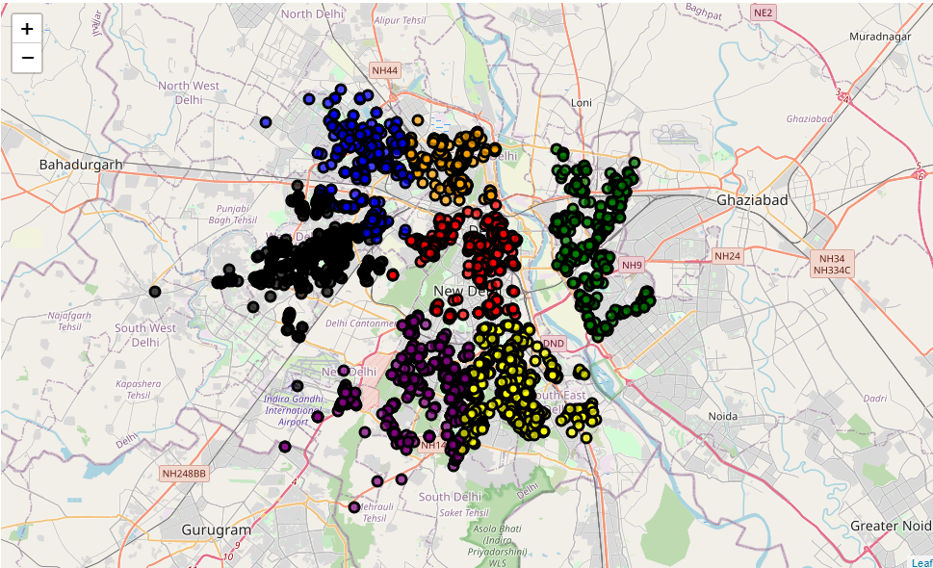
Clustering New Delhi
Restaurants into 7 groups
in terms of their ratings

Slide 8
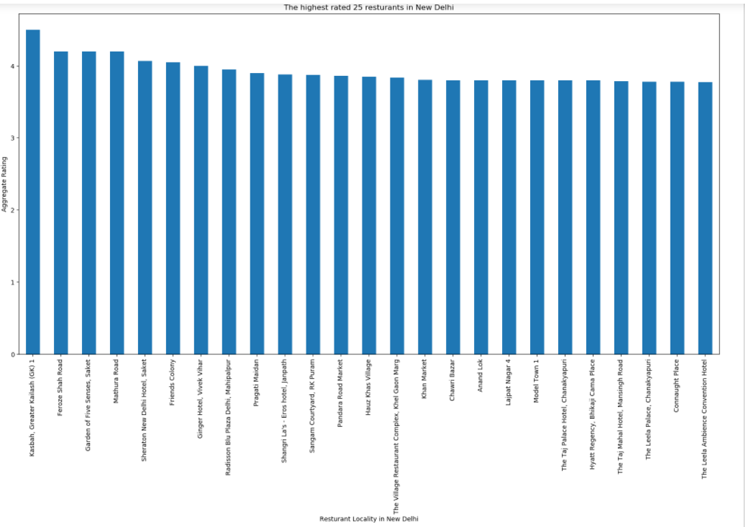

Slide 9
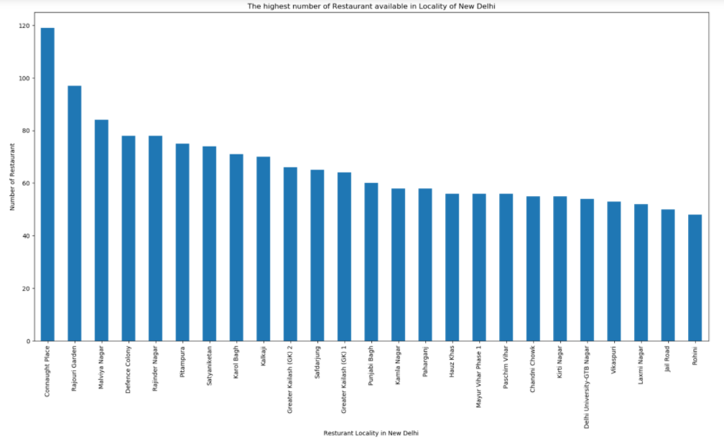

Slide 10
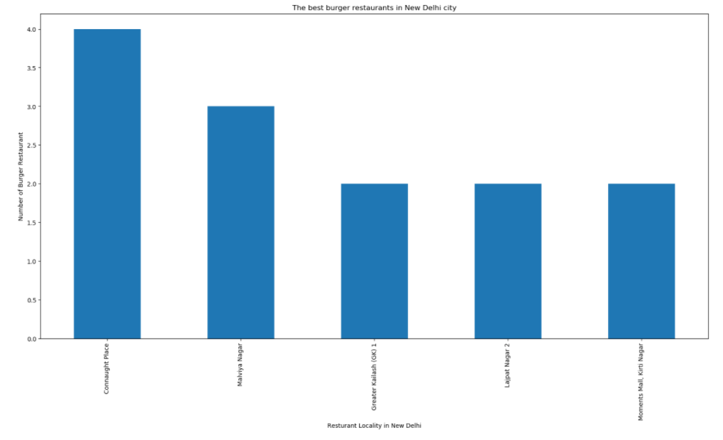

Slide 11
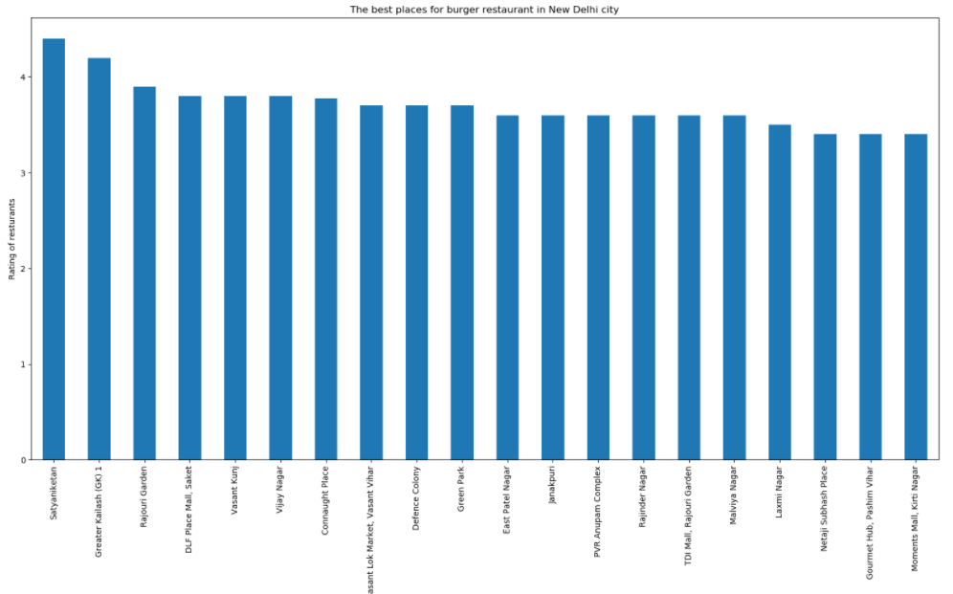

Slide 12
Conclusion
Chanakyapuri, Pitampura, Safdarjung are some of the best neighborhoods for Chinese cuisine.
Panchsheel park, Nehru place have the best Chinese Restaurant.
Connaught place, Rajouri garden, Malviya nagar are the best places for edible person.
Greater kailash, Feroze shah road, Saket have best rated restaurants in New Delhi.

