Slide 1
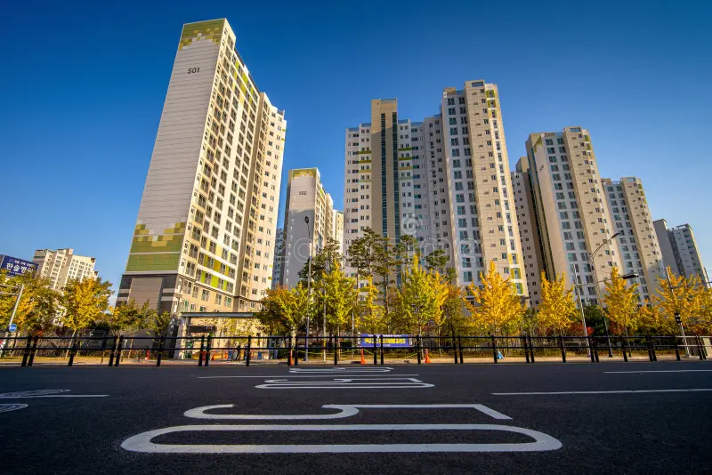
Apartment Price Prediction
26 Mei 2024
Firdaus Zamroni Fauzi

Slide 2
Content
Business Problem Understanding
Data Undestanding
Explanatory Data Analysis
Data Preprocessing
Conclusion
Modelling
Recomendation

Slide 3

01
Business Problem Understanding

Slide 4

Context
Daegu City is the 3rd largest metropolitan area in Korea
The majority of residents, especially in big cities in South Korea, prefer to sell or buy apartments through real estate agents
Price competition determines sales
Sumber : https://en.wikipedia.org/wiki/Daegu

Slide 5

Problem Statements
Determine the selling price of the apartment in accordance with market prices
Before making a transaction, consumers will find out about the price of the apartment
Determining the right selling price to be able to remain competitive in the environment in the city of Daegu, South Korea is very important to ensure that apartment prices in an area are still considered reasonable.

Slide 6

Goals
To help real estate agents and buyers determine fair apartment rental prices, it's important to create a model that can predict those prices based on available data. The model should have the best learning rate and the lowest possible error rate to ensure accuracy.
This will result in higher customer satisfaction for buyers who can get competitive rental prices.

Slide 7

Analytical Approach
Analysis to explore and see patterns in the data and build a regression model as a method to test whether there is an influence between various features and the selling price of the apartment. expressed in the form of a mathematical equation.
The regression model formed can also predict the selling price of apartments and so can help new apartment owners to determine the selling price of apartments.

Slide 8

Matric Evaluation
The evaluation metrics used for the regression model are RMSE, MAE, and MAPE.
RMSE is the root of the mean square residual.
MAE is the average of absolute errors and is a metric that is not sensitive to outliers.
MAPE is the absolute average percentage error.
The smaller the RMSE, MAE, and MAPE values,
the better the model will be at predicting apartment prices.
R-Squared can also be used if the best model chosen is a linear model.
The closer the value is to 1,
the better the regression line will represent the data.

Slide 9
02
Data Understanding

Slide 10
Dataset :
Dataset obtained from the official website of the Korean government, namely data.go.kr from 2007 - 2017
HallwayType | TimeToSubway | SubwayStation | N_FacilitiesNearBy(ETC) | N_FacilitiesNearBy(PublicOffice) | N_SchoolNearBy(University) | N_Parkinglot(Basement) | YearBuilt | N_FacilitiesInApt | Size(sqf) | SalePrice
terraced | 0-5min | Kyungbuk_uni_hospital | 0 | 3 | 2 | 1270 | 2007 | 10 | 1387 | 346017
terraced | 10min-15min | Kyungbuk_uni_hospital | 1 | 5 | 1 | 0 | 1986 | 4 | 914 | 150442
mixed | 15min-20min | Chil-sung-market | 1 | 7 | 3 | 56 | 1997 | 5 | 558 | 61946
mixed | 5min-10min | Bangoge | 5 | 5 | 4 | 798 | 2005 | 7 | 914 | 165486
terraced | 0-5min | Sin-nam | 0 | 1 | 2 | 536 | 2006 | 5 | 1743 | 311504
Feature :
Hallway Type : Apartment type
TimeToSubway : Time needed to the nearest subway station
SubwayStation : The name of the nearest subway station
N_FacilitiesNearBy(ETC) : The number of facilities nearby
N_FacilitiesNearBy(PublicOffice) : The number of public office facilities nearby
N_SchoolNearBy(University) : The number of universities nearby
N_Parkinglot(Basement) : The number of the parking lot
YearBuilt : The year the apartment was built
N_FacilitiesInApt : Number of facilities in the apartment
Size(sqft) : The apartment size (in square feet)
SalePrice : The apartment price (Won)

Slide 11
03
Exploratory Data Analysis

Slide 12

Summary Statistics
 | HallwayType | TimeToSubway | SubwayStation
count | 4123 | 4123 | 4123
unique | 3 | 5 | 8
top | terraced | 0-5min | Kyungbuk_uni_hospital
freq | 2528 | 1953 | 1152
 | N_FacilitiesNearBy(ETC) | N_FacilitiesNearBy(PublicOffice) | N_SchoolNearBy(University) | N_Parkinglot(Basement) | YearBuilt | N_FacilitiesInApt | Size(sqf) | SalePrice
count | 4123 | 4123 | 4123 | 4123 | 4123 | 4123 | 4123 | 4123
mean | 1.930876 | 4.135338 | 2.746301 | 568.97914 | 2002.99976 | 5.81785 | 954.63085 | 221767.927
std | 2.198832 | 1.80264 | 1.49661 | 410.37274 | 8.905768 | 2.34051 | 383.80565 | 106739.84
min | 0 | 0 | 0 | 0 | 1978 | 1 | 135 | 32743
25% | 0 | 3 | 2 | 184 | 1993 | 4 | 644 | 144752
50% | 1 | 5 | 2 | 536 | 2006 | 5 | 910 | 209734
75% | 5 | 5 | 4 | 798 | 2008 | 7 | 1149 | 291150
max | 5 | 7 | 5 | 1321 | 2015 | 10 | 2337 | 585840

Slide 13
Summary :
There are 4,123 data with 11 features in the dataset.
The most common type of apartment is a terraced apartment
The majority of apartments in Daegu are quite close to the station because the majority only need 0-5 minutes to get to the station and Kyungbuk Uni Hospital Station is the closest station to the majority of apartments.
Apartments in Daegu have an average of 2 facilities, 4 public offices, 3 universities, and 569 nearby basement parking spaces.
The average apartment in Daegu was built in 2003 or can be said to be quite old because the oldest apartment in Daegu was built in 1978 and the newest apartment was built in 2015.
Apartments in Daegu have an average of 6 facilities in the apartment where the number of facilities can be said to be quite large because the highest number of facilities in the apartment reaches 10 facilities.
Apartment sizes and apartment prices in Daegu vary quite a bit with an average size of 954.63 square feet and an average price of 221,767.93 won so the average apartment price in Daegu is 232.31 won/square feet.

Slide 14
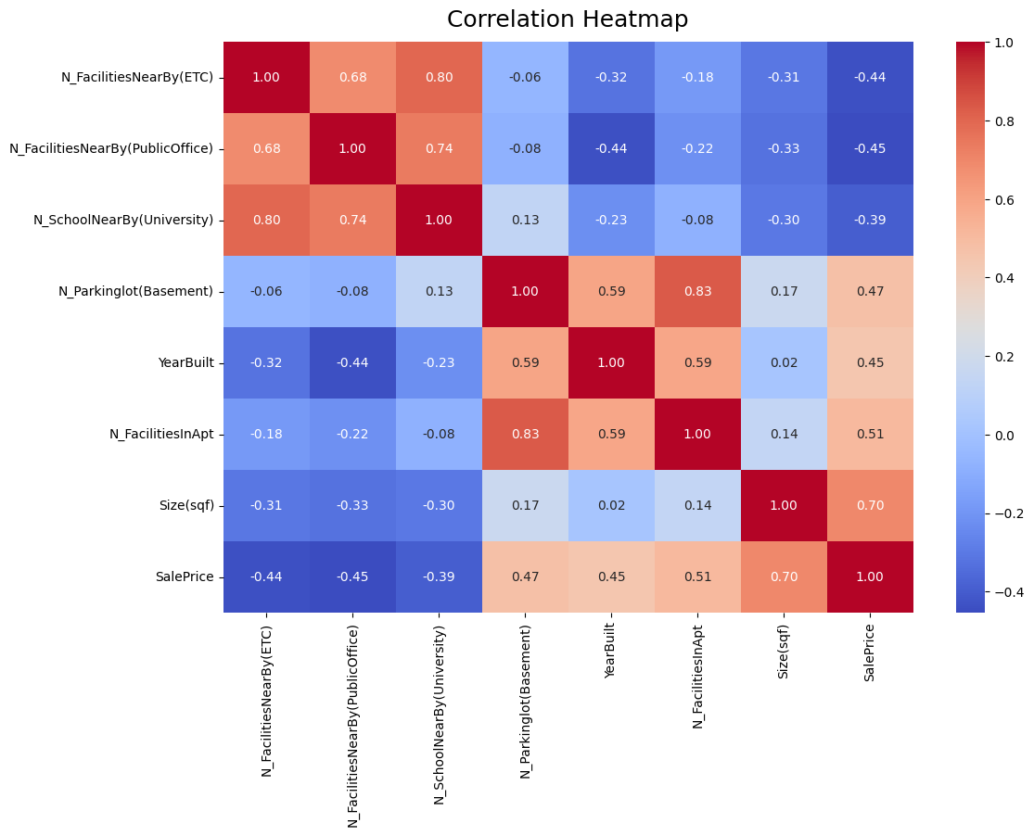
Data Correlation
Overall, the correlation matrix shows that all features have a medium correlation (correlation value 0.3 to 0.7)
There is a strong correlation between the independent variables, namely the number of other closest facilities from the apartment with the number of universities closest to the apartment (correlation value=0.8) and other closest facilities by public office from the apartment with the number of universities closest to the apartment (correlation value=0.74 ).
This indicates the existence of multicollinearity where two or more independent variables in the model have a high correlation with each other and can cause problems in regression analysis that uses the least squares method to estimate regression parameters such as linear regression or logistic regression because it can affect the interpretation of regression coefficients and make unstable estimates.

Slide 15
04
Data Preprocessing

Slide 16
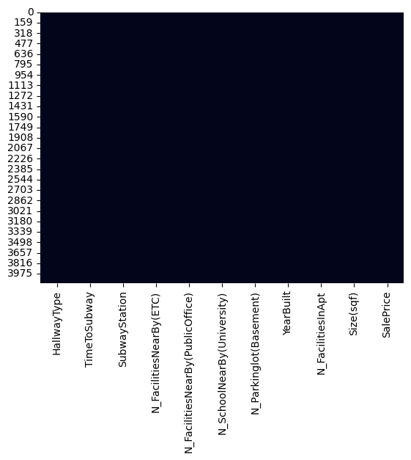
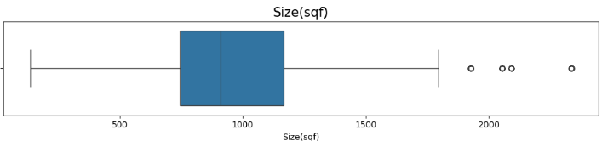
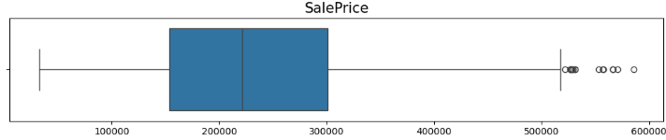
Data Cleaning
2. Duplicate
1. Missing Value
There are 1422 duplicate data in the dataset and the percentage of duplicate data reaches 34.49%.
Duplicate data in machine learning datasets can cause bias in the model, causing overfitting because the same data points can be calculated several times. Therefore we will drop all duplicate data.
3. Outlier
84 Outlier
17 Outlier
According to domain knowledge, the outliers represent normal data variations such as very large house sizes and very expensive house prices.
Nothing Missing Value

Slide 17
05
Modelling

Slide 18
Feature Engineering
1. Scalling
N_Parkinglot(Basement) and Size(Sqf) : Robust Scaller
2. Encoding
HallwayType : One-Hot Encoding will be performed on this feature because it consists of 3 categories
SubwayStation : Binary Encoding will be performed on this feature because it consists of 8 categories
TimeToSubway : Ordinal Encoding will be performed on this feature because the data will be sorted from the lowest (far from the subway) to the highest (close to the subway)
X / Features :
HallwayType
TimeToSubway
SubwayStation
N_FacilitiesNearBy(ETC)
N_FacilitiesNearBy(PublicOffice)
N_SchoolNearBy(University)
N_Parkinglot(Basement), YearBuilt
N_FacilitiesInApt, Size(sqf)
Y / Target :
Sales Price
Train Test Distribution :
80 : 20

Slide 19
Benchmark Model
Linear Regression
Ridge Regression
Lasso Regression
Support Vector Regressor
KNN Regressor
Decision Tree
Random Forest
XGBoost Regressor
Best Model By Cross Validation
Model | Mean R2 | Standar Deviasi R2 | Mean RMSE | Standard Deviasi RMSE | Mean MAE | Standard Deviasi MAE | Mean MAPE | Standard Deviasi MAPE
Decision Tree Regressor | 0.807112 | 0.013265 | -46270.7855 | 884.24817 | -37259.3236 | 955.537365 | -0.190018 | 0.001301
Random Forest Regressor | 0.807865 | 0.01337 | -46178.9943 | 885.653165 | -37214.8226 | 965.821287 | -0.190385 | 0.001295
XGBoost Regressor | 0.806841 | 0.013167 | -46303.8759 | 865.292775 | -37297.5247 | 922.828434 | -0.190406 | 0.001068
Voting Regressor | 0.801248 | 0.010692 | -46984.6059 | 550.603985 | -38382.1282 | 710.306153 | -0.197593 | 0.003136
KNN Regressor | 0.782673 | 0.017688 | -49095.7201 | 1221.113625 | -39484.0833 | 1473.590874 | -0.202705 | 0.004851
Stacking Regressor | 0.781767 | 0.02449 | -49143.5998 | 1739.925149 | -39401.1886 | 1778.271802 | -0.203574 | 0.006333
Linear Regression | 0.755169 | 0.010342 | -52161.7316 | 561.053598 | -42090.4483 | 748.236544 | -0.216895 | 0.005181
Lasso Regression | 0.755168 | 0.010343 | -52161.8015 | 561.102159 | -42090.9708 | 748.139394 | -0.216901 | 0.005173
Ridge Regression | 0.755153 | 0.010346 | -52163.4155 | 562.70117 | -42099.9641 | 747.786206 | -0.217047 | 0.005091
SVR | -0.00708 | 0.005022 | -105855.515 | 2178.696754 | -85494.5364 | 3745.076433 | -0.559577 | 0.049023

Slide 20
Prediction from Testing Data with Benchmark 3 Best Models
 | R2 | RMSE | MAE | MAPE
XGBoost | 0.783239 | 47985.30313 | 38951.3142 | 0.198598
Random Forest | 0.781391 | 48189.46003 | 39010.78694 | 0.200358
Decision Tree | 0.777481 | 48618.45297 | 39169.16265 | 0.202106

Slide 21
Hyperparameter Tuning
Best Hyparameter XGBoost :
subsample: 0.8,
reg_alpha: 0.46415888336127775,
n_estimators: 120,
max_depth: 3,
learning_rate: 0.68,
gamma: 4,
colsample_bytree: 0.6
Before Tuning :
 | R2 | RMSE | MAE | MAPE
XGBoost | 0.78324 | 47985.3031 | 38951.3142 | 0.1986
After Tuning :
 | R2 | RMSE | MAE | MAPE
XGBoost | 0.78705 | 47562.1205 | 38599.2833 | 0.19492

Slide 22
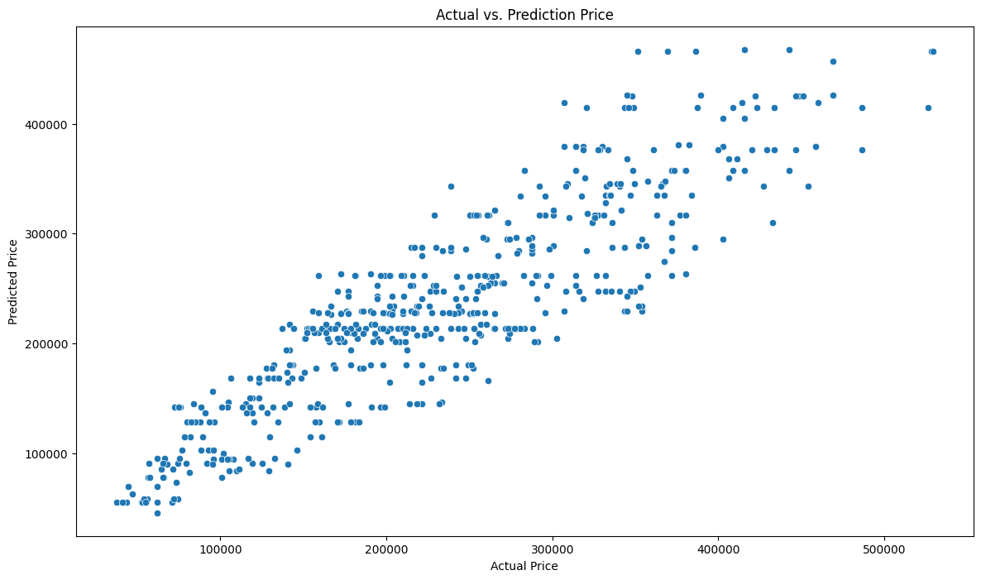
Hyperparameter Tuning
Based on the residual plot above, the residuals appear to be randomly distributed along the horizontal axis and do not have a particular pattern, indicating that the regression model is generally suitable for apartment price data in Daegu, South Korea.

Slide 23
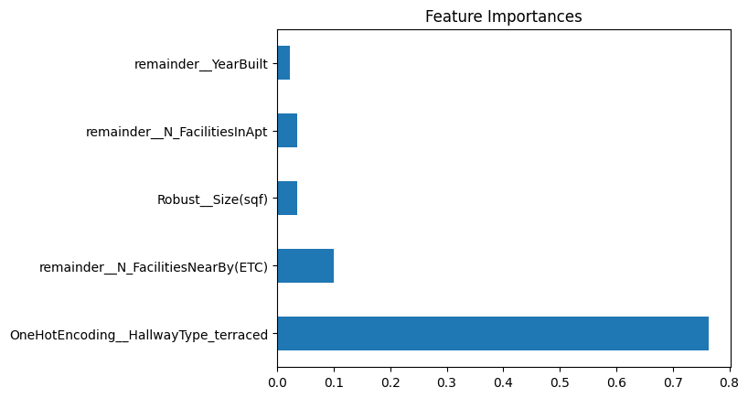
Feature Importance
 | Feature Importances
OneHotEncoding__HallwayType_terraced | 0.764231
remainder__N_FacilitiesNearBy(ETC) | 0.100243
Robust__Size(sqf) | 0.035617
remainder__N_FacilitiesInApt | 0.034851
remainder__YearBuilt | 0.022182
BinaryEncoding__SubwayStation_3 | 0.01179
Robust__N_Parkinglot(Basement) | 0.007103
OneHotEncoding__HallwayType_mixed | 0.006031
OrdinalEncoding__TimeToSubway | 0.004452
remainder__N_FacilitiesNearBy(PublicOffice) | 0.003652
remainder__N_SchoolNearBy(University) | 0.003079
BinaryEncoding__SubwayStation_2 | 0.003002
BinaryEncoding__SubwayStation_1 | 0.002157
BinaryEncoding__SubwayStation_0 | 0.001611
In the XGboost Regressor model with tuned parameters, the features that most influence apartment prices in Daegu, South Korea are the type of terraced apartment, the number of nearby facilities, and the size of the apartment.

Slide 24
06
Conclusion

Slide 25
The evaluation metrics used for regression models are RMSE, MAE, and MAPE
The final model chosen is XGboost Regressor model where the model has a MAPE value of 19.4%, so this means that if the model is used to predict apartment prices within the same price range has been trained on the model (the minimum apartment price is 32,743 won and the maximum apartment price is 521,902 won) then the average percentage of absolute error between the predicted apartment price and the actual value of the apartment price is 19.4%. Based on Lewis (1982), a MAPE value of 10% to 20% can be interpreted as a model that has good forecasting capabilities.
However, apartment price predictions can also miss the actual apartment price due to bias that may occur due to the limited features used so that the features in the dataset do not adequately represent the factors that influence apartment prices in Daegu, South Korea.
Based on the final model chosen, the features that most influence apartment prices in Daegu, South Korea are the type of terraced apartment, the number of nearby facilities, and the size of the apartment.
Before there was a regression model, we only had raw data regarding apartment characteristics and apartment prices in Daegu which was difficult to interpret and did not provide useful insight into the relationship between apartment characteristics and apartment prices. With a regression model, we can conduct a more detailed analysis and gain a better understanding of how apartment characteristics and apartment prices are related. Apart from that, the regression model can also be used to predict changes in the value of apartment prices that might occur if the characteristics of the apartment change. In this case, the impact after the regression model is greater than before the regression model, because real estate agents can take more appropriate actions or decisions based on the results of the regression model analysis, namely being able to determine the appropriate apartment price.

Slide 26
07
Recomendation

Slide 27
Consider adding features that have a stronger relationship to the price of an apartment in Daegu, South Korea, such as what floor the apartment is on, the year the apartment was sold, the number of rooms in the apartment (number of bedrooms, bathrooms, kitchen), information on the inclusiveness of furniture in the apartment, and so on.
Expand the dataset by collecting more data that has more updated information regarding apartment prices in Daegu, South Korea to increase the relevance of the dataset when building prediction models so that it can produce better prediction model accuracy and help improve regression models to learn patterns in the data.

Slide 28
Thank You

