Slide 1
Design, Test and Integration of Force Sensor and Strain Gage
Presented by
Firdous Saleheen
firdous.saleheen@temple.edu
Date: November 30, 2011

Slide 2
Outline
Basic Sensor System Building Blocks
Force Sensing System Design
Strain Gage System Design
Application Software
Application to Tactile Imaging System

Slide 3
Overview
Sensor
Signal Conditioning System
Data Acquisition System
Application Software

Slide 4
Force Sensing System
Force Sensing Resistor as Force Sensor
Measurement Circuit for Force Sensor
Arduino Uno board and Matlab script as Data Acquisition System
Application Software written in Matlab R2010b

Slide 5
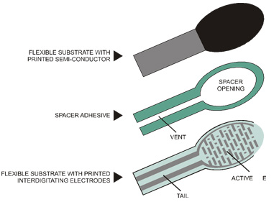
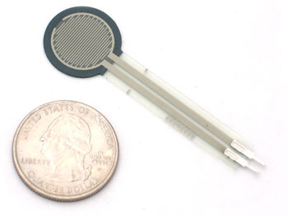
Force Sensing Resistor (FSR)
FSR is a material whose resistance changes when a force is applied.
Small size, low cost and easy to use.
Interlink Model 402
Sensing area diameter 12.7mm

Slide 6
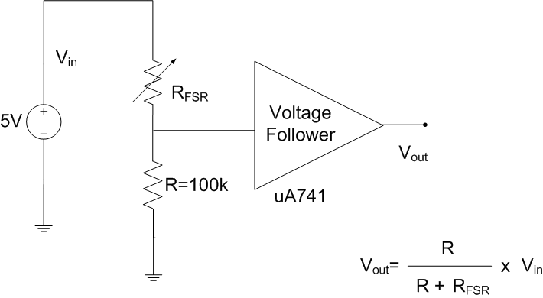
Measurement Circuit
Measurement based on simple voltage divider rule
Output voltage changes as resistance of FSR varies by above formula
A voltage follower is used to match the upstream high impedance circuit.

Slide 7
Data Acquisition from Force Sensor
Divided into two parts:
Hardware for data acquisition
Software for data acquisition
Hardware – Output of measurement circuit is connected to analog pin Arduino UNO board
Software –
Matlab package to support Arduino IDE.
Upload matlab written srv.pde file into board
Run a script to read the analog pin of Arduino in Matlab

Slide 8
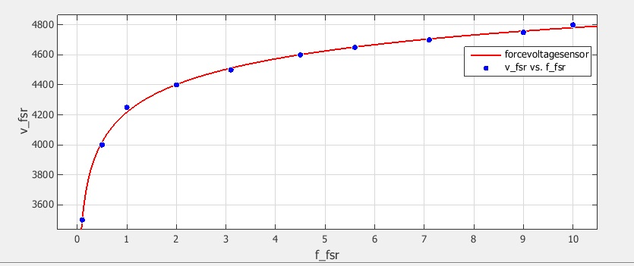
Resistance vs Force Curve
Used matlab curve fitting tool logarithmic fitting
f_fsr = exp(log((v_fsr-6835)/(-2617))/(-0.1054))

Slide 9
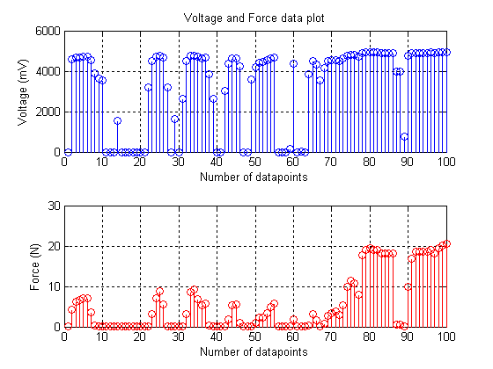
Force Sensing Graph

Slide 10
Strain Gage System
Strain Gage
Signal Conditioning Circuit
Arduino Uno board and Matlab script as Data Acquisition System
Application Software written in Matlab R2010b

Slide 11
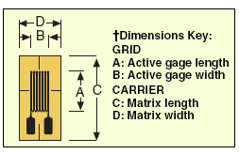
Strain Gage
SGT-2C/350-TY11 used as strain gage.
Nominal resistance value is 350 ohms
A = 1.5mm, B = 4.6mm, C = 6.4mm and D = 4.6mm.

Slide 12
Basic Building Block for Signal Conditioning
Strain Gage in Quarter Bridge Configuration
EMI Filter
Instrumentation
Amplifier
DAQ
Constant Current Generator
Voltage Reference
DAQ- Data Acquisition System

Slide 13
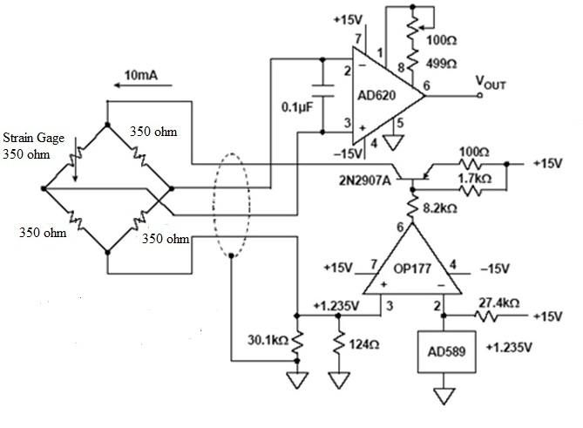
Signal Conditioning Circuit

Slide 14
Data Acquisition from Strain Gage
Divided into two parts:
Hardware for data acquisition
Software for data acquisition
Hardware – Output of measurement circuit is connected to analog pin Arduino UNO board
Software –
Matlab package to support Arduino IDE.
Upload matlab written srv.pde file into board
Run a script to read the analog pin of Arduino in Matlab

Slide 15
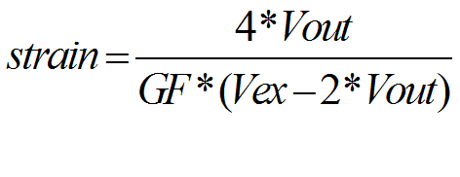
Strain Calculation from Signal Conditioning Output
Vout = Output voltage of signal conditioning circuit
GF = Gage factor = 2
Vex = Excitation voltage = 1200mV

Slide 16
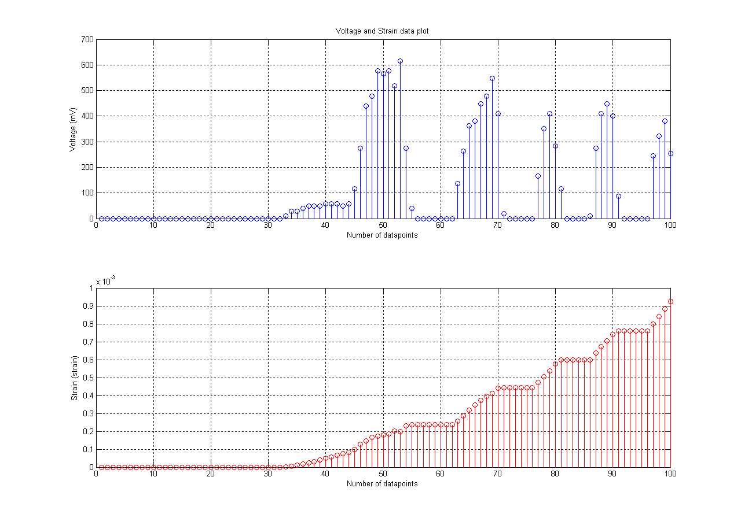
Strain Gage Graph

Slide 17
Application Software
Fruit ripeness checker, rubber ball hardness test
Simple Algorithm
Start of Program
Take user input of force and strain data
Make force data into stress data by dividing the force with area
Find Young’s modulus for each datapoint
Take the mean of Young’s modulus
Design a look up table of Young’s modulus vs Ripeness rating
Check the look up table for decision
Display a decision
End of Program

Slide 18
Application to Tactile Imaging System
Force sensor can be put around TIS probe to get the force applied in the neighboring region of tumor
Instead of a single FSR, four sensors might be used to get an improved force estimation, essentially hardness of tumor estimation
Improvement of force estimation will cost less than $100
Strain gage senses the dimension change of the surface it is mounted on. So it may give an indirect estimation of strain of tumor when force is applied.

Slide 19


