Slide 1
Functional Block Diagram
GUI
PRELAB
LAB
Theory
Pretest:
Theory
Simulation
With Q/A
Image
Processing
Safety
Video
Safety
Test
Hardware
Post
Test
Lab
Report
Steve
Sung
HELP
Videos
Pretest
Help
Simulation
Help
Hardware
Help
Post Test
Help
General
Help
Tal
SPEECH
Record
Speech
Process
Speech
Help
Interrupt
Sal
WEB
Prelab
(same as above)
Help
(same as above)

Slide 2
Text Input
Pre-Test Database
Simulation Database
Get help request source & question string
Grab corresponding database
Analyze question & answers database
Hardware Database
Post-Test Database
General Database
Q&A Analysis
Return string containing answer & link for video/pictures
Text Output
Home

Slide 3
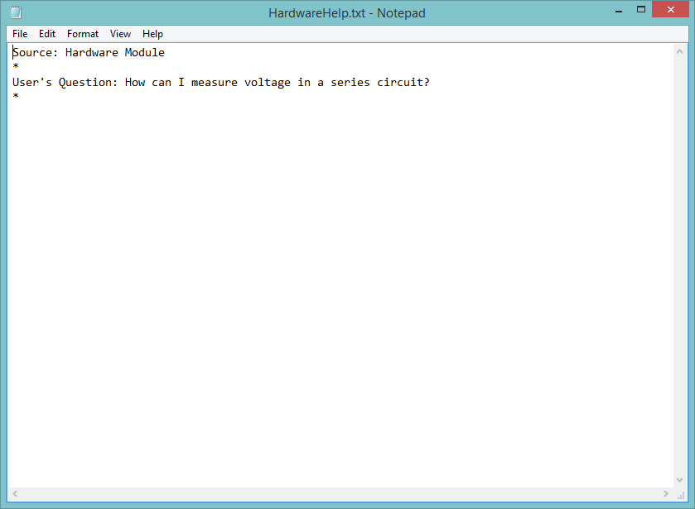
Example Text Input
Back

Slide 4
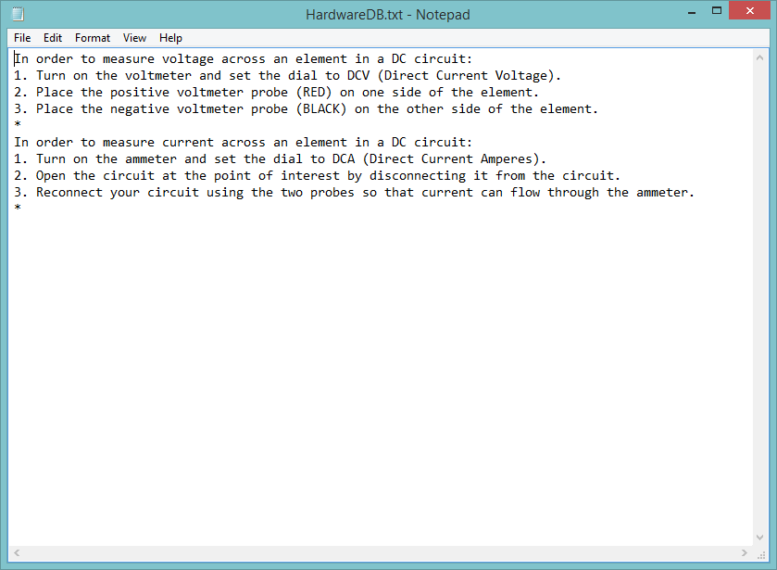
Example Hardware Database
Back

Slide 5
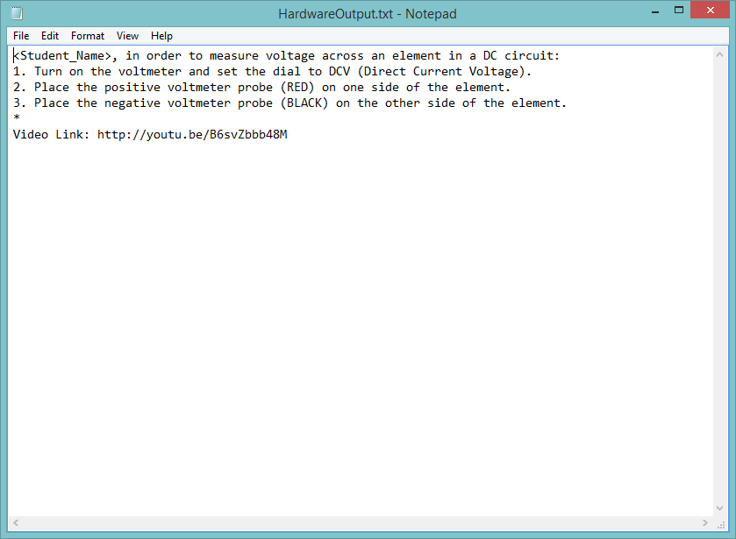
Example Text Output
Back

Slide 6
Question & Answers Database Analysis Module
Input
Take question string & answers string
Chop
Separate each word
Store
Save individual words into array
Search
Find keywords in array
Compare
Match question keywords with corresponding answer keywords
Output
Return proper string with file/link/text
Back

Slide 7
