Slide 1


The Pitchers Friend
Fire Ants

Slide 2

Who Do we want to break Down like a Fraction?
Daniel Murphy
Mike Trout
DJ LeMahieu
Jose Altuve
Wilson Ramos
Xander Bogaerts
Martin Prado
David Ortiz
Carlos Gonzalez
Ian Desmond

Slide 3
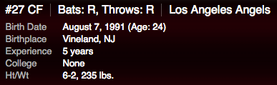
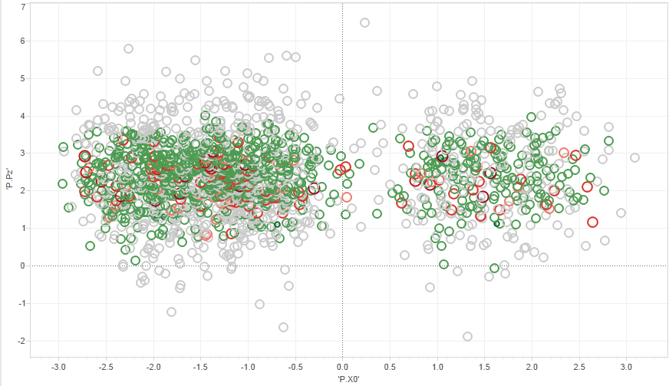
Mike Trout
Expected Hitter Values
Last Dozen Outcomes
Outcome | Count | Vs Pitcher
Walk | 3-2 | Hamels
Hit By Pitch | 1-2 | Hamels
Intentional Walk | 3-0 | Scherzer
Double | 1-1 | Scherzer
Home Run | 2-1

