Slide 1

Project 1
B Tree
張賢宗

Slide 2
Description
Program Name: btree
A B Tree structure which stores a lots of URLs as keys in the disk.
Syntax: btree [operation] DIR_OF_BTREE
  If the specified DIR_OF_BTREE is empty, create the necessary data/file for your own b tree.
  If no operation specified, output the basic information of your b tree. At least includes
    Minimum Degree
    Total Nodes
    Total Keys
    Height
B-Tree
115/11/07

Slide 3
Description II
  Operation
    -i URL
      Add URL into the B Tree
    -d URL
      Delete URL from the B Tree
    -q URL
      Query if URL exists in the B Tree
    -I FileName
      Add URLs in the FileName into the B Tree
    -D FileName
      Delete URLs in the FileName from the B Tree
    -Q FileName
      Query if URL in the FileName exists in the B Tree
B-Tree
115/11/07

Slide 4
Description III
Output
  If the operation is successfully executing, output “OK”.
  If any problem occurs, output reasonable string to notify user.
  If the operation is query, you should output as following
    If the URL exists in the B Tree
      O\tURL
    If the URL does not exist in the B Tree
      X\tURL
B-Tree
115/11/07

Slide 5
Definition
#define DISK_BLOCK_SIZE 16*1024
#define MAX_URL_SIZE 128
#define MINIMUM_DEG ((int)(DISK_BLOCK_SIZE-2*sizeof(int)+MAX_URL_SIZE)/(2*(MAX_URL_SIZE+sizeof(int))))
#define PADDING
DISK_BLOCK_SIZE-2*sizeof(int)-2*(MINIMUM_DEG2)*MAX_URL_SIZE+MAX_URL_SIZE-2*sizeof(int)*(MINIMUM_DEG2)
typedef struct stBT_NODE{
int iNumber;
int isLeaf;
char pszaKeys[2*MINIMUM_DEG-1][MAX_URL_SIZE];
unsigned int iaChildren[2*MINIMUM_DEG];
char pszPadding[PADDING];
}BT_NODE;
B-Tree
115/11/07

Slide 6
Definition II
iNumber stores the number of keys in the node
isLeaf stores if the node in the leaf
pszaKeys stores the URL keys
  Each URL key is length of MAX_URL_SIZE-1
iaChildren stores the number in the file pointer to children
  The number is the B Tree Node sequence in the file, the real offset of the node will be DISK_BLOCK_SIZE*iaChildren [i]
pszPending is useless, it makes the structure size become DISK_BLOCK_SIZE
B-Tree
115/11/07

Slide 7
Definition III
Files in the DIR_OF_BTREE
  bt.meta stores the information of your B Tree
  bt.nodes stores the nodes in the B Tree
  bt.del stores the B Tree Node sequence which is deleted
B-Tree
115/11/07

Slide 8
Definition IV
If you need a new B Tree Node to store the URLs.
  You must first check the bt.del file. If there exists a deleted block, you must use it first.
  Otherwise, you can expand the file to yield a new node.
If you need to delete a node due to the deletion operation
  You don’t need to really delete the node, just write the B Tree Node sequence into the bt.del file.
B-Tree
115/11/07

Slide 9
Due Date
2008 06/18
Demo to course TA
Mail a doc/pdf report to ds@widelab.org
  程式說明/完成功能
  你的程式架構
  遇到的問題與解決方法
  心得
Final Project
115/11/07

Slide 10
配分方式
Score
  Correctness 80%
  Codes 10%
  Reports 10%
Delay
  -5% per day for first 5 days.
  -10% per day for more or equal to 6 days.
B-Tree
115/11/07

Slide 11

Btree Homework
B-Tree
115/11/07

Slide 12
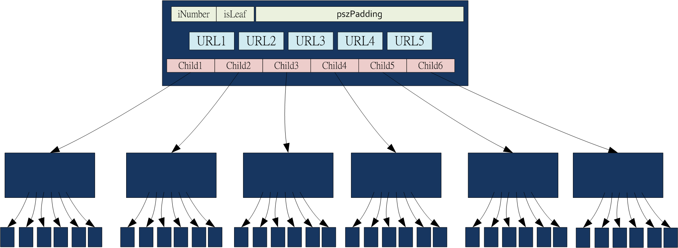
Btree
MINIMUM_DEGREE = 3,
# of Keys = 2~5
# of Children = 3~6
B-Tree
115/11/07

Slide 13
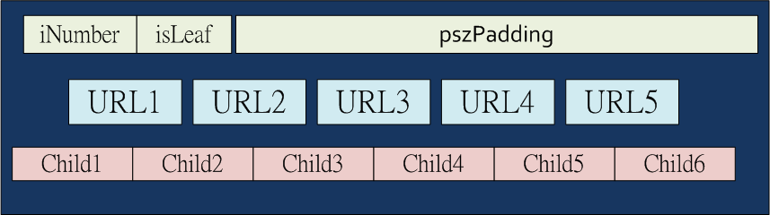
其中一個 Node 定義
typedef struct stBT_NODE{
int iNumber;
int isLeaf;
char pszaKeys[2*MINIMUM_DEG-1][MAX_URL_SIZE];
unsigned int iaChildren[2*MINIMUM_DEG];
char pszPadding[PADDING];
}BT_NODE;
B-Tree
115/11/07

Slide 14
怎麼設定 Minimum Degree？ (t)
B Tree 被發明出來的原因就是為了讓每個 Node Size 相當於一次 Disk Read 的 Size，因此一個 Node的 Size 會被定義為一個 Disk Block Size。
如果
  一個 Disk Block Size = 16KBytes
  每個 Key 需要 128 Bytes 存放
  每個 ChildPointer 需要 4 Bytes 存放
  一個 Node 最多可以放 2t-1 Keys
  一個 Node 最多可以放 2t ChildPointer
B-Tree
115/11/07

Slide 15
怎麼設定 Minimum Degree？ (t)
那 t=?
16KBytes =
  128* (2t-1) Keys
  + 4 * 2t ChildPointers
  + 4 # of Keys
  + 4 isLeaf
t= (16K+128-8)/264 = 62.51515151….
t=62
少掉的 0.5151515… 用 padding 補
B-Tree
115/11/07

Slide 16
Definition
#define DISK_BLOCK_SIZE 16*1024
#define MAX_URL_SIZE 128
#define MINIMUM_DEG ((int)(DISK_BLOCK_SIZE-2*sizeof(int)+MAX_URL_SIZE)/(2*(MAX_URL_SIZE+sizeof(int))))
#define PADDING
DISK_BLOCK_SIZE-2*sizeof(int)-2*(MINIMUM_DEG2)*MAX_URL_SIZE+MAX_URL_SIZE-2*sizeof(int)*(MINIMUM_DEG2)
typedef struct stBT_NODE{
int iNumber;
int isLeaf;
char pszaKeys[2*MINIMUM_DEG-1][MAX_URL_SIZE];
unsigned int iaChildren[2*MINIMUM_DEG];
char pszPadding[PADDING];
}BT_NODE;
B-Tree
115/11/07

Slide 17
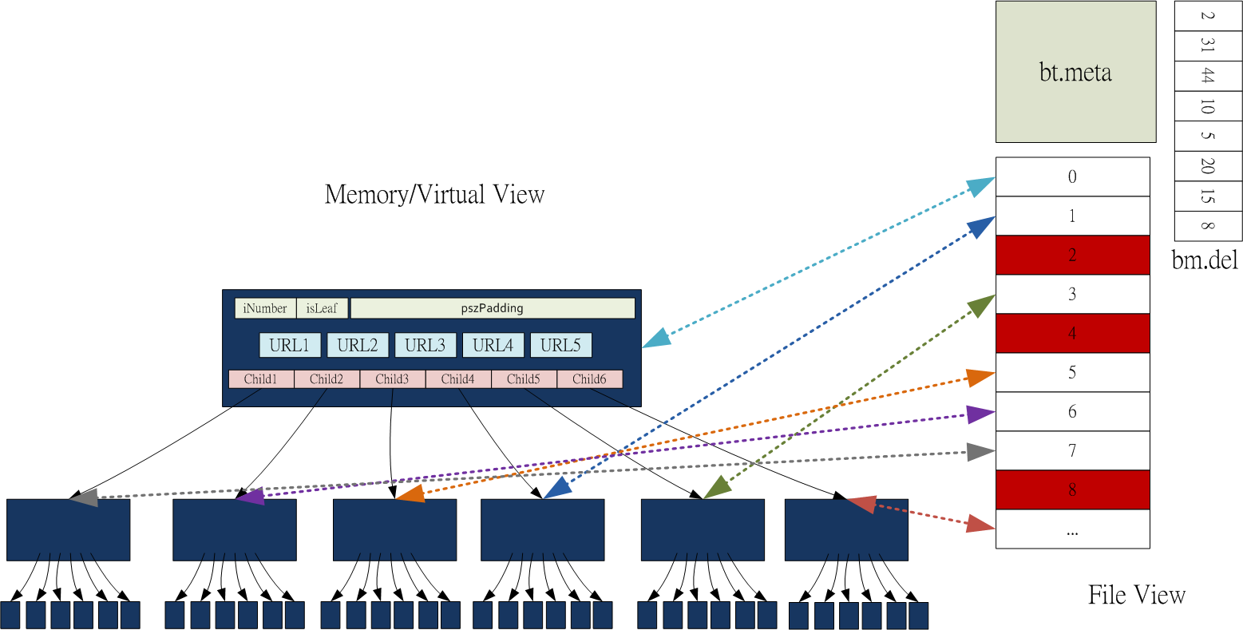
File Structure
B-Tree
115/11/07

Slide 18
檔案：bt.meta
紀錄 Btree 的資訊
  # of nodes
  # of keys
  Height
  RootNode <如果永遠使用 0 當 root，則此資訊沒有必要存放>
  MINIMUM_DEGREE
  NODE_SIZE
  …. （其他你認為需要的資訊）
每次 Delete or Insert
  就必須修改 bt.meta
B-Tree
115/11/07

Slide 19
檔案：bt.nodes
用來存放所有 Btree 的 nodes
bt.nodes 中每個 nodes 的位置為他的編號
Root 存放在第一個位置，編號為 0
B-Tree
115/11/07

Slide 20
檔案：bt.nodes
使用某一個 nodes 必須從檔案中讀出
例如想要讀取編號 15 號的 node
ifstream bt;
BT_NODE btNode;
bt.open(“DIR_OF_BTREE/bt.nodes”, ios ::binary|ios::in);
bt.seekg( (15) * DISK_BLOCK_SIZE, ios::beg);
bt.read( &btNode, DISK_BLOCK_SIZE);
B-Tree
115/11/07

Slide 21
檔案：bt.nodes
nodes 15 修改後，必須寫回 bt.nodes
ofstream bt;
bt.open(“DIR_OF_BTREE/bt.nodes”, ios ::binary| ios ::in|ios::out);
bt.seekp( 15 * DISK_BLOCK_SIZE, ios_base::beg);
bt.write( &btNode, DISK_BLOCK_SIZE);
B-Tree
115/11/07

Slide 22
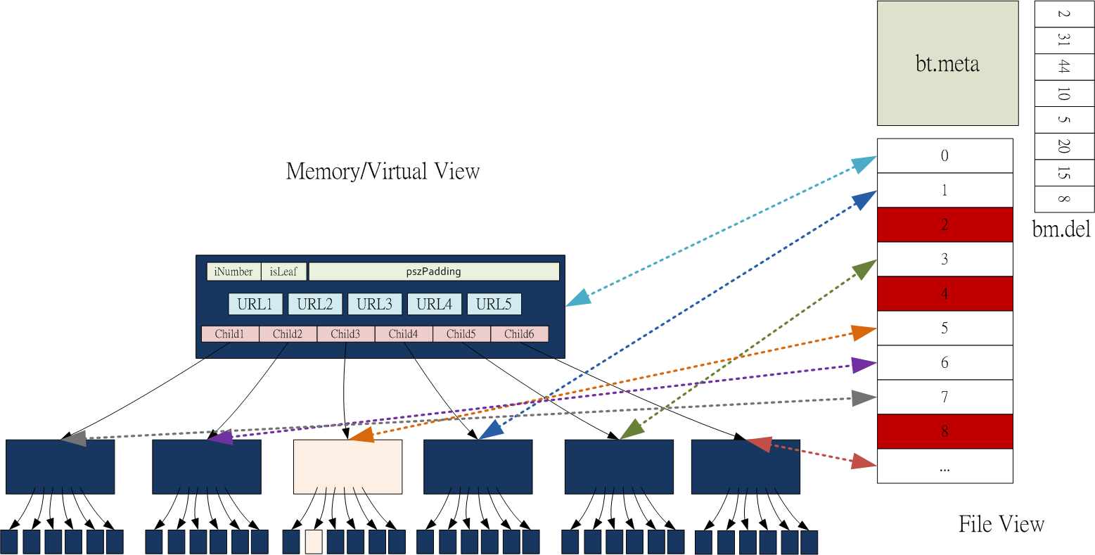
Query
Read node 0, Read node 5, Read node 42
B-Tree
115/11/07

Slide 23
Insertion:
先塞到葉子裡，任何時候如果某個節點滿了，則一分為二，並且把正中間的key拉到上一層，讓上面一層來的指標一分為二。
l
k
e
y
s
l
+
1
k
e
y
s
2
t
-
1
k
t
-
1
k
e
y
s
t
-
1
k
e
y
s
e
y
s
B-Tree
115/11/07

Slide 24
10
20
30
40
21
22
23
24
25
B-Tree
115/11/07

Slide 25
10
20
23
30
40
21
22
24
25
B-Tree
115/11/07

Slide 26
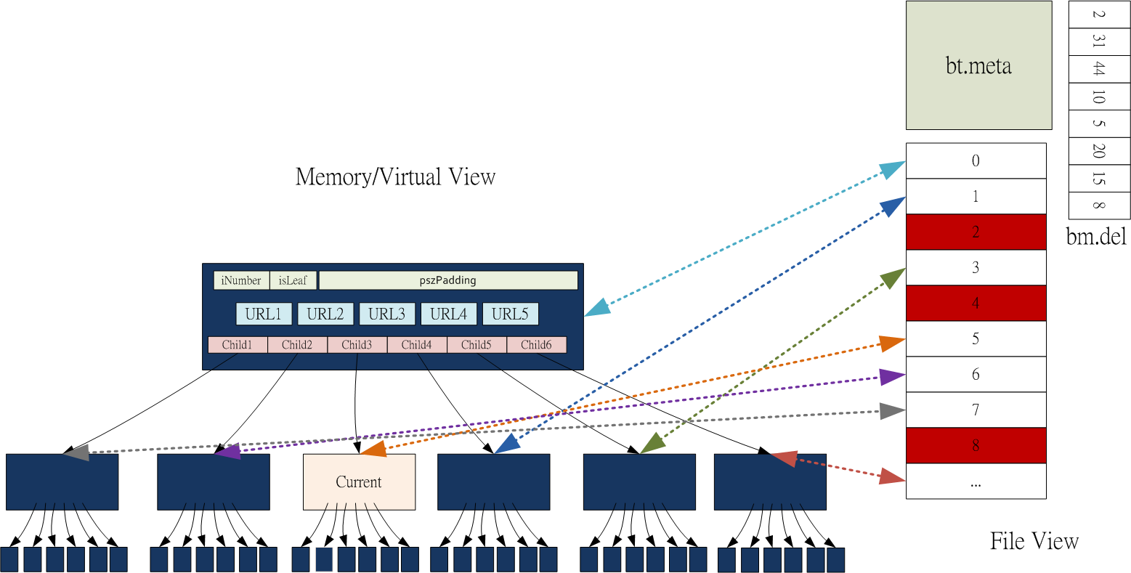
Insertion
B-Tree
115/11/07

Slide 27
Insertion
Read nodes root
  Compare and follow Child3 Pointer (5)
Read node 5
  Found # of Keys == 2t-1
Separate node 5
  Create a new node ( node # = # of nodes +1)
  Copy last t-1 keys to new node
  Modify parent node
  Write back parent, current, new nodes
  Continue
  Update bt.meta
B-Tree
115/11/07

Slide 28
Delete a Key
自己思考…
B-Tree
115/11/07

Slide 29
檔案：bt.del
當有一個 node 被 Delete 後
檔案 bt.nodes，除修改必要的 Child Pointers
不必理會被 Delete 的 node
紀錄 該 node # 於檔案 bt.del 中
B-Tree
115/11/07

Slide 30
檔案： bt.del
在 Insertion 需要一個新的 node
如果 bt.del 檔案裡面還有 “存貨”
  # of new node = bt.del 檔案裡面的存貨
如果 bt.del 檔案裡面已經沒有存貨了
  # of new node = # of nodes +1
B-Tree
115/11/07

Slide 31
因此…
整個程式並不會把整棵 Btree 讀到記憶體中
每次只會讀取需要的 nodes 即可
  一般僅有 2 個 Nodes 在記憶體內
  除非有分裂、合併時會有 3~4 Nodes 在記憶體內（看程式寫法）
已經讀取但是不需要的 nodes 可以還給系統或是重複使用
B-Tree
115/11/07

Slide 32
程式的 Performance
不是這次程式的重點
是挑戰的重點
  bt.meta 何時寫入？
  One/two pass insert or delete
  如何減少 Read/Write node 次數
  …
B-Tree
115/11/07

