Slide 1
Gparted 使用步驟

Slide 2
Outline
使用情況
如何使用Gparted
Install step
Using step

Slide 3
使用情況
當想要將windows或linux系統的硬碟空間(大小)重新分配,但又不想重灌系統時
新增硬碟要格式化配置空間時

Slide 4
如何使用Gparted
Linux系統可用apt-get install安裝,這邊以Live CD開機的方式使用
!!! 不可以有snapshot, 原因大概是因為snapshot前後的硬體配置設定不同會導致讀取時有問題…所以最好是備份必要的東西到其它地方,並且將snapshot全部刪除

Slide 5
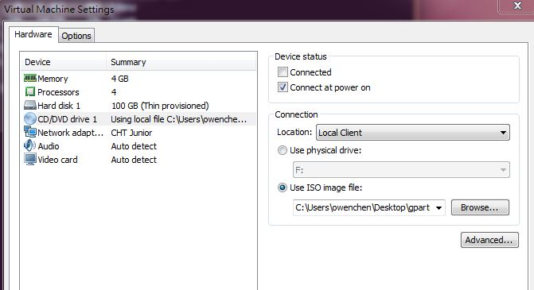
Install step
Download iso data:
https://gparted.org/download.php -- download latest version
Ensure already expand disk storage and not allocated
Ensure VM setting has already insert iso into CD-ROM

Slide 6
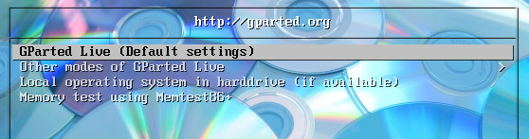
Install step (cont.)
Restart VM (Enter F2 to enter BIOS)
Alter to boot from CD-ROM, then F10 to save setting
When reboot , the below screen will appear
Choose default and then choose some options in next page

Slide 7
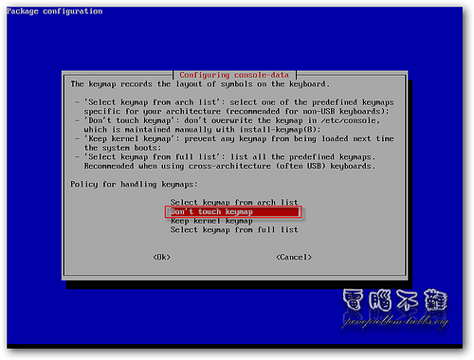
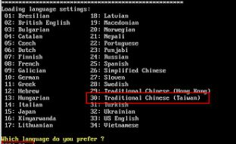
Install step
Choose “Don’t touch keymap”
Then, choose language (traditional Chinese: 30, US English: 33)

Slide 8
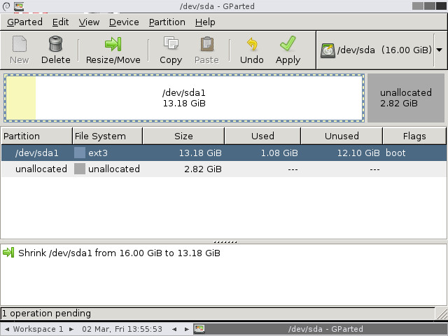
Using step
Enter Gparted screen, then will show the disk partition like below
You will have a diskspace( /dev/sda1) and unallocated area, possibly it will also have a swap/extend area between the two areas
!!! If we want to reallocated the space of original one and unallocated, they must be neighbors

Slide 9
Using step
If there are swap/extend area between the others, we have to do below steps
Choose swap area and right-click choose delete
Choose extend area and also delete
At this time, /dev/sda1 and unallocated area should be neighbor. Then choose /dev/sda1 and right-click choose Resize/Move to resize the space , remind to remain 2~4G space for swap use
After setting the space , the remain unallocated will be new a partition and choose to be linux/swap space
Press the Apply botton to activate setting
!!! If press apply botton , then windows disappear. Try again from beginning and choose US English language

