Slide 1
10 malware static statistics

Slide 2
Outline
Filetype , Filesize , ISA(指令集架構)
Hash value
Header
Virustotal
Strings
Packers
Symbol table
Capabilities
Dependency

Slide 3
File type & File size & ISA (malware)
Type : use ‘file’ command and search type column -> 10 malware are all EXEC (executable file)
Size : use ‘ls –l –h’ command and find the size is between 85k and 126k
ISA : 10 malware are different with each other like x86, MIPS, ARM …
Type | EXEC (executable file)
 | 80k~90k | 85k, 87k, 88k, 88k | 4
Size | 100k~110k | 101k,101k,102k,107k | 4
 | > 120k | 122k,126k | 2
ISA | ARM, x86_64, Renesas SH, sparc, 80386, MIPS |  | 6
 | Motorola m68k ,Power pc |  | 4
40%
40%
20%

Slide 4
File type & File size & ISA (normal)
Type | EXEC (executable file)
 | < 100k | 11k,11k,11k,15k,15k,15k,20k,23k,24k,31k,31k,31k,47k, 51k,55k,55k,59k,63k,91k,96k | 20
Size | > 100k | 109k,148k,148k,167k,189k,207k,368k,488k | 8
 | > 1000k | 1014k , 1900k | 2
ISA | x86_64 |  | 30
67%
27%
6%

Slide 5
Hash value
Filename | Md5 hash | Fuzzy hash (ssdeep hash)
00ac5b2b1a16314b9861e22a4e262847 | 00ac5b2b1a16314b9861e22a4e262847 | 3072:NkOtoPkqlHfSFgM9152bsB1Xo+rrXigN79iy91jefYMW3bBDI3NvHKmDrqQudz4v:Nevy9EfYMW3eqmDrqQudz40uYs
00cc269bbaac4846b62ef0afd2989187 | 00cc269bbaac4846b62ef0afd2989187 | 3072:cijd1sbPk6MI0lz6robtQyKpe287PQu5mmiU0xgucgkM6:caTs7krI0lz6vyK8PQu5mmiU0xgucgkR
00d85b064b98a44ccb5771a35dd8232b | 00d85b064b98a44ccb5771a35dd8232b | 3072:NMqUMTg1tXO1g6eNod9m+D3A9/RuImmsVYZLxEyxs:NMnNoPm+7A9/RuImmsVYZLxEyxs
00dd4ca79b38cd47553efb8264397299 | 00dd4ca79b38cd47553efb8264397299 | 1536:wbnLku3CLpTXkcWaWj8drcN0/qGS3QtHqiC7T/73rLYcoaIuOVj4yuGia:0F3CacWaLrcy/U34HMT7rLYcNIuOV0y3
00e7f3c48a9472bfa1a2a6e441cd9a11 | 00e7f3c48a9472bfa1a2a6e441cd9a11 | 1536:TAEfTAWLrhO0kgsP8GDfwh6DcQ+UfKSsBwbew7vP/EKIHUIN:TAELZnxspS6gQH/bew7vU7

Slide 6
Hash value (cont.)
Filename | Md5 hash | Fuzzy hash (ssdeep hash)
00fe6f23a6e9c4629ea7f906d3cd2f8b | 00fe6f23a6e9c4629ea7f906d3cd2f8b | 1536:zhkpXXB3ff5/Z/Ke9LlTEQX7KqpFsYNQIsV5wtwHUIe:NyHB3friolTEQXOGdQPwtl
0a2aa8ac9b3ca7aacf9886f66dbd89e9 | 0a2aa8ac9b3ca7aacf9886f66dbd89e9 | 3072:0IYVFnuB+9FR2O/oh36hQJi8ImxjVRAVRDSF2:0IYO+zRCh36aiTmxjVRAVRDSF2
0a40baeca42086eb11bd0911cef2033d | 0a40baeca42086eb11bd0911cef2033d | 1536:ygZumh7ei2QEjo958vWtmftiLgfzEjzUI8:V7CjoPzBuEo
0a4dadb84cabc51cb0c79fecebd8afc1 | 0a4dadb84cabc51cb0c79fecebd8afc1 | 1536:IAqPa0J8lJqYcWHsykQCEHvpfbqSG4wmJVbgm77ZVcTzP5pEmZW:sa0JWVMR3EHvp1/wLm3ZVcTzRpEmZW
0a8daaedb6511365debdddafbe5fa2fc | 0a8daaedb6511365debdddafbe5fa2fc | 1536:qxF4Pk8LCM6GsTlCnpRhmj6Ku2rKvacHf+8Je16T5hUQM82+ADURxdfNobtBfmgG:qeUGhacHf+8JT5yQMAcURxfobtBegypX

Slide 7
ssdeep value comparison
從前面的hash value 比較表可以得知,這10隻除了計算完後每塊單元的大小只有3072和1536這兩個值外,算出的value兩兩不相似
1 因為檔名過長,故以 前5碼代表
2 以compare函數出來的數值單位為%
 | 00ac5 | 00cc2 | 00d85 | 00dd4 | 00e7f | 00fe6 | 0a2aa | 0a40b | 0a4da | 0a8da
00ac5 |  | 0 | 0 | 0 | 0 | 0 | 0 | 0 | 0 | 0
00cc2 | 0 |  | 0 | 0 | 0 | 0 | 0 | 0 | 0 | 0
00d85 | 0 | 0 |  | 0 | 0 | 0 | 0 | 0 | 0 | 0
00dd4 | 0 | 0 | 0 |  | 0 | 0 | 0 | 0 | 0 | 0
00e7f | 0 | 0 | 0 | 0 |  | 0 | 0 | 0 | 0 | 0
00fe6 | 0 | 0 | 0 | 0 | 0 |  | 0 | 0 | 0 | 0
0a2aa | 0 | 0 | 0 | 0 | 0 | 0 |  | 0 | 0 | 0
0a40b | 0 | 0 | 0 | 0 | 0 | 0 | 0 |  | 0 | 0
0a4da | 0 | 0 | 0 | 0 | 0 | 0 | 0 | 0 |  | 0
0a8da | 0 | 0 | 0 | 0 | 0 | 0 | 0 | 0 | 0
Notes:
Next step : 看normal sample是否能有不同的單元大小

Slide 8
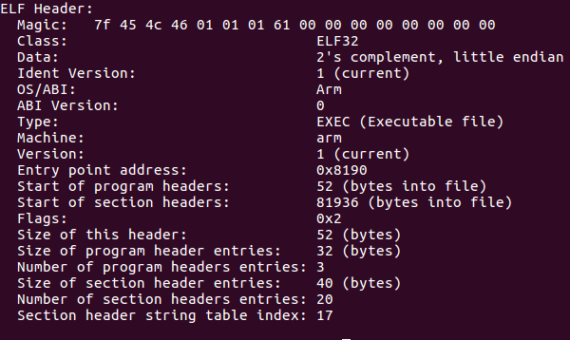
Header – ELF header
Red: different with sample
Size of header and program header changes with class(bits)
Number of Section headers and section header index are different with samples
The same element is list below : Ident version, Type, ABI version, version

Slide 9
Header statistics
Magic number | First 4 number : 7f 45 4c 46 => ELF 全部相同 5th number : (32-bit: 1) : 9 , (64-bit: 2) : 1 6th number : (LSB: 1) : 4 , (MSB: 2) : 6 7th number: 必定是1 , 8th開始為padding,無特定規則
Data | LSB(Little-endian): 4 | MSB(Big-endian): 6
Start of program header (1) Size of this header(2) Size of program header entries(3) | If 32-bits : 52 ,52 ,32 (bytes) : 9 If 64-bits : 64 ,64, 56 (bytes) : 1
Size of section header entries | If 32-bits: 40 (bytes) : 9 , if 64-bits: 64 (bytes) : 1
Number of section entries (1) Section header string table index(2) | If malicious , the 2 parameters are confused, but if normal , the parameters are ordered (34,33)=1, (31,30)=1 , (30,29)=1, (29,28)=16 , (28,27)=8 , (27,26)=3

Slide 10
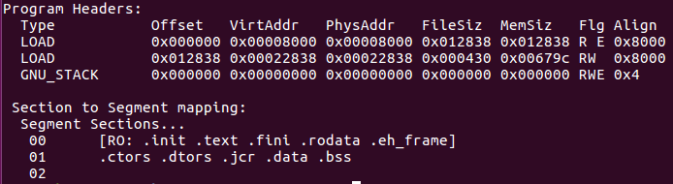
Header – program header (malware)
Malware sample all have 2 LOAD , each shows text segment or data segment
We summary the Filesize of LOAD of each sample
 | mal1 | mal2 | mal3 | mal4 | mal5 | mal6 | mal7 | mal8 | mal9 | mal10
LOAD₁ | 75832 | 98376 | 78108 | 58552 | 67708 | 67180 | 77948 | 79476 | 61732 | 92984
LOAD₂ | 1072 | 1364 | 1072 | 1936 | 948 | 968 | 1272 | 972 | 988 | 2804
% | 70.7 | 72.1 | 72.9 | 30.2 | 71.4 | 69.4 | 61.2 | 81.8 | 62.5 | 33.2
30~40 : 2
60~70 : 3
71~80 : 4
>80 : 1
% = LOAD₁/LOAD₂
Notes:
Program header table 是程式要能執行的重要資訊,紀錄 ELF image 裡的 'segment' 分佈

Slide 11
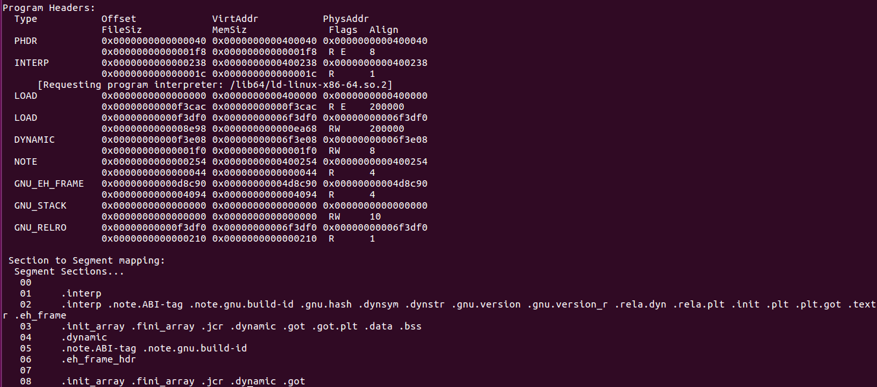
Header – program header (normal)
Obviously, more than 2 LOAD diff. from malware
We also compute all size of LOAD of samples to compare with malware

Slide 12
Header – program header (normal)
% = LOAD₁/LOAD₂
 | nor1 | nor2 | nor3 | nor4 | nor5 | nor6 | nor7 | nor8 | nor9 | nor10
LOAD₁ | 998572 | 27420 | 1947287 | 27420 | 27420 | 8012 | 45932 | 8860 | 56052 | 51644
LOAD₂ | 36504 | 1024 | 8686 | 1024 | 1024 | 720 | 1252 | 808 | 1252 | 1188
% | 27.3 | 26.8 | 224.2 | 26.8 | 26.8 | 11.1 | 36.7 | 11.0 | 44.8 | 43.5
<10 : 5
10~20 : 9
21~30 : 4
31~40 : 5
41~50 : 5
> 50 : 2
 | nor11 | nor12 | nor13 | nor14 | nor15 | nor16 | nor17 | nor18 | nor19 | nor20
LOAD₁ | 58452 | 4764 | 143676 | 17972 | 204164 | 90452 | 171948 | 11708 | 351596 | 479424
LOAD₂ | 1252 | 672 | 1940 | 1616 | 4320 | 2468 | 15256 | 888 | 20312 | 13552
% | 46.7 | 7.1 | 74.1 | 11.1 | 47.3 | 36.7 | 11.3 | 13.2 | 17.3 | 35.4
 | nor21 | nor22 | nor23 | nor24 | nor25 | nor26 | nor27 | nor28 | nor29 | nor30
LOAD₁ | 6052 | 19092 | 141500 | 152260 | 5140 | 13124 | 49308 | 67772 | 43476 | 86316
LOAD₂ | 672 | 1012 | 4696 | 14140 | 652 | 2060 | 1232 | 40192 | 2592 | 2628
% | 9.0 | 18.9 | 30.1 | 10.8 | 7.9 | 6.4 | 40.0 | 1.7 | 16.8 | 32.8

Slide 13
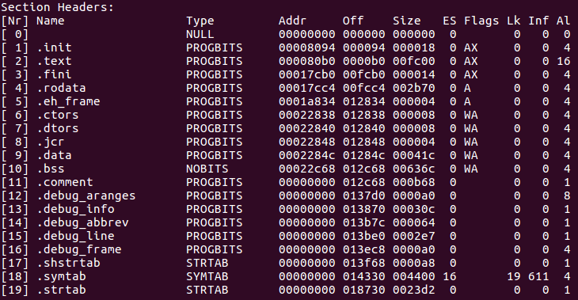
Header – section header
Red: 10 malware common section headers
We statistic the common name and its size

Slide 14
Header – section header
共同section name (malware) : init , text , fini , rodata , ctors , dtors , eh_frame , jcr , data , bss , comment , shstrtab , symtab , strtab
共同section name (normal): interp , note.ABI-tag , note.gnu build-i , gnu.hash , dynsym , dynstr , gnu.version, gnu.version_r , rela_dyn , rela_plt , init , plt , plt.got , text , fini , rodata , eh_frame_hdr , eh_frame , init_array , fini_array , jcr , got , got.plt , data , bss , shstrtab
ctors: This section contains a list of global constructor function pointers
dtors: This section contains a list of global destructor function pointers
從只有malware才有ctors 和 dtors這兩個section name, 可以猜測只有malware在程式開頭會以constructor定義自身元素,最後再執行destructor
Notes:
ctors , dtors, comment: This section holds version control information
, symtab: This section holds a symbol table , strtab:This section holds strings, most commonly the strings that represent the names associated with symbol table entries

Slide 15
Header – section header
bytes
 | mal1 | mal2 | mal3 | mal4 | mal5 | mal6 | mal7 | mal8 | mal9 | mal10
.init | 24 | 20 | 36 | 19 | 20 | 36 | 48 | 28 | 28 | 140
.text | 64512 | 80084 | 66732 | 46712 | 60592 | 59896 | 63936 | 71924 | 51300 | 81312
.fini | 20 | 14 | 32 | 14 | 14 | 32 | 36 | 20 | 23 | 92
.rodata | 11120 | 18104 | 11152 | 11537 | 60592 | 7064 | 13748 | 7352 | 10208 | 11700
.ctors | 8 | 8 | 8 | 16 | 8 | 8 | 8 | 8 | 8 | 8
.dtors | 8 | 8 | 8 | 16 | 8 | 8 | 8 | 8 | 8 | 8
.eh+_frame | 4 | 4 | 4 | 4 | 4 | 4 | 4 | 4 | 4 | 4
.jcr | 4 | 4 | 4 | 8 | 4 | 4 | 4 | 4 | 4 | 4
.data | 1052 | 1344 | 976 | 1896 | 928 | 884 | 1236 | 952 | 928 | 1536
.bss | 25452 | 25452 | 25328 | 27472 | 24932 | 24820 | 25452 | 24952 | 26340 | 25508
.comment | 2920 | 2952 | 2934 | 2628 | 2328 | 2376 | 2934 | 2214 | 2970 | 2934
.shstrtab | 168 | 102 | 115 | 102 | 102 | 115 | 107 | 220 | 111 | 141
.symtab | 17408 | 12064 | 11584 | 16704 | 10144 | 9952 | 11728 | 10272 | 11696 | 11632
.strtab | 9170 | 9130 | 8760 | 8567 | 7498 | 7303 | 8875 | 7606 | 8819 | 8794

Slide 16
VirusTotal
According the AV –Test report in 2018, we choose several top manufacturers report as the statistical target: AVG , G-Data , Tencent
Filename | Imported symbol | Judgement | Refenence
00ac5b2b1a16314b9861e22a4e262847 | __deregister_frame_info _Jv_RegisterClasses __register_frame_info __pthread_initialize_minimal | Trojan , Backdoor , Gafgyt | ELF:DDoS-S [Trj] Linux.Trojan.Gafgyt.A Linux.Backdoor.Gafgyt.Duy
00cc269bbaac4846b62ef0afd2989187 | __deregister_frame_info _Jv_RegisterClasses __register_frame_info __pthread_initialize_minimal | Trojan , Backdoor , Gafgyt | ELF:DDoS-Y [Trj] Linux.Trojan.Gafgyt.B Trojan.Linux.Gafgyt.taa
00d85b064b98a44ccb5771a35dd8232b | The same as above | Trojan , Backdoor , Gafgyt | ELF:DDoS-Y [Trj] Linux.Trojan.Gafgyt.A Linux.Backdoor.Gafgyt.Eyi
00dd4ca79b38cd47553efb8264397299 | The same as above | Trojan , Backdoor , Gafgyt | ELF:Gafgyt-BU [Trj] Linux.Trojan-DDoS.Lightaidra.A Backdoor.Linux.Gafgyt.ye
Notes:
https://3c.yipee.cc/120160/av-test-%E5%85%AC%E4%BD%88-2018-%E5%B9%B4-1-%E6%9C%88-android-%E5%B9%B3%E5%8F%B0%E6%9C%80%E4%BD%B3%E8%B3%87%E5%AE%89%E9%98%B2%E6%AF%92%E8%BB%9F%E9%AB%94%E6%8E%92%E8%A1%8C%E6%A6%9C

Slide 17
Filename | Imported symbol | judgement | reference
00e7f3c48a9472bfa1a2a6e441cd9a11 | __deregister_frame_info _Jv_RegisterClasses __register_frame_info __pthread_initialize_minimal __h_errno_location | Trojan , Backdoor , Gafgyt | ELF:DDoS-Y [Trj] Linux.Trojan.Gafgyt.B Trojan.Linux.Gafgyt.taa
00fe6f23a6e9c4629ea7f906d3cd2f8b | The same as the above | Backdoor , Gafgyt | ELF:DDoS-Y [Trj] Gen:Variant.Backdoor.Linux.Gafgyt.1 Linux.Backdoor.Gafgyt.Fsg
0a40baeca42086eb11bd0911cef2033d | The same as the above | Trojan , Backdoor , Gafgyt | ELF:Gafgyt-BU [Trj] Linux.Trojan.Gafgyt.B Linux.Backdoor.Gafgyt.Fhw
0a2aa8ac9b3ca7aacf9886f66dbd89e9 | __deregister_frame_info _Jv_RegisterClasses __register_frame_info __pthread_initialize_minimal | Trojan , Backdoor , Gafgyt | ELF:DDoS-Y [Trj] Linux.Trojan.Gafgyt.A Linux.Backdoor.Gafgyt.Eoo
0a4dadb84cabc51cb0c79fecebd8afc1 | The same as the above | Backdoor , Gafgyt | Linux/Fgt.BP Gen:Variant.Backdoor.Linux.Gafgyt.1 Linux.Backdoor.Gafgyt.Fij
0a8daaedb6511365debdddafbe5fa2fc | The same as the above | Trojan , Backdoor , Gafgyt | ELF:DDoS-Y [Trj] Linux.Trojan.Gafgyt.A Linux.Backdoor.Gafgyt.Gvt

Slide 18
Strings – ASCII and Unicode
指令strings 的參數 --encoding可以指定要以n-bit ASCII輸出,且模式中也有預設輸出Unicode的模式(={l,b})
當指定Unicode輸出(encoding=l or encoding =b)時,沒有任何output,只有指定輸出ASCII時有output
但是這種情況的output會含有所有的 section部份的strings(一般字串,symbol…)混在一起,判讀起來難度更高,也許會增加一些關鍵字,但是判讀不出來就沒有意義

Slide 19
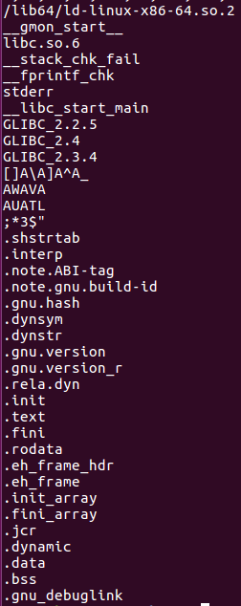
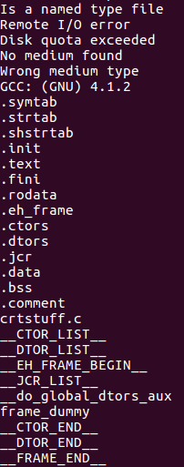
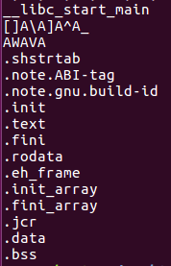
Normal common string
(>26隻共同擁有字串)
Malware common string (10)
Normal common string (30)
String of
symbol
Normal
string
String of
symbol
Normal
string
String of
Section
header
String of
section
header
String of
section
header
String of
symbol
Notes:
Section : symbol : normal
Malware: 14 : many : many
Normal: 13 : 1 : 2 (30)
Normal: 23 : 4 : 9 (26)

Slide 20
Strings
因此, 嘗試計算了共同section header , symbol , 一般string的個數
由上表可以看出正常樣本, 因為彼此之間的用途差異, 在symbol和others的重疊率相當低, 一般字串重疊的部份也大多是使用的函式庫名稱(ex: libc.so.6 , GLIBC_2.3.4…)
 | Section header | symbol | others
Malware (10) | 14 | many | many
Normal (30) | 13 | 1 | 2
Normal (26) | 23 | 4 | 9

Slide 21

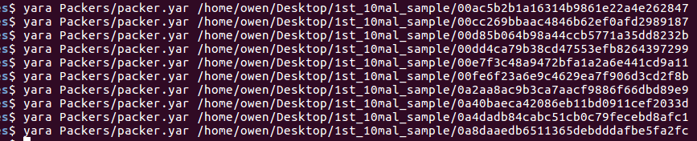
Packers – YARA_rules
For judge which packers the sample used, we download the github project YARA-rules and use the rule in the packers file to assist us
1st, show the rules can detect packers correctly
2nd, analyze the malware sample
Packer name
Sample name
Graph shows these samples are not packed by known packer inside packers

Slide 22
Symbol table
we separately collect symbol from text section, data section and rodata section(read-only) in 10 malware
The below shows the symbols that all malwares have
Common symbol in data section:
__atexit_lock
__CTOR_END__
__CTOR_LIST__
__data_start
__dso_handle
__DTOR_END__
__DTOR_LIST__
__JCR_END__
__JCR_LIST__
mylock
randtbl
_stdio_openlist_add_lock
_stdio_openlist_del_lock
_stdio_streams
unsafe_state
Common symbol in rodata section:
__C_ctype_b_data
__C_ctype_toupper_data
.eh_frame
__EH_FRAME_BEGIN__
exp10_table
Fmt
__FRAME_END__
__GI___C_ctype_b_data
__GI___C_ctype_toupper_data
random_poly_info
.rodata
_string_syserrmsgs
type_codes
type_sizes
Notes:
Text section too many symbol , we can compute normal text section symbol to reduce

Slide 23
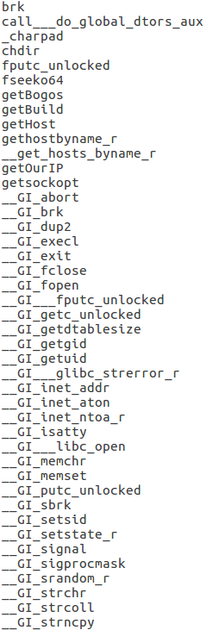
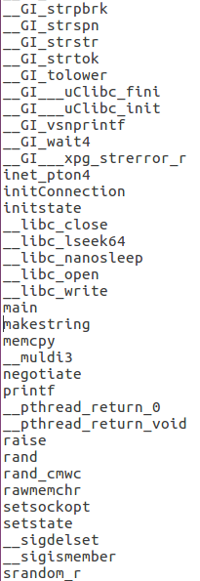
Symbol table
Common symbol in text section
Library_fun_call: 45
System call: 1
Memory 存取: 3
存取設定檔: 3
存取系統設定: 7
開關檔案: 4
R/W: 1
Delay : 2
Notes:
Library_fun_call : 40(GI) : 5(libc)
Syscall : 2 , mem存取: 3
存取設定檔: 3 , 存取系統資訊: 7
開關檔案: 4 , 延遲: 2

Slide 24
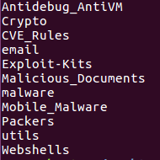
Malware capabilities – YARA_rules
There are other types of detection in the project YARA_rules
As the rules files list in left , there are other 10 types that can detect
Except the Mobile_malware which needs other relative tools , we run other 9 types for detecting ability of malware in the below
Utils file contains domain, ip, url , suspicious string…

Slide 25
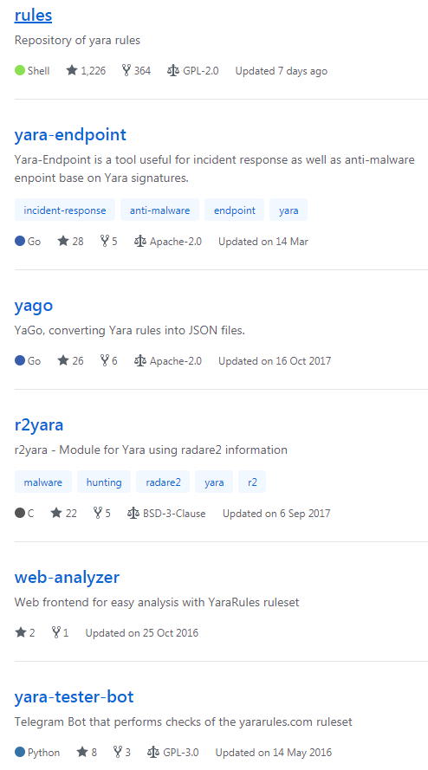
Malware capabilities – YARA_rules
For persuading other people that our statistical is convincible, we check the credibility of YARA_rules project in github
It shows that only this project use the shell. Besides , the stars is also the most among all 6 projects

Slide 26
Malware capabilities – yara_rules
 | mal1 | mal2 | mal3 | mal4 | mal5 | mal6 | mal7 | mal8 | mal9 | mal10
Anti_VM Anti_debug | 0 | 0 | 0 | 0 | 0 | 0 | 0 | 0 | 0 | 0
crypto | 0 | 0 | 0 | 0 | 0 | 0 | 0 | 0 | 0 | 0
CVE_rules | 0 | 0 | 0 | 0 | 0 | 0 | 0 | 0 | 0 | 0
email | 0 | 0 | 0 | 0 | 0 | 0 | 0 | 0 | 0 | 0
Exploit-kits | 0 | 0 | 0 | 0 | 0 | 0 | 0 | 0 | 0 | 0
Malicious-documents | 0 | 0 | 0 | 0 | 0 | 0 | 0 | 0 | 1 | 0
malware | 0 | 0 | 0 | 0 | 0 | 0 | 0 | 0 | 0 | 0
Utils | 4 | 4 | 4 | 4 | 4 | 4 | 4 | 4 | 4 | 4
Webshells | 0 | 0 | 0 | 0 | 0 | 0 | 0 | 0 | 0 | 0
For malicious-document: getEIP
For utils: base64 , Domain , ip ,url
Notes:
maldoc_getEIP_method_1
contentis_base64,Domain,ip,url

Slide 27
Normal capabilities – YARA_rules
 | nor1 | nor2 | nor3 | nor4 | nor5 | nor6 | nor7 | nor8 | nor9 | Nor10
Anti_VM Anti_debug | 0 | 0 | 0 | 0 | 0 | 0 | 0 | 0 | 0 | 0
crypto | 0 | 0 | 6 | 0 | 0 | 0 | 0 | 0 | 0 | 0
CVE_rules | 0 | 0 | 0 | 0 | 0 | 0 | 0 | 0 | 0 | 0
email | 0 | 0 | 0 | 0 | 0 | 0 | 0 | 0 | 0 | 0
Exploit-kits | 0 | 0 | 0 | 0 | 0 | 0 | 0 | 0 | 0 | 0
Malicious-documents | 0 | 0 | 0 | 0 | 0 | 0 | 0 | 0 | 0 | 0
malware | 0 | 0 | 0 | 0 | 0 | 0 | 0 | 0 | 0 | 0
Utils | 4 | 2 | 4 | 2 | 2 | 2 | 3 | 2 | 3 | 3
Webshells | 0 | 0 | 0 | 0 | 0 | 0 | 0 | 0 | 0 | 0
Packer | 0 | 0 | 0 | 0 | 0 | 0 | 0 | 0 | 0 | 0
Notes:
Crypto : CRC32b_poly_Constant , MD5_Constants, RIPEMD160_Constants, SHA1_Constants, SHA512_Constants, BASE64_table
Utils: contentis_base64, domain (必有) url, Misc_Suspicious_Strings (optional)

Slide 28
Normal capabilities – YARA_rules
 | nor11 | nor12 | nor13 | nor14 | nor15 | nor16 | nor17 | nor18 | nor19 | Nor20
Anti_VM Anti_debug | 0 | 0 | 0 | 0 | 0 | 0 | 0 | 0 | 0 | 0
crypto | 0 | 0 | 0 | 0 | 0 | 1 | 0 | 0 | 0 | 1
CVE_rules | 0 | 0 | 0 | 0 | 0 | 0 | 0 | 0 | 0 | 0
email | 0 | 0 | 0 | 0 | 0 | 0 | 0 | 0 | 0 | 0
Exploit-kits | 0 | 0 | 0 | 0 | 0 | 0 | 0 | 0 | 0 | 0
Malicious-documents | 0 | 0 | 0 | 0 | 0 | 0 | 0 | 0 | 0 | 0
malware | 0 | 0 | 0 | 0 | 0 | 0 | 0 | 0 | 0 | 0
Utils | 3 | 2 | 3 | 2 | 3 | 3 | 2 | 2 | 2 | 3
Webshells | 0 | 0 | 0 | 0 | 0 | 0 | 0 | 0 | 0 | 0
Packer | 0 | 0 | 0 | 0 | 0 | 0 | 0 | 0 | 0 | 0
Notes:
Crypto: CRC32_poly_Constant, Big_Numbers1

Slide 29
Normal capabilities – YARA_rules
 | nor21 | nor22 | nor23 | nor24 | nor25 | nor26 | nor27 | nor28 | nor29 | Nor30
Anti_VM Anti_debug | 0 | 0 | 0 | 0 | 0 | 0 | 0 | 0 | 0 | 0
crypto | 0 | 0 | 0 | 0 | 0 | 0 | 0 | 0 | 0 | 0
CVE_rules | 0 | 0 | 0 | 0 | 0 | 0 | 0 | 0 | 0 | 0
email | 0 | 0 | 0 | 0 | 0 | 0 | 0 | 0 | 0 | 0
Exploit-kits | 0 | 0 | 0 | 0 | 0 | 0 | 0 | 0 | 0 | 0
Malicious-documents | 0 | 0 | 0 | 0 | 0 | 0 | 0 | 0 | 0 | 0
malware | 0 | 0 | 0 | 0 | 0 | 0 | 0 | 0 | 0 | 0
Utils | 2 | 2 | 2 | 3 | 2 | 2 | 3 | 2 | 2 | 2
Webshells | 0 | 0 | 0 | 0 | 0 | 0 | 0 | 0 | 0 | 0
Packer | 0 | 0 | 0 | 0 | 0 | 0 | 0 | 0 | 0 | 0

Slide 30
Normal capabilities – YARA_rules
 | amount
Crypto | 3
Utils – 4 (base64 , domain , url ,ip) | 2
Utils – 3 (base64 , domain , url) | 10
Utils – 2 (base64 , domain) | 18

Slide 31
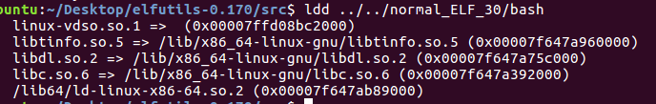
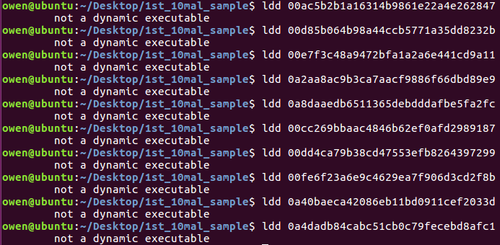
Dependency of library of malware
If there is a need to include external library , use ldd to list library. Example for normal sample bash
But for our malware sample , they are not include external library
Call external library

Slide 32
Dependency of library of normal
Library_name | amount
linux-vdso.so.1 | 29
libc.so.6 | 29
libdl.so.2 | 8
libpthread.so.0 | 6
libpcre.so.3 | 5
libbz2.so.1.0 | 4
libacl.so.1 | 4
libattr.so.1 | 4
librt.so.1 | 3
liblzma.so.5 | 3
libgcrypt.so.20 | 3
Others(16_different_libraries) | <=2

