Slide 1



Slide 2
Active
Questions
Ask the
Lecturer a question
Answers to past
Questions
Feedback

Slide 3
Create a new
Question
Statistics
Saved
Questions
Create a Test
Fastest Answers

Slide 4
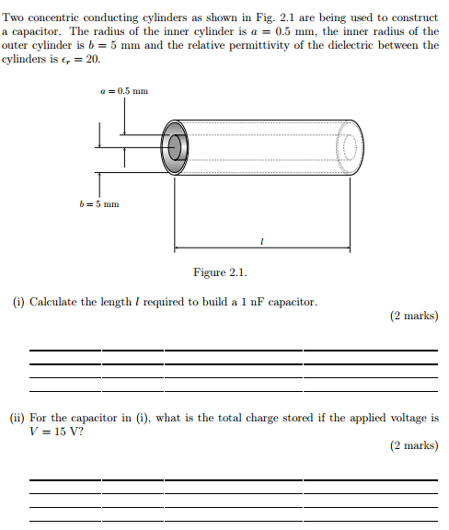

Slide 5
Select a saved test to make it active
Confirm selected questions and save test
Activate selected test

Slide 6
Creating Test
Select Questions
Saved Tests
Creating new question

