Slide 1

Modern Platform-Supported Rootkits
Rodrigo Rubira Branco (@bsdaemon) & Gabriel Negreira Barbosa (@gabrielnb)
{ rodrigo.branco || gabriel.negreira.barbosa } @ intel.com
“As the area of our knowledge grows, so too does the perimeter of our ignorance”
Notes:
Some poetic license is used in terminology to facilitate understanding (like we say architectural features even showing elements that are micro-architectural)

Slide 2
Disclaimers
We don’t speak for our employer. All the opinions and information here are of our responsibility (actually no one ever saw this talk before)
The talk focus mostly in Intel Architecture. We’ll try to generalize as much as possible though – in that, probably many mistakes might happen, so…
Interrupt us if you have questions or important comments at any point.
IMPORTANT: No, We are not part of the Intel Security Group (McAfee)

Slide 3
Agenda
Motivation
Objectives
Current Rootkits Challenges
Wrong Assumptions
AES-NI
Cache Tricks
Miscellaneous
NVDIMM Surprises
ECC-based faults
CAT/CMT
MPX
Resources (github link)

Slide 4
Figure Index
Huahuahuahua, you really expected that?
Most images were taken from Intel 64 and IA-32 Architectures Software Developer’s Manual Combined Volumes

Slide 5
Motivation
A quick (but not dirty) history on why we decided to talk about this…
Notes:
Aqui falaremos de como tanto o Gabriel quanto o Rodrigo tiveram ideias muito semelhantes de tecnicas de exploracao ao rever conceitos fundamentais da arquitetura com a experiencia atual

Slide 6
Objectives
We have two main concerns in regards to computer security:
Assumptions
Composition
Notes:
Exemplo de um assumption que pode ser mudado no futuro, seria o caso da NVDIMM e o impacto em atestacao
premisses

Slide 7
Current Rootkit Challenges
OS dependency and security mechanisms
Different versions of the same OS have different capabilities
Windows platforms usually run additional defense mechanisms (such as AV). *nix-based platforms change frequently (difficult to cross-work on multiple systems)
The computer is an amazing platform, but also has lots of differences between different models
Difficult to work across the board
Some functionalities remain the same for many years though
Most security tools don’t expect things to work in a different way than
the usual expected platform-provided features

Slide 8
Widely Known Rootkit Capabilities
Connect-back to bypass perimeter outgoing filters
Keylogging, session logging in general
Update mechanism (for deploying new functionalites)
Pivoting mechanism (for attacking additional machines within the perimeter)
We will NOT discuss any of them ;) Instead, we will abuse
the platform to hide and protect our code

Slide 9
Platform Capabilities Covered
Generally available architectural features (ECC, Caches, IVT, DMA)
Modern architectural features (AES-NI, MPX, NVDIMM, CAT, CMT)
Some tips on other architectures (along the way, nothing specific)

Slide 10
IDT/IVT – What we will see next
Quick Introduction
Related Abuses:
Assumption: Fixed location for IDTR target?
Assumption: Always protected mode on dumps?
Assumption: 32-bits only malware? (ahn??)

Slide 11
IVT Introduction
Real-mode counterpart of the Interrupt Descriptor Table of Protected Mode
Let’s visualize the differences…

Slide 12
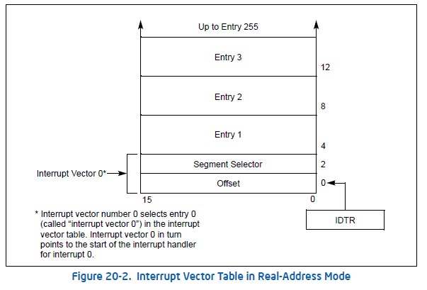
IVT Introduction (2)
Notes:
Reference:
http://download.intel.com/design/processor/manuals/253668.pdf. Vol. 3A. Page: 17-7.

Slide 13
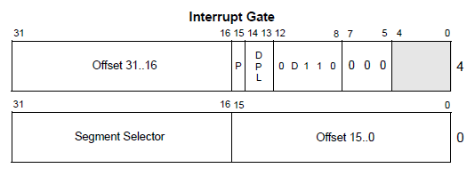
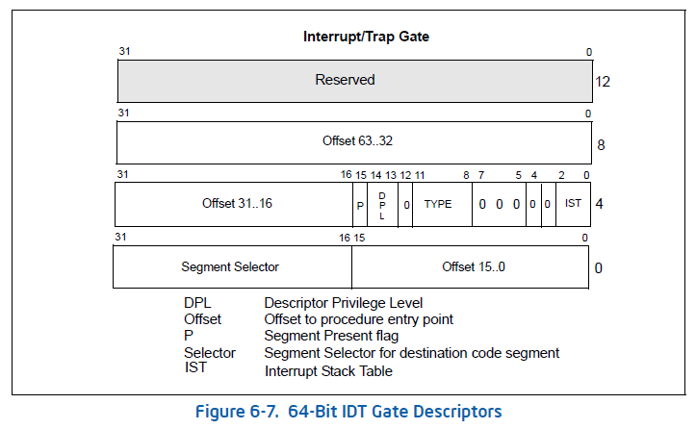
IDT 32 and 64 bits

Slide 14
IVT Abuse – idt.py (Volatility) Where is the mode check?
if not addr_space is None and not symtab is None:
KPCR = 0xFFDFF000
if not addr_space.is_valid_address(KPCR):
print "KPCR is UNAVAILABLE"
return
idt_mem = read_value(addr_space, 'unsigned long', KPCR+0x38)
print 'IDT#\tISR\tunused_lo\tsegment_type\tsystem_segment_flag\tDPL\tP'
for i in range(0, 256):
offset = (i) * 8
LowOffset = read_value(addr_space, 'unsigned short', idt_mem+0 + offset)
selector = read_value(addr_space, 'unsigned short', idt_mem+2 + offset)
unused_lo = read_value(addr_space, 'unsigned char', idt_mem+4 + offset)
options = read_value(addr_space, 'unsigned char', idt_mem+5 + offset)
segment_type = options & 0x0f
system_segment_flag = (options & 0x10) >> 4
DPL = (options & 0x60) >> 5
P = (options & 0x80) >> 7
HiOffset = read_value(addr_space, 'unsigned short', idt_mem+6 + offset)
print '%s\t%4.4x:%4.4x%4.4x\t%x' % (str(i), selector, HiOffset, LowOffset, unused_lo),
print '\t%2.2x\t%x\t%x\t%x' % (segment_type, system_segment_flag, DPL, P)
If a malware changes IDTR but do not update the Windows structure,
it will still hook calls, but will be ‘invisible’ to Volatility
Notes:
Hardcoded KPCR address and the IDTR not necessarily points there, and only 32 bits

Slide 15
Bonus Abuse? check_idt.py (Volatility) Where is the mode check?
# hw handlers + system call check_idxs = list(range(0, 20)) + [128] if self.profile.metadata.get('memory_model', '32bit') == "32bit": idt_type = "desc_struct" else: idt_type = "gate_struct64" # this is written as a list b/c there are supposdly kernels with per-CPU IDTs # but I haven't found one yet... addrs = [self.addr_space.profile.get_symbol("idt_table")] for tableaddr in addrs: table = obj.Object(theType = 'Array', offset = tableaddr, vm = self.addr_space, targetType = idt_type, count = tblsz) for i in check_idxs: ent = table[i] if not ent: continue idt_addr = ent.Address if idt_addr != 0: if not idt_addr in sym_addrs: hooked = 1 sym_name = "HOOKED" else: hooked = 0 sym_name = self.profile.get_symbol_by_address("kernel", idt_addr) yield(i, idt_addr, sym_name, hooked)
If you hook a function, but export the target’s function symbol, it is all fine?
Notes:
Linux version in the trunk:
https://code.google.com/p/volatility/source/browse/trunk/volatility/plugins/linux/check_idt.py
Supports 64 and 32 bits but the names are exported, and it is gone…
They at least check for 32/64 bits, but only some entries and for them, if a given symbol is exported, the hook is not malicious!

Slide 16
And just for fun? Btw, also does not check mode…
https://code.google.com/p/volatility/source/browse/trunk/volatility/plugins/malware/idt.py
“# Currently we only support x86. The x64 does still have a GDT
# but hooking is prohibited and results in bugcheck. “
Notes:
Malware in 64 bit needs to deal with Patchguard

Slide 17
Disclaimer 2
We appreciate the work the guys did in Volatility, it is an interesting and useful tool
The idea of our point is to clarify that assumptions are everywhere and we need to understand what we use so we can have a better grasp on the limitations

Slide 18
AES-NI – What we will see next
AES-NI Quick Introduction
AES-NI Abuse:
Disabling the AES-NI instructions and handling the interrupts to backdoor AES implementations
Everyone read the PoC || GTFO released in this conference, right??
Should we skip this part?

Slide 19
AES-NI Introduction
Intel® Advanced Encryption Standard New Instructions (AES-NI)
“What is it?
Intel® AES-NI is a new encryption instruction set that improves on the Advanced Encryption Standard (AES) algorithm and accelerates the encryption of data”.

Slide 20
AES-NI Locking and Enabling
MSR 0x13C
Bit Description
0 Lock bit (always unlocked on boot time, BIOS sets it)
1 Not defined by default, 1 will disable AES-NI
2-32 Reserved

Slide 21
The Code
Please, see at your magazine ;)
There is a chipsec check we created for you to check your system (also in the article and soon on chipsec github): http://github.com/chipsec/chipsec
We add a handle to the #UD and we set the MSR to disable AES-NI (we don’t let BIOS set the lock bit, so we can modify it at runtime)

Slide 22
AES-NI Disable for other purposes
Useful anti-disassembly mechanism (kernel driver + malware implementation)
One can obviously use this idea to analyze a malware that counts on AES-NI
The BIOS part…

Slide 23
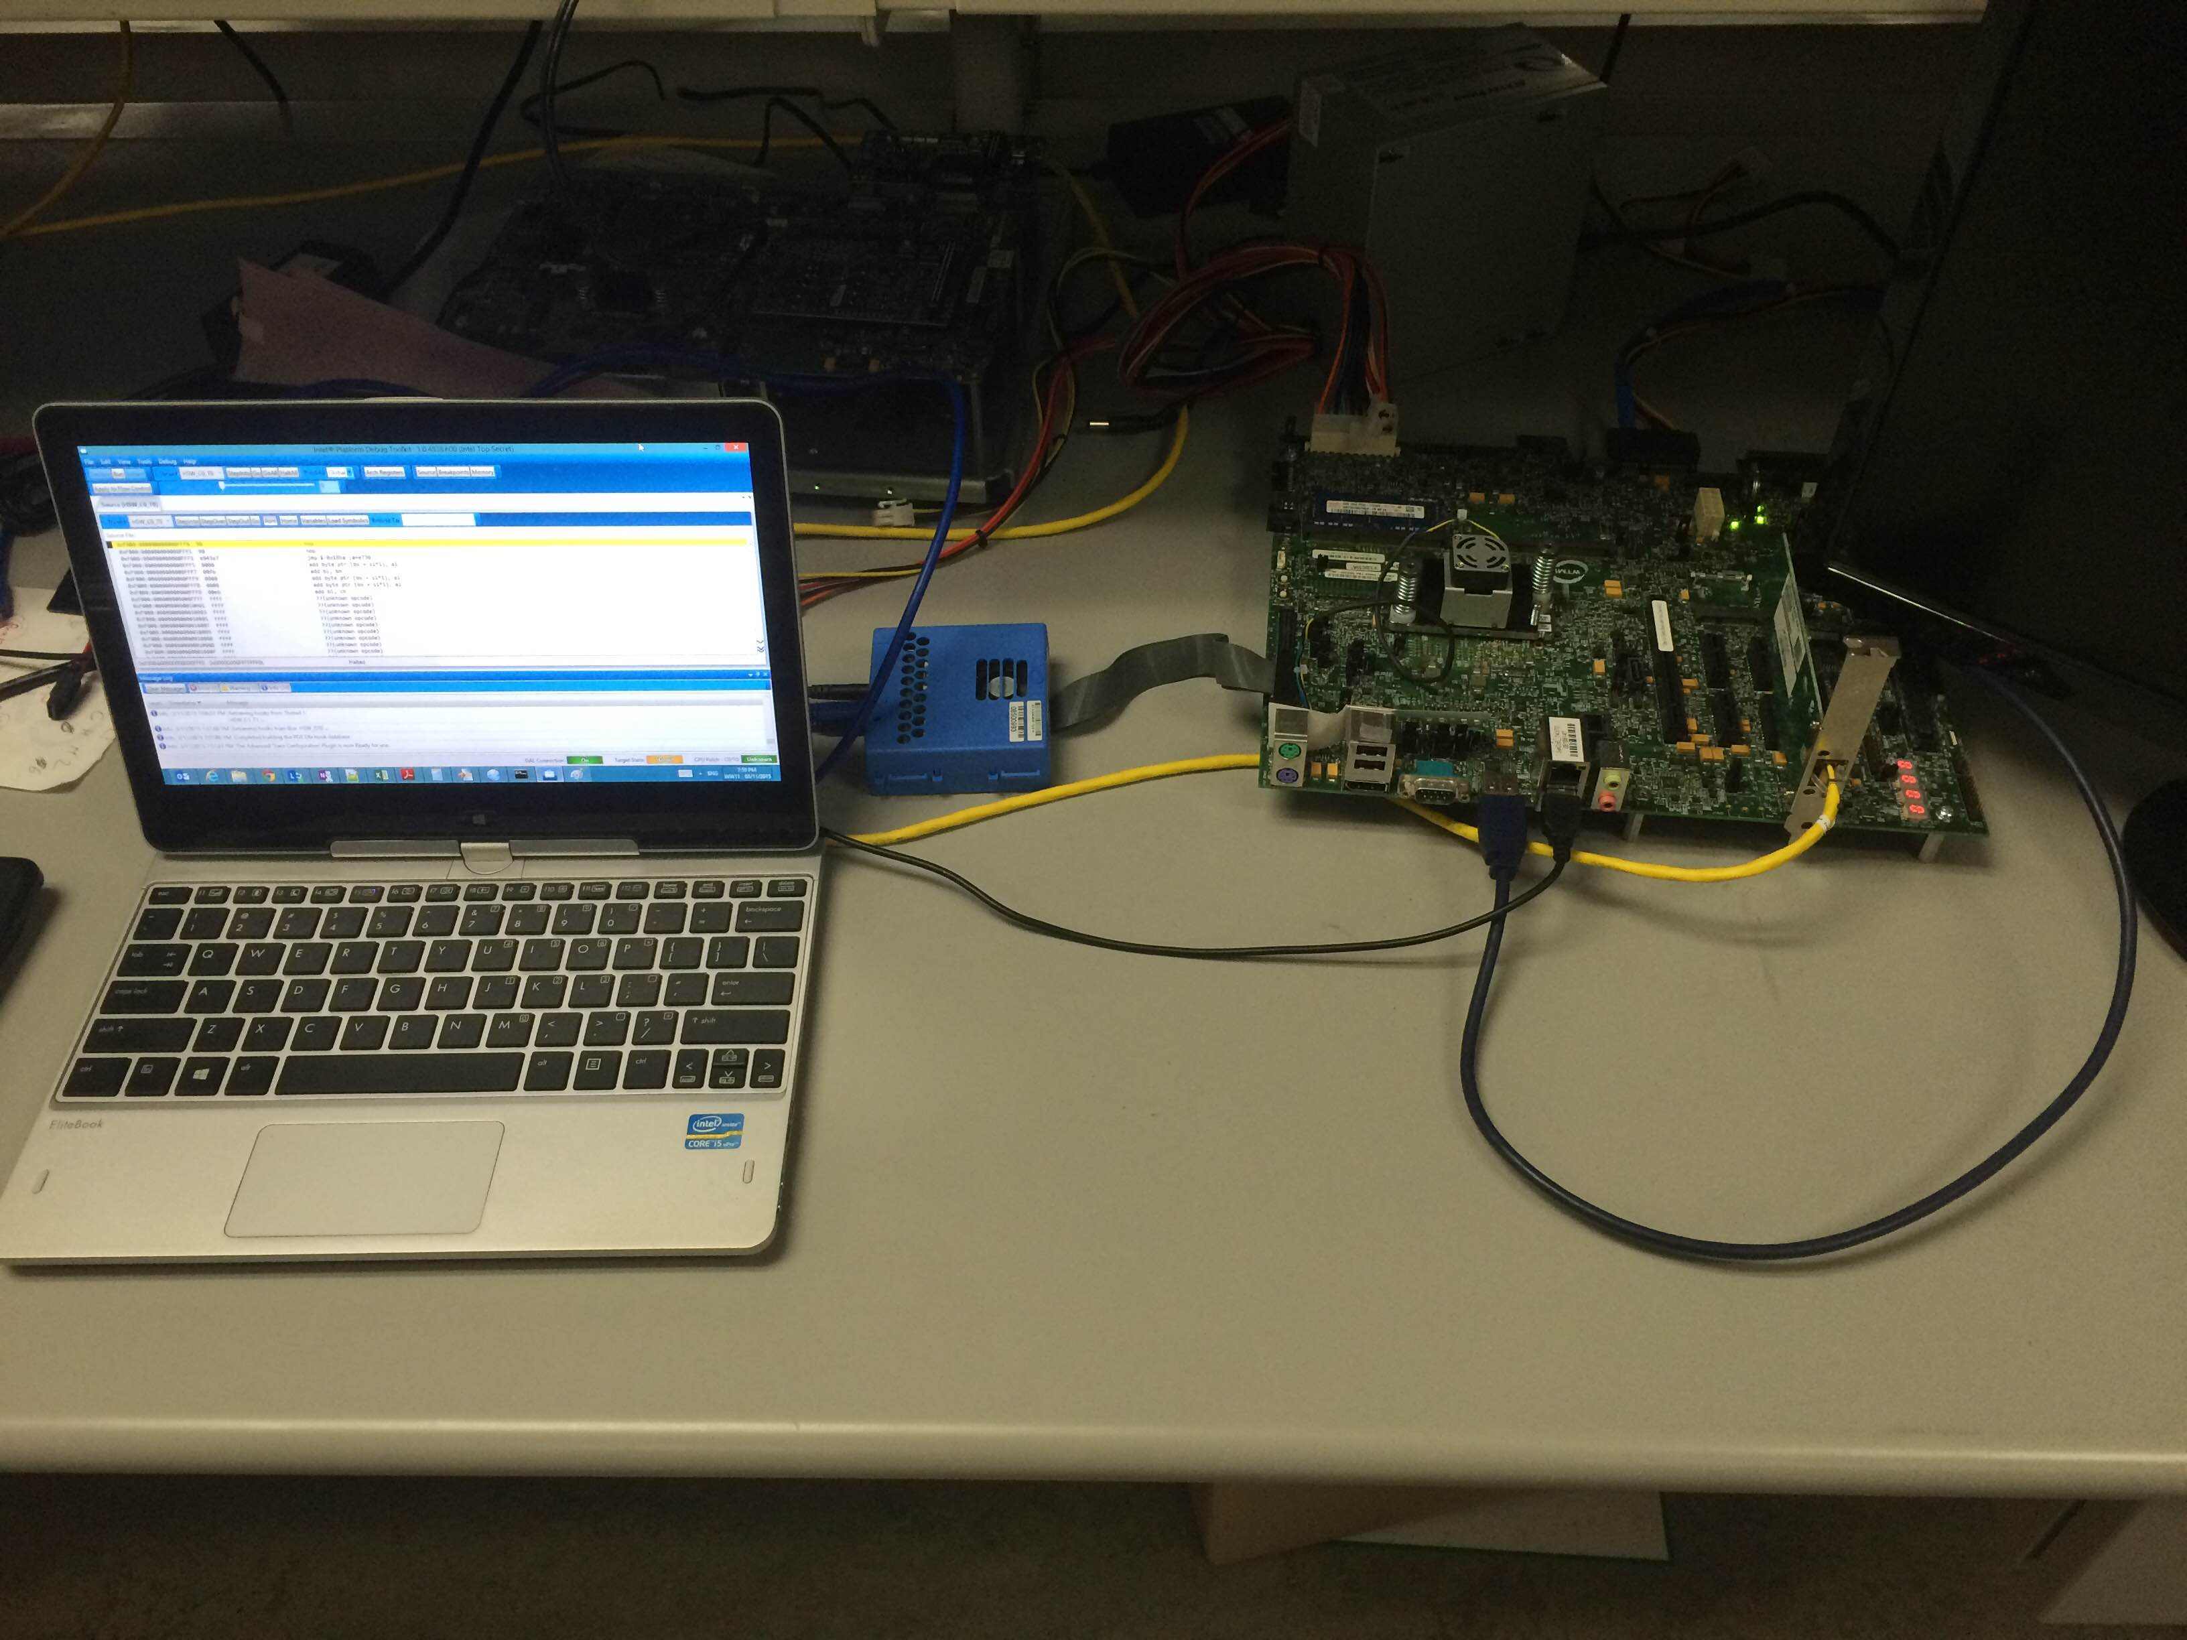
JTAG-based debugger

Slide 24
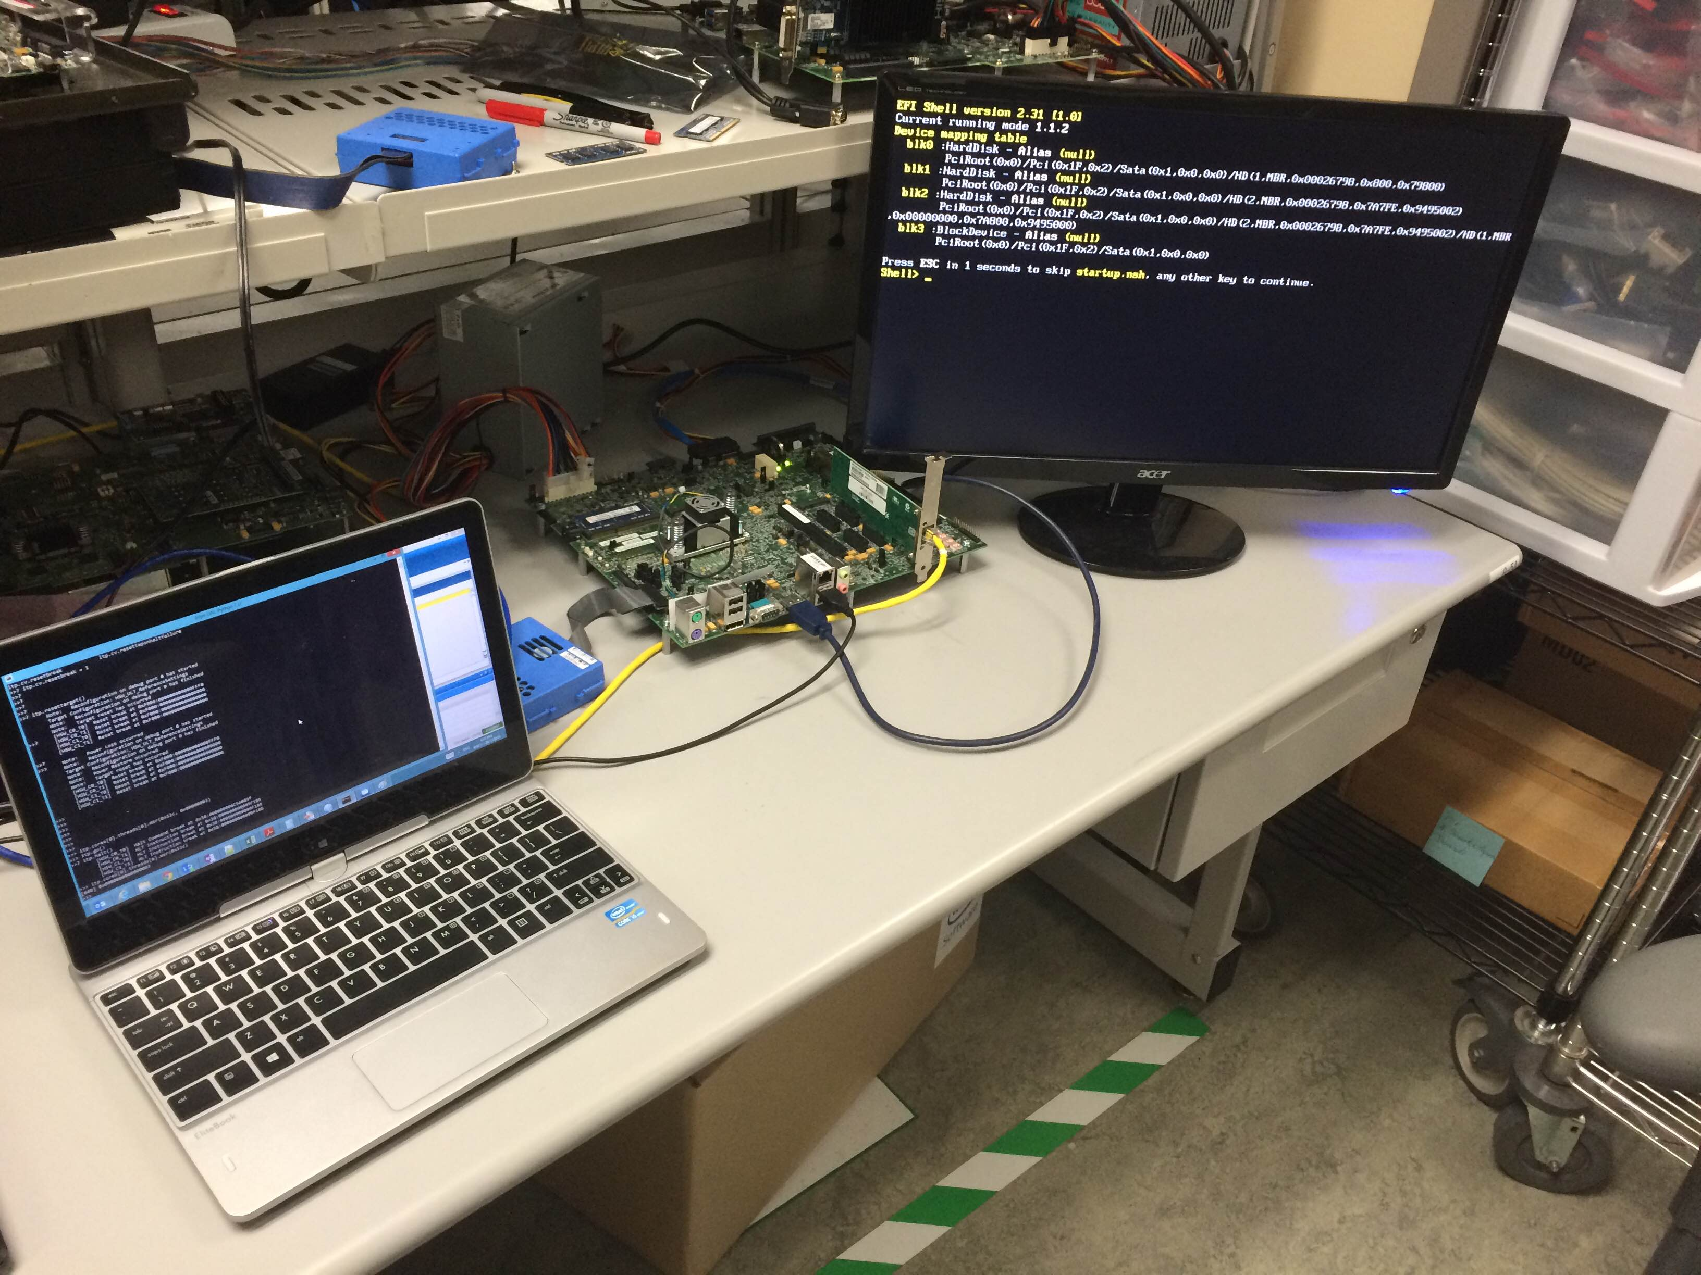
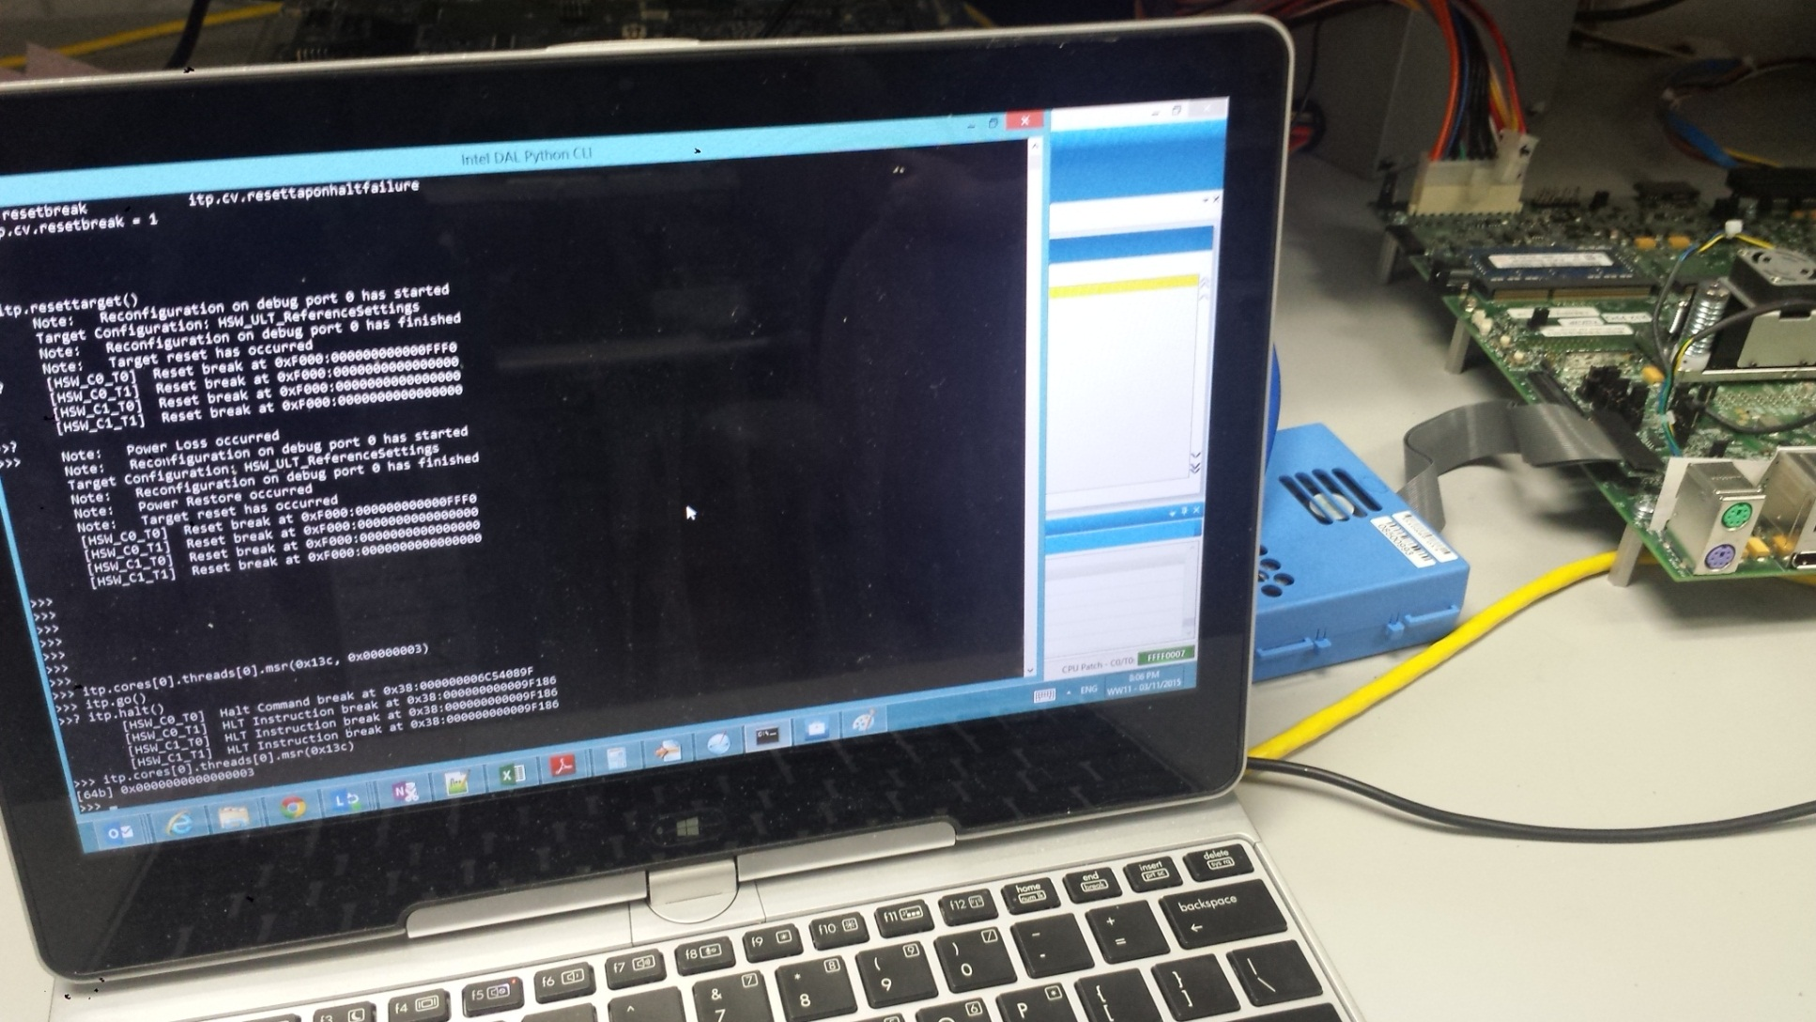


Slide 25
BIOS Analysis?
We start stopping the machine execution at the BIOS entrypoint. We defined some functions
to be used thru our code, such as:
get_eip(): Get the current RIP
get_cs(): Get the current CS
get_ecx(): Get the current value of RCX
get_opcode(): Get the current opcode (disassembly the current instruction)
find_wrmsr(): Uses the get_opcode() to compare with the '300f' (wrmsr opcode) and
return True if found (False if not)
search_wrmsr():
while find_wrmsr() == False: step() -> go to the next instruction (single-step)
find_aes():
while True:
step()
search_wrmsr()
if get_ecx() == '0000013c':
print "Found AES MSR"
break

Slide 26
BIOS Analysis Tip
All BIOS we know sets its General Protection Fault (#GP) handler to just resume the execution
Thus, if you set any MSR locks after giving the MSR the value you like, the BIOS will try to set it, will receive a #GP that it ignores and just continue happily

Slide 27
Talking about disabled instructions
As we just saw, some instructions can be disabled…
Next Abuse:
Disabling the fast system call handler in 64 bit machines to create a stealth syscall hook (is it ok to say hooker?)

Slide 28
Changing subjects – check_syscall.py (Volatility)
memory_model = self.addr_space.profile.metadata.get('memory_model', '32bit')
if memory_model == '32bit':
mode = distorm3.Decode32Bits
func = "sysenter_do_call"
else:
mode = distorm3.Decode64Bits
func = "system_call_fastpath"

Slide 29
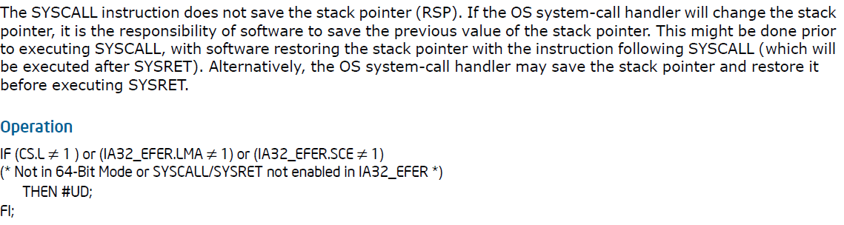
We got inspired… Thanks!
Now we claim credits for ALL instruction disabling related attacks (even
future ones!!)…
huahuahuAHUAhuAhuahuaU
IF the rootkit, in a 64-bit Linux machine:
- Unset: IA32_EFER.SCE
- Hook the #UD handler
- On the #UD exception, disassemble the instruction: if syscall
- Hook as wanted ☺ - New way to hook system calls on 64 bit
Machines (should work on Windows too)
Notes:
Disable the IA32_EFER.SCE (set bit to 0), handle the UD. Check if the fault instruction is syscall opcode, if so, emulate and hook as wanted.
The joke:
Of course the credits are for whoever find new ones, we do hope that more people will pay attention to those kind of problems

Slide 30
Cache – What we will see next
Cache Quick Introduction
Cache-related Abuse:
Forcing async between cache and memory

Slide 31
Quick Introduction
Write-back
Cache Hit, Cache Miss
Cache Eviction, Cache Fill
Notes:
Cache Hit, Cache Miss, Eviction

Slide 32
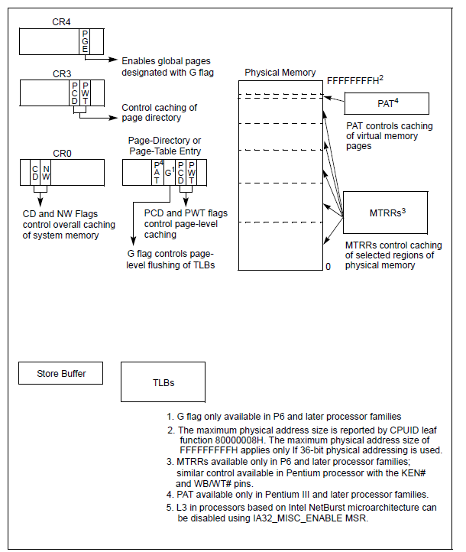
Cache Control

Slide 33
Abusing Cache
Hide malicious code in disabled cache
L3 disabling is possible in netburst (up to July 2006 accordingly to Wikipedia) microarchitecture (and all caches can be disabled in Atom cores)
When L3 is enabled, malicious code is executed. When is disabled, malicious code is hidden
Causes performance loss
Life was easy ☺
Notes:
Cache is micro-architectural, thus very dependent on the CPU model

Slide 34
Cache Async
“FrozenCache – Mitigating Cold-Boot Attacks For Software-Based Full-Disk Encryption” presentation, 27C3 (2011)
A big challenge: How to prove the cache async? The author discuss some ideas (like performing the cold-boot attack as a test), but had not figured out a way to do from software
Some proposed using DMA…

Slide 35
DMA x Cache
IO device issues a DMA request on the PCIe port
The PCI CPU Agent forwards the request to the DMA arbitrator
PCIe
DMI
DDR
DDR
1
4b
A
B
PCI CPU Agent
MC
The DMA Arbitrator sends the request to the CPU/caches
If cache hit, data requested is sent to the DMA Arbitrator
DMI
Conclusion:
DMA accesses in Intel Platform is coherent ! No cache async there
Conclusion 2:
- We don’t want to point our fingers, but:
“We have x86 problems, but arm ain’t one”
The DMA Arbitrator forwards the request to the memory controller
The memory controller forwards request to DDR
2b
3b
2a
DMA Arbitrator
3a
4a
DMA Arbitrator combines the A and B responses and completes the request
IA Core
Cache
IA Core
Cache
Graphics
Notes:
If a forensics tool get the data thru DMA, it will get our hidden data from the cache as well. But cold boot and other approaches (like turning off the machine) would not work. Against DMA-related capture, VT-d is to your rescue [Joanna’s presentation: “Beyound the CPU: Defeating Hardware Based RAM Acquisition”]

Slide 36
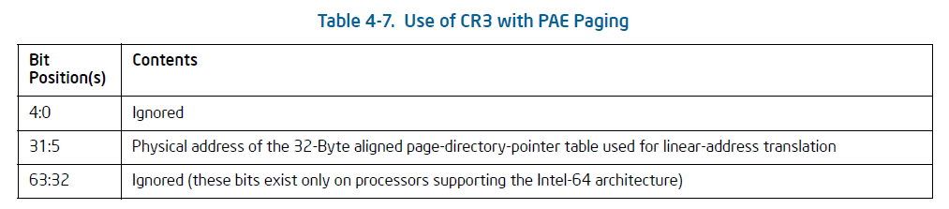
Cache Async – Proof Introducing Concepts
Page-walking mechanism
Notes:
We only discuss how it works with PAE enabled

Slide 37
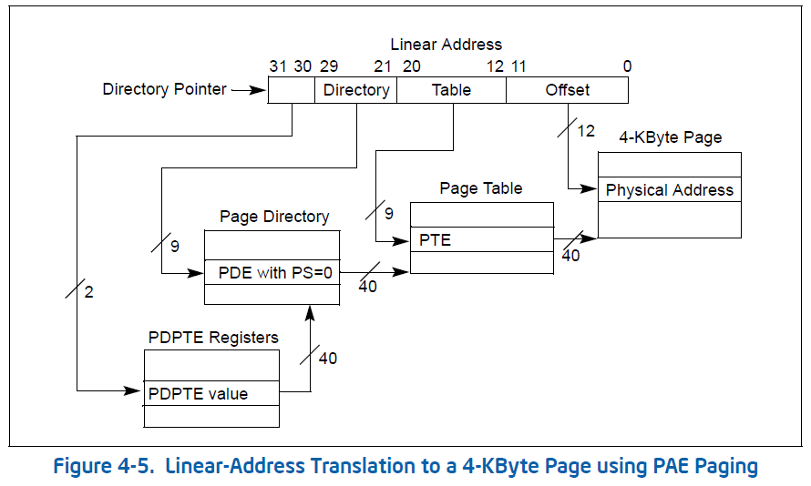
Cache Async – Proof Introducing Concepts
Page Directory Pointer Table

Slide 38
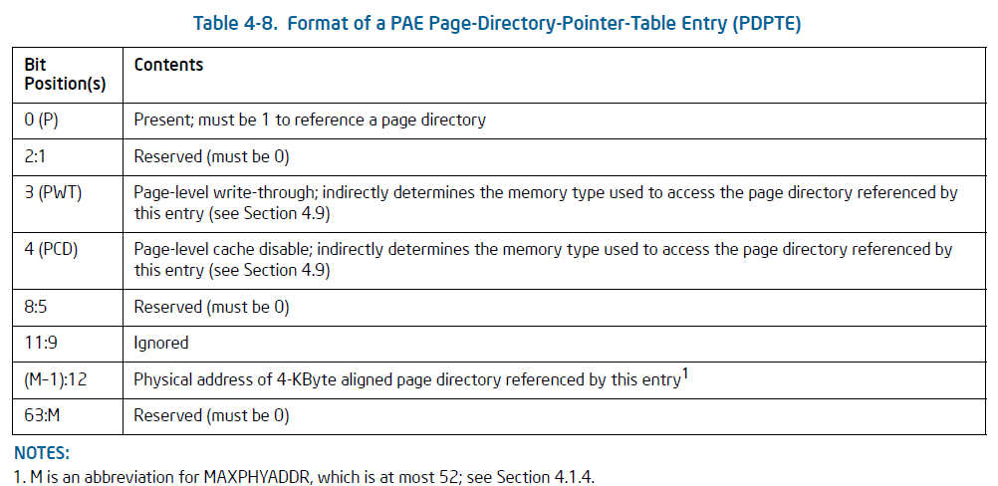
PDPTE Structure

Slide 39
Theory – We prove it next
Page-walk hardware does not use cache when PAE is enabled
Not part of the theory, but JUST FYI: If it did, we could actually create nice attacks with the async of cache and memory of the cr3 pointed memory
If we prove that, it is also proven that we can force a situation where cache and memory are not sync’ed

Slide 40
Proofs Reminder: PoCs on github
Given the way that pagewalking works (PDPTE, cr3, etc)
Without interrupts and with only one thread we:
We make sure that the PDPTEs are marked as write-back
Invalidate the cache (wbinvd)
We access the PDPTE entries, thus forcing it to the cache
We change the present bit (not present) – given the cache hit, it changed in the cache
We do random memory accesses, using virtual memory (forcing pagewalking to occur) – not enough accesses to fill the cache (otherwise, eviction would occur)
The system did not crash, thus pagewalking does not use cache when PAE is enabled

Slide 41
Now, if you don’t want the data anymore Reminder: PoCs on github
Just add a ‘invd’
It will not write back memory
Proof:
The same steps as before, adding the invd in the end, before returning (the system will not crash later, even after ‘eviction’ – there will be no eviction)

Slide 42
Small consideration on FrozenCache
In the blog (http://frozencache.blogspot.com/) he uses the ordering:
“
3-) Flush the cache (thus truly overwriting the encryption key in RAM) wbinvd
4-) Add the desired RAM region to the CPU's MTRR (the 4K segment containing the key)
5-) Disable/freeze the CPU's cache (CR0.CD=1) movl %cr0, %eax orl 0x40000000, %eax movl %eax, %cr0
6-) Write the encryption key from the CPU registers to RAM (data remains in the cache, doesn't get written to memory) movq %xmm0, [X] movq %xmm1, [X+8] movq %xmm2, [X+16] movq %xmm3, [X+24]”
5 and 6 should be inverted (no-fill mode will not let cache to be filled)
It probably worked for him, because wbinvd takes time to complete (more on
It later) and thus, he had a cache hit, which will update the cache entry
Notes:
3 zeroes the cache. 4 sets the MTRRs to be WB. 5 sets the no-fill mode (nothing enters the cache, only write hits update it). 6 he reads memory (there will be no cache hits since he invalidated the cache, thus the writes are to memory not to the cache). The only theory is if wbinvd have not been completed until the rest is executed and the 6 actually hit and thus updated the cache contents… the ideal implementation would invert steps 5 and 6.

Slide 43
Comments on ‘no-fill’ mode
If you are in no-fill mode, once you exit, it will write-back to memory
‘invd’ does not invalidate the cache entries while in the no-fill mode
We mentioned it was performing a write-back, but it was happening because of the exit from no-fill mode
Interesting Coreboot file to take a look as well (src/cpu/intel/haswell/cache_as_ram.inc)

Slide 44
Challenges
Besides ‘someone’ commenting out our assembly function called in the C code and we spending like 3 hours (total) analyzing something that was not even called (twice)…
wbinvd

Slide 45
Miscellaneous – What we will see next Just sharing some other ideas…
ECC
NVDIMM
CAT/CMT
MPX
Notes:
- Marking memory regions as ECC-failed to avoid inspection

Slide 46
ECC - Introduction
ECC (Error Checking & Correction) memory was introduced to detect (and correct) common kinds of internal data corruption in data storage (memory, flash drives, etc)
ECC-capable memory controllers (workstation and servers) are able to detect and correct errors of a single bit per 64-bit word or only detect in two bits per 64-bit word

Slide 47
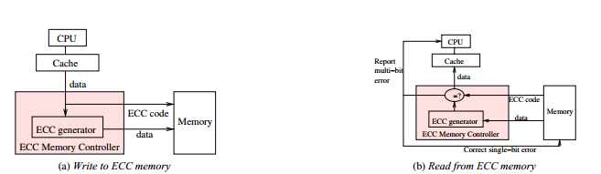
ECC – Introduction (2)
Most controllers support four modes:
Disabled
Check-only
Correct-error
Correct-and-Scrub (correct on detection of errors, but periodically scrubs the memory for finding errors)
Source: SafeMem: Exploiting ECC-Memory for Detecting Memory Leaks and
Memory Corruption During Production Runs
Notes:
How it will behave with DMA, memory acquisition??

Slide 48
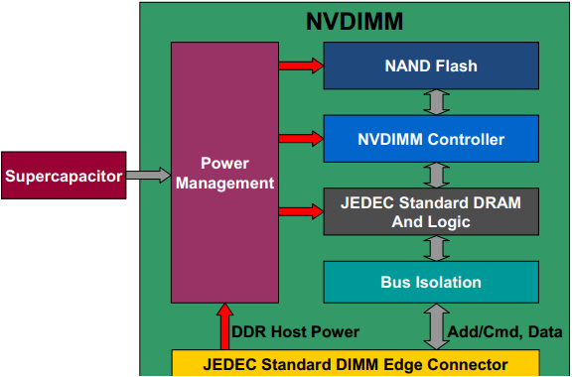
NVDIMM

Slide 49
NVDIMM Surprises
How does it affect platform attestation??
How does it affect software disk-encryption technologies???

Slide 50
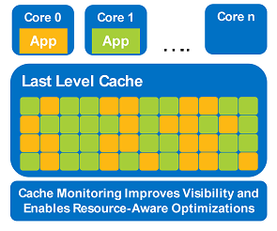
New Intel Cache Technologies - CMT
CMT – Cache Monitoring Technology
The OS/VMM can indicate a Resource Monitoring ID (RMID) for each application (or group of applications) it intends to monitor cache utilization (L3 only);
See the cache occupancy per RMID;
The intention is to provide better migration of applications to different sockets as needed, or to better mix applications in a given processor;
Cache requests have the RMID tag;
The HW thread tags are controlled by MSR, IA32_PQR_ASSOC
The counters can be read thru the IA32_QoSEvtSel MSR
Latest processors support 4 RMIDs per HW thread;

Slide 51
Cache Coloring x Cache Partitioning
Cache Coloring is a software-based way to implement cache partitioning:
You map logical addresses to physical addresses that will create a split in the cache lines between different processes
Used by RTOS OSes to implement partitioning in hardware that do not support it

Slide 52
New Intel Cache Technologies
CAT – Cache Allocation Technology
Intended to enforce a cache QoS
Does that through Dynamic Cache Partitioning based on a mask that is applied into the associative cache, thus permitting one to map certain addresses to a given cache location (changing the fixed locality of the cache associativity)

Slide 53
MPX (Memory Protection eXtensions)
New ISA set of instructions
Configured thru registers that define memory bounds
Instructions executed before memory accesses (to check the bounds)
On bound violation, #BR
Notes:
Mention that we already claimed credits for disabling new instructions, but this one specifically when disabled (legacy), they will became a nop, so no game there

Slide 54
MPX (cont.)
int main(int argc, char* argv) {
int buf[100];
return buf[argc];
}
Original Assembly (no-MPX):
movslq %edi, %rdi
movl -120(%rsp,%rdi,4), %eax
Assembly (gcc supporting MPX):
movl $399, %edx // load array length to edx
movslq %edi, %rdi // rdi contains value of argc
leaq -104(%rsp), %rax // load start address of buf to rax
bndmk (%rax,%rdx), %bnd0 // create bounds for buf
bndcl (%rax,%rdi,4), %bnd0 // check that memory access doesn’t violate buf’s low bound
bndcu 3(%rax,%rdi,4), %bnd0 // check that memory access doesn’t violate buf’s upper bound
movl -104(%rsp,%rdi,4), %eax // original memory access
Source:
https://software.intel.com/en-us/blogs/2013/07/22/intel-memory-protection-extensions-intel-mpx-support-in-the-gnu-toolchain

Slide 55
MPX (Abuse)
Two components in a malware code:
User-land
Kernel-land
Kernel-land hooks #BR, user-land, uses bound exceptions as trampoline to the kernel
Kernel-land defines the flow of user-land application, inviable for AV to track the flow

Slide 56
Conclusions
Assumptions are dangerous. When we compose a system, lots of assumptions are part of the final design
The architecture is well defined, but complex. Software on top of that, even more
SGX (already discussed past year) and other technologies will change the way we imagine computer forensics, it is time to evolve!

Slide 57
Resources
All the code discussed will be available at:
https://github.com/rrbranco/Troopers2015
We will update it with other ideas that we had no time to implement/test thus we did not present
Latest PoC || GTFO has the AES-NI part, but we will put it there as well ;)

Slide 58
“As the area of our knowledge grows, so too does the perimeter of our ignorance”
The end! Really is??
Rodrigo Rubira Branco (@bsdaemon) & Gabriel Negreira Barbosa (@gabrielnb)
{ rodrigo.branco || gabriel.negreira.barbosa } @ intel.com

