Slide 1
RPGCraft
Serena et Cedric

Slide 2
Pillars
Building/Editing
Dynamic/Procedural Environment
Social/Interactive

Slide 3
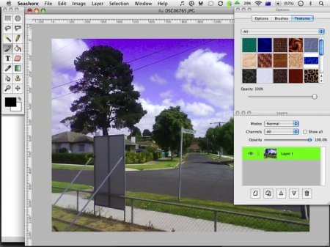
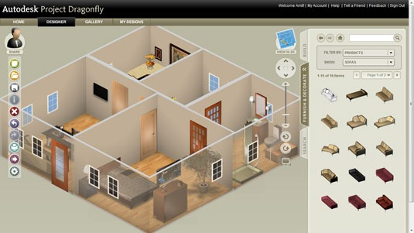
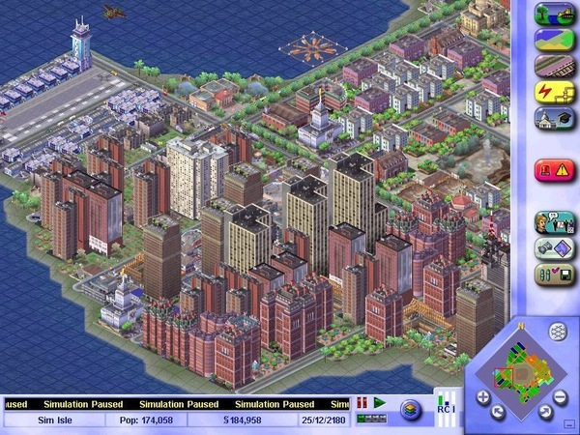
Building/Editing
The Editor IS the game.

Slide 4
Building/Editing
Similar Games
Sim City
Terraria/Minecraft
Dungeon Keeper
Smiliar Apps
Photoshop
3ds Max

Slide 6
Dynamic
Similar Games
Diablo2
Terraria/Minecraft

Slide 7
Social/Interactive
Inspiration
Subspace
Terraria/Minecraft
World of Warcraft
League of Legends

Slide 8
Conclusion
Papa
Maman
Krystal
Grand-maman
Grand-papa
Abcdefghijklmnopqrstuvwxyz
Serena
Cedric
Quebec

