Slide 1
Week 7 – Model Binding and Entity Framework
- Saptaparnee Saha

Slide 2
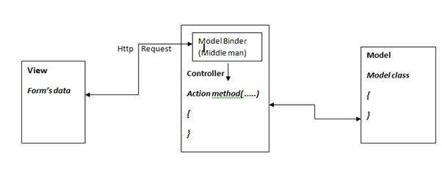
Understanding Model Binding in ASP.NET Core
Automatically maps HTTP request data to action method parameters.
Works with data from:
Query strings
Form data
Headers and body (JSON/XML)
Eliminates need to manually parse request data.
HTTP Request (Form, Query, Route, Body, Headers)
↓
ASP.NET Core Model Binder
↓
+----------------------------------+
| Action Parameters |
| public IActionResult Post( |
| [FromBody] PostDto dto) |
+----------------------------------+
↓
Controller Logic

Slide 3
Value Providers — Behind the Scenes of Model Binding
Responsible for fetching raw data from:
Query String
Route Data
Form Data
Headers
Cookie
Value Providers work in a chain during model binding
Provide values as strings to model binders
Examples:
QueryStringValueProvider
RouteValueProvider
FormValueProvider
Custom Value Providers can be implemented for special data sources

Slide 4
FROM FORM
// Razor form
<form method="post">
<input name="Name" />
<input name="Age" />
<button type="submit">Submit</button>
</form>
// Controller
[HttpPost]
public IActionResult SubmitForm(UserModel model)
{
// model.Name and model.Age are bound from form data
return View(model);
}

Slide 5
FROM QUERY STRING
[Http(“Search”)]
public IActionResult Search( string keyword, int page)
{
// example request :
//Search? keyword=ASP,..NET & page=2
return Ok($ “ Searching for keyword {keyword} and page {page}”);
}

Slide 6
FROM ROUTE VALUES
// Route: /products/details/10
[Route("products/details/{id}")]
public IActionResult Details(int id)
{
// id = 10 from route
return View();
}

Slide 7
Custom Model Binders
CODE SNIPPET
public class DateTimeModelBinder : IModelBinder {
public Task BindModelAsync(ModelBindingContext context) {
var value = context.ValueProvider.GetValue(context.FieldName).FirstValue;
if(DateTime.TryParseExact(value, "yyyyMMdd", null, out var date)) {
context.Result = ModelBindingResult.Success(date);
} else {
context.Result = ModelBindingResult.Failed();
}
return Task.CompletedTask;
}
}
Why?
When default binding can’t handle complex or special formats
Custom parsing or transformation needed
How?
Create a class implementing IModelBinder.
Implement BindModelAsync method
Register binder globally or via [ModelBinder] attribute

Slide 8
Binding Nested and Complex Models
Collections and Dictionaries Binding
Supports binding properties of properties, e.g.:
public class Address {
public string City { get; set; }
public string Zip { get; set; }
}
public class User {
public string Name { get; set; }
public Address HomeAddress { get; set; }
} Matches input names using Dot Notation :
HomeAddress.City=Seattle
HomeAddress.Zip=98101
public IActionResult Post(List<int> ids, Dictionary<string, string> dict)
{
// ids and dict automatically bound from request
}
Arrays, Lists, and Dictionaries can be bound automatically:
Example query string for list: ids=1&ids=2&ids=3
Example for dictionary keys: dict[key1]=value1&dict[key2]=value2
Works with [FromForm], [FromQuery]
Supports zero-based indexed naming for complex lists: items[0].Name=Book&items[1].Name=Pen

Slide 9
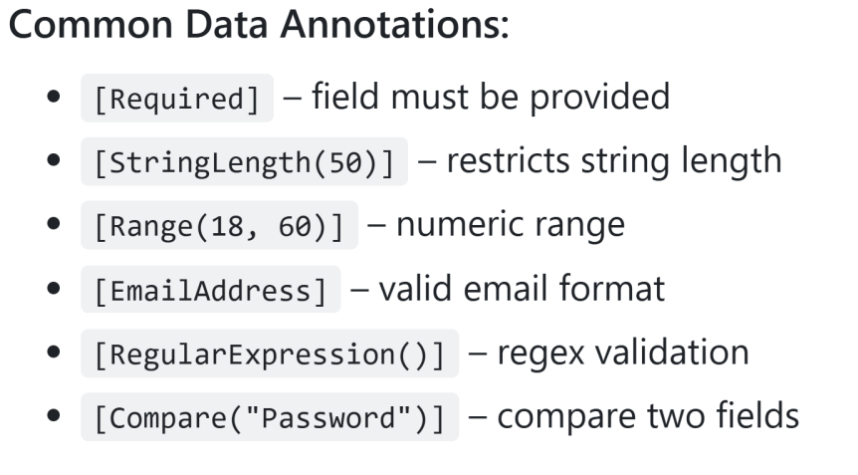
Model Validation
public class RegisterViewModel {
[Required]
[StringLength(50)]
public string Username { get; set; }
[Required]
[EmailAddress]
public string Email { get; set; }
[Range(18, 100)]
public int Age { get; set; }
[Compare("Password")]
public string ConfirmPassword { get; set; }
[RegularExpression(@"^[a-zA-Z0-9]*$")]
public string Code { get; set; }
}
Purpose:
Ensures incoming data meets expected rules
Works with Data Annotations or custom validation logic
Occurs after model binding

Slide 10
Custom Validation
public IActionResult Register(User model) {
if (!ModelState.IsValid) {
return View(model); // show errors
}
// Proceed if valid
return RedirectToAction("Success");
}
Example to Create a Custom Validation :
public class NoSpecialCharsAttribute : ValidationAttribute {
public override bool IsValid(object value) {
var str = value as string;
return str != null && !str.Any(char.IsPunctuation);
}
}
public class User {
[NoSpecialChars(ErrorMessage = "No special characters allowed.")]
public string Username { get; set; }
}

Slide 11
Model Binding
Model Validation
Purpose: Converts HTTP request data into C# types or objects.
When It Happens: Before the action method executes.
Sources:
Route values
Query strings
Form fields
JSON body
Headers, cookies, etc.
Mechanism: Uses value providers and model binders.
Failure Effect: Leaves properties as default values or null —
no error unless validation is applied.
Purpose: Ensures the bound data meets specific business
or data integrity rules.
When It Happens: After model binding is completed.
Defined Using:
Data Annotations Custom validation attributes
Checks: Property-level and cross-property rules.
Failure Effect: Adds errors to Model State.

Slide 12

Entity Framework in ASP.NET Core

Slide 13
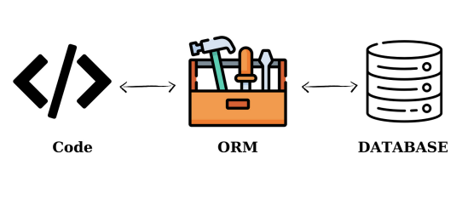
ORM (Object Relational Mapping)
Definition:
A programming technique that allows you to interact with a database using objects, rather than writing raw SQL.
Key Idea:
Maps classes to tables, and properties to columns
Why Use ORM?
Simplifies database interaction
Promotes clean, maintainable code
Reduces boilerplate SQL
Popular ORM Tools:
Tool | Language / Platform
Entity Framework Core | .NET (C#)
Hibernate | Java
Dapper | .NET (micro ORM)
TypeORM | Node.js / TypeScript
SQLAlchemy | Python

Slide 14
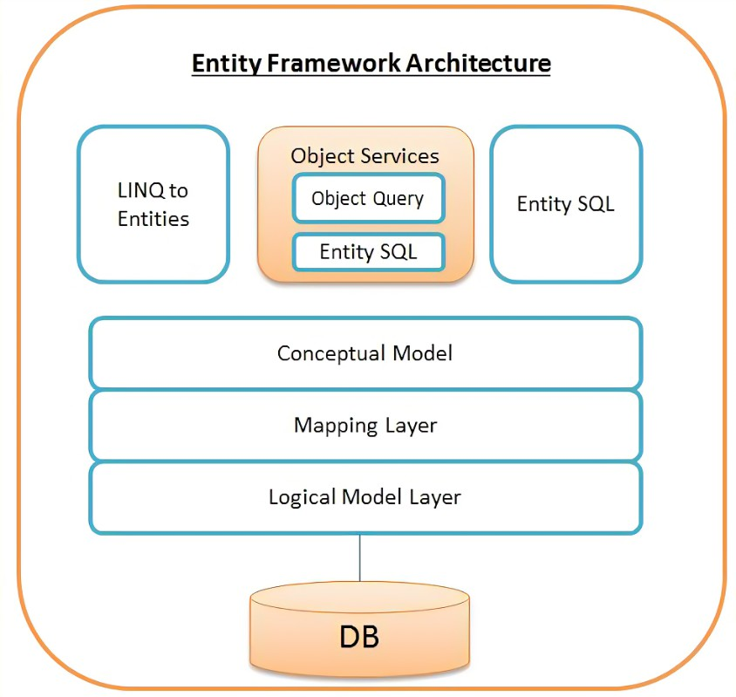
What is EF Core? Microsoft’s official, lightweight, cross-platform ORM for .NET Successor to Entity Framework (classic) Actively developed and open-source Why Choose EF Core? ✅ Deep .NET integration (works with ASP.NET Core, LINQ, dependency injection) ✅ Cross-platform (Windows, Linux, macOS) ✅ Supports code-first, database-first, and migrations ✅ Rich LINQ support — query using C# syntax ✅ Pluggable architecture — supports custom conventions, logging, and providers ✅ Wide database provider support: SQL Server SQLite PostgreSQL MySQL Cosmos DB, etc.
EF Core Architecture & Workflow
Key Components:
Entity Classes
Represent tables
Properties = columns
Example: Product, User, Order
DbContext
Central class to manage data access
Tracks changes, executes queries
Contains DbSet<TEntity>
Database Provider
SQL Server, PostgreSQL, SQLite, etc.
Pluggable backend layer
LINQ Queries
Queries written in C#
Translated to SQL by EF Core
Entity Framework Core

Slide 15
What is DbContext?
public class AppDbContext : DbContext {
public DbSet<Product> Products { get; set; }
public AppDbContext(DbContextOptions<AppDbContext> options)
: base(options) { }
}
The main EF Core class for database operations
Acts as a session/bridge between your app and the database
Manages:
Connection
Change tracking
Query translation
Saving changes
Use Case :
var product = new Product { Name = "Phone", Price = 699 };
_context.Products.Add(product);
_context.SaveChanges();

Slide 16
Entity Class
Configuring DbContext with Dependency Injection
//In Program.cs
builder.Services.AddDbContext<AppDbContext>(options => options.UseSqlServer(builder.Configuration.GetConnectionString("Default")));
Entity Class – A Table in Code
Each property = column, each class = table
A POCO class (Plain Old CLR Object) that represents a table in your database.
// In appsettings.json
"ConnectionStrings": {
"Default": "Server=.;Database=MyAppDb;Trusted_Connection=True;"
}
// Injecting into constructor
public class ProductService {
private readonly AppDbContext _context;
public ProductService(AppDbContext context) {
_context = context;
}
}

Slide 17
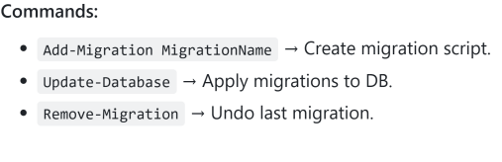
Steps in Code-First Approach
🛠️ Migrations – Managing Schema Changes in Code
What are Migrations?
Migrations track model changes and keep the database schema in sync with your C# code.
Migration Components:
A migration generates:
MigrationName.cs → Contains Up() and Down() methods
Snapshot.cs → Represents the latest model state (used for diffing)
Code First Approach
Define Entity Class
Create a DbConext
Register DbContext using DI
Run migrations and apply
What is Code-First?
Start by writing C# classes (entities), and EF Core generates the database schema from them.
No need to design tables manually in the database.

Slide 18
CRUD Operations in EF Core
Operation | Description | EF Core Method
Create | Add new data | Add(), AddAsync()
Read | Fetch existing data | Find(), ToList(), LINQ
Update | Modify existing data | Update() + SaveChanges()
Delete | Remove existing data | Remove() + SaveChanges()
Asynchronous CRUD in EF Core
Why use async?
Non-blocking I/O — improves scalability in web apps
Frees up threads while waiting on the database
Essential in ASP.NET Core for responsive APIs
Usage Context: All operations are performed through the DbContext using DbSet<TEntity>

Slide 19
// CREATE (async)
var product = new Product { Name = "Phone", Price = 799 };
await _context.Products.AddAsync(product);
await _context.SaveChangesAsync();
// READ (async)
var allProducts = await _context.Products.ToListAsync();
var oneProduct = await _context.Products.FindAsync(1);
// UPDATE (async-style pattern)
var productToUpdate = await _context.Products.FindAsync(1);
productToUpdate.Price = 699;
await _context.SaveChangesAsync();
// DELETE (async)
var productToDelete = await _context.Products.FindAsync(1);
_context.Products.Remove(productToDelete);
await _context.SaveChangesAsync();

Slide 20
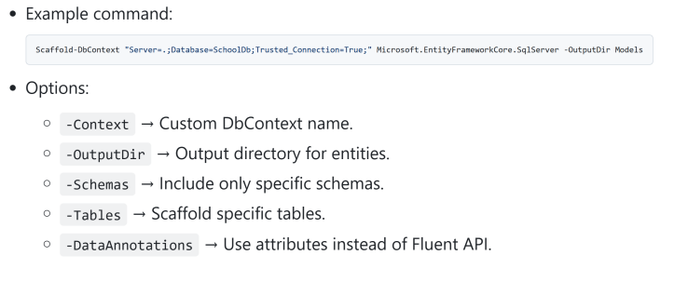
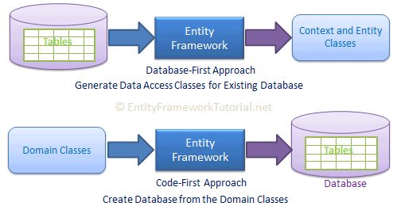
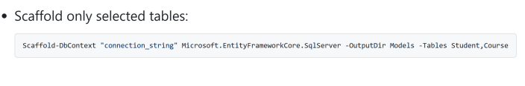
Entity Specific Scaffolding
Scaffold from Existing Db using Scaffold DbContext
DB – First Approach
You start with an existing database, and EF Core generates C# entity classes and
DbContext from it.

Slide 21
Code-First vs. Database-First – EF Core Approaches
Feature / Factor | Code-First | Database-First
Starting Point | C# entity classes | Existing database schema
Model Generation | Developer writes models manually | EF Core scaffolds models from DB
Schema Generation | Schema created from C# models (via migration) | Models generated from existing schema
Migrations Support | ✅ Fully supported | ⚠️ Manual after initial scaffold
Best For | New projects, agile workflows | Legacy DBs, database-first orgs
Customization | Full control via code | Customizations require partial classes
Re-scaffolding Risk | N/A | ⚠️ Can overwrite changes

Slide 22
// Tracking (default)
var product = await _context.Products.FirstOrDefaultAsync(p => p.Id == 1);
product.Price = 199;
await _context.SaveChangesAsync(); // EF Core knows what changed
// NoTracking (faster, read-only)
var products = await _context.Products
.AsNoTracking()
.ToListAsync(); // Better for read-only scenarios
What is Change Tracking?
EF Core tracks changes to entities fetched from the database.
When you call SaveChanges(), it knows what to update.
Tracking vs. No Tracking – Performance & Purpose
Feature | Tracking (Default) | NoTracking
Change Detection | ✅ Yes | ❌ No
Use in Updates | ✅ Required | 🚫 Must re-attach manually
Performance | 🐢 Slower (more overhead) | ⚡ Faster (no tracking logic)
Ideal For | ✏️ Edit forms | 📄 Read-only views & APIs

Slide 23
Relations in EF Core
Navigation Properties
A navigation property is a reference to a related entity or a collection of related entities.
Enables EF Core to navigate relationships when querying.
One-to-One
+--------+ 1 — 1 +----------+
| Person |◄──────────►| Passport |
+--------+ +----------+
One-to-Many
+------+ 1 — * +------+
| Blog |◄─────────────| Post |
+------+ +------+
Many-to-Many
+---------+ * — * +--------+
| Student |◄────────►| Course |
+---------+ +--------+
EF Core supports 3 types of relationships:
One-to-One
One-to-Many
Many-to-Many
Relationships are typically defined using:
Navigation properties
Foreign keys
Fluent API
// One-to-Many
public class Blog {
public int Id { get; set; }
public string Title { get; set; }
public List<Post>? Posts { get; set; } // Navigation property
}
public class Post {
public int Id { get; set; }
public int BlogId { get; set; }
public Blog? Blog { get; set; } // Navigation property
}

Slide 24
One to One Relationship (1-1)
public class Person
{
public int Id { get; set; }
public string Name { get; set; }
public Passport Passport { get; set; } // Navigation
}
public class Passport
{
public int Id { get; set; }
public int PersonId { get; set; }
public Person Person { get; set; } // Navigation
}

Slide 25
One to Many Relationship (1-*)
public class Blog
{
public int Id { get; set; }
public string Title { get; set; }
public List<Post> Posts { get; set; } // Navigation
}
public class Post
{
public int Id { get; set; }
public string Content { get; set; }
public int BlogId { get; set; }
public Blog Blog { get; set; } // Navigation
}

Slide 26
Many to Many Relationship (*-*)
public class Student
{
public int Id { get; set; }
public string Name { get; set; }
public List<Course> Courses { get; set; } // Navigation
}
public class Course
{
public int Id { get; set; }
public string Title { get; set; }
public List<Student> Students { get; set; } // Navigation
}

Slide 27
LINQ with EF Core
Filtering
var techBlogs = context.Blogs
Sorting
var blogs = context.Blogs
Joins
var query = from p in context.Posts
.Where(b => b.Title.Contains("Tech"))
.ToList();
var blog = context.Blogs
.FirstOrDefault(b => b.Id == 1);
.OrderBy(b => b.Title)
.ToList();
var recentPosts = context.Posts
.OrderByDescending(p => p.CreatedAt)
.ToList();
join b in context.Blogs on p.BlogId equals b.Id
select new {
PostTitle = p.Title,
BlogTitle = b.Title
};
Aggregation
// Count posts per blog
var postCounts = context.Blogs
.Select(b => new {
b.Title,
PostCount = b.Posts.Count()
})
.ToList();
// Sum of post views
var totalViews = context.Posts.Sum(p => p.ViewCount);
// Average rating of posts
var avgRating = context.Posts.Average(p => p.Rating);
// Max views on a post
var maxViews = context.Posts.Max(p => p.ViewCount);
// Min views on a post
var minViews = context.Posts.Min(p => p.ViewCount);
LINQ (Language Integrated Query) lets you write queries directly in C# to interact with databases via EF Core.
Fully integrated with EF Core
Converts to SQL under the hood
Supports querying, filtering, projecting, and joining

Slide 28
EAGER LOADING
LAZY LOADING
Data Loading in EF Core
Related data is loaded up front with .Include()
Related data is loaded only when accessed in code
✅ Pros:
Loads only what you actually use
Cleaner, lazy behavior
❌ Cons:
Multiple hidden queries (N+1 problem)
Harder to debug
Slower performance if overused
When querying related data three loading strategies:
Eager Loading – load related data immediately
Lazy Loading – load related data only when accessed
Explicit Loading – manually load related data.
✅ Pros:
Single query (fewer round-trips)
Predictable performance
No extra DB hits later
❌ Cons:
May load more data than needed
Slower initial query if many relations
var blogs = context.Blogs
.Include(b => b.Posts)
.ToList();
var blog = context.Blogs.First();
var posts = blog.Posts; // Triggers DB query

Slide 29
Feature | Eager Loading | Lazy Loading
Load timing | At query time | When accessed
Syntax | .Include() | Virtual props + proxies
Query count | Usually 1 | Can cause many
Performance | Fast if well-planned | Slower if overused
Use case | Known relationships | Optional or large data

Slide 30
Explicit Loading
Manually load related data when you choose.
Useful when:
You want full control
Need conditional logic for when to load
var blog = context.Blogs.First();
context.Entry(blog) .Collection(b => b.Posts) .Load();

Slide 31
How to Optimize EF Core Performance
Why optimize EF Core?
Reduce query time
Minimize memory usage
Avoid DB bottlenecks
Scale efficiently under load
Optimization | Use Case
AsNoTracking() | Read-only queries
Projection with .Select | Limit data retrieved
.Include() wisely | Avoid N+1 problem
Indexes | Speed up queries
Batching SaveChanges() | Bulk inserts/updates
Paging | Large result sets
Compiled Queries | High-frequency access patterns

Slide 32
Thank You

