Slide 1
Deep Learning Programming
Robust CAPTCHA Recognition under Corrupted Conditions:
Sequence-based
Recognition vs Position-wise Character Classification
112503519盛正璿 112503503吳睿嬛 112503513葉俊廷

Slide 2
Project Overview
Dataset Design
Workflow
Module A
Agenda
Module B
Module C
Module Results
Before/After Restoration
Conclusion

Slide 3
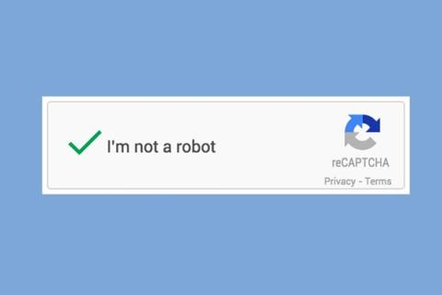
Deep Learning Programming
Overview
CAPTCHA is a common human-verification system. After corruption, can deep learning models restore the image and recognize it correctly?
We build clean, dirty, and restored datasets to compare model performance and test whether restoration improves downstream recognition robustness.
Module A
吳睿嬛
Data prep, corruption, restoration
CRNN / Transformer
sequence recognition
Report
Module B
葉俊廷
CNN multi-head classifier
position-wise classification
Project Plan
Module C
盛正璿

Slide 4



Dataset Design
We use 5-character CAPTCHA images with uppercase letters and digits
Filename example
13_YN040.png
YN040 after the underscore is the image label
normal image: original CAPTCHA image
corrupted image: normal image with added corruption; also called a dirty image
clean image: a clean CAPTCHA regenerated from the same label

Slide 5
Workflow
The same CAPTCHA batch is compared under three input states.
clean/original: an uncorrupted reference baseline; dirty: a stress-test input with added corruption; restored: used to check whether restoration recovers recognition performance.
Clean CAPTCHA
Corruption
Restoration
Recognition
Robustness
5-character labels:
A-Z + 0-9
noise / blur / rotation / interference / occlusion
DAE / DnCNN:
dirty -> restored
B sequence model and C position-wise model
drop under corruption and gain after restoration

Slide 6
Module A
Image Restoration and Data Preparation

Slide 7
Module A
Module A turns CAPTCHA into a controlled robustness problem:
generate corruption, then use a restoration model to preserve character structure.
variant | implementation
A | DnCNN
data pair - 1 | dirty → normal
data pair - 2 | normal → clean
training settings | supervised / contrastive / semi-supervised / consistency

Slide 8
Module B
CRNN: sequence-based CAPTCHA recognition

Slide 9
Module B
Module B assumes CAPTCHA characters cannot always be segmented reliably,so it treats the whole image as a sequence recognition problem.
variant | implementation
B-1 | CRNN + CTC Loss
B-2 | CNN + Transformer Encoder + CTC
training settings | supervised / contrastive / semi-supervised / consistency
B-specific metrics | char, seq, edit, failure cases

Slide 10
Module C
CNN multi-head classifier: position-wise character classification

Slide 11
Module C
Module C treats CAPTCHA as a fixed five-character string.
A shared encoder extracts features; five classification heads predict characters 1 through 5.
variant | implementation
C-1 | Pure Multi-head CNN
C-2 | STN + ResNet18 + Multi-head classifier
training settings | supervised / contrastive / semi-supervised / consistency
C-specific metrics | per-position, char, seq, edit, failure cases

Slide 12
Module A Results
DnCNN restoration quality

Slide 13
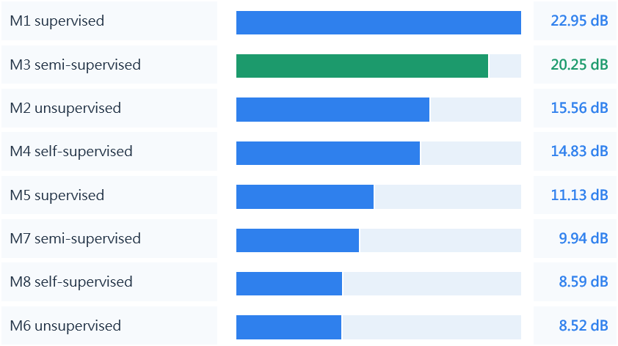
Module A Results
M1 is the restoration model best suited for downstream recognition.
M3 is next best; M2/M4 and normal->clean models provide limited recognition gains.

Slide 14
Module B/C Results
recognition comparison

Slide 15
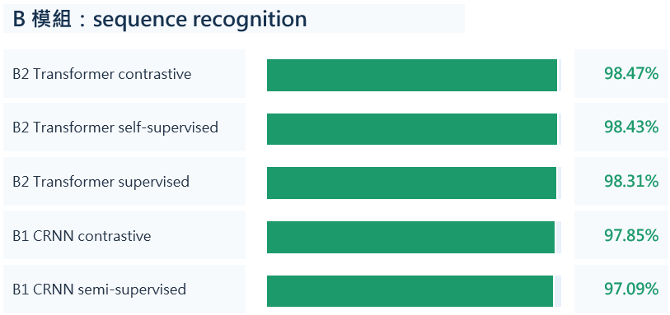
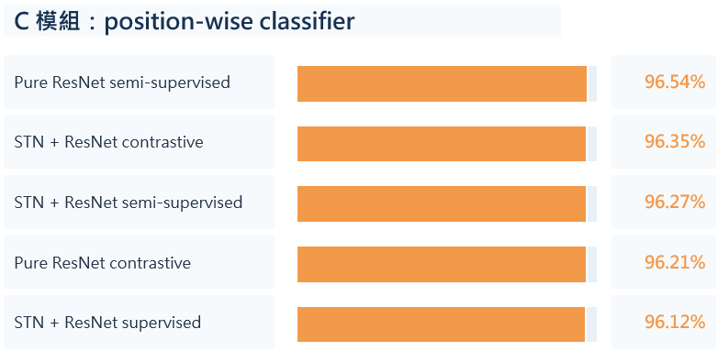
Module B/C Results (Normal)
Module B performs slightly better in end-to-end sequence recognition.
Module C provides a fixed-length baseline that decomposes position-wise errors.

Slide 16
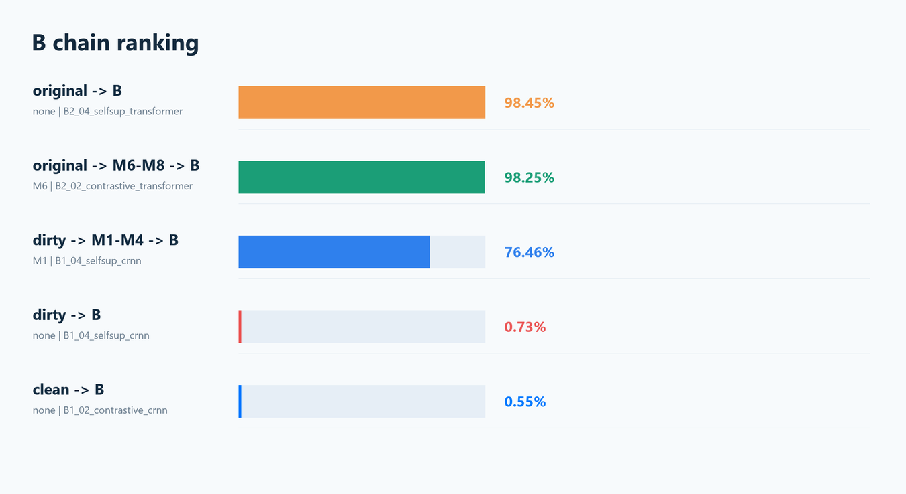
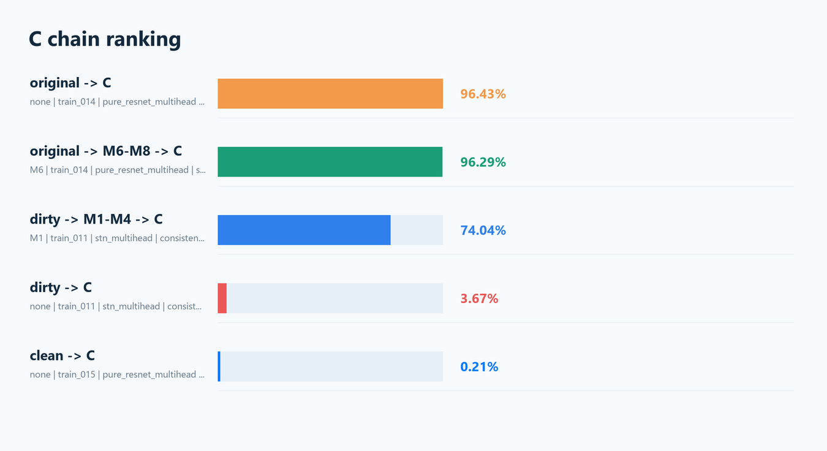
Comparison of Module B/C Pipeline Results

Slide 17
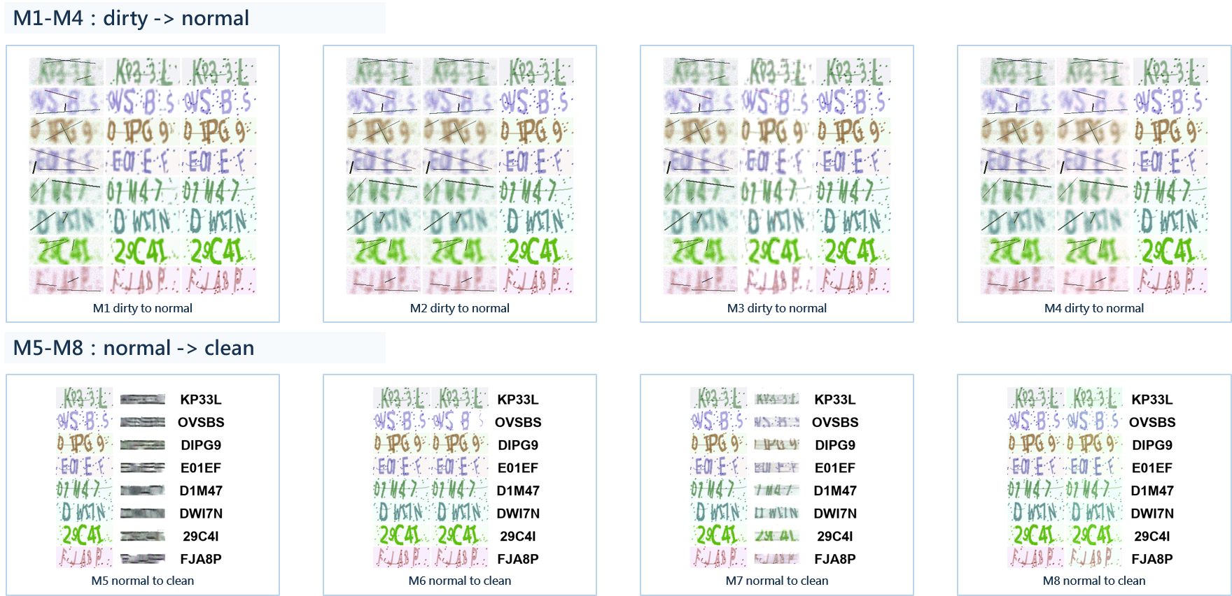
Before/After Restoration

Slide 18
Conclusion
Beyond CAPTCHA recognition, we test whether image restoration first improves recognition,
comparing full-sequence recognition with position-wise classification.
Image restoration brings corrupted CAPTCHA images from nearly unrecognizable back into a recognizable range; the clearest evidence is +75.73 pts from Module B dirty -> M1 -> B.
Sequence-based Transformer/CRNN is currently the most stable full-sequence route and works well as the downstream recognizer.
Position-wise Module C also performs well on the clean set, showing that character-by-character classification still has value.
STN should be interpreted together with the ResNet backbone; this experiment shows that model capacity and data alignment strongly affect results.

