Slide 1
Results appendix for Canva insertion
generated locally
CAPTCHA recognition and denoising results
This appendix is prepared as a drop-in section after the current Canva deck.
It summarizes A result, B result, C result, chained downstream evaluation, and Denoised CNN before/after difference previews.
A models
B models
C models
Chained eval
9 DnCNN restoration runs
8 sequence-recognition runs
8 position-wise CNN runs
39 evaluated tasks, expected 88
Source folder: C:\Users\buckl\.spyder-py3\智慧學習\captchas

Slide 2
A result - DnCNN restoration quality
test split
Relative test PSNR by denoiser
Best PSNR
M1 corrupted -> to -> normal: 22.95 dB
M1 supervised
100.00%
M2 unsupervised
67.71%
M2 unsupervised
67.80%
M3 semi-supervised
88.25%
M4 self-supervised
64.60%
M5 supervised
48.48%
M6 unsupervised
37.13%
M7 semi-supervised
43.33%
ID
pair
M8 self-supervised
37.41%
mode
PSNR
SSIM
handoff
M1
corrupted -> to -> normal
supervised
22.95
0.870
yes
M2
corrupted -> to -> normal
unsupervised
15.54
0.485
no
M2
corrupted -> to -> normal
unsupervised
15.56
0.490
no
M3
corrupted -> to -> normal
semi-supervised
20.25
0.771
no
M4
corrupted -> to -> normal
self-supervised
14.83
0.515
no
M5
normal -> to -> clean
supervised
11.13
0.615
no
M6
normal -> to -> clean
unsupervised
8.52
0.311
no
M7
normal -> to -> clean
semi-supervised
9.94
0.531
no
M8
normal -> to -> clean
self-supervised
8.59
0.311
no

Slide 3
B result - sequence recognition
last epoch
Test sequence accuracy
Best sequence accuracy
B2_02 Transformer contrastive
B2_02
98.47%
98.47% seq / 99.66% char
B2_04
98.43%
B2_01
98.31%
B1_02
97.85%
B2_03
97.81%
B1_01
97.30%
B1_04
97.29%
B1_03
97.09%
ID
branch
training
seq acc
char acc
edit
B2_02
Transformer
contrastive
98.47%
99.66%
0.0154
B2_04
Transformer
self-supervised
98.43%
99.66%
0.0158
B2_01
Transformer
supervised
98.31%
99.62%
0.0170
B1_02
CRNN
contrastive
97.85%
99.52%
0.0218
B2_03
Transformer
semi-supervised
97.81%
99.52%
0.0223
B1_01
CRNN
supervised
97.30%
99.35%
0.0275
B1_04
CRNN
self-supervised
97.29%
99.44%
0.0275
B1_03
CRNN
semi-supervised
97.09%
99.30%
0.0298

Slide 4
C result - position-wise multi-head CNN
last epoch
Test sequence accuracy
Best C-module run
ResNet multi-head / semi-supervised
semi-supervised
96.44%
96.44% seq / 99.27% char
contrastive
96.31%
semi-supervised
96.22%
contrastive
96.18%
supervised
96.17%
supervised
96.11%
consistency
95.31%
consistency
95.29%
backbone
training
seq acc
char acc
edit
ResNet multi-head
semi-supervised
96.44%
99.27%
0.0363
STN multi-head
contrastive
96.31%
99.24%
0.0378
STN multi-head
semi-supervised
96.22%
99.22%
0.0387
ResNet multi-head
contrastive
96.18%
99.22%
0.0389
ResNet multi-head
supervised
96.17%
99.22%
0.0390
STN multi-head
supervised
96.11%
99.20%
0.0397
STN multi-head
consistency
95.31%
99.03%
0.0484
ResNet multi-head
consistency
95.29%
99.03%
0.0483

Slide 5
Chained result - denoising + recognition
88-task evaluation
input group
best recognition model
denoiser
seq acc
char acc
gain
normal
train_014 semisupervised
-
96.43%
99.27%
-
dirty
train_011 consistency
-
3.67%
42.20%
-
clean
train_015 consistency
-
0.21%
30.12%
-
dirty denoised
train_011 consistency
M1
74.04%
93.17%
70.37%
normal denoised
train_014 semisupervised
M6
96.29%
99.23%
-0.14%
Top restoration gains on dirty-denoised chain
M1 + train_009
72.86%
M1 + train_008
72.03%
M1 + train_013
70.73%
M1 + train_011
70.37%
M1 + train_012
69.67%
M1 + train_015
69.62%
Key read: dirty inputs improve most after M1 dirty->normal restoration; normal->clean restoration is nearly neutral for recognition.

Slide 6
Overall comparison
quick read
Sequence accuracy comparison
B best
98.47%
C best
96.44%
Normal chain
96.43%
Dirty + denoise
74.04%
B Transformer remains the strongest standalone recognizer (98.47%).
C module is close on clean/normal fixed-position recognition (96.44%).
The chained setup shows restoration is most valuable on dirty inputs, where M1 boosts downstream sequence accuracy to 74.04%.

Slide 7
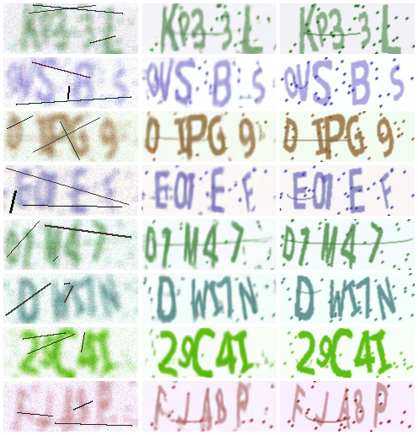
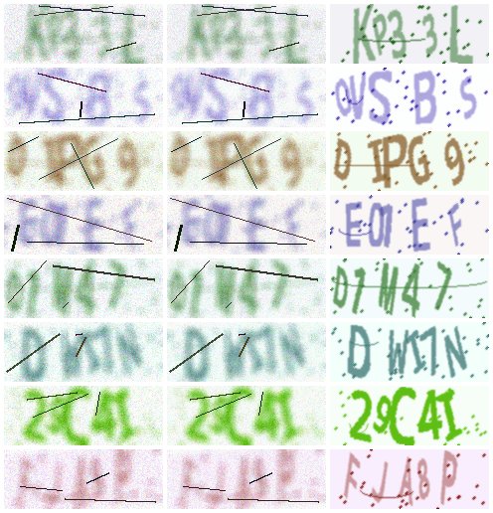
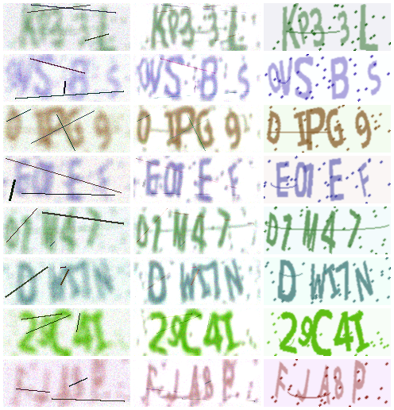
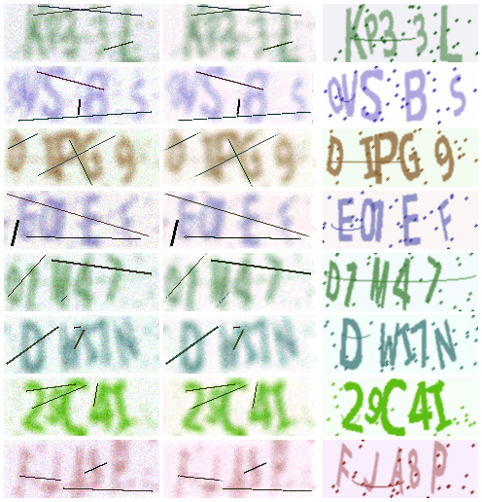
Denoised CNN previews - dirty to normal
before / after / difference previews
M1 dirty to normal
M2 dirty to normal
M3 dirty to normal
M4 dirty to normal

Slide 8
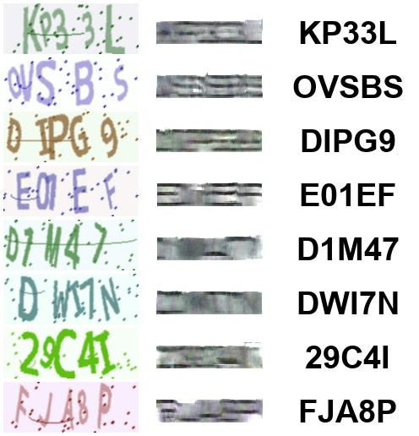
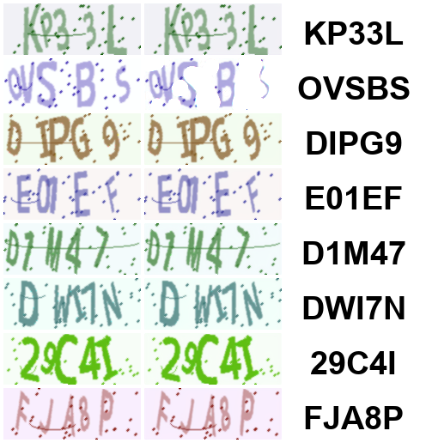
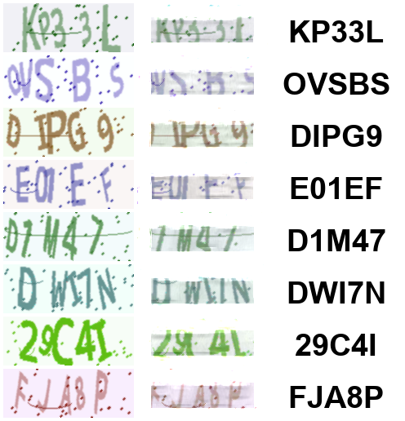
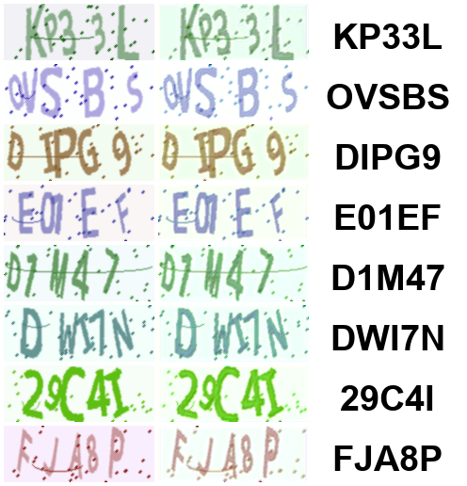
Denoised CNN previews - normal to clean
before / after / difference previews
M5 normal to clean
M6 normal to clean
M7 normal to clean
M8 normal to clean

